Slide 1
Comparing Estimates from the ACS and WG Question Sets
Eric A Lauer
Institute on Disability
University of New Hampshire

Slide 2
Background
National surveys are considering changes to the annual inclusion of standardized disability identifiers
These question sets include the Washington Group Short Set (WGSS) and American Community Survey (ACS) identifiers
There has been limited research to understand and compare these questions in disability research.

Slide 3
ACS & WG Question Topics
Hearing Deaf or difficulty hearing (even with hearing aids)?
Vision Blind or difficulty seeing (even when wearing glasses)?
Cognition Difficulty remembering, concentrating, or making decisions?
Ambulation Difficulty walking or climbing stairs?
Self-care Difficulty bathing or dressing?

Slide 4
Development Goals
Question sets developed with goals that include:
Policy relevance
Lengths appropriate for censuses
Comparable across populations
Development narratives recognize:
General disability measurement
Not comprehensive disability assessment
Not identifying “true” disabled population (if one exists)
Limited by data collection processes

Slide 5
Methods
2010-2015 National Health Interview Survey data
ACS responses (yes) versus Washington Group responses (a lot of difficulty and cannot do)
Prevalence and 95% confidence intervals were estimated
Exploratory Null Hypotheses:
Disability type prevalence would be consistent for people reporting disabilities
Demographic and social factors would be consistent for people reporting disabilities
Disability prevalence by type and for multiple disabilities

Slide 6
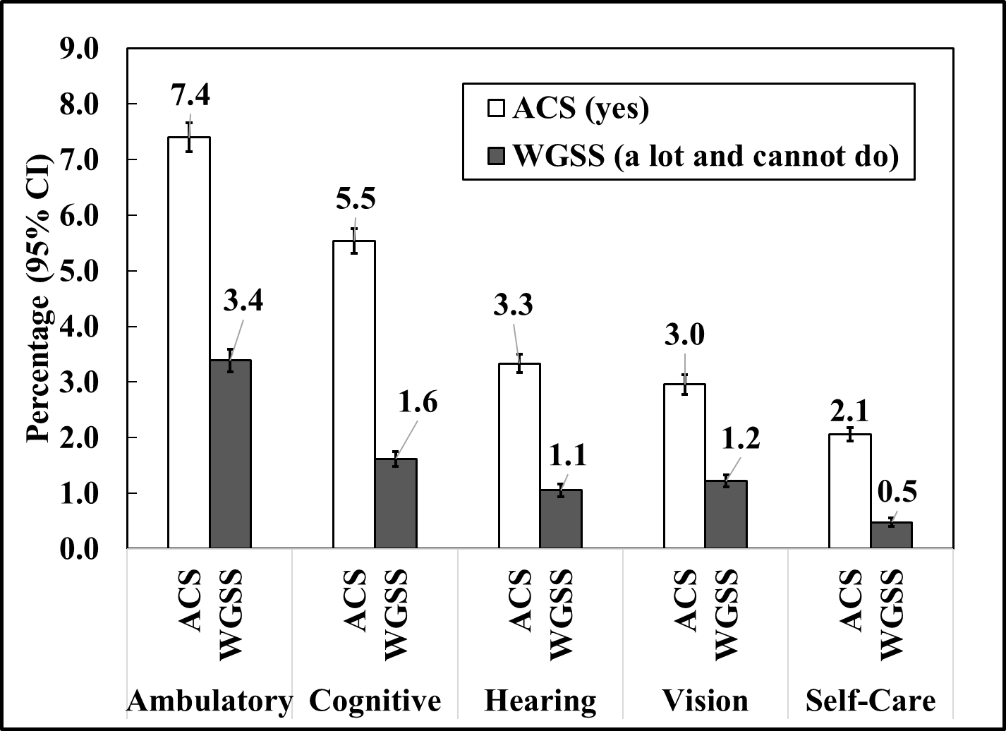
Percentage of people with Disabilities by Question Type and Set

Slide 7
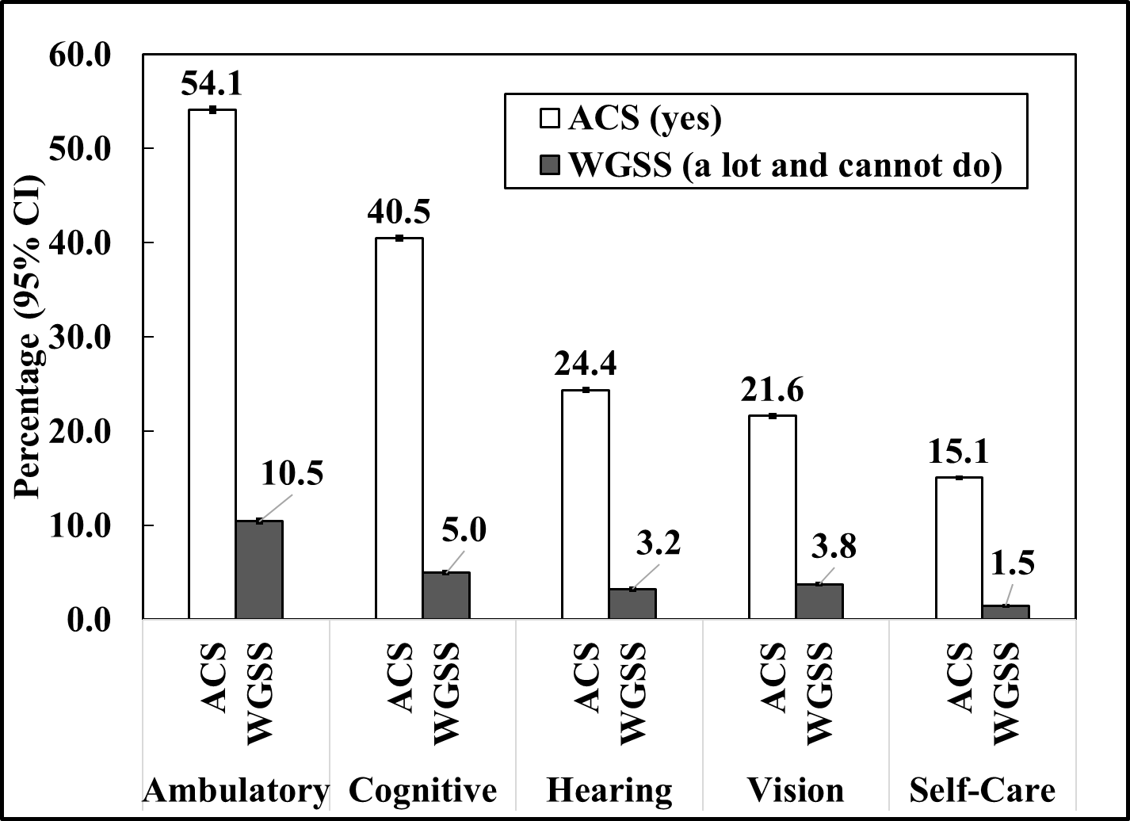
Percentage of Disability Types among People with Any Disability

Slide 8
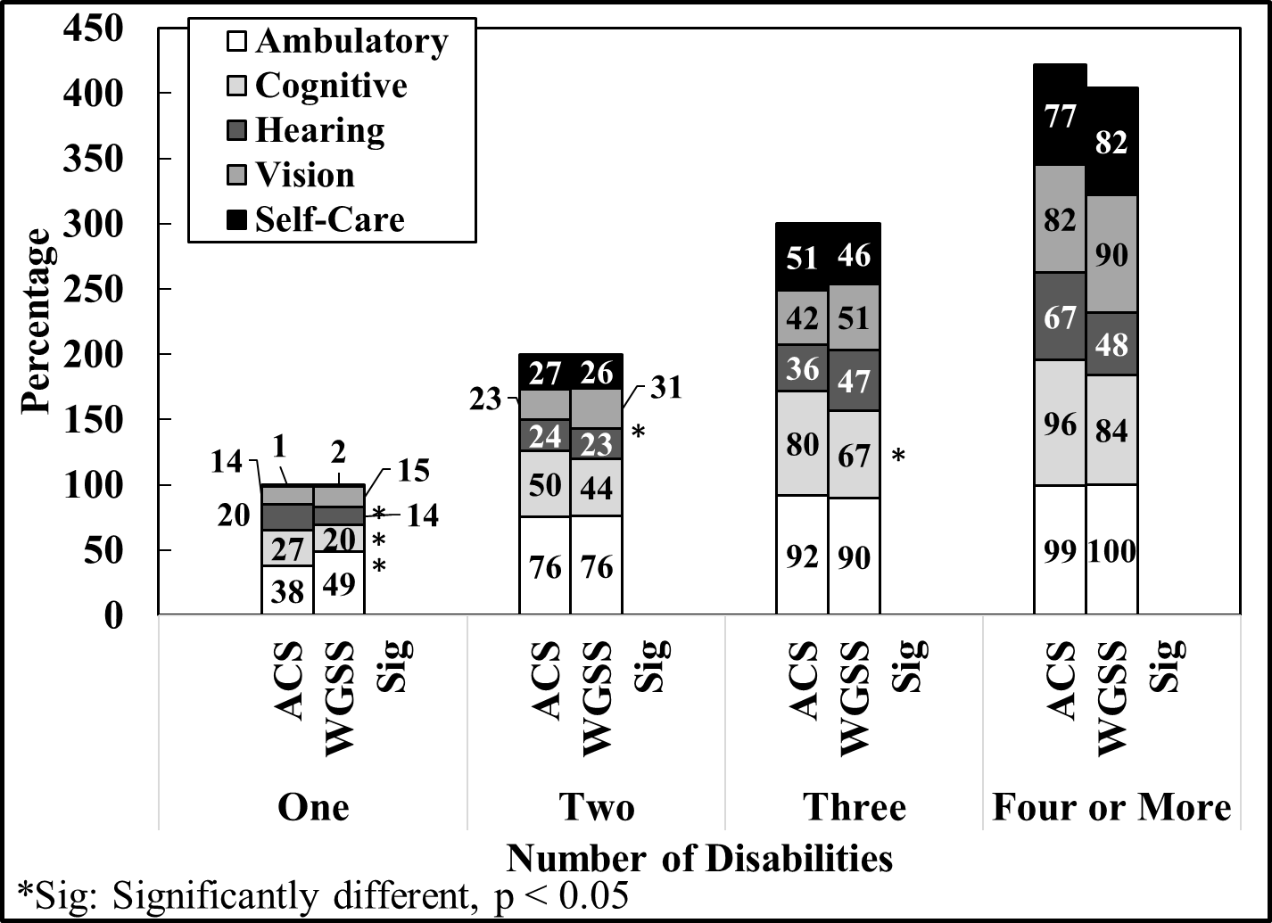
Percentages of Disability Types among People with Multiple Disabilities

Slide 9
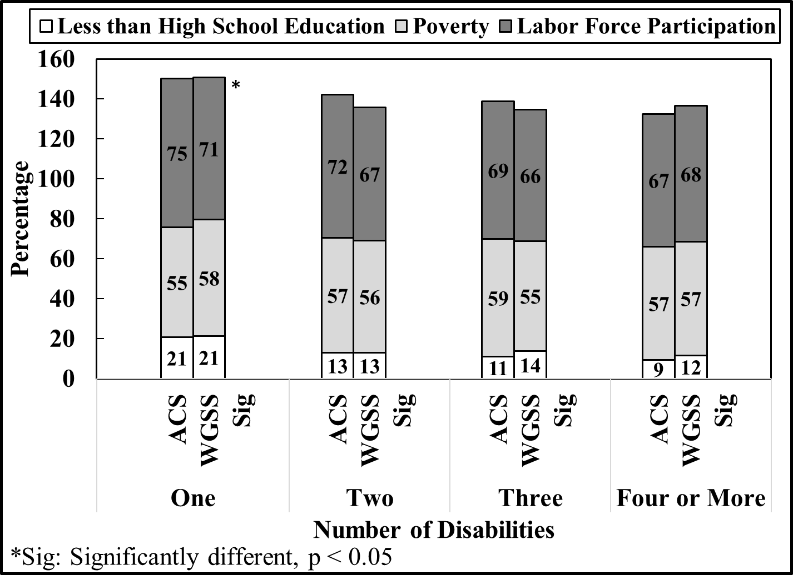
Percentages of Social Factors among People with Multiple Disabilities

Slide 10
Discussion
Prevalence estimates vary significantly
WG coding (a lot of difficulty or cannot do)
Demographic distributions consistent between question sets
Multiple disability estimates consistent from ACS and WGSS
ACS and WGSS questions can be used to study similar hypotheses
Multivariate analyses recommended

Slide 11
Thank You
Eric A. Lauer, MPH, PhD
Project Director
Institute on Disability
University of New Hampshire
Durham, NH 03824
eric.lauer@unh.edu

