Slide 1
Budget Outlook for 2015
and
Looming Action on SSDI
Ellen Nissenbaum
Center on Budget and Policy Priorities
December 3, 2014
www.cbpp.org

Slide 2
Goals in Past Ryan Budgets Would Result in Large Cuts to Non-Defense Discretionary and Low-Income Entitlement Programs
Balanced Budget in Ten Years
Increase Defense
No New Revenues
No Significant Savings in Current Social Security or Medicare Beneficiaries
NDD and Low-Income Entitlements
Notes:
The House-passed budgets crafted by then Budget Committee Chair Paul Ryan were built on four goals:
Balance the Budget in 10 years and do it while…
Not increasing revenues at all
Increasing spending on defense
And securing no significant savings in Medicare and Social Security for current beneficiaries
Any budget based on these four premises will result in large cuts to non-defense discretionary programs and low-income entitlements like SNAP and Medicaid. Why? Because if revenues, Social Security and Medicare are off the table and defense has to increase, the only large parts of the budget left are non-defense discretionary programs and non-retirement-related entitlements like SNAP and Medicaid. There are dog-and-cat savings they can cobble together in other parts of the budget, but not nearly enough to make a significant dent in the balance-in-10-year goal.
So – when we think about the upcoming budget debate, one important question is will the House and Senate walk away from any of these four constraints? If not, then it is virtually impossible to see how low-income programs and non-defense discretionary programs will not be targets for significant cuts.
Note that you want to be careful not to appear to be suggesting that we should make large Medicare and Social Security cuts to current beneficiaries. You may want to add something like – Now, I want to be clear that I am not suggesting that we should make big cuts in Medicare and Social Security. While there are some responsible Medicare cuts that can be made there are real limits there too – because while there is sometimes a view that seniors are wealthy, fully three-fifths of Medicare beneficiaries had incomes at or below $30,000 in 2009. Similarly, Social Security benefits are modest and protection millions from poverty and hardship.

Slide 3
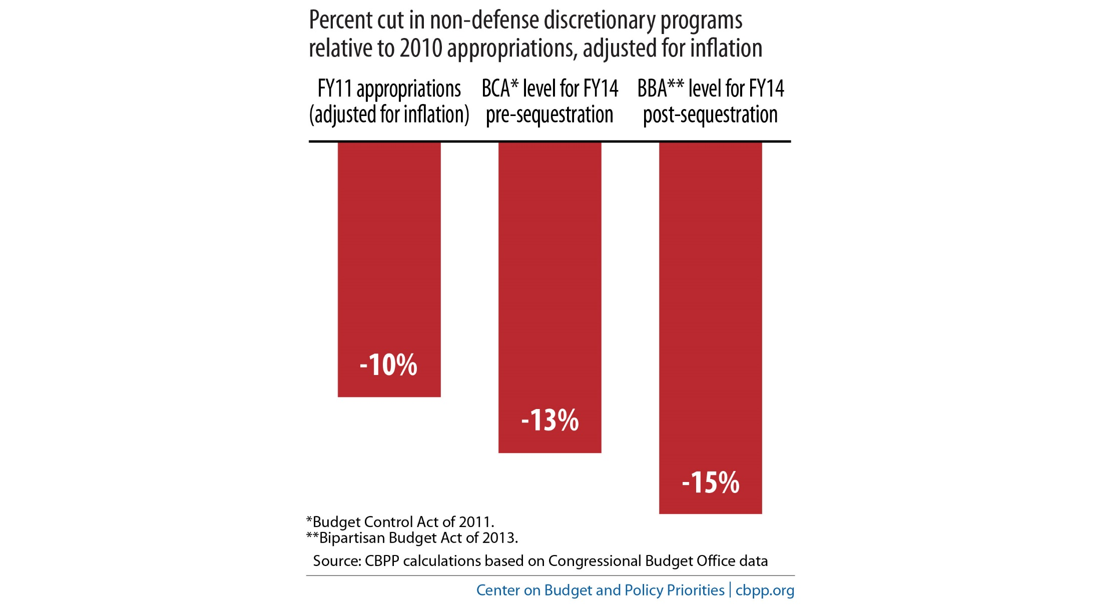
Three Waves of Cuts in Non-Defense Discretionary Programs Since 2010
Notes:
IS IT TIME TO SWITCH TO 15?

Slide 4
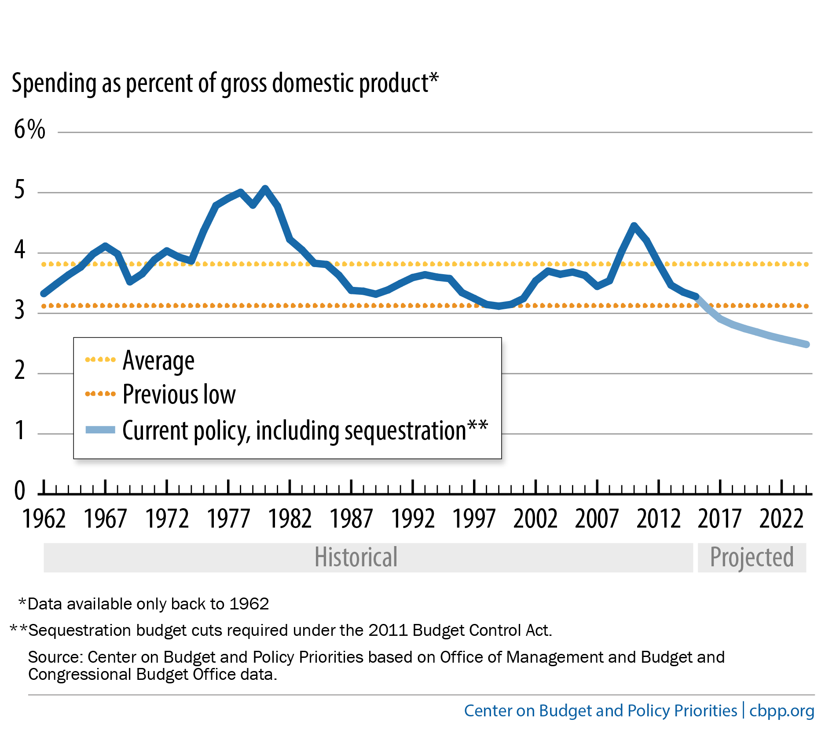
Non-Defense Discretionary Spending Set to Fall Below Historical Low

Slide 5
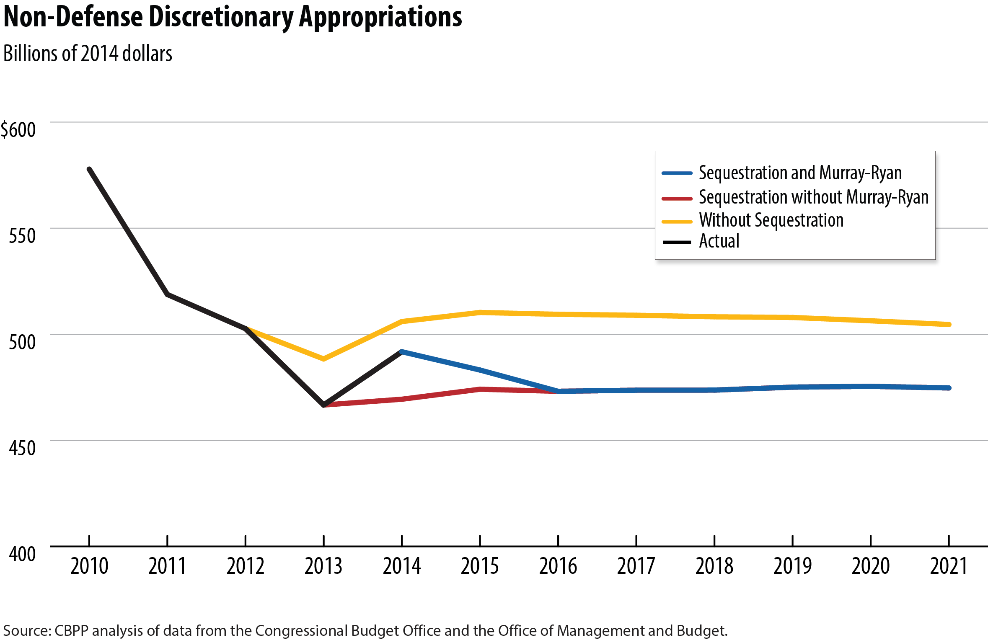
Non-Defense Discretionary Caps Will Return to Sequestration Levels
Notes:
When this is updated, through 2013 are OMB estimates, not CBO. 14 is CBO actual and 15 on are CBO August baseline.

Slide 6
Recent growth in the DI rolls stems mostly from well-understood demographic factors
The number of DI benefi-ciaries has grown chiefly for four reasons:
Population growth
Aging of the baby boom
Growth in women’s labor force participation
Rise in Social Security’s full retirement age from 65 to 66
When adjusted for these factors, the rate of receipt has grown only modestly.
For more information, see “Decoding Demographics’ Role in Disability Program’s Growth,” Off the Charts blog, January 30, 2014.

Slide 7
Growth in the DI rolls has slowed
Growth in the DI rolls has slowed sharply, to its lowest rate in 25 years.
Both demographic and economic pressures on the program are easing.
For more information, see How Much of the Growth in Disability Insurance Stems From Demographic Changes?, CBPP, January 27, 2014; monthly data from Office of the Chief Actuary, Social Security Administration.

Slide 8
Getting on DI is difficult
SSA weeds out applicants who are technically disqualified (chiefly because they lack insured status for DI) and sends the rest to state disability determination services (DDSs) for medical evaluation. If denied by the DDS, the applicant may appeal.
Eligibility criteria are strict.
Ultimately, fewer than half of applicants are awarded benefits.
For more information, see SSA, “Outcomes of Applications for Disability Benefits.” Data are for 2007-2009 applications; a recent study suggests allowance rates have fallen since then.

Slide 9
Many DI beneficiaries are poor
Poverty rates are about twice as high for DI recipients as for others.
Overall, about one-fifth of all disabled-worker families are in poverty. Without DI, nearly half would be poor.
Most beneficiaries are not poor, however, and many are middle class.
For more information, see Melissa Favreault and others, How Important Is Social Security Disability Insurance to U.S. Workers?, Urban Institute, June 2013; Michelle S. Bailey and Jeffrey Hemmeter, “Characteristics of Noninstitution-alized DI and SSI Program Partici-pants, 2010 Update,” Social Security Administration, February 2014.

Slide 10
SSA’s administrative funding has not kept up with rising caseloads
Since 2010, the agency’s administrative funding (which — unlike benefit costs — is subject to annual appropriation) has been cut in real terms, even as caseloads have climbed.
That has reduced SSA’s ability to keep up with vital program-integrity activities and impaired customer service.
For more information, see SSA, Justification of Estimates for Appropriations Committees, March 2014; “Starving the Watchdogs Is Bad Policy,” Off the Charts blog, June 7, 2013.

Slide 11
Reallocating taxes from OASI to DI is necessary to avoid a 20-percent cut in DI benefits after 2016
Raising the DI share of the 12.4-percent payroll tax for a few years would enable both trust funds to pay scheduled benefits through 2033 while policymakers work on overall solvency.
Reallocations have often occurred in the past — in either direction — and were not controversial.
Reallocation should not be held hostage to eligibility restrictions or benefit cuts.
For more information, see Congress Needs to Boost Disability Insurance Share of Payroll Tax by 2016 , CBPP, July 31, 2014.

