Slide 1
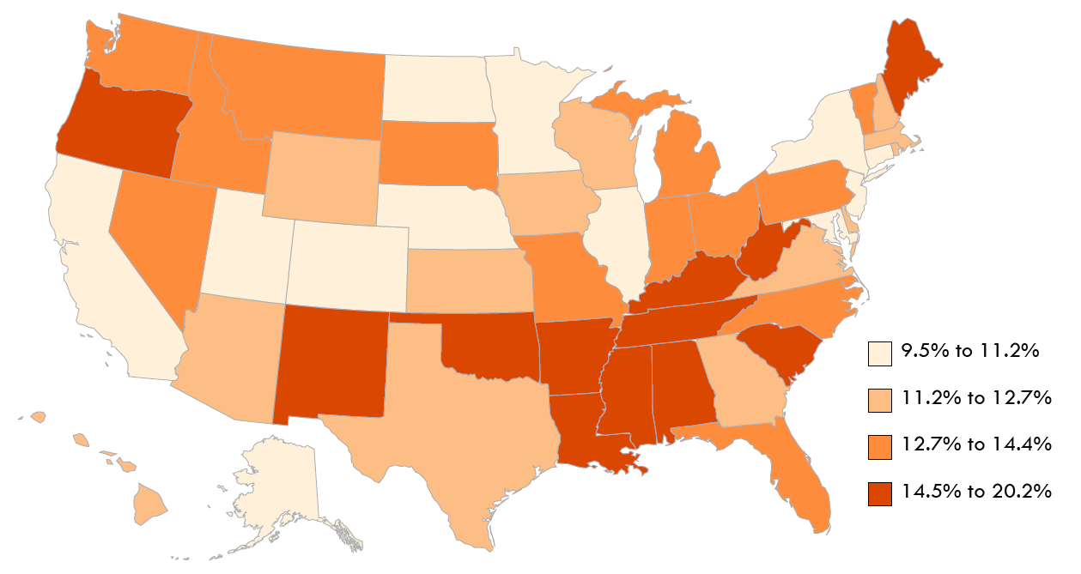
Civilians with Disabilities Living in the Community as a Percentage of the US Population, by State, 2013
Data Source: American Community Survey, 2013
1
Notes:
In 2013, the state with the lowest percentage of the US population having a disability was Utah (9.5%). The state with the highest percentage of disability, West Virginia, was over twice as high with a percentage of 20.2%. For the most part, higher percentages of disability were clustered in the southern US, around the lower Mississippi, with concentrations also high in the states of Maine, Oregon and New Mexico.
Stoddard, Susan. (2014). 2014 Disability Statistics Annual Report. Durham, NH: University of New Hampshire. http://www.researchondisability.org/docs/default-document-library/annualreport_2014_draft5.pdf?sfvrsn=2

Slide 2
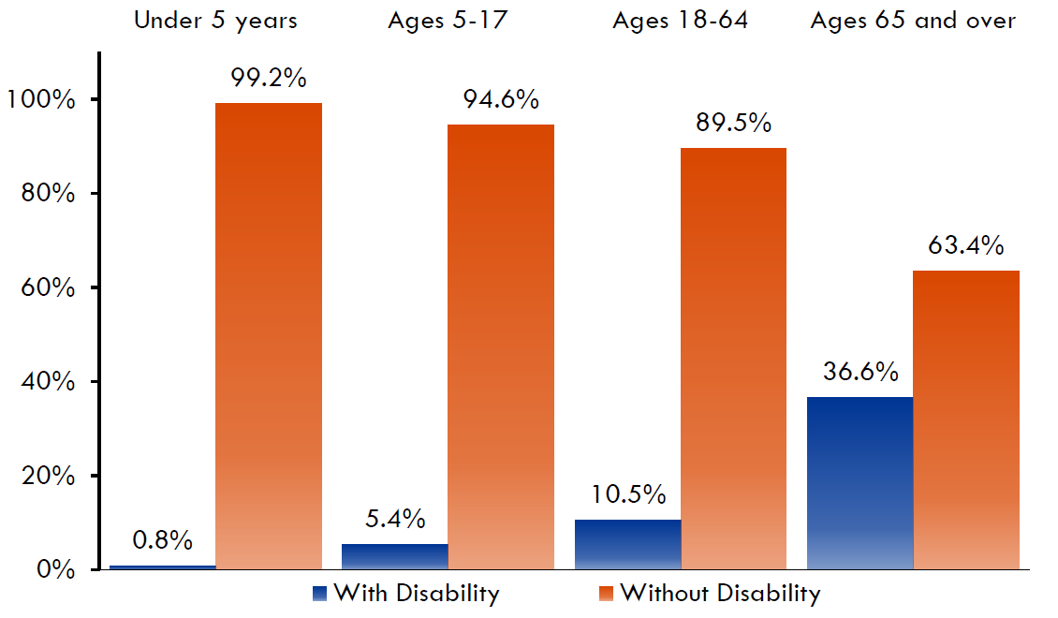
Age Distribution of Disability in the US Population, 2013
Data Source: American Community Survey, 2013
2
Notes:
As the US population ages, the percentage of people with disabilities grows. This slide shows that in the population under 5 years old, less than 1.0% had a disability. For the population ages 5-17, the percentage was 5.4%. For ages 18-64 the rate was 10.5%, while people ages 65 and over had a percentage of 36.6%.

Slide 3
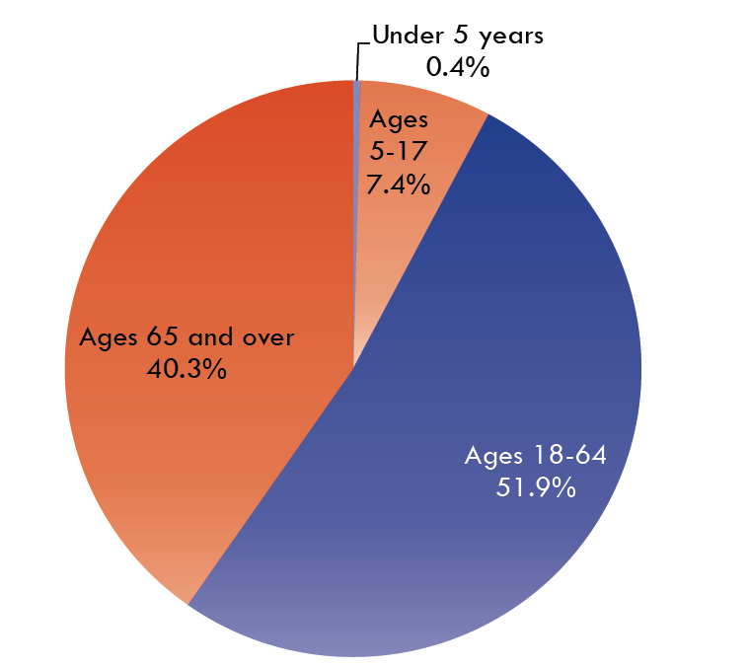
Age Distribution in the US Population of Citizens with Disabilities, 2013
Data Source: American Community Survey, 2013
3
Notes:
This slide shows the composition of the population of persons with disabilities in the US, by age. Of the US population in 2013 with disabilities, over half (51.9%) were people in the working-ages of 18-64. Forty percent (40.3%) of people with disabilities were 65 and older. Disability in children and youth accounted for only 7.4% (ages 5-17) and 0.4% (under 5 years old).

Slide 4
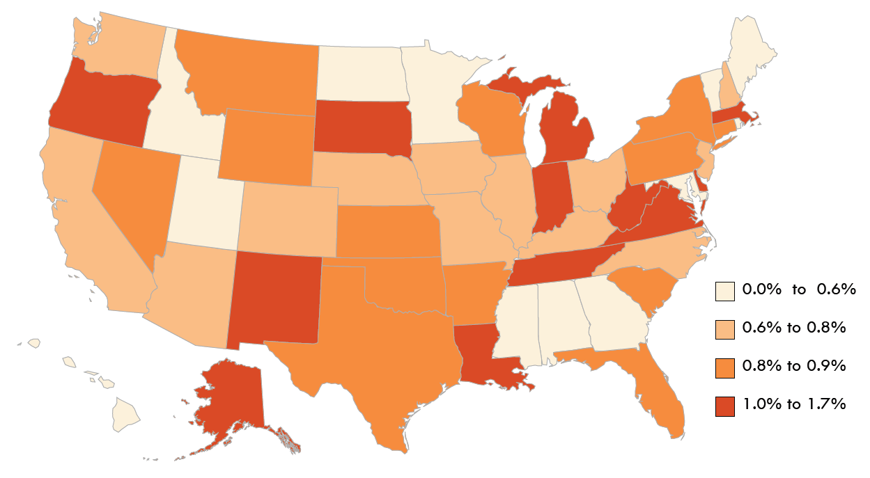
Civilians with Disabilities Ages Under 5 Years Living in the Community, by State, 2013
Data Source: American Community Survey, 2013
4
Notes:
The next 4 slides show state variation in the disability percentages by age, demonstrating how disability percentages increase with age. The percentage of disability in children under age 5 was very low, about 0.8% nationally, 1.7% or less in any state. The states with the highest percentages were Oregon, New Mexico, and West Virginia. Seven states and the District of Columbia had percentages equal to or less than 0.5%.

Slide 5
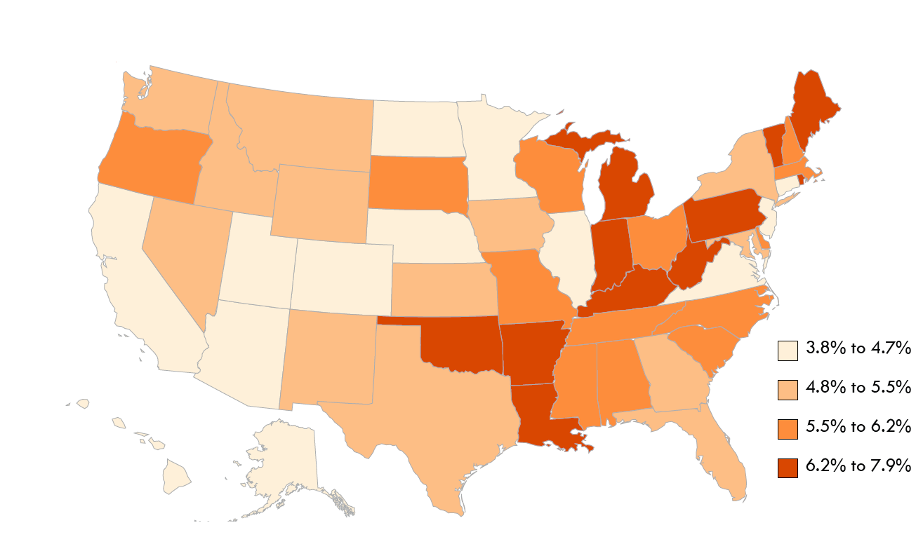
Civilians with Disabilities Ages 5-17 Years Living in the Community, by State, 2013
Data Source: American Community Survey, 2013
5
Notes:
For children ages 5-17, the percentages ranged from 3.7% (North Dakota) to more than twice that percentage in Maine (7.9%). In general, percentages for this age group were lower in the Western US, Hawaii and Alaska, and more concentrated in the Eastern US.

Slide 6
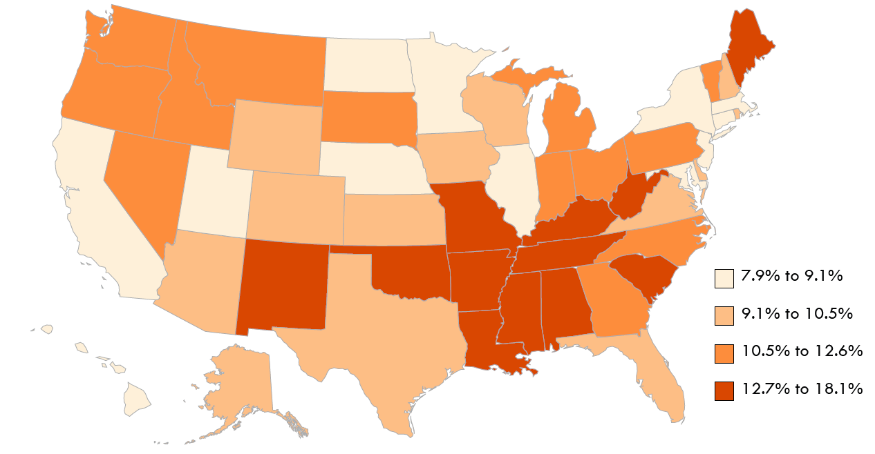
Civilians with Disabilities Ages 18-64 Years Living in the Community, by State, 2013
Data Source: American Community Survey, 2013
6
Notes:
For adults ages 18-64, the highest percentages were in many states in the Southern US from New Mexico to West Virginia, and also in Maine. The percentage was lowest in Hawaii (7.9%) and more than twice as high in West Virginia (18.1%).

Slide 7
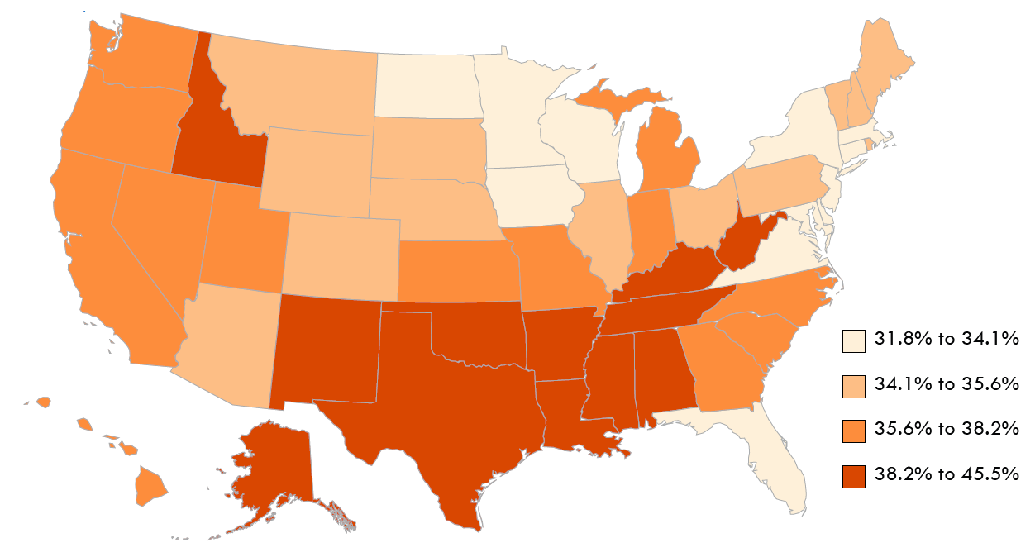
Civilians with Disabilities Ages 65 and Over Living in the Community, by State, 2013
Data Source: American Community Survey, 2013
7
Notes:
The highest percentages of disability were in the US population 65 and over; more than one third of the civilian population 65 and over (36.6%) had a disability. In nine states, mainly in the South, the percentage was over 40%, or more than two in every five people: West Virginia, Mississippi, Oklahoma, Arkansas, Kentucky, New Mexico, Louisiana, Alabama, and Tennessee. Disability percentages were generally lowest in the Midwest and Northeast; six states had disability percentages of less than one third (33.3%): Minnesota, Delaware, Connecticut, Iowa, Maryland, and Wisconsin.

Slide 8
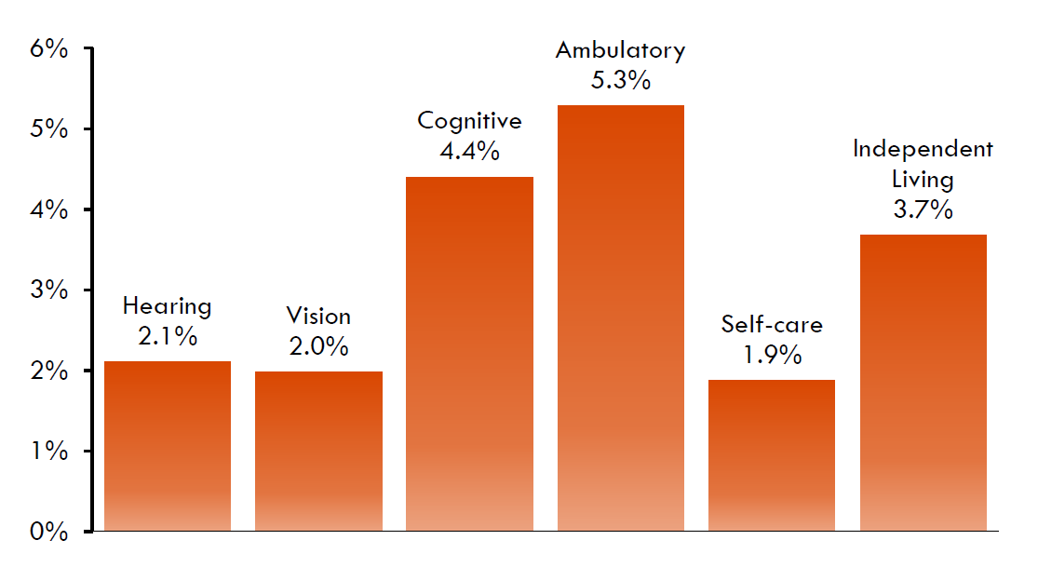
Prevalence of Types of Disabilities Ages 18-64, 2013
Data Source: American Community Survey, 2013
8
Notes:
The American Community Survey (ACS) asks about six types of disability: vision, hearing, cognitive, ambulatory, self-care, and independent living. For the US working-age population, ages 18-64, these types of disabilities were prevalent in the population at different levels. This slide shows the relative prevalence of disabilities in US working-age population in 2013. The percentages vary from 1.9% for self-care disabilities to 5.3% for ambulatory disabilities.

Slide 9
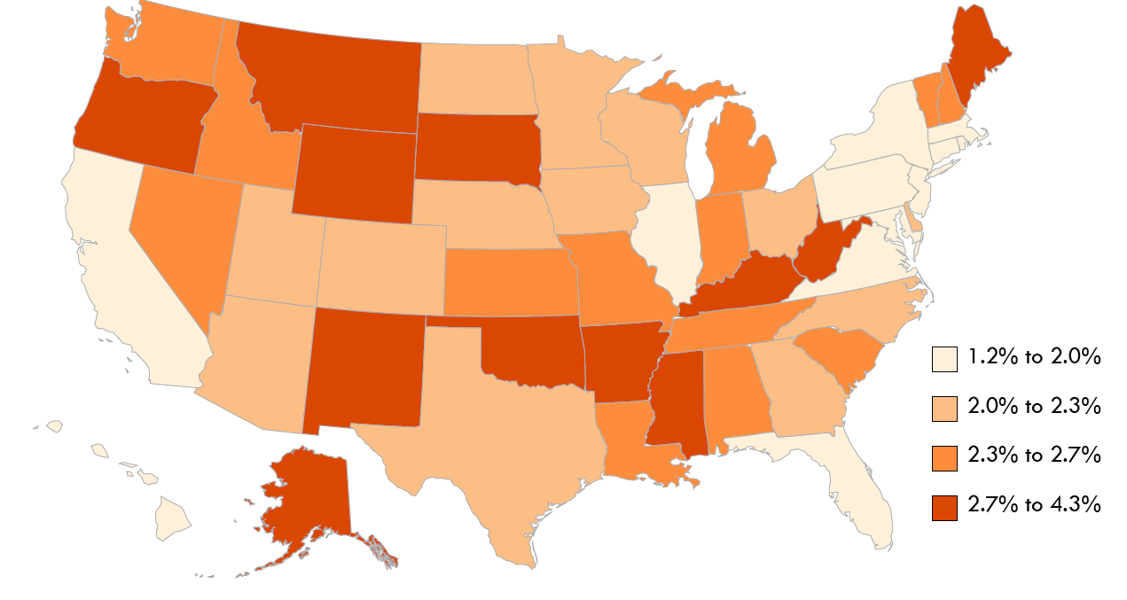
Civilians with Hearing Disabilities Ages 18-64, by State, 2013
Data Source: American Community Survey, 2013
9
Notes:
In the US in 2013, about 2.1% of the US working-age population had a hearing disability. The percentages ranged from 1.2% (District of Columbia) to 4.3% (West Virginia). Thirteen states and the District of Columbia reported hearing disability percentages of less than 2%, while six states’ percentages exceeded 3%. High-percentage states include Maine, Oregon, and Alaska as well as states in the upper Midwest and Southern US.

Slide 10
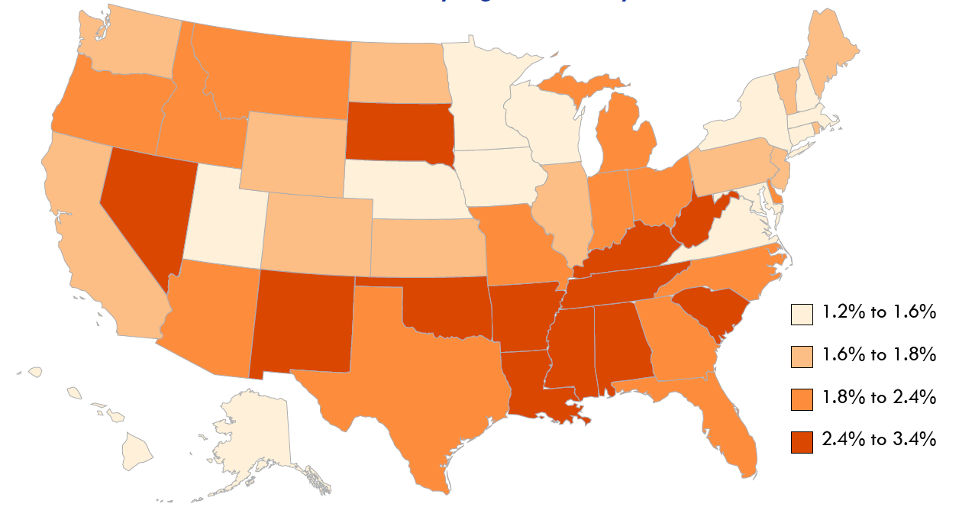
Civilians with Vision Disability Ages 18-64, by State, 2013
Data Source: American Community Survey, 2013
10
Notes:
Vision disability also had a relatively low prevalence in this age group, with an overall percentage of 2.0% for the US in 2013. Percentages ranged from 1.2% (Minnesota) to 3.4% (West Virginia). Vision disability was more clustered in the southern states around the lower Mississippi, and also South Dakota, New Mexico, Oklahoma, South Carolina and Nevada. In twenty-eight states, the percentage of vision disability was less than 2.0% for people ages 18- 64.

Slide 11
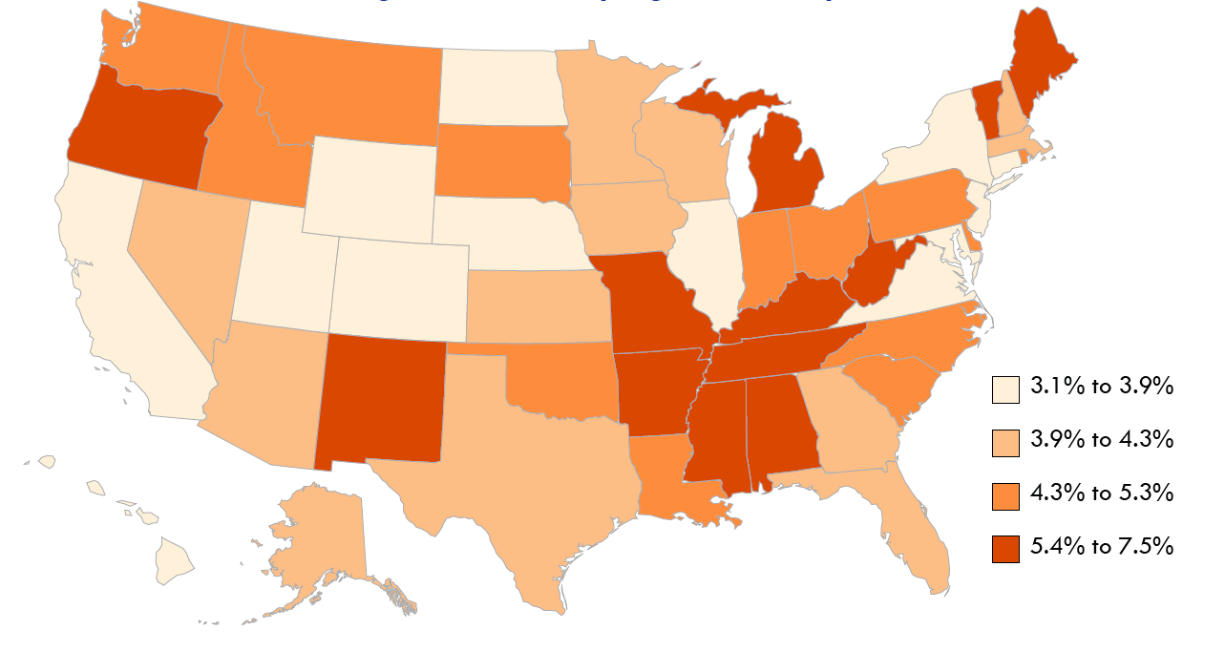
Civilians with Cognitive Disability Ages 18-64, by State, 2013
Data Source: American Community Survey, 2013
11
Notes:
The national prevalence percentage for civilians ages 18-64 with cognitive disabilities was 4.4% in 2013. State percentages ranged from 3.1% (New Jersey) to 7.5% (West Virginia). In seventeen states, the percentage was higher than 5.0%. In fourteen (14) states and the District of Columbia, the percentage was less than 4.0%. There was some concentration of higher percentages (over 4.3%) in states around the lower Mississippi, and also in Oregon, New Mexico, Michigan, Vermont and Maine.

Slide 12
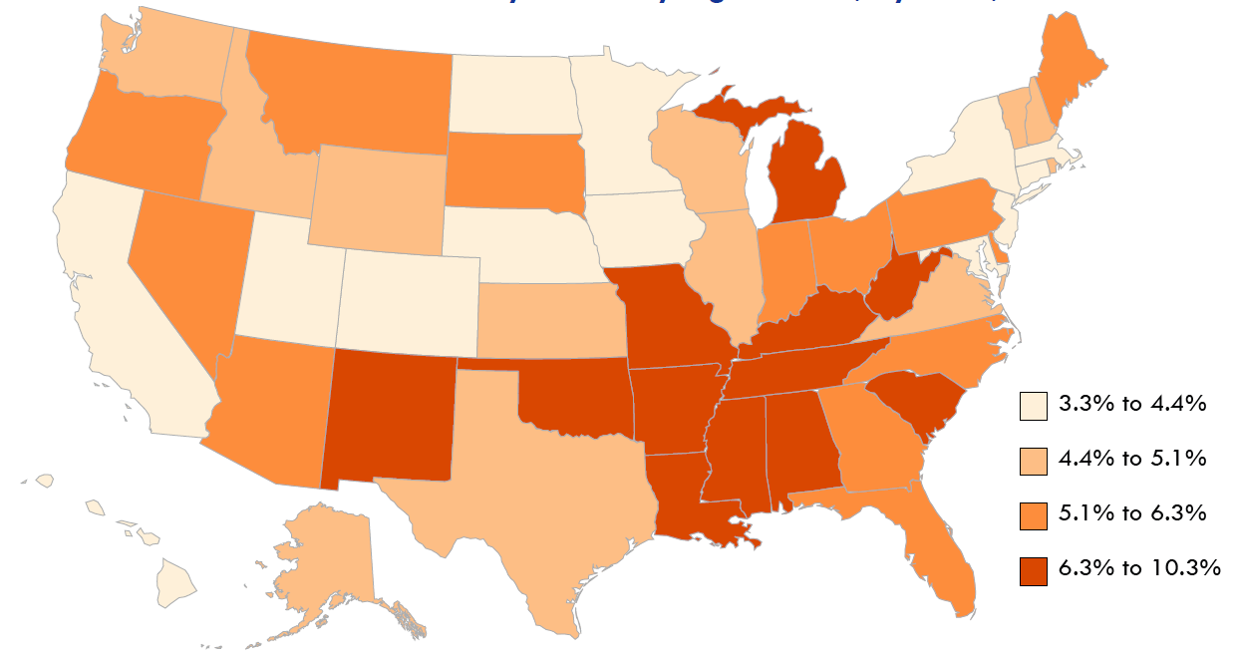
Civilians with Ambulatory Disability Ages 18-64, by State, 2013
Data Source: American Community Survey, 2013
12
Notes:
In 2013, the percentage of ambulatory disability in the US working-age population was 5.3%. Percentages varied from 3.3% (Hawaii) to over three times that percentage in West Virginia (10.3%). States in the lower Mississippi area had the highest percentages (4.4% and over), along with Michigan, Oklahoma, South Carolina and New Mexico.

Slide 13
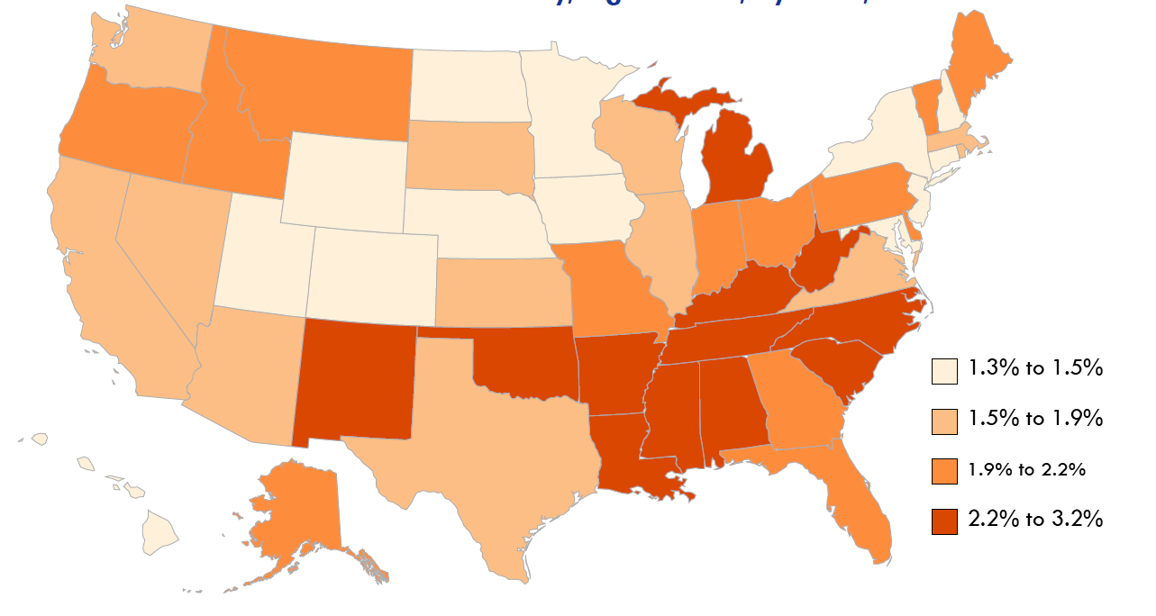
Civilians with Self-Care Disability Ages 18-64, by State, 2013
Data Source: American Community Survey, 2013
13
Notes:
The national percentage for self-care disability for civilians ages 18-64 was 1.9%. In the states, this percentage ranged from 1.3% (Nebraska) to 3.2% (West Virginia). In general, the percentages were higher in the South, and also Michigan and New Mexico.

Slide 14
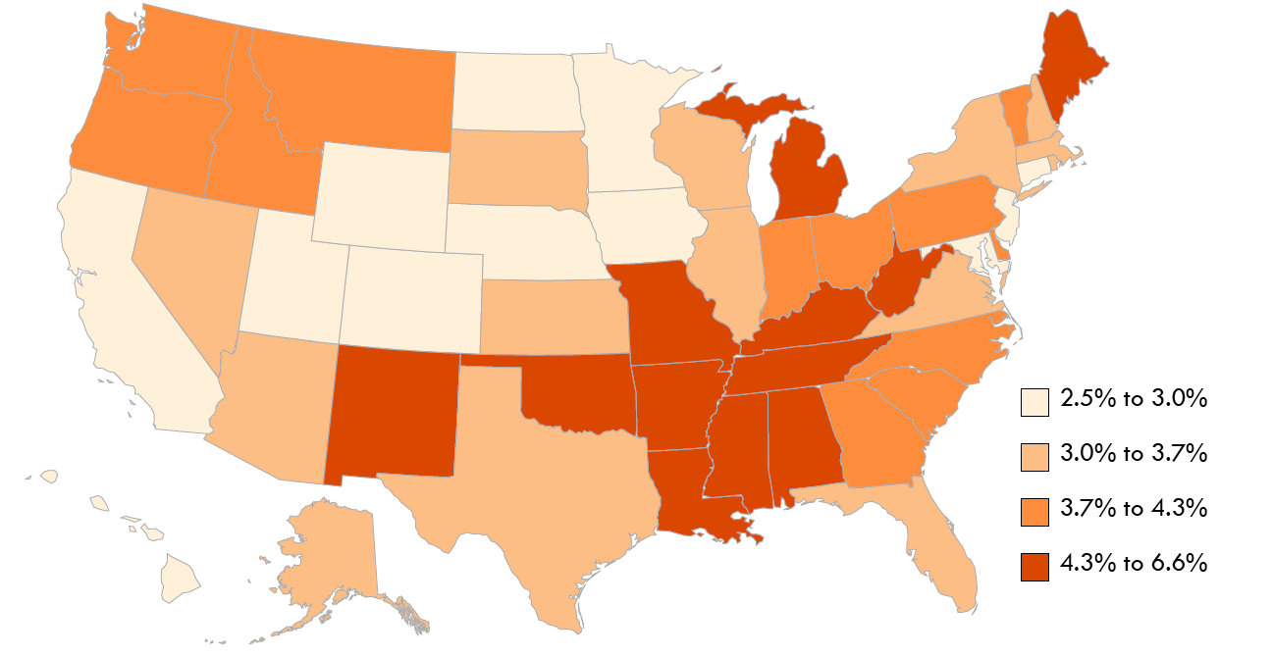
Civilians with Independent Living Disability Ages 18-64, by State, 2013
Data Source: American Community Survey, 2013
14
Notes:
The national percentage for independent living disability for civilians ages 18-64 was 3.7%. In the states, this percentage ranged from 2.5% (Nebraska) to 6.6% (West Virginia). In general, the percentages were higher in the region centered on the lower Mississippi, and also in Maine, Michigan, Oklahoma and New Mexico.

Slide 15
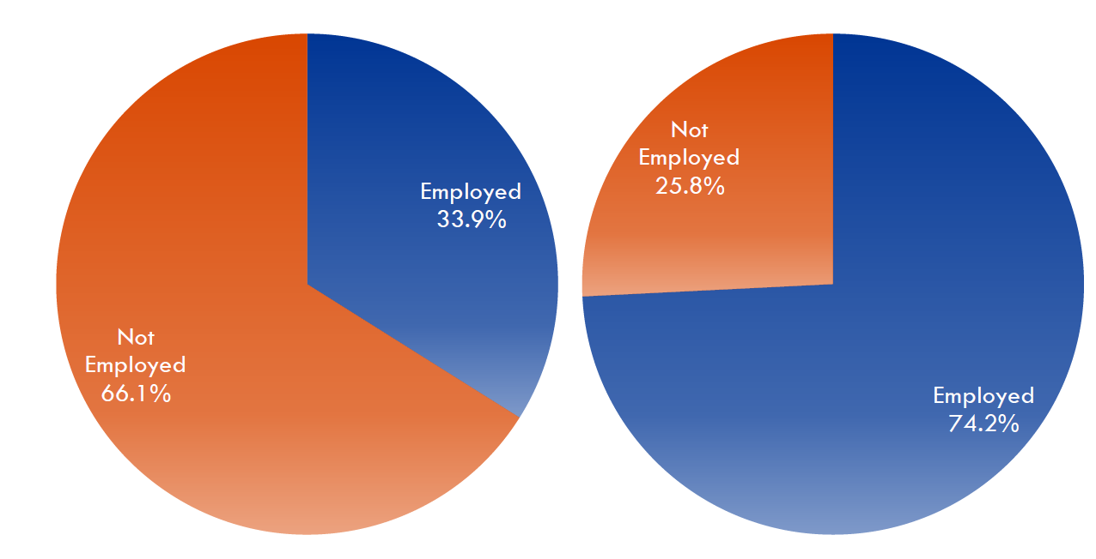
Employment Percentages of People With and Without Disabilities, 2013
People with Disabilities People without Disabilities
Data Source: American Community Survey, 2013
15
Notes:
In the US in 2013, 33.9% of civilians with disabilities ages 18-64 living in the community were employed. The employment percentage was much higher for people without disabilities, 74.2%.

Slide 16
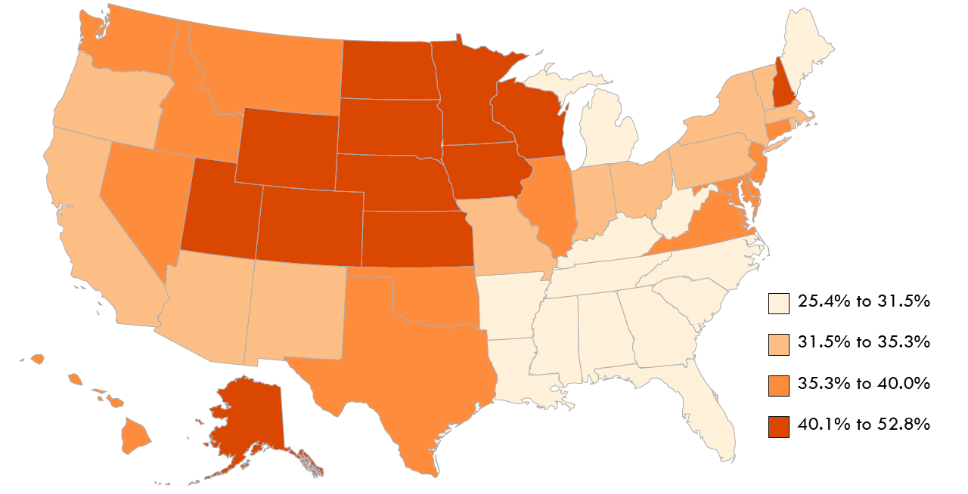
Employment of Civilians with Disabilities State Variation, 2013
Data Source: American Community Survey, 2013
16
Notes:
For persons with disabilities, employment rates ranged from a high of 52.8% (North Dakota) to a low of 25.3% (West Virginia).

Slide 17
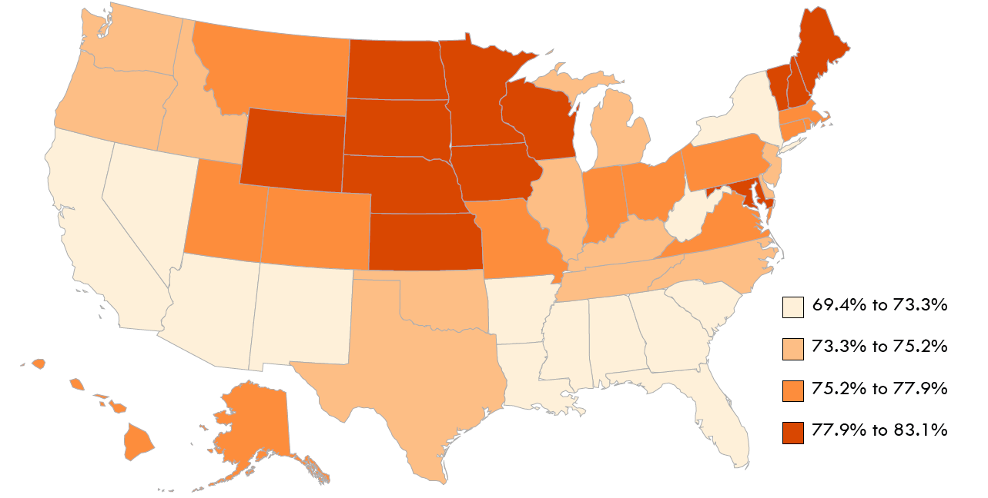
Employment of Civilians without Disabilities State Variation, 2013
Data Source: American Community Survey, 2013
17
Notes:
For those without disabilities, the employment percentages ranged from 69.4% (Mississippi) to 83.1% (North Dakota).

Slide 18
Employment of Civilians By State, 2013
With Disability Without Disability
Data Source: American Community Survey, 2013
18
Notes:
For persons with disabilities, employment rates ranged from a high of 52.8% (North Dakota) to a low of 25.3% (West Virginia).
For those without disabilities, the employment percentages ranged from 69.4% (Mississippi) to 83.1% (North Dakota).

Slide 19
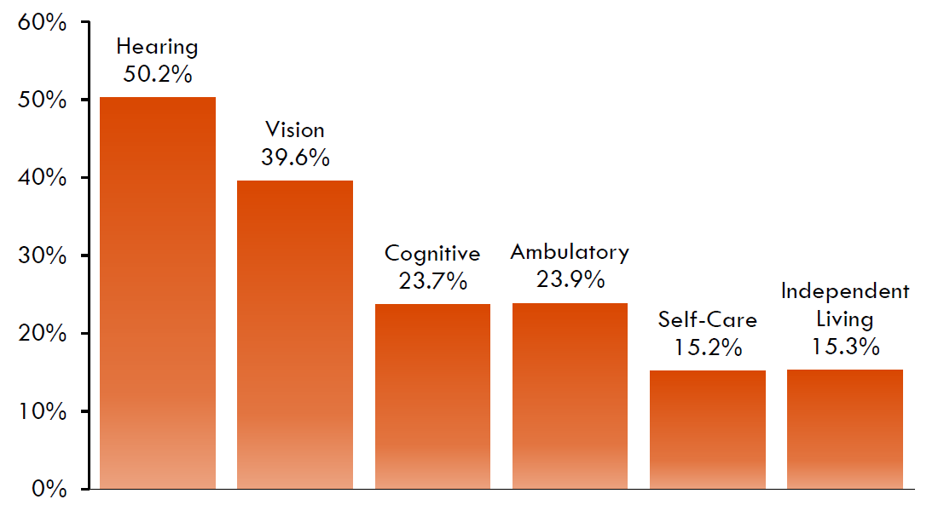
Employment Percentage by Type of Disability Ages 18-64, by State, 2013
Data Source: American Community Survey, 2013
19
Notes:
Employment percentages were highest for people with hearing disabilities (50.2%) and vision disabilities (39.6%) and lowest for self-care (15.2%) and independent living (15.3%) impairments.

Slide 20
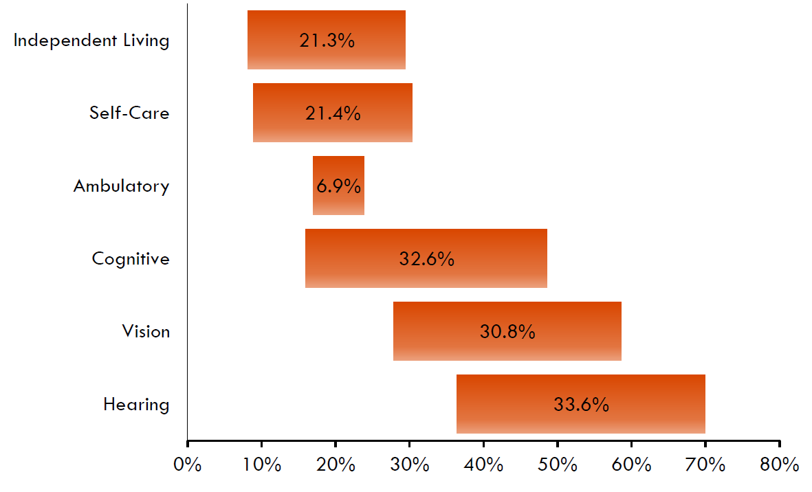
Range in State Disability Employment Percentages, 2013
Data Source: American Community Survey, 2013
20
Notes:
This slide shows the range of employment among states for each of the six ACS disability types.

Slide 21
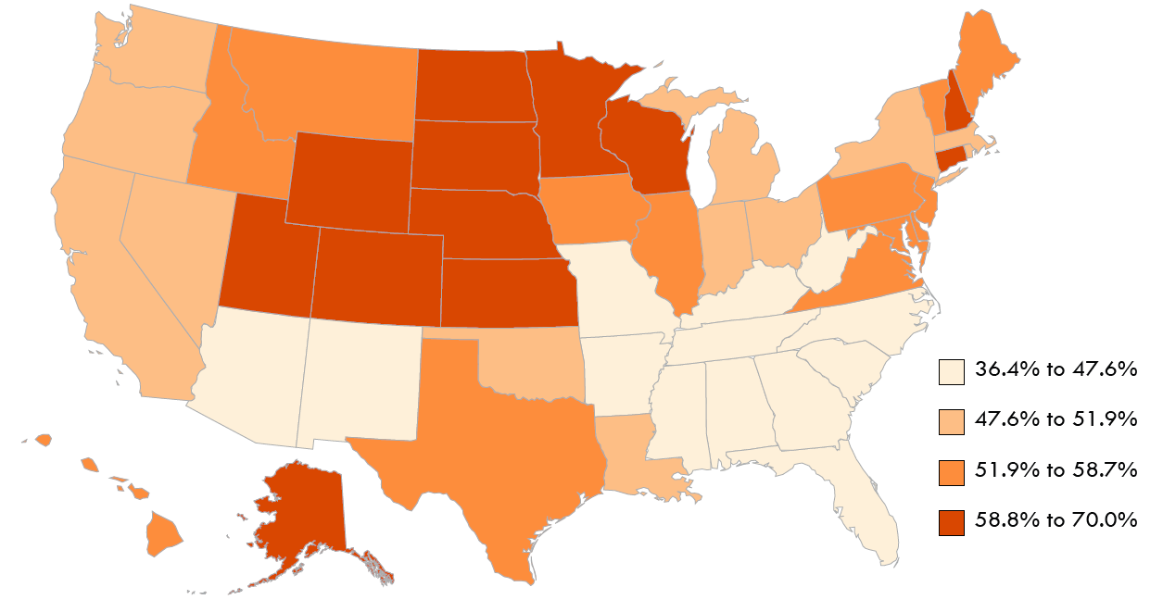
Hearing Disability Employment Percentage Ages 18-64, by State, 2013
Data Source: American Community Survey, 2013
21
Notes:
The map shows the variation in the state employment percentages for hearing disability with the highest percentages concentrated in the upper Midwest, and lowest employment percentages in the South.

Slide 22
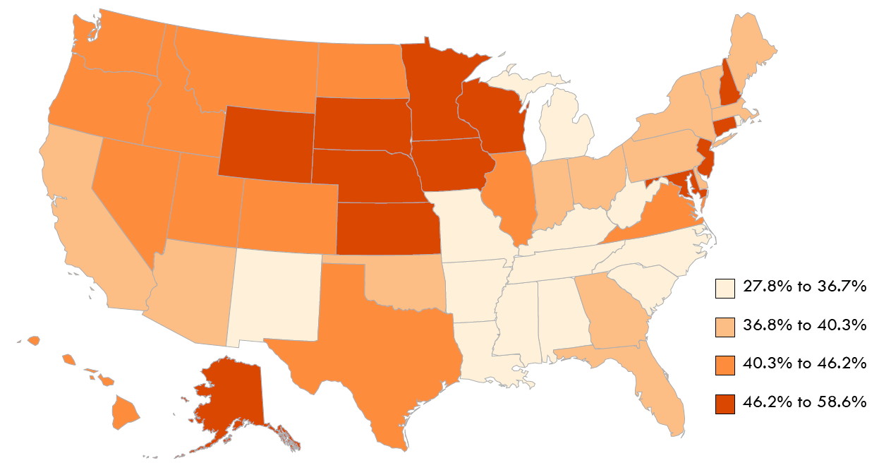
Vision Disability Employment Percentage Ages 18-64, by State, 2013
Data Source: American Community Survey, 2013
22
Notes:
The map shows the variation in the state employment percentages for vision disability with the highest percentages concentrated in the upper Midwest, and lowest employment percentages in the South.

Slide 23
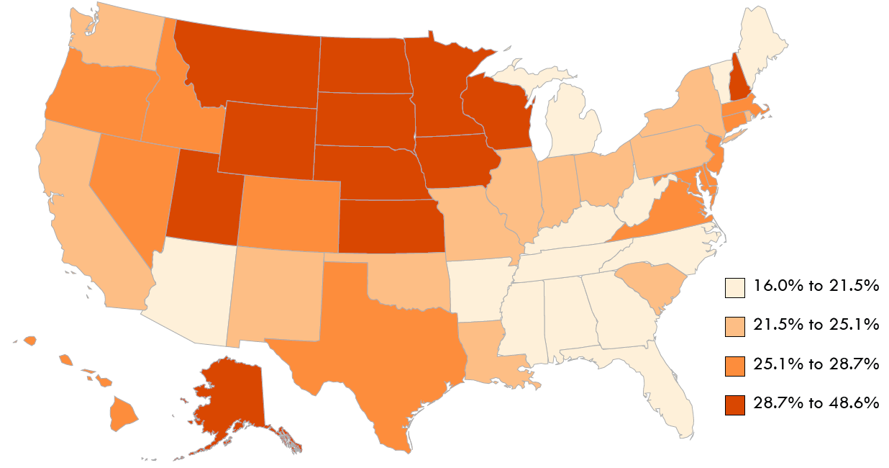
Cognitive Disability Employment Percentage Ages 18-64, by State, 2013
Data Source: American Community Survey, 2013
23
Notes:
The map shows the variation in the state employment percentages for cognitive disability with the highest percentages concentrated in the upper Midwest, and lowest employment percentages in the South.

Slide 24
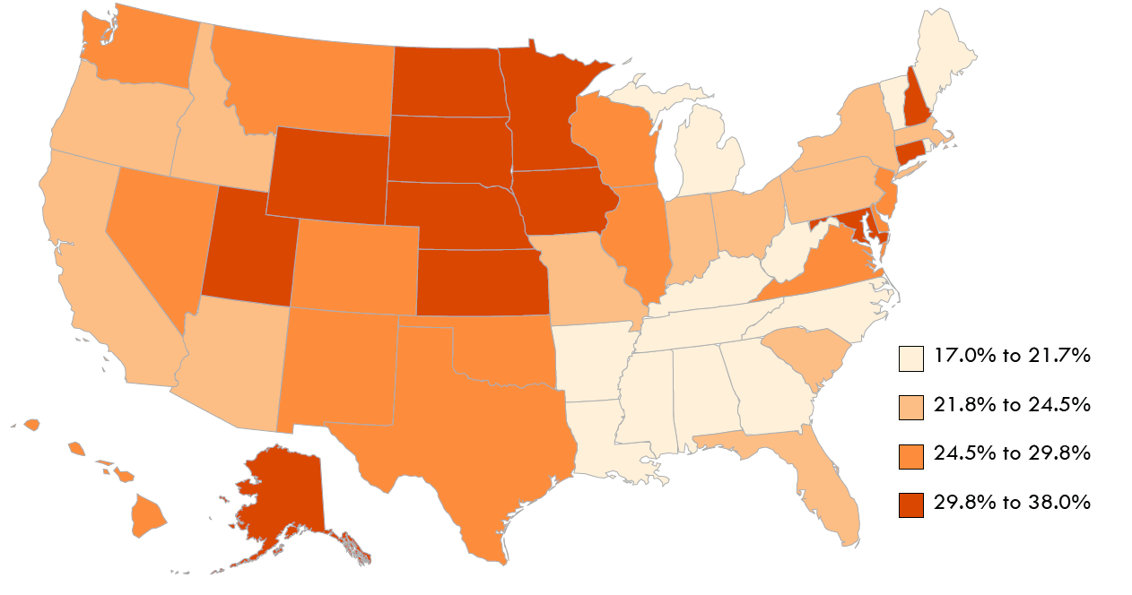
Ambulatory Disability Employment Percentage Ages 18-64, by State, 2013
Data Source: American Community Survey, 2013
24
Notes:
The map shows the variation in the state employment percentages for ambulatory disability with the highest percentages concentrated in the upper Midwest, and lowest employment percentages in the South.

Slide 25
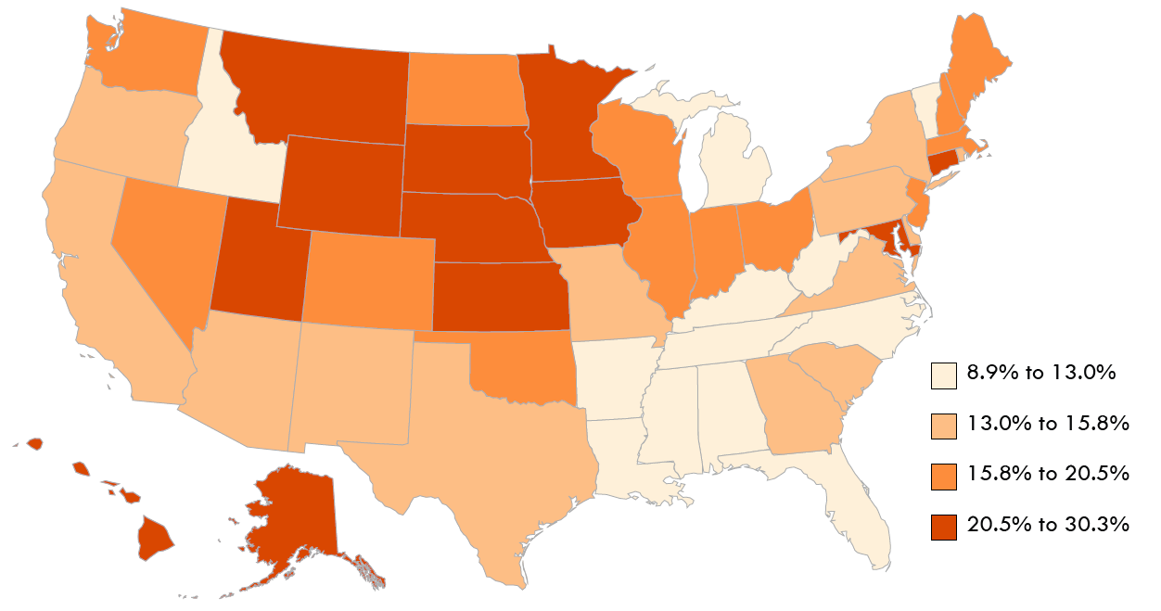
Self-Care Disability Employment Percentage Ages 18-64, by State, 2013
Data Source: American Community Survey, 2013
25
Notes:
The map shows the variation in the state employment percentages for self-care disability with the highest percentages concentrated in the upper Midwest, and lowest employment percentages in the South.

Slide 26
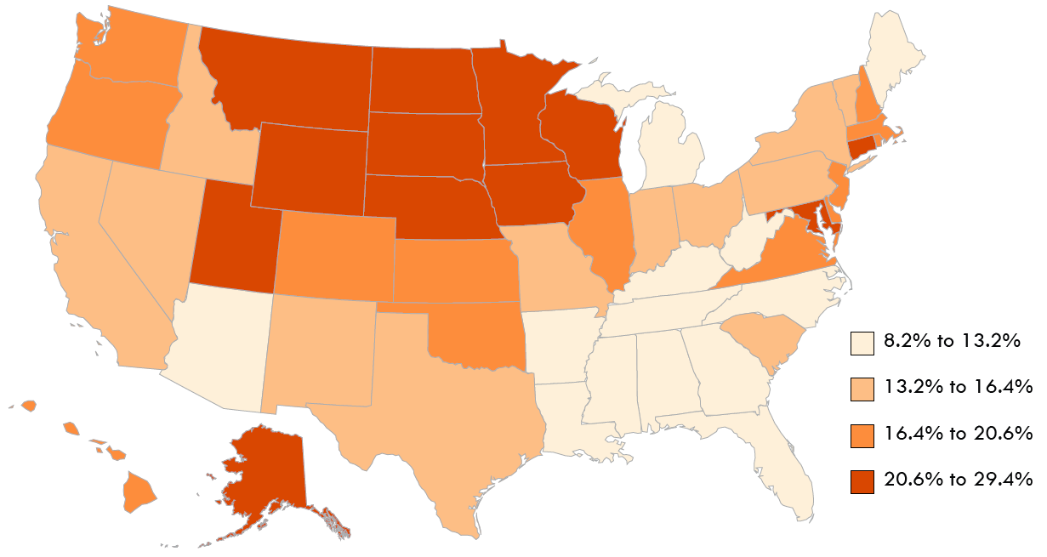
Independent Living Disability Employment Percentage, Ages 18-64, by State, 2013
Data Source: American Community Survey, 2013
26
Notes:
The map shows the variation in the state employment percentages for independent living disability with the highest percentages concentrated in the upper Midwest, and lowest employment percentages in the South.

Slide 27
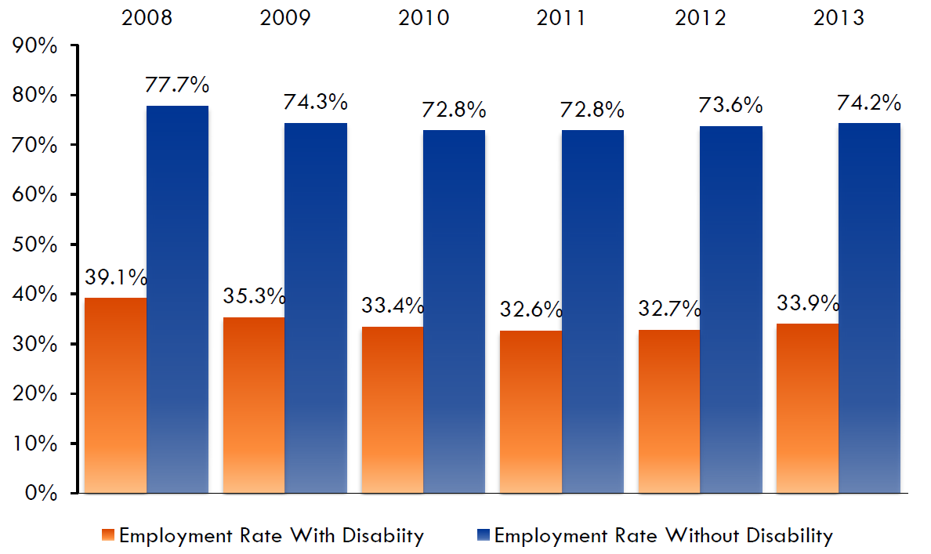
Employment Percentage With and Without Disability, 2008-2013
Data Source: American Community Survey, 2013
27
Notes:
In the six years from 2008 to 2013, the US employment percentage for people with disabilities declined from a high of 39.1% in 2008 to 33.9% in 2013, which was still a slight increase in value after lower percentages from 2010 to 2012.
The US employment percentage for people without disabilities in this same period also declined from 77.7% in 2009. After a low of 72.8% in 2010 and 2011, the percentage increased to 75.6% in 2012 and 74.2% in 2013.
While percentages for both groups have increased, the gap between percentages for people with and without disabilities has increased also. In 2008, the gap was 38.6%; it has been higher than 40.0% for the last three years.

Slide 28
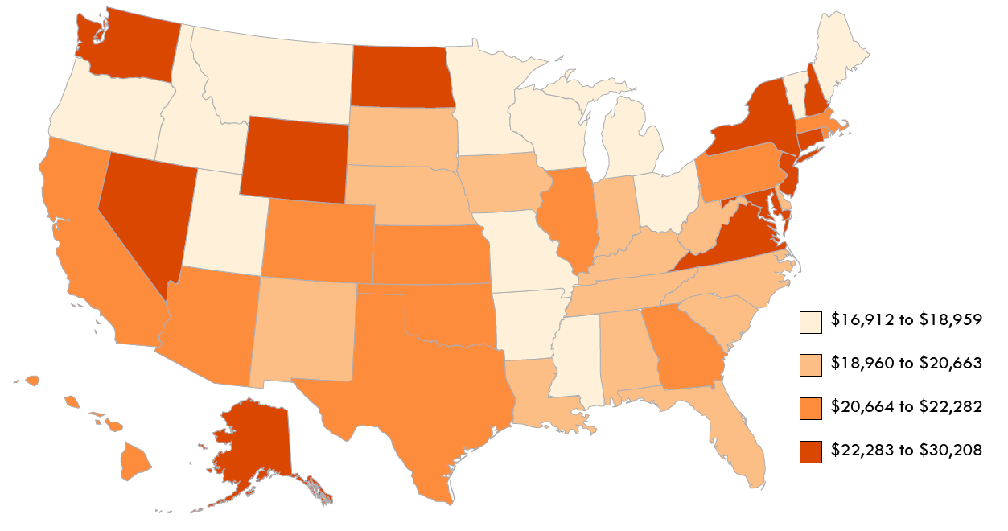
State Median Earnings, Past 12 Months Ages 16 and Over with Disability, 2013
Data Source: American Community Survey, 2013
28
Notes:
In 2013, the median earnings of civilians with disabilities ages 16 and over in the US was $20,785, about two-thirds of the median earnings of people without disabilities, $30,728. These slides show variations in earnings for persons with and without disabilities, by state. In three states (Alaska, Maryland, and New Jersey), the median earnings for people with disabilities was over $25,000, while nineteen states had median disability earnings lower than $20,000.

Slide 29
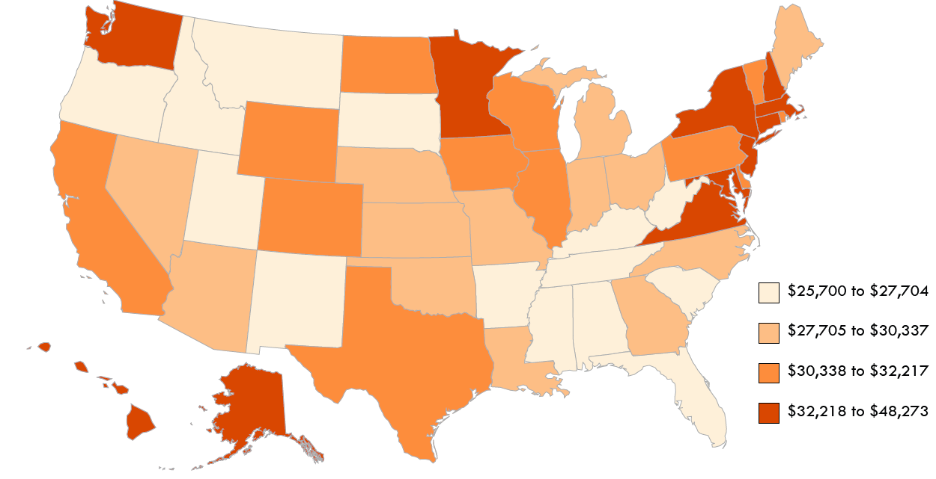
State Median Earnings, Past 12 Months Ages 16 and Over without Disability, 2013
Data Source: American Community Survey, 2013
29
Notes:
The median earnings for civilians without disabilities in the states ranged from $25,700 in Montana to $48,273 in the District of Columbia.

Slide 30
State Median Earnings, Past 12 Months Ages 16 and Over By State, 2013
With Disability Without Disability
Data Source: American Community Survey, 2013
30
Notes:
In 2013, the median earnings of civilians with disabilities ages 16 and over in the US was $20,785, about two-thirds of the median earnings of people without disabilities, $30,728. These slides show variations in earnings for persons with and without disabilities, by state. In three states (Alaska, Maryland, and New Jersey), the median earnings for people with disabilities was over $25,000, while nineteen states had median disability earnings lower than $20,000.
The median earnings for civilians without disabilities in the states ranged from $25,700 in Montana to $48,273 in the District of Columbia.

Slide 31
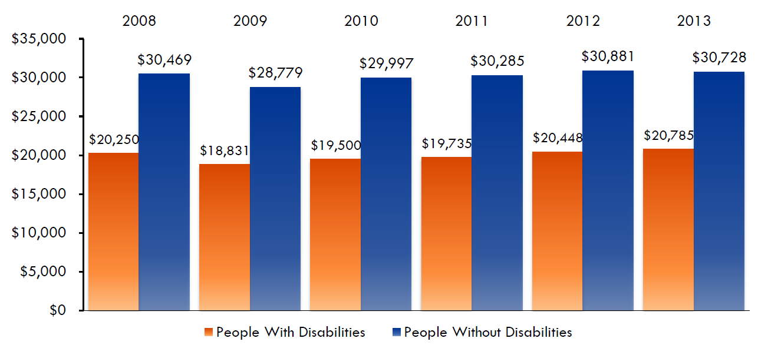
Median Earnings, Civilians With and Without Disabilities, Ages 16 and Over, 2008-2013
Data Source: American Community Survey, 2013
31
Notes:
Nationally, from 2008 to 2013, the earnings percentages for both people with and without disabilities showed a slight downward trend from 2008 to 2009, until increasing in 2011.
The earnings gap ranged from $10,550 in 2011 to $9,943 in 2013.

Slide 32
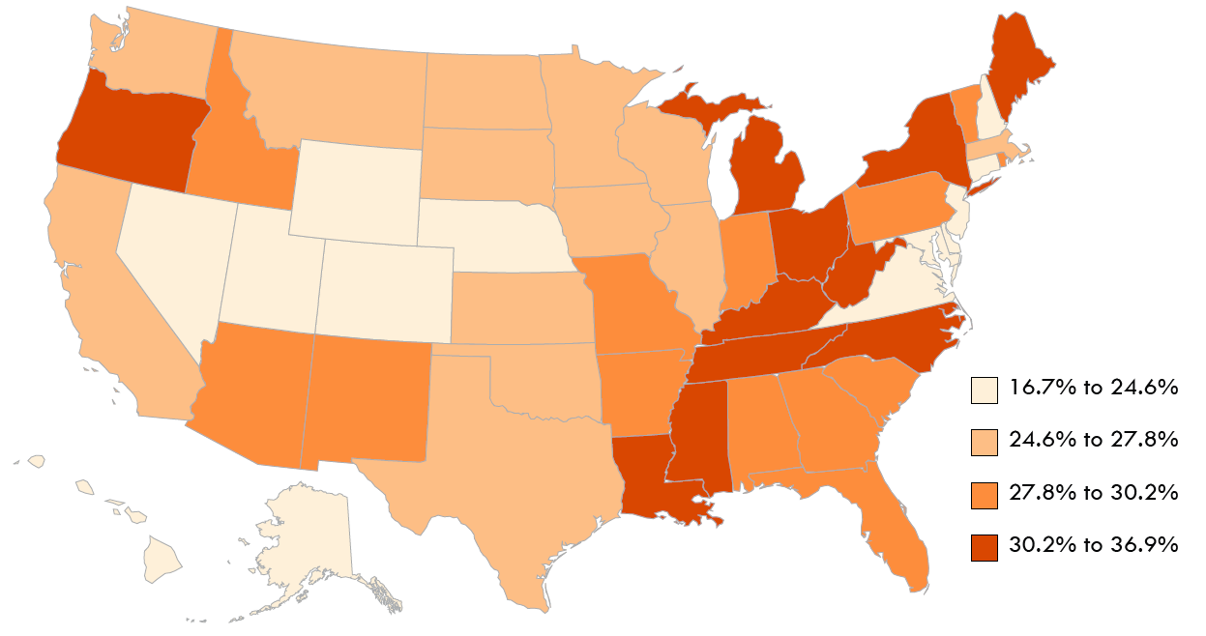
Poverty Percentage Civilians with Disabilities Ages 18-64, 2013
Data Source: American Community Survey, 2013
32
Notes:
Almost thirty percent (28.7%) of US civilians with disabilities of working-age in 2013 were living in poverty. The percentages ranged from 16.7% (Wyoming) to 36.9% (District of Columbia).
The disability poverty percentage was less than 25.0% in fourteen states, lowest in Wyoming (16.7%) and Alaska 17.3%.

Slide 33
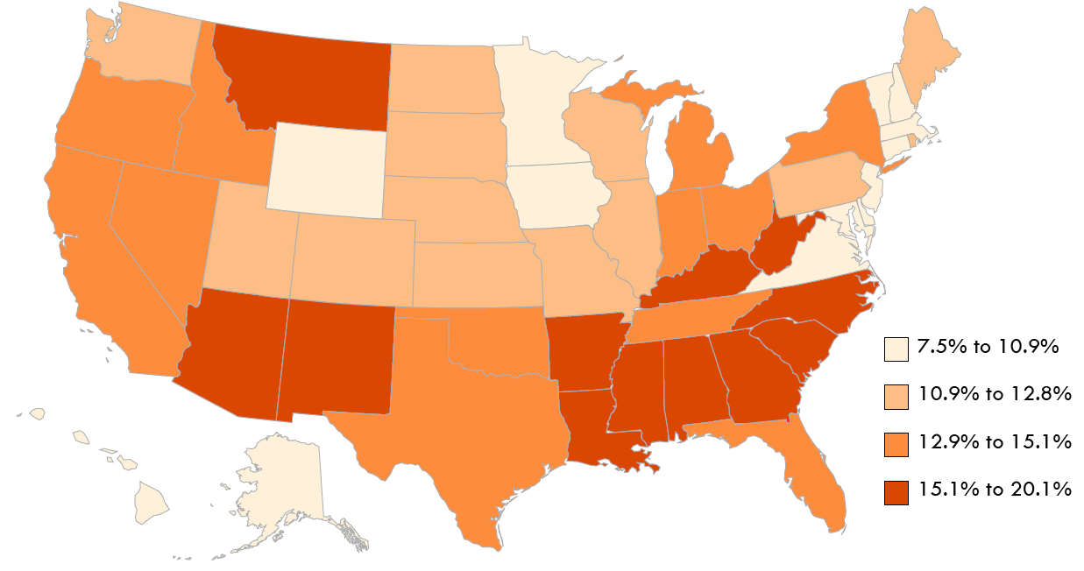
Poverty Percentage Civilians without Disabilities Ages 18-64, 2013
Data Source: American Community Survey, 2013
33
Notes:
For US civilians of working-age without disabilities, the national poverty percentage was 13.6%. State poverty percentages ranged from 7.5% in New Hampshire to 20.1% in Mississippi.

Slide 34
Poverty Percentage By State, Ages 18-64, 2013
With Disability Without Disability
Data Source: American Community Survey, 2013
34
Notes:
Almost thirty percent (28.7%) of US civilians with disabilities of working-age in 2013 were living in poverty. The percentages ranged from 16.7% (Wyoming) to 36.9% (District of Columbia).
The disability poverty percentage was less than 25.0% in fourteen states, lowest in Wyoming (16.7%) and Alaska 17.3%.
For US civilians of working-age without disabilities, the national poverty percentage was 13.6%. State poverty percentages ranged from 7.5% in New Hampshire to 20.1% in Mississippi.

Slide 35
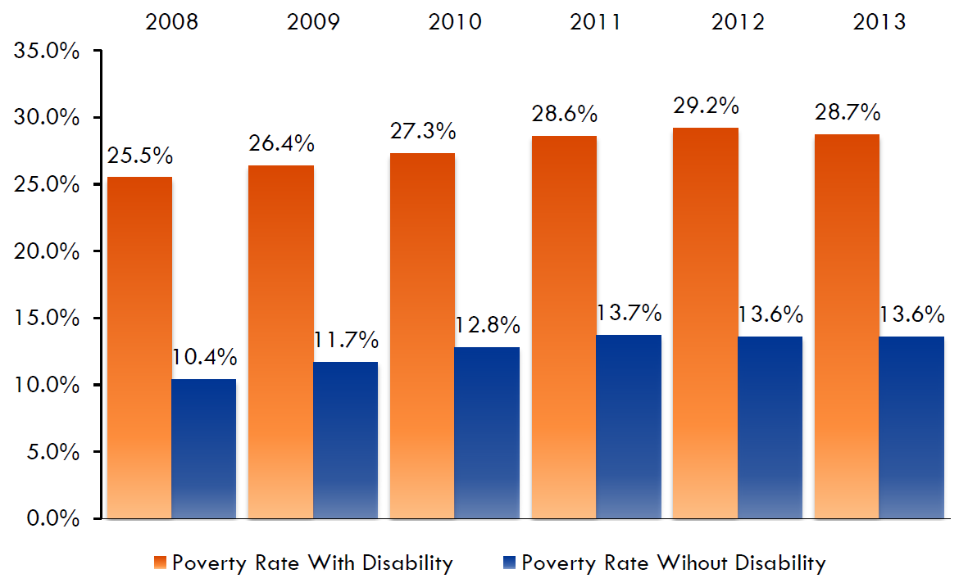
Poverty Percentage People with and without Disabilities, 2008-2013
Data Source: American Community Survey, 2013
35
Notes:
From 2008 and 2013, poverty rose among people with and without disabilities. For people with disabilities, the percentage increased from 25.5% in 2008 to 28.7% in 2013, after a high of 29.2% in 2012. For people without disabilities, the percentage increased from 10.4% in 2008 to 13.6% in 2013, also seeing a high in 2012 of 15.6%.
The poverty percentage gap, or the difference between the percentages of these two groups, was about 15.0%. For these six years, the gap was highest (15.8%) in 2012, lowest in the years 2009-2011, and in 2008 and 2013, the gap was 15.1%.

Slide 36
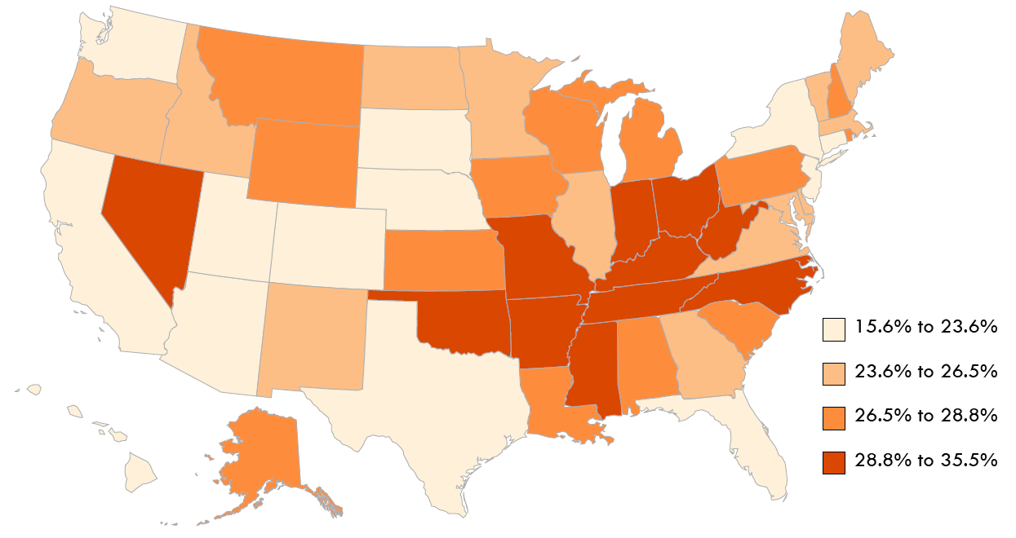
Smoking Among Persons Ages 18 and Over With Disabilities, 2013
Data Source: Behavioral Risk Factor Surveillance Survey , 2013
36
Notes:
In the US, the percentage of smoking for people with disabilities was 25.4%, much higher than the percentage of 16.2% for people without disabilities. Percentages ranged from 15.6% to 35.5% among states 2013.

Slide 37
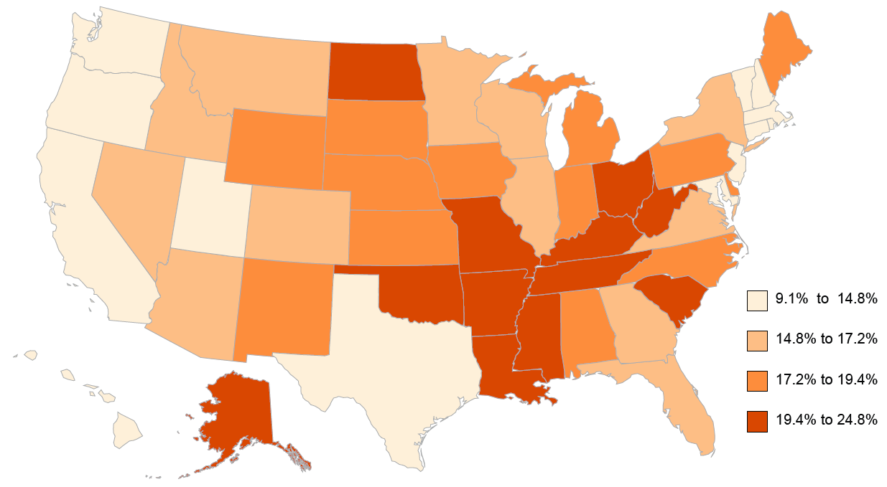
Smoking Among Persons Ages 18 and Over Without Disabilities, 2013
Data Source: Behavioral Risk Factor Surveillance Survey, 2013
37
Notes:
For people without disabilities, the state percentages of smoking for persons ages 28 and over ranged from 9.1% to 24.8% in 2013.

Slide 38
Smoking Among Persons Ages 18 and Over By State, 2013
With Disability Without Disability
Data Source: Behavioral Risk Factor Surveillance Survey, 2013
38
Notes:
In the US, the percentage of smoking for people with disabilities was 25.4%, much higher than the percentage of 16.2% for people without disabilities. Percentages ranged from 15.6% to 35.5% among states 2013.
For people without disabilities, the state percentages of smoking for persons ages 28 and over ranged from 9.1% to 24.8% in 2013.

Slide 39
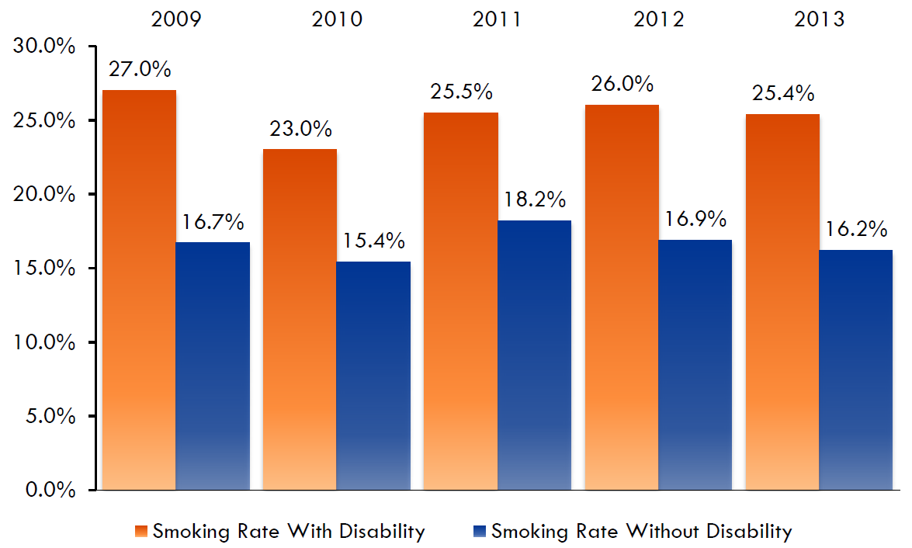
Smoking Percentages With and Without Disabilities, 2009-2013
Data Source: Behavioral Risk Factor Surveillance Survey , 2013
39
Notes:
The difference between the percentages of people with and without disabilities was over 15.0% in Tennessee, where this difference in percentages was the greatest. The gap was smallest, less than 5.0%, in Hawaii, South Dakota and Arizona.
Since 2009, the percentage of people with disabilities who smoke has varied from 27.0% in 2009 to 23.0% in 2010. The gap between the percentages for smokers with disabilities and people without disabilities was 9.2% in 2013, lower than in 2009 (10.3%) but higher than the other years.

Slide 40
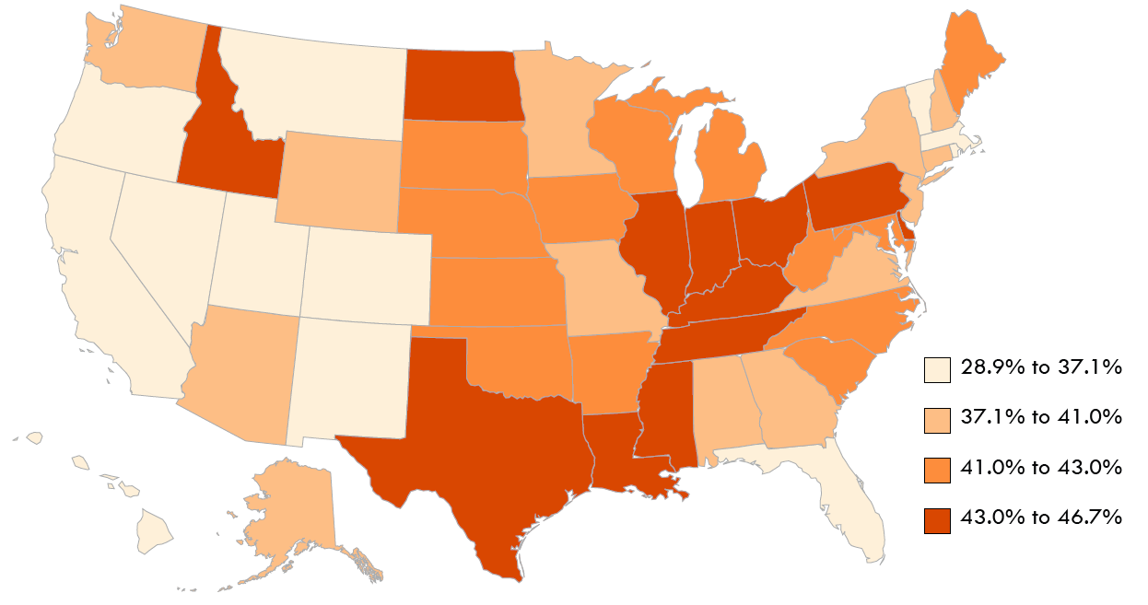
Obesity Among Persons Ages 18 and Over With Disabilities, 2013
Data Source: Behavioral Risk Factor Surveillance Survey , 2013
40
Notes:
In 2013, 40.1% of adults with disabilities were obese. State obesity percentages for people with disabilities ranged from 28.9% to 46.6%.

Slide 41
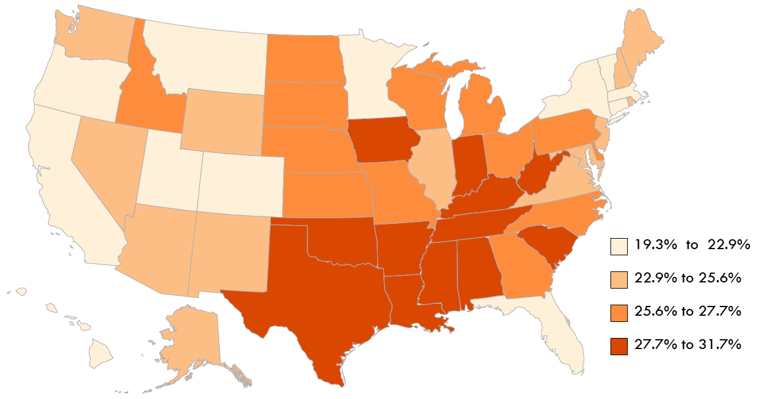
Obesity Among Persons Ages 18 and Over Without Disabilities, 2013
Data Source: Behavioral Risk Factor Surveillance Survey , 2013
41
Notes:
State obesity percentages for people without disabilities ranged from 19.3% to 31.7%.

Slide 42
Obesity Among Persons Ages 18 and Over By State, 2013
With Disability Without Disability
Data Source: Behavioral Risk Factor Surveillance Survey , 2013
42
Notes:
In 2013, 40.1% of adults with disabilities were obese. State obesity percentages for people with disabilities ranged from 28.9% to 46.6%.
State obesity percentages for people without disabilities ranged from 19.3% to 31.7%.

Slide 43
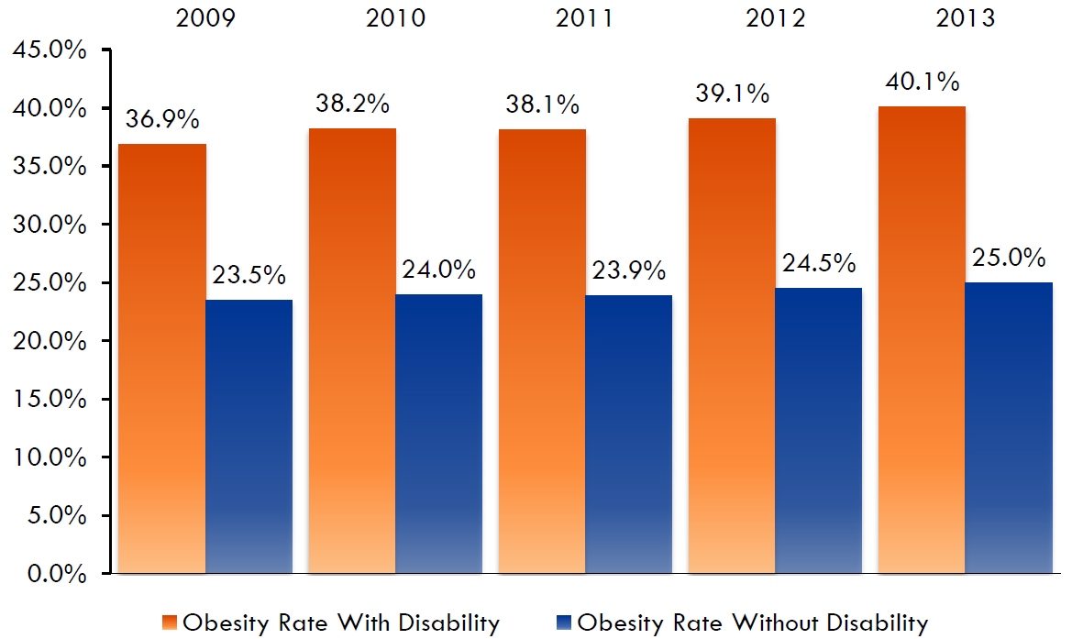
Obesity Percentages With and Without Disabilities, 2009-2013
Data Source: Behavioral Risk Factor Surveillance Survey , 2013
43
Notes:
Since 2009, the obesity percentage increased for both people with disabilities (from 36.9% in 2009 to 40.1% in 2013) and people without disabilities (from 23.5% in 2009 to 25.0% in 2013). In 2013, the gap between the percentages of obesity for people with and without disabilities increased from 13.4% in 2009 to 15.1%, the largest difference in this period.

Slide 44
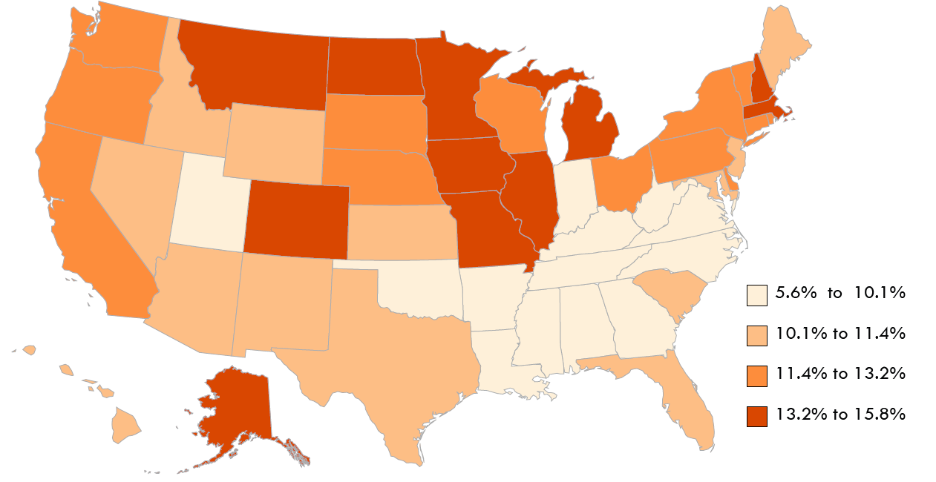
Binge Drinking Among Persons Ages 18 and Over With Disabilities, 2013
Data Source: Behavioral Risk Factor Surveillance Survey , 2013
44
Notes:
The 2013 state percentages for binge drinking among people with disabilities, ages 18 and over ranged from 5.6% in Tennessee to 15.8% in Massachusetts.

Slide 45
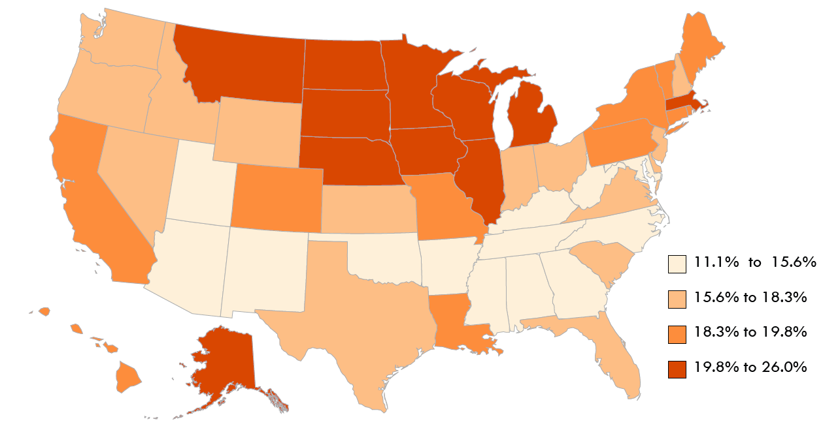
Binge Drinking Among Persons Ages 18 and Over Without Disabilities, 2013
Data Source: Behavioral Risk Factor Surveillance Survey , 2013
45

Slide 46
Binge Drinking Among Persons Ages 18 and Over by State, 2013
With Disability Without Disability
Data Source: Behavioral Risk Factor Surveillance Survey , 2013
46
Notes:
The 2013 state percentages for binge drinking among people with disabilities, ages 18 and over ranged from 5.6% in Tennessee to 15.8% in Massachusetts

Slide 47
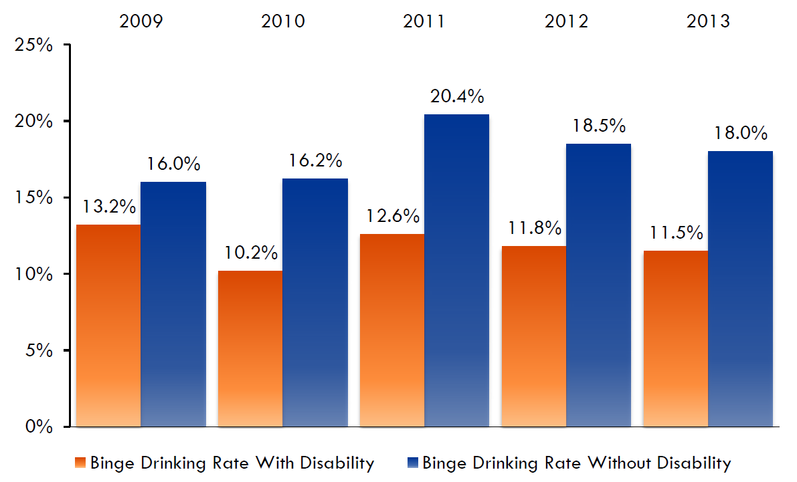
Binge Drinking Percentages With and Without Disabilities, 2009-2013
Data Source: Behavioral Risk Factor Surveillance Survey , 2013
47
Notes:
In the years 2009 through 2013, the binge drinking percentage for people with disabilities varied from a high of 13.2% in 2009 to a low of 10.2% in 2010. For people without disabilities the percentages were higher, varying from 16.0% in 2009 to 20.4% in 2011. The binge drinking gap measures the degree to which people with disabilities have less binge drinking; the gap was 6.5% in 2013, lower in 2009 (2.8%) and 2010 (5.9%), and higher in 2011 (7.8%) and 2012 (6.7%).

