Slide 1
2020 Annual Disability Statistics Compendium
Shreya Paul
Feb 9, 2021
University of New Hampshire
Notes:
Hello everyone, Good morning. My name is Shreya Paul and its my pleasure to welcome you to the virtual release of the 2020 annual disability statistics compendium.

Slide 2
Purpose of this Presentation
Describe the need and purpose of the Compendium
Introduce Compendium content and features
How to access the Compendium and technical assistance
Describe a few uses of the Compendium
Notes:
The purpose of today’s presentation is to talk to you about the need of disability statistics and the purpose of the compendium. In this presentation I will also introduce you to our content and features, describe how to access the compendium and technical assistance and finally describe a few uses of the Compendium.

Slide 3
Background
In the U.S. disability statistics are often difficult to find or scattered across multiple sources.
The Compendium and the Supplement aim to compile all these statistics in one place.
The goal is to bridge the gap between producers and consumers of disability statistics.
Notes:
Disability statistics are often difficult to find and if available they are often scattered across multiple sources. Through the compendium and the supplement, we aim to provide a comprehensive compilation of disability statistics all in one place. Our number one goal is to bridge the gap between producers and consumers of disability statistics and to do so in an accessible and timely fashion.

Slide 4
Current Products
The Annual Disability Statistics Compendium
The Annual Disability Statistics Supplement
The Annual Report on People with Disabilities in America
State reports with county-level data
Infographics
Notes:
These are our current products – the annual disability statistics compendium, its supplement report statistics on a variety of topics like prevalence, employment, health insurance coverage and so on. The annual report on people with disabilities in America tracks the progress of people with disabilities using key social and economic indicators and make a call as to whether a change was detected. We also have state reports with county level data on topics like prevalence, employment and poverty. This year, we also have two infographics – one on rural people with disabilities and the other one on African American people with disabilities.

Slide 5
The Design
Comprehensive, accessible, reliable and timely.
Notes:
This is how our products look this year. Our team works very hard to make these comprehensive, accessible, reliable and timely. Most of our products are available in both HTML and PDF format.

Slide 6

The Website
www.disabilitycompendium.org
Download our products
Request copies by mail
Contact us
Between Sept ‘19 – Sept ‘20, our products were downloaded ~8186 times.
This Photo by Unknown Author is
licensed under CC
Notes:
That’s our website up there – visit to download our products, request copies by mail or contact us with questions or for technical assistance.

Slide 7
Data Sources
American Community Survey Public Use Microdata Sample (ACS PUMS), 5-year estimates
Behavioral Risk Factor Surveillance System (BRFSS)
Social Security Administration (SSA)
Veterans Benefits Administration (VBA)
Rehabilitation Services Administration (RSA)
Notes:
Our reports use data from a variety of sources.
We use the American Community Survey Public Use Microdata Sample to report estimates of prevalence, employment, housing and insurance.
The Behavioral Risk Factor Surveillance System (BRFSS) is used to obtain estimates on factors affecting health such as smoking and binge drinking.
Estimates on various benefits and incomes received by people with disabilities such as the supplemental income and social security disability insurance are obtained from the SSA and VBA reports.
Reports from RSA or rehabilitation services administration is used to estimate statistics on people with disabilities served by vocational rehabilitation programs.
There are times, when a data source doesn’t get updated – in any case, we always use the latest data available.

Slide 8
Topics Covered
Population Size, Prevalence, and Disability Type
Demographic Characteristics
Health, Health Insurance, Risky Behavior
Employment, Earnings, and Poverty
Social Security Disability Insurance (SSDI) and Supplemental Security Income (SSI)
Special Education Services and Outcomes
and more..
Notes:
Topics covered include population size, prevalence and disability type, demographic characteristics, health, health insurance …. Read the slide

Slide 9
New this Year
Changes from previous year
Most calculations for the age group 18-64 years
ACS stats based on Public Use Microdata Sample (PUMS) instead of Census Bureau’s 1-year estimates
Newer sections in the Compendium
Functioning
Industry and Occupation
Home Environment
Rural
Notes:
There have been a few changes this year – till last year, we reported different estimates for different age groups such as 21-64 and ages 15+, this year we have calculated most of our estimates for the age group 18-64 years to increase consistency in our reporting. Moreover, this year, we have changed our source from ACS 1-year estimates to ACS public use microdata sample so the estimates that you see are based on an edited sample. Though we do not have an entirely new section in this year’s compendium, the sections functioning, industry and occupation, home environment and rural which were introduced last year are some of our newer sections.

Slide 10
Using the Compendium – An Example
Notes:
Moving on to our next section.
Statistics are a powerful tool. Statistics is used to tell stories as well as for making important decisions by policymakers. It is often used to monitor and evaluate the effectiveness of a program/policy. Many a times, a simple and quick visualization can help us make inferences about what is going on. Here is a quick example of how we can visualize the status-quo using estimates from our compendium and tell a story with it.

Slide 11
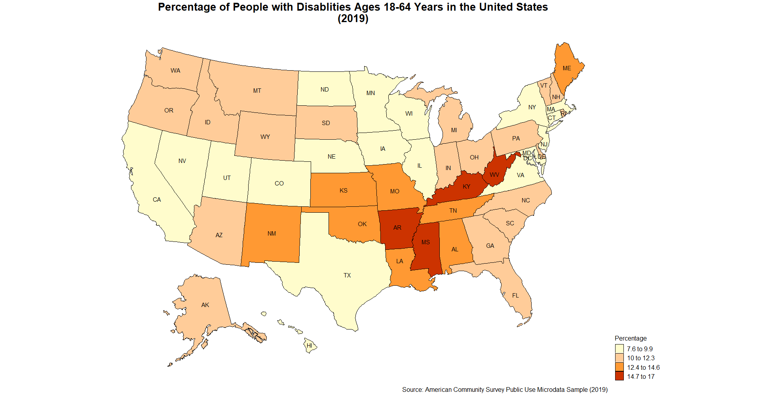
Notes:
I will pause for a moment to let you go through this map and draw conclusions from it. The map shows the prevalence of disability in the different states across the United States. As we can see Arkansas, Missouri, Kentucky and West Virginia have the highest percentage of people with disabilities. . Determining the size, composition, and geographic distribution of the population with disabilities is needed to support the allocation of resources to public programs. Similar visualizations about employment and education can help us understand about existing opportunities and risks and also states in which the government needs to expand opportunities for people with disabilities.

Slide 12
Ongoing Efforts
Include a section on mental health and substance use by people with disabilities (even if only national level)
Expand state reports with county level data
Produce more infographics
Make the reports and the website more user-friendly
Notes:
We are continuously working to include new sections in our compendium including expanding county level reports, reporting on mental and substance use by people with disabilities and so on. Moreover, we are working to make the reports and the website more accessible and user friendly.

Slide 13
Contact Information
Shreya Paul
Shreya.Paul@unh.edu
Institute on Disability
University of New Hampshire
10 West Edge Drive, Suite 101
Durham, NH 03824
Website: www.disabilitycompendium.org
Technical Assistance: disability.statistics@unh.edu
866-538-9521
Notes:
Thank you so much for joining us today. If you have any questions, please do not hesitate to reach me or the team. Our contact information is here.

Slide 14
Thank you
Notes:
Thank you. IF you have any questions for me, I am happy to answer those after the session. I will now invite my colleague, Megan Henly to present on state reports using county level data.

