Slide 1
2018 Annual Disability Statistics Compendium Data & Resources to Inspire a Vision of Employment “DRIVE” Website
Savi Swick, Director of Research & Evaluation, ODEP/USDOL
Richard Davis, Policy Advisor, ODEP/USDOL
February 13, 2018

Slide 2
Office of Disability Employment Policy – On going work to build evidence in disability employment
Stay-At-Work/Return-To-Work research on adults and youth
Nationally-representative survey of employers
Number of research projects in collaboration with DOL’s Chief Evaluation Office
Research on the public workforce system and its impact on disability employment

Slide 3
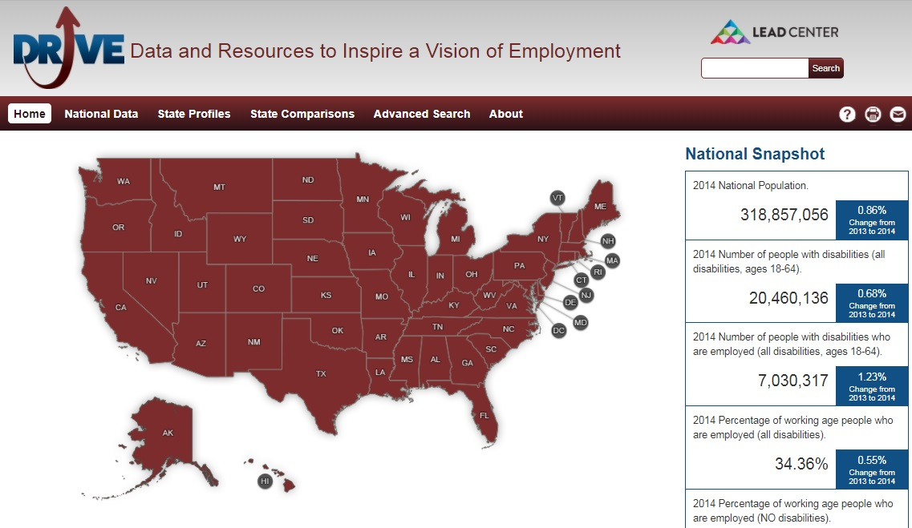
“DRIVE” Online Platform
www.drivedisabilityemployment.org

Slide 4
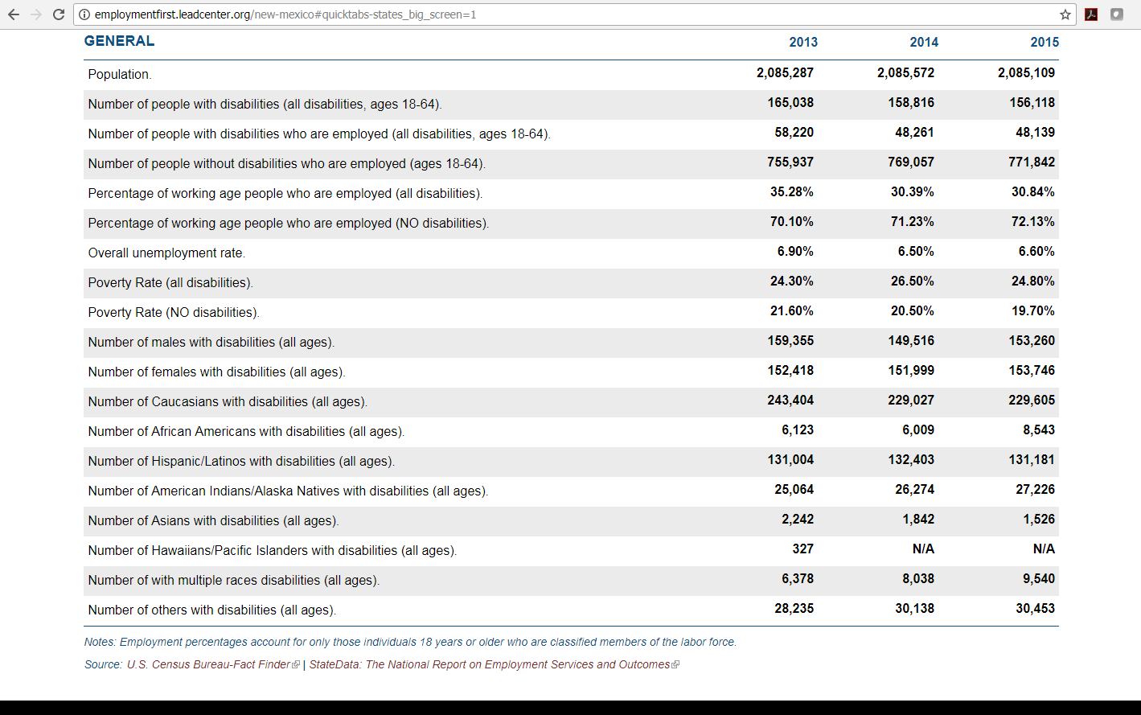
Sample State Profile
State Data: General, SSA Outcomes, Mental Health Outcomes, Workforce Development Outcomes, VR Outcomes, I/DD Outcomes, Education Outcomes, AbilityOne/JWOD Program Stats, Wage and Hour Division 14(c) Certificate Holding Entities Stats

Slide 5
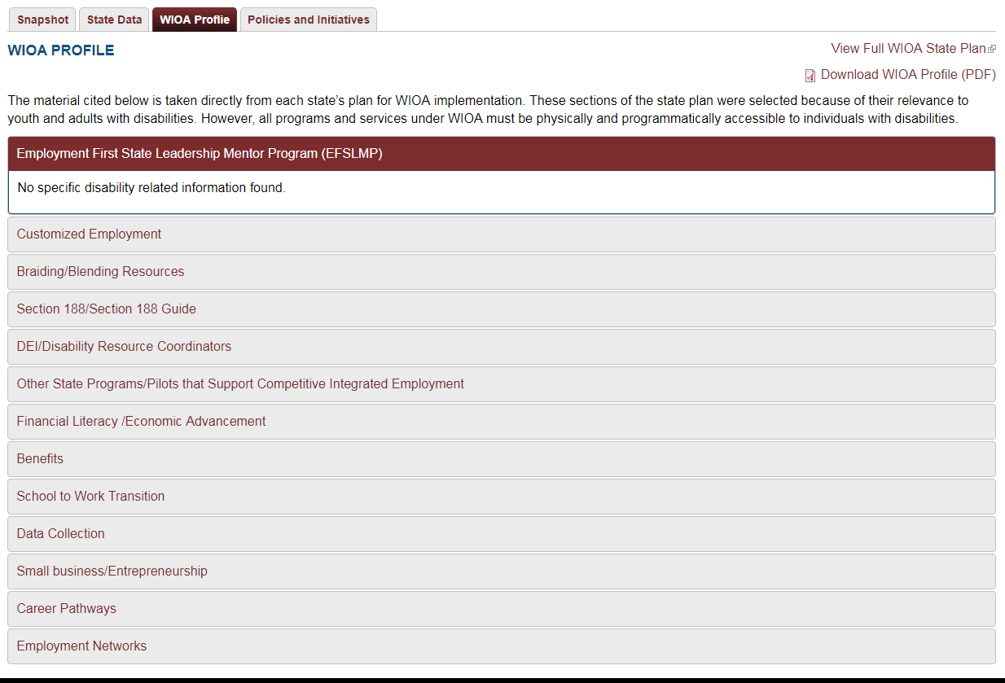
Sample State Profile
WIOA Profile:
Customized Employment
Braiding/Blending
Section 188
DEI/Disability Resource Coordinators
Other State Programs
Financial Literacy
Economic Advancement
Benefits
School to Work Transition
Data Collection
Career Pathways
Employment Networks

Slide 6
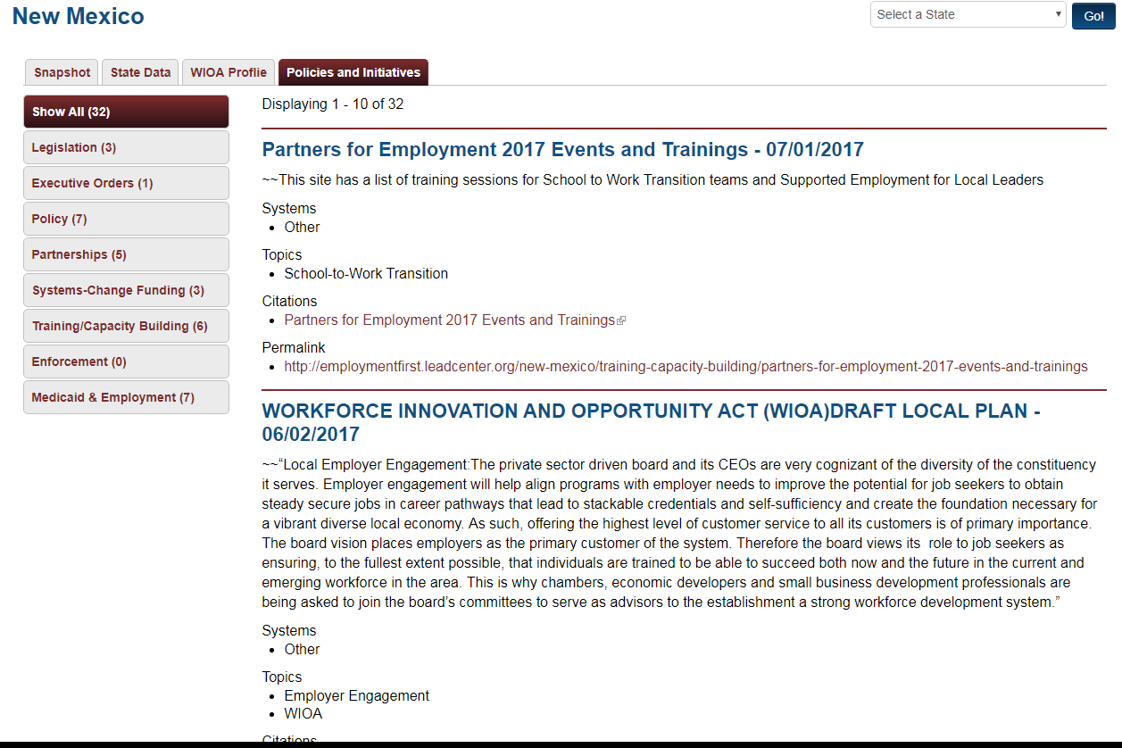
Sample State Profile
Policies & Initiatives:
Legislation (3)
Executive Orders (1)
Policy (7)
Partnerships (5)
Systems-Change Funding (3)
Training/Capacity Building (6)
Enforcement (0)
Medicaid & Employment (7)

Slide 7
Contact
Richard Davis
Policy Advisor Office of Disability Employment Policy U.S. Department of Labor 202-693-4923
Davis.Richard.A@dol.gov

