Slide 1
nTIDE Lunch & Learn
Webinar Series
Kessler Foundation, AUCD,
University of New Hampshire Institute on Disability
Season 9, Episode 2
Date: February 2, 2024

Slide 2

nTIDE Lunch & Learn
Webinar Series
Kessler Foundation, AUCD,
University of New Hampshire Institute on Disability
Season 9, Episode 2
Date: February 2, 2024

Slide 3
Up Front Matters
This webinar is being recorded. We will post an archive of along side the Monthly nTIDE broadcast on our webinar, each month, on our website at www.researchondisability.org/nTIDE. This site will also provide copies of the presentations, the speakers’ bios, full transcripts, and other valuable resources.
As an attendee of this webinar, you are a viewer. To ask questions of the speakers, click on the Q & A box on your webinar screen and type your questions into the box. Speakers will review these questions and provide answers during the last section of the webinar. Some questions may be answered directly in the Q & A box.

Slide 4
Up Front Matters – Contact Info
If you have any questions following this recording, please contact us at disability.statistics@unh.edu, or toll free at 866-538-9521 for more information. Thanks for joining us. Enjoy today's webinar!

Slide 5
Welcome
Megan Henly
University of New Hampshire

Slide 6
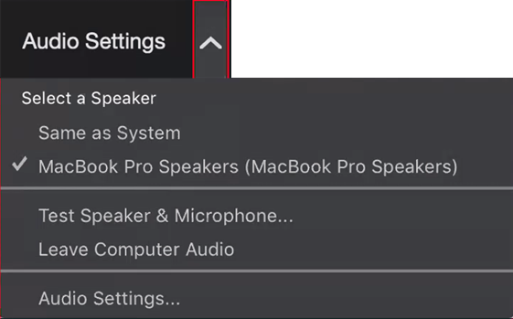
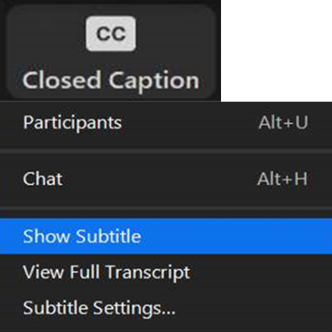
Zoom Tips
Tip #1: Sound
To select your speaker system, click on the up arrow next to Audio Settings, and then select one of the options.
Tip #2: Closed Captioning
Click on Closed Caption, and then select Show Subtitle for subtitles, or select View Full Transcript for a running transcript of the captions.

Slide 7
About nTIDE Lunch & Learn
  Occurs at noon Eastern-time on the first Friday day of each month, with the release of the nTIDE Report.
  A joint effort of the University of New Hampshire, Kessler Foundation, and the Association of University Centers on Disabilities (AUCD).

Slide 8
Today’s Program
Part 1: nTIDE Report … “The Numbers”
  John O’Neill, Kessler Foundation
  Megan Henly, University of New Hampshire
Part 2: nTIDE News
  Denise Rozell, Association of University Centers on Disabilities (AUCD)
Part 3: Guest Speakers
  Yonatan Ben-Shalom and Monica Farid, Mathematica
Part 4: Q&A

Slide 9
Part 1: The nTIDE Report
John O’Neill
Kessler Foundation

Slide 10
The Monthly nTIDE Report
The monthly nTIDE Report is a press release and infographic, looking at the latest employment statistics.
Uses data from the “jobs report” released by the U.S. Bureau of Labor Statistics, on the 1st Friday of each month.

Slide 11
Source of the Data
U.S. BLS, Current Population Survey (CPS).
  Source of the “official” unemployment rate.
Civilians, ages 16-64, not living in institutions.
Available September 2008 onward.
Not yet seasonally adjusted.
  which is why we compare to the same month last year.

Slide 12
The Numbers
Megan Henly
University of New Hampshire

Slide 13
But first…
2024 Annual Disability Statistics Conference
will be held on March 28, 2024!
In person from 11 – 4:30 (ET) at the Mary E. Switzer Building in Washington, DC, where you’ll find the NIDILRR offices.
As usual, it will also be online!
Go to our website to learn more and register: https://www.researchondisability.org/annual-event

Slide 14
Employment- to-Population
Ratio:

Slide 15
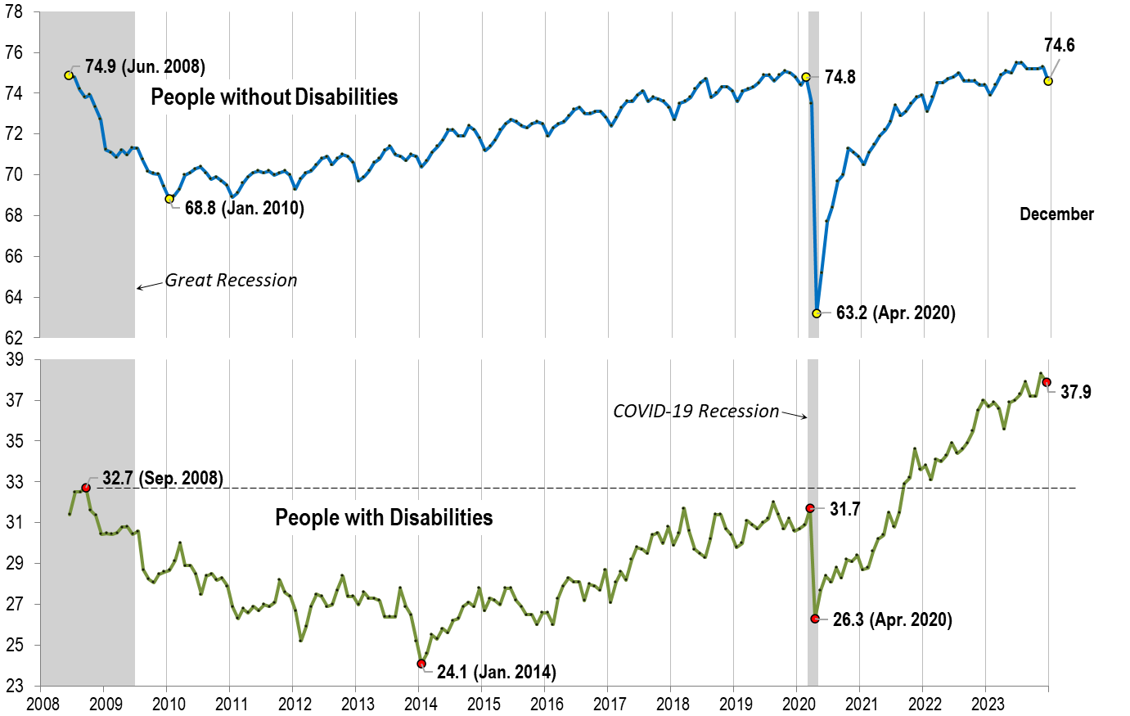
Employment- to-Population
Ratio:
December

Slide 16
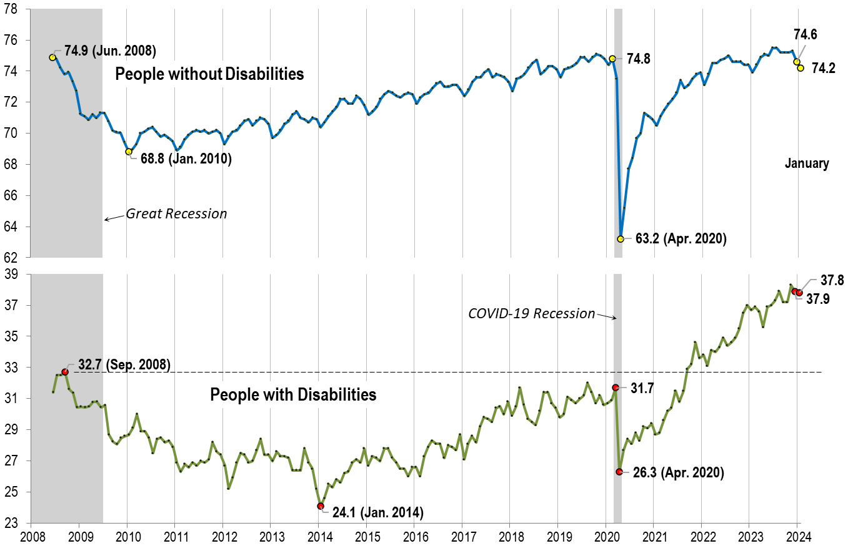
Employment- to-Population
Ratio:
January

Slide 17
Labor Force
Participation
Rate:

Slide 18
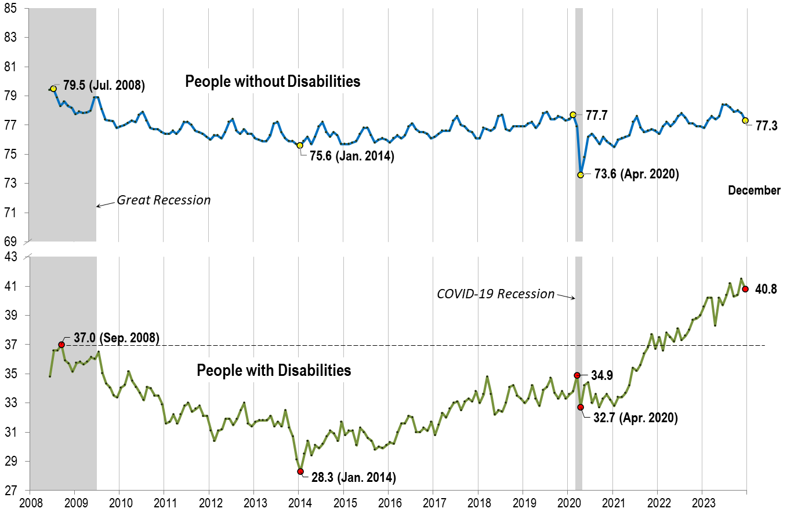
Labor Force
Participation
Rate:
December

Slide 19
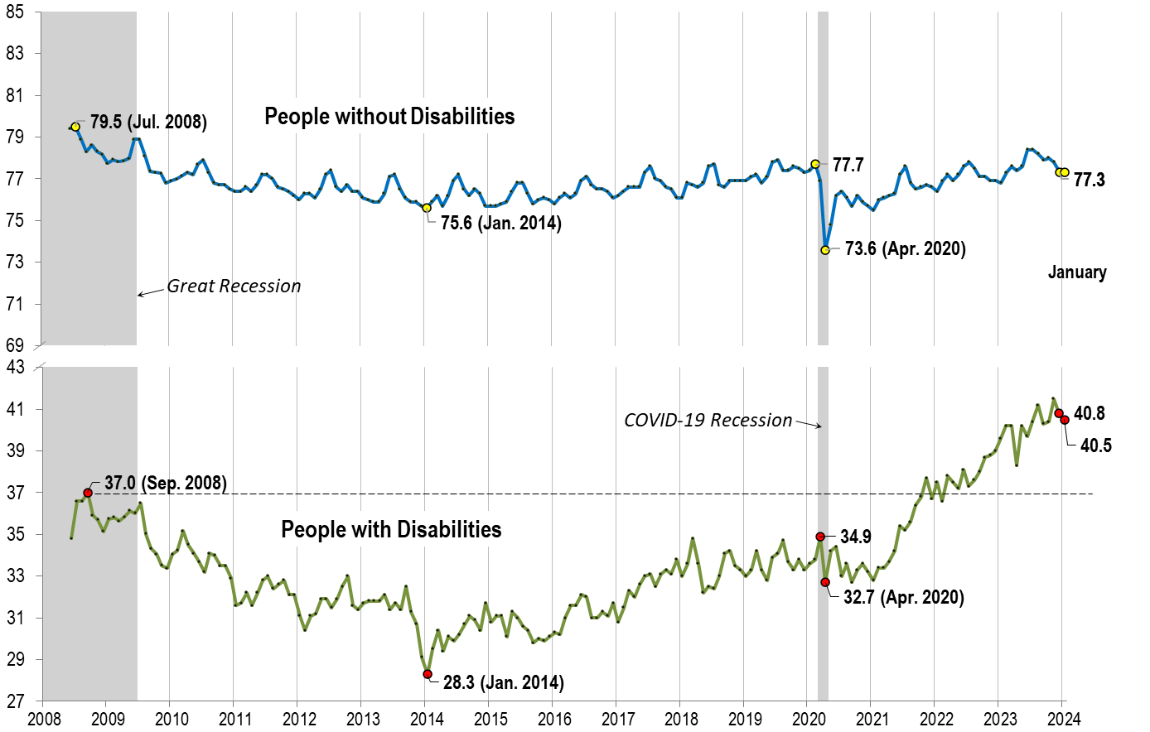
Labor Force
Participation
Rate:
January

Slide 20

Part 2 nTIDE News
Denise Rozell
Association of University Centers on Disabilities (AUCD)

Slide 21
Federal Policy Update
Appropriations:
  Continuing Resolution through March 1 (Ag, Transportation/HUD, Military construction/VA, Energy/Water) or March 8 (All the rest including Labor HHS)
  Does NOT include Ukraine, Israel, border security…
WIOA reauthorization bill in the House - A Stronger Workforce for America Act; H.R. 6655; (Foxx-NC)
  Does not include changes to Title IV – Rehabilitation Act
  Titles I-III -- strengthens language in support of pwd, including disabled veterans and youth with disabilities:
    Strengthens workforce system for inclusion of pwd,
    Evaluates the effectiveness of services to pwd
    YouthBuild: targeted funds to programs serving, rural, Native American, pwd

Slide 22
NIDILRR’s Long Range Plan 2024-2028
New areas of emphasis:
  Expanded commitment to broader inclusion of people with disabilities across the research enterprise;
  New opportunities for international research and development;
  Increased focus on the enabling or disabling characteristics of the communities in which we live; and
  Pursue work that has an intersectional focus.
Employment Domain:
  Focus on the needs and experiences of day habilitation program participants;
  Research toward increased participation in CIE;
  Systematically building the evidence base for services, supports, and interventions that promote CIE.

Slide 23
Turning 18: What Youth with Intellectual and Developmental Disabilities Should Know
Center on Youth Voice, Youth Choice
1-3 minute videos by self advocates talking about research findings from the Guardianship Alternatives and Transfer-of-Rights project. They explain:
  Transfer-of-rights;
  Transition planning;
  Turning 18;
  Alternatives to guardianship;
  What self-advocacy and decision-making means to them.
Turning 18: What Youth with Intellectual and Developmental Disabilities Should Know - Center on Youth Voice, Youth Choice (youth-voice.org)

Slide 24
ODEP: Small Business Focus
ODEP’s Employer Assistance and Resource Network on Disability Inclusion EARN’s Small Business Toolkit:
  Guide to help small businesses recruit, hire, retain and advance workers with disabilities;
  Addresses benefits of disability-inclusive workforce -- deeper talent pool, expanded business reach, reduced workforce turnover, and insight into the large disabled customer base.
Sign up for ODEP’s monthly Business Sense Newsletter -- developed specifically for small businesses
  Provides information and tips for advancing disability inclusion in smaller organizations that might not have dedicated HR or personnel people.
    Subscribe to Business Sense Read previous newsletters

Slide 25
New Rehab Services (RSA) Guidance
New technical assistance from RSA: RSA-TAC-24-01, October 30, 2023. State VR agencies should:
  Provide more than “minimal services” to help pwd gain employment;
  Make changes to promote “meaningful and sustained engagement” in the VR program;
  Engage with pwd in a timely manner by simplifying application process, expediting the determination of eligibility and eliminate other barriers;
  Develop policies to ensure a minimum level of communication with pwd in the VR system address issues and challenges.
    “Simply providing basic service alone is no longer enough to constitute meaningful engagement with the individual,” wrote Carol L. Dobak, deputy commissioner of RSA

Slide 26
VR Applicants and Services
Donahue, Meghan Lee et al. ‘Vocational Rehabilitation Applicants, the Services They Receive, and Their Employment Outcomes’. 1 Jan. 2024 : 63 – 85.
Analyzed VR population’s personal characteristics, services received, and program for all 572,490 adult cases that closed between 2017 and 2018; divided into participants and non-participants in VR:
  7 of the 20 primary “impairment categories” encompassed 78% of applicants;
  63% of applicants completed an individualized plan for employment (IPE) and became participants;
  85% of participants and 43%of non-participants received VR services;
  Half of VR participants exited unemployed and 44% were in CIE;
  2/3 of non-participants exited before developing their IPE mostly because they either lost interest in VR or VR lost the ability to talk to them.

Slide 27
Charting Equality: Why Demographic Disability Data is Good for Everyone
From National Health Law Project and DREDF; by Mary Lou Breslin and Silvia Yee
People with disabilities cannot be fully included in healthcare equity and equality work without being recognized and counted demographically:
  What is meant by demographic disability data?
  Common myths and stereotypes that influence why government and health entities tend to overlook a need to collect it;
  Explain why demographic disability data is needed, how it differs from medical or insurance information, and why it is important for proper medical and insurance assessments;
  Look at current examples of providers, health systems, and states that are working to collect demographic disability data;
  Provide recommendations for how to begin to collect this information, which is critical for ensuring that people with disabilities receive equally effective health care.

Slide 28
Mental Health Services Delivery for Youth: Policy Considerations
New publication from ODEP’s Center for Advancing Policy on Employment for Youth (CAPE-Youth) -- Leveraging State Policy to Support Positive Mental Health and Employment for Youth with Marginalized Racial Identities.
  Drawn from a virtual roundtable hosted by CAPE-Youth in collaboration with the White House Office of Public Engagement
  Key policy considerations for states to improve delivery of mental health services to youth from marginalized racial groups :
    Expanding cultural responsiveness mental health care;
    Increased access to mental health supports;
    Embedding mental health supports into workforce systems;
    Includes specific policy changes that states can make (and examples).

Slide 29
PEAT Online Dialogue on Artificial Intelligence
Making AI Hiring Tools More Inclusive - a National Online Dialogue- launching February 6
Hosted by Partnership on Employment & Accessible Technology (PEAT) to gather public input on how artificial intelligence (AI)-enabled hiring tools can be made more inclusive for pwd
Results will help inform PEAT’s efforts to build a profile on inclusive hiring based on the National Institute of Standards and Technology’s AI Risk Management Framework.
Join ODEP’s ePolicyWorks community today and receive an email on Tuesday to join the conversation!
Register for dialogue updates

Slide 30


Part 3: nTIDE Guest Speakers
Yonatan Ben-Shalom
Mathematica
Monica Farid
Mathematica

Slide 31


The RETAIN Demonstration: Update on Enrollment and Enrollee Characteristics
Retaining Employment and Talent After Injury/Illness Network

Slide 32
Agenda
What is RETAIN and why is it needed?
States’ approaches to enrollment
Comparing RETAIN enrollees with other populations

Slide 33
What is RETAIN?
RETAIN = Retaining Employment and Talent After Injury/Illness Network
Joint initiative of the U.S. Department of Labor (DOL) and the Social Security Administration (SSA)
Aims to help workers with recently acquired injuries/disabilities remain in labor force
5 states providing RETAIN services under cooperative agreements with DOL: Kansas, Kentucky, Minnesota, Ohio, Vermont

Slide 34
Why is RETAIN needed?
Annually, over 3 million workers experience medical conditions that put them at risk of losing their jobs
Workers who leave the workforce often experience adverse effects on their health, family finances, and quality of life
There is no coordinated service delivery system to help injured/ill workers remain in the workforce
In 2021, 1.8 million people applied for Social Security Disability Insurance (SSDI) disabled worker benefits

Slide 35
RETAIN program components
Coordination of medical and employment services throughout the medical recovery period
Training for medical providers on occupational health best practices (and incentives to implement them)
Workplace accommodations and job modifications
Retraining and rehabilitation services

Slide 36
State approaches to enrollment
Review of electronic medical record (EMR) data
Referrals from medical providers and other partners (e.g., state vocational rehabilitation agency)
Self-referral (including through targeted digital advertising)

Slide 37
Cumulative enrollment as of December 31, 2023

Slide 38
Comparing enrollees with other populations
We compared characteristics of RETAIN enrollees to adult workers and SSDI or Supplemental Security Income (SSI) applicants in same state
Goals:
  Understand how RETAIN enrollees who are at risk of leaving the labor force differ from the larger worker population
  Understand whether the RETAIN demonstration is reaching people who look similar to SSDI/SSI applicants

Slide 39
Data
Baseline enrollee characteristics from RETAIN enrollment forms
Worker characteristics from American Community Survey
Applicant characteristics from SSDI and SSI application data
Enrollee and applicant earnings information from SSA program data

Slide 40
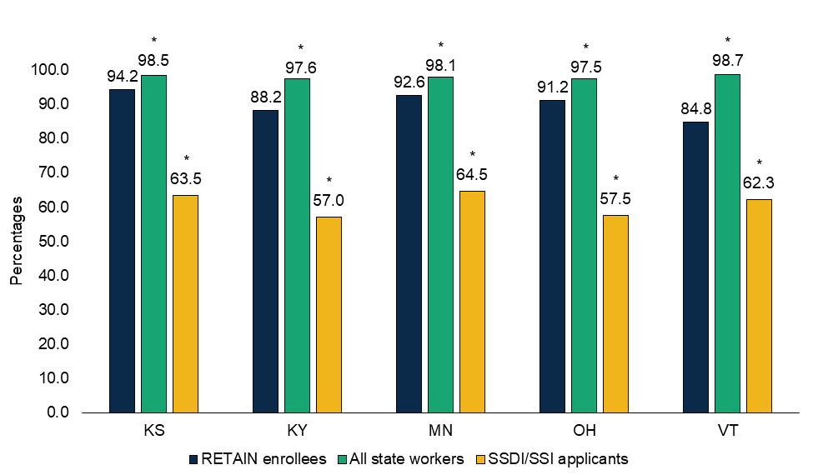
RETAIN enrollees had lower employment than all workers and higher employment than SSDI/SSI applicants
* Difference between the mean outcomes of RETAIN enrollees and the comparison population is significantly different from zero (p-value < 0.05) using a two-tailed t-test.
Notes:
Kansas Percentage of Employment:
RETAIN Enrollees: 94.2%
All state workers: 98.5%
SSDI/SSI applicants: 63.5%
Kentucky Percentage of Employment:
RETAIN Enrollees: 88.2%
All state workers: 97.6%
SSDI/SSI applicants: 57.0%
Minnesota Percentage of Employment:
RETAIN Enrollees: 92.6%
All state workers: 98.1%
SSDI/SSI applicants: 64.5%
Ohio Percentage of Employment:
RETAIN Enrollees: 91.2%
All state workers: 97.5%
SSDI/SSI applicants: 57.5%
Vermont Percentage of Employment:
RETAIN Enrollees: 84.8%
All state workers: 98.7%
SSDI/SSI applicants: 62.3%

Slide 41
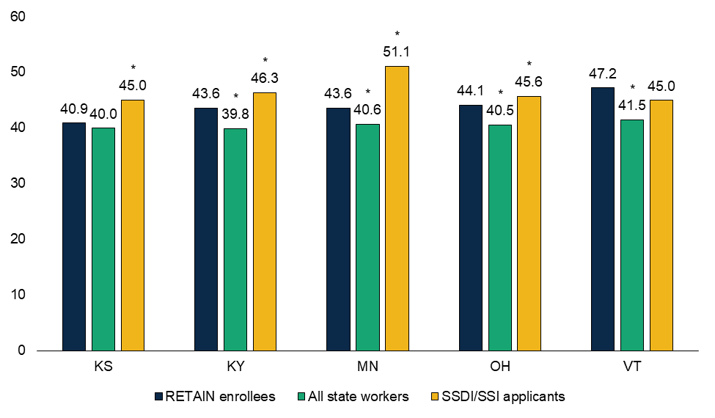
RETAIN enrollees were generally older than state workers and younger than SSDI/SSI applicants
* Difference between the mean outcomes of RETAIN enrollees and the comparison population is significantly different from zero (p-value < 0.05) using a two-tailed t-test.
Notes:
Kansas Average age:
RETAIN Enrollees: 40.9
All state workers: 40.0
SSDI/SSI applicants: 45.0
Kentucky Average age:
RETAIN Enrollees: 43.6
All state workers: 39.8
SSDI/SSI applicants: 46.3
Minnesota Average age:
RETAIN Enrollees: 43.6
All state workers: 40.6
SSDI/SSI applicants: 51.1
Ohio Average age:
RETAIN Enrollees: 44.1
All state workers: 40.5
SSDI/SSI applicants: 45.6
Vermont Average age:
RETAIN Enrollees: 47.2
All state workers: 41.5
SSDI/SSI applicants: 45.0

Slide 42
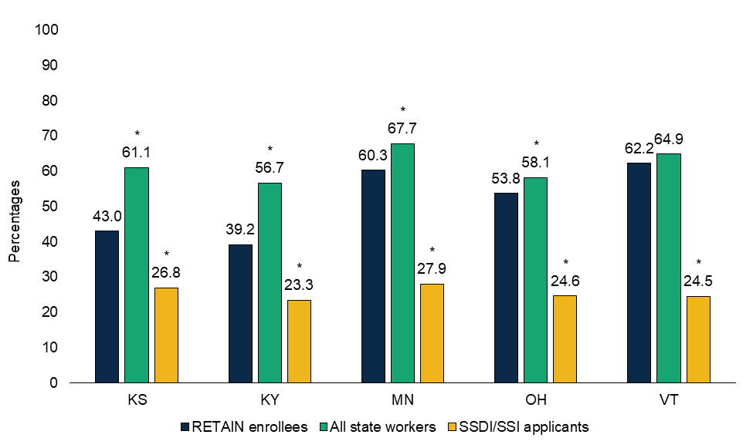
RETAIN enrollees were less likely to have post-secondary education than state workers, but more likely than SSDI/SSI applicants
* Difference between the mean outcomes of RETAIN enrollees and the comparison population is significantly different from zero (p-value < 0.05) using a two-tailed t-test.
Notes:
Kansas Percentage with Post-Secondary Education:
RETAIN Enrollees: 43.0%
All state workers: 61.1%
SSDI/SSI applicants: 26.8%
Kentucky Percentage with Post-Secondary Education:
RETAIN Enrollees: 39.2%
All state workers: 56.7%
SSDI/SSI applicants: 23.3%
Minnesota Percentage with Post-Secondary Education:
RETAIN Enrollees: 60.3%
All state workers: 67.7%
SSDI/SSI applicants: 27.9%
Ohio Percentage with Post-Secondary Education:
RETAIN Enrollees: 53.8%
All state workers: 58.1%
SSDI/SSI applicants: 24.6%
Vermont Percentage with Post-Secondary Education:
RETAIN Enrollees: 62.2%
All state workers: 64.9%
SSDI/SSI applicants: 24.5%

Slide 43
Additional findings
RETAIN enrollees lie between workers and SSDI/SSI applicants in terms of their economic and demographic characteristics
Compared to all workers, RETAIN enrollees:
  Have lower earnings, and health insurance coverage
  Are more likely to be in service occupations and less likely to be in management/professional occupations
  Are more likely to be female
  Are more likely to be Black
  Are more likely to report that English is their preferred language

Slide 44
Additional findings (continued)
Compared to SSDI/SSI applicants, RETAIN enrollees:
  Have greater earnings
  Are more likely to be female

Slide 45
Potential reasons for differences between RETAIN enrollees and comparison groups
RETAIN enrollees work in occupations with greater risk of injury/illness than all workers
RETAIN programs have tried to recruit historically underserved populations
RETAIN enrollees must have worked recently to qualify for RETAIN
Age is associated with ability to recover from injury; education is associated with higher opportunity cost of not working

Slide 46
Policy implications
Differences between RETAIN enrollees and SSDI/SSI applicants inform the generalizability of findings from the RETAIN demonstration
Differences between RETAIN enrollees and all state workers suggest lessons for programs’ outreach and recruitment practices

Slide 47
Evaluation reports and timeline
Report | Release date
Evaluation design | December 2021
Early assessment | January 2022
Process | ~ Spring 2024
Short-term impacts and experiences | ~ Spring 2025
Final impacts | ~ Winter 2025
Special topics | Ongoing (3 completed)
Completed reports are available at: https://www.mathematica.org/projects/retaining-employment-and-talent-after-injury-illness-network-retain-evaluation.

Slide 48
Questions?

Slide 49
Contacts
Yonatan Ben-Shalom
YBen-Shalom@mathematica-mpr.com
Monica Farid
MFarid@mathematica-mpr.com

Slide 50

Questions and Answers
Use Q&A button on Zoom
Slides will be archived at: https://researchondisability.org/home/ntide.
Take our feedback survey at …
www.researchondisability.org/ntide/ntide-survey

Slide 51

Thank You!
Information about the nTIDE partners may be found at
  Kessler Foundation (www.kesslerfoundation.org)
  UNH/Institute on Disability (www.ResearchOnDisability.org)
  AUCD (www.AUCD.org)
Contact us at
  Email: Disability.Statistics@unh.edu
  Call: 866-538-9521 (toll free)
  Twitter at #nTIDELearn

Slide 52
Bye!

