Slide 1
nTIDE Lunch & Learn Webinar Series
Kessler Foundation, AUCD, University of New Hampshire Institute on Disability Season 8, Episode 11 Date: November 3, 2023

Slide 2
nTIDE Lunch & Learn Webinar Series
Kessler Foundation, AUCD, University of New Hampshire Institute on Disability Season 8, Episode 11 Date: November 3, 2023

Slide 3
Up Front Matters
This webinar is being recorded. We will post an archive of along side the Monthly nTIDE broadcast on our webinar, each month, on our website at www.researchondisability.org/nTIDE. This site will also provide copies of the presentations, the speakers’ bios, full transcripts, and other valuable resources.
As an attendee of this webinar, you are a viewer. To ask questions of the speakers, click on the Q & A box on your webinar screen and type your questions into the box. Speakers will review these questions and provide answers during the last section of the webinar. Some questions may be answered directly in the Q & A box.

Slide 4
Up Front Matters – Contact Info
If you have any questions following this recording, please contact us at disability.statistics@unh.edu, or toll free at 866-538-9521 for more information. Thanks for joining us. Enjoy today's webinar!

Slide 5
Welcome
Andrew Houtenville University of New Hampshire

Slide 6
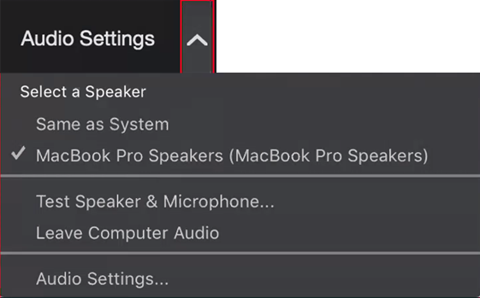
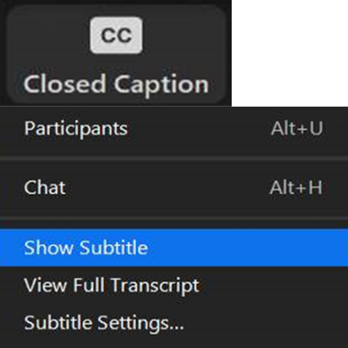
Zoom Tips
Tip #1: Sound
To select your speaker system, click on the up arrow next to Audio Settings, and then select one of the options.
Tip #2: Closed Captioning
Click on Closed Caption, and then select Show Subtitle for subtitles, or select View Full Transcript for a running transcript of the captions.

Slide 7
About nTIDE Lunch & Learn
Occurs at noon Eastern-time on the first Friday day of each month, with the release of the nTIDE Report.
A joint effort of the University of New Hampshire, Kessler Foundation, and the Association of University Centers on Disabilities (AUCD).

Slide 8
Today’s Program
Part 1: nTIDE Report … “The Numbers”
John O’Neill, Kessler Foundation
Andrew Houtenville, University of New Hampshire
Part 2: nTIDE News
Denise Rozell, Association of University Centers on Disabilities (AUCD)
Part 3: Guest Speakers
Kim Churches, The Washington Center
Part 4: Q&A

Slide 9
Part 1: The nTIDE Report
John O’Neill
Kessler Foundation

Slide 10
The Monthly nTIDE Report
The monthly nTIDE Report is a press release and infographic, looking at the latest employment statistics.
Uses data from the “jobs report” released by the U.S. Bureau of Labor Statistics, on the 1st Friday of each month.

Slide 11
Source of the Data
U.S. BLS, Current Population Survey (CPS).
Source of the “official” unemployment rate.
Civilians, ages 16-64, not living in institutions.
Available September 2008 onward.
Not yet seasonally adjusted.
which is why we compare to the same month last year.

Slide 12
The Numbers
Andrew Houtenville University of New Hampshire

Slide 13
Employment- to-Population Ratio: September

Slide 14
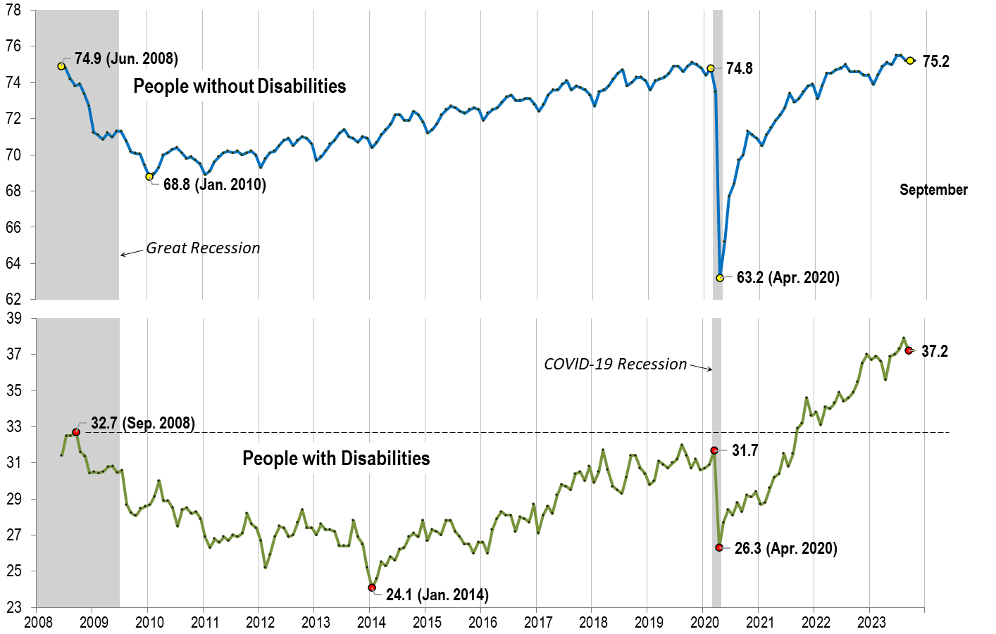
Employment- to-Population Ratio: September

Slide 15
Employment- to-Population Ratio: October

Slide 16
Labor Force Participation Rate: September

Slide 17
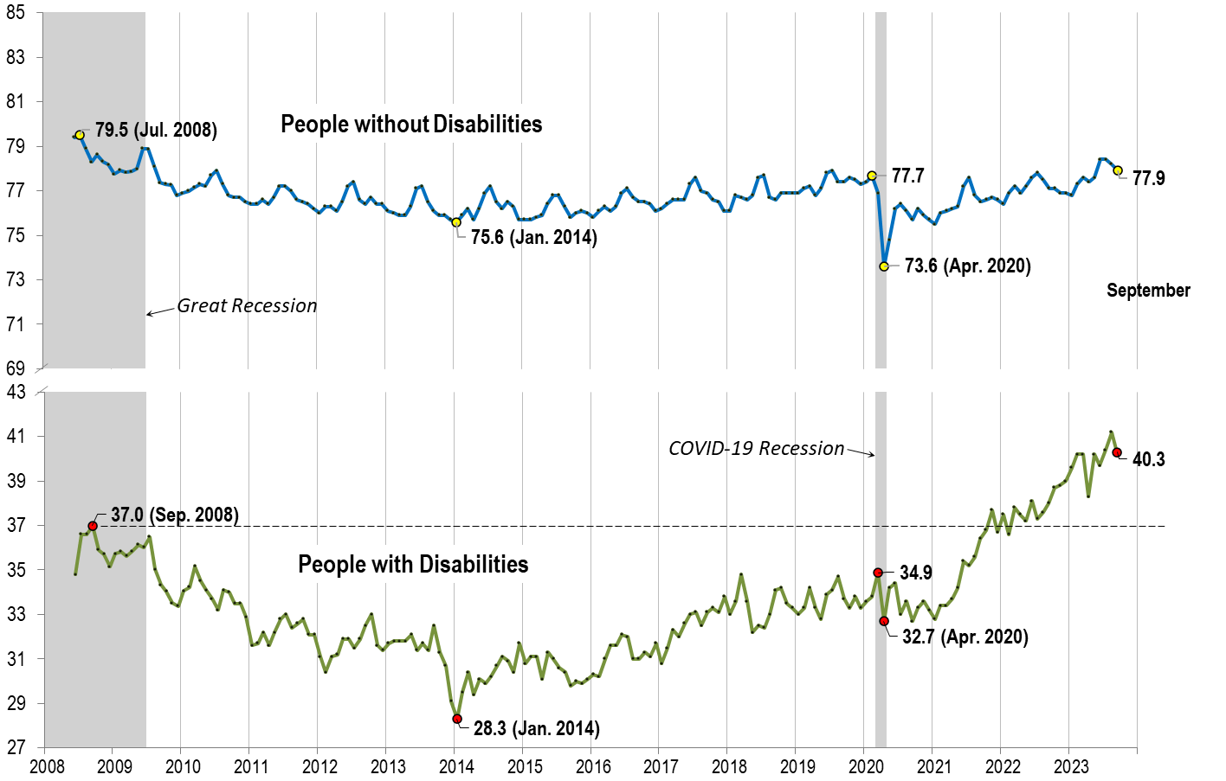
Labor Force Participation Rate: September

Slide 18
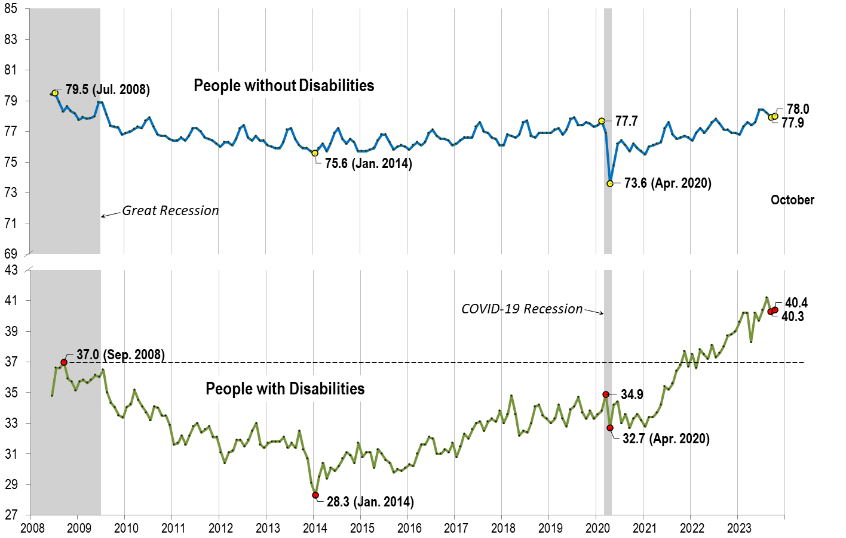
Labor Force Participation Rate: October

Slide 19
Part 2 nTIDE News
Denise Rozell
Association of University Centers on Disabilities (AUCD)

Slide 20
Federal Policy Update
What is going on in Washington?? New Speaker!
Appropriations:
Continuing Resolution through November 17
Department of Justice Guidance on ADA and Employment Services for People with Disabilities
Rescinded during the last Administration.
How Olmstead’s “integration mandate” applies to public employment and day services.
”Integration mandate” requires state and local governments to provide services to people with disabilities in the most integrated setting appropriate.

Slide 21
Department of Labor 14(c) Listening Session
Stakeholder engagement sessions on 14(c) subminimum wage
November 15, 2023, from 5:30 to 7:00 PM ET. Members of the public wishing to participate must register in advance of the meeting by November 6. Register
Anyone can share: self-advocates, family advocates, and providers with experience successfully transitioning to competitive integrated employment.
Tell the Department of Labor about the importance of competitive integrated employment opportunities for people with disabilities.
Learn more: https://www.dol.gov/agencies/odep/14cEngagement

Slide 22
Subminimum Wage
“ The Department of Labor – led by the Office of Disability Employment Policy, the Wage and Hour Division, our Solicitor, and our policy office– is embarking on engaging stakeholders to ensure opportunities for competitive integrated employment and to move toward greater equity and economic security for workers with disabilities. We are launching a comprehensive review of the Section 14(c) program to re-examine its use and future viability. As part of this effort, we want to hear from all of you – and especially individuals with disabilities – about your experiences with the 14(c) program, and what changes are needed to expand equitable employment opportunities for people with disabilities.”

Slide 23
Subminimum Wage studies/Resources
Subminimum Wages: Impacts on the Civil Rights of People with Disabilities | U.S. Commission on Civil Rights (usccr.gov) https://www.usccr.gov/meetings/2019/11-15-subminimum-wages-impacts-civil-rights-people-disabilities
National Council on Disability applauds U.S. Commission on Civil Rights’ call to repeal 14(c) subminimum wages | NCD.gov https://ncd.gov/newsroom/2020/ncd-applauds-usccr-call-repeal-14c
Examining 50 years of the Rehabilitation Act of 1973- Advancing Access and Equity for individuals with disabilities | U.S. Department of Labor Blog (dol.gov) https://blog.dol.gov/2023/09/28/examining-50-years-of-the-rehabilitation-act-of-1973-advancing-access-and-equity-for-individuals-with-disabilities

Slide 24
SSI/SSDI and Earning above SGA Levels
Baker, Livermore, Drury, J, Social Security Disability Beneficiaries Who Earn Above the Substantial Gainful Activity Level, Mathematica, September, 2023
NIDILRR funded StatsRRTC – Disability Data Brief
2018-2023 data
Statistics on characteristics/employment experiences of SSI/SSDI beneficiaries who earn more than SGA for at least 3 consecutive months
How do they differ from other working beneficiaries?
Younger and healthier;
Have more education and higher-quality jobs;
Are more likely to know that they can keep their Medicaid or Medicare coverage after losing their SSI or DI benefits because of earnings.

Slide 25
Anti-Racism and Anti-Ableism in Transition
Scott, L. A., & Shogren, K. A. (2023). Advancing Anti-Racism and Anti-Ableism in Transition: Equity-Oriented Indicators for Research. Career Development and Transition for Exceptional Individuals, 46(4), https://doi.org/10.1177/21651434231189665
Rethink who is the center of transition research and disrupt race-neutral strategies embedded in interventions and assessments that have been used in transition research, teacher education, and transition practices adopted in schools.
Propose a set of equity-oriented indicators that advance DEI in research, teacher education, and practice.
Give direction for conducting equity-focused research with transition-age youth, especially racially and ethnically marginalized youth with disabilities.
Advance the adoption of anti-ableist and anti-racist values that center on of those who are marginalized in our current research, teacher education, and school systems.

Slide 26
Including Disability in DEI
Including Disability in Diversity, Equity & Inclusion Priorities: Building A Maturity Model
EARN: Employer Assistance and Resource Network on Disability Inclusion/ based on research from the Center for Advanced Human Resource Studies (CAHRS) at Cornell University’s ILR School.
Targeted to employers and DEIA professionals.
How to integrate proven disability-inclusion practices into their organization-wide DEIA plan.
Strategies to support efforts to sustain, grow and measure these policies and practices.

Slide 27
Future of Work Podcast… Emerging Workforce Technology Trends
Podcast: Increasing the Talent Pool by Delivering Equitable Access to the Internet and Technology
Oneisha Freeman, Digital Connectivity Manager at the Georgia Technology Authority (GTA) and Nikhil Deshpande, Chief Digital Officer for the State of Georgia
Why high-speed, reliable internet is critical.
How you can make inclusion and accessibility a core part of your organizational culture.
How the Georgia Technology Authority is advancing equitable digital access for all Georgians.
Sponsored by PEAT/ODEP

Slide 28
EARN: Workplace Flexibility Webpage
Benefits to both employers and workers.
Types of Workforce flexibility – flexible time, place or manner of work.
Considerations for employers: related to accommodations, scheduling, technology, performance management and other workplace policies.
How to ensure flexibility is implemented equitably.
Links to issue briefs on workplace flexibility’s intersection with family caregiving and employee transportation and related materials.

Slide 29
Webinar: Veterans with Disabilities
From Deployment to Employment: Hiring + Supporting Veterans with Disabilities
Thursday, November 9 | 1-2 PM ET, sponsored by the National Organization on Disability
27% of all veterans have a service connected disability and 40% of post 9/11 veterans have a disability.
Speakers:
Luke Visconti, chairman and founder of Fair360 (formerly DiversityInc)
Speakers from Charter Communications, known through its Spectrum Brand, and Northrop Grumman
Built successful inclusion programs for veterans with disabilities.

Slide 30
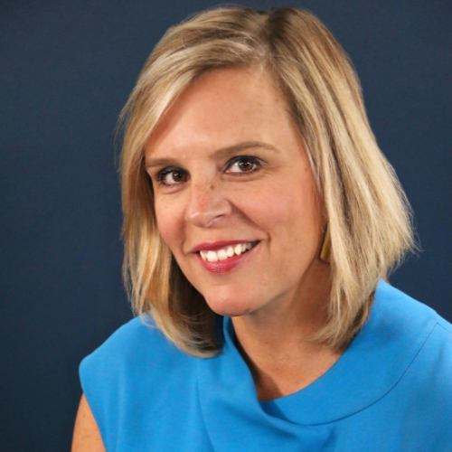
Part 3: nTIDE Guest Speaker
Kim Churches
The Washington Center

Slide 31
Workforce Development Flexibility for your Lived Experience
nTIDE Lunch & Learn Kim Churches, President,
The Washington Center

Slide 32
The Washington Center’s Vision & Mission
Our Vision
Empowering every learner to secure a better future for themselves and the world around them.
Our Mission
Creating flexible, immersive pathways to enhance the pipeline of diverse talent and build more equitable, inclusive workplaces and communities.
www.twc.edu

Slide 33
The Audiences We Serve
Learners
Employers
Higher Education
www.twc.edu

Slide 34
The Power of Skills Training for Today’s Workplace
Technology will transform more than one billion jobs by 2030.
Shelf life of skills is now down to 5-years vs.
30-years a decade ago.
69% of HR professionals believe their organization has a skills gap.
www.twc.edu

Slide 35
An Inclusive Living & Learning Community
TWC’s Housing and Community Life
Disability Services team on site.
ADA accessible classrooms and apartments all located on the same physical site making transitioning between spaces easier.
Collaboration with D.C. organizations to provide public transportation orientation for visually impaired students.
Accommodations for visible & non-visible disabilities, including:
Support Animal-friendly housing
Live-captions during presentations
Mental health resources via trained staff
Since 2016, TWC has welcomed more than 300 learners with accommodations into our living and learning programs.
Housing accommodations include (but not limited to):
36”-40” doorways
Automatic door opener
Wheelchair accessible appliances
Bedshaker, Strobe fire alarms & doorbells
Braille-labeled apartment
Adjustable/removable shower head
Grab bars & Shower seat in bathroom
Bidet
www.twc.edu

Slide 36
Short-Term Programs: Access & Adaptation
Flexible modalities (virtual microinternships, in-person bootcamp weekends, hybrid)
Bolster diverse, historically marginalized learners including those with neurodiversity, disabilities, first-generation students, people with caregiving needs, adult learners
60% first generation college student
Broad age range of 18-43
20% neurodiverse
90% identifying as non-white
11% self-identify as having a disability
80% identify as female or non-binary
88% identify as part of a historically marginalized racial/ethnic group
www.twc.edu

Slide 37
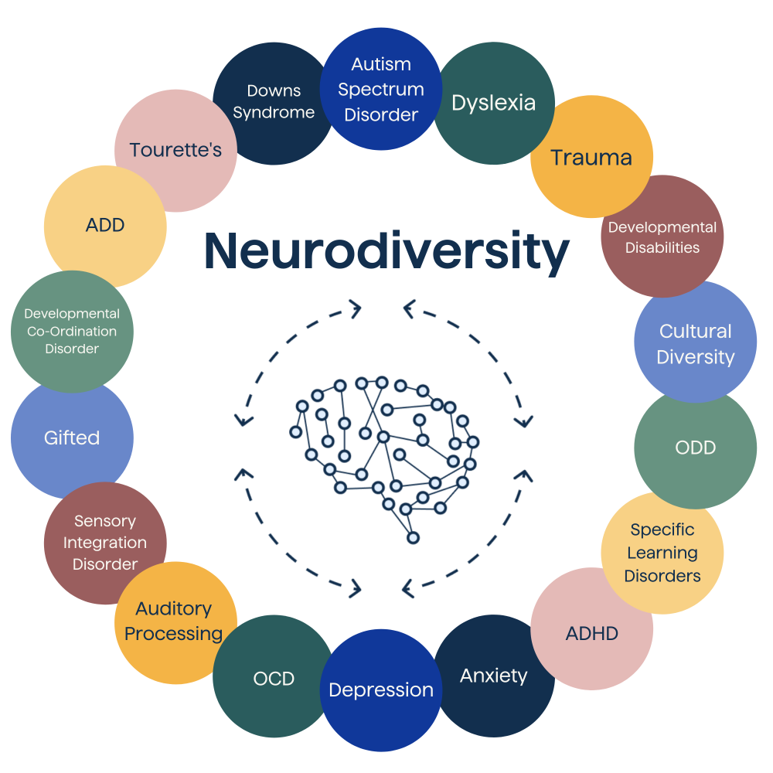
Our Work Continues
Program Design
The way we teach
Accommodations for all
Understand and champion disability in all its forms
Advocacy
Embrace hybridity
Invest in education access
Rethink credentials & experiences
www.twc.edu

Slide 38
Thank You
Let’s Stay in Touch
Email
kim.churches@twc.edu
LinkedIn
Linkedin.com/in/Kimberly-Churches
twc.edu

Slide 39
Questions and Answers
Use Q&A button on Zoom
Slides will be archived at: https://researchondisability.org/home/ntide.
Take our feedback survey at …
www.researchondisability.org/ntide/ntide-survey

Slide 40
Thank You!
Information about the nTIDE partners may be found at
Kessler Foundation (www.kesslerfoundation.org)
UNH/Institute on Disability (www.ResearchOnDisability.org)
AUCD (www.AUCD.org)
Contact us at
Email: Disability.Statistics@unh.edu
Call: 866-538-9521 (toll free)
Twitter at #nTIDELearn

Slide 41
Bye!

