Slide 1
nTIDE Lunch & Learn Webinar Series
Kessler Foundation, AUCD, University of New Hampshire Institute on Disability Season 8, Episode 10 Date: October 6, 2023

Slide 2
nTIDE Lunch & Learn Webinar Series
Kessler Foundation, AUCD, University of New Hampshire Institute on Disability Season 8, Episode 10 Date: October 6, 2023

Slide 3
Up Front Matters
This webinar is being recorded. We will post an archive of along side the Monthly nTIDE broadcast on our webinar, each month, on our website at www.researchondisability.org/nTIDE. This site will also provide copies of the presentations, the speakers’ bios, full transcripts, and other valuable resources.
As an attendee of this webinar, you are a viewer. To ask questions of the speakers, click on the Q & A box on your webinar screen and type your questions into the box. Speakers will review these questions and provide answers during the last section of the webinar. Some questions may be answered directly in the Q & A box.

Slide 4
Up Front Matters – Contact Info
If you have any questions following this recording, please contact us at disability.statistics@unh.edu, or toll free at 866-538-9521 for more information. Thanks for joining us. Enjoy today's webinar!

Slide 5
Welcome
Andrew Houtenville University of New Hampshire

Slide 6
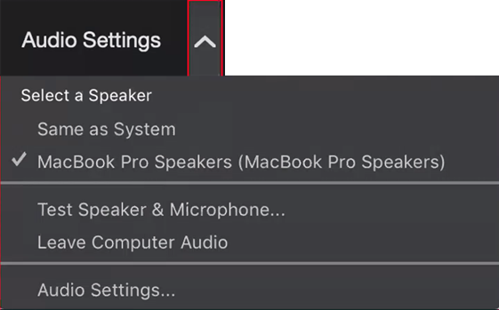
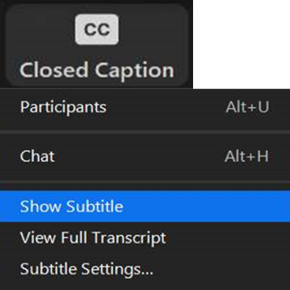
Zoom Tips
Tip #1: Sound
To select your speaker system, click on the up arrow next to Audio Settings, and then select one of the options.
Tip #2: Closed Captioning
Click on Closed Caption, and then select Show Subtitle for subtitles, or select View Full Transcript for a running transcript of the captions.

Slide 7
About nTIDE Lunch & Learn
Occurs at noon Eastern-time on the first Friday day of each month, with the release of the nTIDE Report.
A joint effort of the University of New Hampshire, Kessler Foundation, and the Association of University Centers on Disabilities (AUCD).

Slide 8
Today’s Program
Part 1: nTIDE Report … “The Numbers”
John O’Neill, Kessler Foundation
Andrew Houtenville, University of New Hampshire
Part 2: nTIDE News
Denise Rozell, Association of University Centers on Disabilities (AUCD)
Part 3: Guest Speakers
Leslie Jones and Dalia Sakas from the Filomen M. D’Agostino Greenberg Music School
Part 4: Q&A

Slide 9
Part 1: The nTIDE Report
John O’Neill
Kessler Foundation

Slide 10
The Monthly nTIDE Report
The monthly nTIDE Report is a press release and infographic, looking at the latest employment statistics.
Uses data from the “jobs report” released by the U.S. Bureau of Labor Statistics, on the 1st Friday of each month.

Slide 11
Source of the Data
U.S. BLS, Current Population Survey (CPS).
Source of the “official” unemployment rate.
Civilians, ages 16-64, not living in institutions.
Available September 2008 onward.
Not yet seasonally adjusted.
which is why we compare to the same month last year.

Slide 12
The Numbers
Andrew Houtenville University of New Hampshire

Slide 13
Employment -to- Population Ratio

Slide 14
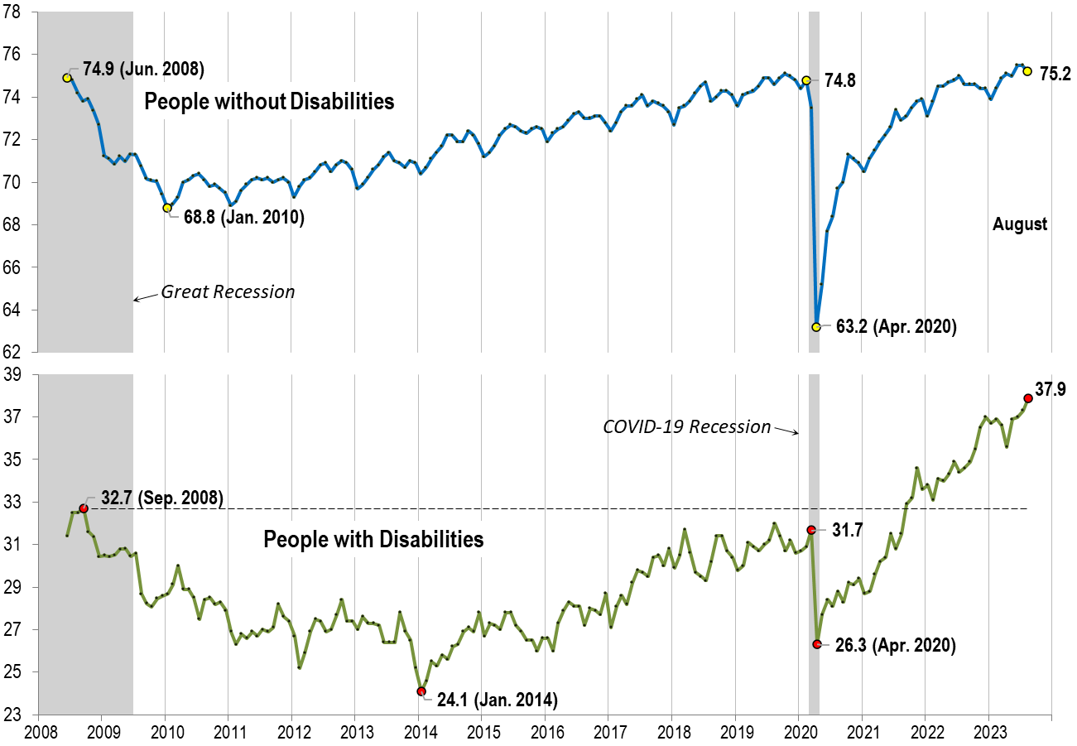
Employment -to- Population Ratio: Aug.

Slide 15
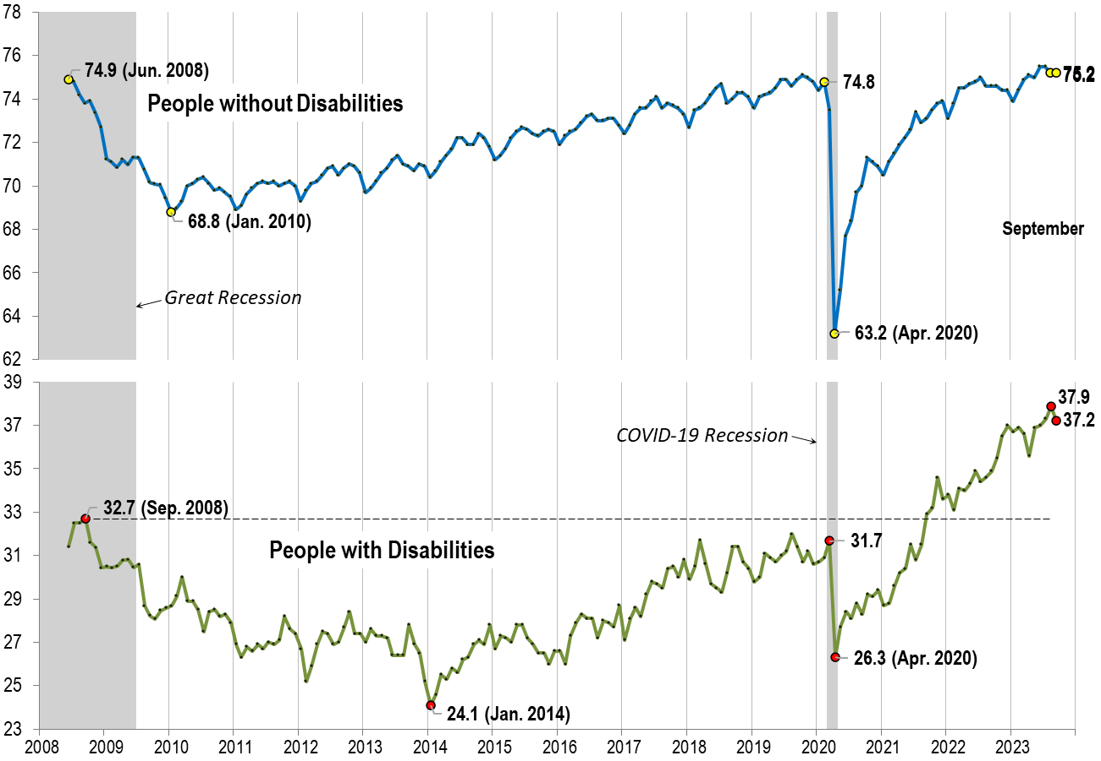
Employment -to- Population Ratio: Sept.

Slide 16
Labor Force Participation Rate

Slide 17
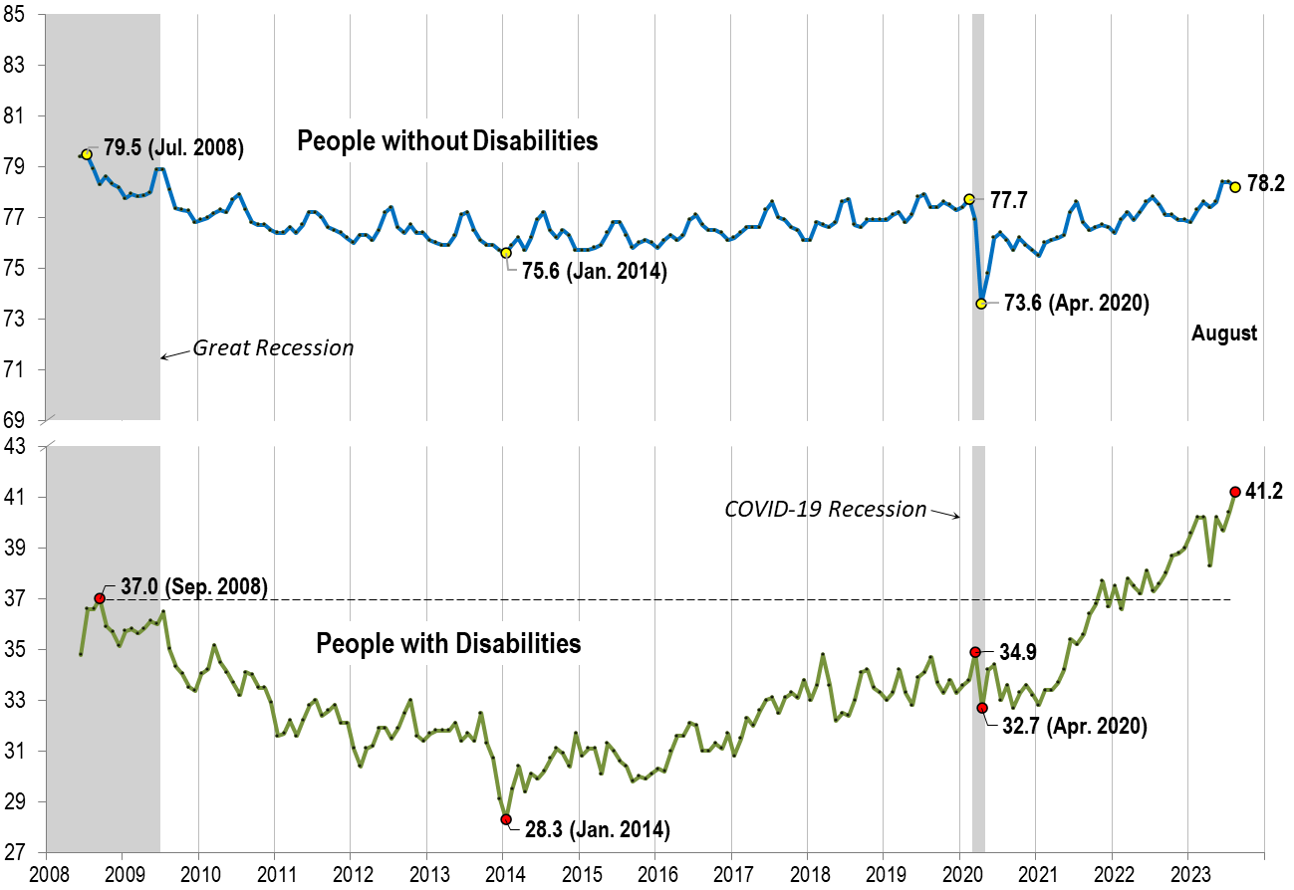
Labor Force Participation Rate: Aug.

Slide 18
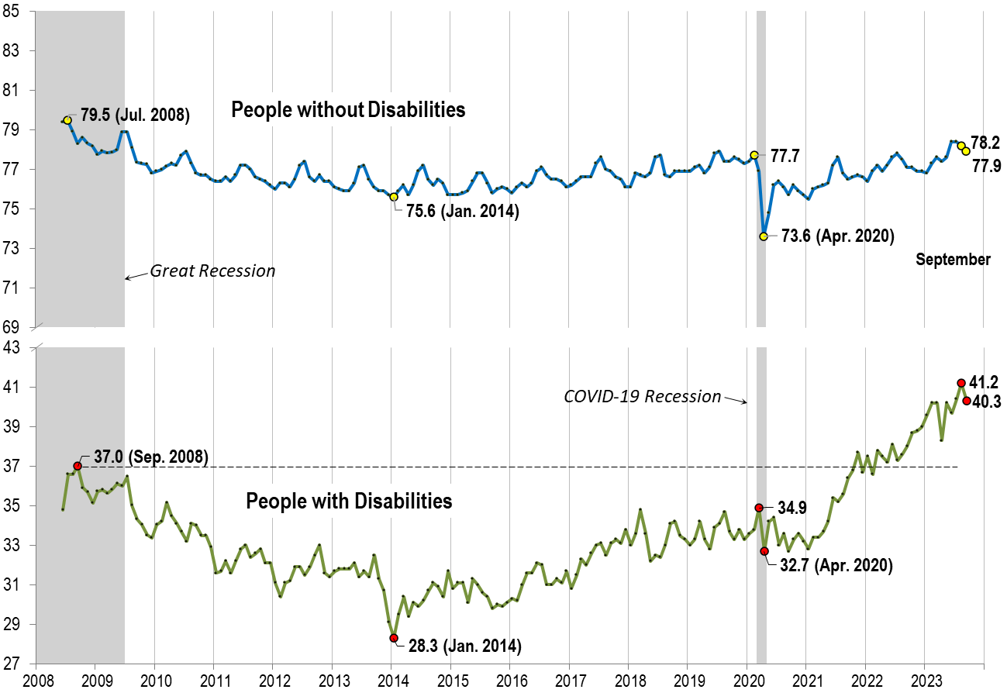
Labor Force Participation Rate: Sept.

Slide 19
Part 2 nTIDE News
Denise Rozell
Association of University Centers on Disabilities (AUCD)

Slide 20
Federal Policy Update
What is going on in Washington??
Appropriations:
Continuing Resolution through November 17
Rehab Act 50th Anniversary! Rehabilitation Act 50 | U.S. Department of Labor (dol.gov)
Comments on Subminimum Wage to Department of Labor – GET READY!

Slide 21
Subminimum Wage
“ The Department of Labor – led by the Office of Disability Employment Policy, the Wage and Hour Division, our Solicitor, and our policy office– is embarking on engaging stakeholders to ensure opportunities for competitive integrated employment and to move toward greater equity and economic security for workers with disabilities. We are launching a comprehensive review of the Section 14(c) program to re-examine its use and future viability. As part of this effort, we want to hear from all of you – and especially individuals with disabilities – about your experiences with the 14(c) program, and what changes are needed to expand equitable employment opportunities for people with disabilities. In the coming weeks we will be engaging with key organizations, stakeholders, and impacted workers directly on these important issues. “

Slide 22
Subminimum Wage studies/Resources
Subminimum Wages: Impacts on the Civil Rights of People with Disabilities | U.S. Commission on Civil Rights (usccr.gov)
National Council on Disability applauds U.S. Commission on Civil Rights’ call to repeal 14(c) subminimum wages | NCD.gov
Examining 50 years of the Rehabilitation Act of 1973- Advancing Access and Equity for individuals with disabilities | U.S. Department of Labor Blog (dol.gov)

Slide 23
Subminimum Wage
State-Level Analysis of Subminimum Wage Use for Individuals With Disabilities in the United States: Implications for Policy and Practice - Lauren Avellone, Joshua Taylor, Paul Wehman, Katherine Inge, Valerie Brooke, 2023 (sagepub.com)
Look at continued use of subminimum wages and whether there are any state-level characteristics/policies that predict it
Findings:
Subminimum wage continue to be prevalent in most states most prominently in the Midwest region.
Implications and recommendations for reducing subminimum wage pay for individuals with disabilities are provided.

Slide 24
Blending, Braiding and Sequencing
New ODEP web site
How state/local can blend, braid and/or sequence to promote competitive integrated employment (CIE)
What is it/How to do it
What is allowed under WIOA – transition, equity employment, using Olmstead
Who is doing it – Colorado, North Carolina, Maryland, Wisconsin

Slide 25
Employment of Hispanics with Disabilities in Skilled Trade Professions
ODEP data spotlight – part of Administration’s Good Jobs Initiative to “increase equitable pathways to good infrastructure jobs for underrepresented groups,… including individuals with disabilities. “
Based on American Community Survey data from 2017-2021
5.1 million Hispanic adults aged 16 and older with disabilities, about 1,410,000 are currently employed, and of these disabled workers an estimated 430,000 (or 30.5%) are working in skilled trade professions
Compares to 32.2% of non-disabled Hispanic workers professions, or 21.9% of all workers
Read the data spotlight

Slide 26
EARN Mental Health Toolkit
Updated Toolkit! The Employer Assistance and Resource Network on Disability Inclusion (EARN)
Resources, tips, and strategies for supporting mental health
Why…
Cost calculators
Mental health and substance abuse
Case studies
Marginalized communities
Long COVID - Working_with_Long_COVID.pdf (dol.gov)
Access the Mental Health Toolkit

Slide 27
Employment among Autistic Individuals
Roux, Miller, Tao, Rast, Ventimiglia, Shattuck, Shea, Unrealized Cross‐System Opportunities to Improve Employment and Employment‐Related Services Among Autistic Individuals; The Milbank Quarterly, October 2023
Compared employment services among autistic people with those with intellectual disability
2008–2016 data from the CMS (Medicaid) and RSA (VR)
Number of autistic people served through VR tripled, and spending pending increased by 384%
Number of autistic people served through Medicaid only increased slightly, and Medicaid costs decreased by 29%
Estimated that only 1.1% of working-age autistic adults who needed employment services received them across Medicaid and VR. Estimated 1.98 million autistic adults did not receive employment services

Slide 28
VR and Rural
Ipsen, Catherine, Jain, Kamini, and Stern, Steven. ‘Vocational Rehabilitation Service Receipt, Service Expenditures, and Ruralness’. Journal of Vocational Rehabilitation, 1 Jan. 2023 : 1–11
Effect of geography, such as distance from the VR office and availability of providers
Being Black or living at a long distance from a metro area increased the probability of receiving agency-based services but lowered the probability of receiving purchased services.
Being older and having less education lowered the probability of receiving agency services but increased the probability of receiving purchased services.
Females, Blacks, and those living at a distance greater than 50 miles from a metro area received significantly lower expenditures.

Slide 29
NDEAM!! Advancing Access and Equity
National Disability Employment Awareness Month

Slide 30
Part 3: nTIDE Guest Speakers
Leslie Jones Executive Director
Dalia Sakas Director of Music Studies
Filomen M. D’Agostino Greenberg Music School

Slide 31
Questions and Answers
Use Q&A button on Zoom
Slides will be archived at: https://researchondisability.org/home/ntide.
Take our feedback survey at …
www.researchondisability.org/ntide/ntide-survey

Slide 32
Thank You!
Information about the nTIDE partners may be found at
Kessler Foundation (www.kesslerfoundation.org)
UNH/Institute on Disability (www.ResearchOnDisability.org)
AUCD (www.AUCD.org)
Contact us at
Email: Disability.Statistics@unh.edu
Call: 866-538-9521 (toll free)
Twitter at #nTIDELearn

Slide 33
Bye!

