Slide 1
nTIDE Lunch & Learn Webinar Series
Kessler Foundation, UNH, and AUCD nTIDE Deeper Dive Date: August 18, 2023

Slide 2
nTIDE Lunch & Learn Webinar Series (audio)
Kessler Foundation, UNH, and AUCD nTIDE Deeper Dive Date: August 18, 2023
Notes:
X`

Slide 3
Up Front Matters
This webinar is being recorded. We will post an archive of along side the Monthly nTIDE broadcast on our webinar, each month, on our website at www.researchondisability.org/nTIDE. This site will also provide copies of the presentations, the speakers’ bios, full transcripts, and other valuable resources.
As an attendee of this webinar, you are a viewer. To ask questions of the speakers, click on the Q & A box on your webinar screen and type your questions into the box. Speakers will review these questions and provide answers during the last section of the webinar. Some questions may be answered directly in the Q & A box.

Slide 4
Up Front Matters Continued
If you have any questions following this recording, please contact us at disability.statistics@unh.edu, or toll free at 866-538-9521 for more information. Thanks for joining us. Enjoy today's webinar!

Slide 5
ASL Interpreter & Closed Captioning
To see interpreter and the gallery of speakers at the same time, we recommend using a computer or laptop, rather than a phone or tablet.
For closed captioning, click on the Closed Caption button and select Show Subtitle or View Full Transcript.

Slide 6
About the nTIDE Deeper Dive
Occurs at noon Eastern-time on two weeks after the first Friday day of each month (when nTIDE Report is released).
A joint effort of the University of New Hampshire, Kessler Foundation, and the Association of University Centers on Disabilities (AUCD).
Each month, the nTIDE Deeper Dive focuses on specific sub-populations within the population with disabilities.
Brings in a guest speaker to provide greater context.

Slide 7
Today’s Agenda
● 12:00 pm: Welcome and Introduction
● 12:05 pm: Moderator: Andrew Houtenville
 Reviews the nTIDE (First Friday) statistics
12:20 pm: Guest Speaker: Russell Stein, Gallaudet Innovation and Entrepreneurship
● 12:35 pm: Open Q&A Period

Slide 8
The Numbers From “First Friday” nTIDE

Slide 9
Employment- -to- Population Ratio

Slide 10
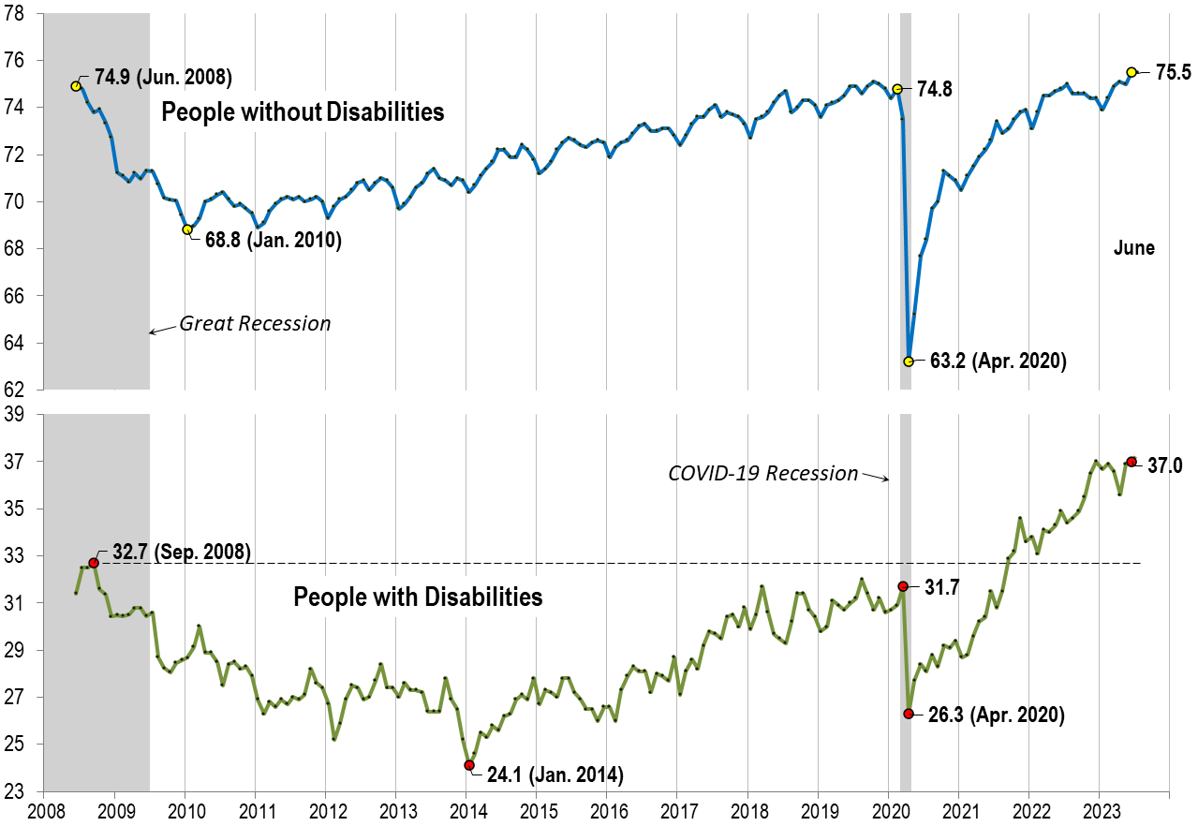
Employment -to- Population Ratio June

Slide 11
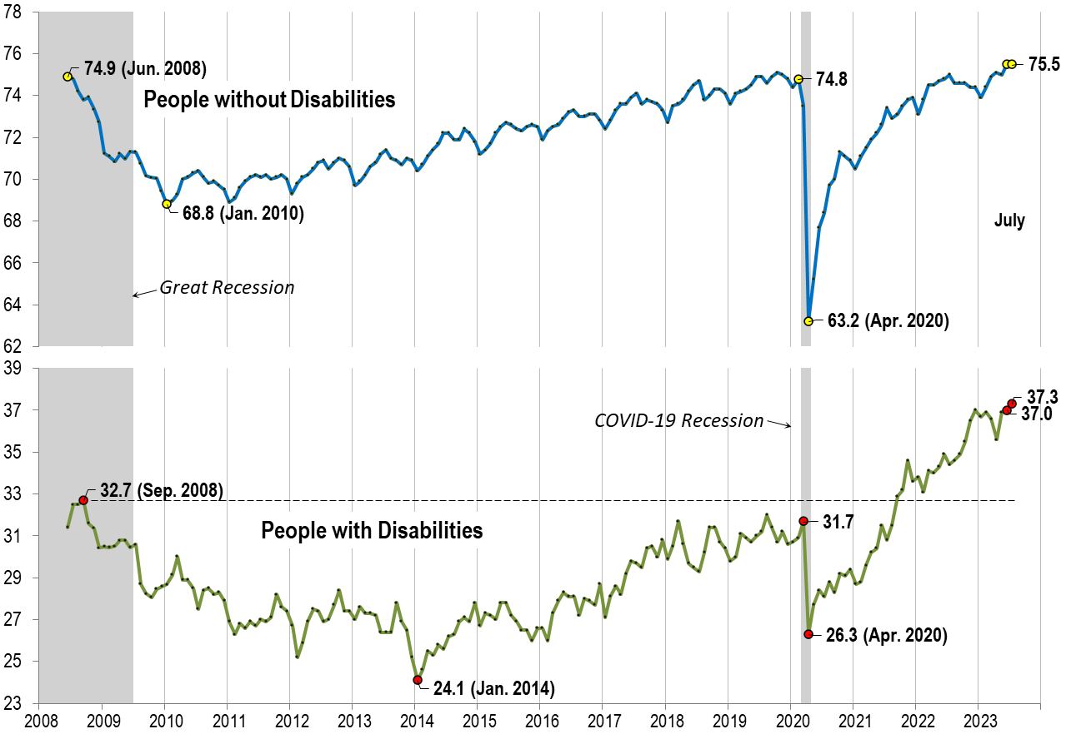
Employment -to- Population Ratio July

Slide 12
Employment- Population Ratio 12-Month Avg. April to March
This space left intentionally blank

Slide 13
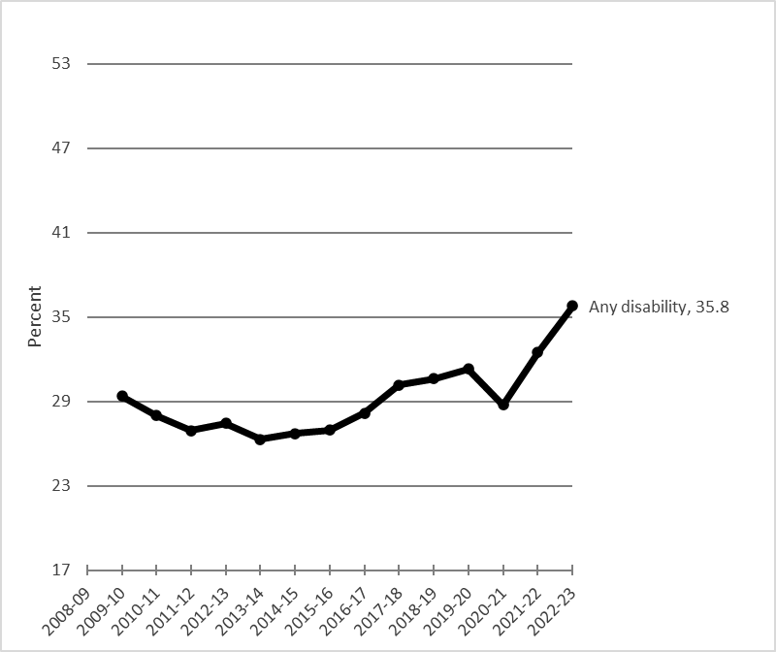
Employment- Population Ratio 12-Month Avg. April to March Any Disability

Slide 14
Brief Detour

Slide 15
“Definition of Disability”
Six Questions:
Hearing Disability – Deaf or having serious difficulty hearing.
Vision Disability – Blind or having serious difficulty seeing, even when wearing glasses.
Cognitive Disability – Because of a physical, mental, or emotional problem … difficulty remembering, concentrating, or making decisions.
Ambulatory Disability – Because of a physical, mental, or emotional problem … serious difficulty walking or climbing stairs.

Slide 16
“Definition of Disability” cont’d
Six Questions (continued):
Self-Care Disability – Because of a physical, mental, or emotional problem … difficulty bathing or dressing.
Independent Living Disability–Because of a physical, mental, or emotional problem, having difficulty doing errands alone such as visiting a doctor’s office or shopping.

Slide 17
Back to the Main Road
All data in the following charts may be found in the Employment-to-Population Ratio data table at the end of this PowerPoint.

Slide 18
Employment- Population Ratio 12-Month Avg. April to March Any Disability

Slide 19
Employment- Population Ratio 12-Month Avg. April to March Any Disability Hearing

Slide 20
Employment- Population Ratio 12-Month Avg. April to March Any Disability Hearing Vision

Slide 21
Employment- Population Ratio 12-Month Avg. April to March Any Disability Hearing Vision Ambulatory

Slide 22
Employment- Population Ratio 12-Month Avg. April to March Any Disability Hearing Vision Ambulatory Cognitive

Slide 23
Employment- Population Ratio 12-Month Avg. April to March
Shift axis a Little

Slide 24
Employment- Population Ratio 12-Month Avg. April to March Any Disability

Slide 25
Employment- Population Ratio 12-Month Avg. April to March Any Disability Self-care

Slide 26
Employment- Population Ratio 12-Month Avg. April to March Any Disability Self-care Independent Living

Slide 27
Another Detour
All data in the following charts may be found in the Prevalence Rate data table at the end of this PowerPoint.

Slide 28
Prevalence Rate 12-Month Avg. April to March
This space left intentionally blank

Slide 29
Prevalence Rate 12-Month Avg. April to March Any Disability

Slide 30
Prevalence Rate 12-Month Avg. April to March Any Disability Hearing

Slide 31
Prevalence Rate 12-Month Avg. April to March Any Disability Hearing Vision

Slide 32
Prevalence Rate 12-Month Avg. April to March Any Disability Hearing Vision Ambulatory

Slide 33
Prevalence Rate 12-Month Avg. April to March Any Disability Hearing Vision Ambulatory Cognitive

Slide 34
Prevalence Rate 12-Month Avg. April to March Any Disability Hearing Vision Ambulatory Cognitive Self-Care

Slide 35
Prevalence Rate 12-Month Avg. April to March Any Disability Hearing Vision Ambulatory Cognitive Self-Care Independent living

Slide 36
Checking under the Hood

Slide 37
Employment- Population Ratio 12-Month Avg. April to March Any Disability Cognitive

Slide 38
Employment- Population Ratio 12-Month Avg. April to March Any Disability Cognitive Non-Cognitive

Slide 39
Checking under the Hood - the Brakes

Slide 40
Employment- Population Ratio –pt 2 12-Month Avg. April to March Any Disability

Slide 41
Employment- Population Ratio 12-Month Avg. April to March Any Disability Adjusted, holding Composition Constant

Slide 42
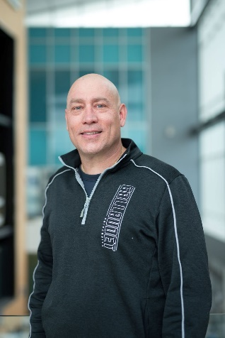
nTIDE Guest Speaker
Russell Stein
Gallaudet Innovation
and Entrepreneurship

Slide 43
Gallaudet Innovation and Entrepreneurship Institute

Slide 44
Incidental
Learning

Slide 45
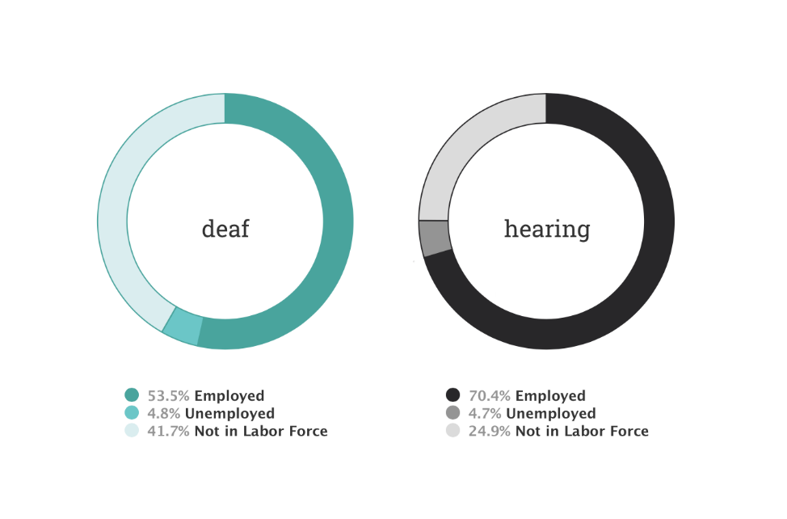
Deaf
Employment
Rate
Credit: National Deaf Center
Notes:
https://nationaldeafcenter.org/resources/research-data/dashboard/ National Deaf Center

Slide 46
4.1% of deaf people own a business
3.8% of hearing people do

Slide 47
4.1% of deaf people own a business
160,000 deaf people own a business
3.8% of hearing people do
25 million hearing people do.

Slide 48
But we provide accommodations!
"Can you read lips?"
"Did you bring someone to translate for you? If not, we need
to reschedule.
"When/how did you become hearing impaired?"
"Tell him/her....
"We forgot to schedule an interpreter for your appointment."
﻿﻿﻿"Is there another person we can talk with about your condition/treatment plan?
﻿﻿﻿﻿﻿"I'm not sure who to contact to get the accommodation (s) (e.g., interpreter, real-time captioning, and assistive listening device) that you are requesting.
Credit: www.2axend.com
Notes:
Corey Axelrod

Slide 49
Mouse in a Maze
Inconsistency sucks for us all.
Notes:
Mouse in a maze represents Deaf people trying to get to the same resource as Hearing people. The inconsistent level that dispenses food represents the myth that “accommodations provided should be enough”

Slide 50
Only ONE deaf focused investment fund.
ZERO entrepreneurship programs for deaf people.

Slide 51
Audio
Supremacy
Notes:
Steve harvey- host two situations One inequitable the other equitable by all known signs. Ties into Mouse in the maze and removing “but I provide accommodations” as quick fix it approach

Slide 52
What’s the Solution?
Gallaudet Innovation and Entrepreneurship Institute

Slide 53
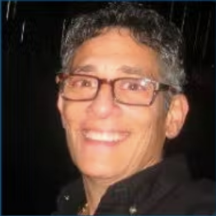
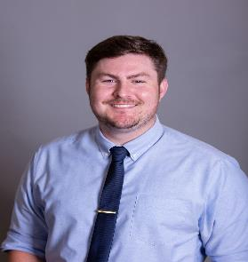
What does GIEI do Now? Mentorship
(Gallaudet Alumni Business Owners)

Slide 54
What does GIEI do Now? Entrepreneurship Education
BisonTalk series- bi-weekly
Courses: Social Entrepreneurship & Foundations of Entrepreneurship
Notes:
Deaf to Deaf No mouse in maze. Everyone gets the same info at the same time

Slide 55
Recent Success & Current Plans
Accelerator program - the very first deaf accelerator program ever, worldwide!
Targeted cohorts for minority populations within the deaf community, e.g. LGBTQIA
Train the Trainer
2nd Annual Alumni BisonTank in Fall 2023 during Homecoming

Slide 56
Future Plans
On-campus & off-campus space(s) for students and community members to innovate
Pop-up spaces
Planned development on 6th street across from Union Market will include incubator space(s)

Slide 57
Thank you!
gu.live/GIEI & bisontank.com
GIEI@gallaudet.edu
facebook.com/GIEI.GU
@GIEI.GU

Slide 58
Q & A
Use “Q&A” button on Zoom to ask a questions
Slides will be archived at  https://www.researchondisability.org/ntide-episodes-list
Take our feedback survey at  https://www.researchondisability.org/ntide-episodes-list

Slide 59
Thank You!
Thanks to our partners: - UNH/Institute on Disability (www.ResearchOnDisability.org) - Kessler Foundation (www.KesslerFoundation.org) - AUCD (www.AUCD.org)
Contact us: - Email: Disability.Statistics@unh.edu - Call: 866-538-9521 (toll free)
Twitter at #nTIDELearn

Slide 60
Thank You! audio
Thanks to our partners: - UNH/Institute on Disability (www.ResearchOnDisability.org) - Kessler Foundation (www.KesslerFoundation.org) - AUCD (www.AUCD.org)
Contact us: - Email: Disability.Statistics@unh.edu - Call: 866-538-9521 (toll free)
Twitter at #nTIDELearn

Slide 61
Employment-to-Population Ratio: Averaged over 12-month periods, April to March, by Disability Status and Type (percentage)
Period | No disability | Any disability | Hearing disability | Vision disability | Cognitive disability | Ambulatory disability | Self-care disability | Independent living disability | Non-cognitive disability | Adjusted any disability
2009-10 | 70.2 | 29.4 | 48.8 | 34.0 | 20.3 | 21.1 | 10.8 | 11.2 | 36.2 | 30.0
2010-11 | 69.9 | 28.0 | 48.3 | 35.2 | 19.7 | 19.0 | 12.0 | 10.7 | 34.5 | 28.6
2011-12 | 70.0 | 26.9 | 45.8 | 30.1 | 18.7 | 19.5 | 12.0 | 11.3 | 33.9 | 28.1
2012-13 | 70.5 | 27.4 | 47.8 | 31.1 | 18.7 | 18.9 | 10.8 | 11.0 | 34.8 | 28.7
2013-14 | 71.0 | 26.3 | 45.4 | 30.9 | 18.1 | 18.5 | 10.2 | 10.1 | 33.4 | 28.1
2014-15 | 71.9 | 26.7 | 46.5 | 30.7 | 19.7 | 18.5 | 10.5 | 10.1 | 32.8 | 28.5
2015-16 | 72.5 | 27.0 | 46.2 | 32.2 | 19.2 | 18.5 | 9.9 | 10.2 | 32.4 | 28.7
2016-17 | 73.1 | 28.2 | 46.5 | 32.5 | 20.8 | 19.6 | 10.6 | 11.6 | 33.8 | 29.8
2017-18 | 73.7 | 30.2 | 49.3 | 36.6 | 23.0 | 20.2 | 11.6 | 12.0 | 35.4 | 31.4
2018-19 | 74.3 | 30.6 | 50.7 | 38.4 | 22.9 | 20.2 | 11.6 | 12.4 | 35.9 | 31.8
2019-20 | 74.8 | 31.3 | 50.8 | 36.4 | 25.1 | 20.4 | 11.2 | 12.9 | 35.9 | 32.4
2020-21 | 69.3 | 28.7 | 46.4 | 34.5 | 23.0 | 18.1 | 8.7 | 11.2 | 33.4 | 29.9
2021-22 | 73.2 | 32.5 | 49.2 | 36.2 | 27.6 | 21.3 | 11.8 | 13.6 | 36.7 | 33.1
2022-23 | 74.8 | 35.8 | 52.0 | 40.3 | 31.9 | 23.1 | 11.9 | 14.7 | 39.2 | 36.0

Slide 62
Prevalence of Disability: Averaged over 12-month periods, April to March, by Disability Type (percentage)
Period | Any disability | Hearing disability | Vision disability | Cognitive disability | Ambulatory disability | Self-care disability | Independent living disability
2009-10 | 7.5 | 1.4 | 1.1 | 2.8 | 4.1 | 1.1 | 2.3
2010-11 | 7.4 | 1.4 | 1.0 | 2.7 | 4.0 | 1.1 | 2.2
2011-12 | 7.5 | 1.4 | 1.0 | 2.8 | 4.1 | 1.2 | 2.4
2012-13 | 7.6 | 1.5 | 1.1 | 2.9 | 4.2 | 1.2 | 2.5
2013-14 | 7.6 | 1.3 | 1.0 | 2.9 | 4.2 | 1.3 | 2.5
2014-15 | 7.7 | 1.4 | 1.1 | 3.0 | 4.2 | 1.3 | 2.6
2015-16 | 7.6 | 1.4 | 1.1 | 3.0 | 4.1 | 1.3 | 2.6
2016-17 | 7.7 | 1.4 | 1.0 | 3.1 | 4.1 | 1.2 | 2.6
2017-18 | 7.5 | 1.4 | 1.1 | 3.0 | 4.0 | 1.2 | 2.5
2018-19 | 7.4 | 1.4 | 1.1 | 3.0 | 3.8 | 1.2 | 2.5
2019-20 | 7.3 | 1.3 | 1.0 | 3.0 | 3.7 | 1.2 | 2.5
2020-21 | 7.2 | 1.4 | 0.9 | 3.0 | 3.5 | 1.1 | 2.5
2021-22 | 7.8 | 1.5 | 1.1 | 3.4 | 3.6 | 1.2 | 2.6
2022-23 | 7.8 | 1.5 | 1.1 | 3.5 | 3.6 | 1.2 | 2.6

