Slide 1
nTIDE Lunch & Learn Webinar Series
Kessler Foundation, AUCD, University of New Hampshire Institute on Disability Season 8, Episode 8 Date: August 4, 2023

Slide 2
nTIDE Lunch & Learn Webinar Series audio
Kessler Foundation, AUCD, University of New Hampshire Institute on Disability Season 8, Episode 8 Date: August 4, 2023

Slide 3
Up Front Matters
This webinar is being recorded. We will post an archive of along side the Monthly nTIDE broadcast on our webinar, each month, on our website at www.researchondisability.org/nTIDE. This site will also provide copies of the presentations, the speakers’ bios, full transcripts, and other valuable resources.
As an attendee of this webinar, you are a viewer. To ask questions of the speakers, click on the Q & A box on your webinar screen and type your questions into the box. Speakers will review these questions and provide answers during the last section of the webinar. Some questions may be answered directly in the Q & A box.

Slide 4
Up Front Matters Cont’d
If you have any questions following this recording, please contact us at disability.statistics@unh.edu, or toll free at 866-538-9521 for more information. Thanks for joining us. Enjoy today's webinar!

Slide 5
Welcome
Andrew Houtenville University of New Hampshire

Slide 6
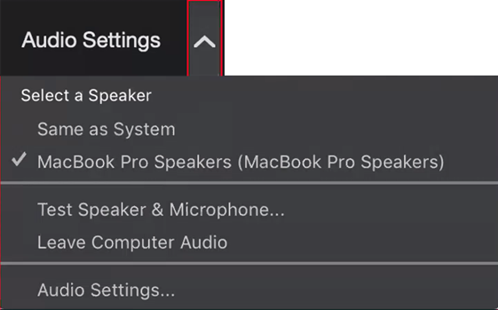
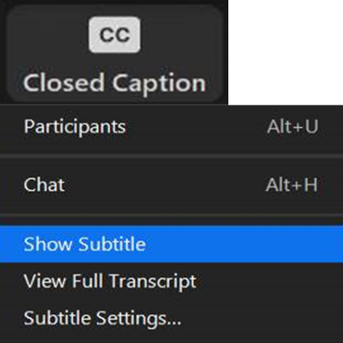
Zoom Tips
Tip #1: Sound
To select your speaker system, click on the up arrow next to Audio Settings, and then select one of the options.
Tip #2: Closed Captioning
Click on Closed Caption, and then select Show Subtitle for subtitles, or select View Full Transcript for a running transcript of the captions.

Slide 7
About nTIDE Lunch & Learn
Occurs at noon Eastern-time on the first Friday day of each month, with the release of the nTIDE Report.
A joint effort of the University of New Hampshire, Kessler Foundation, and the Association of University Centers on Disabilities (AUCD).

Slide 8
Today’s Program
Part 1: nTIDE Report … “The Numbers”
John O’Neill, Kessler Foundation
Andrew Houtenville, University of New Hampshire
Part 2: nTIDE News
Denise Rozell, Association of University Centers on Disabilities (AUCD)
Part 3: Guest Speaker
Clare Papay and Rebecca Lazo, Think College, UMass Boston
Part 4: Q&A

Slide 9
Part 1: The nTIDE Report
John O’Neill
Kessler Foundation

Slide 10
The Monthly nTIDE Report
The monthly nTIDE Report is a press release and infographic, looking at the latest employment statistics.
Uses data from the “jobs report” released by the U.S. Bureau of Labor Statistics, on the 1st Friday of each month.

Slide 11
Source of the Data
U.S. BLS, Current Population Survey (CPS).
Source of the “official” unemployment rate.
Civilians, ages 16-64, not living in institutions.
Available September 2008 onward.
Not yet seasonally adjusted.
which is why we compare to the same month last year.

Slide 12
The Numbers
Andrew Houtenville University of New Hampshire

Slide 13
Employment -to- Population Ratio

Slide 14
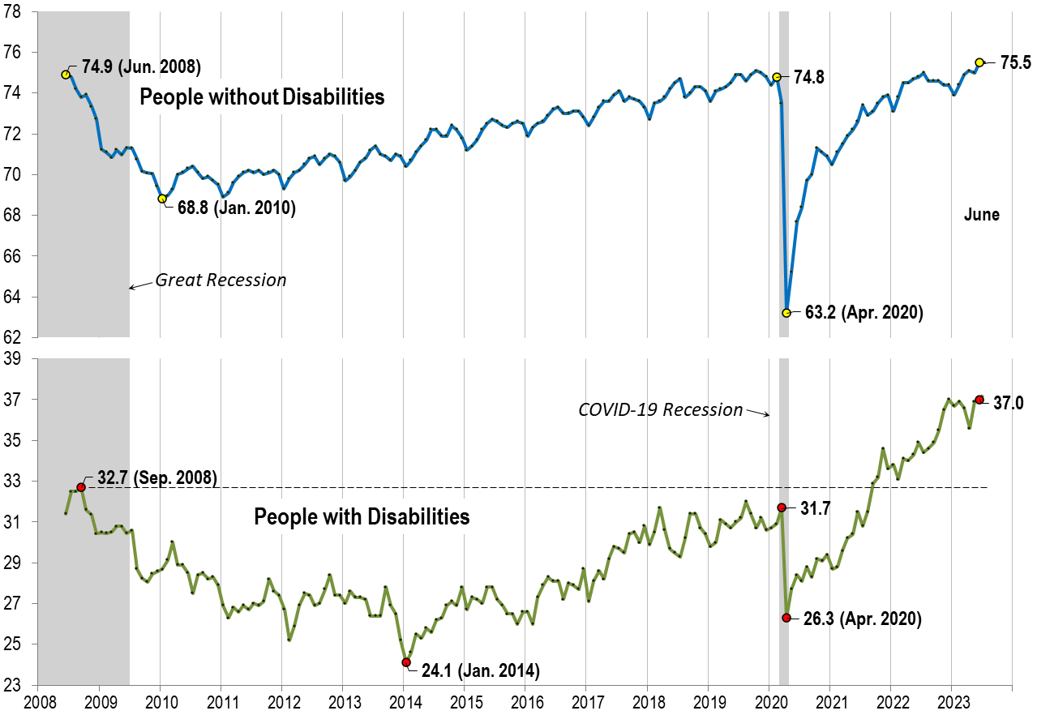
Employment -to- Population Ratio: June

Slide 15
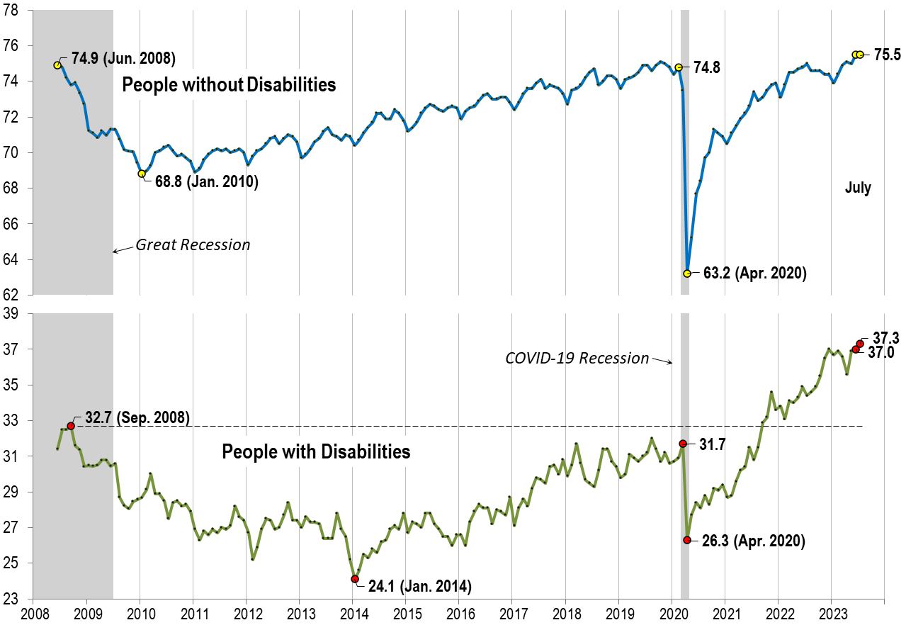
Employment -to- Population Ratio: July

Slide 16
Labor Force Participation Rate

Slide 17
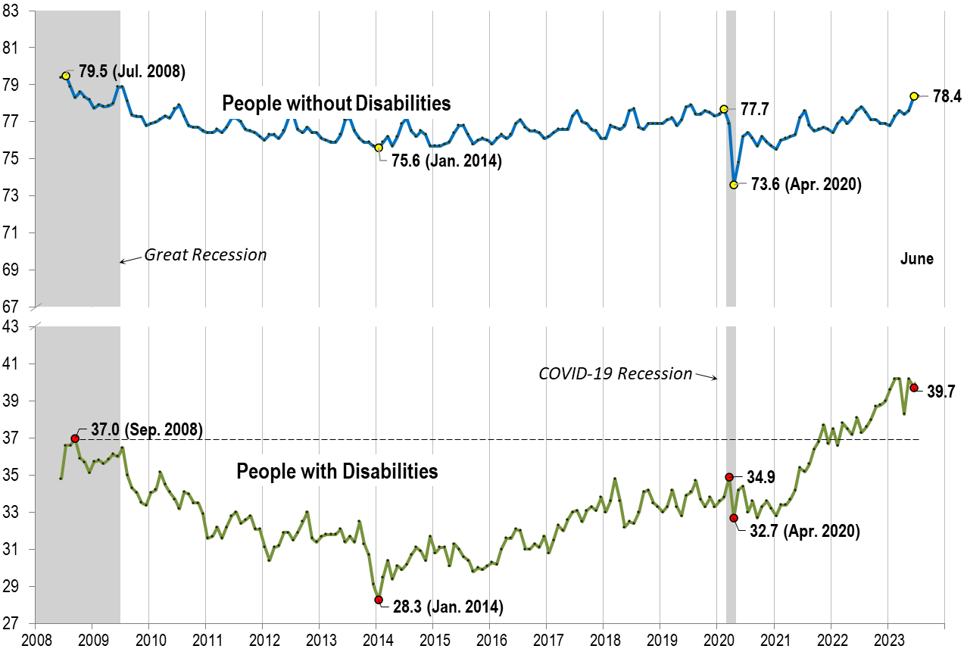
Labor Force Participation Rate: June

Slide 18
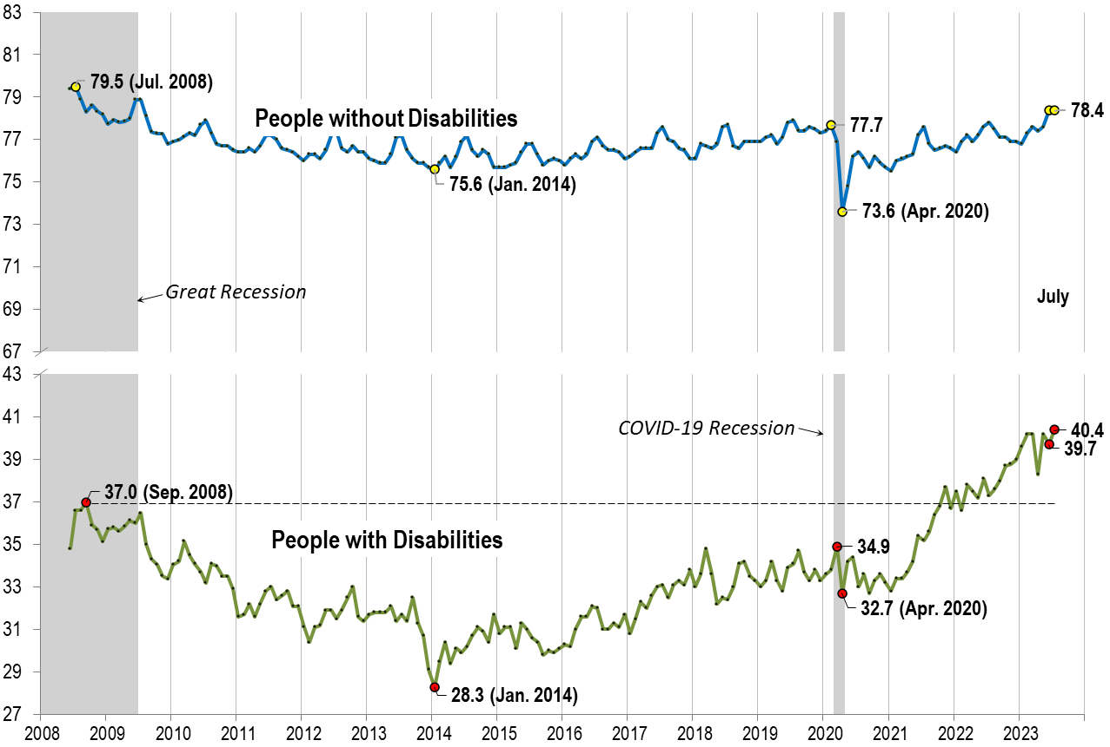
Labor Force Participation Rate: July

Slide 19
Part 2 nTIDE News
Denise Rozell
Association of University Centers on Disabilities (AUCD)

Slide 20
Federal Policy Update
Appropriations:
House – Subcommittee??
“Maintains funding at the FY23 enacted levels for programs for certain vulnerable populations, such as Americans with disabilities...” – what does that mean??
Senate – Committee passed all 12 bills
Level funding - first time in five years that all 12 of the appropriations bills were moved in a bi-partisan manner through the Appropriations Committee before the August recess.
RECESS!! They are home.

Slide 21
Disability and Diversity at Work
EARN – (Employer Assistance and Resource Network on Disability Inclusion ) – New Web page:
Introduction to the concept of intersectionality in the workplace and tips for supporting employees with disabilities who are multiply marginalized –preferred language, employee benefits and support programs, learn more about diversity, Employee Resource Groups. .
Intersectionality in the Workplace explores disability as an intersection with race, gender, sexual orientation; steps businesses can take to ensure all feel respected and welcomed. Includes Action Steps for Employers.

Slide 22
VR and Young Adults with Autism
Mathematica - The Research Support Services for Employment of Young Adults on the Autism Spectrum (REYAAS) project
Series of publications on young adults with autism and employment strategies, VR engagement, outcomes, services, and more.
Includes a new infographic – one page!
2017–2019, 86,616 young autistic adults applied for VR services.
VR counselors identified barriers to autistic young adults getting employment; having low household incomes was the most common barrier.
Among autistic young adults who exited VR during 2017–2019, about half had employment, and most of them had competitive integrated employment.

Slide 23
Self Employment – JVR Special Issue pg 1
Hansen, Kathryn, Keeton, Beth, and Jones, Joseph. ‘Understanding the Provision of Self-employment for People with Disabilities in the State Vocational Rehabilitation Services Program: A Policy Review’. 1 Jan. 2023 : 25 – 40. – Harkin Institute.
Self-employment remains an infrequent outcome for VR participants (less than 2%)– Why?
Policy changes to increase outcomes: self-employment assessments, market analysis or business planning requirements, and self-employment funding and financing guidelines.

Slide 24
Self Employment – JVR Special Issue pg 2
Revell, William Grant et al. ‘A Summary of the Self-employment Outcomes in the State Vocational Rehabilitation Services Program: Program Years 2018, 2019, and 2020’. 1 Jan. 2023 : 41 – 53.
“Self-employment outcomes are predominantly achieved in the VR system by a homogenous population of older (age 50+) participants whose race is white and gender is male.”
Taylor, Joshua P., Inge, Katherine J., and Malouf, Emily. ‘Facilitating Self-employment as a Competitive Integrated Employment Outcome: Results of a Focus Group Study with Vocational Rehabilitation Professionals’. 1 Jan. 2023 : 55 – 67.

Slide 25
DETAC Podcasts: Self-Employment
Disability Employment TA Center Podcasts: https://aoddisabilityemploymenttacenter.com/community-of-practice/#podcasts
New: Sue Babin of The Rhode Island DD Council on establishing a self-employment program for people I/DD in your state:
Nuts and bolts of establishing a program, funding sources, critical partners
Success stories of people with I/DD that have participated in the program who now successfully operate their own business. In two parts -- Part 1 here and Part 2 here.
Learn more about the RIDDCs self-employment program

Slide 26
Self Identification in Employment
From Compliance to Culture: Reimagining the Role of Self Identification in the Era of Disability Inclusion Reid Jewett Smith and Michael Lopez; DisabilityIN
What if companies see disability differently? What if employers see disability as a benefit that attracts employees and investors?
What does that mean for disability disclosure? What if we positively promote collection, promotion, and use of voluntary self identification of disability data.
What if systems that support self identification are seen as the key to disability inclusion strategy and argues that by disclosing disability data, both companies and individuals can benefit from a new era of inclusive corporate culture.

Slide 27
Revised Federal Voluntary Self-Identification Disability Form
The Office of Federal Contract Compliance Programs (OFCCP) has revised the Voluntary Self-Identification of Disability Form (CC-305)
Update the preferred language for disabilities
Includes additional examples of disabilities.
Section 503 information page and list of frequently asked questions.
OFCCP Help Desk at 1-800-397-6251 or online.

Slide 28
National Online Dialogue on Transition
The U.S. Department of Labor (DOL) and federal agency partners sponsoring national online dialogue -- "Our Future Matters: Informing the Federal Interagency Strategy“
How to enhance services for youth/young adults with disabilities for smooth transition to adulthood re education, employment, health and human Services, Social Security.
Visit the dialogue (https://ourfuturematters.ideascale.com/) now through August 14. Logon, register, submit your ideas, or comment and vote on ideas submitted by others.
Log on 24 hours a day, as many times as they like.
The dialogue platform functions like a virtual space with dedicated “chat rooms” to share ideas about specific topics.

Slide 29
Social Security: The Future of Mortality, Disability and Work: Helping to Inform the Social Security Trust Fund Projections
August 25, 9:30 am – 4:00 pm (Eastern)
Panel of experts to discuss perspectives on the future of mortality, disability and work to inform assumptions used in projecting the finances of SS trust fund – SSDI
9:45 am Mortality
11:30 am Disability
2:00 pm Work
Register: https://zoom.us/webinar/register/WN_FvrcYJYeS3GWfrlESR6B5w#/registration

Slide 30
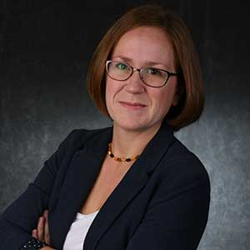
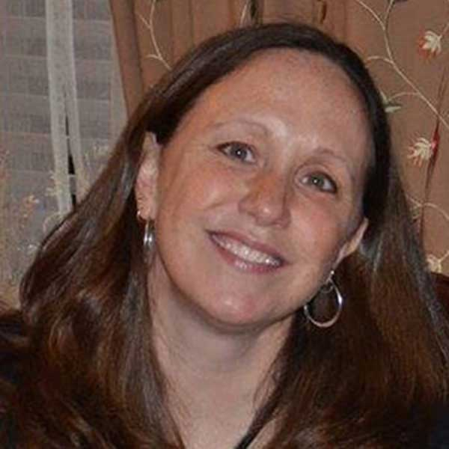
Part 3: nTIDE Guest Speaker
Clare Papay Rebecca Lazo
Think College, UMass Boston Think College, UMass Boston

Slide 31
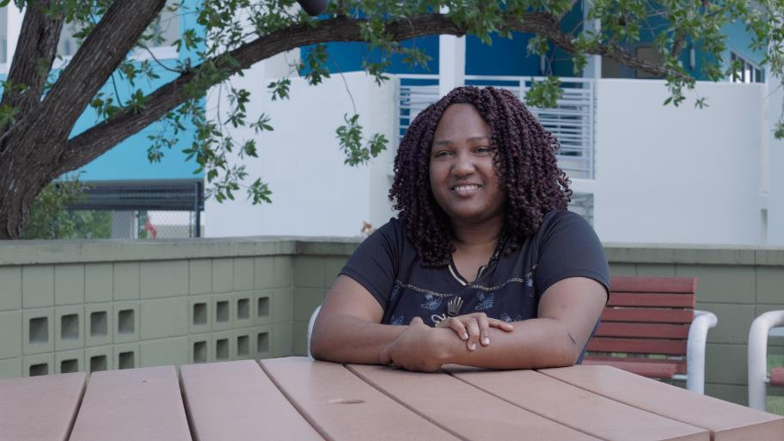
Think Higher. Think College.
Rebecca Lazo and Clare Papay
Institute for Community Inclusion, UMass Boston

Slide 32
At Think College, we help
Develop college options for students with intellectual disability
Improve existing college programs
Assist students and families to prepare for college

Slide 33
This year…
Students with ID attending college 2%
There are more than 420,000 school age students with intellectual disability in the United States¹
Fewer than 2% are likely to attend college after high school
Students with ID who do not attend college 98%

Slide 34
For the 98% of adults with intellectual disability who don’t go to college - the current reality
Only 15% have paid employment in the community²
42% attend a day program or sheltered workshop²
44% report they often or sometimes feel lonely²
29.3% live below the poverty line³

Slide 35
For the 2% who attend postsecondary education, the outcomes are promising…
59% find competitive, integrated employment 1 year after exit⁴
51% earned higher wages than those who did not access postsecondary education⁵
87% of students were enrolled in a credential program⁴*
100% of programs provided peer mentor support to students⁴*
…but options are limited.

Slide 36
Why is it so difficult for students
with intellectual disability to go to college?
Lack of Preparation
College preparation for students with intellectual disability is minimal or absent in most middle and high schools
Minimal Awareness
Students and families are unaware of the opportunities
Few Options
Just 7% of the 4,360 colleges/universities nationally include students with intellectual disability
Notes:
TC Team Member

Slide 37
Think Higher. Think College.

Slide 38
Watch & share campaign video, find new resources, view recordings & learn more at www.thinkhighered.net
Notes:
Recordings, resources, campaign video and more are available on our campaign website (www.thinkhighered.net).

Slide 39
Tools to Use to Spread the Word: “Think Higher. Think College.”
Campaign videos, images, and other resources are accessible to anyone and ready to share!
Dissemination Toolkit with suggestions for use
Comprehensive, easy-to-use Resource Guide with talking points, tips, research, and tools
Link to Spanish resources for families

Slide 40
Campaign website: thinkhighered.net
This campaign informs and encourages people to consider college as an option for students with intellectual disability.
For our target audiences, we created guides to making this happen:
Students & families
Educators, transition specialists & vocational rehab professionals
Higher education faculty & staff
Notes:
We hope you will connect and share with the “Think Higher. Think College.” campaign. Please help us spread the word!
Share the “Think Higher. Think College” message on social media. Tag Think College and use these hashtags: #THTC, #ThinkHigher, #ThinkCollege.
You can find our social media and dissemination kit on the ”Think Higher. Think College.” website (www.thinkhighered.net).

Slide 41
Interested in more data?

Slide 42
Data the National Coordinating Center collects from TPSIDs
Program data
Student data
Follow-up data
Once per year from each graduate
For example:
Employment
Further education
Living situation
For example:
Operation
Partners
Charges
Staff
For example:
Core data (collected once)
Annual data (course enrollments, jobs, etc)
Status at exit
Notes:
Transition Postsecondary Education Programs for Students with Intellectual Disabilities
Grant funded model demonstration projects aimed at developing and expanding inclusive higher education options for people with intellectual disability.
Funded by the Office of Postsecondary Education US DOE in 2010
Receives technical assistance and evaluation from the TC NCC
3 funding cycles since 2010

Slide 43
12 Years of TPSIDs (2010 – 2022)
Paid jobs while in program |  | 3,675
Course enrollments |  | 59,727
Inclusive course enrollments |  | 26,597
Students who completed program and earned credential |  | 2,134
Notes:
Paid Jobs (paid employment only, not WBL): 3,675 (I used 8/1/22 as the start date cut off, but this could potentially include jobs inputted as part of 22-23 data collection.
https://franksmith2.quickbase.com/db/bf5rr57hy?a=q&qid=257
Course Enrollments: 59,727
https://franksmith2.quickbase.com/db/bf62xex4j?a=q&qid=189
Inclusive Course Enrollments: 26,597
Completion + Credential, this report didn’t cut it: https://franksmith2.quickbase.com/db/bf5rvsg65?a=q&qid=449
Took 1962 + 58 (20-21 AR) + 114 (21-22) for 2,134

Slide 44
Employment after Graduation Statistics

Slide 45
See more data
Annual Reports
Fast Facts
Data Reports
Journal articles
https://thinkcollege.net/researchproducts

Slide 46
Learn More and Contact info
Notes:
Meg
Thanks! Please stay in touch – through our website, mailing list, social media – in addition to a
FB page, we have two FB groups we support as well – one for families and one for college program staff. Find out how to join on our website, or email me!

Slide 47
Questions and Answers
Use Q&A button on Zoom
Slides will be archived at: https://researchondisability.org/home/ntide.
Take our feedback survey at …
www.researchondisability.org/ntide/ntide-survey

Slide 48
Thank You!
Information about the nTIDE partners may be found at
Kessler Foundation (www.kesslerfoundation.org)
UNH/Institute on Disability (www.ResearchOnDisability.org)
AUCD (www.AUCD.org)
Contact us at
Email: Disability.Statistics@unh.edu
Call: 866-538-9521 (toll free)
Twitter at #nTIDELearn

Slide 49
Bye!

