Slide 1
nTIDE Lunch & Learn Webinar Series
Kessler Foundation, UNH, and AUCD nTIDE Deeper Dive Date: July 21, 2023

Slide 2
nTIDE Lunch & Learn Webinar Series (audio)
Kessler Foundation, UNH, and AUCD nTIDE Deeper Dive Date: July 21, 2023
Notes:
X`

Slide 3
Up Front Matters
This webinar is being recorded. We will post an archive of along side the Monthly nTIDE broadcast on our webinar, each month, on our website at www.researchondisability.org/nTIDE. This site will also provide copies of the presentations, the speakers’ bios, full transcripts, and other valuable resources.
As an attendee of this webinar, you are a viewer. To ask questions of the speakers, click on the Q & A box on your webinar screen and type your questions into the box. Speakers will review these questions and provide answers during the last section of the webinar. Some questions may be answered directly in the Q & A box.

Slide 4
Up Front Matters Continued
If you have any questions following this recording, please contact us at disability.statistics@unh.edu, or toll free at 866-538-9521 for more information. Thanks for joining us. Enjoy today's webinar!

Slide 5
ASL Interpreter & Closed Captioning
To see interpreter and the gallery of speakers at the same time, we recommend using a computer or laptop, rather than a phone or tablet.
For closed captioning, click on the Closed Caption button and select Show Subtitle or View Full Transcript.

Slide 6
About the nTIDE Deeper Dive
Occurs at noon Eastern-time on two weeks after the first Friday day of each month (when nTIDE Report is released).
A joint effort of the University of New Hampshire, Kessler Foundation, and the Association of University Centers on Disabilities (AUCD).
Each month, the nTIDE Deeper Dive focuses on specific sub-populations within the population with disabilities.
Brings in a guest speaker to provide greater context.

Slide 7
Today’s Agenda
● 12:00 pm: Welcome and Introduction
● 12:05 pm: Moderator: Andrew Houtenville
 Reviews the nTIDE (First Friday) statistics
12:20 pm: Guest Speaker: Nate Thomas, Institute on Disability/UNH
● 12:35 pm: Open Q&A Period

Slide 8
The Numbers From July’s “First Friday” nTIDE

Slide 9
Employment -to- Population Ratio

Slide 10
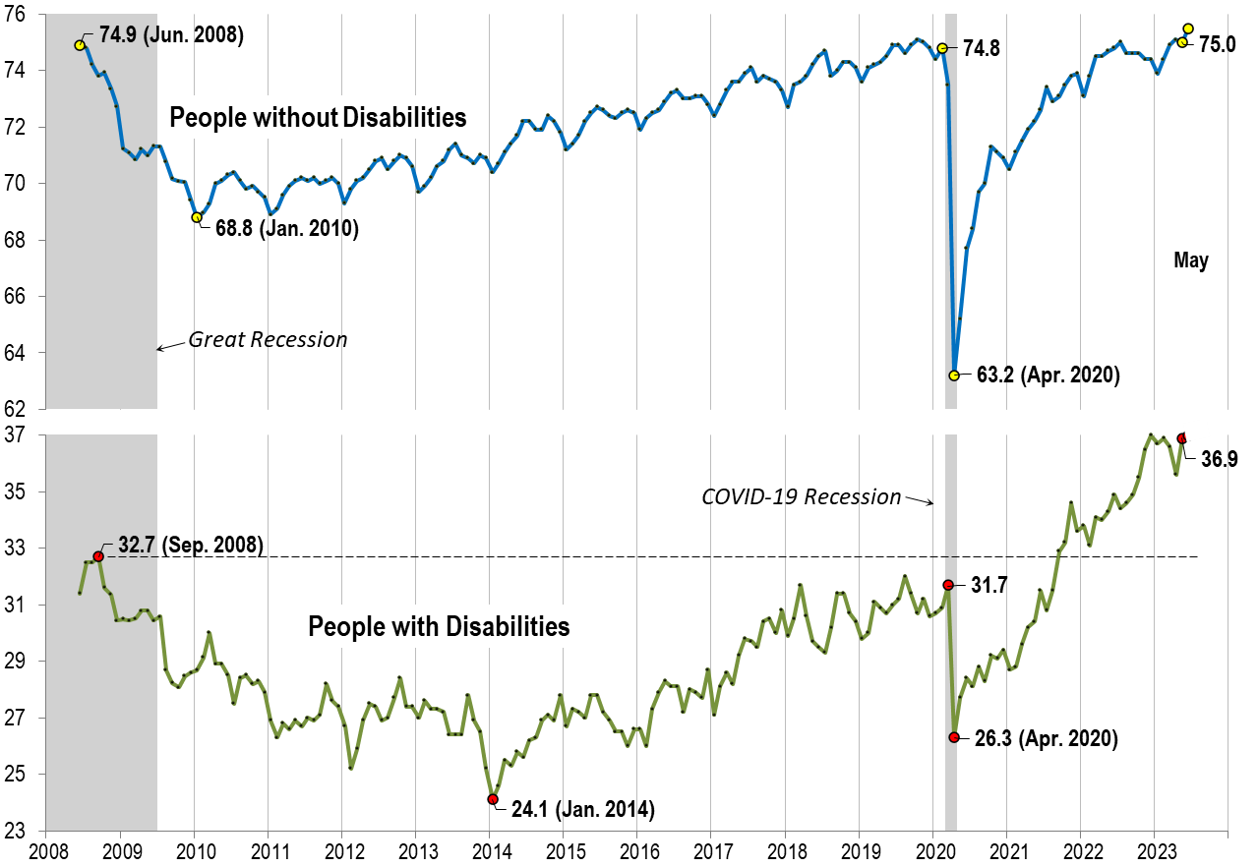
Employment -to- Population Ratio: May

Slide 11
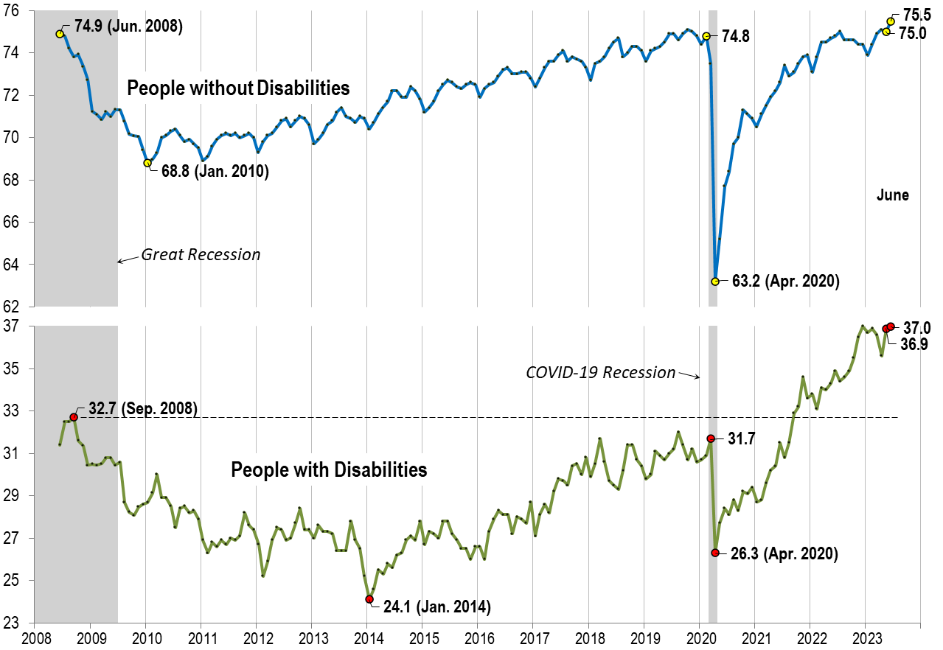
Employment -to- Population Ratio: June

Slide 12
Labor Force Participation Rate

Slide 13
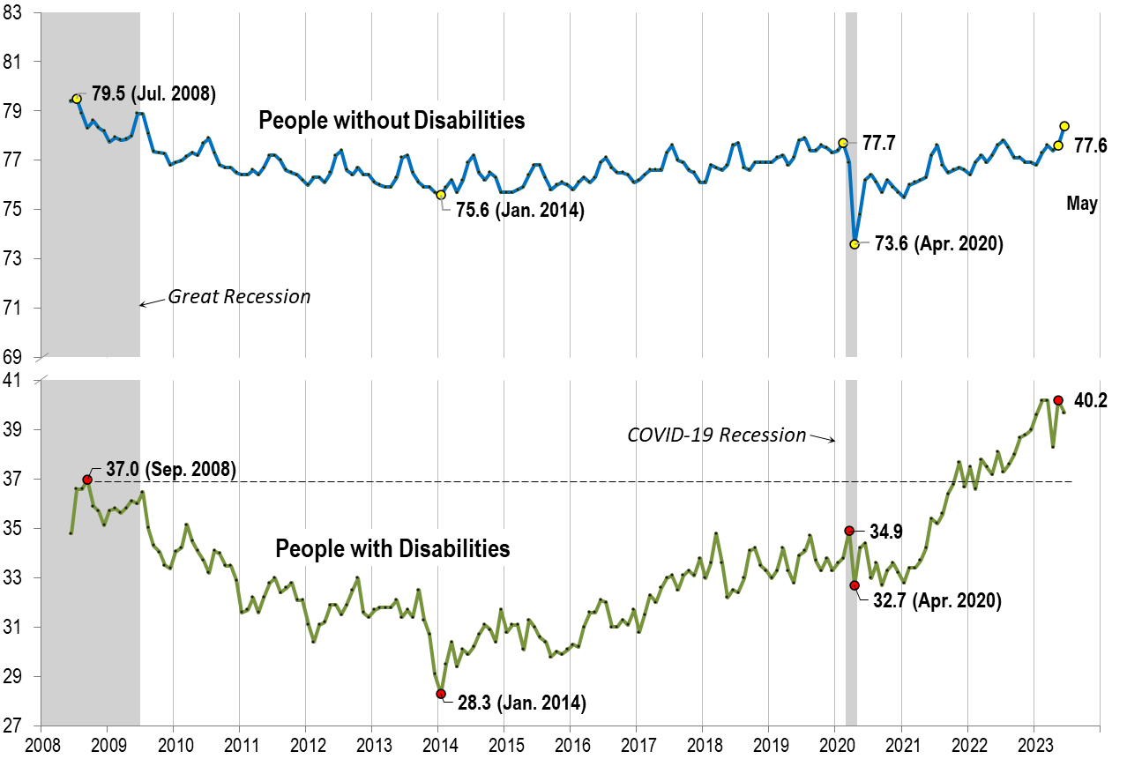
Labor Force Participation Rate: May

Slide 14
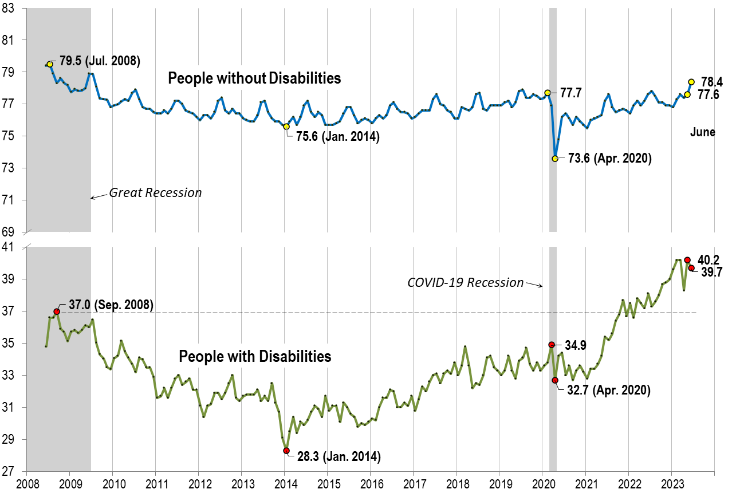
Labor Force Participation Rate: June

Slide 15
nTIDE Guest Speaker
Nate Thomas
Institute on Disability
UNH

Slide 16
Deeper Dive: COVID-19 vaccination patterns of workers with disabilities within work setting
Nate Thomas and Liu Yang, PhD
Disclaimer: This project was funded by the CDC, National Institute for Occupational Safety and Health (NIOSH). Its contents are solely the responsibility of the authors and do not necessarily represent the official views of the CDC/NIOSH.

Slide 17
Study Background
Essential Workers are at particularly high risk of COVID-19 infection in the workplace.
Full-time Workers with Disabilities experience reduced access to necessary care (Reichard, et al. 2019).
December 2020 - COVID-19 vaccine phased approach when supply was limited
In this study, supported by NIOSH with Supplemental Funds (PAR-20-312), the following is investigated:
Vaccination proportions in sub-groups of employment and demographics, nationally and by state - including comparisons to workers at home, applicable demographic reference groups, and other states.

Slide 18
Household Pulse Survey by Census Bureau
The Household Pulse Survey (HPS) began on Apr. 2020
Starting January 2021 (Phase 3, week 23):
Vaccination: Have you received a COVID-19 vaccine?
Starting April 2021 (Phase 3.1, week 28):
Employment: Did you do ANY work for either pay or profit?
Outside Home: Have you worked or volunteered outside your home?
Essential Work Setting: Which best describes the primary location/setting where you worked or volunteered outside your home?
We focused on August 2021 to August 2022 (Phases 3.2 - 3.5, weeks 35 - 48)

Slide 19
Defining Essential Work Settings pg. 1
Full set starting in Phase 1b:
Healthcare (e.g., hospital, doctor, dentist or mental health specialist office, outpatient facility, long-term care, home health care, pharmacy, medical laboratory)
Social service (e.g., child, youth, family, elderly, disability services)
Death care (e.g., funeral home, crematory, cemetery)
Education:
Preschool or daycare
K-12 school
Other schools and instructional settings (e.g. college, university, professional, business, technical or trade school)
(Continued)

Slide 20
Defining Essential Work Settings pg. 2
First response (e.g., police or fire protection, emergency relief services)
Correctional facility (e.g., jail, prison, detention center, reformatory)
Agriculture, forestry, fishing, or hunting
Food manufacturing facility (e.g., meat-processing, produce packing, food or beverage manufacturing)
Food and beverage store (e.g., grocery store, warehouse club, supercenters, convenience store, specialty food store, bakery)
Non-food manufacturing facility (e.g., metals, equipment and machinery, electronics)
(Continued)

Slide 21
Defining Essential Work Settings pg. 3
Public transit (e.g., bus, commuter rail, subway, school bus)
United States Postal Service
Other job deemed “essential” during the COVID-19 pandemic
Other Work Settings:
None of the above (Working outside the home in non EW setting)
Missing Data (Working outside the home, but did not provide work setting info).
Workers at home (a synthetic setting created to include workers who worked at home)

Slide 22
Definition of Disability
Disability is a broad and far-reaching term. Here, disability status is defined based on the following 4 questions:
Do you have difficulty seeing, even when wearing glasses?
Do you have difficulty hearing, even when using a hearing aid?
Do you have difficulty remembering or concentrating?
Do you have difficulty walking or climbing stairs?

Slide 23
Employment-to-Population Ratio (%), by Disability Status and Work Setting
Group | Disability | No Disability
Total | 42.1 | 61.4
- At-Home | 19.1 | 27.3
- At-Setting | 23.0 | 34.1
-- Essential | 4.3 | 8.8
-- Non-Essential | 2.0 | 4.5
-- Missing | 16.7 | 20.8

Slide 24
Vaccination Rates (%), by Disability Status, Employment Status, and Work Setting
Group | Disability | No Disability
Total | 83 | 86
- Employed | 85 | 85
-- Remote | 86 | 87
-- Non-Remote | 84 | 84
--- Essential | 84 | 84
--- Non-Essential | 83 | 84
- Not Employed | 82 | 87

Slide 25
Relative Likelihood of Being Vaccinated between Workers with and without Disabilities, by Work Setting Intro
Before Showing Detailed Graph:
If “relative likelihood” is equal to 1, then workers with and without disabilities have the same likelihood of being vaccinated.

Slide 26
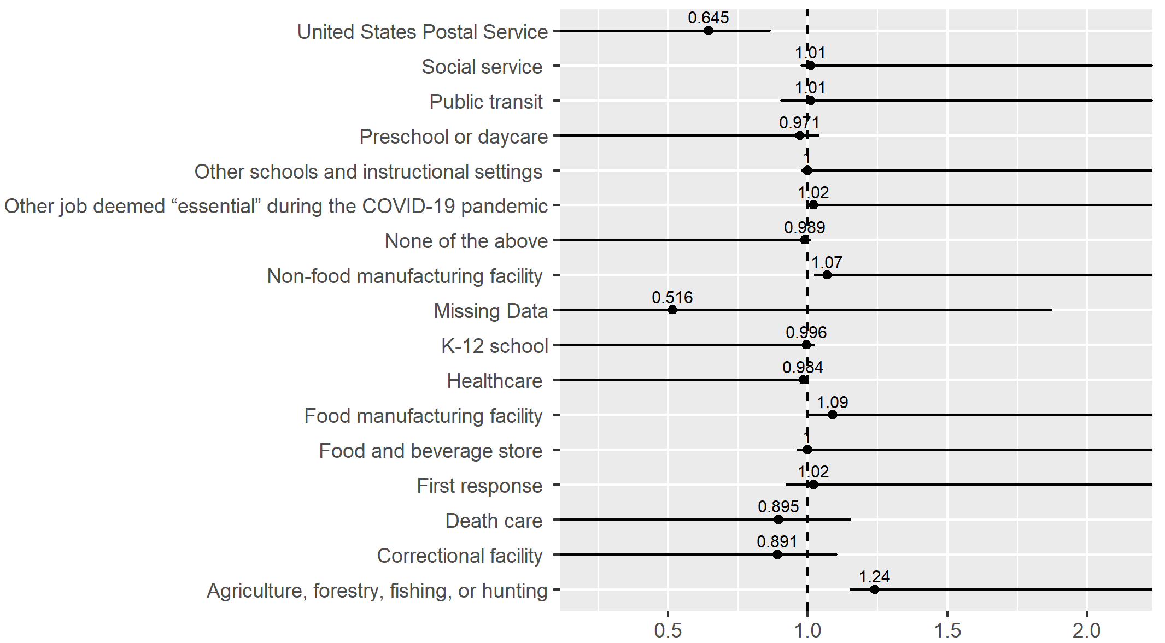
Relative Likelihood of Being Vaccinated between Workers with and without Disabilities, by Work Setting

Slide 27
Findings … within Work Setting
Worker with disabilities working in the US Postal Service were only 49.9% vaccinated,
Workers without disabilities working in the US Postal Service were 77.4% vaccinated
A “relative likelihood” of 0.645.
Meaning that in the US Postal Service, workers with disabilities were 0.645 times as likely (less likely) to be vaccinated that workers without disabilities.

Slide 28
Among Workers with Disabilities: Relative Likelihood of Being Vaccinated between “In-Setting Workers” and At-Home Workers Intro
Before Showing Detailed Graph:
If “relative likelihood” is equal to 1, then in-setting workers and at-home workers have the same likelihood of being vaccinated.

Slide 29
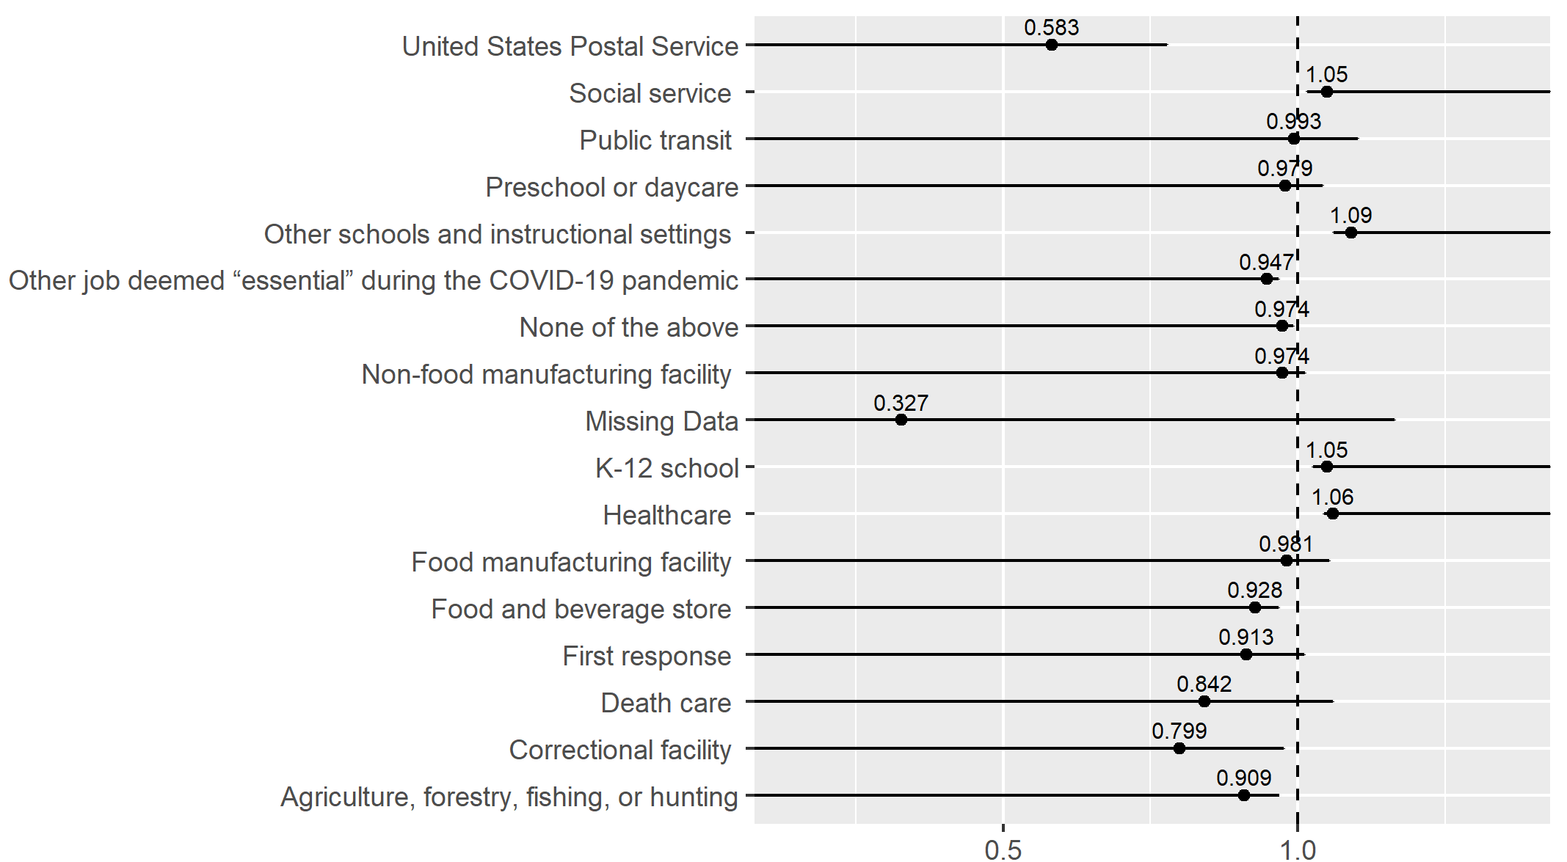
Among Workers with Disabilities: Relative Likelihood of Being Vaccinated between “In-Setting Workers” and At-Home Workers

Slide 30
Findings … Among Workers with Disabilities
Among workers with disabilities, when comparing “in-setting’ workers to total at-home workers:
Low vaccination rates were found in the …
United States Postal Service
Other job deemed essential during the COVID-19 pandemic”,
Food and beverage stores,
Correctional facilities,
Agriculture, forestry, fishing, or hunting settings,
Non-essential worker settings

Slide 31
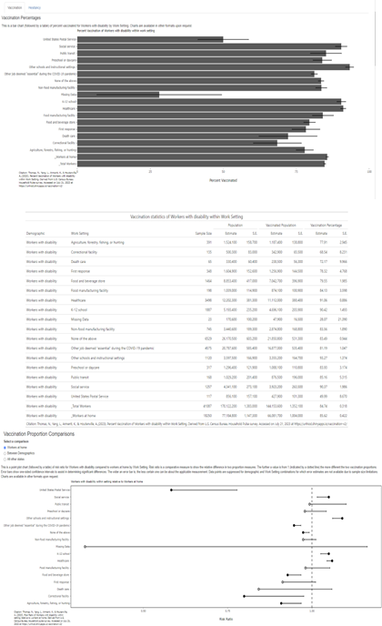
Interactive Dashboard (Beta Version)
[Intentionally Blurry]
For additional statistics at both national and state level, please visit our interactive dashboard.

Slide 32
Discussion
Data can guide continued vaccine distribution to target both the most vulnerable sub-groups (by work setting and demographics), and the group of respondents “[who] plan to wait and see if it is safe and may get it later”; thereby ensuring both an equitable and highly impactful vaccine campaign.
Significant disparities are observed within work setting.
Data helps to inform effective strategies facing future infectious diseases outbreak/vaccination
Continued research looking into “why” - barriers and difficulties in the workplace as well as best practices

Slide 33
Potential future work
Looking into demographic composition of the highly “distrustful” unvaccinated (“I don’t trust the government”, “I don’t trust the COVID-19 vaccines”)
Looking into the demographic composition of workers with disabilities within the US Postal Service.

Slide 34
References
[1] Amanda Reichard, Michelle Stransky, Debra Brucker & Andrew Houtenville (2019). The relationship between employment and health and health care among working-age adults with and without disabilities in the United States, Disability and Rehabilitation, 41:19, 2299-2307, DOI: 10.1080/09638288.2018.1465131

Slide 35
Q & A
Use “Q&A” button on Zoom to ask a questions
Slides will be archived at  https://www.researchondisability.org/ntide-episodes-list
Take our feedback survey at  https://www.researchondisability.org/ntide-episodes-list

Slide 36
Thank You!
Thanks to our partners: - UNH/Institute on Disability (www.ResearchOnDisability.org) - Kessler Foundation (www.KesslerFoundation.org) - AUCD (www.AUCD.org)
Contact us: - Email: Disability.Statistics@unh.edu - Call: 866-538-9521 (toll free)
Twitter at #nTIDELearn

Slide 37
Thank You! audio
Thanks to our partners: - UNH/Institute on Disability (www.ResearchOnDisability.org) - Kessler Foundation (www.KesslerFoundation.org) - AUCD (www.AUCD.org)
Contact us: - Email: Disability.Statistics@unh.edu - Call: 866-538-9521 (toll free)
Twitter at #nTIDELearn

