Slide 1
nTIDE Lunch & Learn Webinar Series
Kessler Foundation, AUCD, University of New Hampshire Institute on Disability Season 8, Episode 5 Date: May 5, 2023

Slide 2
nTIDE Lunch & Learn Webinar Series
Kessler Foundation, AUCD, University of New Hampshire Institute on Disability Season 8, Episode 5 Date: May 5, 2023

Slide 3
Up Front Matters
This webinar is being recorded. We will post an archive of along side the Monthly nTIDE broadcast on our webinar, each month, on our website at www.researchondisability.org/nTIDE. This site will also provide copies of the presentations, the speakers’ bios, full transcripts, and other valuable resources.
As an attendee of this webinar, you are a viewer. To ask questions of the speakers, click on the Q & A box on your webinar screen and type your questions into the box. Speakers will review these questions and provide answers during the last section of the webinar. Some questions may be answered directly in the Q & A box.

Slide 4
Up Front Matters Continued
If you have any questions following this recording, please contact us at disability.statistics@unh.edu, or toll free at 866-538-9521 for more information. Thanks for joining us. Enjoy today's webinar!

Slide 5
Welcome
Andrew Houtenville University of New Hampshire

Slide 6
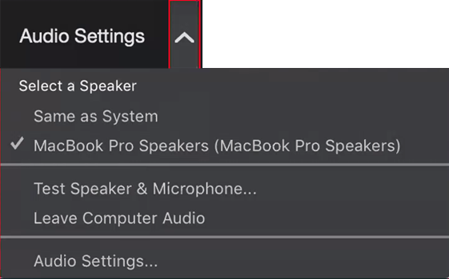
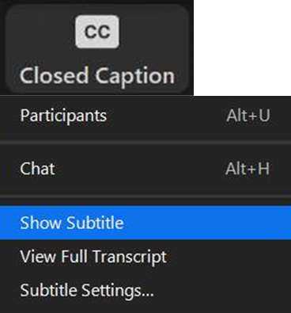
Zoom Tips
Tip #1: Sound
To select your speaker system, click on the up arrow next to Audio Settings, and then select one of the options.
Tip #2: Closed Captioning
Click on Closed Caption, and then select Show Subtitle for subtitles, or select View Full Transcript for a running transcript of the captions.

Slide 7
About nTIDE Lunch & Learn
Occurs at noon Eastern-time on the first Friday day of each month, with the release of the nTIDE Report.
A joint effort of the University of New Hampshire, Kessler Foundation, and the Association of University Centers on Disabilities (AUCD).

Slide 8
Today’s Program
Part 1: nTIDE Report … “The Numbers”
John O’Neill, Kessler Foundation
Andrew Houtenville, University of New Hampshire
Part 2: nTIDE News
Denise Rozell, Association of University Centers on Disabilities (AUCD)
Part 3: Guest Speaker
Jade Gingerich, Director of Employment Policy for the MD Department of Disabilities
Part 4: Q&A

Slide 9
Part 1: The nTIDE Report
John O’Neill
Kessler Foundation

Slide 10
The Monthly nTIDE Report
The monthly nTIDE Report is a press release and infographic, looking at the latest employment statistics.
Uses data from the “jobs report” released by the U.S. Bureau of Labor Statistics, on the 1st Friday of each month.

Slide 11
Source of the Data
U.S. BLS, Current Population Survey (CPS).
Source of the “official” unemployment rate.
Civilians, ages 16-64, not living in institutions.
Available September 2008 onward.
Not yet seasonally adjusted.
which is why we compare to the same month last year.

Slide 12
The Numbers
Andrew Houtenville University of New Hampshire

Slide 13
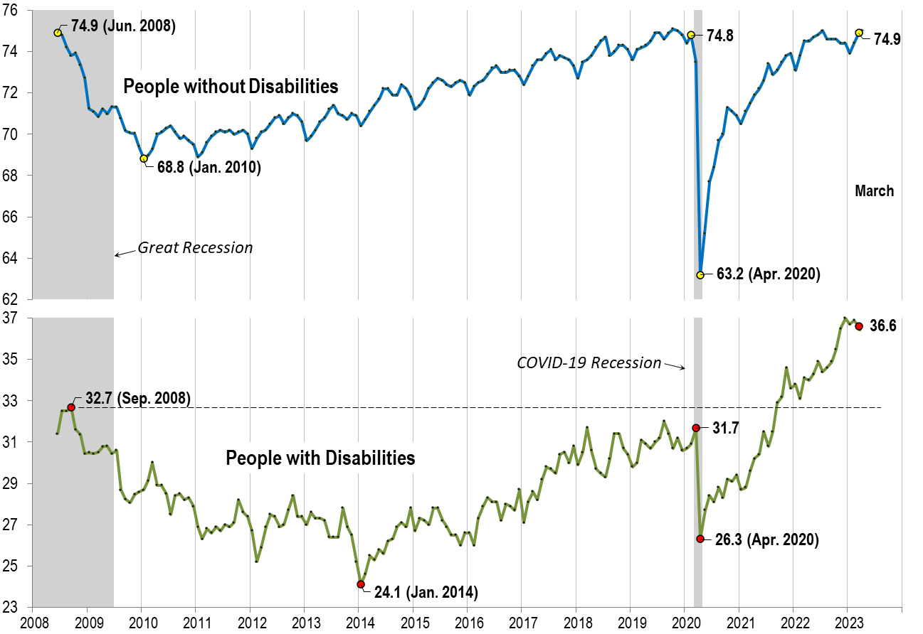
Employment -to- Population Ratio March

Slide 14
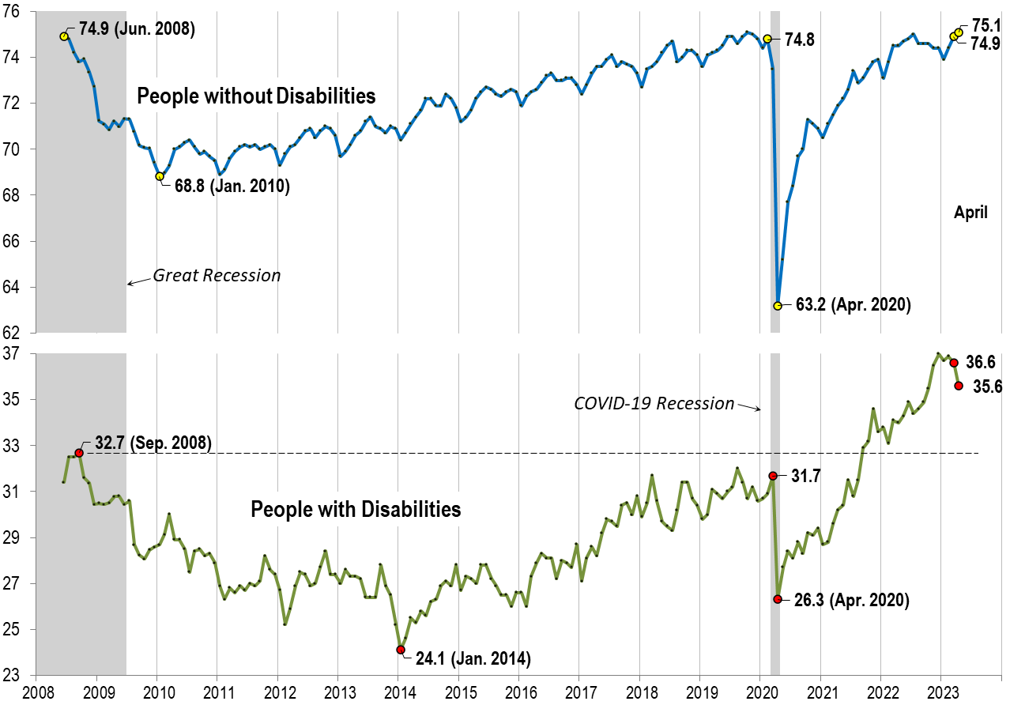
Employment -to- Population Ratio April

Slide 15
Labor Force Participation Rate

Slide 16
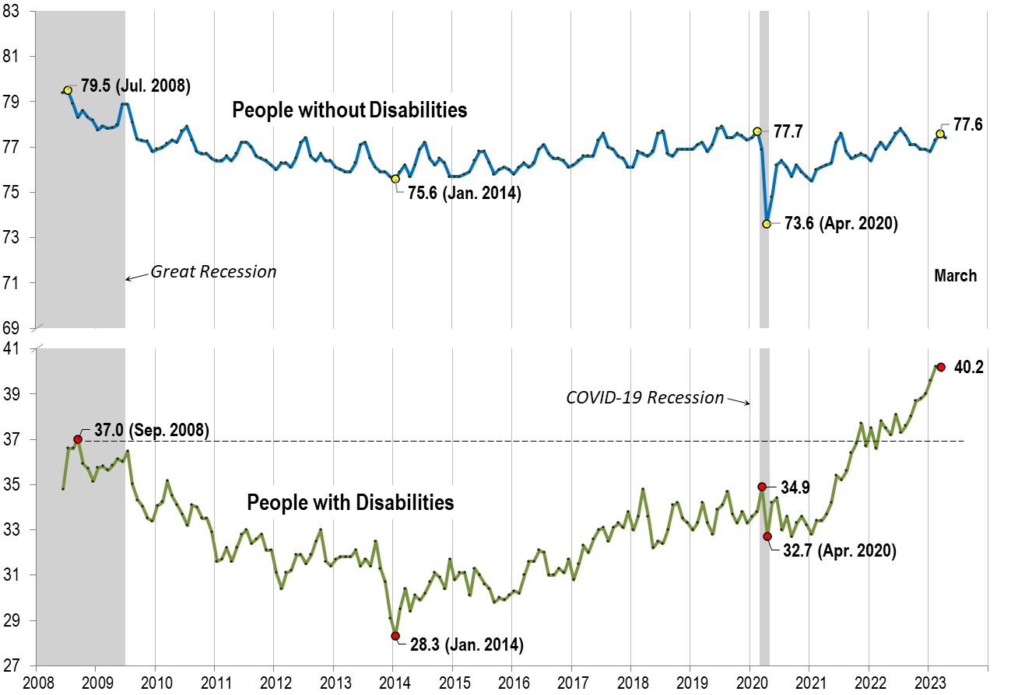
Labor Force Participation Rate March

Slide 17
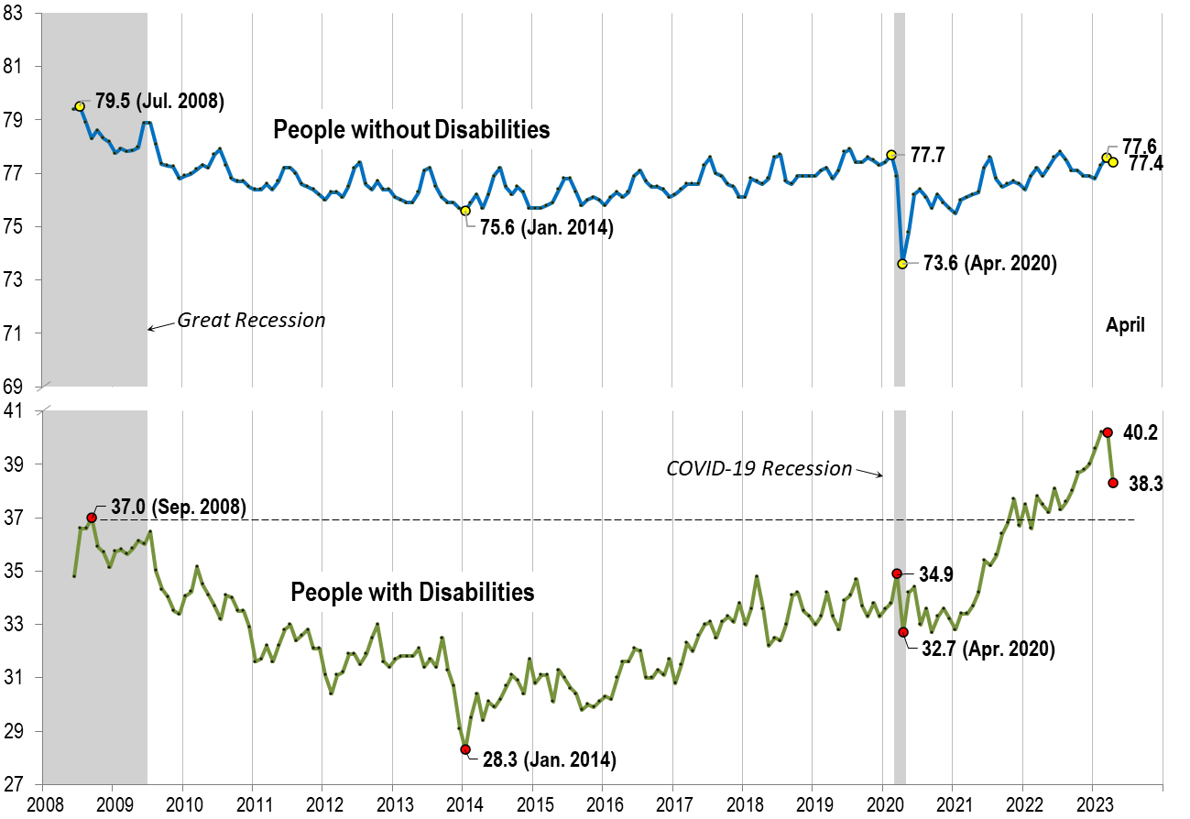
Labor Force Participation Rate April

Slide 18
Part 2 nTIDE News
Denise Rozell
Association of University Centers on Disabilities (AUCD)

Slide 19
Federal Policy Update
Budget and Appropriations/Debt ceiling
HCBS Access (S.762/H.R.1493)
Eliminate waiting lists/need for applying for waivers
Increase HCBS funding
Address training, support, resources for caregivers
Better Care Better jobs Act (S.100/H.R.547)
10% increase in Federal match (FMAP) for HCBS
Make spousal impoverishment limits and MFP permannt

Slide 20
SSAB: Unintended Consequences of Social Security's Return to Work Policies
Commissioned report by the Urban Institute’s policy researchers Chantel Boyens and Jack Smalligan. “Raising the Alarm on the Unintended Consequences of Social Security’s Return to Work Policies.” Social Security Advisory Board, pp. 1–28.
Highlights the disincentives in Social Security’s return to work policies both in its design and administration.
Work-related overpayments in SSDI and SSI programs among beneficiaries who work with a focus on the root causes of overpayments
Frequency and causes of overpayments and the effectiveness of SSA’s current processes, and their impact on beneficiaries.
Options for reform, including lessons from the Supplemental Nutrition Assistance Program (formerly known as food stamps), which has considerable overlap with the SSI population.

Slide 21
Skills Based Learning in States
Colorado Shifts to Skills-Based Hiring to Fill State Government Workforce Needs and Hire More Individuals with Disabilities – Disability Employment Policy (csg.org)
Hiring focused on skills instead of education to meet hiring shortages/build a more diverse workforce
Reduces bias in hiring, eliminates educational against people with disabilities (less likely to have BA)
Colorado EO (2023) – developing training, resources for HR, skills based selection plan template, integrating work-based learning models, ensure postings are skills based, etc.
Other states:
Alabama
Minnesota
Oklahoma
Utah

Slide 22
How to Bridge Different Access Needs.
PEAT – The Partnership on Employment & Accessible Technology/ODEP
Building an inclusive workplace means meeting the technology access needs of all your employees:
Two workplace scenarios in which an employee with one type of disability has a different technology requirement than another
Lists of potential solutions for bridging differences, noting that all parties should work together to find solutions and balance their needs.
List of ongoing best practices for mitigating different access needs, such as promoting accommodations and a culture of inclusion, encouraging creativity and open dialogues, and procuring flexible workplace technologies that work for everyone.
“Instead of viewing access needs as competing, try reframing accessibility as an ongoing practice that staff accomplish together.”

Slide 23
Supported and Customized Employment
Side-by-Side Referral Decision Guide by VCU, Utah State, TA Center for Quality Employment (VRTAC-QE)
Definition, designed for who, defining features of each
Identifying who may benefit and which they may benefit from – CE or SE
A chart outlining how the employment planning process works within each service
Key Differences: differences in job development for CE and SE
Step-by-step yes/no decision-making flow chart…

Slide 24
How has COVID-19 impacted disability employment?
Ari Ne’eman, Nicole Maestras, Disability and Health Journal, Volume 16, Issue 2, April 2023
Employment trends for people with and without disabilities over the course of the COVID-19 recession and subsequent economic recovery, both overall and by occupational category (essential, non-essential, teleworkable, non-teleworkable, frontline, non-frontline).
Current population survey
People with disabilities are disproportionately benefiting from the rapid recovery from the initial economic contraction at the start of the pandemic

Slide 25
Telework during the pandemic: Patterns, challenges, and opportunities for people with disabilities
Mason Ameri, Douglas Kruse, So Ri Park, Yana Rodgers, Lisa Schur, Disability and Health Journal, Volume 16, Issue 2, April 2023
Compare people with and without disabilities in the expansion of telework as the pandemic began, and during the pandemic.
American Community Survey and Current Population Survey
People with cognitive/mental health and mobility impairments were the most likely to telework
Tight labor markets especially favored the expansion of telework for people with vision impairments and difficulty with daily activities inside the home.

Slide 26
Sar-TAC Webinar Series on Accessibility and Plain Language
SAR-TAC, the self-advocacy resource and technical assistance center funded by ACL and managed by Self-Advocates Becoming Empowered (SABE) targeted for government or nonprofits.
April 17 | 4:00 pm - 5:00 pm ET: Overview of Accessible Formats
May 8 | 4:00 pm - 5:00 pm ET: Plain Language: Ins and outs of plain language
June 5 | 4:00 pm - 5:00 pm ET: Easy Read Text: what is East Read and how to write in it.
July 10 | 4:00 pm - 5:00 pm ET: Easy Read Icons: Make pictures for Easy Read documents.
July 31 | 4:00 pm - 5:00 pm ET: Formatting Basics: Learn how to use computer programs like InDesign or Illustrator to format plain language and Easy Read documents.

Slide 27
Webinar: Brain Injury, AT & Employment
"Fitting the Pieces Together: Assistive Technology Solutions for Brain Injury and Employment", Tuesday, May 9, 2023, 3:00-4:00 P.M. ET
Sponsored by the AoD Disability Employment TA Center's National Community of Practice (CoP) webinar (open to all)
Importance of AT navigator to guide best practice and
How AT programs assess specific sensory, physical, social, emotional, cognitive challenges;
Process for analyzing, determining, and providing support before work begins, or during job retention;
Case examples re AT for individuals with brain injury;
Resources and program information.

Slide 28
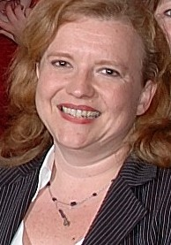
Part 3: nTIDE Guest Speaker
Jade Gingerich
Director of Employment Policy
for the MD Department of Disabilities

Slide 29
Maryland Department
Of Disabilities
Opportunity Access Choice
Notes:
Carol

Slide 30
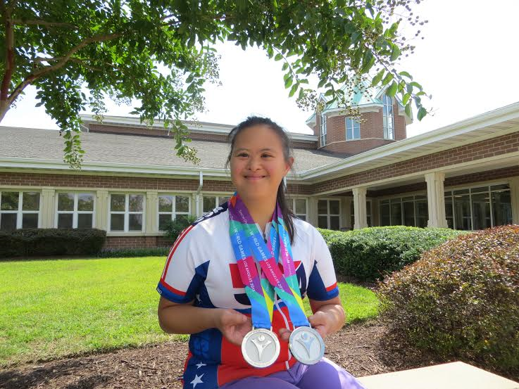
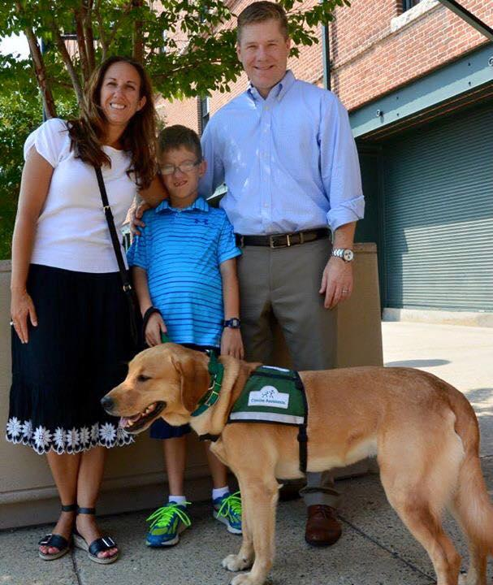
Vision:
A Maryland in which all people have the knowledge and influence to make a difference in their lives and the lives of others
Notes:
Carol

Slide 31
History/Mission
Created in 2004
Only cabinet level department in the US representing all disabilities
Secretary or Deputy must have a disability
Charged with coordinating​ and improving the delivery of services in Maryland
Informed by the Maryland Commission on Disabilities
State Disabilities Plan
Notes:
Carol

Slide 32
MDOD Policy Areas
Employment/Transition
Health and Behavioral Health
Community Living/MD Attendant Care Program
Housing
Transportation
Emergency Preparedness
Telecommunications Access Maryland (TAM) https://doit.maryland.gov/mdrelay/Pages/TAM.aspx
MD Technology Assistance Program https://mdod.maryland.gov/mdtap/Pages/MDTAP-Home.aspx

Slide 33
Education/Transition
Transition planning starts at age 14 (Federal law starts at 16)
Moved Transition section up in the Online IEP so not an after thought
Added section re linkages to post school services in IEP, Piloting linkage tool in Charles County in partnership with REL
Creating endorsements in areas of college, career and/or community for certificate students
State Agency Transition Collaborative: Information and AT Checklist, Flow of Services
Earlier outreach/engagement of Family Support Specialists/Parents Place to help families set higher expectations, Self Determination/Guiding the Journey, diversity
Complex Care Needs and Transition
Hispanic engagement
Project SEARCH

Slide 34
Employment
Employer engagement/education and training, such as Northrop Grumman, JHU APL, GXO and others
Diversity, Equity, Inclusion, Accessibility
Commission to Study VR https://www.marylandpublicschools.org/programs/Pages/Gov-Rel/Commission/index-commission.aspx
College Student Engagement/outreach
Autism Hiring Initiative
Employment First-how community engagement can lead to work (eliminated subminimum!)
Training for Labor staff and others
Expansion of Employed Individuals with Disabilities program (Medicaid Buy In)
2GEN and more…..!

Slide 35
For more information
Jade Gingerich Director of Employment and Transition, MDOD Jade.Gingerich@maryland.gov
Follow Maryland Department of Disabilities on Facebook
Visit: Mdod.Maryland.gov
Mdtransitions.org

Slide 36
Questions and Answers
Use Q&A button on Zoom
Slides will be archived at: https://researchondisability.org/home/ntide.
Take our feedback survey at …
www.researchondisability.org/ntide/ntide-survey

Slide 37
Thank You!
Information about the nTIDE partners may be found at
Kessler Foundation (www.kesslerfoundation.org)
UNH/Institute on Disability (www.ResearchOnDisability.org)
AUCD (www.AUCD.org)
Contact us at
Email: Disability.Statistics@unh.edu
Call: 866-538-9521 (toll free)
Twitter at #nTIDELearn

Slide 38
Bye!

