Slide 1
nTIDE Lunch & Learn Webinar Series
Kessler Foundation, UNH, and AUCD nTIDE Deeper Dive Date: May 19, 2023

Slide 2
nTIDE Lunch & Learn Webinar Series (audio)
Kessler Foundation, UNH, and AUCD nTIDE Deeper Dive Date: May 19, 2023
Notes:
X`

Slide 3
Up Front Matters
This webinar is being recorded. We will post an archive of along side the Monthly nTIDE broadcast on our webinar, each month, on our website at www.researchondisability.org/nTIDE. This site will also provide copies of the presentations, the speakers’ bios, full transcripts, and other valuable resources.
As an attendee of this webinar, you are a viewer. To ask questions of the speakers, click on the Q & A box on your webinar screen and type your questions into the box. Speakers will review these questions and provide answers during the last section of the webinar. Some questions may be answered directly in the Q & A box.

Slide 4
Up Front Matters Continued
If you have any questions following this recording, please contact us at disability.statistics@unh.edu, or toll free at 866-538-9521 for more information. Thanks for joining us. Enjoy today's webinar!

Slide 5
ASL Interpreter & Closed Captioning
To see interpreter and the gallery of speakers at the same time, we recommend using a computer or laptop, rather than a phone or tablet.
For closed captioning, click on the Closed Caption button and select Show Subtitle or View Full Transcript.

Slide 6
About the nTIDE Deeper Dive
Occurs at noon Eastern-time on two weeks after the first Friday day of each month (when nTIDE Report is released).
A joint effort of the University of New Hampshire, Kessler Foundation, and the Association of University Centers on Disabilities (AUCD).
Each month, the nTIDE Deeper Dive focuses on specific sub-populations within the population with disabilities.
Brings in a guest speaker to provide greater context.

Slide 7
Today’s Agenda
● 12:00 pm: Welcome and Introduction
● 12:05 pm: Moderator: Andrew Houtenville
 Reviews the nTIDE (First Friday) statistics
 Takes a “Deeper Dive” into the statistics
12:20 pm: Guest Speaker: Eric Bridges from the
American Foundation
● 12:35 pm: Open Q&A Period

Slide 8
nTIDE Source of the Data
U.S. BLS, Current Population Survey (CPS).
Source of the “official” unemployment rate.
Civilians, ages 16-64, not living in institutions.
Available September 2008 onward.
Uses the Public-Use Microdata (PUMS) file, which comes out several days after the release of the first Friday nTIDE Report.

Slide 9
Identifying People with Disabilities 6 Questions
Six Questions:
Hearing Disability – Deaf or having serious difficulty hearing.
Vision Disability – Blind or having serious difficulty seeing, even when wearing glasses.
Cognitive Disability – Because of a physical, mental, or emotional problem … difficulty remembering, concentrating, or making decisions.
Ambulatory Disability – Because of a physical, mental, or emotional problem … serious difficulty walking or climbing stairs.

Slide 10
Identifying People with Disabilities 6 Questions cont’d
Six Questions:
Self-Care Disability – Because of a physical, mental, or emotional problem … difficulty bathing or dressing.
Independent Living Disability–Because of a physical, mental, or emotional problem, having difficulty doing errands alone such as visiting a doctor’s office or shopping.

Slide 11
Identifying People with Disabilities Various Combinations
Various Combinations
People with Vision Disability – Answer “yes” to vision question (and maybe one or more of the other five disability questions).
People with Vision Disability Only – Answer “yes” to vision question and none of the other five disability question.
Misses people answering “yes” to self-care and/or independent living qns.
People with Vision Disability and Activity Limitation – Answer “Yes” to vision question and “yes” to the self-care and/or independent living qns.
Reflects a degree of severity (although the activity limitation may reflect other disabilities if also answered “yes” to hearing, cognitive, and/or ambulatory qns).

Slide 12
Employment -to- Population Ratio

Slide 13
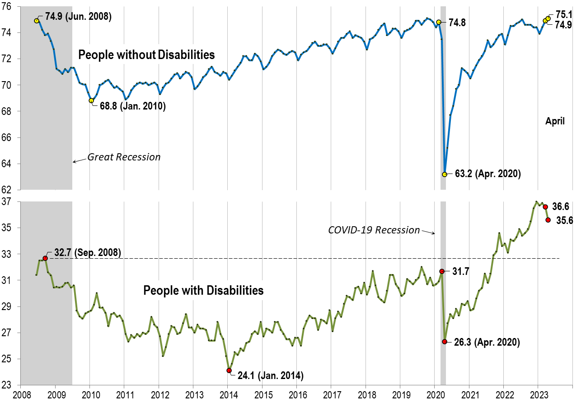
Employment -to- Population Ratio Slide from First Friday nTIDE

Slide 14
Employment -to- Population Ratio 12 Month Avg. April to March

Slide 15
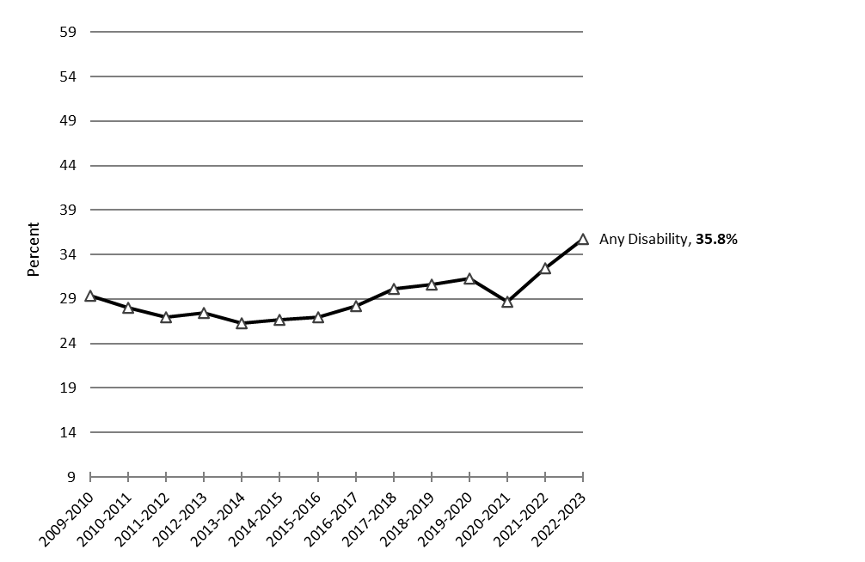
Employment -to- Population Ratio 12 Month Avg. April to March Any Disability

Slide 16
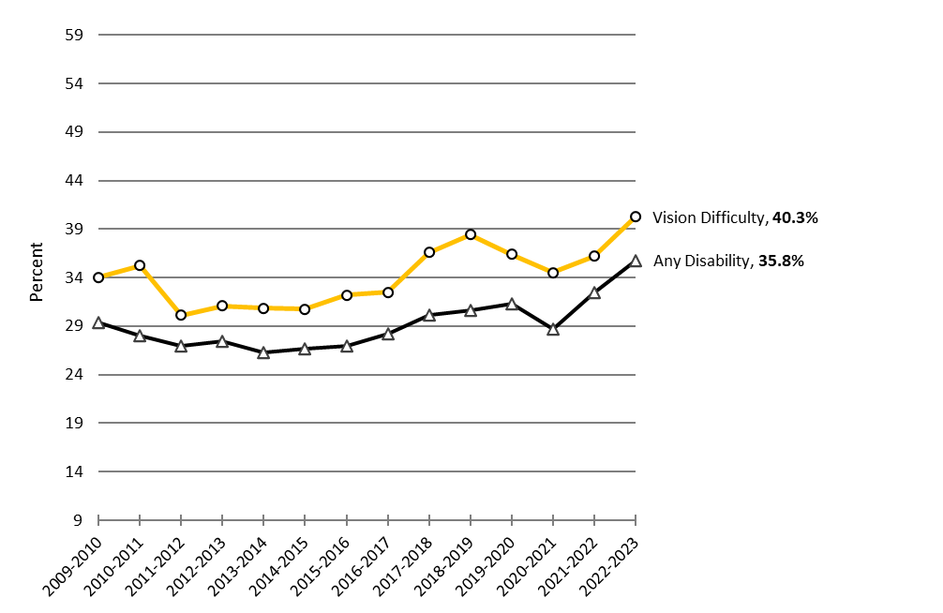
Employment -to- Population Ratio 12 Month Avg. April to March Any Disability Vision Difficulty

Slide 17
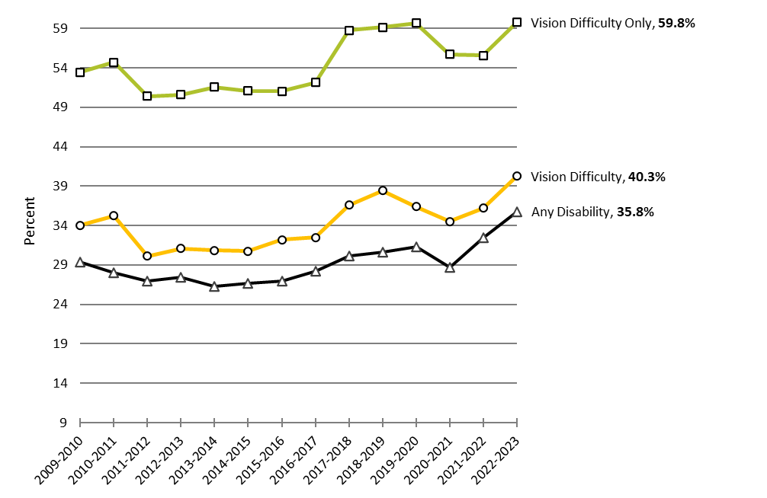
Employment -to- Population Ratio 12 Month Avg. April to March Any Disability Vision Difficulty Vision Difficulty Only

Slide 18
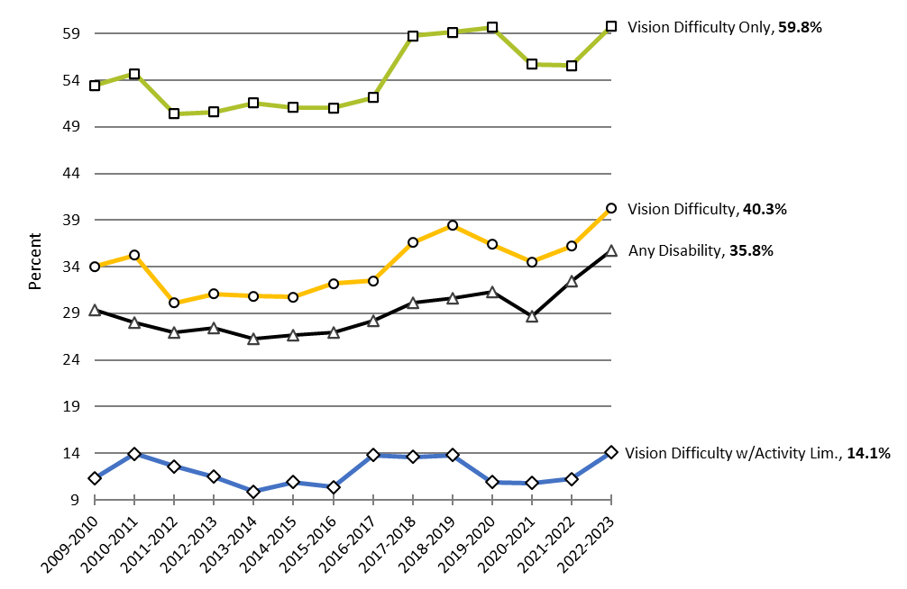
Employment -to- Population Ratio 12 Month Avg. April to March Any Disability Vision Difficulty Vision Difficulty Only Vision Difficulty w/Act. Lim.

Slide 19
Observations
There are substantial level-differences across three ways vision difficulty was characterized, reflecting the degree of severity.
People with vision difficulty only were slower to recover than form the Pandemic, and just about fully recovered.
The same is true for people with vision difficulty and activity limitation (self-care and/or independent living difficulty).

Slide 20
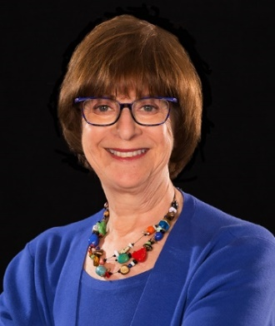
Introducing our Guest Speaker
Elaine Katz
Kessler Foundation

Slide 21
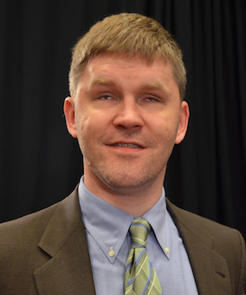
nTIDE Guest Speaker
Eric Bridges
American Foundation
for the Blind

Slide 22
Q & A
Use “Q&A” button on Zoom to ask a questions
Slides will be archived at  https://www.researchondisability.org/ntide-episodes-list
Take our feedback survey at  https://www.researchondisability.org/ntide-episodes-list

Slide 23
Thank You!
Thanks to our partners: - UNH/Institute on Disability (www.ResearchOnDisability.org) - Kessler Foundation (www.KesslerFoundation.org) - AUCD (www.AUCD.org)
Contact us: - Email: Disability.Statistics@unh.edu - Call: 866-538-9521 (toll free)
Twitter at #nTIDELearn

Slide 24
Thank You! audio
Thanks to our partners: - UNH/Institute on Disability (www.ResearchOnDisability.org) - Kessler Foundation (www.KesslerFoundation.org) - AUCD (www.AUCD.org)
Contact us: - Email: Disability.Statistics@unh.edu - Call: 866-538-9521 (toll free)
Twitter at #nTIDELearn

