Slide 1
nTIDE Lunch & Learn Webinar Series
Kessler Foundation, UNH, and AUCD nTIDE Deeper Dive Date: April 21, 2023

Slide 2
nTIDE Lunch & Learn Webinar Series
Kessler Foundation, UNH, and AUCD nTIDE Deeper Dive Date: April 21, 2023

Slide 3
Up Front Matters
This webinar is being recorded. We will post an archive of along side the Monthly nTIDE broadcast on our webinar, each month, on our website at www.researchondisability.org/nTIDE. This site will also provide copies of the presentations, the speakers’ bios, full transcripts, and other valuable resources.
As an attendee of this webinar, you are a viewer. To ask questions of the speakers, click on the Q & A box on your webinar screen and type your questions into the box. Speakers will review these questions and provide answers during the last section of the webinar. Some questions may be answered directly in the Q & A box.

Slide 4
Up Front Matters
If you have any questions following this recording, please contact us at disability.statistics@unh.edu, or toll free at 866-538-9521 for more information. Thanks for joining us. Enjoy today's webinar!

Slide 5
ASL Interpreter & Closed Captioning
To see interpreter and the gallery of speakers at the same time, we recommend using a computer or laptop, rather than a phone or tablet.
For closed captioning, click on the Closed Caption button and select Show Subtitle or View Full Transcript.

Slide 6
nTIDE Deeper Dive
Andrew Houtenville
University of New Hampshire
Elaine Katz Kessler Foundation
Denise Rozell
Association of University Centers on Disabilities

Slide 7
Today’s Agenda
● 12:00 pm: Welcome and Introduction
● 12:05 pm: Review Latest Employment Statistics
Outline the Focus Deeper Dive Areas
12:20 pm: Guest Speaker: Javier Robles, Rutgers
● 12:35 pm: Open Q&A Period

Slide 8
Employment -to- Population Ratio

Slide 9
Employment -to- Population Ratio

Slide 10
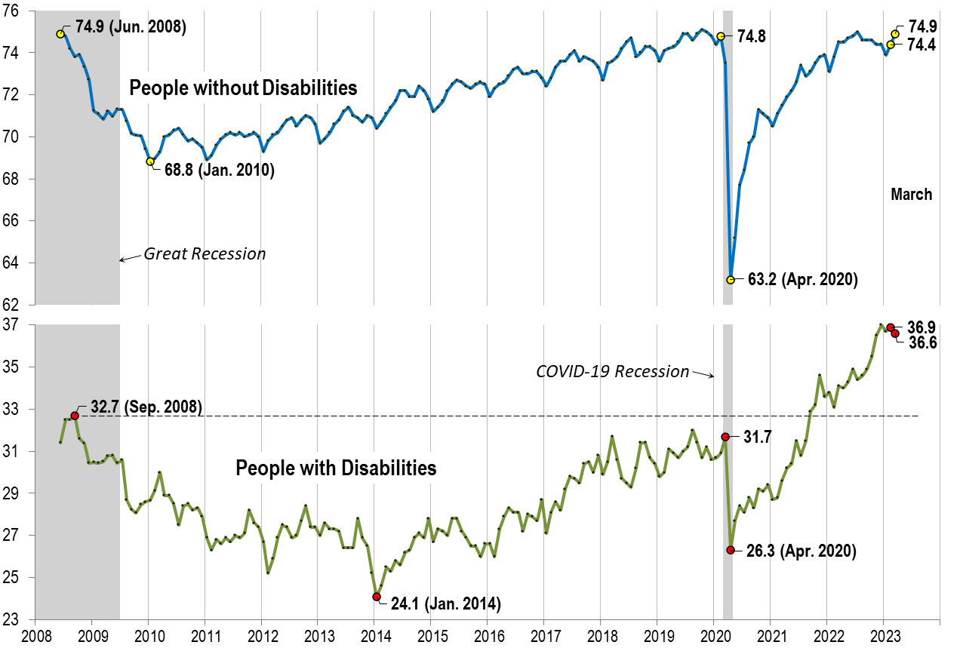
Employment -to- Population Ratio

Slide 11
Labor Force Participation Rate

Slide 12
Labor Force Participation Rate

Slide 13
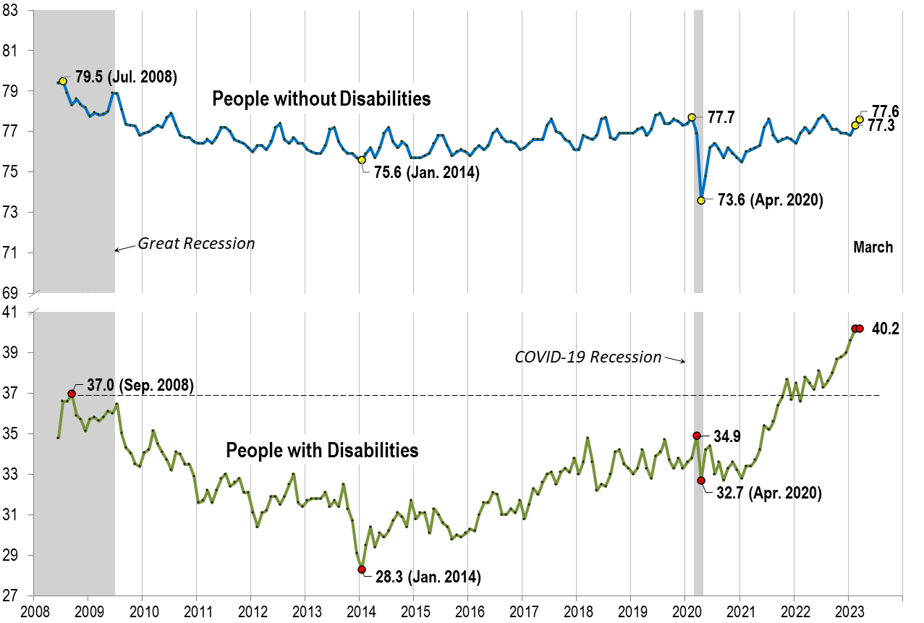
Labor Force Participation Rate

Slide 14
Deeper Dive
Introduction

Slide 15
Average Monthly Employment-to- Population Ratio
12-Month Average of Monthly Stats
April to March because of the COVID Lockdown starting in April

Slide 16
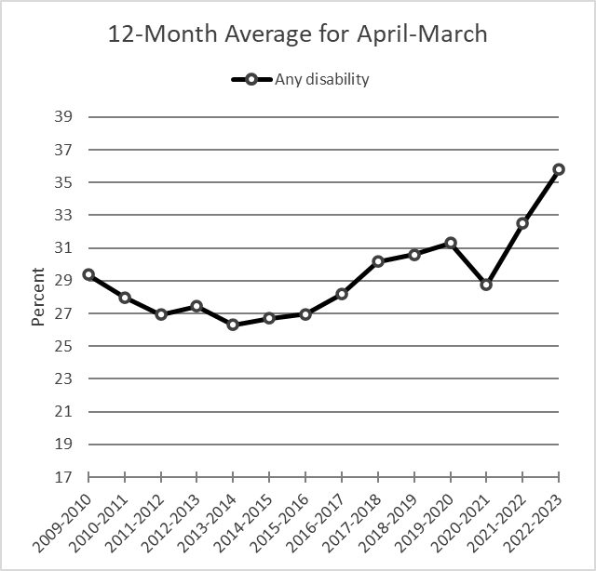
Average Monthly Employment-to- Population Ratio

Slide 17
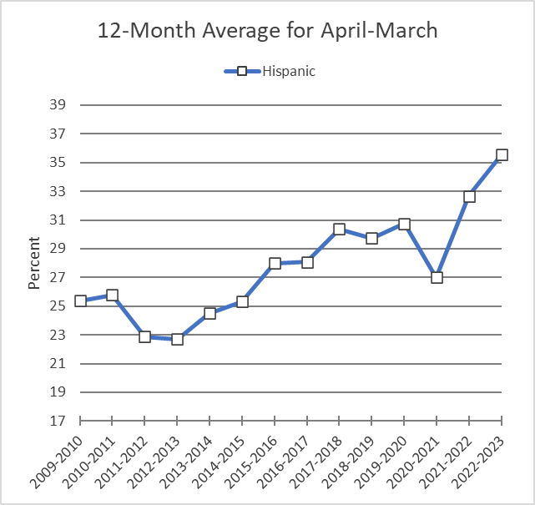
Average Monthly Employment-to- Population Ratio

Slide 18
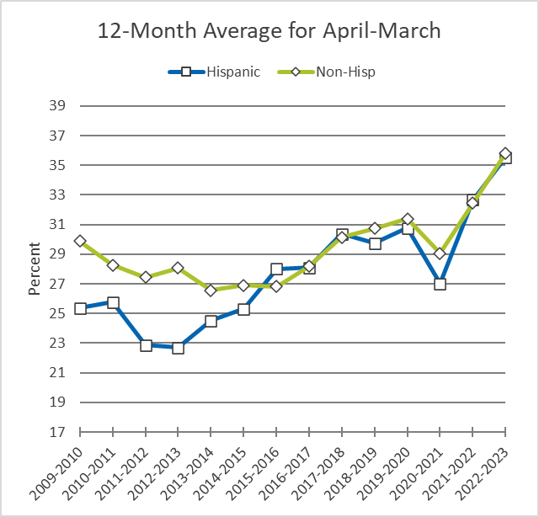
Average Monthly Employment-to- Population Ratio

Slide 19
Average Monthly Employment-to- Population Ratio

Slide 20
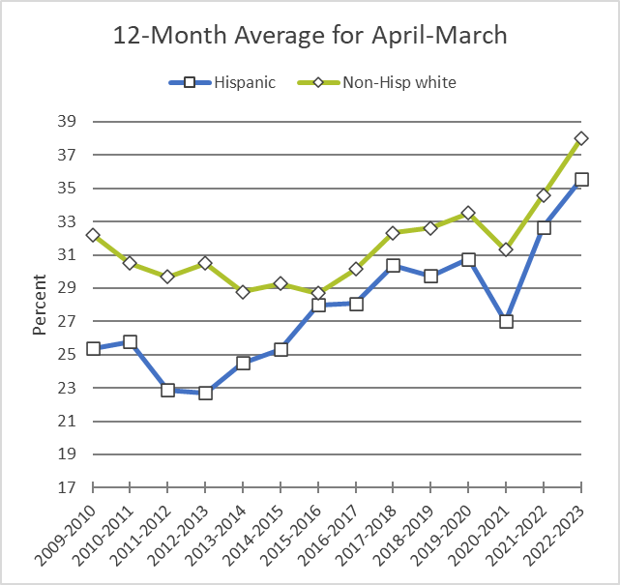
Average Monthly Employment-to- Population Ratio

Slide 21
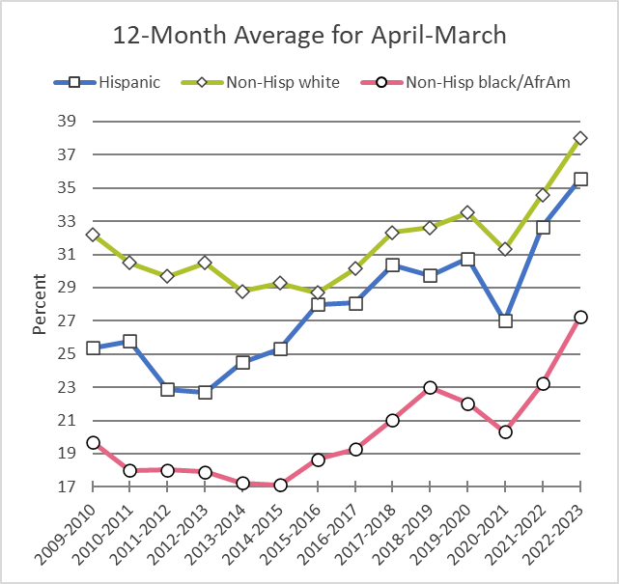
Average Monthly Employment-to- Population Ratio

Slide 22
Observations
There are substantial level-differences across groups.
The labor market improvements seen by people with disabilities since the Pandemic Lockdown Recession, were slower to materialize for black/African Americans with disabilities, but in the recent 12-months, they have made up ground.

Slide 23
Average Monthly Employment-to- Population Ratio
Other Groups
with
Relatively Small Sample Size

Slide 24
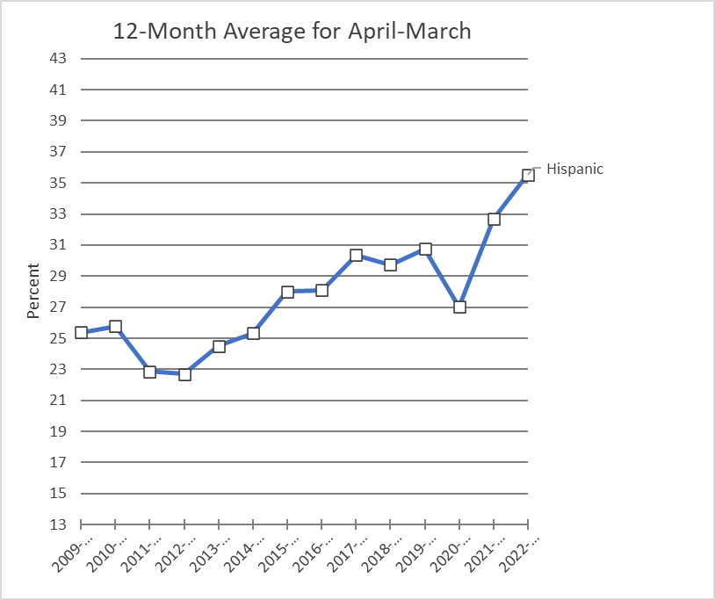
Average Monthly Employment-to- Population Ratio

Slide 25
Average Monthly Employment-to- Population Ratio

Slide 26
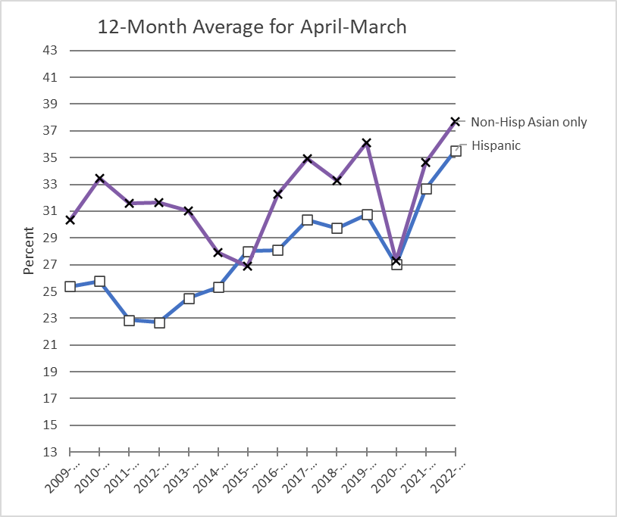
Average Monthly Employment-to- Population Ratio

Slide 27
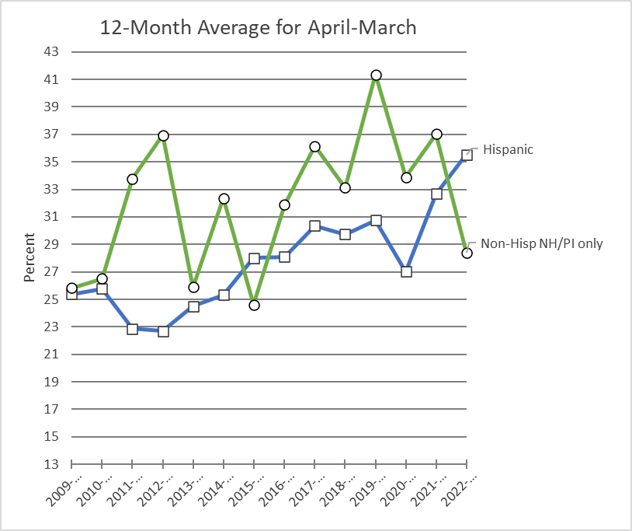
Average Monthly Employment-to- Population Ratio

Slide 28
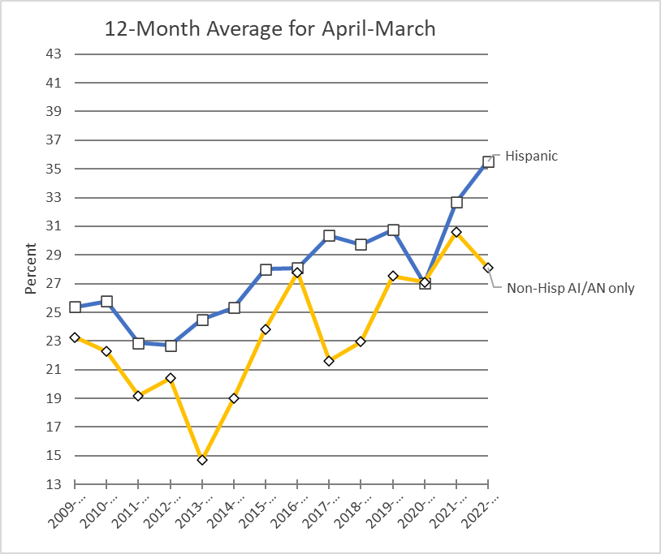
Average Monthly Employment-to- Population Ratio

Slide 29
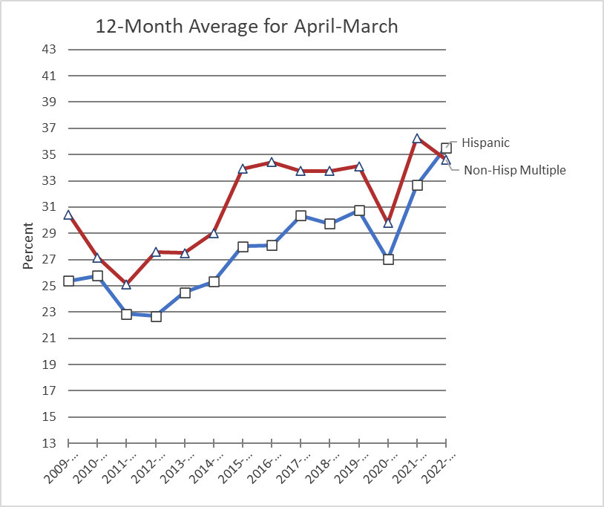
Average Monthly Employment-to- Population Ratio

Slide 30
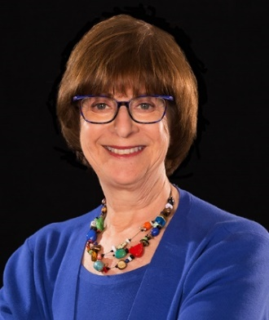
Introducing our Guest Speaker
Elaine Katz
Kessler Foundation

Slide 31
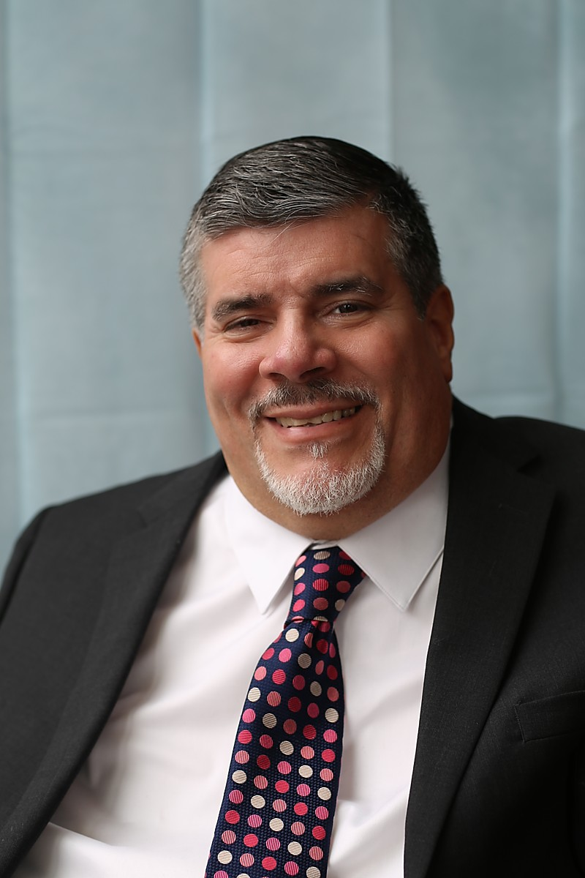
nTIDE Guest Speaker
Javier Robles
Rutgers

Slide 32
Q & A
Use “Q&A” button on Zoom to ask a questions
Slides will be archived at  https://www.researchondisability.org/ntide-episodes-list
Take our feedback survey at  https://www.researchondisability.org/ntide-episodes-list

Slide 33
Thank You!
Thanks to our partners: - UNH/Institute on Disability (www.ResearchOnDisability.org) - Kessler Foundation (www.KesslerFoundation.org) - AUCD (www.AUCD.org)
Contact us: - Email: Disability.Statistics@unh.edu - Call: 866-538-9521 (toll free)
Twitter at #nTIDELearn

Slide 34
Thank You!
Thanks to our partners: - UNH/Institute on Disability (www.ResearchOnDisability.org) - Kessler Foundation (www.KesslerFoundation.org) - AUCD (www.AUCD.org)
Contact us: - Email: Disability.Statistics@unh.edu - Call: 866-538-9521 (toll free)
Twitter at #nTIDELearn

