Slide 1
nTIDE Lunch & Learn Webinar Series
Kessler Foundation, AUCD, University of New Hampshire Institute on Disability Season 8, Episode 2 Date: February 3, 2023

Slide 2
nTIDE Lunch & Learn Webinar Series
Kessler Foundation, AUCD, University of New Hampshire Institute on Disability Season 8, Episode 2 Date: February 3, 2023

Slide 3
Up Front Matters
This webinar is being recorded. We will post an archive of along side the Monthly nTIDE broadcast on our webinar, each month, on our website at www.researchondisability.org/nTIDE. This site will also provide copies of the presentations, the speakers’ bios, full transcripts, and other valuable resources.
As an attendee of this webinar, you are a viewer. To ask questions of the speakers, click on the Q & A box on your webinar screen and type your questions into the box. Speakers will review these questions and provide answers during the last section of the webinar. Some questions may be answered directly in the Q & A box.

Slide 4
Up Front Matters
If you have any questions following this recording, please contact us at disability.statistics@unh.edu, or toll free at 866-538-9521 for more information. Thanks for joining us. Enjoy today's webinar!

Slide 5
Welcome
Andrew Houtenville University of New Hampshire

Slide 6
Some Upcoming Events and Information
Release of the Annual Disability Statistics Collection
Tuesday & Wednesday, February 7th & (repeated live) 8th
Virtual via Zoom
ICDR - State of the Science Conference on Disability Statistics
Thursday & Friday, February 9th & 10th
10:00 a.m. – 4:00 p.m. ET
Virtual via Zoom
nTIDE Registration – Separate registration and link for each month’s nTIDE
nTIDE Mid-Month COVID Update  nTIDE Mid-Month Deeper Dive

Slide 7
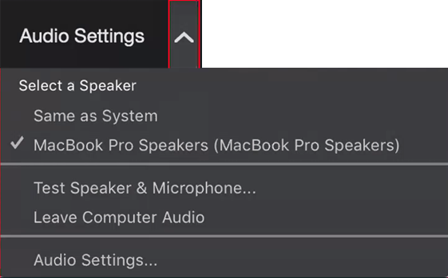
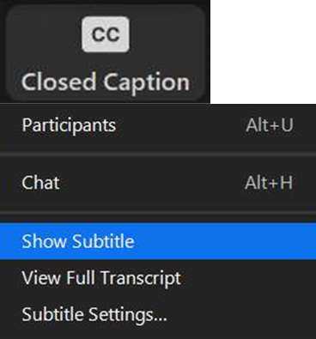
Zoom Tips
Tip #1: Sound
To select your speaker system, click on the up arrow next to Audio Settings, and then select one of the options.
Tip #2: Closed Captioning
Click on Closed Caption, and then select Show Subtitle for subtitles, or select View Full Transcript for a running transcript of the captions.
Your screen may
look a bit different

Slide 8
About nTIDE Lunch & Learn
Occurs at noon Eastern-time on the first Friday day of each month, with the release of the nTIDE Report.
A joint effort of the University of New Hampshire, Kessler Foundation, and the Association of University Centers on Disabilities (AUCD).

Slide 9
Today’s Program
Part 1: nTIDE Report … “The Numbers”
John O’Neill, Kessler Foundation
Andrew Houtenville, University of New Hampshire
Part 2: nTIDE News
Denise Rozell, Association of University Centers on Disabilities (AUCD)
Part 3: Guest Speaker
Jennifer Mathis, Civil Rights Division, Department of Justice
Part 4: Q&A

Slide 10
Part 1: The nTIDE Report
John O’Neill
Kessler Foundation

Slide 11
The Monthly nTIDE Report
The monthly nTIDE Report is a press release and infographic, looking at the latest employment statistics.
Uses data from the “jobs report” released by the U.S. Bureau of Labor Statistics, on the 1st Friday of each month.

Slide 12
Source of the Data
U.S. BLS, Current Population Survey (CPS).
Source of the “official” unemployment rate.
Civilians, ages 16-64, not living in institutions.
Available September 2008 onward.
Not yet seasonally adjusted.
which is why we compare to the same month last year.

Slide 13
The Numbers
Andrew Houtenville University of New Hampshire

Slide 14
Employment -to- Population Ratio

Slide 15
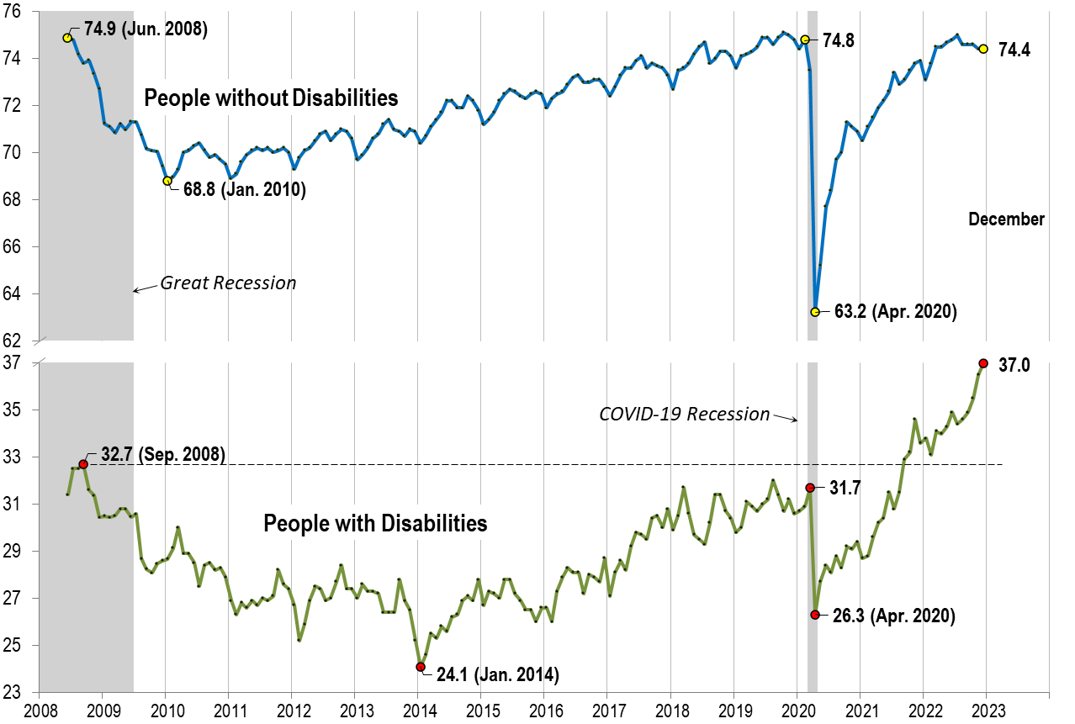
Employment -to- Population Ratio

Slide 16
Employment -to- Population Ratio

Slide 17
Labor Force Participation Rate

Slide 18
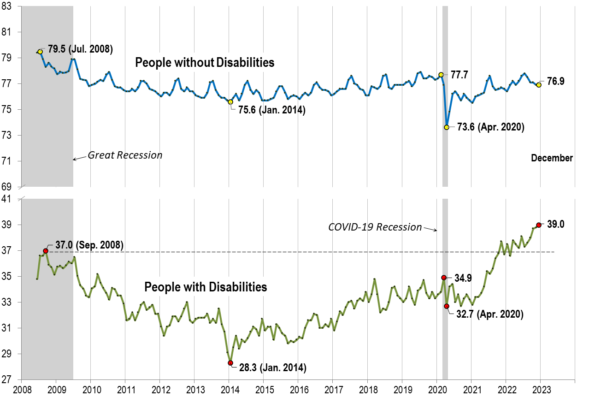
Labor Force Participation Rate

Slide 19
Labor Force Participation Rate

Slide 20
Part 2 nTIDE News
Denise Rozell
Association of University Centers on Disabilities (AUCD)

Slide 21
Federal Policy Update
State of the Union Address – February 7
Committee Chairs and members appointed
Senate HELP: Sanders (I-VT); Ranking Cassidy (R-LA)
House Education and the Workforce: Chair Foxx (R-NC); Ranking Scott (D-VA)
Appropriations:
Senate – Chair Murray (D-WA); Ranking Collins (ME)
House – Chair Granger (R-TX); Ranking DeLauro (CT)
Reintroduced:
BCBJ – Better Care Better Jobs Act
Still waiting for Transformation to Competitive Integrated Employment...and others

Slide 22
Broadband’s Impact on Disability Employment
How the Infrastructure Investment and Jobs Act Can Help Close the Employment Gap for People with Disabilities ,”
From PEAT – Partnership on Employment & Accessible Technology - ODEP
Infrastructure Investment and Jobs Act (Bipartisan Infrastructure law) – $65 billion available to support broadband use for all Americans
Large portion of $$ to states and territories to expand broadband deployment for unserved and underserved communities.
Also includes $2.75 billion for the Digital Equity Act, which targets helping the most underserved groups get digitally connected
www.internet4all.gov

Slide 23
ODEP Interactive Data Maps re Employment
The Employment Population Ratio Map illustrates how the employment rate, or employment-population ratio, varies by state and race/ethnicity among working-age adults with disabilities.
8 states have disability employment-population ratios 40% or higher.
The Median Annual Earnings Map shows how median earnings differ by state and sex among currently working adults with disabilities.
Workers w/disabilities have the highest median wages in WA, NV, ND, MD, VA, NJ, DC
Women with disabilities have lower median wages than men with disabilities
Both maps based on 2016-2020 American Community Survey data
For more ODEP data dol.gov/agencies/odep/research-evaluation/statistics.

Slide 24
What do we know about Social Security?
Messel, Matt, Tokunbo B. Oluwole, and David Rogofsky. “Public Knowledge About the Social Security Administration’s Disability Programs: Findings from the Understanding America Study.” Social Security Bulletin, vol. 82, no. 4, 2022, pp. 1–22.
2021 survey results from Understanding America Study
Descriptive statistics re program knowledge of SSI and SSDI and across age, race/ethnicity, educational attainment, income, and presence of a long-term disabling condition
Includes financial/medical eligibility, application and disability determination, typical processing times and benefit amounts

Slide 25
CIE vs Segregated Employment
Taylor, Joshua P. Lauren Avellone, Paul Wehman, and Valerie Brooke. ‘The Efficacy of Competitive Integrated Employment Versus Segregated Employment for Persons with Disabilities: A Systematic Review’. Journal of Voc. Rehab., vol 58, no 1; Jan. 2023 : 63 – 78.
“Our findings provide further evidence against the use of segregated vocational services for individuals with IDD.”
Implications for policy;
Implications for practice.

Slide 26
“Despite calls for CIE as the preferred employment outcome for all, many individuals with disabilities continue to receive segregated vocational services. This review demonstrated the comprehensive lack of evidence to support this approach, and thus we revisit the call to end its practice and serve employees with disabilities in integrated and evidence-based service delivery models. However, as we add further evidence to a long history of research, policy, and advocacy opposing segregation in employment, there are reasons for optimism regarding progress in this area thanks to recent policy, legislation, and executive action to provide systems change toward CIE. Further innovation and implementation of these policies and practices targeting CIE hold great promise for the employment potential of individuals with IDD.” emphasis added

Slide 27
JAN Employers' Practical Guide - Reasonable Accommodation During the Hiring Process
From ODEP’s Job Accommodation Network -- Summarizes situations employers face with accommodation requests in hiring - includes examples of:
How to ask for accommodations and how employer can respond
Ideas for streamlining requests including building the process as accessible as possible to start with
Incudes ideas/resources for providing accommodations quickly during the hiring process
Ideas for exploring, choosing and implementing accommodations for new hires including onboarding
Using the steps in JAN’s sample interactive process,

Slide 28
Webinar – Interagency Collaboration
Enhancing Interagency Collaboration: Strategies to Improve Student Experiences (transitionta.org) February 7, 2 - 3 PM (Eastern); NTACT:The Collaborative
Information gained from state personnel across Career Technical Education (CTE), Vocational Rehabilitation (VR), and Special Education (SpEd) regarding how their state developed collaborative processes across CTE, VR, and SpEd agencies/offices.
Includes specific strategies to enhance the states’ interagency collaboration
Strengthen transition programming to support students with disabilities participation in CTE and VR

Slide 29
Webinar: Ticket to Work
Exploring the Ticket to Work Program to Elevate Employment for Job Seekers with Disabilities Tuesday, February 14 2023, 3:00-4:00 P.M. ET The AoD Disability Employment TA Center's National CoP Spotlight on a Center for Independent Living (CIL) that is part of an Employment Network (EN) through SSA’s Ticket to Work Program. Hear from a national (SSA) and local (CIL) leader about: structure of Ticket to Work program; how program involvement can support CIL or other service delivery diversify funds; how this program helps people with disabilities find jobs in the community.

Slide 30
Webinar: Financial Support for Provider Transformation
Exploring Networks of Financial Support for Provider Transformation: An Update from California; Wednesday, February 15, 2023: 3:00-4:00 p.m. The National Employment First Community of Practice (CoP)
Revisit Bakersfield ARC (last featured in November 2021) and their efforts to end subminimum wage and close their sheltered workshop.
Learn about the funding sources they used to move from site-based services anHear from California state agencies develop financial support mechanisms for provider transformation
d into community employment
Bring replicable know-how on developing and pursuing grants that support developing Competitive Integrated Employment solutions

Slide 31
Part 3: nTIDE Guest Speaker
Jennifer Mathis
Civil Rights Division
Department of Justice

Slide 32
Questions and Answers
Use Q&A button on Zoom
Slides will be archived at: https://researchondisability.org/home/ntide.
Take our feedback survey at …
www.researchondisability.org/ntide/ntide-survey

Slide 33
Thank You!
Information about the nTIDE partners may be found at
Kessler Foundation (www.kesslerfoundation.org)
UNH/Institute on Disability (www.ResearchOnDisability.org)
AUCD (www.AUCD.org)
Contact us at
Email: Disability.Statistics@unh.edu
Call: 866-538-9521 (toll free)
Twitter at #nTIDELearn

Slide 34
Bye!

