Slide 1
nTIDE Lunch & Learn Webinar Series
Kessler Foundation, UNH, and AUCD COVID Update – Year in Review Date: January 20, 2023

Slide 2
nTIDE Lunch & Learn Webinar Series
Kessler Foundation, UNH, and AUCD COVID Update – Year in Review Date: January 20, 2023

Slide 3
Up Front Matters
This webinar is being recorded. We will post an archive of along side the Monthly nTIDE broadcast on our webinar, each month, on our website at www.researchondisability.org/nTIDE. This site will also provide copies of the presentations, the speakers’ bios, full transcripts, and other valuable resources.
As an attendee of this webinar, you are a viewer. To ask questions of the speakers, click on the Q & A box on your webinar screen and type your questions into the box. Speakers will review these questions and provide answers during the last section of the webinar. Some questions may be answered directly in the Q & A box.

Slide 4
Up Front Matters
If you have any questions following this recording, please contact us at disability.statistics@unh.edu, or toll free at 866-538-9521 for more information. Thanks for joining us. Enjoy today's webinar!

Slide 5
ASL Interpreter & Closed Captioning
To see interpreter and the gallery of speakers at the same time, we recommend using a computer or laptop, rather than a phone or tablet.
For closed captioning, click on the Closed Caption button and select Show Subtitle or View Full Transcript.

Slide 6
Annual Disability Statistics Collection Webinar
February 7-8, 2023
Join us for the virtual release of the Annual Disability Statistics Collection on Tuesday, February 7th, 2023, or on a second repeated live broadcast Wednesday, February 8th, 2023. People can attend either date … or even both dates.
Register here: https://www.researchondisability.org/annual-event.
Same link works both days

Slide 8
COVID-19 Update – Year in Review
Andrew Houtenville
University of New Hampshire
John O’Neill
Kessler Foundation
Denise Rozell
Association of University Centers on Disabilities

Slide 9
Today’s Agenda
● 12:00 pm: Welcome and Introduction
● 12:05 pm: Year in Review of Updated Numbers from the Public-Use Micro Data of the Current Population Survey
● 12:35 pm: Open Q&A period

Slide 10
Employment -to- Population Ratio
Findings in the
nTIDE (First Friday) Report

Slide 11
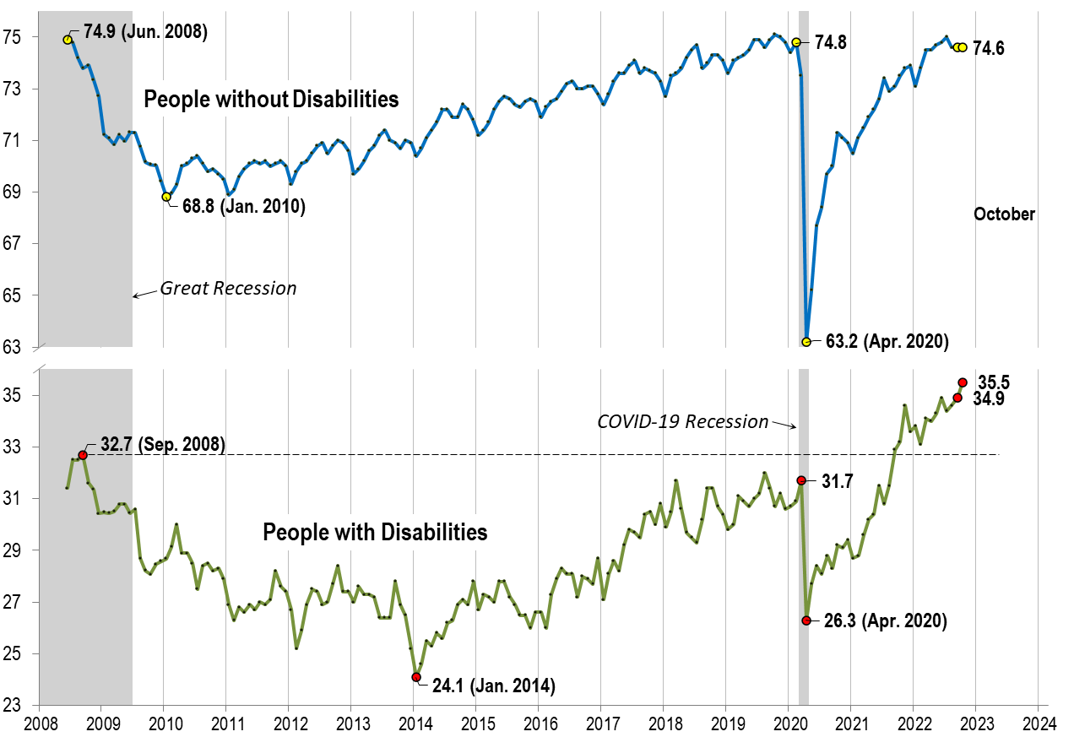
Employment -to- Population Ratio

Slide 12
Labor Force Participation Rate

Slide 13
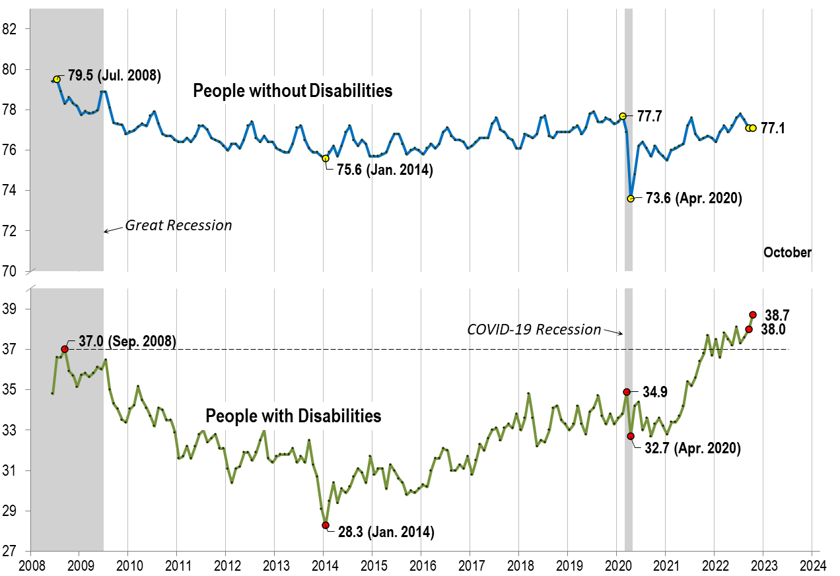
Labor Force Participation Rate

Slide 14
Number Unemployed
Mid-Month Update
Findings

Slide 15
Number Unemployed

Slide 16
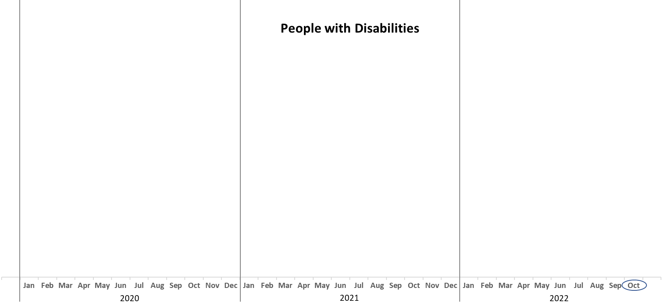
Number Unemployed

Slide 17
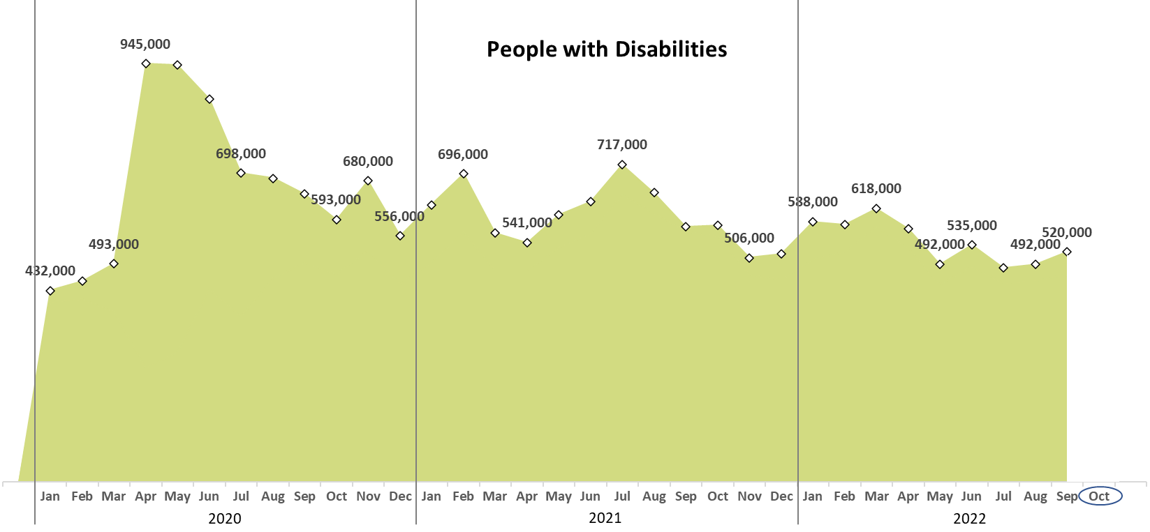
Number Unemployed

Slide 18
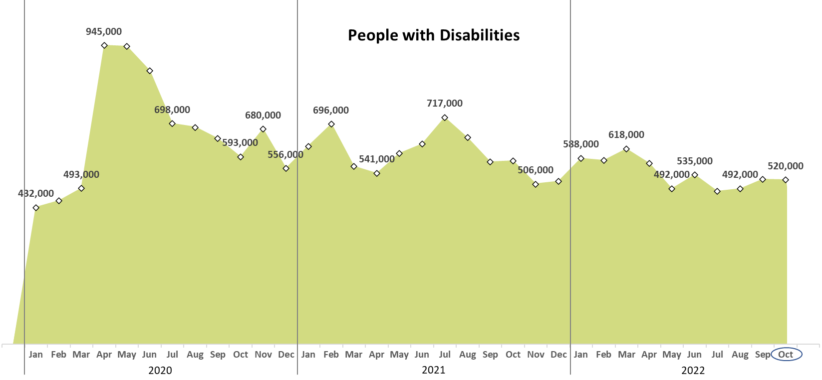
Number Unemployed

Slide 19
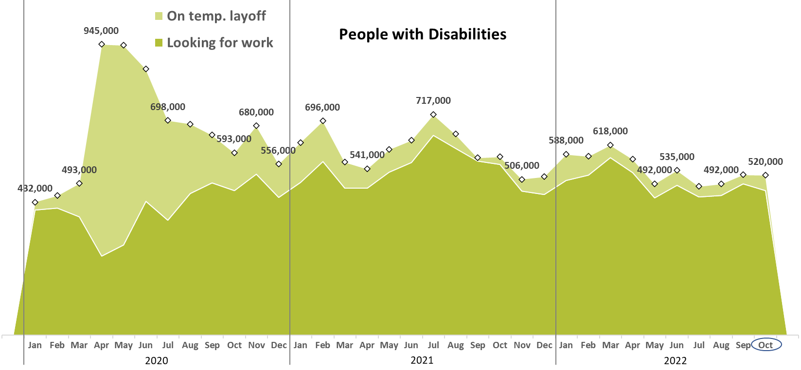
Number Unemployed

Slide 20
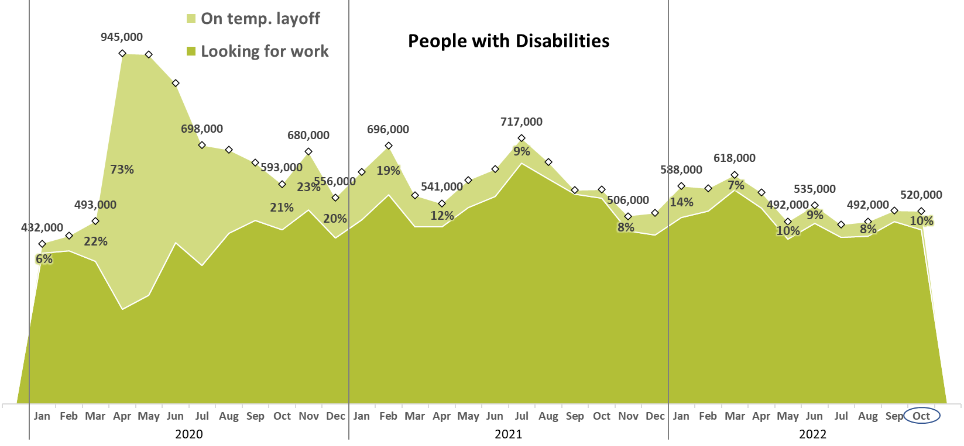
Number Unemployed

Slide 21
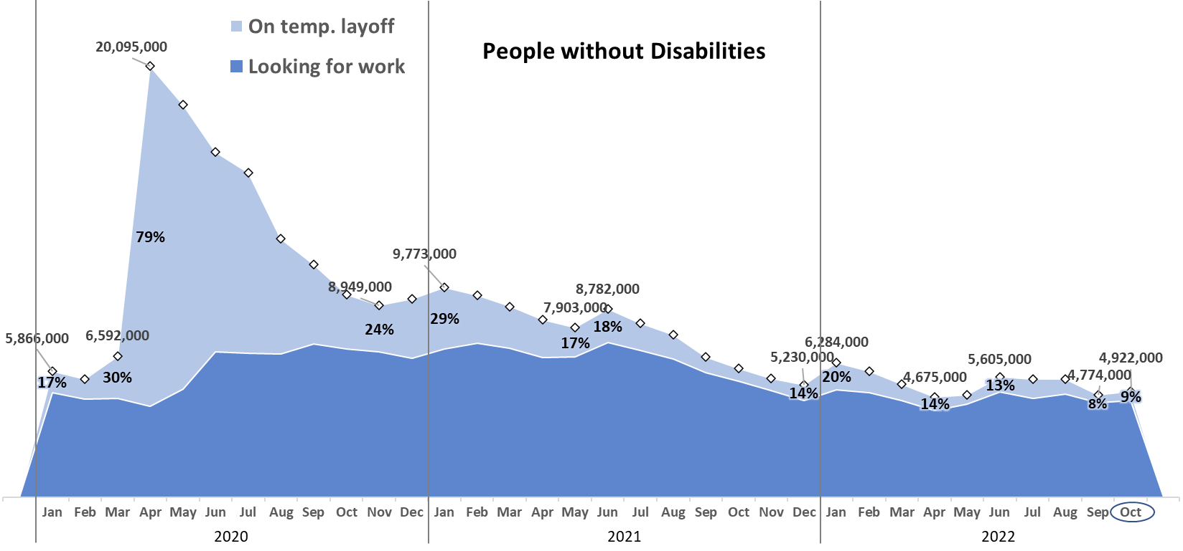
Number Unemployed

Slide 22
Q & A
Use “Q&A” button on Zoom to ask a questions
Slides will be archived at  https://www.researchondisability.org/ntide-episodes-list
Take our feedback survey at  https://www.researchondisability.org/ntide-episodes-list

Slide 23
Thank You!
Thanks to our partners: - UNH/Institute on Disability (www.ResearchOnDisability.org) - Kessler Foundation (www.KesslerFoundation.org) - AUCD (www.AUCD.org)
Contact us: - Email: Disability.Statistics@unh.edu - Call: 866-538-9521 (toll free)
Twitter at #nTIDELearn

Slide 24
Thank You!
Thanks to our partners: - UNH/Institute on Disability (www.ResearchOnDisability.org) - Kessler Foundation (www.KesslerFoundation.org) - AUCD (www.AUCD.org)
Contact us: - Email: Disability.Statistics@unh.edu - Call: 866-538-9521 (toll free)
Twitter at #nTIDELearn

