Slide 1
nTIDE Lunch & Learn Webinar Series
Kessler Foundation, AUCD, University of New Hampshire Institute on Disability Season 7, Episode 12 Date: December 2, 2022

Slide 2
nTIDE Lunch & Learn Webinar Series
Kessler Foundation, AUCD, University of New Hampshire Institute on Disability Season 7, Episode 12 Date: December 2, 2022

Slide 3
Up Front Matters
This webinar is being recorded. We will post an archive of along side the Monthly nTIDE broadcast on our webinar, each month, on our website at www.researchondisability.org/nTIDE. This site will also provide copies of the presentations, the speakers’ bios, full transcripts, and other valuable resources.
As an attendee of this webinar, you are a viewer. To ask questions of the speakers, click on the Q & A box on your webinar screen and type your questions into the box. Speakers will review these questions and provide answers during the last section of the webinar. Some questions may be answered directly in the Q & A box.

Slide 4
Up Front Matters
If you have any questions following this recording, please contact us at disability.statistics@unh.edu, or toll free at 866-538-9521 for more information. Thanks for joining us. Enjoy today's webinar!

Slide 5
Welcome
Debra Brucker University of New Hampshire

Slide 6
ASL Interpreter
We recommend using a computer or laptop (not a phone or tablet), if you want to see the gallery of speakers and the interpreter.

Slide 7
Zoom Tips
Zoom Tip #1: Sound
To select the speaker you want to use for today’s webinar, click on the up arrow next to Audio Settings, and then select one of the options.
Zoom Tip #2: Close Captioning
Click on Closed Caption, and then select Show Subtitle for subtitles, or select View Full Transcript to get a running transcript of the captions.
Your screen may
look a bit different

Slide 8
About nTIDE Lunch & Learn
Occurs at noon Eastern-time on the first Friday day of each month, with the release of the nTIDE Report.
A joint effort of the University of New Hampshire, Kessler Foundation, and the Association of University Centers on Disabilities (AUCD).

Slide 9
Today’s Program
Part 1: nTIDE Report … “The Numbers”
John O’Neill, Kessler Foundation
Debra Brucker, University of New Hampshire
Part 2: nTIDE News
Denise Rozell, Association of University Centers on Disabilities (AUCD)
Part 3: Guest Speaker
Chai Feldblum, AbilityOne
Part 4: Q&A

Slide 10
Part 1: The nTIDE Report
John O’Neill
Kessler Foundation

Slide 11
The Monthly nTIDE Report
The monthly nTIDE Report is a press release and infographic, looking at the latest employment statistics.
Uses data from the “jobs report” released by the U.S. Bureau of Labor Statistics, on the 1st Friday of each month.

Slide 12
Source of the Data
U.S. BLS, Current Population Survey (CPS).
Source of the “official” unemployment rate.
Civilians, ages 16-64, not living in institutions.
Available September 2008 onward.
Not yet seasonally adjusted.
which is why we compare to the same month last year.

Slide 13
The Numbers
Debra Brucker University of New Hampshire

Slide 14
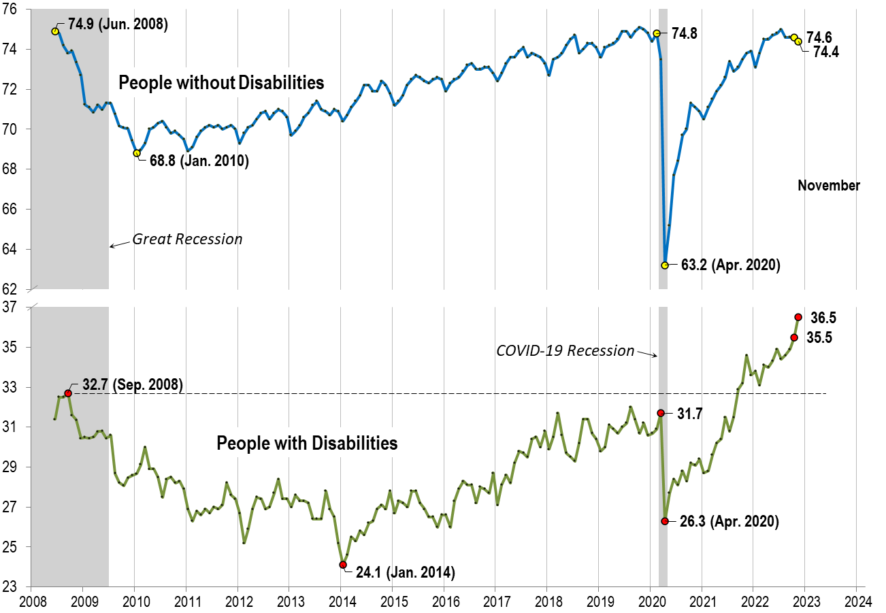
Employment -to- Population Ratio

Slide 15
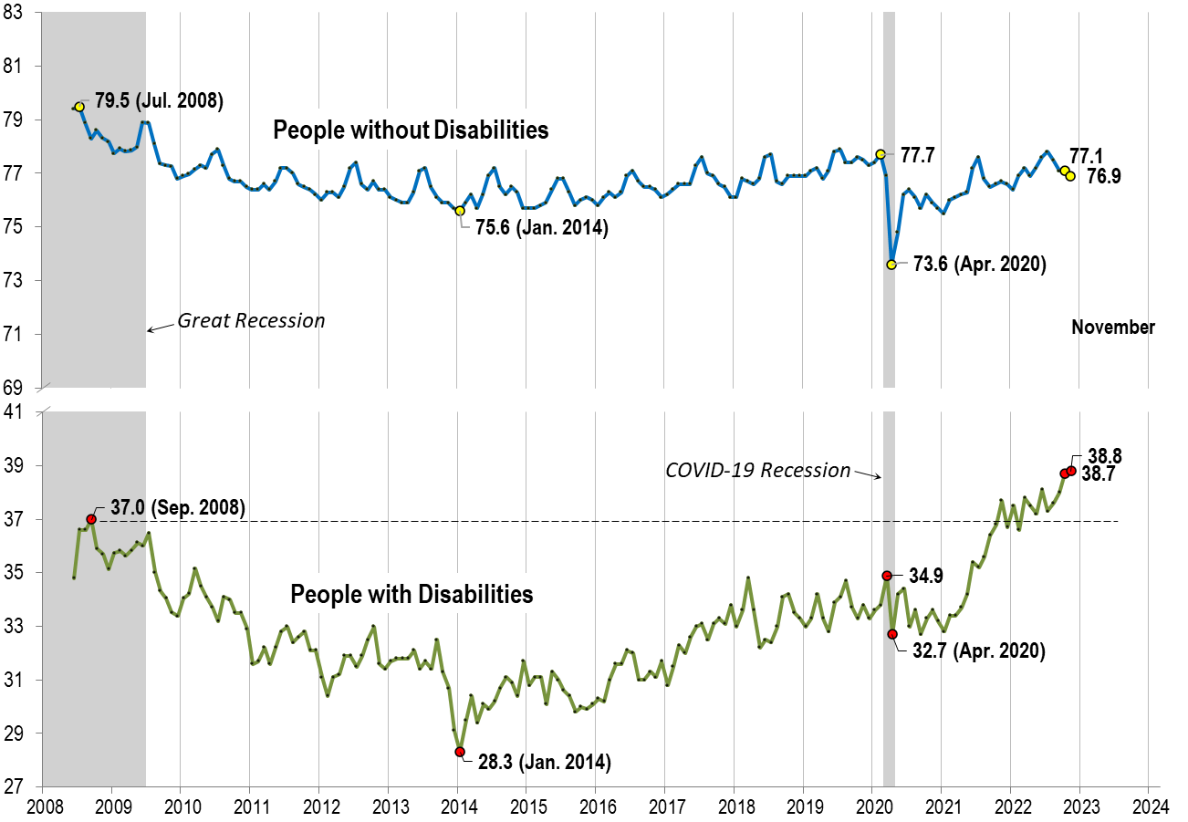
Labor Force Participation Rate

Slide 16
Part 2 nTIDE News
Denise Rozell
Association of University Centers on Disabilities (AUCD)

Slide 17
Federal Policy Update
ELECTIONS!!!
Possible legislation in lame duck session:
Continuing Resolution (CR) runs through December 16 – need to pass appropriations to avoid shut down! Omnibus? CR? December 23?
ABLE Age Adjustment Act -- S. 331, H.R. 1219
Make Money Follows the Person permanent
Make end to spousal impoverishment provisions permanent

Slide 18
New Resources on Improving Employment for Young Adults on the Autism Spectrum
Mathematica/ODEP: Research Support Services for Employment of Young Adults on the Autism Spectrum (REYAAS)
Explore issues of equity and intersectionality re employment challenges and solutions for young adults on the autism spectrum.
Learn more about REYAAS in this fact sheet
Report on listening sessions on employment and young adults with autism
Lit reviews on evidence of effectiveness of programs and models and programs, models, and strategies to support employment outcomes
Sources of data on employment outcomes for autistic youth

Slide 19
Neurodivergent in the Workplace Toolkit
ODEP-funded Employer Assistance and Resource Network on Disability Inclusion (EARN): helps businesses learn more about neurodiversity and how to recruit, hire, retain and advance neurodivergent people.
Benefits of hiring neurodivergent people
Profiles of leading companies and partners that have launched neurodiversity hiring initiatives
Enhanced sections on recruiting and hiring, accommodating and managing neurodivergent candidates and employees
Neurodiversity checklist summarizing lessons learned from successful neurodiversity hiring programs
Library of articles, blogs, videos and podcasts on the topic.

Slide 20
Mentra Featured in Microsoft Blog
Mentra is Reimagining Neurodiverse Employment - Microsoft Accessibility Blog
Came out right before Mentra spoke to us
Universal design “from the ground up”
Proactively recommending candidates to employers based on AI evaluation of core competencies
Includes upskilling

Slide 21
New CRS Report on Federal Hiring of People with Disabilities
Congressional Research Service report dated November 28, 2022
Recommendations:
Need more disability employment data – improve availability and quality of data;
EEOC’s final rule on affirmative action for people with disabilities in federal employment;
Federal agencies retention rates for employees with disabilities

Slide 22
JAN: Role Play Training Videos and Accompanying Presentations
The Job Accommodation Network (JAN) -- role play training videos and presentation slide decks
Depicting situations that are frequently experienced in the workplace
Scenarios in multiple industries with people of varying disabilities during all phases of the employee’s life cycle
Each scenario culminates in a solution to the accommodation situation highlighted.
Videos showing the accommodations and solutions are accompanied by a slide presentation providing learning points from the video.
Watch the Training Videos and Access Resources

Slide 23
Connecting Disability, Poverty, and Employment: Virginia VR’s Experience
“How do poverty, disability, and employment overlap and intersect? How do these intersections act as barriers to populations typically underserved by Vocational Rehabilitation services?” – Project E3; video
Describe key activities that improved quality employment outcomes for people with disabilities in underserved communities
Examples of strengthened relationships between agencies and community service providers
Lessons learned from participating in Project E3
How they will do things differently going forward
Give advice to other communities interested in implementing activities and strategies learned from Project E3.

Slide 24
Two Webinars on Advocacy and Ableism
"Our Disability Roadmap": Lydia X.Z. Brown talks with Samuel Habib about transition - Dec 8, 2022 03:00 PM in Eastern Time
Conversation about transition, including inclusive education, career pathways, higher education, advocacy, and much more. They will also take your questions live. ASL interpretation and captioning will be provided.
Webinar Registration – Zoom
Web series called the “Adjustable Table” by World Institute on Disability (WID)
WID’s Adjustable Table is a 4-part web series featuring conversations with multiply-marginalized leaders within the disability community.
First three episodes are out – first one on employment! The Adjustable Table: Employment Access with Haben Girma - YouTube

Slide 25
Watch Party! State and Tribal VR Working Together
State and Tribal VR Working Together: Partnerships that allow Students and Youth with Disabilities to Succeed
December 7, 2022 12-1:30 Eastern
Importance MOU/MOA between State and Tribal VR.
Examples of effective roles, relationships, and communications between partners.
Identify promising programs and practices when State and Tribal VR work together effectively Access to resources that will assist in developing new partnerships or strengthening existing partnerships.
The "Watch Party" includes a pre-recorded presentation with opportunities for interactive conversation; ask questions, share ideas, and hear from other professionals in the field around the country.

Slide 26
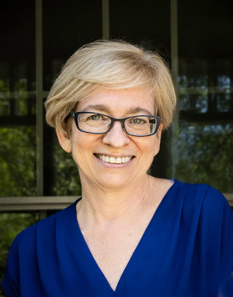
Part 3: nTIDE Guest Speaker
Chai Feldblum
AbilityOne

Slide 27
The AbilityOne Program: Past, Present and Future
Chai Feldblum
Vice Chairperson
U.S. AbilityOne Commission
cfeldblum@abilityone.gov

Slide 28
Historical Perspective
1938 – Wagner-O’Day Act
Establishes employment program for people who are blind through the sale of products to Government customers
Establishes Federal agency
Establishes a mandated 75% direct labor hour ratio
1971 – Javits-Wagner-O’Day Act
Includes people with significant disabilities in employment program, and delivery of services to Government customers
Provides Federal agency with a full-time civil servant staff
No significant legislative updates since the 1970s

Slide 29
Traditional Lines of Business
Products & Manufacturing
Services
Office and Cleaning Products
Clothing, Textiles and Individual Equipment
Medical Supplies and Personal Protective Equipment
Food Processing, Packaging, and Distribution
Custodial Services
Grounds Maintenance
Food Services
Laundry Services
Mail Services
Warehousing and Distribution
Product Packaging and Kitting Services

Slide 30
New Lines of Business
Technology Services
Contract and Financial Support Services
Contact Center Services
Transcription
Document/Data Management
Digital Imaging
Cybersecurity
Software Testing
Section 508 Compliance
Prepare “Ready to close” Contract or Grant files
Pre-Award or Post-Award Administrative Services
Audit Readiness Support
Switchboard Operations
Order Processing
Contact Centers
Help Desk Support

Slide 31
AbilityOne’s Strategic Plan for FY2022-2026
Developed in accordance with the Government Performance and Results Act (GPRA).
Reflects a new approach to the AbilityOne Program.
Benefitted from input provided by a range of stakeholders.
Includes four Strategic Objectives, with corresponding outcome goals, strategies and 28 performance measurements.

Slide 32
1. Amend the JWOD Act to Advance CIE
Strategic Objective 1:
Transform the AbilityOne Program to expand competitive integrated employment (CIE) for people who are blind or have significant disabilities.
Be available and responsive to Members of Congress and staff if they decide to amend the JWOD Act.
Consistent with 898 Panel final report, work with fellow government agencies on proposal to amend the JWOD Act.

Slide 33
2. Modernize AbilityOne Internally
Strategic Objective 2:
Identify, publicize, and support the increase of good jobs and optimal jobs in the AbilityOne Program.
Good Jobs:
Individuals with disabilities are paid competitive wages and benefits;
Individuals are covered under employment laws.
The job matches the individual’s interests and skills, and includes the appropriate supports (“job customization”);
The agency offers person-centered employment plans to help employees with disabilities advance in their careers, with appropriate placement services.
Optimal jobs: Good jobs that take place in integrated work settings.

Slide 34
3. Ensure Good Governance Within AbilityOne
Strategic Objective 3:
Ensure effective governance and results across the AbilityOne Program.
Revise compliance requirements for NPAs to focus on good jobs (and optimal jobs, where possible) and on quality contract performance.
Ensure that the Cooperative Agreements with the CNAs implement the strategic direction of the AbilityOne Program.
Update and modernize the Commission’s data collection.

Slide 35
4. Get More Jobs for People with Significant Disabilities
Strategic Objective 4:
Engage in partnerships to increase employment for people who are blind or have significant disabilities within and beyond the AbilityOne Program.
Work with AbilityOne Representatives (ABORs) to create jobs in the AbilityOne Program.
Foster collaborative efforts with OPM, EEOC and OFCCP to increase employment for people with significant disabilities.

Slide 36
A Process of Change Management
Change is never easy. But it is possible.
The AbilityOne Commission now has a full complement of Commissioners (minus 1), including all four private citizen members.
The AbilityOne senior executive team is talented and committed to the strategic vision of the Commission.
This includes Kim Zeich, Executive Director; Marlin Paschal, General Counsel; Amy Jensen, Acting Deputy Director; and George Govan, Chief Financial Officer.

Slide 37
BE PART OF THE CHANGE EFFORT
We would love it!

Slide 38
Questions and Answers
Use Q&A button on Zoom
Slides will be archived at: https://researchondisability.org/home/ntide.
Take our feedback survey at …
www.researchondisability.org/ntide/ntide-survey

Slide 39
Thank You!
Information about the nTIDE partners may be found at
Kessler Foundation (www.kesslerfoundation.org)
UNH/Institute on Disability (www.ResearchOnDisability.org)
AUCD (www.AUCD.org)
Contact us at
Email: Disability.Statistics@unh.edu
Call: 866-538-9521 (toll free)
Twitter at #nTIDELearn

Slide 40
Bye!

