Slide 1
Disability Measurement and Eligibility Criteria
Operationalization of Disability in Surveys II

Slide 2
Agenda
Strengths and Limitations of Survey Modes
Internet Survey
Mail Survey
Phone Survey
In-person Survey
Existing Disability-Related Survey Data in the U.S.

Slide 3
Strengths and Limitations of Survey Modes

Slide 4
Internet Surveys
Strengths
Weaknesses
Access to unique populations like people with physical disabilities [6]
Saves time for researchers [6]
Affordable, lower cost [6]
Higher speed [6]
Visual, interactive, flexible [6]
Higher response rate [6]
Access issues [6]
Generating a sample from an online community [6]
High chance of non-response bias [6]
Over representation of better educated people with higher incomes [6]
Accessibility barriers [6]
This Photo by Unknown Author is licensed under CC BY-SA-NC

Slide 5
Mail Surveys
Strengths
Weaknesses
Geographical Stratification [5]
Honesty [5]
Convenience [5]
Coverage errors and lower response rates [5]
Questionnaire design can make or break the survey [5]
Accessibility Issues [5]
No control over completion of survey [5]

Slide 6
Don A. Dillman’s Total Design Method
Key Recommendations [8] –
Creating a respondent friendly survey
Including a stamped return envelope
Providing financial incentives
Personalizing correspondence
What is it? [8]
Recognized as state-of-the-art method for maximizing survey response rates
“Guarantees” 80% return rates on mail and internet surveys
Provides guiding principles for improving administrative detail
This Photo by Unknown Author is licensed under CC BY-SA-NC

Slide 7
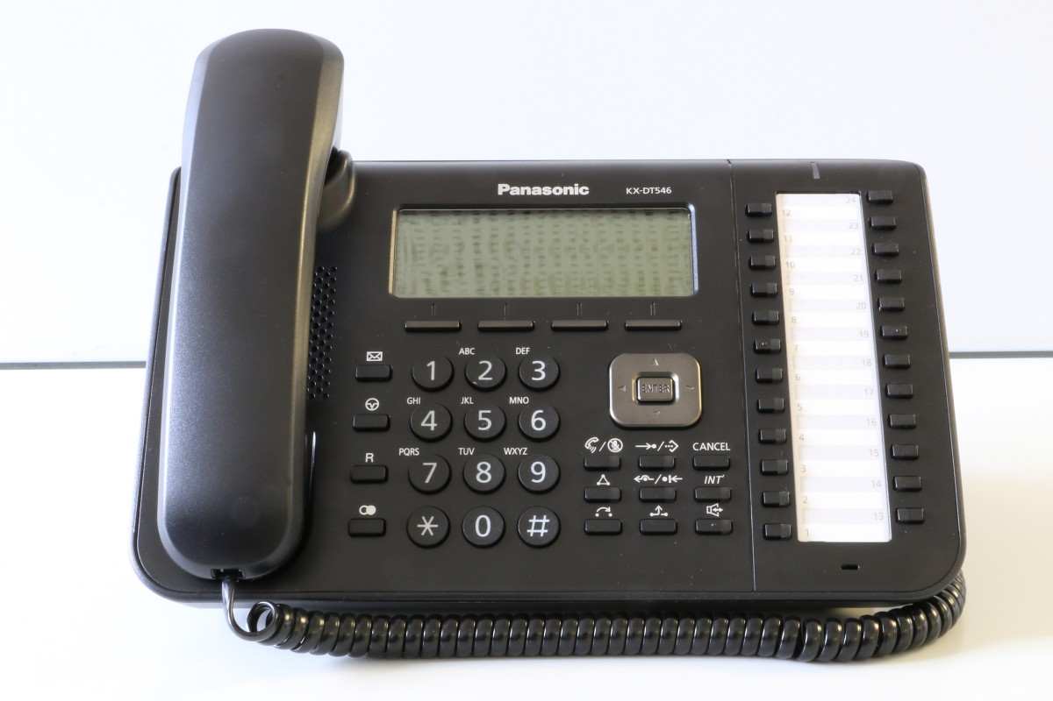
Telephone Surveys
Strengths
Weaknesses
Possibility of Random Digital Dialing (RDD) [4]
Good geographical coverage [4]
Personal interaction
Lower cost compared to face-to-face [4]
Interviewer Bias [4]
Lower response rate [4]
Inability to use visual help [4]
May exclude people with hearing difficulties [4]

Slide 8
In-person Surveys
Strengths
Weaknesses
Clearly structured [4]
Flexible and adaptable [4]
Personal touch [4]
Interviewer Bias [4]
Higher cost per respondent [4]
Geographical limitations [4]
Time pressure on respondents [4]
More susceptible to social desirability bias [4]

Slide 9
Think Out Loud
Who may be underrepresented in each of these modes of surveys?

Slide 10
Existing Disability-Related Survey Data
There is an effort to use a uniform set of disability indicators across national surveys [7]
Few surveys contain measures to identify people with cognitive and intellectual disability
Few surveys contain measures to identify specific health conditions underlying disability
Many national surveys have longitudinal components [7]

Slide 11
Conclusion
Disability prevalence can vary significantly depending on how the question is asked
Different survey modes have different strengths and weaknesses
There is an effort to use standard disability indicators across surveys
Few surveys contain measures to identify people with cognitive and intellectual disabilities

Slide 12
References
Krahn GL, Walker DK, Correa-De-Araujo R. Persons with disabilities as an unrecognized health disparity population. Am J Public Health. 2015 Apr;105 Suppl 2:S198-206.
https://www.washington.edu/doit/sites/default/files/atoms/files/RESPECT_2020_DisabilityData.pdf
https://www.unescap.org/sites/default/d8files/8.%20Part%20One_Chapter%203.pdf
https://www.sciencedirect.com/science/article/pii/S2212977413000331
https://nationalpublicresearch.com/services/mail-surveys/
https://academic.oup.com/jcmc/article/10/3/JCMC1034/4614509
https://aspe.hhs.gov/reports/disability-data-national-surveys-0#overview
https://escholarship.umassmed.edu/cgi/viewcontent.cgi?article=1017&context=pib
​

Slide 13
Answer key
1. (Slide 10) Even minor changes in question wording can impact how people respond and research comparing the 6QS to the WGSS has found that more people tend to report a disability on the ACS 6QS than the WGSS if we use the top 2 response options to count someone as having a disability. It’s useful to note that generally speaking, this does not appear to be biasing. That is, if you are interested in studying the relationship to other outcomes, the disability measurement method does not impact those estimates. While estimates vary a bit, about 16% on the ACS and 9% on the NHIS - one is not “more correct” than the other. Disability can be measured different ways and we will get different estimates depending on mode of operationalization, or due to other methodological differences.

Slide 14
Survey Rules, Concepts and Definitions (ACS)
Living Quarters
Interview rules
Interview rules
Housing Units
Group Quarters
Group of rooms
Separate living quarters
Group homes
Correctional facilities
College dormitories
House
Apartment
Residence rules
Selected Survey Respondents

Slide 15
Structure of the ACS Questionnaire
American Community Survey (ACS)
Household Information
Basic Demographic Information
Detailed Housing Information
Detailed Population Information
Housing unit
Housing unit status
Household
Household roster
Household respondent
Householder
Sex
Age and Date of Birth
Relationship
Hispanic origin
Race
Units in structure
Year Structure Built
Acreage
Business on property
Rooms
Kitchen
Telephone and computer
Place of Birth
Citizenship
Educational attainment
Health insurance
Language spoken at home
Disability
Fertility
Marital status

