Slide 1
nTIDE Lunch & Learn Webinar Series
Kessler Foundation, AUCD, University of New Hampshire Institute on Disability Season 7, Episode 7 Date: July 8, 2022

Slide 2
nTIDE Lunch & Learn Webinar Series
Kessler Foundation, AUCD, University of New Hampshire Institute on Disability Season 7, Episode 7 Date: July 8, 2022

Slide 3
Up Front Matters
This webinar is being recorded. We will post an archive of along side the Monthly nTIDE broadcast on our webinar, each month, on our website at www.researchondisability.org/nTIDE. This site will also provide copies of the presentations, the speakers’ bios, full transcripts, and other valuable resources.
As an attendee of this webinar, you are a viewer. To ask questions of the speakers, click on the Q & A box on your webinar screen and type your questions into the box. Speakers will review these questions and provide answers during the last section of the webinar. Some questions may be answered directly in the Q & A box.

Slide 4
Up Front Matters
If you have any questions following this recording, please contact us at disability.statistics@unh.edu, or toll free at 866-538-9521 for more information. Thanks for joining us. Enjoy today's webinar!

Slide 5
Welcome
Andrew Houtenville University of New Hampshire

Slide 6
ASL Interpreter
We recommend using a computer or laptop (and not a phone or tablet), if you want to see the gallery of speakers and the interpreter.

Slide 7
Zoom Tips
Zoom Tip #1: Sound
To select the speaker you want to use for today’s webinar, click on the up arrow next to Audio Settings, and then select one of the options.
Zoom Tip #2: Close Captioning
Click on Closed Caption, and then select Show Subtitle for subtitles, or select View Full Transcript to get a running transcript of the captions.
Your screen may
look a bit different

Slide 8
2022 Annual Disability Statistics Conference
The State of the Science on Disability Statistics Conference is being deferred to October 6-7, 2022. in Washington DC and Online.
Register at … https://DisabilityCompendium.org/event

Slide 9
About nTIDE Lunch & Learn
Occurs at noon Eastern-time on the first Friday day of each month, with the release of the nTIDE Report.
A joint effort of the University of New Hampshire, Kessler Foundation, and the Association of University Centers on Disabilities (AUCD).

Slide 10
Today’s Program
Part 1: nTIDE Report … “The Numbers”
John O’Neill, Kessler Foundation
Andrew Houtenville, University of New Hampshire
Part 2: nTIDE News
Denise Rozell, Association of University Centers on Disabilities (AUCD)
Part 3: Guest Speakers
Dorothy Garcia, Disability:IN
Part 4: Q&A

Slide 11
Part 1: The nTIDE Report
John O’Neill
Kessler Foundation

Slide 12
The Monthly nTIDE Report
The monthly nTIDE Report is a press release and infographic, looking at the latest employment statistics.
Uses data from the “jobs report” released by the U.S. Bureau of Labor Statistics, on the 1st Friday of each month.

Slide 13
Source of the Data
U.S. BLS, Current Population Survey (CPS).
Source of the “official” unemployment rate.
Civilians, ages 16-64, not living in institutions.
Available September 2008 onward.
Not yet seasonally adjusted.
which is why we compare to the same month last year.

Slide 14
The Numbers
Andrew Houtenville University of New Hampshire

Slide 15
Employment -to- Population Ratio

Slide 16
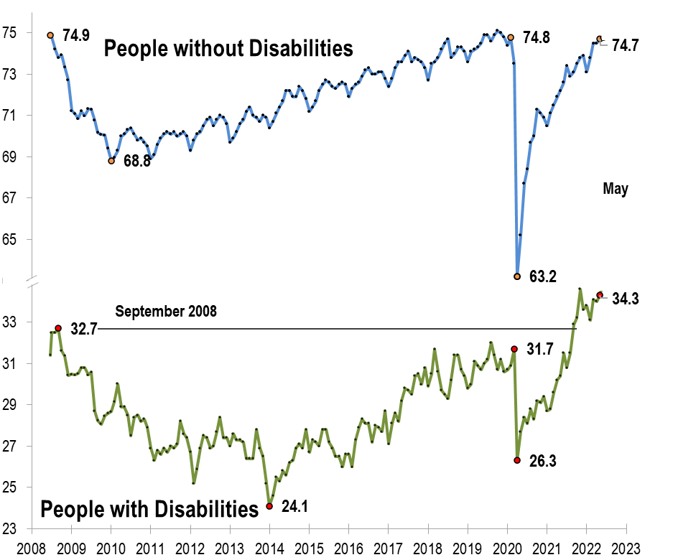
Employment -to- Population Ratio

Slide 17
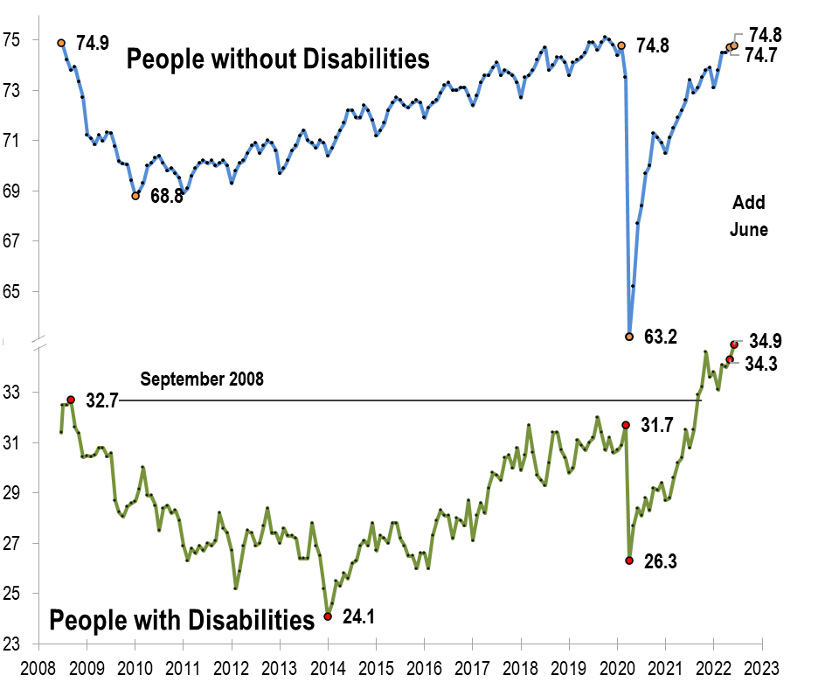
Employment -to- Population Ratio

Slide 18
Labor Force Participation Rate

Slide 19
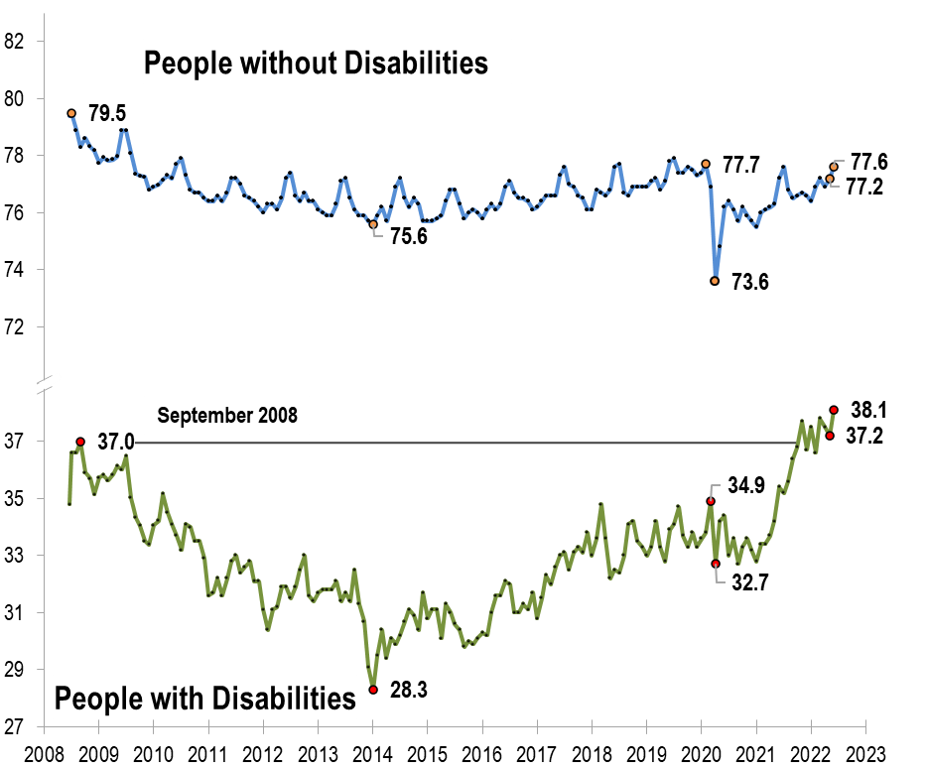
Labor Force Participation Rate

Slide 20
Part 2 nTIDE News
Denise Rozell
Association of University Centers on Disabilities (AUCD)

Slide 21
Federal Policy Update
ABLE Age Adjustment (S.331/H.R. 1219)
Included in Senate Finance Committee retirement tax package, Enhancing American Retirement Now (EARN) Act
Raising the age of disability onset for accessing an ABLE account from 26 to 46;
Age raise would go into effect in 2026.
Does NOT include (yet?) SSI Savings Penalty Elimination Act (S. 4102) to expand SSI savings to $10,000/$20,000
Newest states to prohibit 14c/subminimum wage: Rhode Island (June 15, 2022) and South Carolina!!! (June 1, 2022)
All states with legislation prohibiting 14c : Alaska, Maine, Maryland, New Hampshire, Oregon, Washington, Hawaii, Colorado, California, Delaware, Tennessee, Rhode Island & South Carolina

Slide 22
More Federal Policy Update
New Field Assistance Bulletin on Subminimum Wage:
June 16 from the U.S. Department of Labor;
Employers must pay full$7.25 federal minimum wage if can’t demonstrate requirements under WIOA for age 24 and under –
received transition services;
pursued employment through VR;
provided I&R to other options in their area; and
for those being paid less than minimum wage must receive career counseling and information about training opportunities once every 6 months during the first year and annually after that.
Must have full documentation for all!

Slide 23
RFI: Current Population Survey Disability Supplement 2024
The Department of Labor issued RFI June 24, 2022 re a supplement to the Current Population Survey on disability employment issues.
Conducted by the Bureau of Labor Statistics and the Census Bureau;
Comments due August 8, 2022;
Expected to be fielded in 2024;
Gathering information to help revise the CPS Disability Supplement and to inform its general disability employment research agenda.
Read the Request for Information
Provide Comments Here

Slide 24
Disparate Treatment of Puerto Rico Residents with Disabilities in Federal Programs and Benefits
National Council on Disability, May 2022 – written prior to but released after recent Supreme Court decision United States v. Vaello-Madero
Looks at experiences of people with disabilities and federal safety net programs. Includes:
Medicaid,
Medicare,
Social Security Disability Insurance (SSDI),
Supplemental Security Income (SSI), and
Supplemental Nutrition Assistance Program (SNAP). The report provides Congress with the necessary information to support extending safety net benefits to residents in Puerto Rico and the U.S. territories.

Slide 25
Disability and Remote Work during COVID
Kruse, D., Park, S.R., van der Meulen Rodgers, Y. et al. Disability and remote work during the pandemic with implications for cancer survivors. J Cancer Surviv 16, 183–199 (2022).
Using data on COVID-19 from Current Population Survey from May 202- June 2021 to compare people with and without disabilities;
Workers with disabilities more likely to be teleworking before the pandemic, but less likely to be teleworking as a result of the pandemic;
Primarily due to types of jobs held by people with disabilities;
People with disabilities experienced more pandemic-related hardships -- greater chance of not being able to work due to employer losing business and more difficulty in accessing medical care

Slide 26
Disability and the Digital Divide
Disability and the Digital Divide: Internet Subscriptions, Internet Use and Employment Outcomes
ODEP publication;
Data from 2015-2019;
Includes overview of literature;
Analyzes data on internet subscriptions, internet use and employment status;
Gap between computing devices and the internet disproportionately impacts people with disabilities;
Creates barriers to prepare for, obtain and succeed in employment;
Policy analysis can help improve socioeconomic outcomes.

Slide 27
Performance Management for All Employees
EARN (Employer Assistance and Resource Network on Disability Inclusion) has developed Performance Management web page for employees with disabilities (and really all employees)
Same performance expectations for people with disabilities as for all employees;
Equal access to feedback;
Strategies, tools, resources; links:
Behavioral expectations of the organization;
Performance expectations;
Setting achievable goals;
Ongoing feedback;
What about when individual’s disability may influence a performance issue?

Slide 28
Webinar: State Settlements and Competitive Integrated Employment - Rhode Island's Story
Changes in RI for people with ID/DD in Competitive Integrated Employment (CIE) since the 2014 settlement agreement with the U.S. Department of Justice.
History of RI’s Settlement Agreement and how it prompted an increase in CIE;
RI’s efforts to adopt CIE practices following a settlement agreement;
RI's efforts to transform providers and employment services;
Hear directly from those in CIE positions about how their employment has changed as a result of the settlements
Join the Webinar Wednesday, July 13, 3:00-4:30 P.M. ET

Slide 29
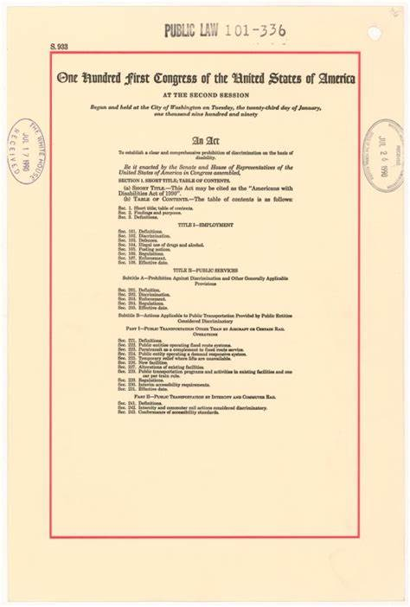
Happy ADA Anniversary Month!!!

Slide 30
Part 3: nTIDE Guest Speaker
Dorothy Garcia
Disability:IN

Slide 31
The 2021 Global Disability Equality Index pilot was launched in response to Disability:IN partners’ desire to benchmark inclusion efforts around the world, both within their own brand as well as other industries. Disability:IN plans to continue the Global DEI with the goal of including more companies and countries on an annual basis, and will open registration to a larger group of companies in July 2022.
Disability:IN
PILOT ROUND
40 participating companies, 30 countries, 100+ submissions
Increased our knowledge of existing legal frameworks outside of the U.S.
Learned from partners about cultural mores and ways to make the Global DEI accessible and relevant to non-U.S. audiences.
A JOINT INITIATIVE:
31

Slide 32
Pilot Findings
Satellite locations/markets need in-country, local leaders who have lives experience with disability and/or are strong allies for the disability community
Employees with disabilities can best identify gaps and opportunities for change
Disability allies were more likely to encourage deeper engagement (i.e., targeted outreach to potential candidates, community activities, increased attention to accessibility and inclusive communication)
Inclusive leadership needs to come from multiple levels
Pilot data shows that having support from the C-suite + an active ERG + an in-country leader who is an ally is the best indicator for success
Global DEI establishes a baseline for inclusion that can be adapted to differing cultural contexts
When it comes to company-wide policy, satellite locations need leeway in order to implement in a way that makes sense for their culture
Inclusion efforts are more impactful when satellite locations/markets take ownership
Global DEI establishes a system to assess whether baseline goals are being met across the globe

Slide 33
Pilot Findings (cont’d)
Participating Countries:
Argentina
Australia
Belgium
Brazil
Canada
Chile
China
Colombia
Costa Rica
Dominican Republic
France
Germany
Hong Kong
India
Israel
Ireland
The pandemic as a catalyst for action
Increase in mental health benefits
Emphasis on retention and advancement of diverse hires
Unfilled positions spur interest in talent pool of disability candidates
Increased allyship from C-suite executives
Satellite locations with an active ERG + in-country leader known as a disability ally performed better on Enterprise-Wide Access, Adjustment & Accommodations, Employment Practices
Companies motivated to lay the groundwork for self-ID campaigns
Italy
Malaysia
Mexico
Morocco
Pakistan
Philippines
Poland
Portugal
Singapore
South Africa
Spain
Switzerland
United Arab Emirates
United Kingdom
A JOINT INITIATIVE:

Slide 34
Building disability inclusion into the global marketplace
WHY FOCUS ON INCLUSION?
Market share and spending power of people with disabilities
Disability as an asset, not a liability, as it’s part of the human experience
Accessibility support for clients and customers
Rethink accessibility from client perspective
Broaden your reach
Companies have an opportunity to brand themselves as pioneers and drivers of inclusion
WHY NOW?
Pandemic + current events have laid bare inequalities, including marketplace access
Digital workplaces = more people with disabilities have the chance to engage and connect
Hunger for human connection through stories and representation
Chance to reimagine strategies for outreach, rather than returning to business as usual

Slide 35
Questions and Answers
Use Q&A button on Zoom
Slides will be archived at: https://researchondisability.org/home/ntide.
Take our feedback survey at …
www.researchondisability.org/ntide/ntide-survey

Slide 36
Thank You!
Information about the nTIDE partners may be found at
Kessler Foundation (www.kesslerfoundation.org)
UNH/Institute on Disability (www.ResearchOnDisability.org)
AUCD (www.AUCD.org)
Contact us at
Email: Disability.Statistics@unh.edu
Call: 866-538-9521 (toll free)
Twitter at #nTIDELearn

Slide 37
Bye!

