Slide 1
nTIDE Lunch & Learn Webinar Series
Kessler Foundation, AUCD, University of New Hampshire Institute on Disability COVID Update Date May 20, 2022

Slide 2
nTIDE Lunch & Learn Webinar Series
Kessler Foundation, AUCD, University of New Hampshire Institute on Disability COVID Update Date: May 20, 2022

Slide 3
Up Front Matters
This webinar is being recorded. We will post an archive of along side the Monthly nTIDE broadcast on our webinar, each month, on our website at www.researchondisability.org/nTIDE. This site will also provide copies of the presentations, the speakers’ bios, full transcripts, and other valuable resources.
As an attendee of this webinar, you are a viewer. To ask questions of the speakers, click on the Q & A box on your webinar screen and type your questions into the box. Speakers will review these questions and provide answers during the last section of the webinar. Some questions may be answered directly in the Q & A box.

Slide 4
Up Front Matters
If you have any questions following this recording, please contact us at disability.statistics@unh.edu, or toll free at 866-538-9521 for more information. Thanks for joining us. Enjoy today's webinar!

Slide 5
ASL Interpreter
We recommend using a computer or laptop (and not aa phone or tablet), if you want to see the gallery of speakers and the interpreter.

Slide 6
Zoom Tips
Zoom Tip #1: Sound
To select the speaker you want to use for today’s webinar, click on the up arrow next to Audio Settings, and then select one of the options.
Zoom Tip #2: Close Captioning
Click on Closed Caption, and then select Show Subtitle for subtitles, or select View Full Transcript to get a running transcript of the captions.
Your screen may
look a bit different

Slide 7
2022 State of the Science Conference on Disability Statistics
October 6-7, 2022
Zoom Broadcast, Live from Washington DC
Live “studio audience” in ballroom of .
Register at …
https://www.researchondisability.org/annual-event

Slide 8
COVID-19 Update
Andrew Houtenville
University of New Hampshire
John O’Neill
Kessler Foundation
Denise Rozell
Association of University Centers on Disabilities

Slide 9
Today’s Agenda
● 12:00 pm: Welcome and Introduction
● 12:05 pm: Updated Numbers from the Public-Use Micro Data of the Current Population Survey
● 12:35 pm: Open Q&A period

Slide 10
Employment -to- Population Ratio
Findings in the
nTIDE (First Friday) Report

Slide 11
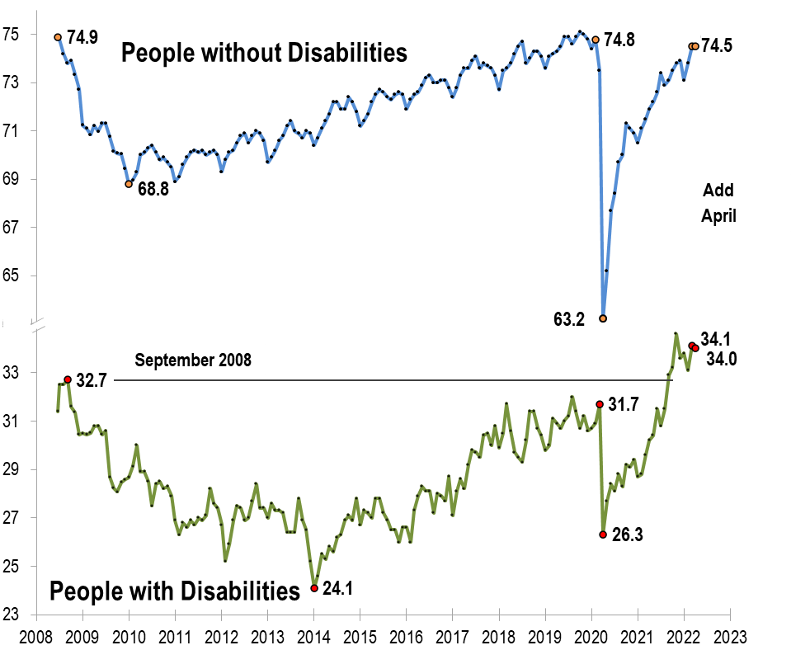
Employment -to- Population Ratio

Slide 12
Labor Force Participation Rate

Slide 13
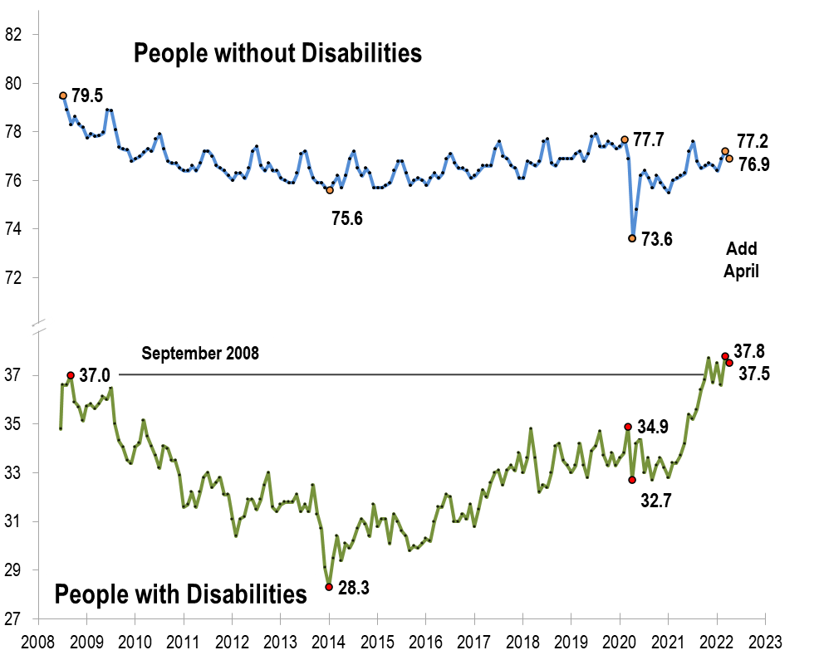
Labor Force Participation Rate

Slide 14
Number Unemployed
COVID Update
Findings

Slide 15
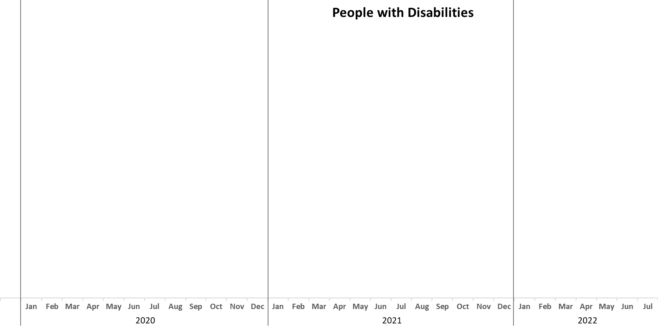
Number Unemployed

Slide 16
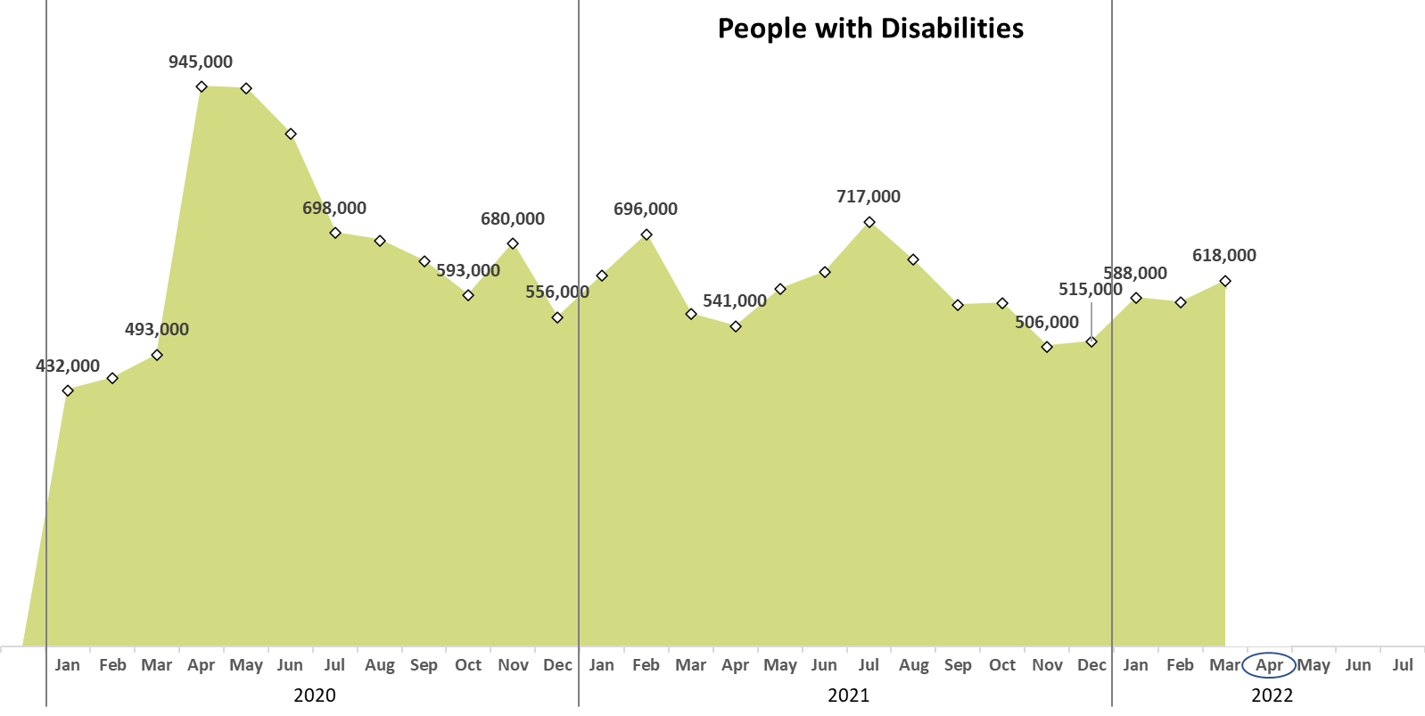
Number Unemployed

Slide 17
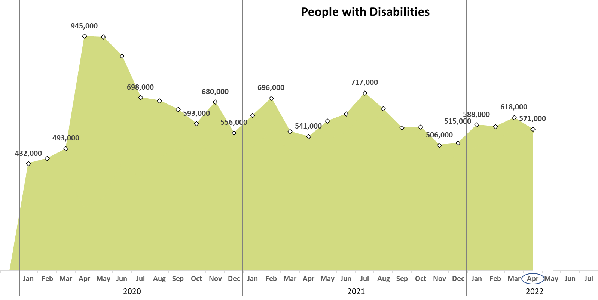
Number Unemployed

Slide 18
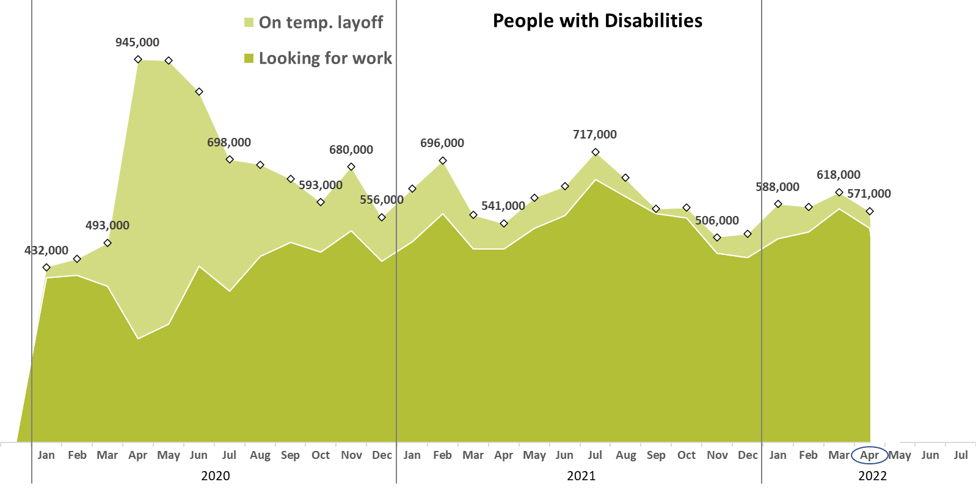
Number Unemployed

Slide 19
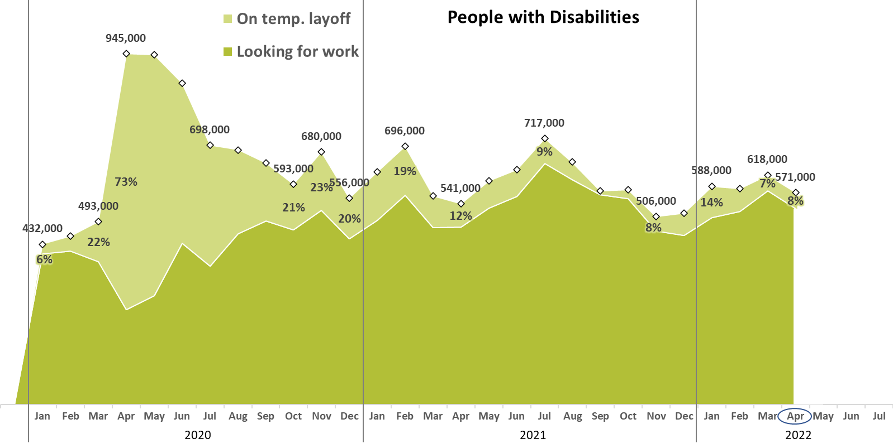
Number Unemployed

Slide 20
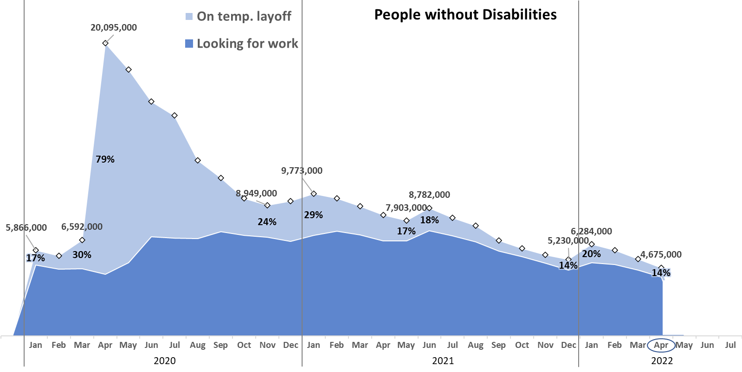
Number Unemployed

Slide 21
Logistic Items
Use “Q&A” button on Zoom to ask a questions
Slides will be archived at - https://researchondisability.org/home/ntide
Take our feedback survey at - https://researchondisability.org/home/ntide

Slide 22
Thank You!
Thanks to our partners: - UNH/Institute on Disability (www.ResearchOnDisability.org) - Kessler Foundation (www.KesslerFoundation.org) - AUCD (www.AUCD.org)
Contact us: - Email: Disability.Statistics@unh.edu - Call: 866-538-9521 (toll free)
Twitter at #nTIDELearn

Slide 23
Thank You!
Thanks to our partners: - UNH/Institute on Disability (www.ResearchOnDisability.org) - Kessler Foundation (www.KesslerFoundation.org) - AUCD (www.AUCD.org)
Contact us: - Email: Disability.Statistics@unh.edu - Call: 866-538-9521 (toll free)
Twitter at #nTIDELearn

