Slide 1
nTIDE Lunch & Learn Webinar Series
Kessler Foundation, AUCD,
University of New Hampshire Institute on Disability
COVID Update
Date: February 18, 2022

Slide 2

nTIDE Lunch & Learn Webinar Series
Kessler Foundation, AUCD,
University of New Hampshire Institute on Disability
COVID Update
Date: February 18, 2022

Slide 3
Up Front Matters
This webinar is being recorded. We will post an archive of along side the Monthly nTIDE broadcast on our webinar, each month, on our website at www.researchondisability.org/nTIDE. This site will also provide copies of the presentations, the speakers’ bios, full transcripts, and other valuable resources.
As an attendee of this webinar, you are a viewer. To ask questions of the speakers, click on the Q & A box on your webinar screen and type your questions into the box. Speakers will review these questions and provide answers during the last section of the webinar. Some questions may be answered directly in the Q & A box.

Slide 4
Up Front Matters
If you have any questions following this recording, please contact us at disability.statistics@unh.edu, or toll free at 866-538-9521 for more information. Thanks for joining us. Enjoy today's webinar!

Slide 5
Welcome!
Just so you know…
We recently started to include ASL Interpretation to be more accessible.
If you would like to see the gallery of speakers as well as the interpreter, we recommend joining from a computer rather than a phone or tablet.

Slide 6
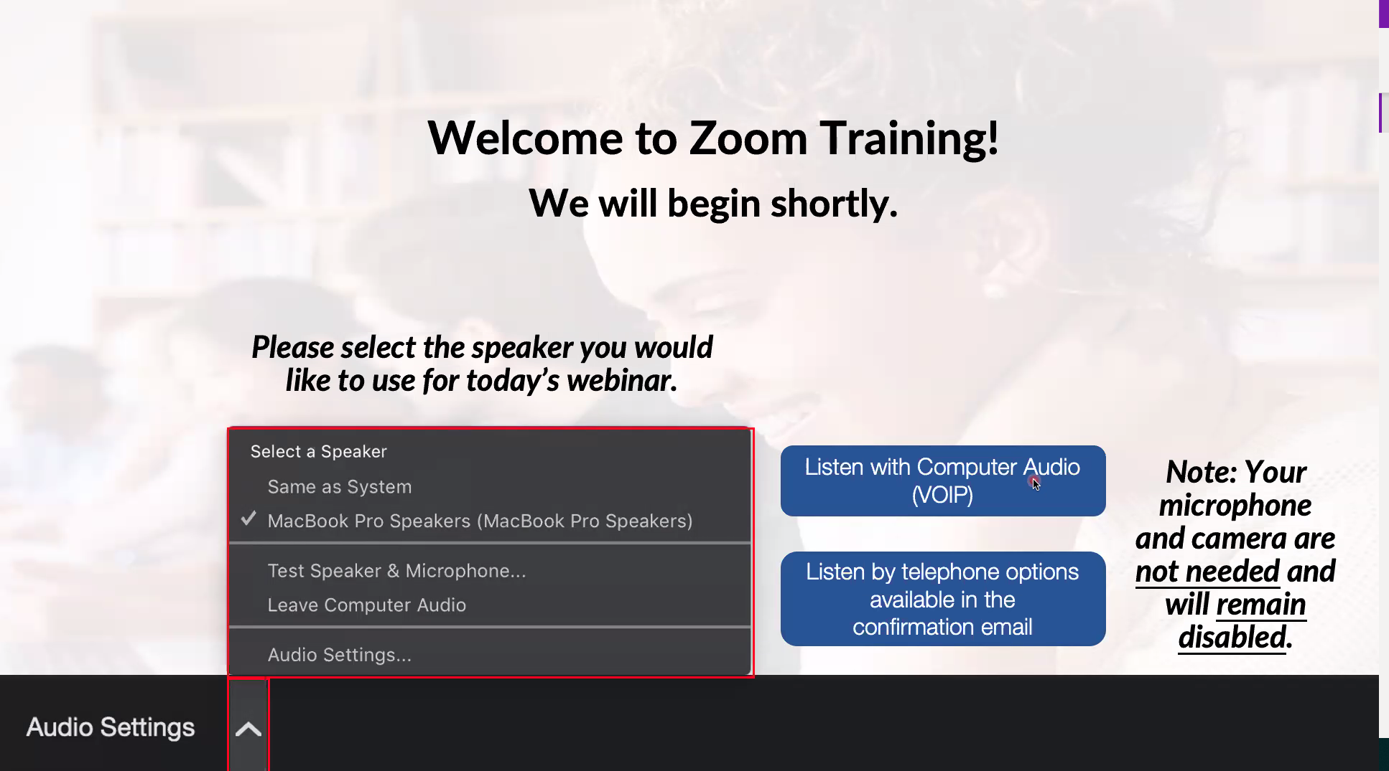
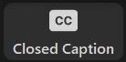
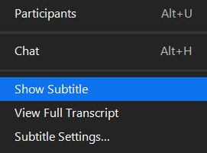
Zoom Tips
Tip #1: Sound
  Select the speakers you want to use for today’s webinar, click on the up arrow next to Audio Settings, and then select one of the options.
Tip #2: Close Captioning
  Click on Closed Caption, and then select Show Subtitle for subtitles, or select View Full Transcript to get a running transcript of the captions.
Your screen may
look a bit differ

Slide 7
COVID-19 Update
and the 2021 Year-in-Review
Andrew Houtenville
University of New Hampshire
John O’Neill
Kessler Foundation

Slide 8
About
A joint effort of the University of New Hampshire, Kessler Foundation, and the Association of University Centers on Disabilities (AUCD).
This is a special episode of the nTIDE Lunch and Learn series based on the unique circumstances in the U.S. economy and the COVID-19 Pandemic.

Slide 9
Today’s Agenda
● 12:00 pm: Welcome and Introduction
● 12:05 pm: Updated Numbers from the Public-Use Micro Data of the Current Population Survey
● 12:35 pm: Open Q&A period

Slide 10
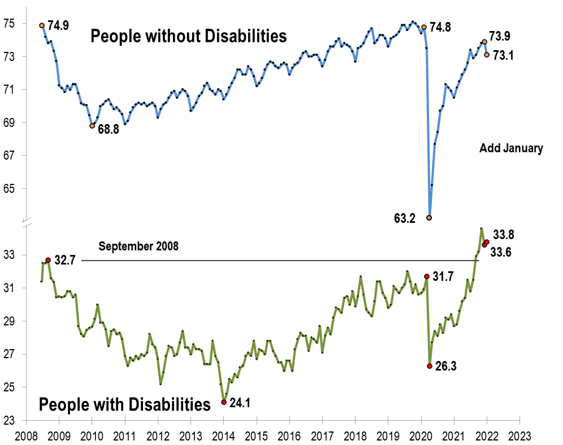
Employment
-to-
Population
Ratio

Slide 11
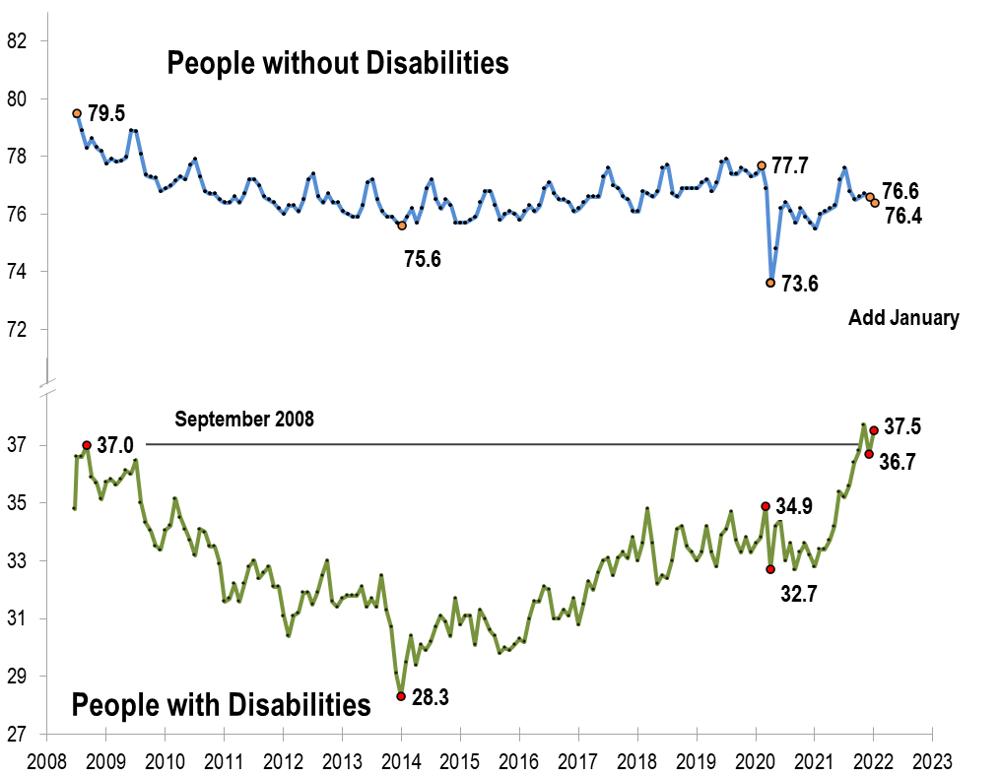
Labor
Force
Participation
Rate

Slide 12
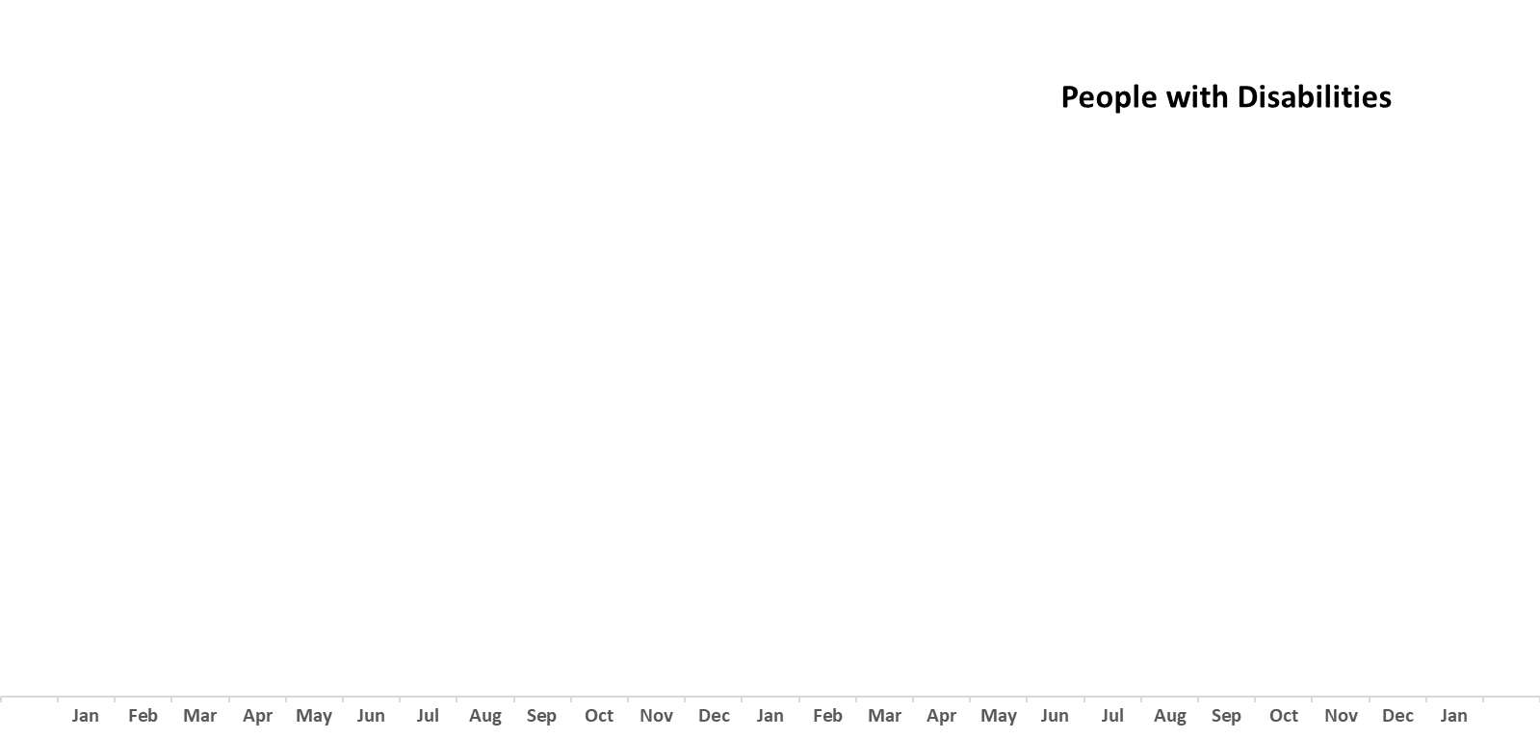
Number
Unemployed

Slide 13
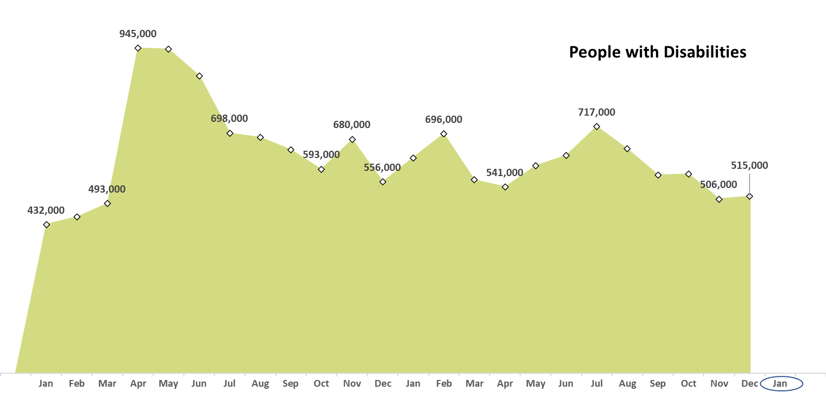
Number
Unemployed

Slide 14
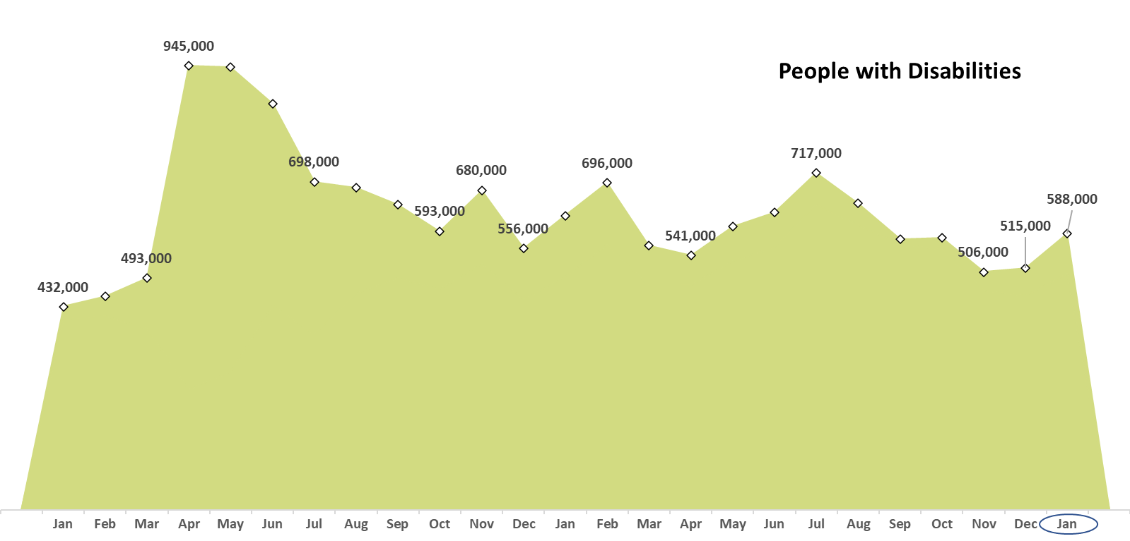
Number
Unemployed

Slide 15
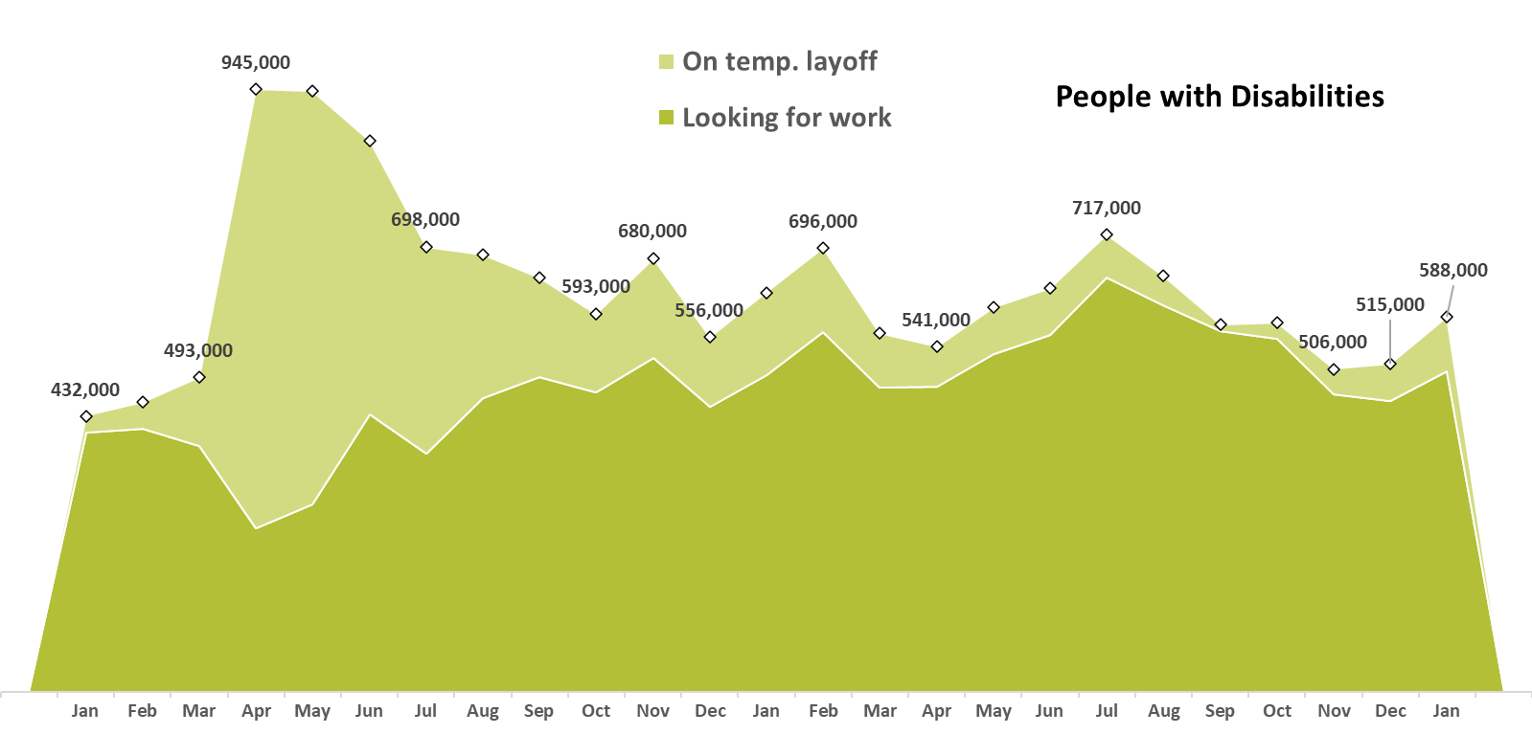
Number
Unemployed

Slide 16
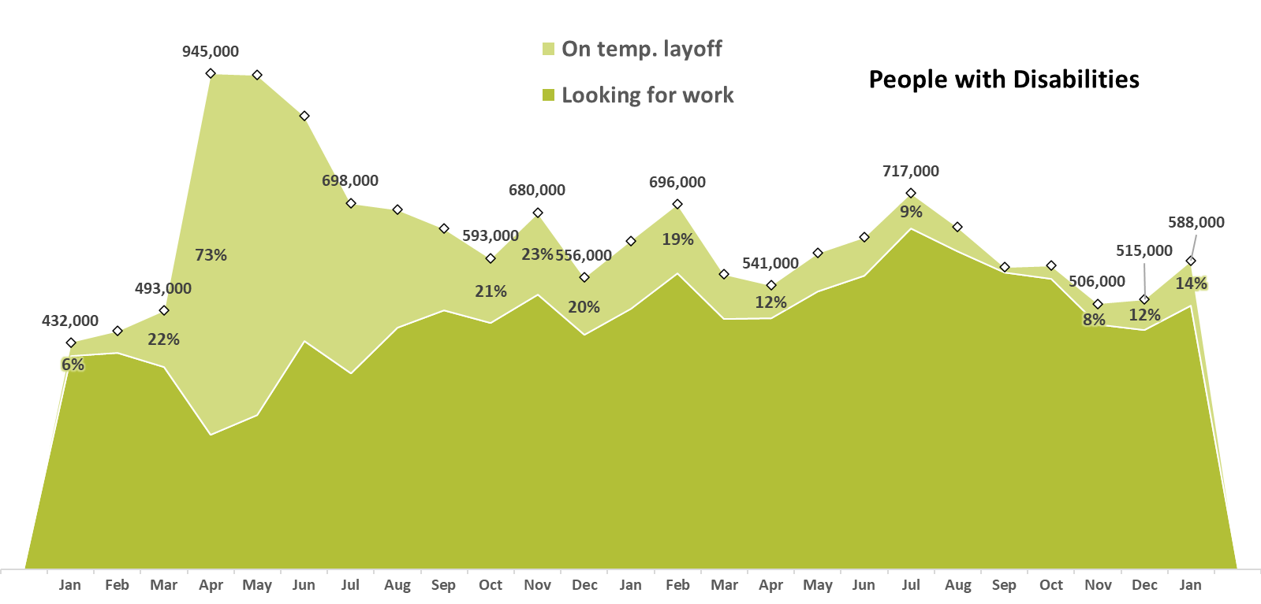
Number
Unemployed

Slide 17
Number
Unemployed

Slide 18
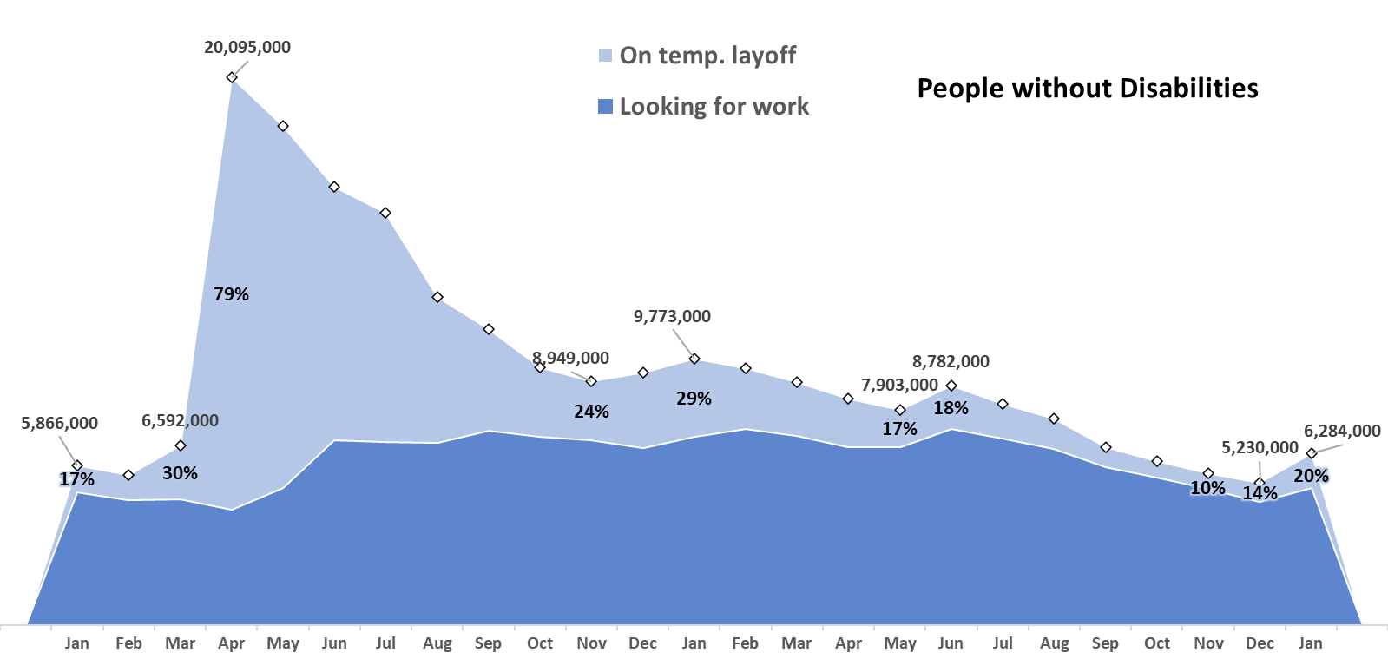
Number
Unemployed

Slide 19
nTIDE
Year-in-Review

Slide 20
nTIDE
Year-in-Review

Slide 21
nTIDE
Year-in-Review

Slide 22
nTIDE
Year-in-Review

Slide 23

Logistic Items
Use “Q&A” button on Zoom to ask a questions
Slides will be archived at
- https://researchondisability.org/home/ntide
Take our feedback survey at
- https://researchondisability.org/home/ntide

Slide 24

Thank You!
Thanks to our partners:
- UNH/Institute on Disability (www.ResearchOnDisability.org)
- Kessler Foundation (www.KesslerFoundation.org)
- AUCD (www.AUCD.org)
Contact us:
- Email: Disability.Statistics@unh.edu
- Call: 866-538-9521 (toll free)
Twitter at #nTIDELearn

Slide 25
Thank You!
Thanks to our partners:
- UNH/Institute on Disability (www.ResearchOnDisability.org)
- Kessler Foundation (www.KesslerFoundation.org)
- AUCD (www.AUCD.org)
Contact us:
- Email: Disability.Statistics@unh.edu
- Call: 866-538-9521 (toll free)
Twitter at #nTIDELearn

