Slide 1
nTIDE Lunch & Learn Webinar Series
Kessler Foundation, AUCD, University of New Hampshire Institute on Disability COVID Update Date: January 21, 2022

Slide 2
nTIDE Lunch & Learn Webinar Series
Kessler Foundation, AUCD, University of New Hampshire Institute on Disability COVID Update Date: January 21, 2022

Slide 3
Up Front Matters
This webinar is being recorded. We will post an archive of along side the Monthly nTIDE broadcast on our webinar, each month, on our website at www.researchondisability.org/nTIDE. This site will also provide copies of the presentations, the speakers’ bios, full transcripts, and other valuable resources.
As an attendee of this webinar, you are a viewer. To ask questions of the speakers, click on the Q & A box on your webinar screen and type your questions into the box. Speakers will review these questions and provide answers during the last section of the webinar. Some questions may be answered directly in the Q & A box.

Slide 4
Up Front Matters
If you have any questions following this recording, please contact us at disability.statistics@unh.edu, or toll free at 866-538-9521 for more information. Thanks for joining us. Enjoy today's webinar!

Slide 5
Welcome! Just so you know…
We recently started to include ASL Interpretation to be more accessible.
If you would like to see the gallery of speakers as well as the interpreter, we recommend joining from a computer rather than a phone or tablet.

Slide 6
Zoom Tips
Tip #1: Sound
Select the speakers you want to use for today’s webinar, click on the up arrow next to Audio Settings, and then select one of the options.
Tip #2: Close Captioning
Click on Closed Caption, and then select Show Subtitle for subtitles, or select View Full Transcript to get a running transcript of the captions.
Your screen may
look a bit differ

Slide 7
nTIDE COVID-19 Update
Andrew Houtenville University of New Hampshire John O’Neill Kessler Foundation

Slide 8
About
A joint effort of the University of New Hampshire, Kessler Foundation, and the Association of University Centers on Disability (AUCD).
This is a special episode of the nTIDE Lunch and Learn series based on the unique circumstances in the U.S. economy and the COVID-19 Pandemic.

Slide 9
Today’s Agenda
● 12:00 pm: Welcome and Introduction
● 12:05 pm: Updated Numbers from the Public-Use Micro Data of the Current Population Survey
● 12:35 pm: Open Q&A period

Slide 10
Employment Trend
- Great Recession
- Slow recovery
- Some good news,
- COVID lockdown,
- Recovery
- Some recent good new

Slide 11
Employment -to- Population Ratio

Slide 12
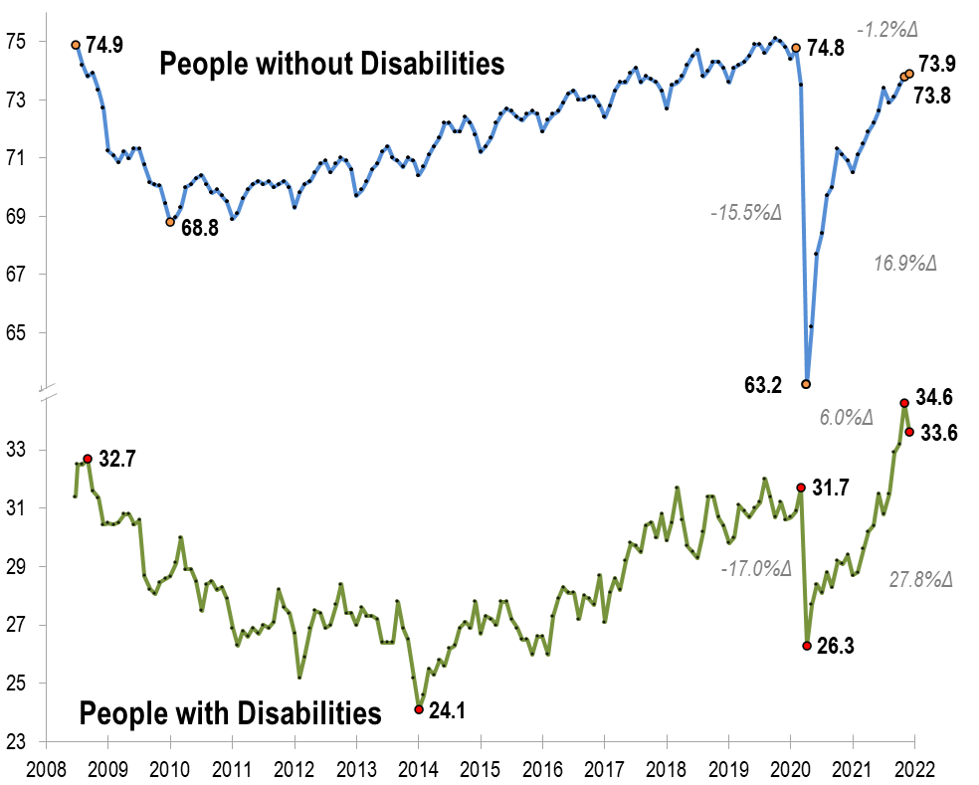
Employment -to- Population Ratio
v
v
v

Slide 13
Employment -to- Population Ratio
v
v
v

Slide 14
Employment -to- Population Ratio
v
v
v

Slide 15
Employment -to- Population Ratio
v
v
v
September 2008

Slide 16
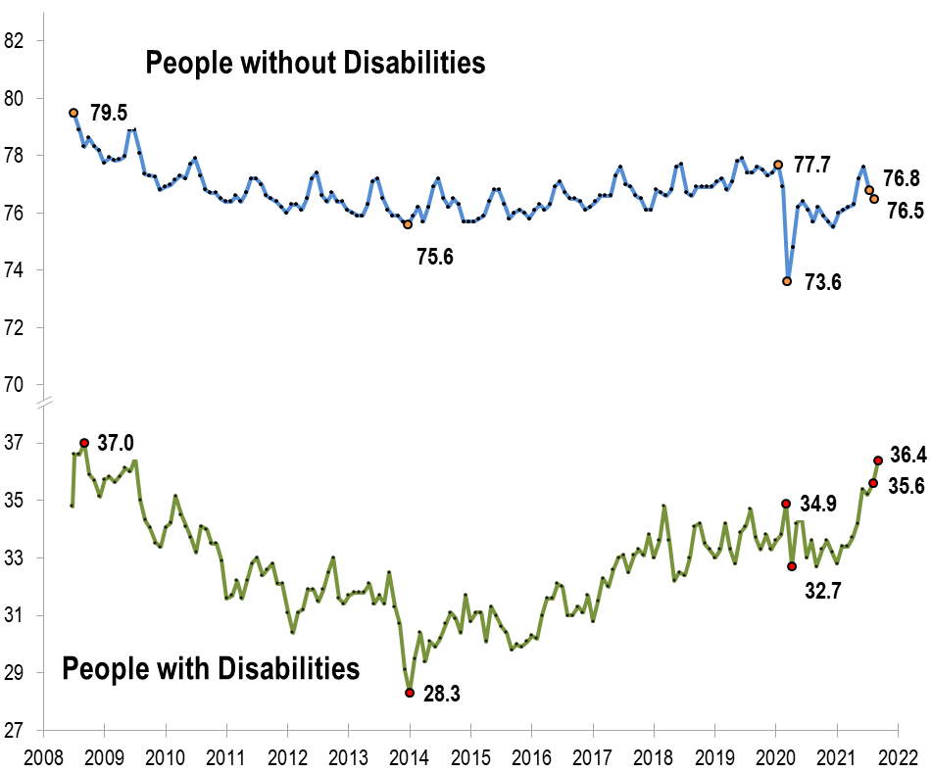
Labor Force Participation Rate

Slide 17
Labor Force Participation Rate

Slide 18
Labor Force Participation Rate
!!! Above October 2008 !!!

Slide 19
Number Unemployed
Closer look at unemployment

Slide 20
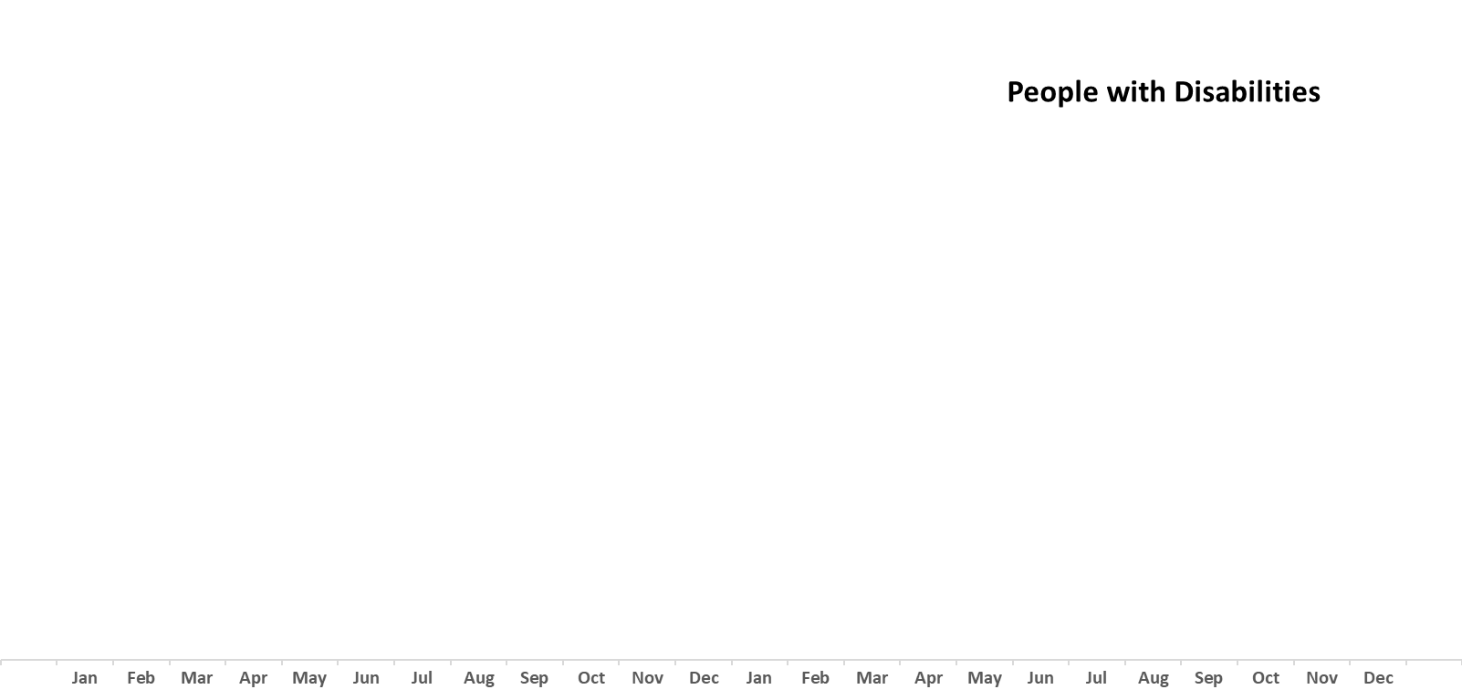
Number Unemployed

Slide 21
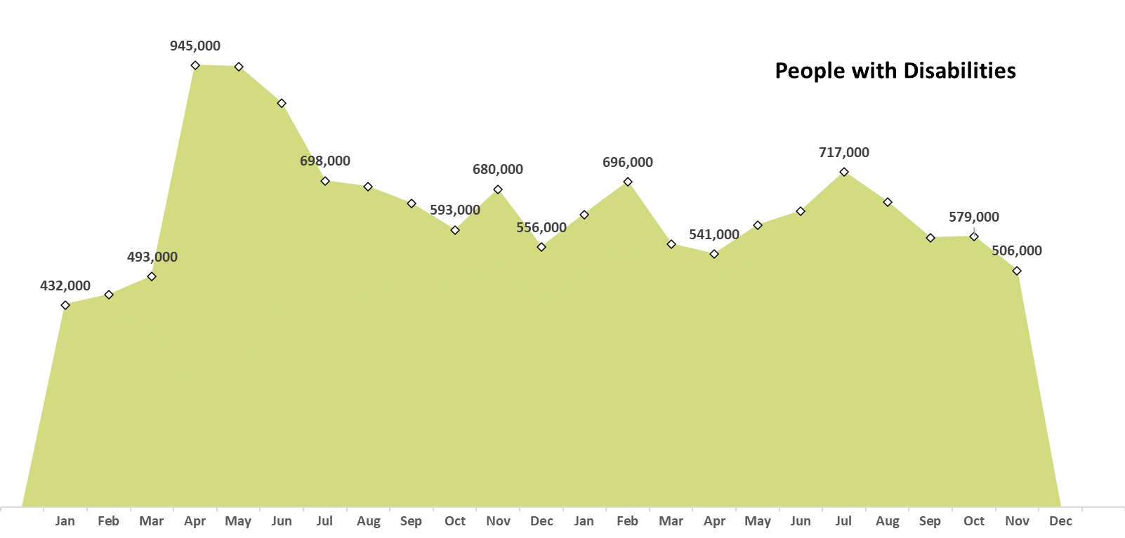
Number Unemployed

Slide 22
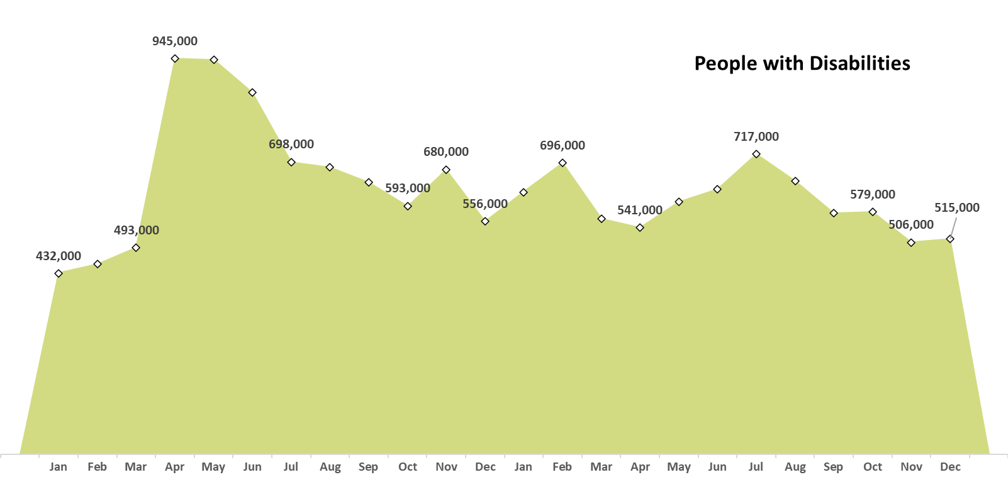
Number Unemployed

Slide 23
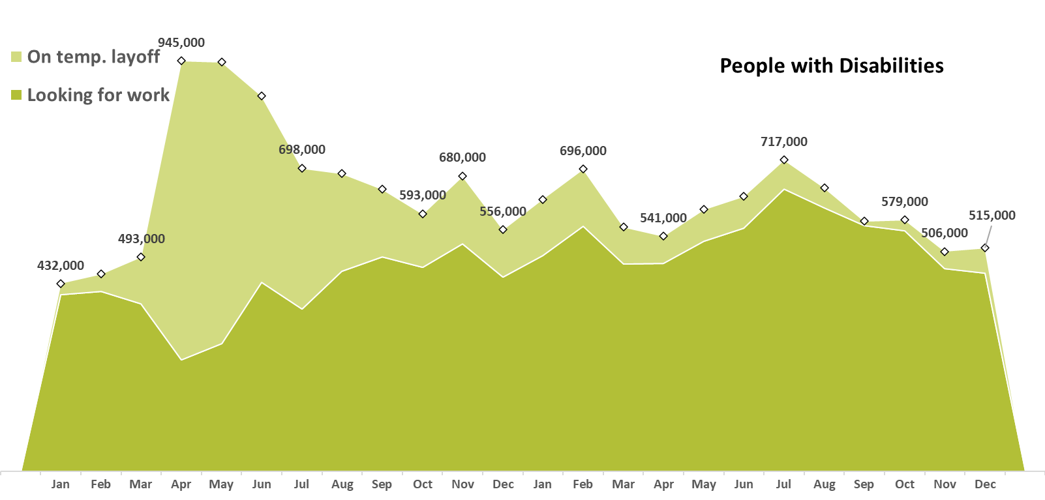
Number Unemployed

Slide 24
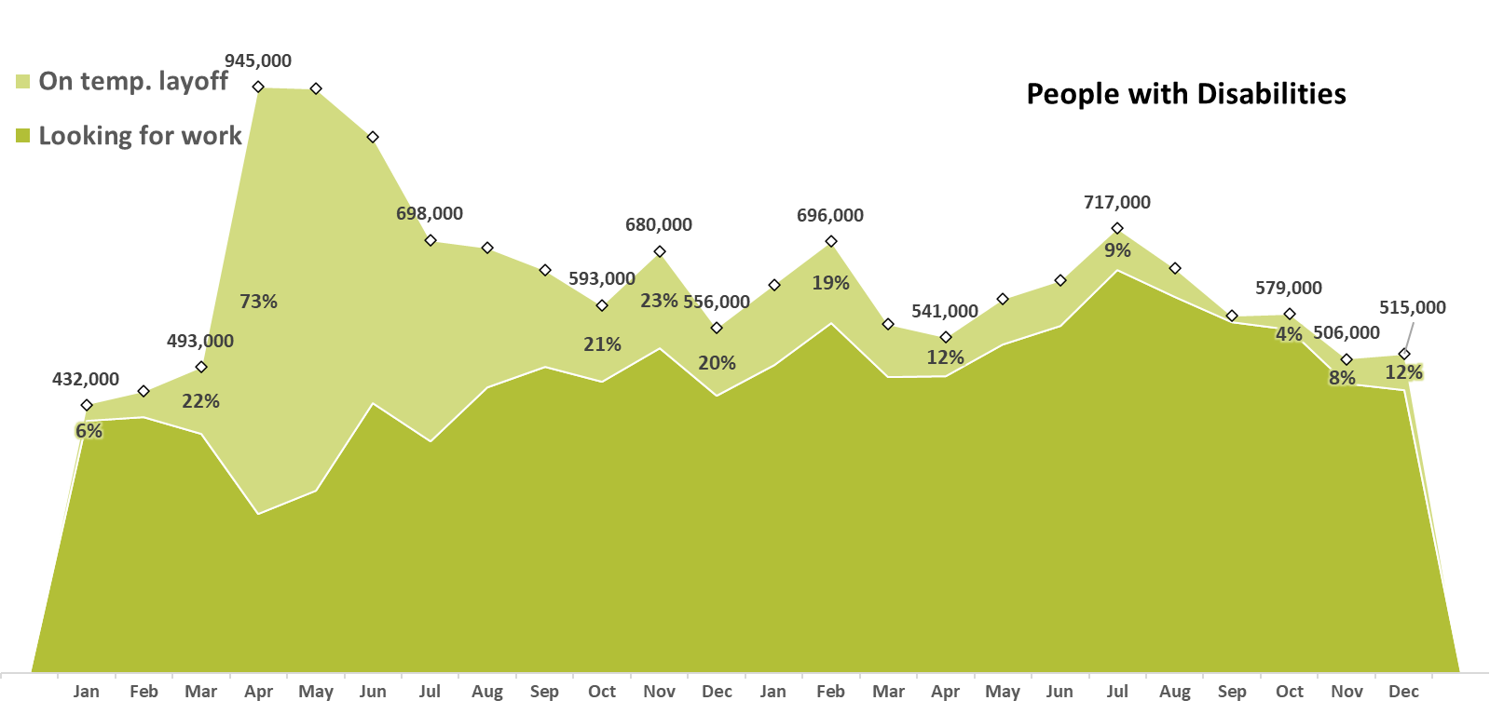
Number Unemployed

Slide 25
Number Unemployed

Slide 26
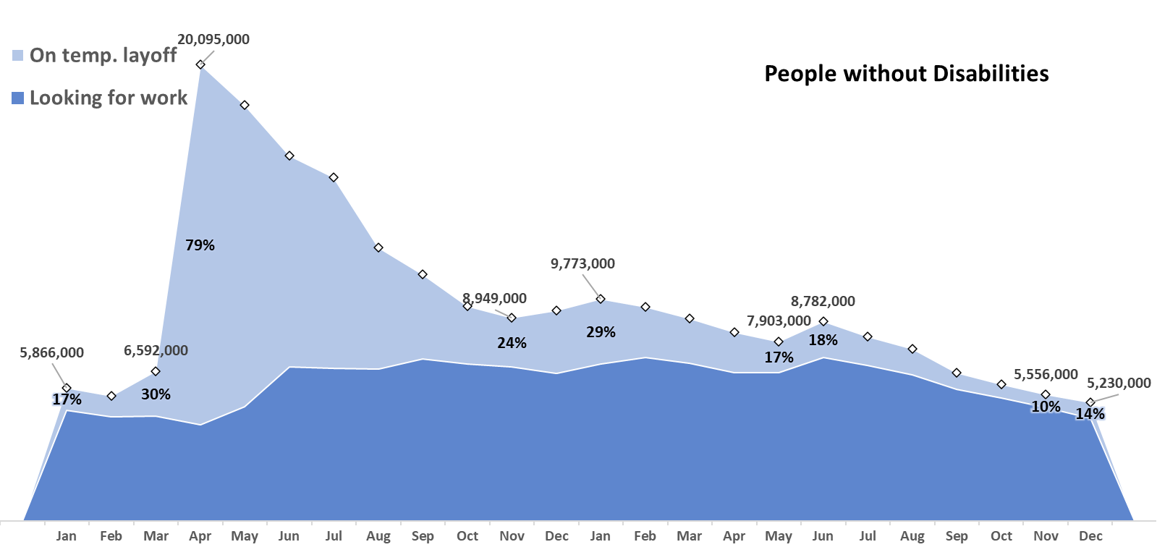
Number Unemployed

Slide 27
nTIDE Year-End Report
Special Preview

Slide 28
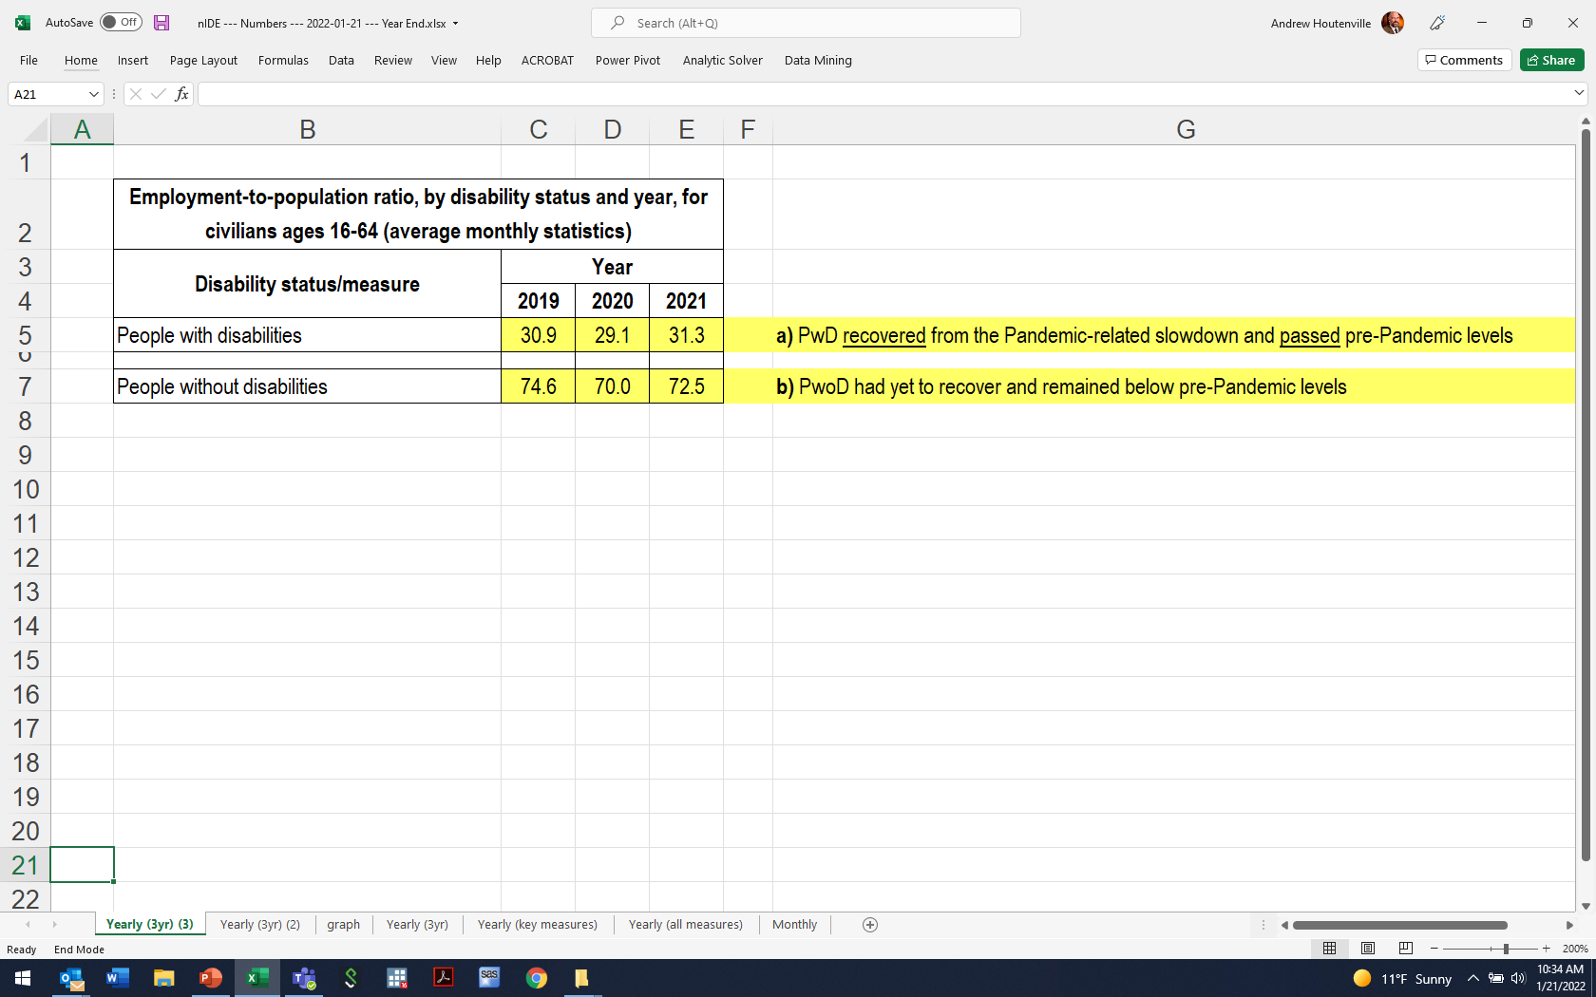

Slide 29
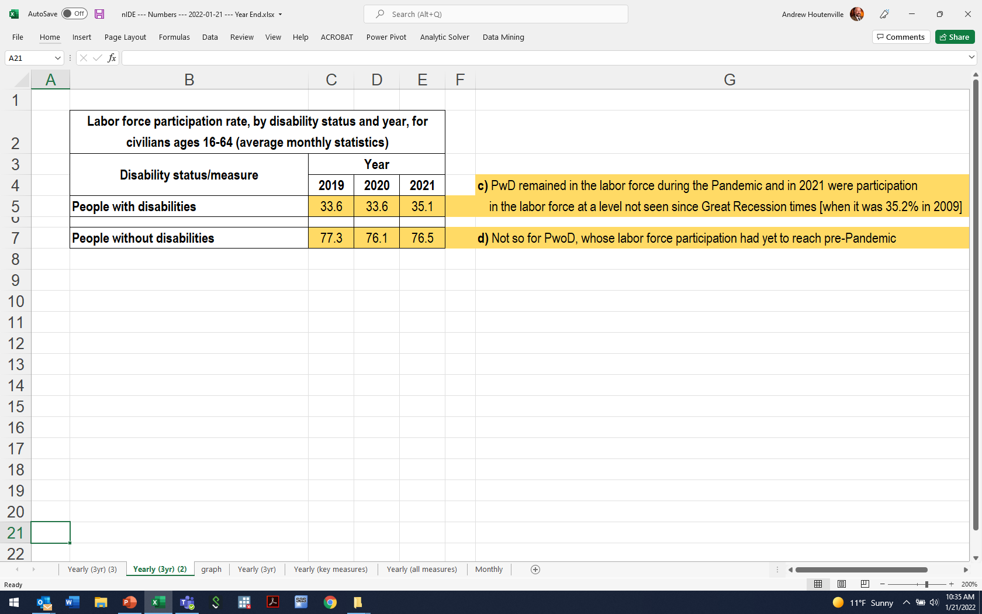

Slide 30
Logistic Items
Use “Q&A” button on Zoom to ask a questions
Slides will be archived at - https://researchondisability.org/home/ntide
Take our feedback survey at - https://researchondisability.org/home/ntide

Slide 31
Thank You!
Thanks to our partners: - UNH/Institute on Disability (www.ResearchOnDisability.org) - Kessler Foundation (www.KesslerFoundation.org) - AUCD (www.AUCD.org)
Contact us: - Email: Disability.Statistics@unh.edu - Call: 866-538-9521 (toll free)
Twitter at #nTIDELearn

Slide 32
Thank You!
Thanks to our partners: - UNH/Institute on Disability (www.ResearchOnDisability.org) - Kessler Foundation (www.KesslerFoundation.org) - AUCD (www.AUCD.org)
Contact us: - Email: Disability.Statistics@unh.edu - Call: 866-538-9521 (toll free)
Twitter at #nTIDELearn

