Slide 1
nTIDE Lunch & Learn Webinar Series
Kessler Foundation, AUCD, University of New Hampshire Institute on Disability Season 6, Episode 12 Date: December 3, 2021

Slide 2
nTIDE Lunch & Learn Webinar Series
Kessler Foundation, AUCD, University of New Hampshire Institute on Disability Season 6, Episode 12 Date: December 3, 2021

Slide 3
Up Front Matters
This webinar is being recorded. We will post an archive of along side the Monthly nTIDE broadcast on our webinar, each month, on our website at www.researchondisability.org/nTIDE. This site will also provide copies of the presentations, the speakers’ bios, full transcripts, and other valuable resources.
As an attendee of this webinar, you are a viewer. To ask questions of the speakers, click on the Q & A box on your webinar screen and type your questions into the box. Speakers will review these questions and provide answers during the last section of the webinar. Some questions may be answered directly in the Q & A box.

Slide 4
Up Front Matters
If you have any questions following this recording, please contact us at disability.statistics@unh.edu, or toll free at 866-538-9521 for more information. Thanks for joining us. Enjoy today's webinar!

Slide 5
Welcome
Andrew Houtenville University of New Hampshire

Slide 6
Just so you know…
We recently started to include ASL Interpretation to be more accessible.
If you would like to see the gallery of speakers as well as the interpreter, we recommend joining from a computer rather than a phone or tablet.

Slide 7
Zoom Tips
Zoom Tip #1: Sound
To select the speaker you want to use for today’s webinar, click on the up arrow next to Audio Settings, and then select one of the options.
Zoom Tip #2: Close Captioning
Click on Closed Caption, and then select Show Subtitle for subtitles, or select View Full Transcript to get a running transcript of the captions.
Your screen may
look a bit different

Slide 8
First, an announcement…
Registration is open for our new hybrid Annual Disability Statistics Conference (ADSC)!
March 10-11, 2022
Online and in person at the Holiday Inn-Capitol in Washington, DC
Day 1: State of the Science Conference on Disability Statistics (SSCDS)
Day 2: Updates on the Disability Compendium and Annual Report
https://www.researchondisability.org/annual-event

Slide 9
About nTIDE Lunch & Learn
Occurs at noon Eastern-time on the first Friday day of each month, with the release of the nTIDE Report.
A joint effort of the University of New Hampshire, Kessler Foundation, and the Association of University Centers on Disabilities (AUCD).

Slide 10
Today’s Program
Part 1: nTIDE Report … “The Numbers”
John O’Neill, Kessler Foundation
Andrew Houtenville, University of New Hampshire
Part 2: nTIDE News
Denise Rozell, Association of University Centers on Disabilities (AUCD)
Part 3: Guest Speaker
Julie Christensen, Association of People Supporting Employment First (APSE)
Part 4: Q&A

Slide 11
Part 1: The nTIDE Report
John O’Neill
Kessler Foundation

Slide 12
The Monthly nTIDE Report
The monthly nTIDE Report is a press release and infographic, looking at the latest employment statistics.
Uses data from the “jobs report” released by the U.S. Bureau of Labor Statistics, on the 1st Friday of each month.

Slide 13
Source of the Data
U.S. BLS, Current Population Survey (CPS).
Source of the “official” unemployment rate.
Civilians, ages 16-64, not living in institutions.
Available September 2008 onward.
Not yet seasonally adjusted.
which is why we compare to the same month last year.

Slide 14
The Numbers
Andrew Houtenville University of New Hampshire

Slide 15
Employment -to- Population Ratio

Slide 16
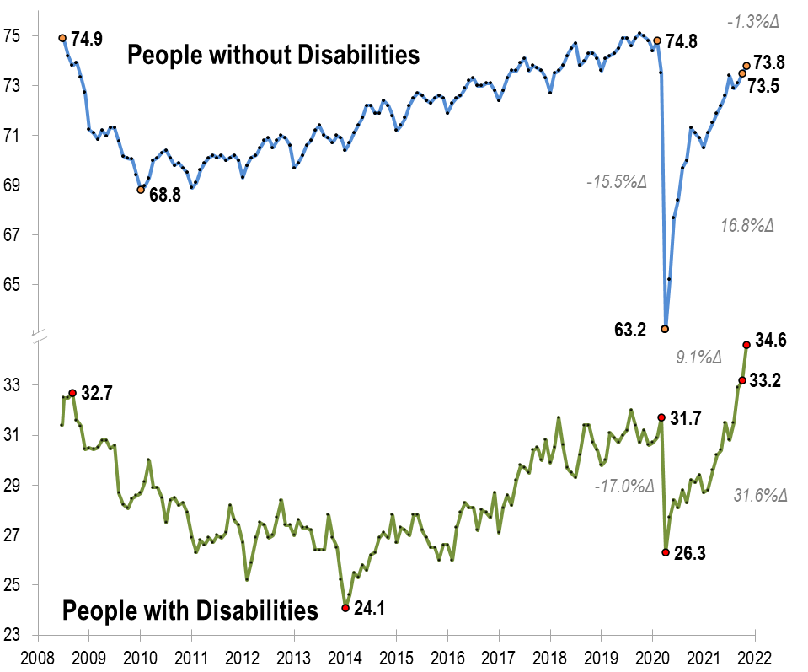
Employment -to- Population Ratio
v
v
v
v

Slide 17
Employment -to- Population Ratio

Slide 18
Employment -to- Population Ratio

Slide 19
Employment -to- Population Ratio
September 2008

Slide 20
Labor Force Participation Rate

Slide 21
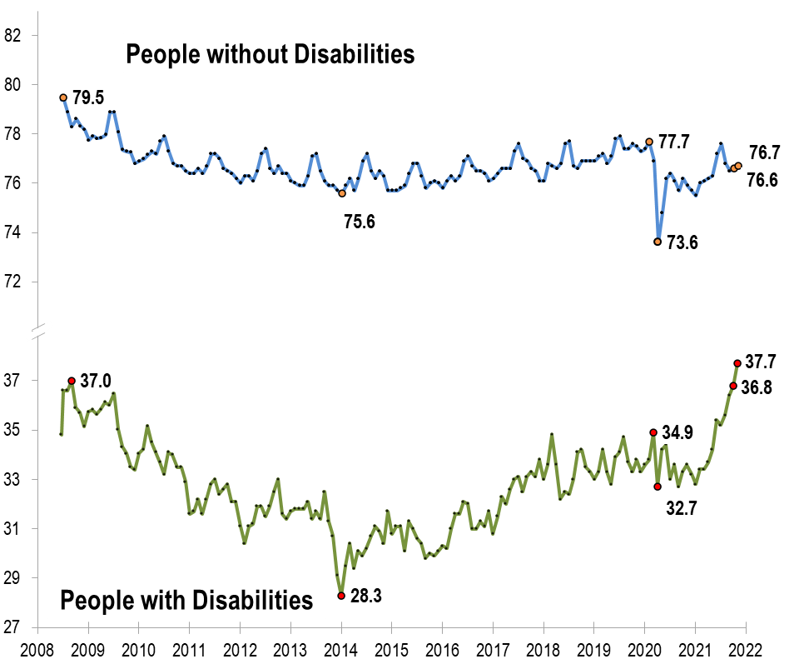
Labor Force Participation Rate

Slide 22
Labor Force Participation Rate
September 2008

Slide 23
Part 2 nTIDE News
Denise Rozell
Association of University Centers on Disabilities (AUCD)

Slide 24
Federal Policy Update
Budget Reconciliation – Build Back Better (BBB)
MFP permanent/spousal impoverishment permanent
HCBS funding – $150 billion
Workforce - $270 million to transform from 14(c)
Permanent MFP/Spousal Impoverishment
$1 billion DSP Workforce
Continuing resolution...February 18!
Debt Ceiling

Slide 25
RSA: Topical Index of VR Monitoring Findings
Index includes findings, observations, and recommendations that RSA has made from FY 2017 through FY 2020.
TA resource for VR agencies (and consumers, advocates) to assist with continuous improvement in program and fiscal performance.
Organized by topics
Includes the year monitoring reports were published, links to the reports, and corresponding page numbers in the reports.
To be updated annually.

Slide 26
GAO Study on Ticket to Work?
Curda, Elizabeth H. “Ticket to Work Helped Some Participants, but Overpayments Increased Program Costs.” Social Security Disability Report No. GAO-22-104031. Washington, D.C.: U.S. Government Accountability Office, October 2021.
GAO –
The costs of Ticket to Work exceeded the savings in disability benefits to SSA by an estimated $806 million from 2002 through 2015
Ticket holders slightly more likely to leave SSI than nonparticipants with similar characteristics
SSI also incurred additional costs from disability overpayments to Ticket holders - $133 million to $169 million

Slide 27
Side by Side View of Transition Services
Compare and contrast transition services in IDEA, VR and Pre-ETS
Definitions of transition services
Target population
Nature, scope and purpose of services
Description of activities and services
Reservation of funds
NTACT:C https://transitionta.org/sidebyside/

Slide 28
Workforce Boards/Bank Partnership Pilot
Sponsored by ODEP; LEAD WIOA Policy Development Center, National Disability Institute, Social Policy Research Associates
Community reinvestment Act (CRA) FAQ: Workforce Systems Can Leverage Bank Resources to Improve Economic Self-Sufficiency and Employment Outcomes for Low- and Moderate-Income Individuals.
Examples of existing workforce/bank partnerships
Focus on people of color with disabilities
Types of things banks can do
3 Workforce board pilots: New York’s Capital Region (Albany, New York), Michigan Works! Southwest (Kalamazoo, Michigan), and CareerSource Broward (Ft. Lauderdale, Florida).

Slide 29
SSI and Adults with Autism
Anderson, K.A., Hemmeter, J., Wittenburg, D. et al. National and State Trends in autistic Adult Supplemental Security Income Awardees: 2005–2019. J Autism Dev Disord (2021).
Social Security data 2005 – 2019
Compare national- and state-level changes number of new adult SSI awardees on the autism spectrum compared to those with ID.
Main findings:
Autistic SSI awards increased when all other mental health disorders declined;
Roughly 9 out of 10 autistic adult awardees were between ages 18–25 years;
Variation in the growth of autistic SSI awards across states. T
Need to consider geographic and age differences in SSI program participation among autistic adults and determine the underlying causes.

Slide 30
Employment of Women with Autism
North Gemma (2021) Reconceptualising ‘reasonable adjustments’ for the successful employment of autistic women, Disability & Society
Gendered prejudice – Autistic women are socialized to “mask” autism to “compensate” for differences
Needs for support at work are overlooked
Narratives of autistic women re difficulties and advantages of being both autistic and a woman in the workplace
Research shows sexist expectations impact opportunities to progress in careers
The research discusses barriers and support at work

Slide 31
The remaining 59%?
Invisible populations: Who is missing from research in intellectual disability? Rosencrans, Tassé, Kim, et al; Research in Developmental Disabilities, vol. 110, Dec. 2021
41% of adults with IDD are served through the DD system. Where are the other 59%?
Highlight where one may identify individuals belonging to this hidden population;
How researchers might effectively recruit from this group;
Need more representative samples.

Slide 32
#AUCD2021: AUCD Conference:
Learning Together: Connecting Research and Lived Experience
Watch recordings through January 30!
Must have been registered – find a friend...
Plenaries will all be online after that

Slide 33
Financial Inclusion, Disability and Race: A National Convening
Webinar: Tuesday December 7 12 -2 EST: national conversation on the intersection of race, ethnicity, disability and poverty
How we can support the most financially vulnerable in our society – BIPOC individuals with disabilities.
New data on banking status and financial behaviors of pwd dissected by race/ethnicity.
Initiatives in financial institutions, government, foundations and corporations.
Brief from National Disability Institute “Race, Ethnicity and Disability: The Financial Impact of Systemic Inequality and Intersectionality
Historical context for understanding intersectionality, including set of conclusions and recommendations

Slide 34
NEON National Plan to Increase Competitive Integrated Employment
Webinar: December 8, 202, 3-4 EST; Dr David Mank and Dr. Richard Luecking
The Employment First Community of Practice (CoP) Webinar Series. Learn about:
The NEON National Plan
Role of NEON in helping local provider organizations achieve their strategic goals
Strategies to increase Competitive Integrated Employment at the local, state, and national level
Joined by five NEON National Provider Organizations: ACCSES, ANCOR, APSE, The Arc US, and SourceAmerica.

Slide 35
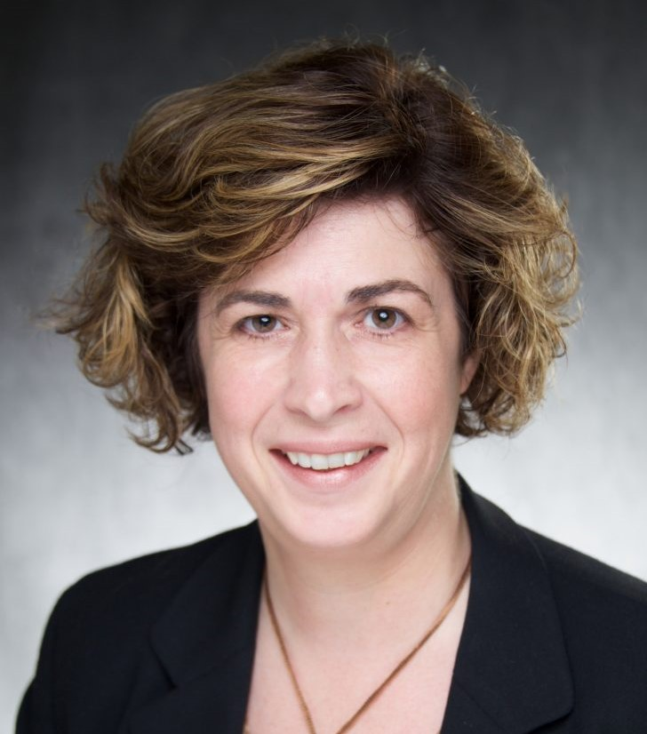
Part 3: nTIDE Guest Speaker
Julie Christensen
Association of People Supporting Employment First (APSE)

Slide 36
COVID-19
Impact on Employment
of Individuals with
Disabilities
Revised December 2021

Slide 37
APSE’s Policy Priorities for COVID-19 Relief
Funding for Home and Community Based Services
Waive of Federal Match Requirements for Vocational Rehabilitation for 2 years
Expansion of the Paycheck Protection Program

Slide 38
What is the impact of COVID-19 on…
the disability employment service system?
employment outcomes for people with disabilities?
job development and job coaching service delivery?

Slide 39
Context: COVID and People with Disabilities
Health status ≠ disability
Many people with disabilities are healthy
Disability alone not associated with higher risk
Common reasons for “higher risk”
Underlying / secondary conditions
Poverty
Lack of access to quality healthcare
Lack of access to PPE, hygiene products
Confinement (congregate settings)
April 24, 2020

Slide 40
COVID’s Disproportionate Impact
Hospitalization more likely for men, elderly, individuals with pre-existing conditions, and Black/African Americans (CDC)
COVID related death rate highest for blacks and Hispanics (APM Research)
•
Approx. HALF of low-income HH have experienced job/wage loss (Pew Research)

Slide 41
Financial Inequality: Disability, Race and Poverty in America,
National Disability Institute (2019)
TOWARD DATA DRIVEN RECOVERY

Slide 42
APSE COVID Impact Survey
Phase 1: June 15-28, 2020
Phase 2: August 31 – September 25, 2020
Phase 3: January 13 – February 8, 2021
Phase 4: June 14 – July 23, 2021

Slide 43
ORGANIZATIONAL AFFILIATIONS

Slide 44
Impact on Service System
Employment services significantly impacted
Dramatic impact at start of pandemic
67% decreased in VR referrals
43% slowing in Medicaid reimbursements
Decreased funding
Service closure
Staff furlough
Partial recovery as a result of policy change and COVID relief efforts
Medicaid and VR flexibility for remote/virtual service delivery
Paycheck Protection Program (PPP) loans

Slide 45
Services Closed Due to COVID-19
Pre-ETS
Customized Employment (CE) Supported Employment (SE)
Adult vocational skills training (non CE/SE)
Job placement (non CE/SE)
IPS
Pre-vocational (facility-based) Pre-vocational (HCBS)
Day habilitation (facil ity-based) Day habilitation (HCBS)
SERVICE CLOSURE
0% 10% 20% 30% 40% 50% 60%
Summer 2020 Summer 2021
Intent to Reopen Facility-Based Services
Summer 2020
Summer 2021
0%
20%
40%
Yes No
60%
80%
100%

Slide 46
Projected loss of DSP jobs due to COVID-19 (n=145)
Positions Lost, 20%
Summer 2020
Summer 2021
DSP JOB LOSS

Slide 47
COVID Impact: Job losses for PWD
Summer 2020 → Summer 2021
Yes
No
0% 10% 20% 30% 40% 50% 60% 70% 80% 90% 100%

Slide 48
Primary Reasons for Job Loss
Mandatory business/industry closure
Individual voluntarily exited employment due to health- related reasons (e.g., individual is medically high-risk)
Changes in job responsibilities and/or work processes were too difficult
Lack of access to a job coach or virtual employment supports
Lack of access to personal protective equipment (PPE)

Slide 49
COVID Impact: Job gains for PWD
Summer 2020 → Summer 2021
Yes
No
0% 10% 20% 30% 40% 50% 60% 70% 80% 90% 100%

Slide 50
Job Gains by Market Sector (n=413)
Job Losses by Market Sector (n=550)
Agr iculture Manufacturing Healthcare
Infor mation technology
Retail Service (general)
Education
Government
Other
Agr iculture Manufacturing Healthcare
Infor mation technology
Retail Service (general)
Education Government
Other
0%
5%
10% 15% 20% 25% 30% 35%
0%
5% 10% 15% 20% 25% 30% 35%
JOB LOSSES AND GAINS BY
MARKET SECTOR

Slide 51
VR & Medicaid Challenges
Funding Challenges
Summer 2020
Summer 2021
0% 10% 20% 30% 40% 50% 60% 70% 80% 90%
VR Medicaid

Slide 52
A SHIFTING SERVICE DELIVERY
SYSTEM

Slide 53
Use of remote/virtual supports post COVID-19
Very likely
Likely Neither likely or unlikely
Unlikely Very unlikely
0%
20%
Summer 2020
40% 60%
Summer 2021
80%
100%
WHAT ABOUT THE FUTURE?

Slide 54
The Pandemic is Not Over
APSE continues to collect data on a quarterly basis
Partnerships have been developed with university partners to share data and inform the direction of academic research
APSE is working with the World Association for Supported Employment to coordinate global response and share lessons learned/emerging best practices
Surveys are now also being done in Canada and Northern Ireland, additional countries to follow

Slide 55
Questions & Thank You!
Julie Christensen, julie@apse.org Executive Director /
Director of Policy & Advocacy

Slide 56
Questions and Answers
Use Q&A button on Zoom
Slides will be archived at: https://researchondisability.org/home/ntide.
Take our feedback survey at …
www.researchondisability.org/ntide/ntide-survey

Slide 57
Just a reminder…
Registration is open for our new hybrid Annual Disability Statistics Conference (ADSC)!
March 10-11, 2022
Online and in person at the Holiday Inn-Capitol in Washington, DC
Day 1: State of the Science Conference on Disability Statistics (SSCDS)
Day 2: Updates on the Disability Compendium and Annual Report
https://www.researchondisability.org/annual-event

Slide 58
Thank You!
Information about the nTIDE partners may be found at
Kessler Foundation (www.kesslerfoundation.org)
UNH/Institute on Disability (www.ResearchOnDisability.org)
AUCD (www.AUCD.org)
Contact us at
Email: Disability.Statistics@unh.edu
Call: 866-538-9521 (toll free)
Twitter at #nTIDELearn

Slide 59
Bye!

