Slide 1
nTIDE Lunch & Learn Webinar Series
Kessler Foundation, AUCD, University of New Hampshire Institute on Disability Season 6, Episode 10 Date: October 8, 2021

Slide 2
nTIDE Lunch & Learn Webinar Series
Kessler Foundation, AUCD, University of New Hampshire Institute on Disability Season 6, Episode 10 Date: October 8, 2021

Slide 3
Up Front Matters
This webinar is being recorded. We will post an archive of along side the Monthly nTIDE broadcast on our webinar, each month, on our website at www.researchondisability.org/nTIDE. This site will also provide copies of the presentations, the speakers’ bios, full transcripts, and other valuable resources.
As an attendee of this webinar, you are a viewer. To ask questions of the speakers, click on the Q & A box on your webinar screen and type your questions into the box. Speakers will review these questions and provide answers during the last section of the webinar. Some questions may be answered directly in the Q & A box.

Slide 4
Up Front Matters
If you have any questions following this recording, please contact us at disability.statistics@unh.edu, or toll free at 866-538-9521 for more information. Thanks for joining us. Enjoy today's webinar!

Slide 5
Welcome
Andrew Houtenville University of New Hampshire

Slide 6
Zoom Tips
Zoom Tip #1: Sound
To select the speaker you want to use for today’s webinar, click on the up arrow next to Audio Settings, and then select one of the options.
Zoom Tip #2: Close Captioning
Click on Closed Caption, and then select Show Subtitle for subtitles, or select View Full Transcript to get a running transcript of the captions.
Your screen may
look a bit different

Slide 7
About nTIDE Lunch & Learn
Occurs at noon Eastern-time on the first Friday day of each month, with the release of the nTIDE Report.
A joint effort of the University of New Hampshire, Kessler Foundation, and the Association of University Centers on Disabilities (AUCD).

Slide 8
Today’s Program
Part 1: nTIDE Report … “The Numbers”
Elaine Katz, Kessler Foundation
Andrew Houtenville, University of New Hampshire
Part 2: nTIDE News
Denise Rozell, Association of University Centers on Disabilities (AUCD)
Part 3: Guest Speaker
Cayte Anderson, University of Wisconsin-Stout
Sara Park, University of Wisconsin-Madison
Part 4: Q&A

Slide 9
Part 1: The nTIDE Report
John O’Neill
Kessler Foundation

Slide 10
The Monthly nTIDE Report
The monthly nTIDE Report is a press release and infographic, looking at the latest employment statistics.
Uses data from the “jobs report” released by the U.S. Bureau of Labor Statistics, on the 1st Friday of each month.

Slide 11
Source of the Data
U.S. BLS, Current Population Survey (CPS).
Source of the “official” unemployment rate.
Civilians, ages 16-64, not living in institutions.
Available September 2008 onward.
Not yet seasonally adjusted.
which is why we compare to the same month last year.

Slide 12
The Numbers
Andrew Houtenville University of New Hampshire

Slide 13
Employment -to- Population Ratio

Slide 14
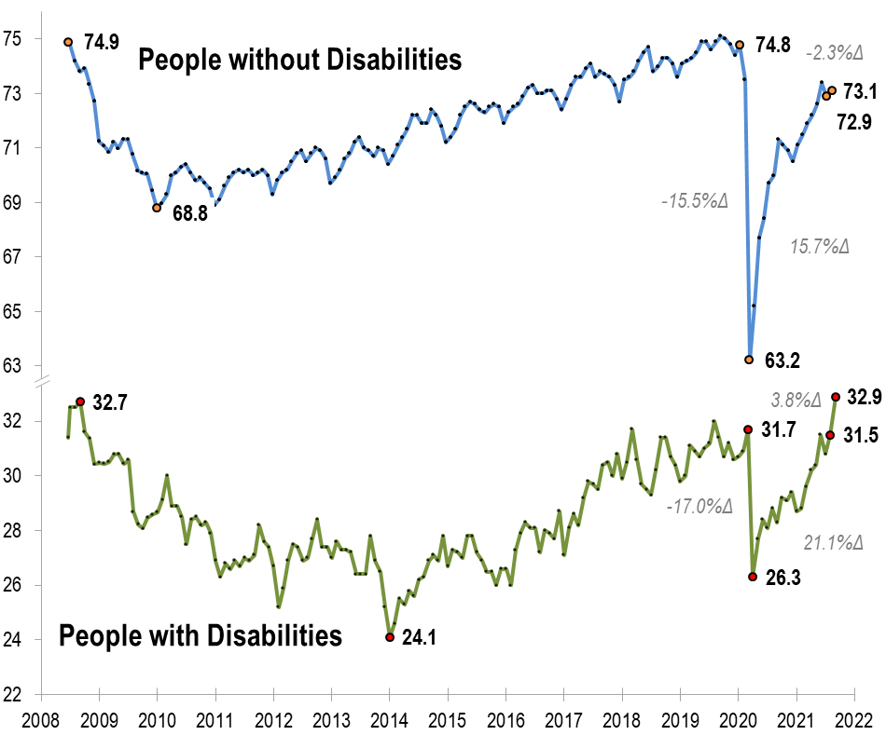
Employment -to- Population Ratio

Slide 15
Employment -to- Population Ratio

Slide 16
Employment -to- Population Ratio

Slide 17
Employment -to- Population Ratio
!!! SEPTEMBER 2008 !!!

Slide 18
Labor Force Participation Rate

Slide 19
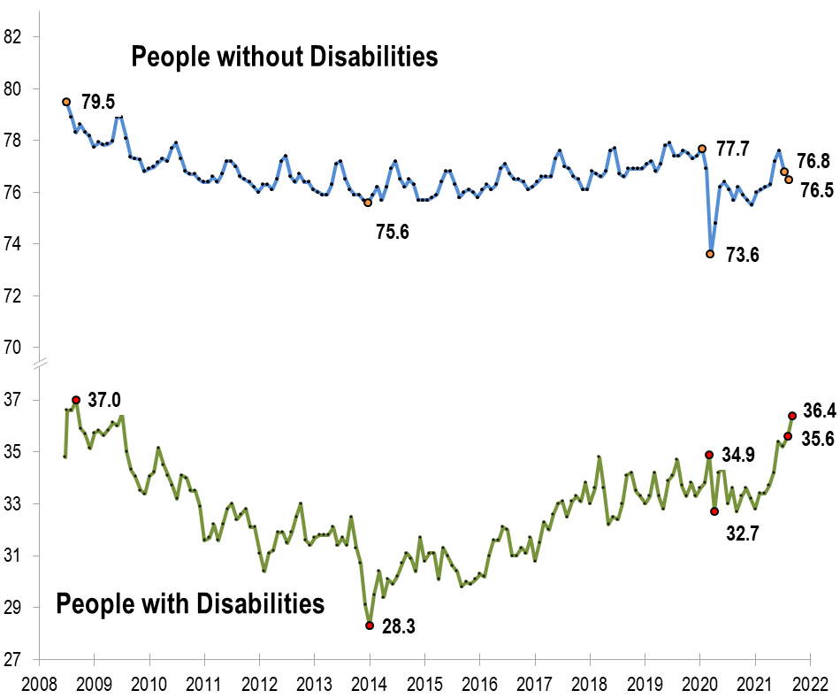
Labor Force Participation Rate

Slide 20
Labor Force Participation Rate
!!! Above October 2008 !!!

Slide 21
Part 2 nTIDE News
Denise Rozell
Association of University Centers on Disabilities (AUCD)

Slide 22
Federal Policy Update
Bipartisan Infrastructure bill
Budget Reconciliation
House:
MFP permanent/spousal impoverishment permanent
HCBS funding – $190 billion??
Workforce - $300 million to transform from 14(c)
Senate
??
Continuing resolutions – December 3
Debt Ceiling
SS – S. 2065 Supplemental Security Income Restoration Act

Slide 23
State Workforce Initiatives-ARPA Spending Plan Topical Analysis
DPS workforce issues; 2019 NCI Staff Stability report indicated pre-pandemic, turnover rate about 43%; postpandemic anecdotal evidence suggests worsening.
NASDDDS (National Association of State Directors of Developmental Disabilities Services) survey of ARPA Plans:
Out of the 49 spending plans, 44 include initiatives aimed at addressing workforce issues: focused in two main areas—increased compensation for DSPs, and staff or workforce development strategies.

Slide 24
Return to Work in a Post COVID World
Employer Assistance and Resource Network on Disability Inclusion (EARN) – Department of Labor, OPEP
New Resources
Disability-Inclusive COVID-19 Workplace Safety and Health Plans: Management and worker protection strategies for workplace reopening– review ADA and OSHA requirements re people with disabilities.
Leveraging Remote Work to Increase Inclusion : How employers can expand their potential talent pool to include people with disabilities seeking flexible work arrangements.
Adopting an Integrated Telework Policy for Employees With and Without Disabilities: Considerations and strategies for employers creating or reworking telework policies as both an option available to some or all employees and a reasonable accommodation under the Americans with Disabilities Act (ADA).

Slide 25
Lessons Learned Delivering Remote Services to Job seekers with Low Incomes During COVID-19 Pandemic
Pathways to Work Evidence Clearing House
Lessons learned from three organizations that adapted existing interventions to remotely provide work readiness activities/education and training services to job seekers with low incomes.
Common challenges
How to change delivery model
Multiple modalities offered
Modified intervention policies
Offered tech assistance
More frequent communication
Updated infrastructure and helped staff adapt
What will service delivery look like after COVID??

Slide 26
The Extra Costs Associated With Living With a Disability in the United States
Morris, McGarity, Goodman; Journal of Disability Policy Studies, September 9. 2021
Estimates of the extra costs of living with a disability in the US taken from four nationally representative surveys. Estimates:
household containing an adult with a work disability requires 29% more income (additional $18,322 a year for a household at the median income level) to obtain the same standard of living as a comparable household without a member with a disability.”
Single adults w/disabilities = higher costs than those married with disabilities; adults with cognitive impairments = have higher costs compared to those with other kinds of impairments.
Calculate the federal poverty rate for households that include adults with disabilities rises from 24% to 35% after adjusting for the extra costs of disability = an estimated 2.2 million more people with disabilities counted as poor.

Slide 27
How Poor Are People with Disabilities? Evidence Based on the Global Multidimensional Poverty Index
Pinilla-Roncancio, Monica, and Sabina Alkire. Journal of Disability Policy Studies, 2020
Study analyses levels of multidimensional poverty of people living in households with members with disabilities in 11 low- and middle-income countries in different regions of the world using global Multidimensional Poverty Index (MPI).
In five of the 11 countries people living in households with disabled members face higher levels of multidimensional poverty compared with people without disabilities.
Differences between the levels of poverty were larger in middle-income countries than in low-income countries = development disability gap.

Slide 28
“Today I felt like my work meant something”: A pilot study on job crafting, a coaching-based intervention for people with work limitations and disabilities
Sundar, Brucker; Work; Vol 69, issue 2; 2021
Test job crafting as an OT intervention strategy for people with disabilities and health conditions
“Job crafting is a proactive, strengths-based, bottom-up approach where workers renegotiate and redefine their job tasks in a personally meaningful way.”
Opportunity to use with disabled and nondisabled individuals
Statistically significant belief in own work abilities and meeting goals
Opportunity to expand job roles and modification of scope

Slide 29
Accessibility Resources
National Clearinghouse of Rehabilitation Training Materials, U.S. Department of Education
Starts with Why Access is Important and a screen reader demo
Examples , how to’s, directions, tutorials, guides, Federal resources:
PDF Accessibility
Webinar Accessibility
PowerPoint Accessibility
Word Accessibility
Excel Accessibility

Slide 30
Happy NDEAM! National Disability Employment Awareness Month
DisabilityIN NDEAM events – global awareness!
APSE Webinars:
"Beyond COVID 19: What We’ve Learned and How We Move Employment First Forward“; Thursday, October 14th, 1-2PM EST; Julie Christensen, John Butterworth
"Implementation and use of telerehabilitation in delivery of individualized community-based vocational rehabilitation services to rural veterans.“; Wednesday, October 27, from 1-2 pm EST; Presenters include Lisa Ottomanelli
Department of Labor:
America’s Economic Recovery is Powered by Inclusion. October 20, 2-3 pm EST

Slide 31
Webinar: Lessons Learned from COVID-19’s Impact on Competitive Integrated Employment (CIE)
October 13, 3-4 pm Eastern; David Mank, PhD, and Rich Toscano, M.Ed
Employment First State Leadership Mentoring Program (EFSLMP) Community of Practice (CoP) Webinar Series
Discuss findings from six group interviews with national/international leaders on COVID-19’s impact on people with disabilities and competitive integrated employment/innovative practices
Long-term and short-term impacts COVID-19 had on employers, providers and workers with disabilities.
Impacts technology had in making the workforce more and less inclusive for people with disabilities during COVID-19.
Strategies that employers and providers should consider post-COVID-19 to maximize CIE for people with disabilities.

Slide 32
Part 3: nTIDE Guest Speaker
Cayte Anderson Sara Park
Associate Professor Doctoral Student
University of WI-Stout University of WI-Madison

Slide 33
Technology Early Career Preparation Intervention (TECH-Prep) Panel Presentation
Cayte Anderson, PhD, LPC, CRC
University of Wisconsin-Stout
Sara Park, MS, CRC
University of Wisconsin-Madison
The contents of this presentation were developed under a grant from the National Institute on Disability, Independent Living, and Rehabilitation Research (NIDILRR grant number #90RTEM0003). NIDILRR is a Center within the Administration for Community Living (ACL), Department of Health and Human Services (HHS). The contents of this presentation do not necessarily represent the policy of NIDILRR, ACL, HHS, and you should not assume endorsement by the Federal Government.
Notes:
Cayte
Welcome! I’m Cayte Anderson with the University of Wisconsin-Stout and it’s a pleasure to be joining you today. The Technology Early Career Preparation Intervention (aka Tech-Prep) project is funded by the National Institute on Disability, Independent Living, and Rehabilitation Research (NIDILRR), and is conducted by the University of Wisconsin-Madison and Stout in partnership with the team at Virginia Commonwealth University. Today we are sharing information regarding early implementation of the model as well as participant engagement, early outcomes, and next steps.
Sara Park, a doctoral student at UW-Madison, and I will be sharing the information together.

Slide 34
TECH-Prep Purpose
Evaluate the efficacy of a technology early career preparation program.
Participants are youth 16-24 years old from diverse racial/cultural backgrounds with Intellectual and/or Developmental Disabilities (IDD), residing in Chicago and/or Cook Co., IL
Two Phases:
RCT intervention development
Efficacy study
Notes:
Cayte
Career pathways in sciences, technology, engineering, and mathematics (STEM) continue to grow. However, there is a need for increased representation of people with disabilities in these fields.
According to a recent study, among individuals with disabilities served by the state-federal VR between years 2017 and 2019, only 5.3% were engaged in STEM jobs/careers (Chun et al., 2021). Research also shows that transition age youth with intellectual and/or developmental disabilities tend to explore less varied career pathways.
Target population:
Youth 16-24 years old
Live in Chicago and/or Cook County, IL
Diverse racial and/or culture
Intellectual and/or Developmental Disability (IDD)
(Screener & Intake Survey)
Purpose:
Evaluate the efficacy of a technology early career preparation program developed in partnership with Chicago technology companies. The intervention involves:
online soft skills training/coaching, and
internship

Slide 35
Intervention/Program Components
Soft Skills Curriculum (10-11 weeks)
Curriculum Modules and IDD Adaptations
Career in Technology Focus
Behavioral Activations
Summer Paid Internship (4-5 weeks)
Project-based collaborative work
Exposure to multiple tech careers
Summer internship support
Notes:
Cayte
The interventional components involve (a) soft skills curriculum with embedded coaching, followed by (b) paid summer internships. We opted to use the Skills to Pay the Bills: Mastering Soft Skills for Workplace Success curriculum (ODEP, 2012) with slight modifications. The curriculum is housed in an online learning management system, and takes participants about 10-11 weeks to complete. We kept the six original ODEP skill areas (Communication, Enthusiasm and Attitude, Teamwork, Networking, Problem Solving and Critical Thinking, and Professionalism) and further adapted the activities to fit the strengths and support needs of youth with IDD, including the use of visuals and videos in teaching materials. Examples and activities were also modified to focus on careers in technology.
This program was originally designed to be offered in-person and on-site in Chicago. However, the emergence of the Covid-19 pandemic required the team to quickly pivot and we were able to successfully transition all project elements online. This included both the soft skills training and coaching as well as the paid summer internships.

Slide 36
Introduction to Computer & Technology Career Pathways
Computer and Tech specific topic modules
“Getting Started in Coding”
Introduction to computer and tech field
Career Pathways exploration activities
Interview videos
Notes:
Sara
An emphasized component of the TECH-prep program is introducing students with Intellectual and developmental disabilities to career pathways in computer and technology.
For this purpose, we’ve added computer and tech-specific topic module and activities to the curriculum as well as providing an opportunity to intern at a tech company during the summer.
Currently, there is one module dedicated specifically to coding, the “Getting Started in Coding” module, where we introduce coding project terms such as Design/Architecture, Software Testing, and Debugging.
We also introduce students to this field through various computer and tech Career Pathways exploration activities and series of interview videos of the founders of big tech companies such as Microsoft and Facebook.
We also set up and adapted soft skills activities such as role playing and interview practices to take place in an IT or Tech company settings.

Slide 37
Student Well-Being: Behavioral Activations, Reaffirming Disability & Racial Identity Activities
Behavioral Activation Modules
Exploring Values and Scheduling Activities
Dealing with Barriers
Managing Stress
Social Skills
At least one activity in each module addressing racial/ethnic and disability identity
Notes:
Sara
Other areas of emphasis in the TECH-prep program are student well-being and culturally responsive teaching (CRT).
Behavioral activation modules were put in place as we recognized that physical and psychological well-being are both important factors for students’ career exploration and development goals beyond the program.
There are four Behavioral Activation Modules spread arocss the curricum: This program focuses on positive emotion, engagement, positive relationships, meaning, and accomplishment as 5 building blocks of well-being. Students explore values that are important to them and schedule activities that reflect their values in the first module. In the second module, students identify barriers to completing the scheduled activities and strategize how to remove these barriers. The third module introduces coping strategies to manage stress, such as mindfulness and meditation. In the final module, we review communication styles and relationship building. Each Session is 30 minutes long, and students leave each session with homework activities to try.
Another area of importance is culturally responsive teaching to reaffirm students’ disability and racial/ethnic identity.
We recognize that we are working with transition age youth of color with IDD, and we find it important to make sure that we introduce these topics in our curriculum. We’ve added at least one activity in each module that addresses students’ racial/ethnic or disability identity.
For example, we discuss the importance of cultural diversity at workplace, talk about how to respond to microaggressions at workplace, and learn about disability legislations and rights.

Slide 38
Summer Internship
Paid Summer internship at YolBe
Project-based Group Work
Real work experience in the field of computer and technology
Work with professionals in the field
Summer Internship Support
Notes:
Sara
Perhaps the most exciting component of the TECH prep program, especially for the students, is the paid summer internship component.
Students have an opportunity to participate in project-based internship experience at a technology company.
YolBe, standing for “Your Life Only Better”, is a career social networking platform company where one can find jobs, internships, trainings, and other opportunities to connect with one’s community.
They provide real work experience in the field of computer, software and technology to our students. Student interns are working with developers, web designers, and software engineers.
From the university side, we continue to offer summer internship support as students complete their summer internship.

Slide 39
Group Projects
Creating a homepage
Technical testing
UX testing
Network project
Individual Projects
Finding resources for the network
Weekly journal entries
Notes:
Sara
Students have a chance to work on both group and individual projects at YolBe.
These are some of the projects that students are working on throughout the month. The flyer credit goes to YolBe.
This summer, students learned html, created a homepage together, completed technical and usability testing, and worked on a network project. They also individually found resources and kept journal entries.

Slide 40
Student Reflections of their Accomplishments
“I enjoyed working in teams.”
“I had lots of leadership opportunities during breakout rooms and working in small groups.”
“I learned how to use the programs better and learned how to code html.”
“I conducted usability testing of the YolBe website and app.”
“I like the Resource project where I researched and identified digital resources.”
“I enjoyed working on the Networking project. I added pictures, made elements, and used graphs in Canva and Google Slide.”
Notes:
Sara
Student support provided from the university side seeks to foster student reflections and meaning-making of their internship experience.
These were some of the student quotes on their reflections of their internship accomplishments.
They enjoyed teamwork, identified leadership opportunities, and mentioned specific projects that hey enjoyed or were proud of completing.
For example, a student said, “I liked the Resource project where I researched and identified digital resources.”
Another student commented on usability testing of the YolBe app.

Slide 41
Preliminary Outcomes and Results
Pilot Cohort (Spring 2020): Two participants
Cohort 1 (Fall 2020): Two participants
Cohort 2 (Spring 2021): Six participants
Graduates (Summer 2021): Eight students graduated from TECH-prep curriculum and internship
Cohort 3: currently recruiting
Notes:
Cayte
In terms of preliminary outcomes, we are now completing the first phase, development of the intervention. Two participants served as our pilot cohort during Spring 2020 and we have subsequently had eight (8) students participate across Cohorts 1 and 2. Participatory formative evaluation helped us better understand student needs and continuously improve the program. As of this summer, all eight (8) students successfully graduated from the program. This reflects a 100% engagement rate with the early (small) sample, with no participants dropping out or disenrolling. We suspect that this is attributed to a combination of (a) actively asking the youth their preferences and adapting our implementation strategies accordingly (Example: Blue Button-Google Hangouts-Slack as communication tools), and (b) the need to shift everything into virtual delivery methods due to the pandemic (a silver lining, perhaps).
Pilot Cohort (Spring 2020): One hour mandatory meeting
Two participants
Cohort 1 (Fall 2020): One mandatory hour/week, with optional second meeting for extra support
Two participants
Improved communication and engagement
Cohort 2 (Spring 2021): Two hours weekly + extra individual support hours (due to occasional absences, extra support requested)
Cohort 1 came back as peer mentors-continued engagement through spring
6 new students
Total of Eight students graduated from TECH-prep curriculum and internship in Summer 2021

Slide 42
The Future of TECH-Prep
Program seeks to broaden Career Pathways for youth with IDD, especially in the field of technology and computer science.
Continue to expand the program-offer it to more students.
Manualize the curriculum to support replication and provide TECH-Prep as a vocational training and service program.
Moving into efficacy study phase…more to come!
Notes:
Cayte
Aim is to address underrepresentation by individuals with disabilities in technology careers.
Additionally, there may be opportunities to expand the model beyond internships into further educational opportunities for those seeking technology credentials.

Slide 43
Questions and Answers
Use Q&A button on Zoom
Slides will be archived at: https://researchondisability.org/home/ntide.
Take our feedback survey at …
www.researchondisability.org/ntide/ntide-survey

Slide 44
Thank You!
Information about the nTIDE partners may be found at
Kessler Foundation (www.kesslerfoundation.org)
UNH/Institute on Disability (www.ResearchOnDisability.org)
AUCD (www.AUCD.org)
Contact us at
Email: Disability.Statistics@unh.edu
Call: 866-538-9521 (toll free)
Twitter at #nTIDELearn

Slide 45
Bye!

