Slide 1
nTIDE Lunch & Learn Webinar Series
Kessler Foundation, AUCD, University of New Hampshire Institute on Disability COVID Update Date: October 22, 2021

Slide 2
nTIDE Lunch & Learn Webinar Series
Kessler Foundation, AUCD, University of New Hampshire Institute on Disability COVID Update Date: October 22, 2021

Slide 3
Up Front Matters
This webinar is being recorded. We will post an archive of along side the Monthly nTIDE broadcast on our webinar, each month, on our website at www.researchondisability.org/nTIDE. This site will also provide copies of the presentations, the speakers’ bios, full transcripts, and other valuable resources.
As an attendee of this webinar, you are a viewer. To ask questions of the speakers, click on the Q & A box on your webinar screen and type your questions into the box. Speakers will review these questions and provide answers during the last section of the webinar. Some questions may be answered directly in the Q & A box.

Slide 4
Up Front Matters
If you have any questions following this recording, please contact us at disability.statistics@unh.edu, or toll free at 866-538-9521 for more information. Thanks for joining us. Enjoy today's webinar!

Slide 5
Zoom Tips
Tip #1: Sound
Select the speakers you want to use for today’s webinar, click on the up arrow next to Audio Settings, and then select one of the options.
Tip #2: Close Captioning
Click on Closed Caption, and then select Show Subtitle for subtitles, or select View Full Transcript to get a running transcript of the captions.
Your screen may
look a bit differ

Slide 6
nTIDE COVID-19 Update
Andrew Houtenville University of New Hampshire John O’Neill Kessler Foundation Denise Rozell Association of University Centers on Disabilities

Slide 7
About
A joint effort of the University of New Hampshire, Kessler Foundation, and the Association of University Centers on Disability (AUCD).
This is a special episode of the nTIDE Lunch and Learn series based on the unique circumstances in the U.S. economy and the COVID-19 Pandemic.

Slide 8
Today’s Agenda
● 12:00 pm: Welcome and Introduction
● 12:05 pm: Updated Numbers from the Public-Use Micro Data of the Current Population Survey
● 12:35 pm: Open Q&A period

Slide 9
Employment Trend
- Great Recession
- Slow recovery
- Some good news,
- COVID lockdown,
- Recovery
- Some recent good new

Slide 10
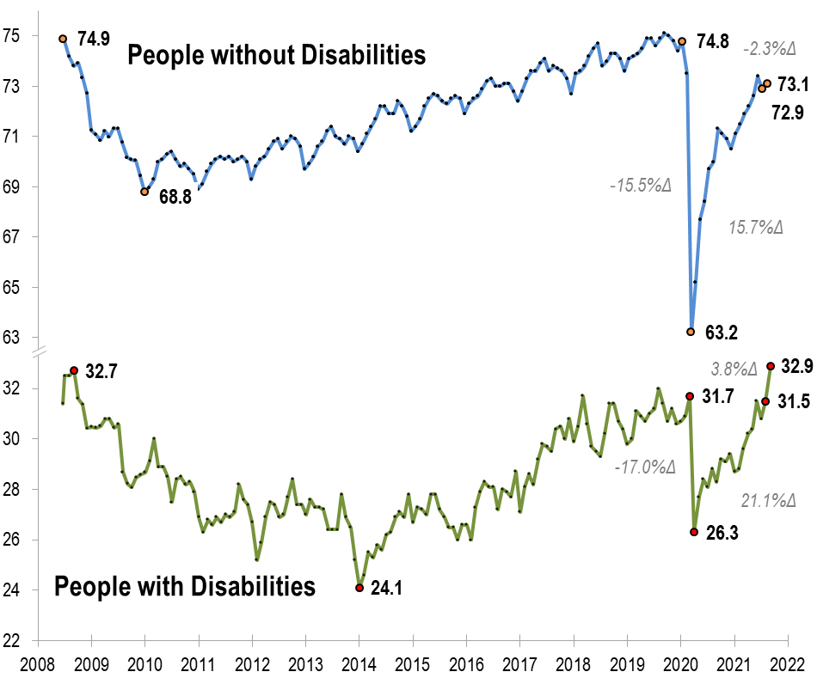
Employment -to- Population Ratio

Slide 11
Employment -to- Population Ratio

Slide 12
Employment -to- Population Ratio

Slide 13
Employment -to- Population Ratio
!!! SEPTEMBER 2008 !!!

Slide 14
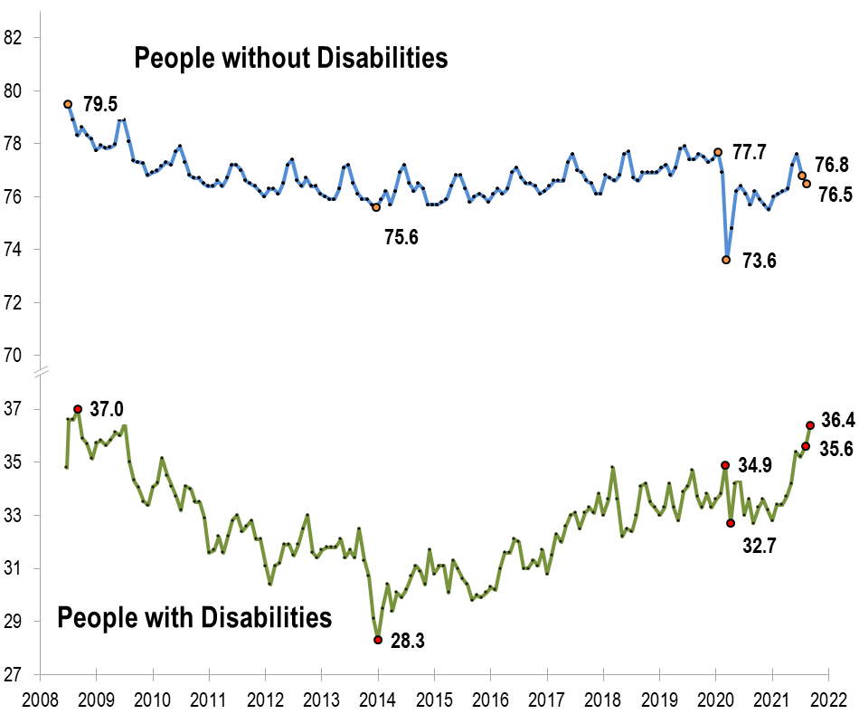
Labor Force Participation Rate

Slide 15
Labor Force Participation Rate

Slide 16
Labor Force Participation Rate
!!! Above October 2008 !!!

Slide 17
Number Unemployed
Closer look at unemployment

Slide 18
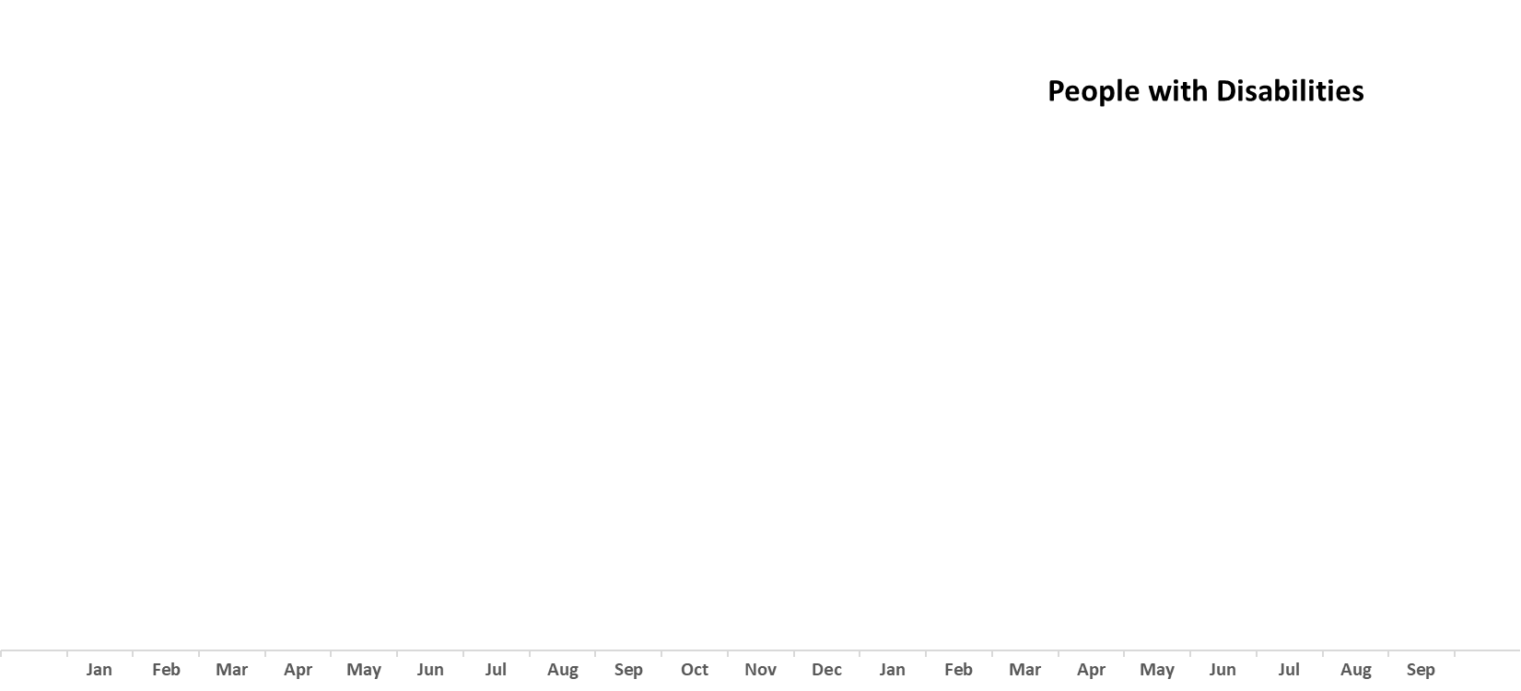
Number Unemployed

Slide 19
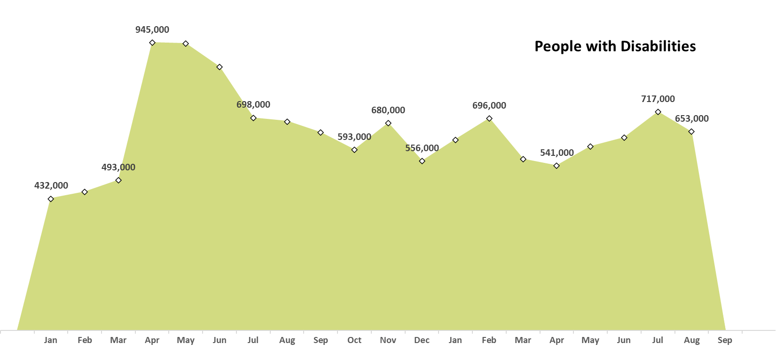
Number Unemployed

Slide 20
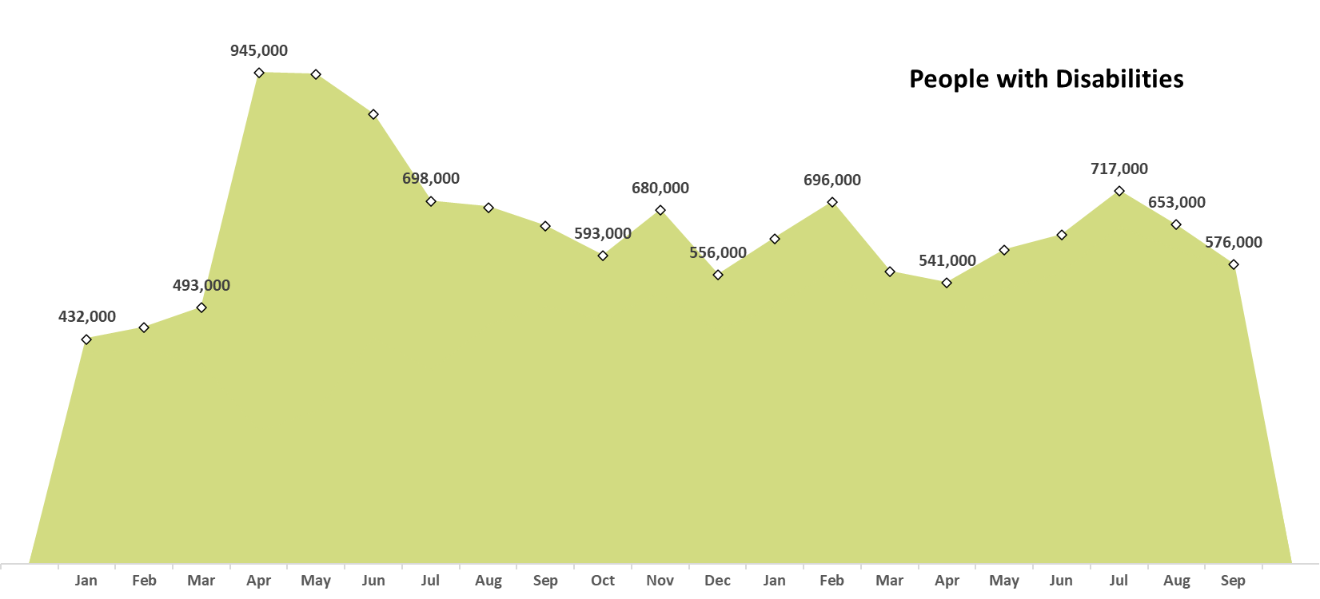
Number Unemployed

Slide 21
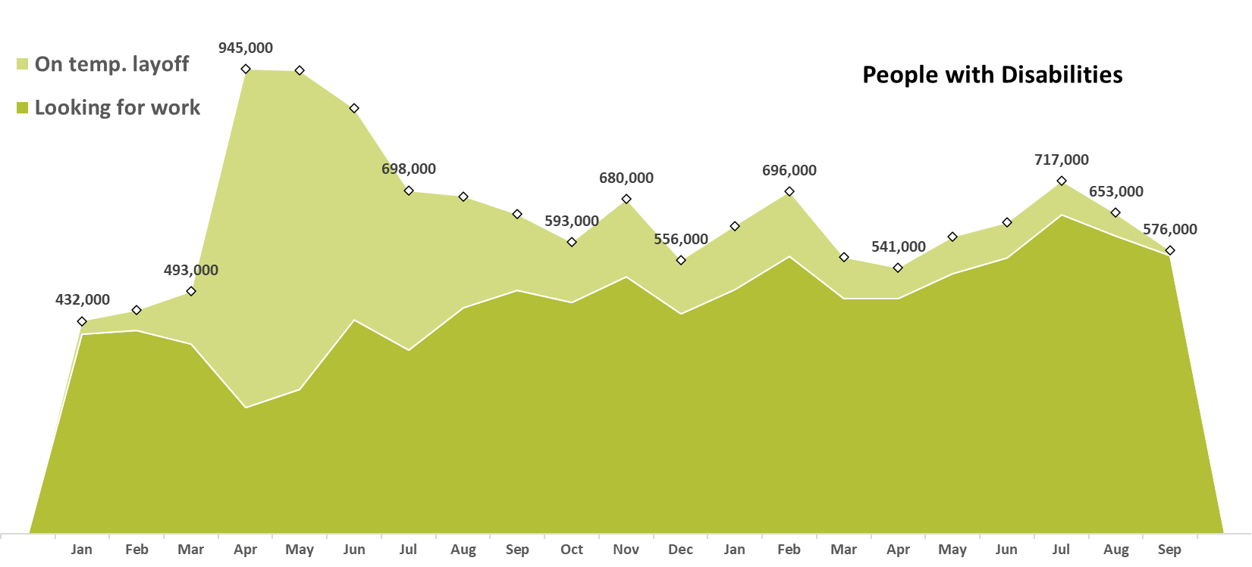
Number Unemployed

Slide 22
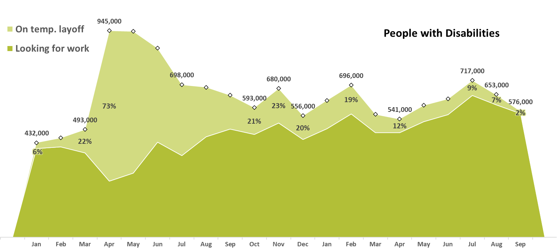
Number Unemployed

Slide 23
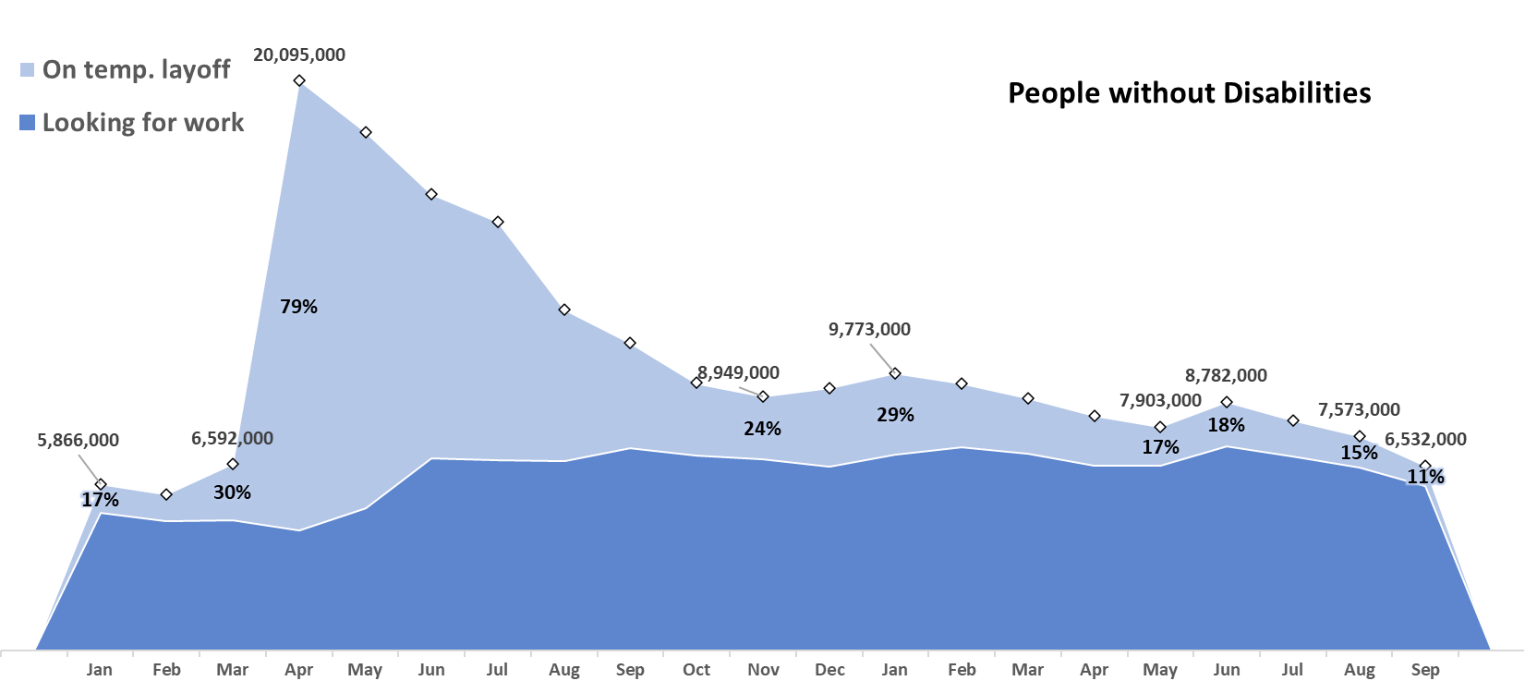
Number Unemployed

Slide 24
Employment-to-Population Ratio
Disability Types
Most recent 12-months
(Oct 2020 – Aug 2021)
versus
Same 12-months prior to COVID
(Oct 2018 – Aug 2019)
… a full year apart

Slide 25
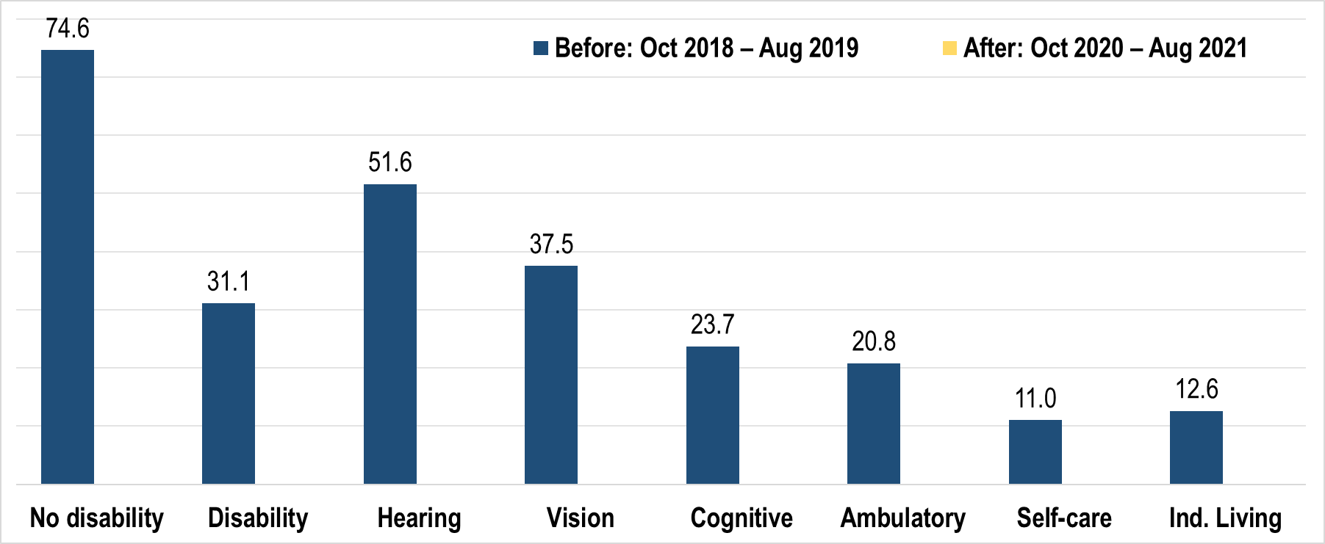
Employment-to-Population Ratio

Slide 26
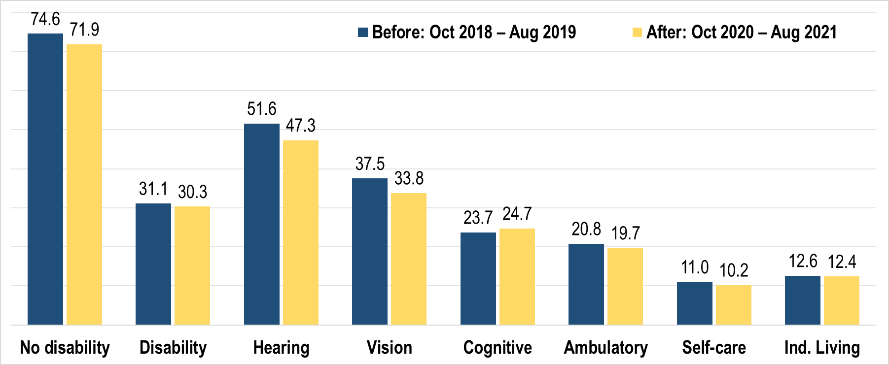
Employment-to-Population Ratio

Slide 27
Discussion
Use Q&A button on Zoom:
Discussion Questions - Is there a “new normal” (200,000+)? - If so, why?

Slide 28
Archive and Feedback
Slides will be archived at - https://researchondisability.org/home/ntide
Take our feedback survey at - https://researchondisability.org/home/ntide

Slide 29
Thank You!
Thanks to our partners: - UNH/Institute on Disability (www.ResearchOnDisability.org) - Kessler Foundation (www.KesslerFoundation.org) - AUCD (www.AUCD.org)
Contact us: - Email: Disability.Statistics@unh.edu - Call: 866-538-9521 (toll free)
Twitter at #nTIDELearn

Slide 30
Thank You!
Thanks to our partners: - UNH/Institute on Disability (www.ResearchOnDisability.org) - Kessler Foundation (www.KesslerFoundation.org) - AUCD (www.AUCD.org)
Contact us: - Email: Disability.Statistics@unh.edu - Call: 866-538-9521 (toll free)
Twitter at #nTIDELearn

