Slide 1
nTIDE Lunch & Learn Webinar Series
Kessler Foundation, AUCD, University of New Hampshire Institute on Disability Season 6, Episode 9 Date: September 3, 2021

Slide 2
nTIDE Lunch & Learn Webinar Series
Kessler Foundation, AUCD, University of New Hampshire Institute on Disability Season 6, Episode 9 Date: September 3, 2021

Slide 3
Up Front Matters
This webinar is being recorded. We will post an archive of along side the Monthly nTIDE broadcast on our webinar, each month, on our website at www.researchondisability.org/nTIDE. This site will also provide copies of the presentations, the speakers’ bios, full transcripts, and other valuable resources.
As an attendee of this webinar, you are a viewer. To ask questions of the speakers, click on the Q & A box on your webinar screen and type your questions into the box. Speakers will review these questions and provide answers during the last section of the webinar. Some questions may be answered directly in the Q & A box.

Slide 4
Up Front Matters
If you have any questions following this recording, please contact us at disability.statistics@unh.edu, or toll free at 866-538-9521 for more information. Thanks for joining us. Enjoy today's webinar!

Slide 5
Welcome
Andrew Houtenville University of New Hampshire

Slide 6
Zoom Tips
Zoom Tip #1: Sound
To select the speaker you want to use for today’s webinar, click on the up arrow next to Audio Settings, and then select one of the options.
Zoom Tip #2: Close Captioning
Click on Closed Caption, and then select Show Subtitle for subtitles, or select View Full Transcript to get a running transcript of the captions.
Your screen may
look a bit different

Slide 7
About nTIDE Lunch & Learn
Occurs at noon Eastern-time on the first Friday day of each month, with the release of the nTIDE Report.
A joint effort of the University of New Hampshire, Kessler Foundation, and the Association of University Centers on Disabilities (AUCD).

Slide 8
Today’s Program
Part 1: nTIDE Report … “The Numbers”
Elaine Katz, Kessler Foundation
Andrew Houtenville, University of New Hampshire
Part 2: nTIDE News
Denise Rozell, Association of University Centers on Disabilities (AUCD)
Part 3: Guest Speaker
Samantha Evans, International Association of Accessibility Professionals
Part 4: Q&A

Slide 9
Part 1: The nTIDE Report
Andrew Houtenville
University of New Hampshire

Slide 10
The Monthly nTIDE Report
The monthly nTIDE Report is a press release and infographic, looking at the latest employment statistics.
Uses data from the “jobs report” released by the U.S. Bureau of Labor Statistics, on the 1st Friday of each month.

Slide 11
Source of the Data
U.S. BLS, Current Population Survey (CPS).
Source of the “official” unemployment rate.
Civilians, ages 16-64, not living in institutions.
Available September 2008 onward.
Not yet seasonally adjusted.
which is why we compare to the same month last year.

Slide 12
The Numbers
Andrew Houtenville University of New Hampshire

Slide 13
Employment -to- Population Ratio

Slide 14
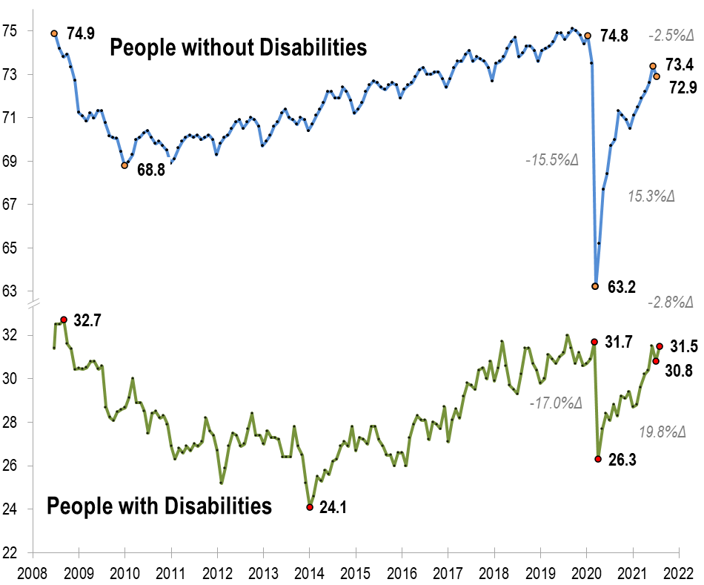
Employment -to- Population Ratio
`

Slide 15
Employment -to- Population Ratio
`

Slide 16
Employment -to- Population Ratio

Slide 17
Employment -to- Population Ratio
Let’s review the Pandemic-related
decline and recovery to date
–and–
Compare people with and without disabilities

Slide 18
Employment -to- Population Ratio

Slide 19
Employment -to- Population Ratio

Slide 20
Employment -to- Population Ratio

Slide 21
Employment -to- Population Ratio

Slide 22
Employment -to- Population Ratio

Slide 23
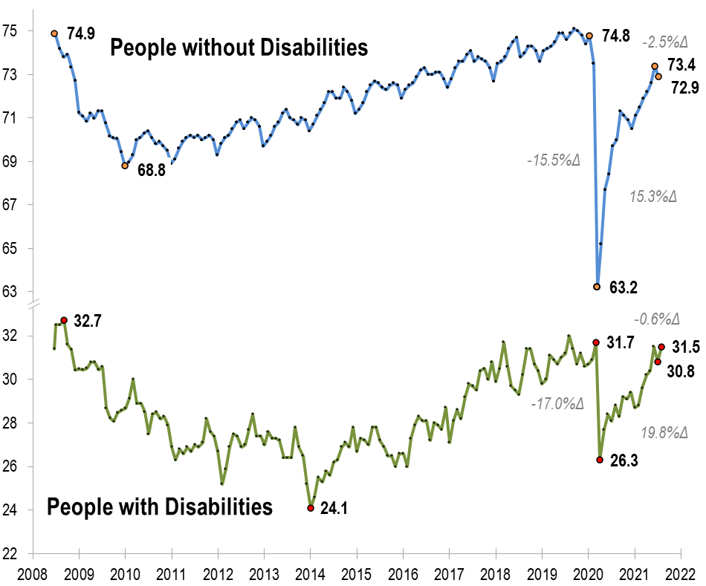
Employment -to- Population Ratio

Slide 24
Employment -to- Population Ratio

Slide 25
Labor Force Participation Rate

Slide 26
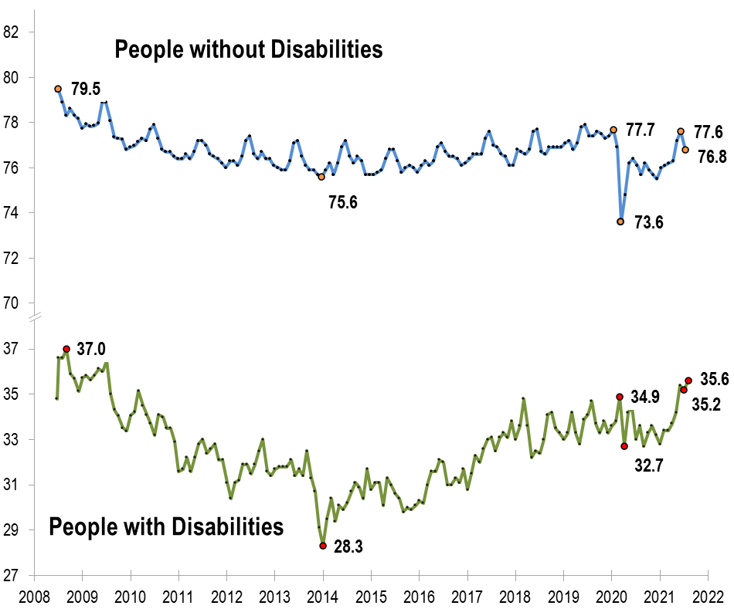
Labor Force Participation Rate

Slide 27
Labor Force Participation Rate
July 2009!!!

Slide 28
Part 2 nTIDE News
Denise Rozell
Association of University Centers on Disabilities (AUCD)

Slide 29
Federal Policy Update
Bipartisan Infrastructure bill
Budget Reconciliation
Better Care Better Jobs Act S. 2210, HR 4231
MFP permanent/spousal impoverishment permanent
HCBS funding – $400 billion??
Subminimum wage
SSI

Slide 30
How States Can Utilize American Rescue Plan Funds: Individuals with Disabilities
Council of State Governments looks at how American Rescue Plan Act funds can be used by states to affect change for people with disabilities:
Education
Home and Food Security
Employment
States as model employers
Private sector employment
Youth transition
Items like database system improvement, Employment First Task Forces, better train staff, develop centralized accommodations fund for state agencies and private sector, accelerate WIOA plan implementation and more.

Slide 31
The Center for Advancing Policy on Employment for Youth (CAPE-Youth)
CAPE-Youth is funded by ODEP
Launching a national research study re how to improve transition outcomes for youth and young adults with disabilities (Y&YAD),
looking at workforce development and educational systems;
explore best practices, challenges, strategies to improve the professional development of youth-serving professionals;
insights to guide the efforts of state policymakers.
https://cornell.ca1.qualtrics.com/jfe/form/SV_cZkCMPHJOCZkehv to indicate your interest in our research study.

Slide 32
Employment: COVID and Long Haul COVID
Department of Labor/ODEP Resources:
Workers: job accommodations, benefits (COBRA, protecting health coverage & retirement benefits), employment services and job training, lay off due to COVID, mental health services, finances and housing supports
Employers: Accommodations, remote work, COVID impacts on pwd
Youth: CAPE-Youth; State COVID-19 Responses to COVID by state and by topic

Slide 33
Trauma-Informed Recruiting and Retention Resources
WorkforceGPS website, but also referred to other resources
Includes videos, website, E-Guide, tip sheet
Fact Sheet is targeted to apprenticeships, but could be used for anything; includes basic practices shifting models
Web page includes additional resources:
Includes description of “trauma informed care”;
Trauma Informed Care Implementation Resource Center ;
Video with infographic explaining TIC and how early trauma can affect health and functioning;
Video on importance of trauma informed approach in all parts of an organization’s services, interactions, processes.

Slide 34
Trauma-Informed Policy Considerations for Youth and Young Adults with Disabilities
October 7, 2021, 2:00 pm Eastern
Hosted by CAPE-Youth
Pervasive nature of trauma and adverse childhood experiences (ACE) among youth and young adults with disabilities
Explore how trauma-informed care practices can be applied to workforce systems to decrease barriers to employment
Look at innovative and promising trauma-informed care and culturally responsive practices being used by states to improve access to employment among youth who have historically experienced barriers.

Slide 35
ThinkWork State Data Blue Book
State specific data since 1988 from state ID/DD agencies, VR, SS Administration, Census, Dept of Labor,
How does your state compare? Read your State Snapshot.
Want to learn about data from different agencies? Browse our publications by data source.
Compare data trends within states and nationally: Try our "Build a Chart" Tool.
Read our Executive Blue Book summary in Data Note 71.
Get the full picture: Download the Blue Book.
StateData is a Longitudinal Data Collection Project of National Significance, funded in part by the Administration for Community Living, US Department of Health and Human Services.

Slide 36
Understanding Persons With Disabilities’ Reasons for Not Seeking Employment
Rehabilitation Counseling Journal, Fyffe, Lequerica, Ward-Sutton, Williams, Sundar, O’Neill, April 2021
Using the 2015 Kessler Foundation National Employment and Disability Survey (KFNEDS); 1,254 adults (ages 18–64) living with disabilities, who self-identified as either unemployed or not seeking employment
Overall, medical conditions, functional limitations, or their disability were more likely to be reported as reasons for not seeking work, rather than situational reasons associated with workplace engagement, such as “lack of job opportunities.”
Variability in reasons reported by respondents by sex, race/ethnicity, age, household income, and disability

Slide 37
America’s housing affordability crisis: Perpetuating disparities
Burns, Mendonca, Pickens, Smith; Disability and Society, online Aug. 2021
PWD particularly hit by rising housing prices; paper looks at affordability crisis since Great Recession 2008 through COVID
Economic impact of the pandemic
Accessibility issues
PWD have heightened risk for COVID and health/safety issues from affordable housing challenges
Major public health problem will only grow as gov’t supports end
Gov’t and housing organizations need to find ways to support affordability, quality, accessibility, and unique needs of pwd

Slide 38
Webinar: Systems Level Inter-Agency Collaboration: How One State Made it Work
September 16, 12:00 Eastern, sponsored by NTACT: The Collaborative
Maryland Departments of Education, Labor, Rehab Services, and Disabilities re how they created a “super” MOU regarding transitioning youth.
Contributions from each agency
Benefits to each/all
Building sustainable practices across agencies
How did they do it?

Slide 39
Part 3: nTIDE Guest Speaker
Samantha (Sam) Evans
Certification Manager,
International Association
of Accessibility Professionals

Slide 40
Virtual Interviews & Hiring To Disclose or Not To Disclose?
Samantha Evans, MBA, CAE
Certification Manager International Association of Accessibility Professionals
A Division of G3ict

Slide 41
Virtual Interviews & Disability Strategy
You’ve made it through the application process
You’ve gone through a series of email conversations
You may have had a phone call or two
Now it’s time for the virtual interview (live)
Or
Recording your interview through a system

Slide 42
Where do you consider disclosing a disability in the hiring and virtual interview process?
Disclose as informational before a virtual interview
Disclose by asking for an accommodation for the virtual process
Disclose during the virtual interview
Exposure during the virtual interview

Slide 43
Disclosing for Information
You want to disclose your disability so that the recruiter or interviewer is aware of your disability
You want the interviewer to understand your communication styles
You want the interviewer to not be surprised when they meet with a disabled candidate

Slide 44
Disclosing to Ask for Accommodations
You require an accommodation during your interview
Provide time for the organization to arrange your requested accommodation
Give insights so that the interview will be aware of how best to engage with you
Advocate for your ability to present your best self using your assistive technology or adaptive strategy of choice
Learn if the organization is familiar with how to accommodations

Slide 45
Disclosing during the interview
Your introduction might include your disability as part of your identity/identities and background
As part of the conversation you may mention to the interviewer a that part of your personal presentation is your disability
Highlighting your familiarity with accommodations and assistive technology or adaptive strategy as a strength for the position

Slide 46
Exposure During The Interview
How you present makes your disability visually or audibly clear to the interviewer
Visible physical disabilty
Speech patterns or use of AAC
Movement
Eye contact or not making eye contact

Slide 47
Recruiters Said:
I believe most of the disabled candidates I serve disclose to me before the interview
I’ve never had an organization decline an accommodation request
Working in job placement it is not uncommon to help set up the best experience for the candidate
Some disabled candidates don’t feel comfortable disclosing prior to the interview and choose to not disclose

Slide 48
Hiring Managers Said:
I’d like to know so that we can provide the best format for our interview
Sometimes I had no idea until the interview
By the time a candidate gets to the “in person” interview they’ve already been qualified for the role

Slide 49
What do you think?
You will learn a lot about an organization no matter how or when you present your disability
You are not required to disclose your disability at the interview level of exploration
You are not required to disclose your disability
You are not required to disclose a disability to request an accommodation
Each person’s approach is different
Inclusion of disabilities as part of DEI is more common than in the past

Slide 50
If you’re interested in learning more about accessibility feel free to contact me!
Contact Details:
sam.evans@accessibilityassociation.org
https://www.linkedin.com/in/samanthaspearsevans/
https://twitter.com/samspearsevans

Slide 51
Questions and Answers
Use Q&A button on Zoom
Slides will be archived at: https://researchondisability.org/home/ntide.
Take our feedback survey at …
www.researchondisability.org/ntide/ntide-survey

Slide 52
Thank You!
Information about the nTIDE partners may be found at
Kessler Foundation (www.kesslerfoundation.org)
UNH/Institute on Disability (www.ResearchOnDisability.org)
AUCD (www.AUCD.org)
Contact us at
Email: Disability.Statistics@unh.edu
Call: 866-538-9521 (toll free)
Twitter at #nTIDELearn

Slide 53
Bye!

