Slide 1
nTIDE Lunch & Learn Webinar Series
Kessler Foundation, AUCD, University of New Hampshire Institute on Disability Season 6, Episode 6 Date: July 2, 2021

Slide 2
nTIDE Lunch & Learn Webinar Series
Kessler Foundation, AUCD, University of New Hampshire Institute on Disability Season 6 Episode 6 Date: July 2, 2021

Slide 3
Up Front Matters
This webinar is being recorded. We will post an archive of along side the Monthly nTIDE broadcast on our webinar, each month, on our website at www.researchondisability.org/nTIDE. This site will also provide copies of the presentations, the speakers’ bios, full transcripts, and other valuable resources.
As an attendee of this webinar, you are a viewer. To ask questions of the speakers, click on the Q & A box on your webinar screen and type your questions into the box. Speakers will review these questions and provide answers during the last section of the webinar. Some questions may be answered directly in the Q & A box.

Slide 4
Up Front Matters
If you have any questions following this recording, please contact us at disability.statistics@unh.edu, or toll free at 866-538-9521 for more information. Thanks for joining us. Enjoy today's webinar!

Slide 5
Welcome
Andrew Houtenville University of New Hampshire

Slide 6
Zoom Tips
Zoom Tip #1: Sound
To select the speaker you want to use for today’s webinar, click on the up arrow next to Audio Settings, and then select one of the options.
Zoom Tip #2: Close Captioning
Click on Closed Caption, and then select Show Subtitle for subtitles, or select View Full Transcript to get a running transcript of the captions.
Your screen may
look a bit different

Slide 7
About nTIDE Lunch & Learn
Occurs at noon Eastern-time on the first Friday day of each month, with the release of the nTIDE Report.
A joint effort of the University of New Hampshire, Kessler Foundation, and the Association of University Centers on Disabilities (AUCD).

Slide 8
Today’s Program
Part 1: nTIDE Report … “The Numbers”
Andrew Houtenville, University of New Hampshire
John O’Neil, Kessler Foundation
Part 2: nTIDE News
Denise Rozell, Association of University Centers on Disabilities (AUCD)
Part 3: Guest Speaker
Clark Rachfal, American Council of the Blind
Part 4: Q&A

Slide 9
Part 1: The nTIDE Report
Andrew Houtenville
University of New Hampshire

Slide 10
The Monthly nTIDE Report
The monthly nTIDE Report is a press release and infographic, looking at the latest employment statistics.
Uses data from the “jobs report” released by the U.S. Bureau of Labor Statistics, on the 1st Friday of each month.

Slide 11
Source of the Data
U.S. BLS, Current Population Survey (CPS).
Source of the “official” unemployment rate.
Civilians, ages 16-64, not living in institutions.
Available September 2008 onward.
Not yet seasonally adjusted.
which is why we compare to the same month last year.

Slide 12
The Numbers
Andrew Houtenville University of New Hampshire

Slide 13
Employment -to- Population Ratio

Slide 14
Employment -to- Population Ratio

Slide 15
Employment -to- Population Ratio

Slide 16
Employment -to- Population Ratio

Slide 17
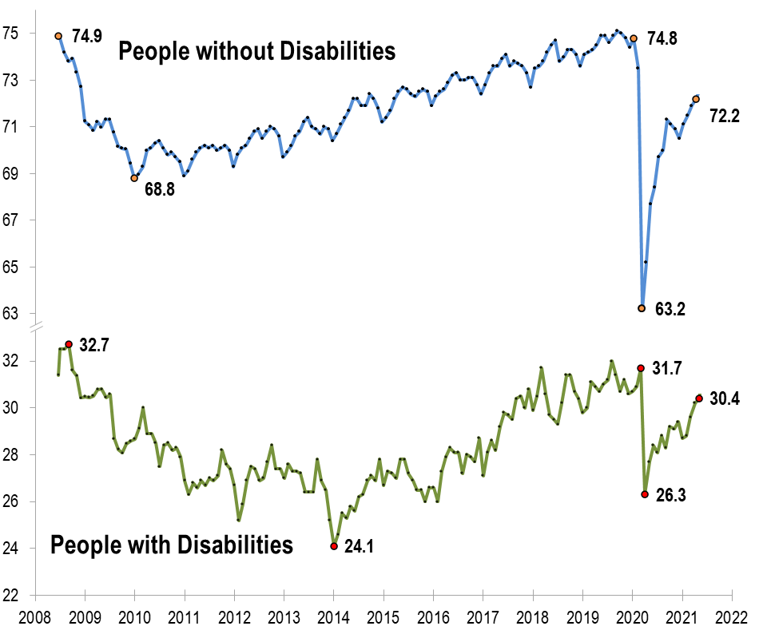
Employment -to- Population Ratio

Slide 18
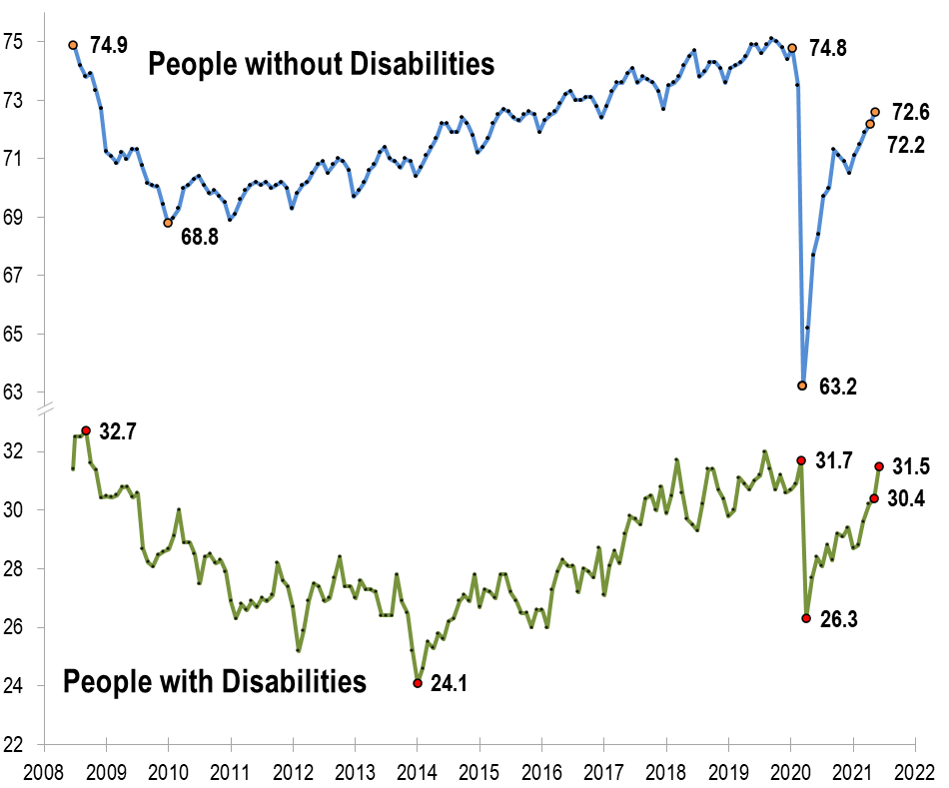
Employment -to- Population Ratio

Slide 19
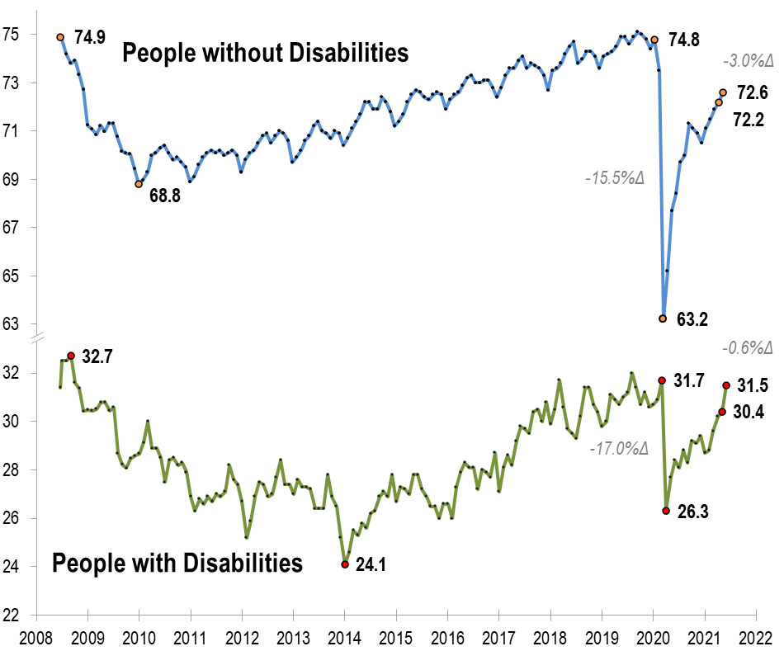
Employment -to- Population Ratio

Slide 20
Labor Force Participation Rate

Slide 21
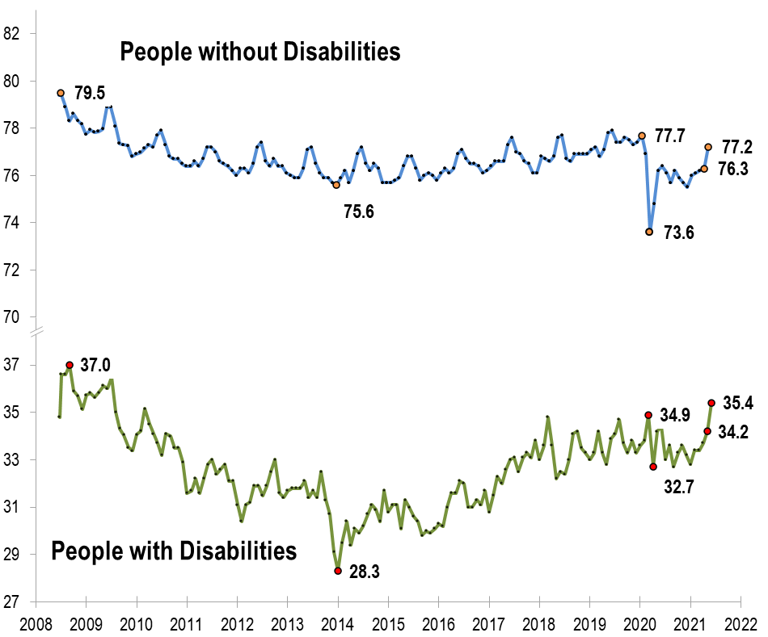
Labor Force Participation Rate

Slide 22
Labor Force Participation Rate
July 2009!!!

Slide 23
Part 2 nTIDE News
Denise Rozell
Association of University Centers on Disabilities (AUCD)

Slide 24
Federal Policy Update
Better Care Better Jobs Act S. 2210, HR 4231
MFP permanent/spousal impoverishment permanent
HCBS funding – $400 billion
Bipartisan Infrastructure bill
Budget Reconciliation
Work without Worry Act S.2108, HR 4003
Appropriations

Slide 25
New from Employer Assistance and Resource Network for Disability Inclusion
Adopting an Integrated Telework Policy for Employees With and Without Disabilities This brief looks at strategies for employers developing or reworking telework policies to ensure inclusion for all, including those with disabilities including:
How to create a single integrated policy by specifying how the ADA applies to the company’s existing telework rules.
A checklist for employers including guidance on telework policy statements, what to include in remote work agreements and strategies for implementation.
Disability-Inclusive COVID-19 Workplace Health and Safety Plans The brief explores health and safety considerations for all workers, including those with disabilities, during COVID-19 recovery.

Slide 26
Changes in the Employment Status of People With and Without Disabilities in the United States During the COVID-19 Pandemic
Archives of Physical Medicine and Rehabilitation, Houtenville, Paul, Brucker, published April 8, 2021
Using data from Current Population Survey
“Estimates show that, like workers without disabilities, workers with disabilities experienced increases in unemployment at the beginning of the pandemic but continued to remain engaged in the labor force. Our analysis finds that employment rates dropped from 74.8% to 63.2% for those without disabilities and from 31.1% to 26.4% for those with disabilities between February 2020 and April 2020 but gradually improved in the succeeding months.”

Slide 27
WIOA State Plan Search Tool
DOL and DOEd developed a WIOA State Plan search tool
Intended for use by the public workforce development system, the public, and stakeholders
Search in your state or across state plans
Includes some past plans

Slide 28
Using Universal Design for Learning in Apprenticeship
Next brief in the series by ODEP in the AIM initiative (Apprenticeship Inclusion Models)
Explains development and key principles of UDL
Identifies practices in tested in education/work based learning that would benefit apprenticeship and pre apprenticeship programs
Lists challenges in adopting UDL
Provides state examples

Slide 29
Exploring Self-Employment Beyond the Business Enterprise Program(BEP)
RRTC on Employment of People Who are Blind or Have Low Vision (NIDILRR funded) at Mississippi State
Self-paced, online course .
For VR counselors who may have limited knowledge about self-employment for people who are blind or have low vision.
Covers cie customized employment, WIOA, and other topics as they relate to self-employment.
Describe how the Small Business Development Center in your state can guide you.
Continuing education credits are available.

Slide 30
Quick Reference Guides: Serving Returning Citizens with Disabilities
The Bureau of Justice Statistics reports that the U.S. disability rate is significantly higher among individuals who have been incarcerated and 600,000 people are released form state and federal prisons each year. .
Workforce GPS, website for the American Job Centers -
Quick reference guides for AJC staff:
Statistics, tips, and resources
Strategies for improving disability disclosure
Leveraging partners to secure wrap-around support services,
Providing reasonable accommodations.

Slide 31
Webinar: Reflecting on the Americans with Disabilities Act: Advancements in Technological Support Solutions on the Job in a COVID World
Tuesday, July 13th, 2021, 3:00 – 4:30 p.m. ET
Sponsored by the Disability Employment TA Center/ ACL
Importance of technological innovation in competitive, integrated employment (CIE)
Information on:
Innovative workplace assistive technologies,
Role of federally-funded assistive technology programs to enhance employment outcomes of people with disabilities; and
Real-life success stories of two people with disabilities who’ve benefited from individualized technological solutions to help them achieve CIE.

Slide 32
APSE COVID Survey – Take 2 (or 3?)
It's been 1 year since APSE launched the COVID impact survey
Assess the direct impact of the COVID-19 pandemic on disability employment outcomes and services, and identify areas of need.
This survey will take 10-15 minutes of your time.
Help Us Tell Congress #WhatWeNeed to Continue to Provide Employment Supports During the COVID-19 Crisis and Recovery.
www.apse.org/covidsurvey

Slide 33
APSE Webinar: Lessons from 2020, Structuring Virtual Internships for Young Professionals with Disabilities
2020 changed the world of job training and coaching for young professionals with disabilities.
RespectAbility’s efforts to improvise, adapt and overcome in the face of transition from an in-person internship program to an all-virtual, remote program.
What worked, what failed, and what we are doing better now.
Thursday, July 8, 2021, from 1:00-2:00 pm EST
$10 APSE Members | $20 Non-Members
Presenters: Philip Kahn-Pauli & Ben Spangenberg

Slide 34
Women and Work National Dialogue: Reinvestment, Return and Recovery
DOL Women's Bureau, ODEP, ETA, and Wage and Hour hosting a national online dialogue
Gathering information on:
Barriers to women's full workforce participation;
Ways to provide resources and tools to support women workers and create a more equitable economy;
Share ideas on ending gender-based harassment and discrimination on the job, tools and training for workplace entry or reentry, creating comprehensive paid family and medical leave, expanding access to affordable childcare and more.
Open through July 9

Slide 35
#AUCDsleeveup Tuesdays with Liz Contest: Why did you get the COVID-19 vaccine?
Deadline: July 16, 2021
Submit short (less than 1 minute) videos from people with disabilities, their family members, and other friends of the disability community
Videos will be posted to AUCD social media and available for you and others to share with your own social media.
The top 3 videos with the most likes, comments, and shares on social media will *win* AUCD gear
The person with the top video will also win an interview on Tuesdays with Liz episode!

Slide 36
Part 3: nTIDE Guest Speaker
Clark Rachfal
Director of Advocacy and Government Affairs
American Council of the Blind

Slide 37
Questions and Answers
Use Q&A button on Zoom
Slides will be archived at: https://researchondisability.org/home/ntide.
Also … take our feedback survey at …
www.researchondisability.org/ntide/ntide-survey

Slide 38
Thank You!
Thanks to our funder: Kessler Foundation (www.kesslerfoundation.org)
And thanks to our partners:
UNH/Institute on Disability (www.ResearchOnDisability.org)
AUCD (www.AUCD.org)
Contact us: - Email: Disability.Statistics@unh.edu - Call: 866-538-9521 (toll free)
Twitter at #nTIDELearn

Slide 39
Thank You!
Thanks to our funder: Kessler Foundation (www.kesslerfoundation.org)
And thanks to our partners:
UNH/Institute on Disability (www.ResearchOnDisability.org)
AUCD (www.AUCD.org)
Contact us: - Email: Disability.Statistics@unh.edu - Call: 866-538-9521 (toll free)
Twitter at #nTIDELearn

