Slide 1
nTIDE Lunch & Learn Webinar Series
Kessler Foundation, AUCD, University of New Hampshire Institute on Disability COVID Update Date: July 23, 2021

Slide 2
nTIDE Lunch & Learn Webinar Series
Kessler Foundation, AUCD, University of New Hampshire Institute on Disability COVID Update Date: July 23, 2021

Slide 3
Up Front Matters
This webinar is being recorded. We will post an archive of along side the Monthly nTIDE broadcast on our webinar, each month, on our website at www.researchondisability.org/nTIDE. This site will also provide copies of the presentations, the speakers’ bios, full transcripts, and other valuable resources.
As an attendee of this webinar, you are a viewer. To ask questions of the speakers, click on the Q & A box on your webinar screen and type your questions into the box. Speakers will review these questions and provide answers during the last section of the webinar. Some questions may be answered directly in the Q & A box.

Slide 4
Up Front Matters
If you have any questions following this recording, please contact us at disability.statistics@unh.edu, or toll free at 866-538-9521 for more information. Thanks for joining us. Enjoy today's webinar!

Slide 5
Zoom Tips
Tip #1: Sound
Select the speakers you want to use for today’s webinar, click on the up arrow next to Audio Settings, and then select one of the options.
Tip #2: Close Captioning
Click on Closed Caption, and then select Show Subtitle for subtitles, or select View Full Transcript to get a running transcript of the captions.
Your screen may
look a bit differ

Slide 6
nTIDE COVID-19 Update – June #s
Andrew Houtenville University of New Hampshire John O’Neill Kessler Foundation

Slide 7
About
A joint effort of the University of New Hampshire, Kessler Foundation, and the Association of University Centers on Disability (AUCD).
This is a special episode of the nTIDE Lunch and Learn series based on the unique circumstances in the U.S. economy and the COVID-19 Pandemic.

Slide 8
Today’s Agenda
● 12:00 pm: Welcome and Introduction
● 12:05 pm: Updated Numbers from the Public-Use Micro Data of the Current Population Survey
● 12:35 pm: Open Q&A period

Slide 9
Employment Trend
Slow Recovery from Great Recession,
Some Good News,
… then COVID

Slide 10
Employment -to- Population Ratio

Slide 11
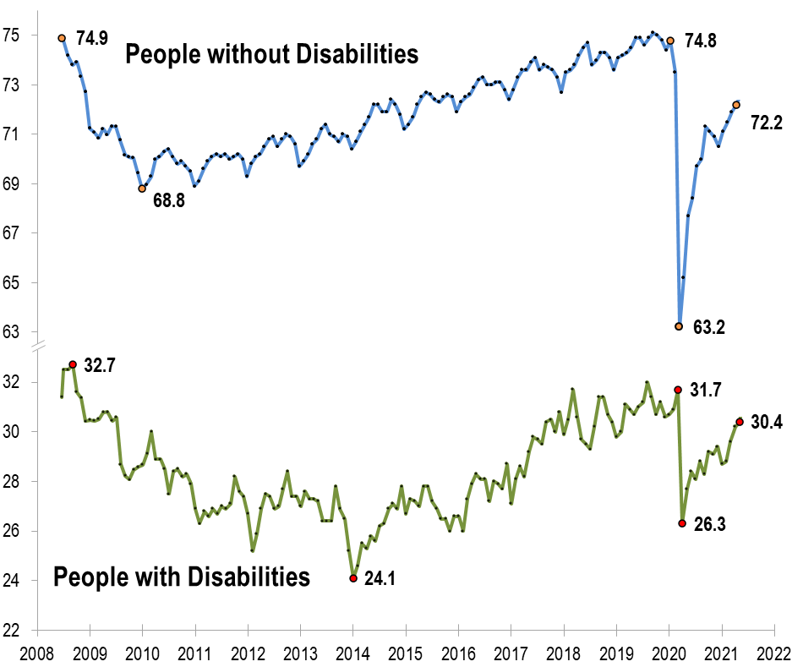
Employment -to- Population Ratio

Slide 12
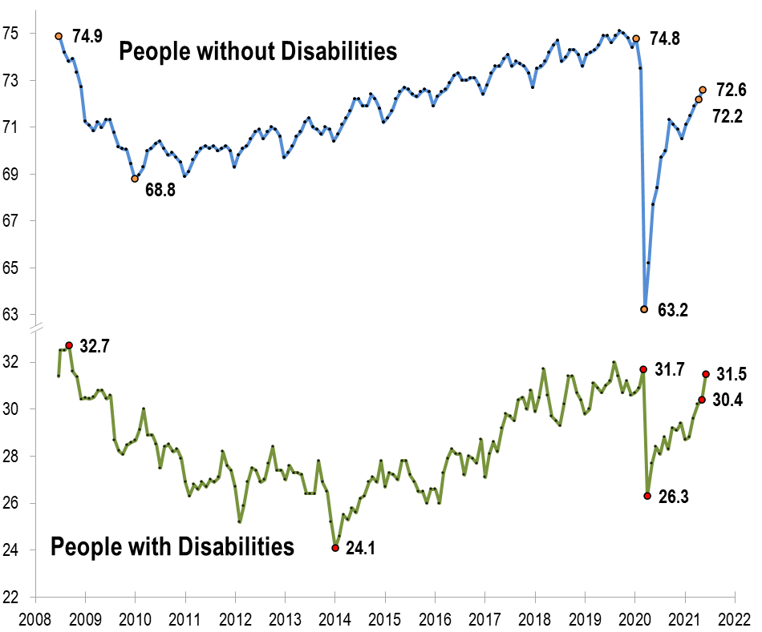
Employment -to- Population Ratio

Slide 13
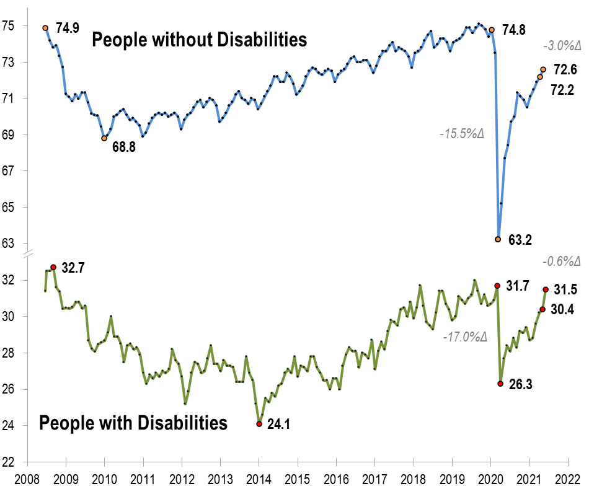
Employment -to- Population Ratio

Slide 14
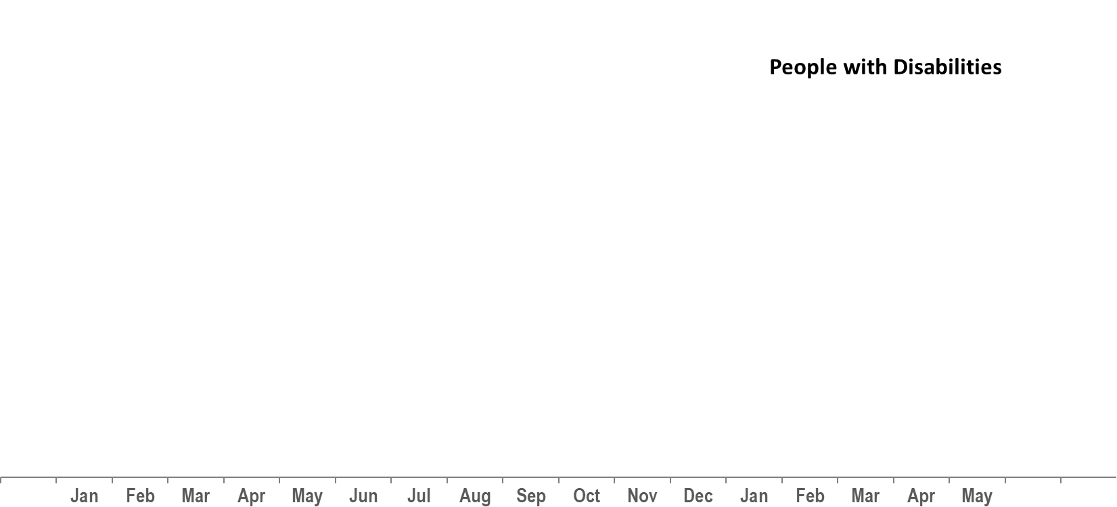
Number Unemployed

Slide 15
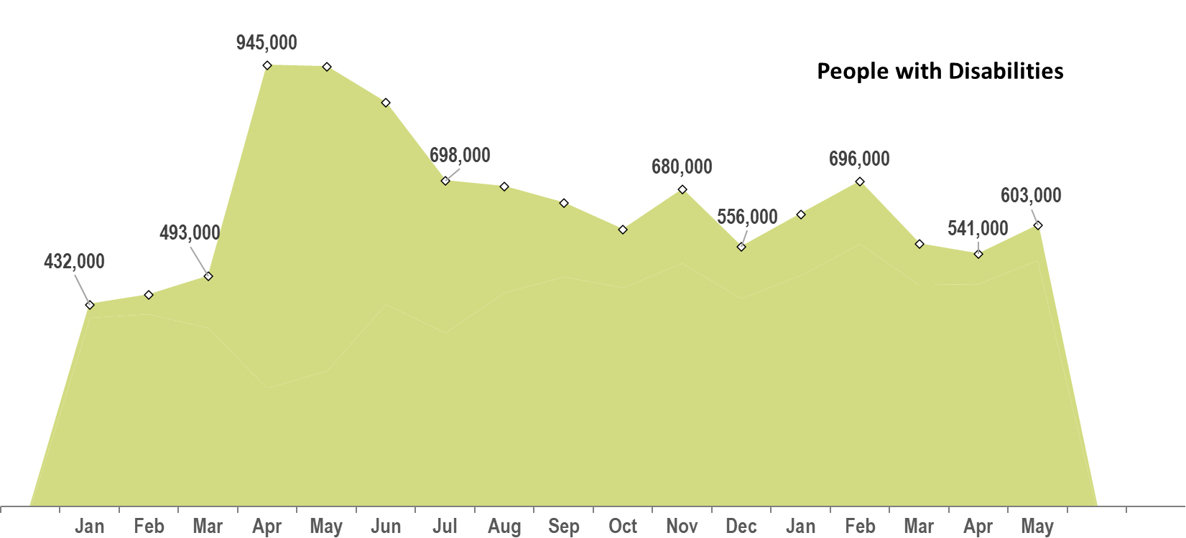
Number Unemployed

Slide 16
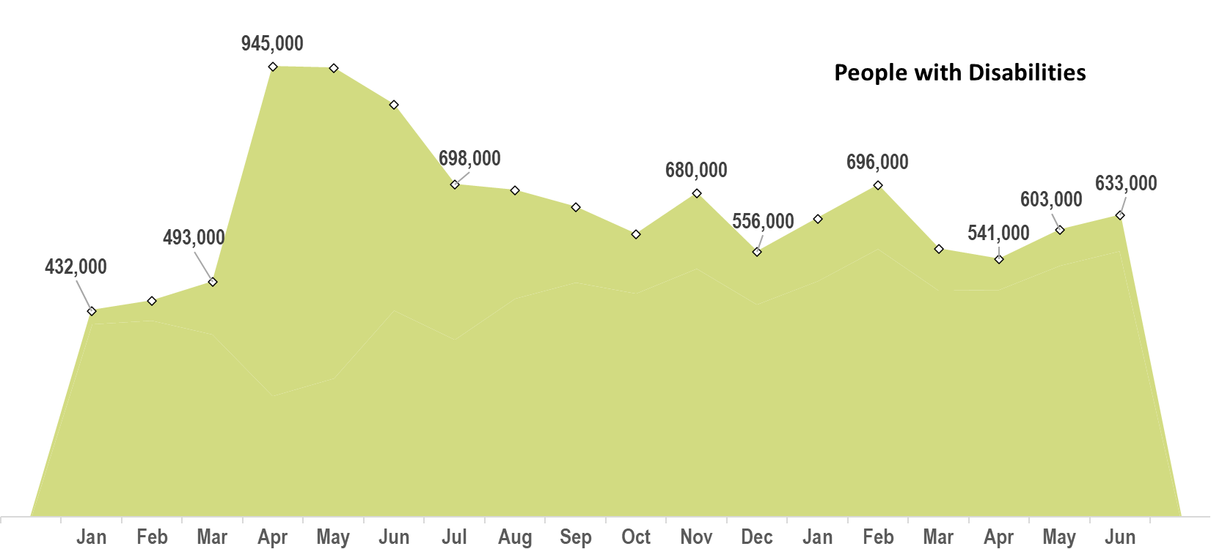
Number Unemployed

Slide 17
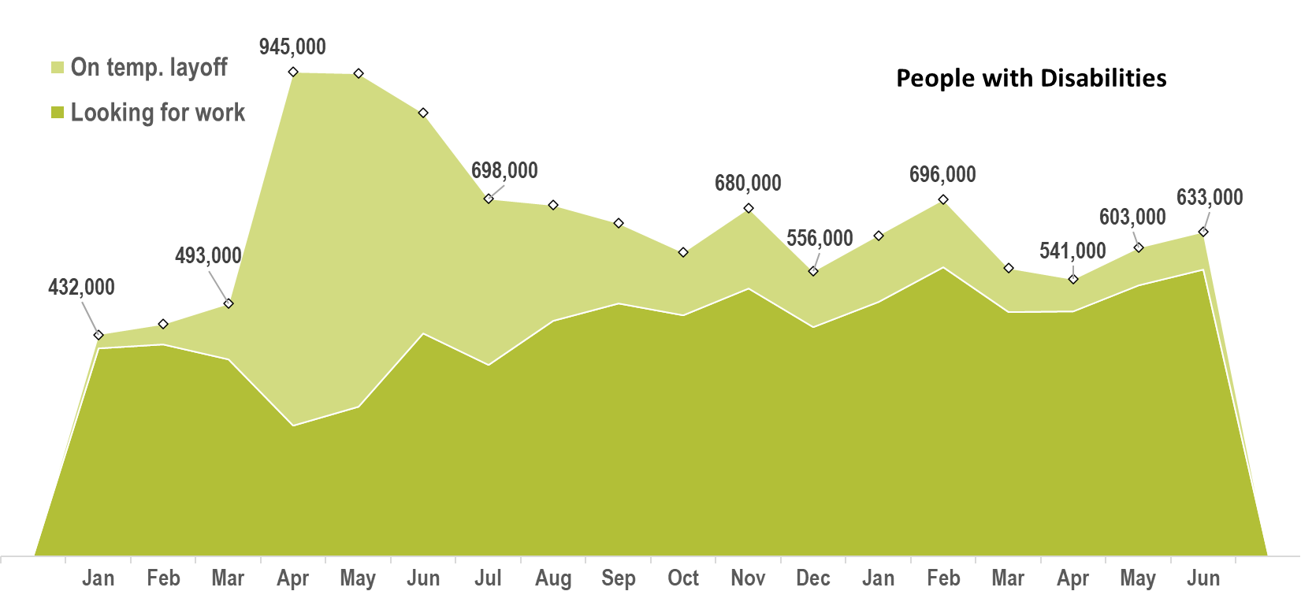
Number Unemployed

Slide 18
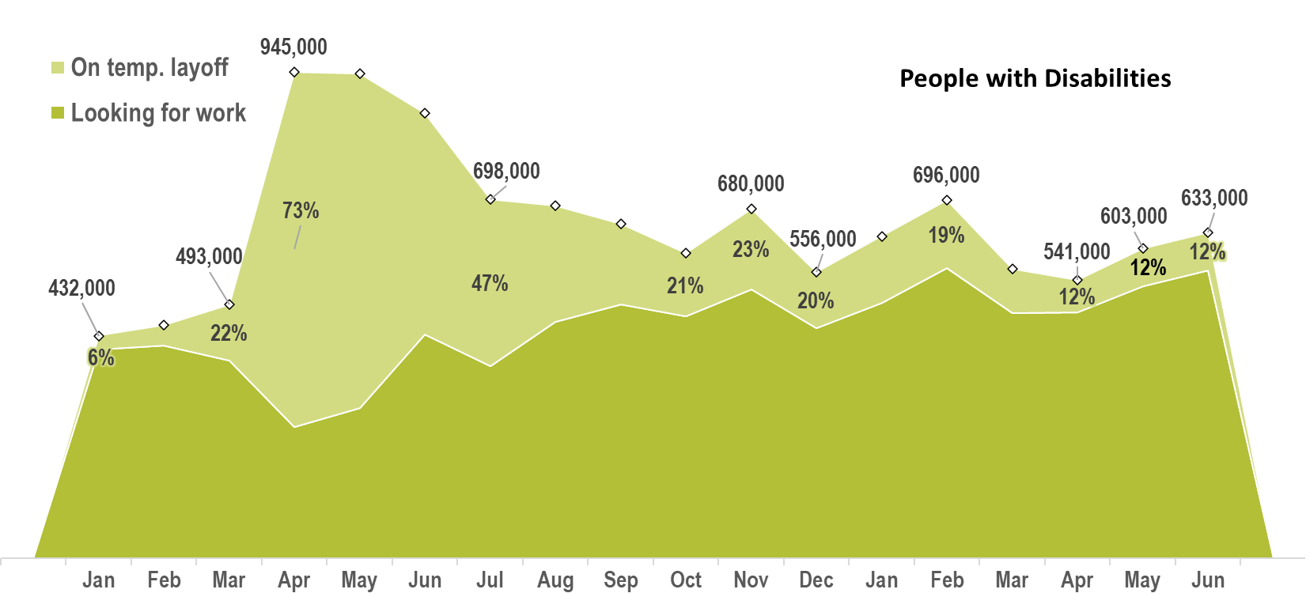
Number Unemployed

Slide 19
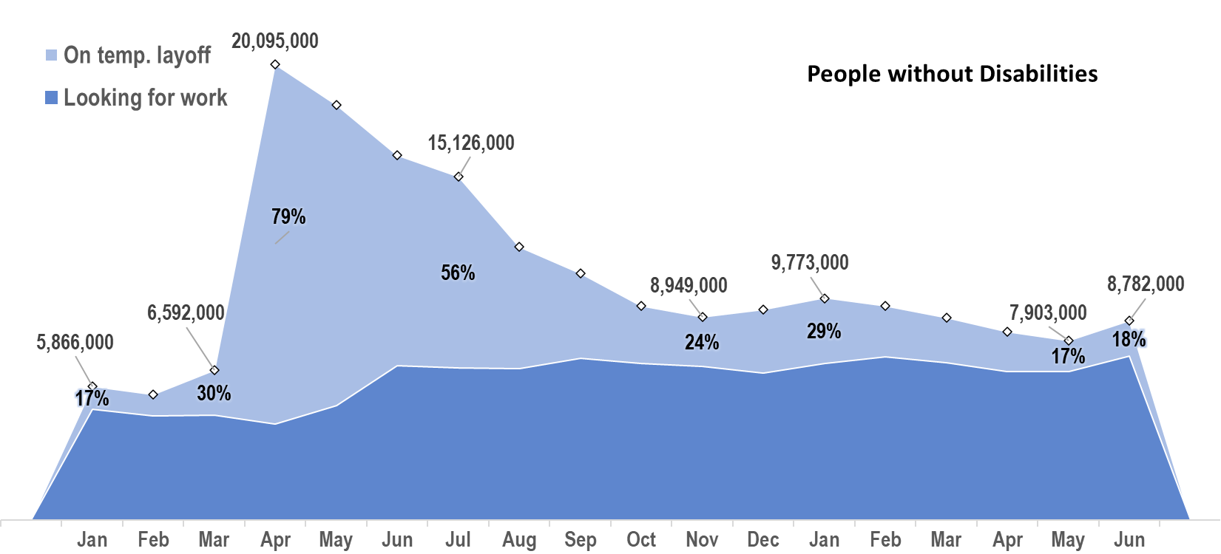
Number Unemployed

Slide 20
Labor Force Participation Rate
Some “good” news

Slide 21
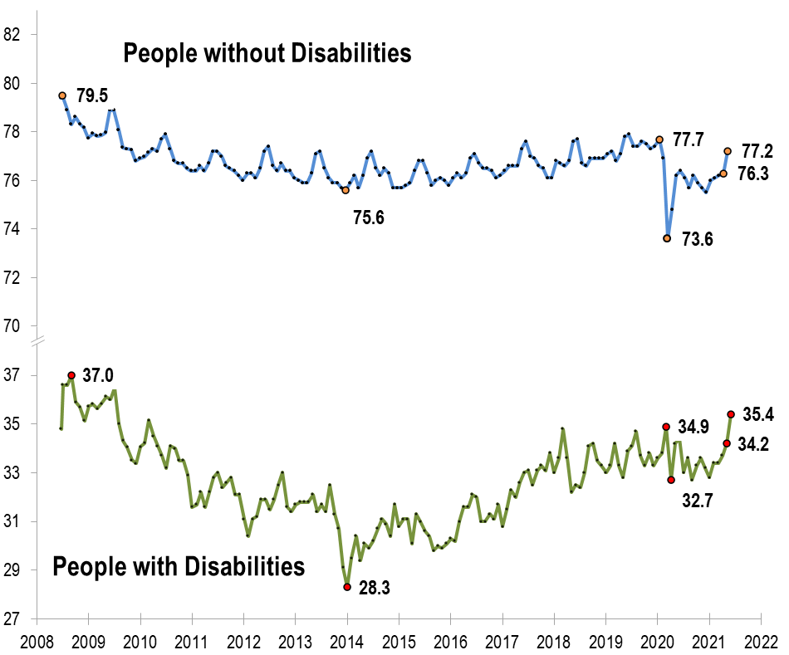
Labor Force Participation Rate

Slide 22
Labor Force Participation Rate
July 2009!!!

Slide 23
Labor Force Participation Rate

Slide 24
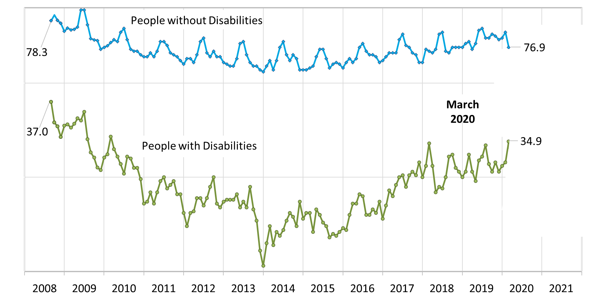
Labor Force Participation Rate

Slide 25
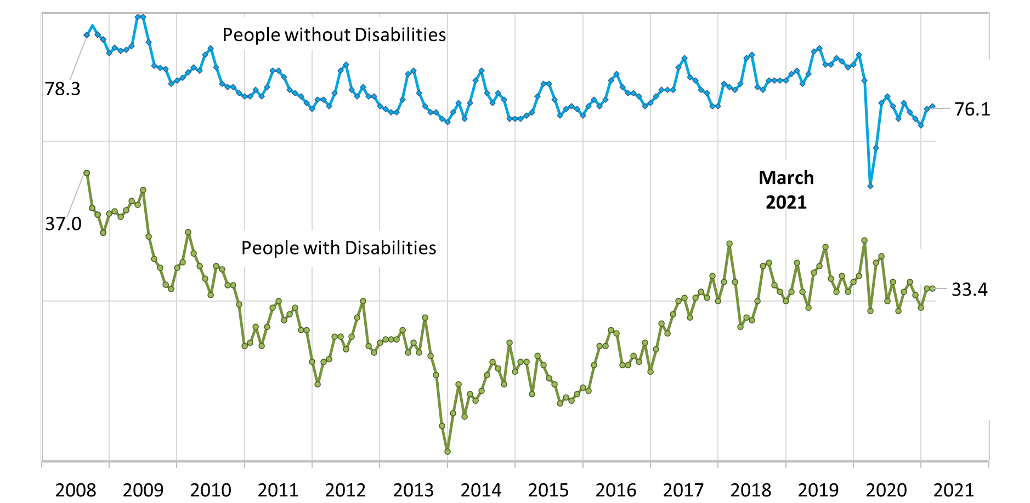
Labor Force Participation Rate

Slide 26
Labor Force Participation Rate

Slide 27
Questions and Answers
Use Q&A button on Zoom:
Slides will be archived at - https://researchondisability.org/home/ntide
Take our feedback survey at - https://researchondisability.org/home/ntide

Slide 28
Thank You!
Thanks to our partners: - UNH/Institute on Disability (www.ResearchOnDisability.org) - Kessler Foundation (www.KesslerFoundation.org) - AUCD (www.AUCD.org)
Contact us: - Email: Disability.Statistics@unh.edu - Call: 866-538-9521 (toll free)
Twitter at #nTIDELearn

Slide 29
Thank You!
Thanks to our partners: - UNH/Institute on Disability (www.ResearchOnDisability.org) - Kessler Foundation (www.KesslerFoundation.org) - AUCD (www.AUCD.org)
Contact us: - Email: Disability.Statistics@unh.edu - Call: 866-538-9521 (toll free)
Twitter at #nTIDELearn

