Slide 1



January 2017
Data to Inform Practitioners
Advocating Using Local Statistics
Susan M. Dooha, JD
Executive Director
Center for Independence of the Disabled, NY (CID*NY)

Slide 2
OUR MISSION
The Center for Independence of the Disabled, New York’s (CIDNY) goal is to ensure full integration, independence and equal opportunity for all people with disabilities by removing barriers to the social, economic, cultural and civic life of the community.

Slide 3
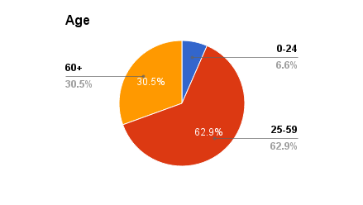
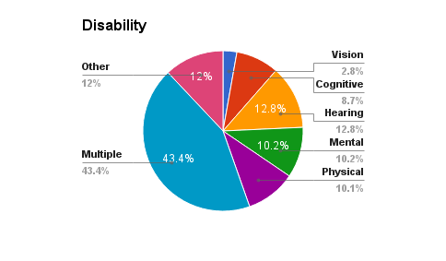
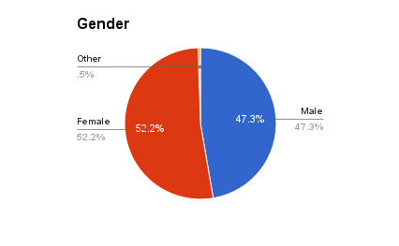
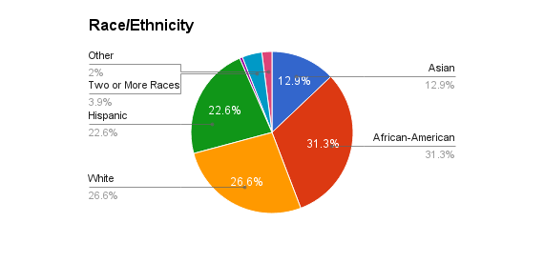
Who We Serve
CIDNY serves any person in New York City with any type of disability. In 2016, CIDNY reached over 22,800 New Yorkers with disabilities, their families and service providers.
CIDNY ACCES-VR consumers mirror the racial and ethnic makeup of New York City. CIDNY serves consumers of all ages. The overwhelming majority are living in poverty.

Slide 4
What do we do?
Help individuals develop roadmaps to meeting their goals;
Provide individualized counseling, screening for benefits, navigational assistance and problem-solving;
Engage individuals in workshops focused on “know your rights,” developing skills for self-advocacy, and independent living, often using peer counselors;
Educate government agencies, corporations, and social service agencies on legal compliance and disability literacy;
Educate the public through the media and social media;
Advocate for change that is responsive to the expressed needs of people with disabilities.

Slide 5
Why do we use research?
We believe in people speaking about their own experiences to policy makers (case studies) and research helps us amplify the experiences they share:
Lawmakers like to know the magnitude of an issue and who is affected—”Give me numbers”;
The media needs to be persuaded that we have expertise and evidence and that we are speaking about a widespread problem;
As people with disabilities we learn from research as it increases our understanding how our experiences relate to the experiences of others like us. We are less alone.

Slide 6
What kind of research do we use?
We engage with people with disabilities through surveys by phone, using internet survey tools, through social media campaigns, community meetings and discussion with advocates.
We conduct “on the street” surveys—we recruit people with disabilities who volunteer and are trained to use survey tools that identify violations of legal standards (sometimes modifying tools available from the U.S. Department of Justice), such as restaurants, health care facilities, polling sites, street access, transportation access.
We scan the literature for research studies that are relevant to the public policy issues that affect us. For example, we are using and citing a recent study of the impact of the Affordable Care Act (ACA) on employment of people with disabilities is being used to help lawmakers understand the implications of ACA repeal for people with disabilities.
We employ policy experts to help us prepare reports, collect documents, survey experiences across states, etc.
We work with the Institute on Disabilities at the University of New Hampshire to provide statistical documentation that illuminates issues that people with disabilities are reporting and to substantiate the impact of barriers that they experience.

Slide 7
How do we work with researchers?
During the past 5 years, we have produced 24 research reports and shared these with policy-makers and the public. These reports have been effective tools in successful campaigns to change law, policy and guidance.
We contact researchers and ask questions that can be answered using the American Community Survey, the Behavioral Risk Factor Surveillance System, or other data systems.
We request data relevant to specific topics that we are working on: poverty; food access; health coverage; transportation; etc.
We discuss the implications of the data for policy makers with the researchers who help us understand findings that are significant—and those that are not.
We make recommendations for policy change based on our own experiences and the available data.
Example: Using the American Community Survey, CIDNY has produced three reports that were distributed to State and City policymakers during 2015-2016: ADA at 26 in New York City (2016); The ADA at 25: Many Bridges to Cross (2015); Disability Status: ADA at 25 (2015).

Slide 8
We distribute reports using data and share them with as Appointees to Government Public Bodies and Nonprofit Advisory Councils
In 2016, we used data from our work with the University of New Hampshire in policy deliberations undertaken by groups including:
NYC DOHMH/NYAM-DASH-NYC Work Group;
Advisory Board at Hunter College (CUNY) for the Rehabilitation Counselor Program;
NYC Department of Finance SCRIE/DRIE Task Force;
NYC Human Resources Administration Disability Advisory work group;
NYC Human Resources Administration SNAP work group;
NYS Medicaid Redesign Team;
New York State Rehabilitation Council;
New York State Department of Education, Commissioner’s Advisory Panel

Slide 9
We distribute reports and policy memos to government officials when seeking legislative change.
CIDNY staff regularly meet with the Governor’s staff and Assembly and Senate members. We testify at public hearings. We write memos of support and opposition. We quote data in meetings, letters, memos, reports, testimony.
In 2016, research contributed to education of lawmakers and State advocacy outcomes, including:
Minimum wage increase;
Paid sick leave;
Increased ADA compliance in health care;
Preserving Medicaid eligibility, access to prescription drugs and transportation;
Increased ADA compliance by NYS Board of Elections and Department of Motor Vehicles web sites;

Slide 10
We use data collected in civil rights litigation and related activities focused on implementing disability civil rights laws in New York City and State.
In 2016, CIDNY is using data in litigation to implement the ADA in New York City and New York State. We are monitoring implementation of three court decisions where we were the representative of the class of plaintiffs.
We cite American Community Survey data in complaints; declarations; testimony; comments on proposed settlements or implementation plans.
In 2016, research data was used in litigation, settlement talks and monitoring in cases related to:
NYC homeless shelter accessibility;
Curb cuts and sidewalk access;
Accessible polling sites;
Accessible voter registration web sites;
Emergency preparedness and disaster response;
Housing discrimination.

Slide 11



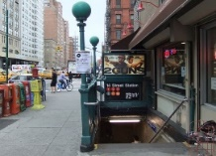
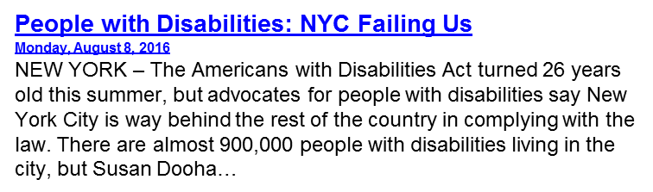
We Use Research with Mainstream and Social Media
This year’s more than 30 stories in general media include:
New York Times: As shelter population surges, housing for disabled comes up short
Wall Street Journal: MTA’s Access-a-Ride Program Fails Disabled Passengers
The Hechinger Report: Eligible but got nothing: Hundreds of thousands of people with disabilities blocked from college aid.
WCBS-TV: ‘It Robs You Of Your Dignity:’ Advocates For Disabled Sue City Over Defective Curb Cuts
Huffington Post: 25 years after the ADA,, Navigating New York City is still daunting for the disabled.
CNN: America still leaves the Disabled Behind
NPR: In Helping those with Disabilities, ADA Improves Access for All
NEW YORK TIMES
N.Y. / REGION
As Shelter Population Surges, Housing for Disabled Comes Up Short by NIKITA STEWART SEPT. 16, 2016
…Susan Dooha, executive director of the Center for Independence of the Disabled in New York, an advocacy group, counted just 32 beds that were fully accessible in the city’s shelter system.
newyork.cbslocal.com
Curb Cuts Around New York Are Defective, Disabled
Advocacy ...
Oct 4, 2016 ... Bartley works at the Center for Independence of the Disabled, a group suing the city claiming 75 percent of cuts they surveyed below 14th...

Slide 12
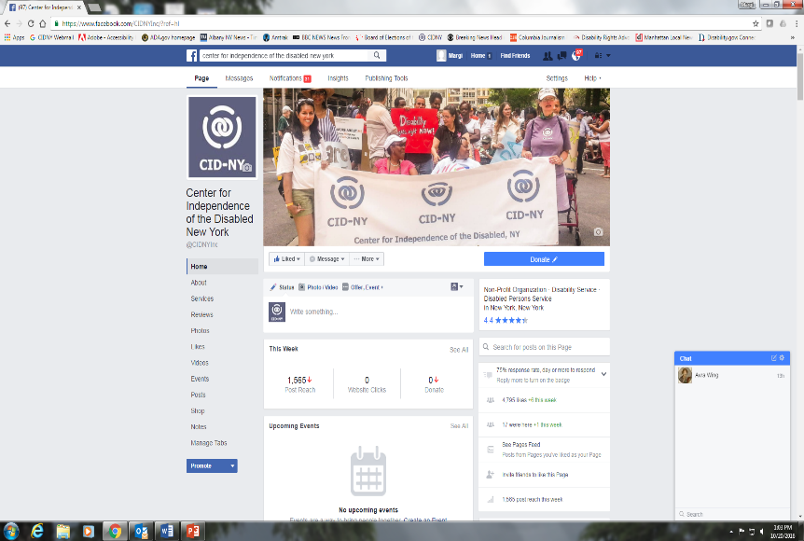
We use research on Social Media with our 61,000 followers
CIDNY’s 2016 Facebook Page
Total fans: 4,748
Total CIDNY posts: 227
Average posts per week: 4
Total reach: 1,016,931
Total likes/reactions, comments, and shares: 37,472
Total “clicks” & views: 26,892
Twitter (linked to our Facebook page):
Followers: 421
Total tweets: 180; Tweet impressions: 47,407

Slide 13
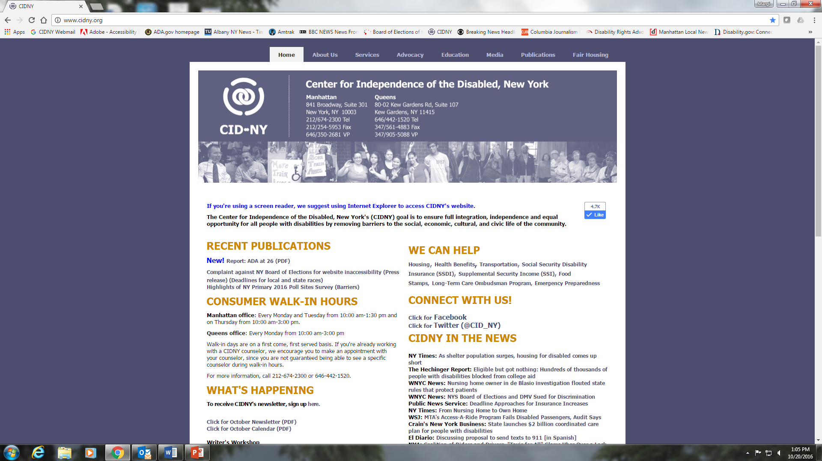
Contact us:
CID*NY
841 Broadway #301
NY, NY 10003
212-674-2300
www.CIDNY.org
Sdooha@CIDNY.ORG

