Slide 1
#nTIDELearn
Welcome to Today’s nTIDE Lunch & Learn
We will begin shortly.
Please select the speaker you would like to use for today’s webinar; your options may look different from those displayed here.
Note: Your microphone and camera are not needed and will remain off.

Slide 2
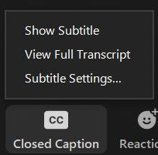
Captions are Available
#nTIDELearn
Select Closed Caption (CC), then
pick Show Subtitle and the captions
will appear on the bottom.
If you pick View Full Transcript, a
running transcript of the captions will
appear on the side.
Select Subtitle Settings to adjust the caption size.
If you prefer to use Streamtext, here is the link: https://www.streamtext.net/player?event=UNH
2
Notes:
This webinar is being recorded. We will post an archive of each webinar, each month, on our Web site at www.researchondisability.org/nTIDE. This site will also provide copies of the presentations, the panelist bios, full transcripts and other valuable resources.
As an attendee of this webinar, you are a viewer and no sound is enabled. To ask questions of the panelists, simply click on the Q & A box on your webinar screen and type your questions into the box. Panelists will review these questions during the assigned question and answer periods.

Slide 3
FRIDAY
August 21, 2020
Notes:
Hello, and welcome, everybody, to the new national trends in disability employment, or nTIDE lunch & learn series. On the first Friday of every month, corresponding with the Bureau of Labor Statistics jobs report, we'll be offering this live broadcast via Zoom webinar to share the results of the latest nTIDE findings. In addition, we will provide news and updates from the field on disability employment, as well as host an invited panelist who will discuss current disability related findings and events.
Just a few housekeeping items before we begin.

Slide 4
FRIDAY
August 21, 2020
Notes:
Hello, and welcome, everybody, to the new national trends in disability employment, or nTIDE lunch & learn series. On the first Friday of every month, corresponding with the Bureau of Labor Statistics jobs report, we'll be offering this live broadcast via Zoom webinar to share the results of the latest nTIDE findings. In addition, we will provide news and updates from the field on disability employment, as well as host an invited panelist who will discuss current disability related findings and events.
Just a few housekeeping items before we begin.

Slide 5
Up Front Matters
#nTIDELearn
This webinar is being recorded. We will post an archive of along side the Monthly nTIDE broadcast on our webinar, each month, on our website at www.researchondisability.org/nTIDE. This site will also provide copies of the presentations, the speakers’ bios, full transcripts, and other valuable resources.
As an attendee of this webinar, you are a viewer. To ask questions of the speakers, click on the Q & A box on your webinar screen and type your questions into the box. Speakers will review these questions and provide answers during the last section of the webinar. Some questions may be answered directly in the Q & A box.
5
Notes:
This webinar is being recorded. We will post an archive of each webinar, each month, on our Web site at www.researchondisability.org/nTIDE. This site will also provide copies of the presentations, the panelist bios, full transcripts and other valuable resources.
As an attendee of this webinar, you are a viewer and no sound is enabled. To ask questions of the panelists, simply click on the Q & A box on your webinar screen and type your questions into the box. Panelists will review these questions during the assigned question and answer periods.

Slide 6
Up Front Matters
#nTIDELearn
If you have any questions following this recording, please contact us at disability.statistics@unh.edu, or toll free at 866-538-9521 for more information. Thanks for joining us. Enjoy today's webinar!
6
Notes:
This webinar is being recorded. We will post an archive of each webinar, each month, on our Web site at www.researchondisability.org/nTIDE. This site will also provide copies of the presentations, the panelist bios, full transcripts and other valuable resources.
As an attendee of this webinar, you are a viewer and no sound is enabled. To ask questions of the panelists, simply click on the Q & A box on your webinar screen and type your questions into the box. Panelists will review these questions during the assigned question and answer periods.

Slide 7
nTIDE COVID-19 Update – July #s Andrew Houtenville University of New Hampshire John O’Neill Kessler Foundation Denise Rozell Association of Centers on Disabilities (AUCD)
#nTIDELearn
7

Slide 8
About
#nTIDELearn
A joint effort of the University of New Hampshire, Kessler Foundation, and the Association of University Centers on Disability (AUCD).
This is a special episode of the nTIDE Lunch and Learn series based on the unique circumstances in the U.S. economy and the COVID-19 Pandemic.
A part of the Rehabilitation and Research Training Center on Employment Policy and Measurement, which is funded by the National Institute on Disability, Independent Living and Rehabilitation Research (NIDILRR), grant no. 90RT0537.
8

Slide 9
Today’s Agenda
#nTIDELearn
● 12:00 pm: Welcome and Introduction
● 12:05 pm: Updated Numbers from the Public-Use Micro Data of the Current Population Survey
● 12:15 pm: Implications from the Field
● 12:35 pm: Open Q&A period
9

Slide 10
The Numbers Andrew Houtenville University of New Hampshire
#nTIDELearn
10

Slide 11
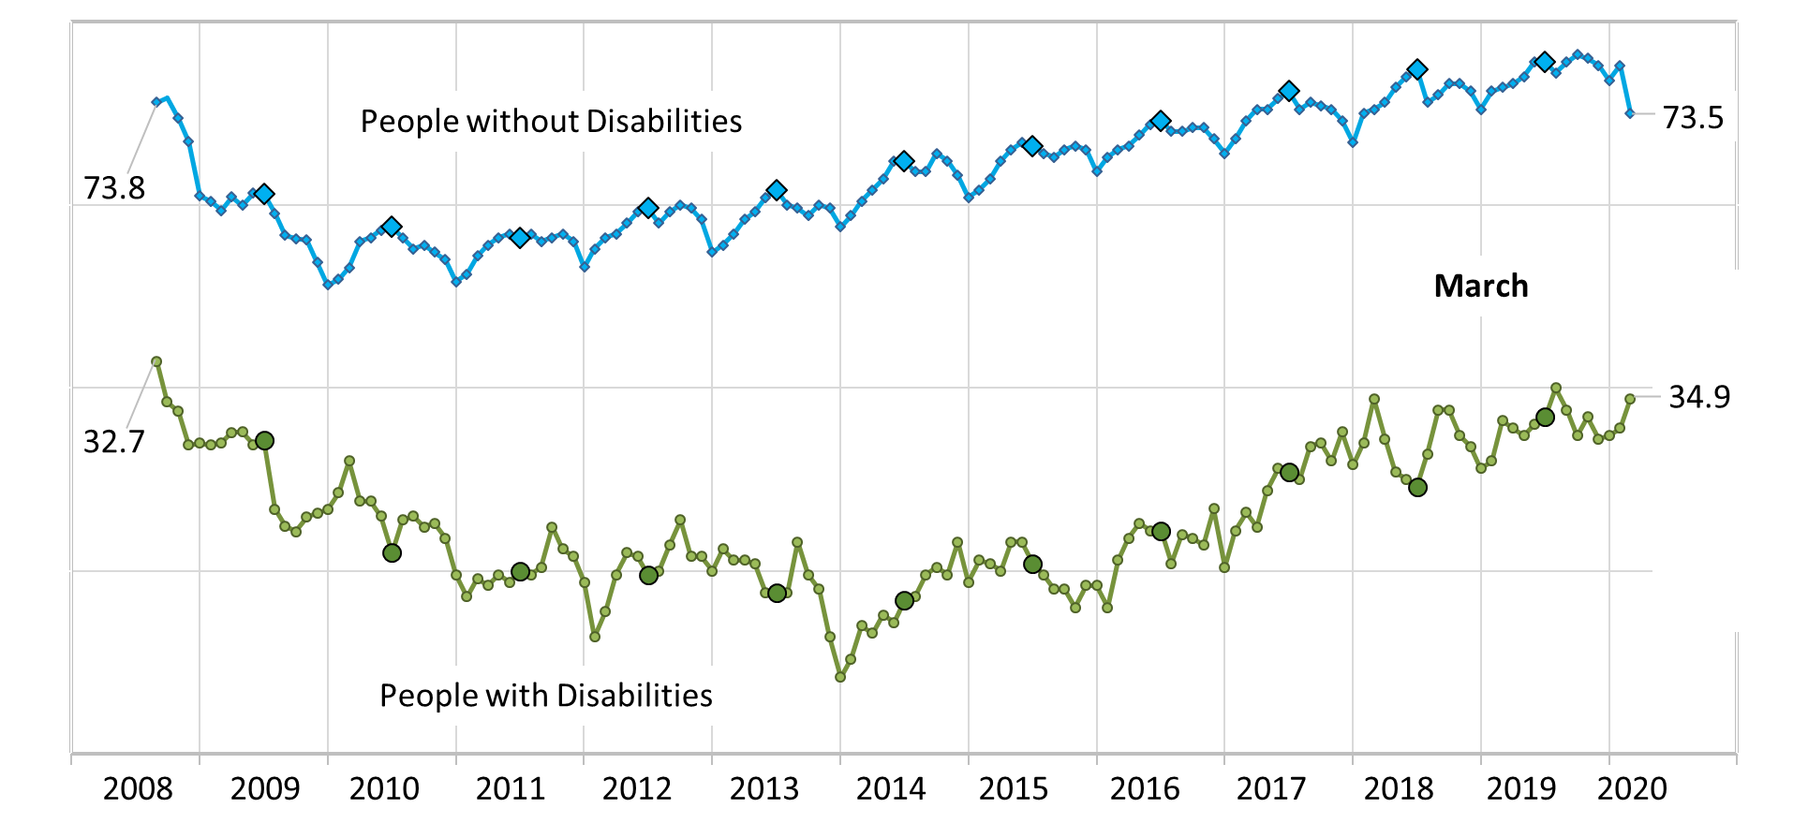
Employment-to-Population Ratio
#nTIDELearn
11

Slide 12
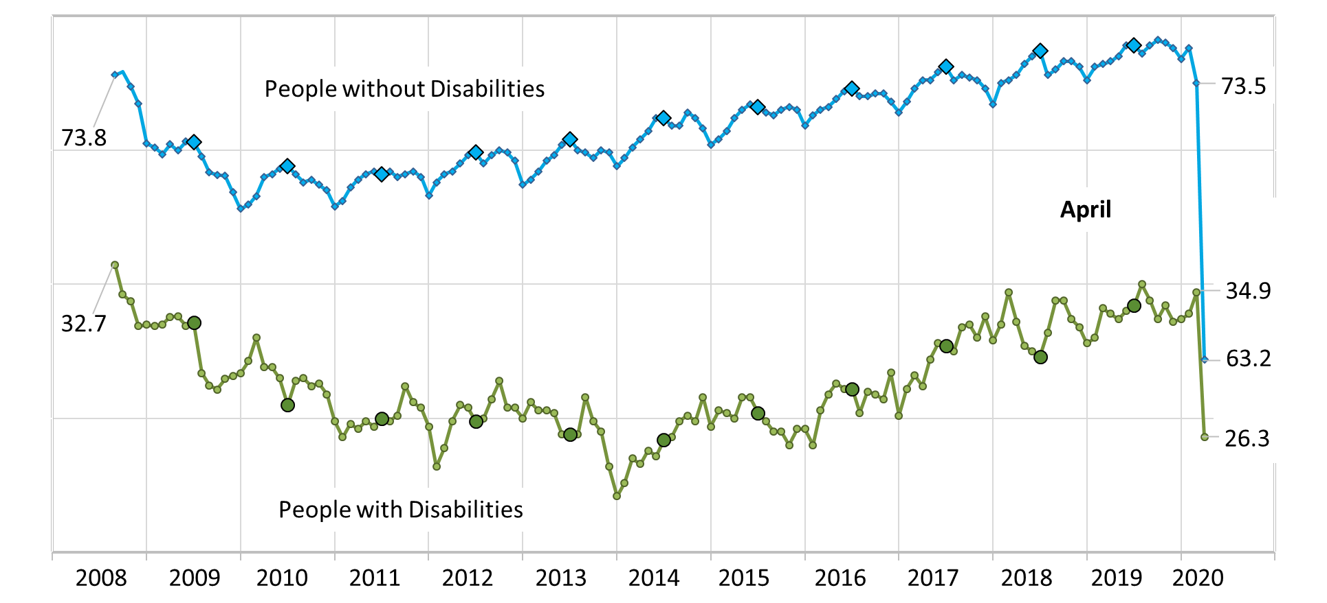
Employment-to-Population Ratio
#nTIDELearn
12

Slide 13
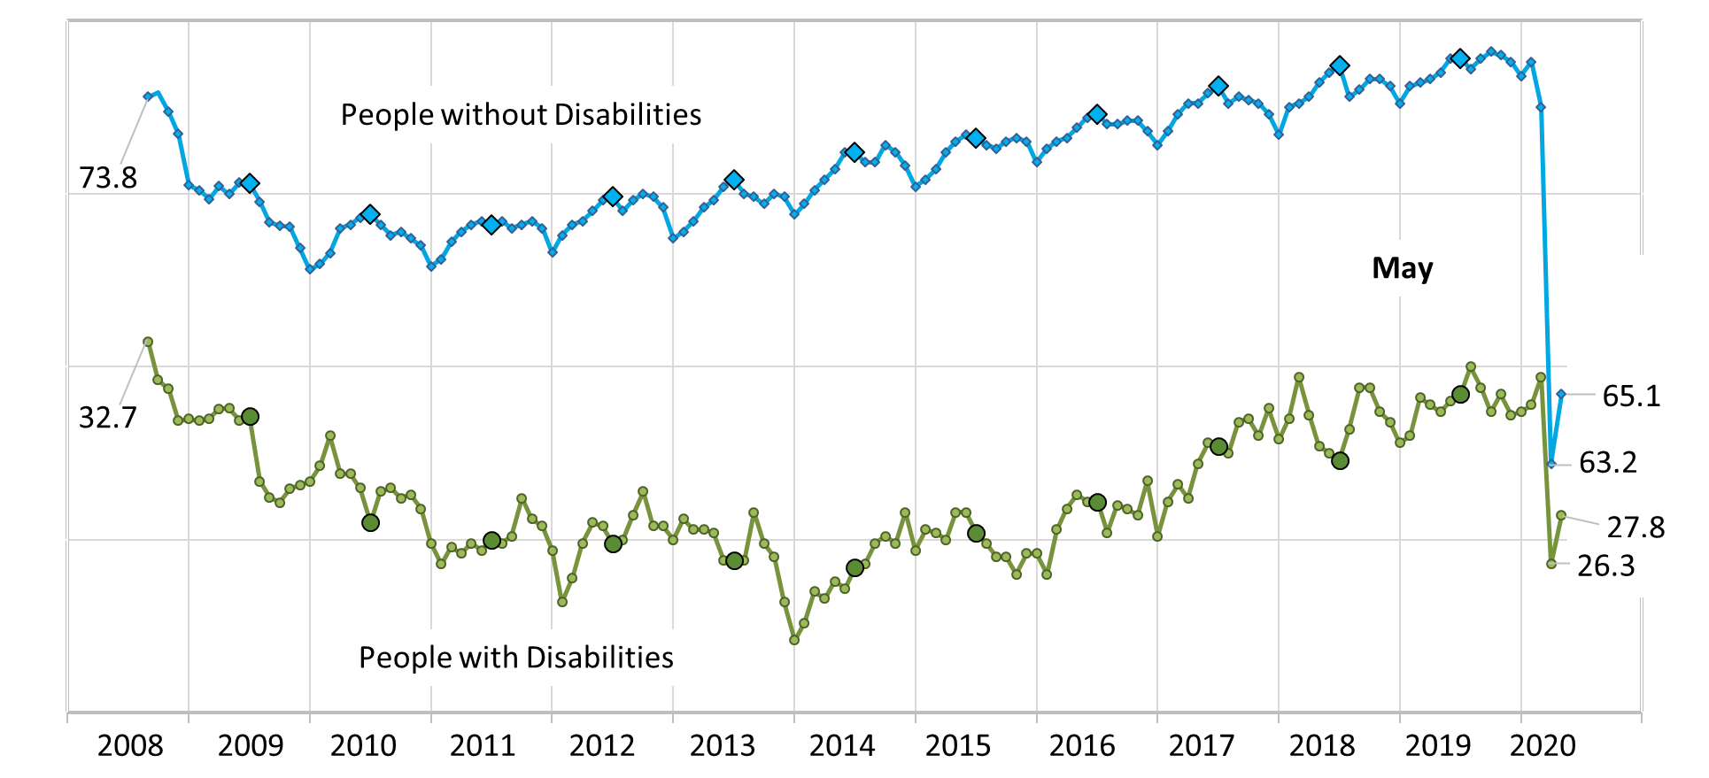
Employment-to-Population Ratio
#nTIDELearn
13

Slide 14
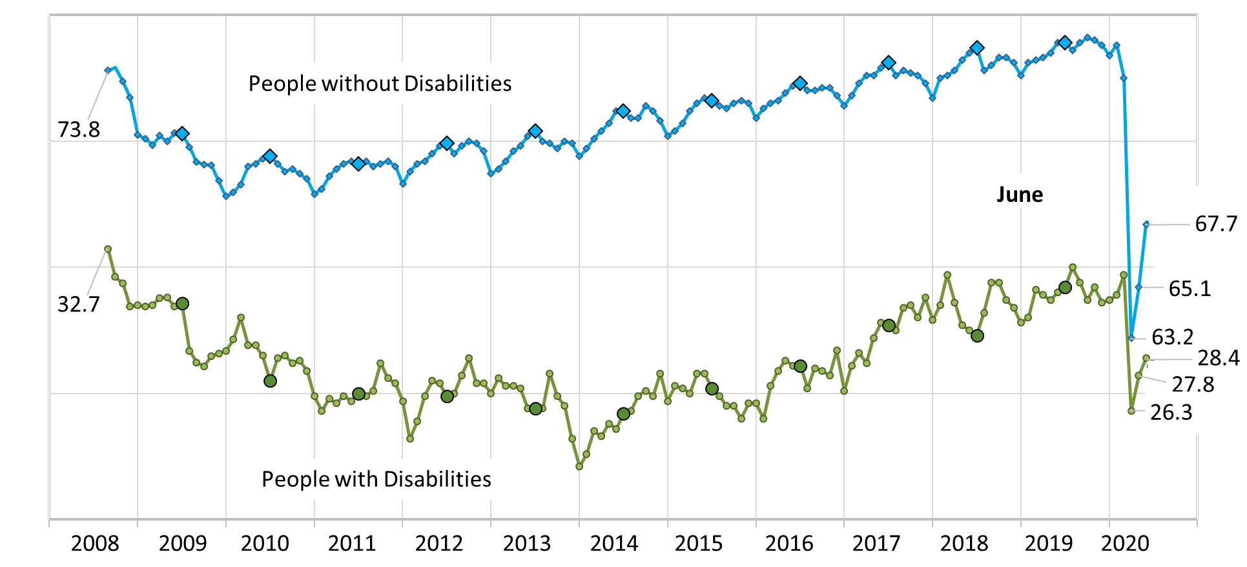
Employment-to-Population Ratio
#nTIDELearn
14

Slide 15
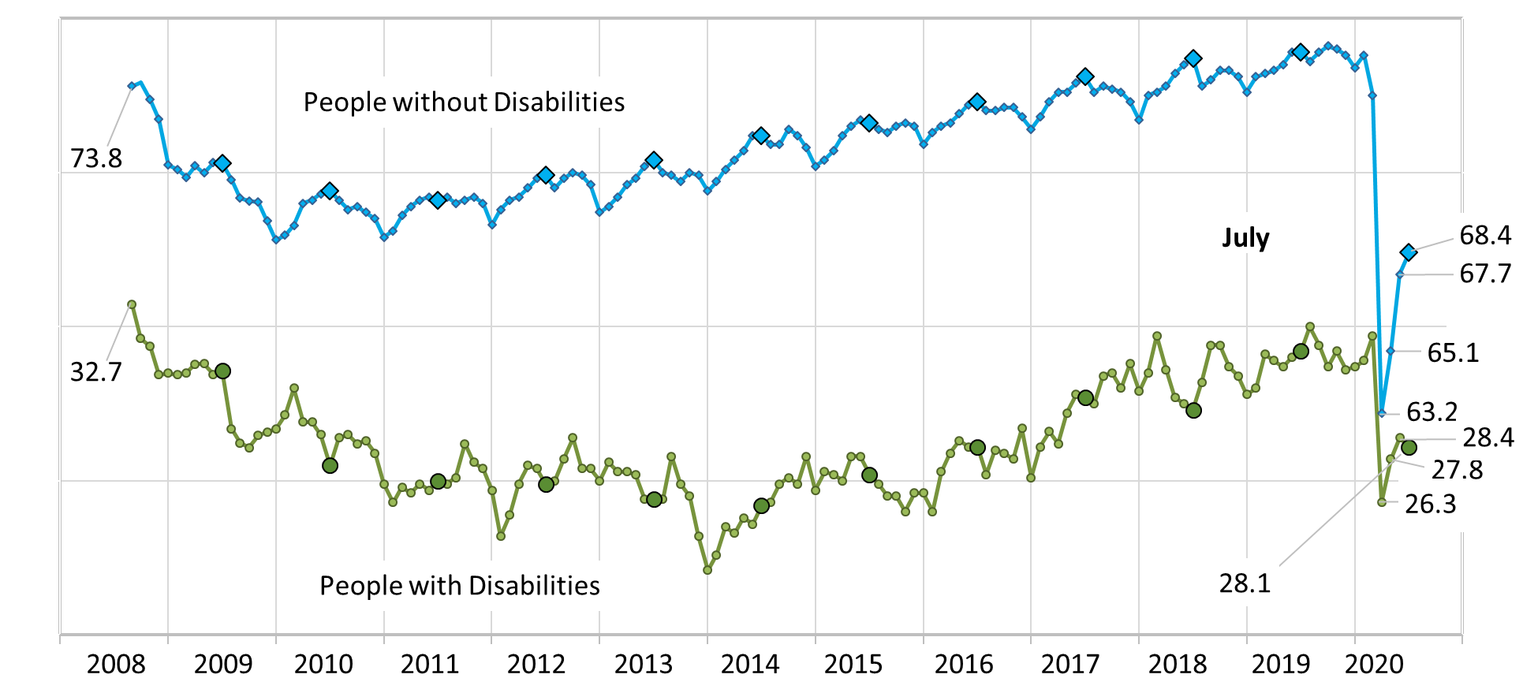
Employment-to-Population Ratio
#nTIDELearn
15

Slide 16
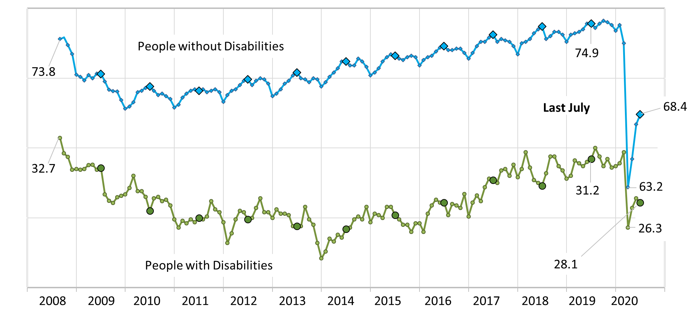
Employment-to-Population Ratio
#nTIDELearn
16

Slide 17
“Employment Status”
#nTIDELearn
People with Disabilities
People without Disabilities
Not in
Labor
Force
65.6
67.1
65.7
65.5
21.8
26.3
25.3
23.8
23.3
66.7
3.1
8.4
7.9
75.1
10.5
9.6
67.8
68.8
63.2
65.1
Unemployed
3.0
6.5
5.9
4.9
Employed
31.4
6.5
26.4
27.8
28.6
28.4
17
June 2019
April 2020
May 2020
June 2020
July 2020
June 2019
April 2020
May 2020
June 2020
July 2020

Slide 18
Unemployed
702,000
858,000
945,000
945,000
#nTIDELearn
Looking for Work
On Temporary Layoff
July
15,125,000
376,000 (53.5%)
326,000 (46.5%)
16,062,000
18,355,000
June
432,000 (50.3%)
20,095,000
People with
Disabilities
426,000 (49.7%)
May
294,000 (31.1%)
651,000 (68.9%)
April
256,000 (27.1%)
689,000 (72.9%)
July
6,700,000 (44.3%)
8,425,000 (55.7%)
June
6,778,000 (42.2%)
9,284,000 (57.8%)
People without
Disabilities
May
5,048,000 (27.5%)
13,307,000 (72.5%)
April
4,216,000 (21.0%)
15,859,000 (79.0%)
18

Slide 19
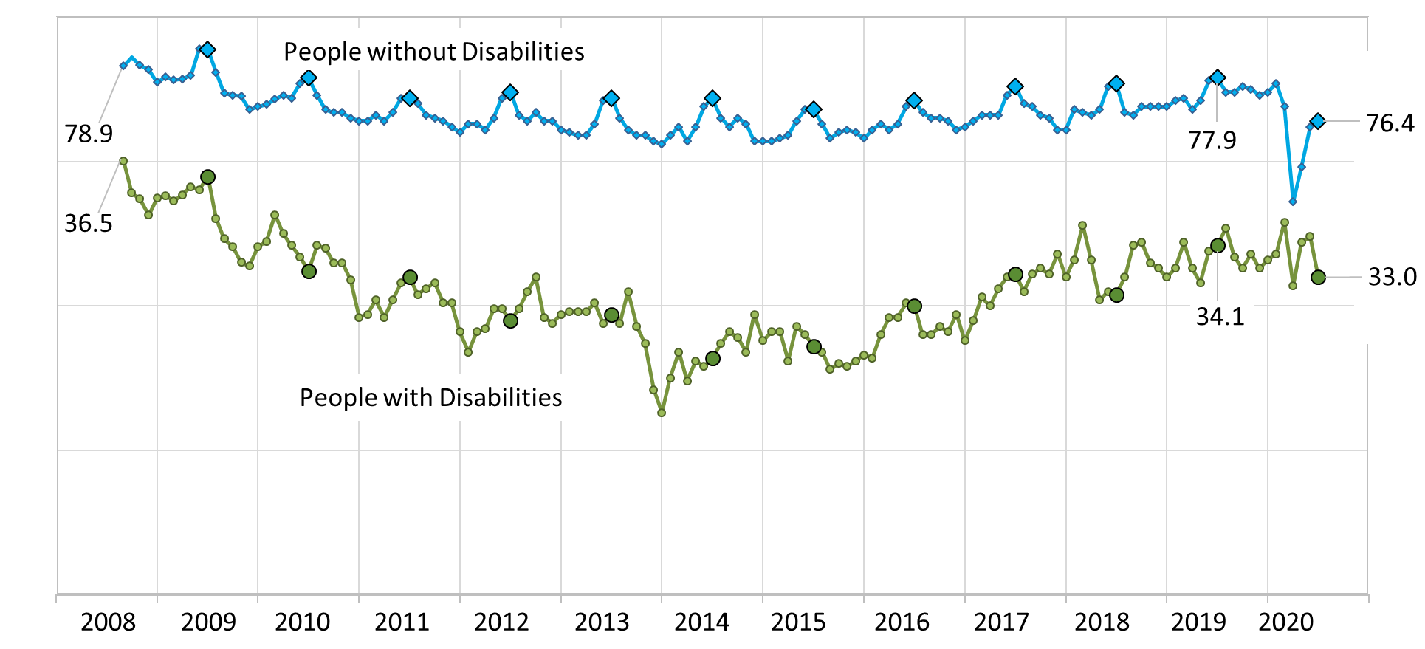
Labor Force Participation Rate
#nTIDELearn
19

Slide 20
Questions and Answers
#nTIDELearn
Use Q&A button on Zoom
Slides will be archived at: https://researchondisability.org/home/ntide.
Also … take our feedback survey at …
www.researchondisability.org/ntide/ntide-survey
20

Slide 21
Closing Comments
#nTIDELearn
Thanks to our partners: - UNH/Institute on Disability (www.ResearchOnDisability.org) - Kessler Foundation (www.KesslerFoundation.org) - AUCD (www.AUCD.org)
Contact us: - Email: Disability.Statistics@unh.edu - Call: 866-538-9521 (toll free)
Twitter at #nTIDELearn
21

