Slide 1
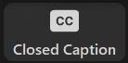
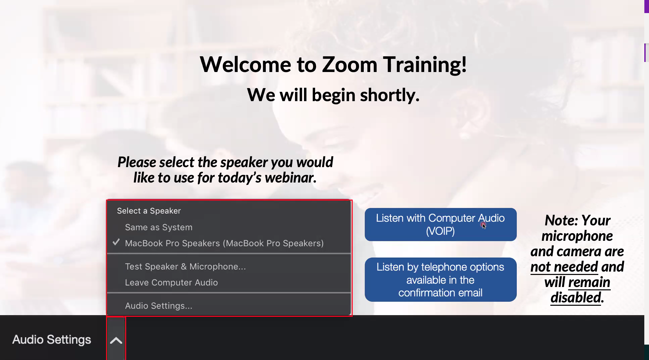
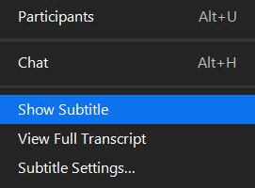
We will begin shortly
Zoom Tip #1: Sound
  To select the speaker you want to use for today’s webinar, click on the up arrow next to Audio Settings, and then select one of the options.
Zoom Tip #2: Close Captioning
  Click on Closed Caption, and then select Show Subtitle for subtitles, or select View Full Transcript to get a running transcript of the captions.
Your screen may
look a bit different
Happy Birthday
to Andrew

Slide 2
nTIDE Lunch & Learn Webinar Series
Kessler Foundation, AUCD,
University of New Hampshire Institute on Disability
Episode #11
Date: November 6, 2020

Slide 3

Up Front Matters
This webinar is being recorded. We will post an archive of along side the Monthly nTIDE broadcast on our webinar, each month, on our website at www.researchondisability.org/nTIDE. This site will also provide copies of the presentations, the speakers’ bios, full transcripts, and other valuable resources.
As an attendee of this webinar, you are a viewer. To ask questions of the speakers, click on the Q & A box on your webinar screen and type your questions into the box. Speakers will review these questions and provide answers during the last section of the webinar. Some questions may be answered directly in the Q & A box.

Slide 4
Up Front Matters
If you have any questions following this recording, please contact us at disability.statistics@unh.edu, or toll free at 866-538-9521 for more information. Thanks for joining us. Enjoy today's webinar!

Slide 5
Welcome
Andrew Houtenville
University of New Hampshire

Slide 6
About nTIDE Lunch & Learn
  Occurs at noon Eastern-time on the first Friday day of each month, with the release of the nTIDE Report.
  A joint effort of the University of New Hampshire, Kessler Foundation, and the Association of University Centers on Disability (AUCD).

Slide 7
Today’s Program
Part 1: nTIDE Report … “The Numbers”
  Andrew Houtenville, University of New Hampshire
  John O’Neill, Kessler Foundation
Part 2: nTIDE News
  Denise Rozell, Association of University Centers on Disabilities (AUCD)
Part 3: Guest Speakers from Job Path NYC
  Fredda Rosen, Executive Director
  Rachel Pollock, Senior Program Advisor and General Counsel
  Carly Teichman, Associate Executive Director
Part 4: Q&A … for Parts 1-3

Slide 8
Part 1: The nTIDE Report
John O’Neill
Kessler Foundation

Slide 9
The Monthly nTIDE Report
The monthly nTIDE Report is a press release and infographic, looking at the latest employment statistics.
Uses data from the “jobs report” released by the U.S. Bureau of Labor Statistics, on the 1st Friday of each month.

Slide 10
Source of the Data
U.S. BLS, Current Population Survey (CPS).
  Source of the “official” unemployment rate.
Civilians, ages 16-64, not living in institutions.
Available September 2008 onward.
Not yet seasonally adjusted.
  which is why we compare to the same month last year.

Slide 11
The Numbers
Andrew Houtenville
University of New Hampshire

Slide 12
Employment-to-Population Ratio

Slide 13
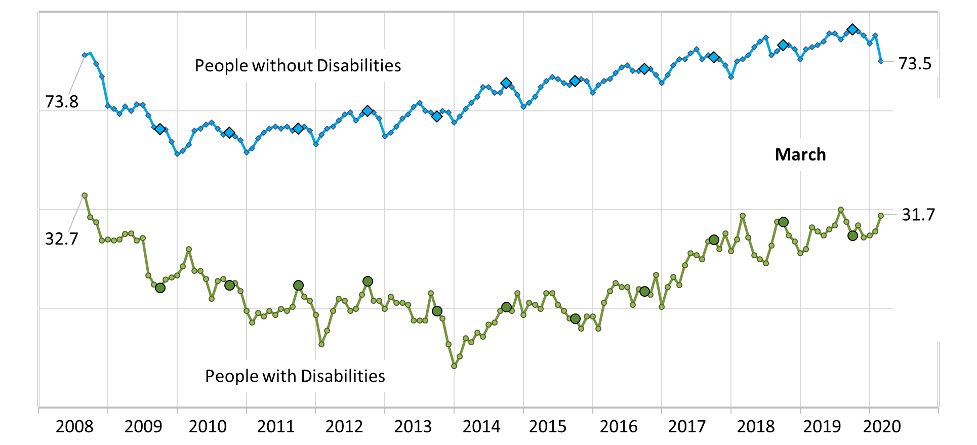
Employment-to-Population Ratio

Slide 14
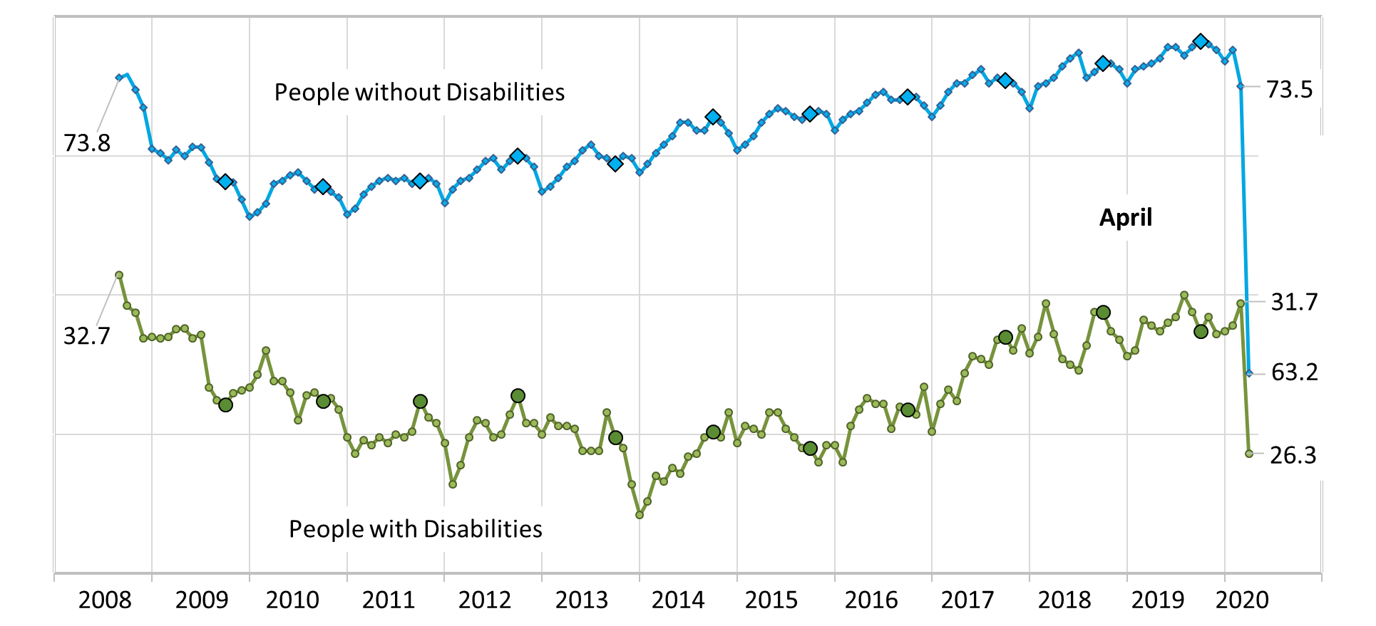
Employment-to-Population Ratio

Slide 15
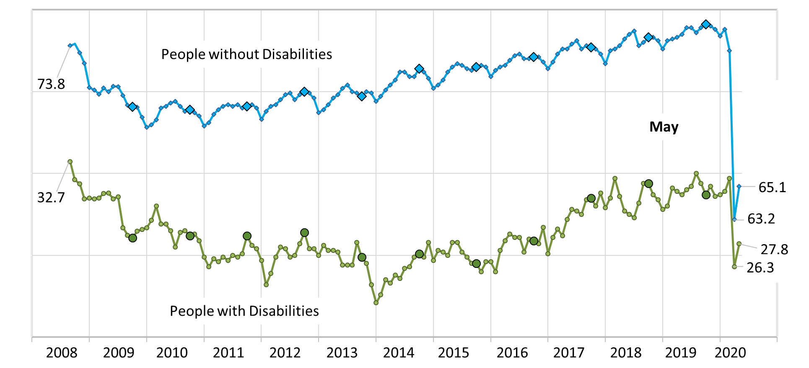
Employment-to-Population Ratio

Slide 16
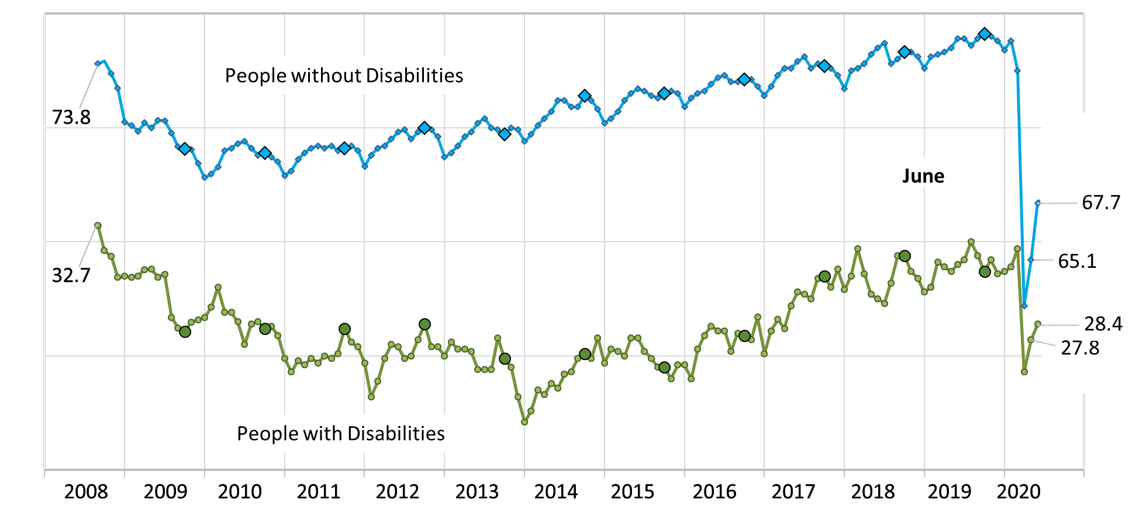
Employment-to-Population Ratio

Slide 17
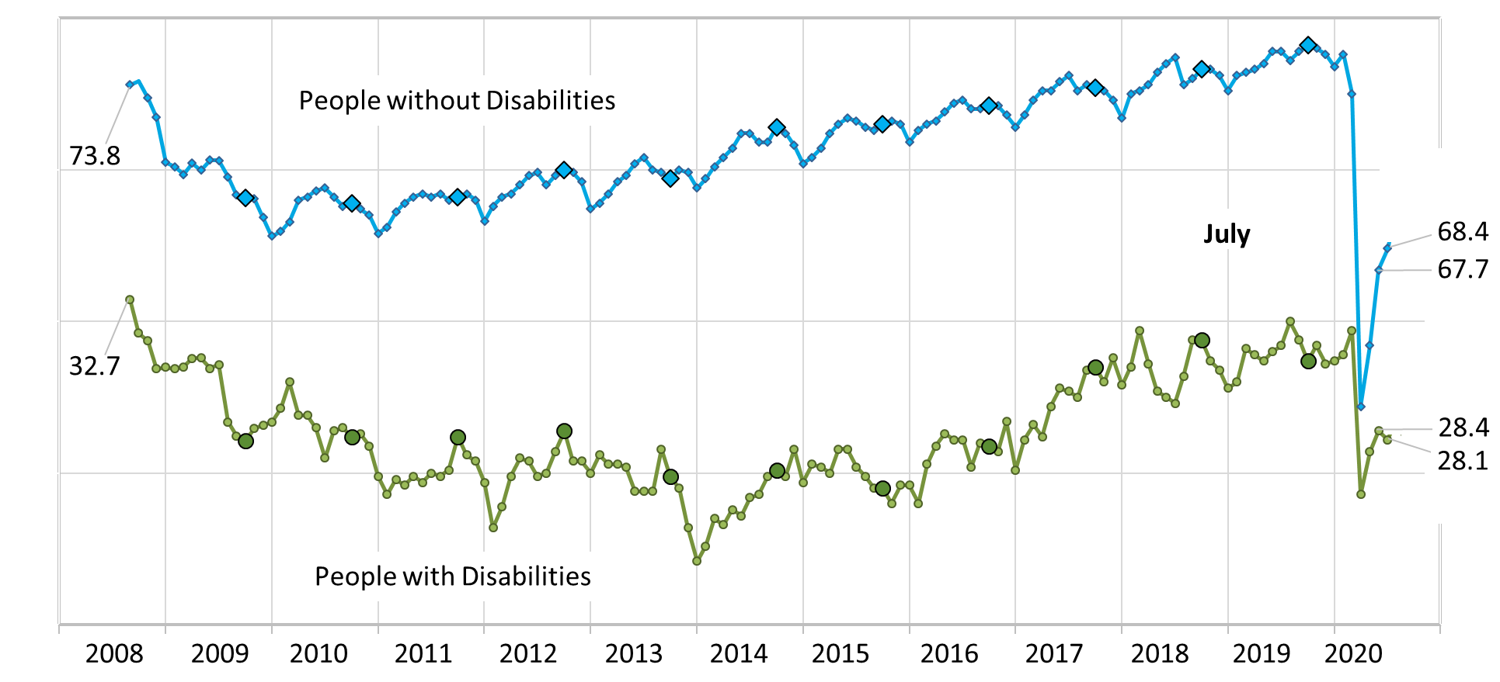
Employment-to-Population Ratio

Slide 18
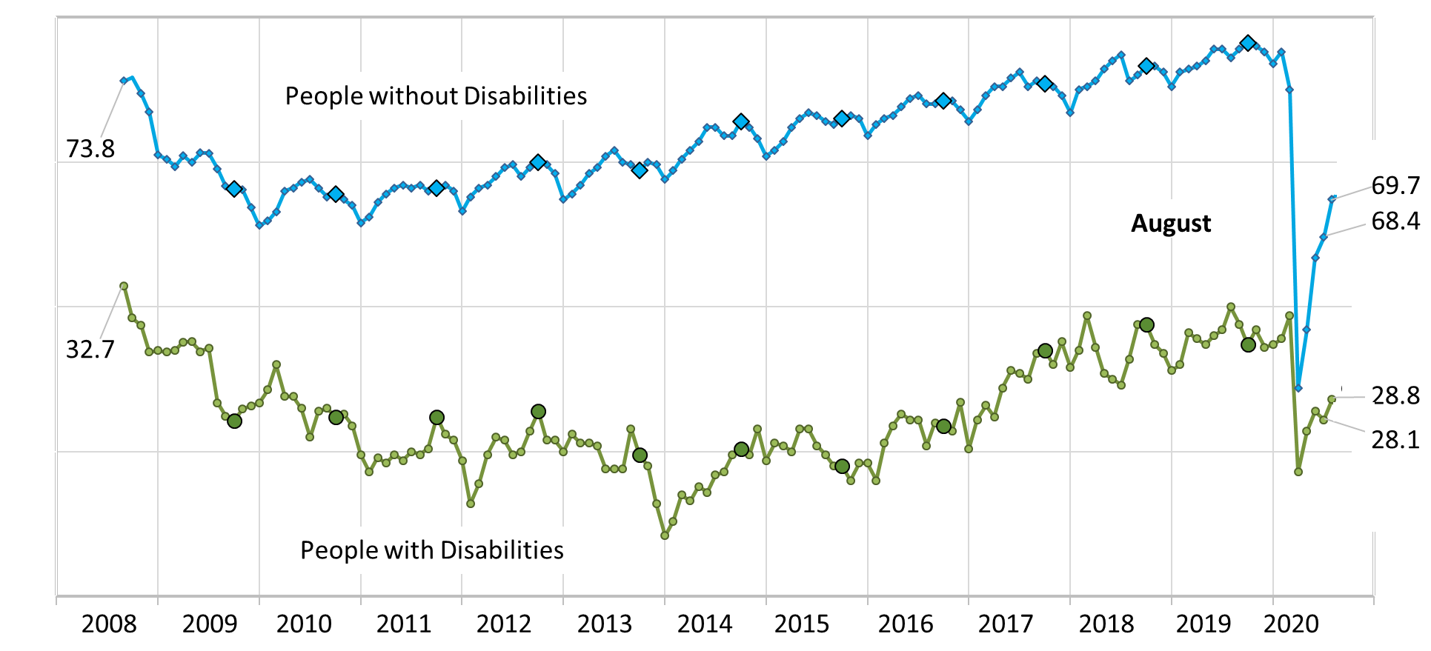
Employment-to-Population Ratio

Slide 19
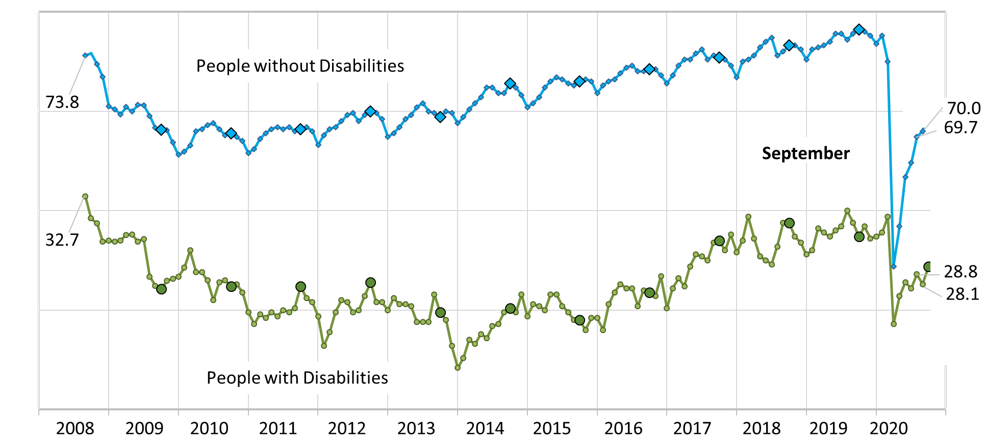
Employment-to-Population Ratio

Slide 20
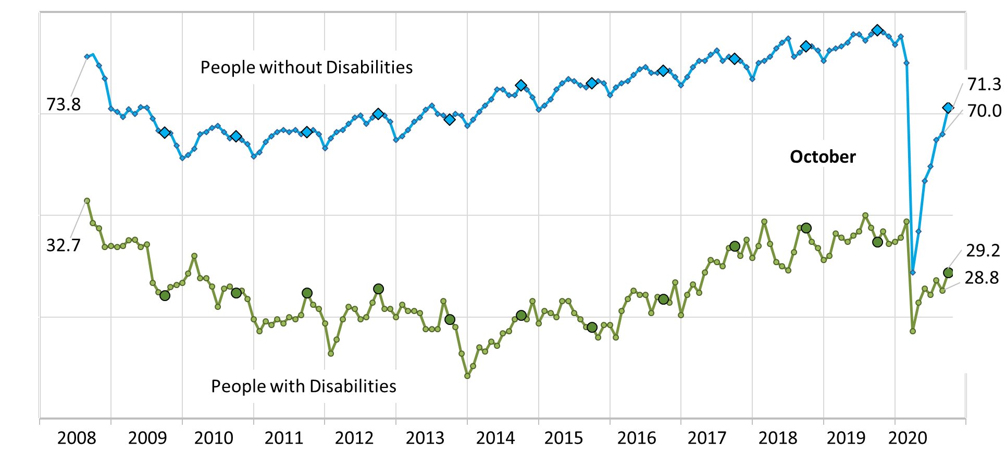
Employment-to-Population Ratio

Slide 21
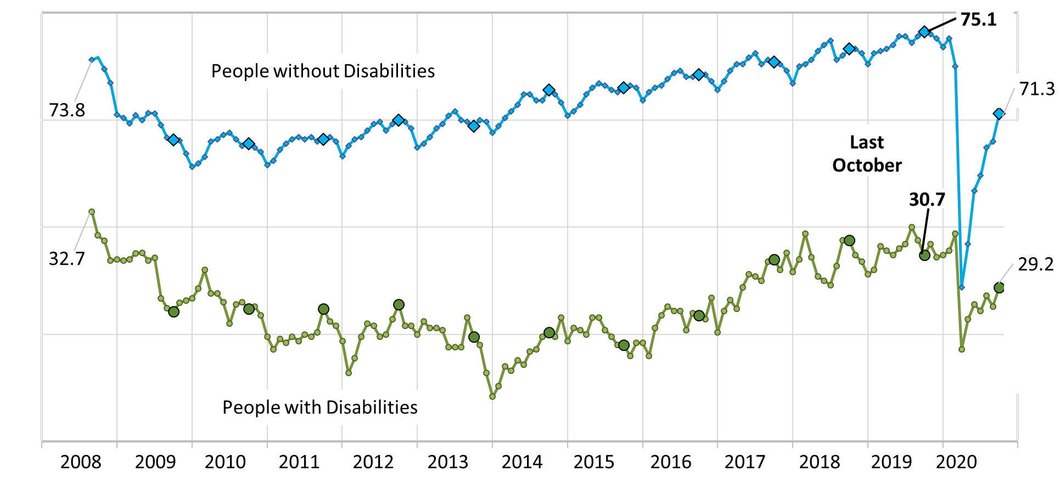
Employment-to-Population Ratio

Slide 22
Labor Force Participation Rate

Slide 23
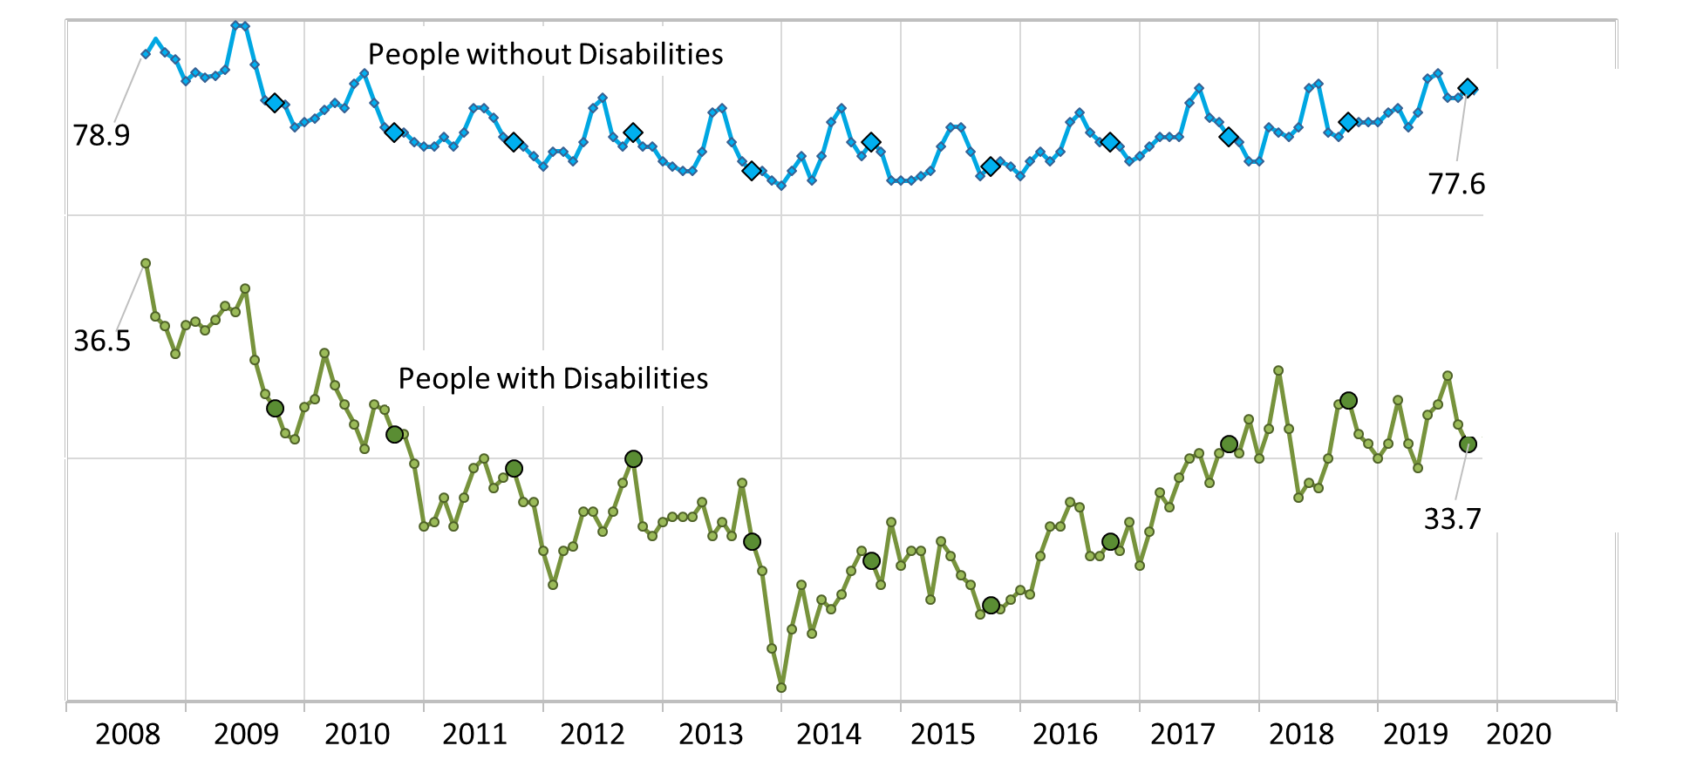
Labor Force Participation Rate

Slide 24
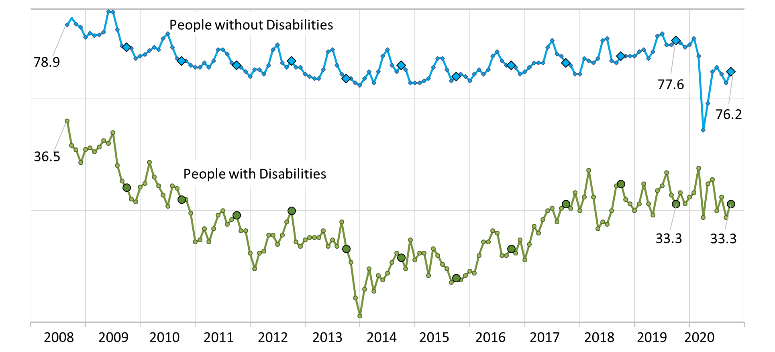
Labor Force Participation Rate

Slide 25
Part 2: nTIDE News
Denise Rozell
Association of University Centers on Disabilities (AUCD)

Slide 26

Federal Policy Update
What is happening in DC?
  ELECTION!!
    VOTING!!
  Lame Duck…
    Appropriations
  COVID
RFI on Ticket to Work -- Published 9/29/20; comments due 11/13/20; Citation: 85 FR 61032

Slide 27
Accommodations & Return to Work Amidst the COVID-19 Pandemic
  Disability:IN Chicagoland; RRTC on Employment of People with Physical Disabilities/NIDILRR
  Recorded Webinar and transcript: Lou Orslene, Director for the Employer and Workplace Policy Team, ODEP
    Strategies to support workers’ mental and physical health
    How to ensure the safety/accessibility of your workplace
    Ways to accommodate your teams in remote work environments
    Other Supportive Materials

Slide 28
COVID-19 Plain Language Guidance for Employees with Developmental Disabilities
Green Mountain Advocates/SARTAC
Booklet with information available in plain language
  General Information About COVID-19
  COVID-19 Information for Employees
  Is It Time for You to Go Out in Public?
  Decision-Making Tree Role-Plays
Includes OSHA rules and information in plain language

Slide 29
How COVID-19 May Change the World of Services to People With Intellectual and Developmental Disabilities
Val Bradley – HSRI; Journal of Intellectual and Developmental Disabilities; Vol. 58; Issue 5; October 2020
What we have learned:
  The strengths and weaknesses of the service system;
  Roadmap for building a more robust and agile system;
  Based on a canvas of leaders in our field;
  Possible reimagined system.

Slide 30
Protect Yourself When Using Transportation,
New CDC publication; specific, targeted information for:
  Public transit;
  Rideshares and taxis;
  Shared bikes, scooters, skateboards and other micro-mobility devices;
  Paratransit;
  Personal bikes, walking, wheelchair rolling or moving with mobility devices; and
  Personal vehicles.

Slide 31
PEAT: Telework and Accessibility
Creating Accessible Content including accessible websites
Hosting Meetings and Presentations
  Picking an accessible virtual meeting platform
Staff Training and Devices
Resources for Employees
  Accessibility and Employment: What PWD Need to Know
  Tips for Being an Effective Teleworker
Resources for Recruiting and Hiring
  Accessible interviews

Slide 32
Annual Statistical Report on the Social Security Disability Insurance Program, 2019
Highlights -- SSDI:
  Disability benefits were paid to almost 10.0 million people.
  Awards to disabled workers (679,449) accounted for 89 percent of awards to all disabled beneficiaries (761,481).
  In December, payments to disabled beneficiaries totaled almost $11.7 billion.
  Benefits were terminated for 870,827 disabled workers.
  Supplemental Security Income payments were another source of income for about one out of seven disabled beneficiaries.

Slide 33
A Tale of Four States: Factors Influencing the Statewide Adoption of IPS
Bond, Johnson-Kwochka, Pogue, Reese, Becker, Drake; Administration and Policy in Mental Health and Mental Health Services Research, 2020
Evidence-based supported employment
  2 states implementing with success; 2 states with challenges (non-adopting); comparing barriers, facilitators, and strategies
  Non-adopting states lacked model clarity, funding, focus on people with SMI, collaboration between state MH and VR agencies
  Successful states had funding, fidelity monitoring, TA, collaboration between state MH and VR agencies; lawsuit settlements as a catalyst

Slide 34
Five Part Webinar Series on Pre-Employment Transition Services
NTACT and WINTAC pre-recorded webinars on the 5 required pre-ETS services -- job exploration counseling; work-based learning experiences; counseling on post-secondary educational programs at institutions of higher education; workplace readiness training; instruction in self-advocacy
. Includes:
  Curricula/activities,
  State spotlights,
  Examples of expected outcomes
  Tips for successful service delivery

Slide 35
Kessler Grantee Symposium on AI
Falling through the Cracks: Implications of AI for employment of individuals with disabilities
  How are employers using artificial intelligence (AI) in employment: resume screening, interviewing, onboarding?
  How does it work? What does this mean for people with disabilities?
  How is disability defined and what is the impact?
  What are the perils of bias in the systems?
November 13, Noon to 1:00 pm Eastern

Slide 36
Part 3: nTIDE Guest Speakers
Fredda Rosen
Executive Director, Job Path NYC
Rachel Pollock
Senior Program Advisor and General
Counsel, Job Path NYC
Carly Teichman
Associate Executive Director, Job Path NYC

Slide 37

A Place in the Workforce/A Place in the Community
Helping People with Developmental Disabilities Lead Full and Active Lives

Slide 38



Job Path began as a project of the Vera Institute in 1978 and became an independent nonprofit in 1998.

Slide 39
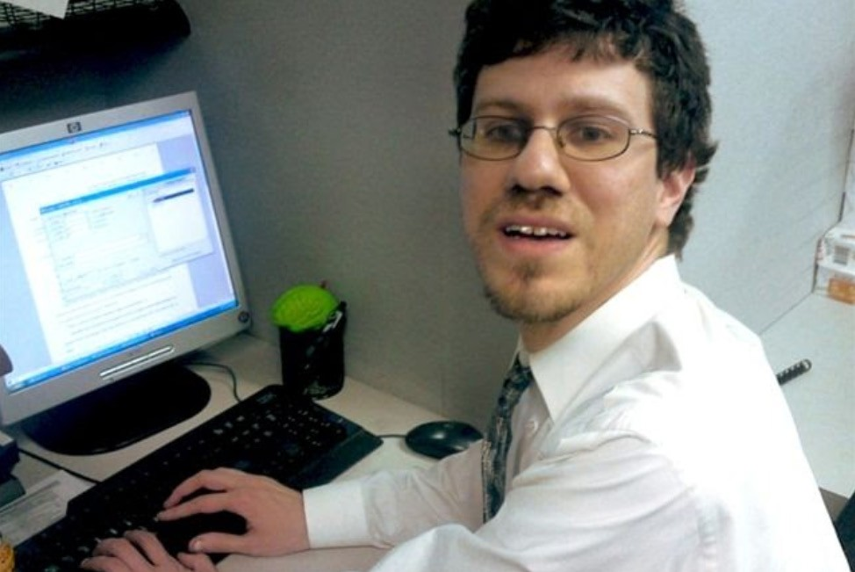
Job Path has been helping New Yorkers with developmental disabilities find meaningful work and create lives in their communities for more than 40 years.

Slide 40



Today Job Path’s programs help people find jobs, live in their own homes and become part of community life.

Slide 41
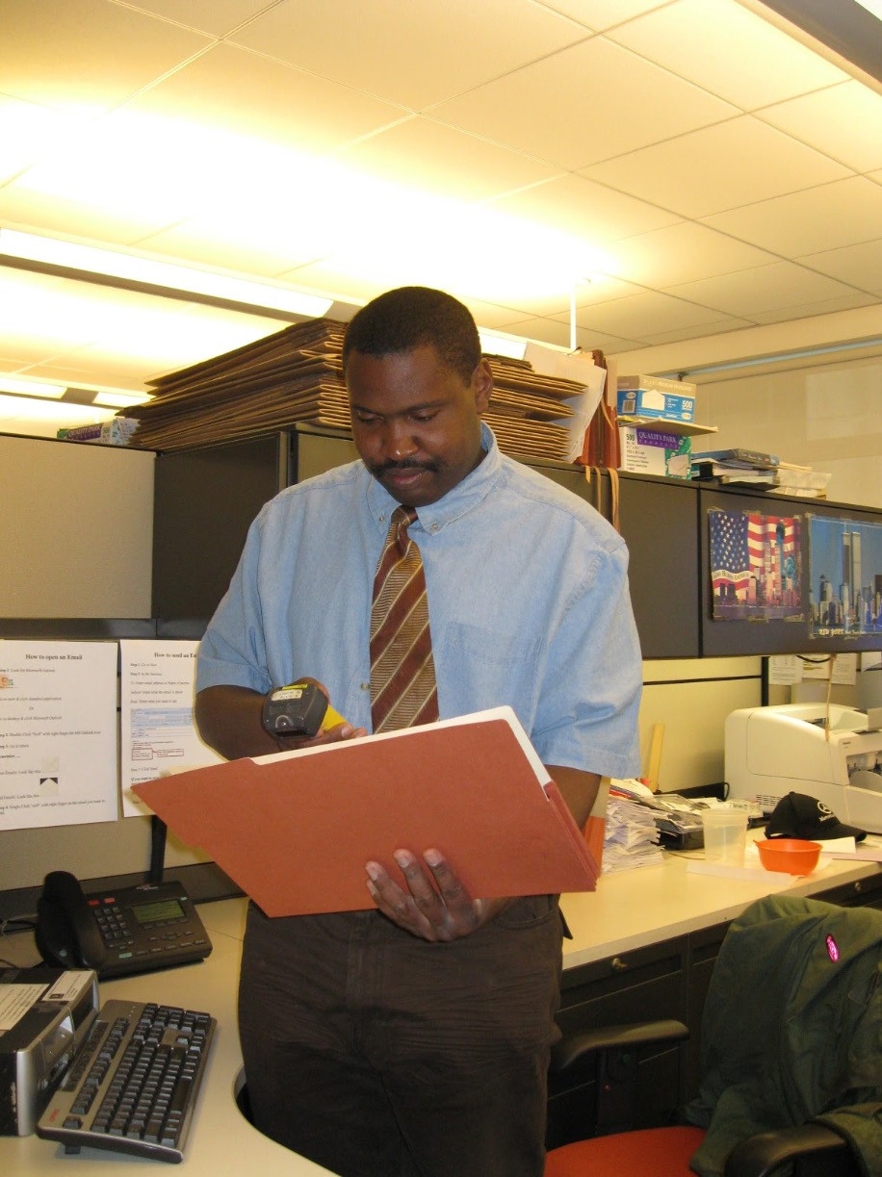
Customized Employment creates jobs that are
well-matched to the needs of both the jobseeker and employer.

Slide 42
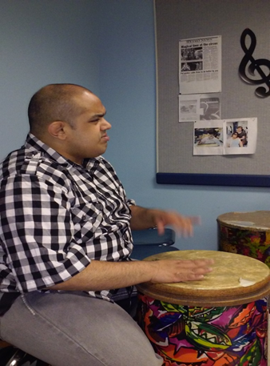
Work. Life. Community
Meet Ruben….
Ruben has a passion for music, singing and playing instruments
For many years, Ruben volunteered as an assistant music teacher at a local special needs school
Ruben also worked in the CD department at a local Barnes and Noble
Ruben used the skills from his volunteer work in a paying job at a local preschool where he worked as an assistant music teacher.
With the help of a support worker, uses a local gym to keep fit
Regularly visits the local library to learn and listen to new music

Slide 43
Using Multiple Funding Sources ….
Special government grant supported transition from special needs high school
Day habilitation supported volunteer work and community activities
Commission for the Blind and Visually Impaired funded initial job development
Employment Training Program through State DD funded wages and support for current job

Slide 44
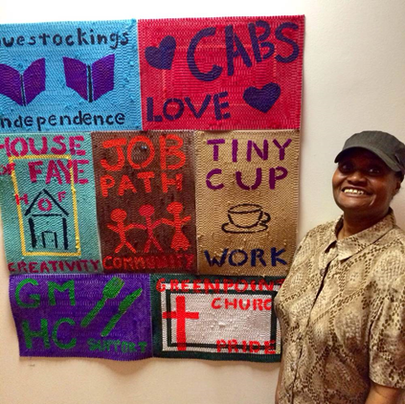
Work. Life. Community
Meet Rita...
Works at Blue Bottle Coffee Shop
Volunteers at Gay Men’s Health Crisis Center in the cafeteria
Volunteers at a local food pantry
Attends a crochet class at Chenchita’s Garden (Community Garden in Harlem)

Slide 45
Using Day Hab Funding as a Foundation
Rita enjoys a variety of volunteer work
Built mother’s trust to allow job development
Day hab funding to locate opportunities and provide support
Launched job development through special short term waiver funding
Located customized job through ETP program that combined state funded wages and waiver funding
Community partnerships
Used State DD family support funding to locate inclusive community activities
Day hab funding provides long term supports

Slide 46
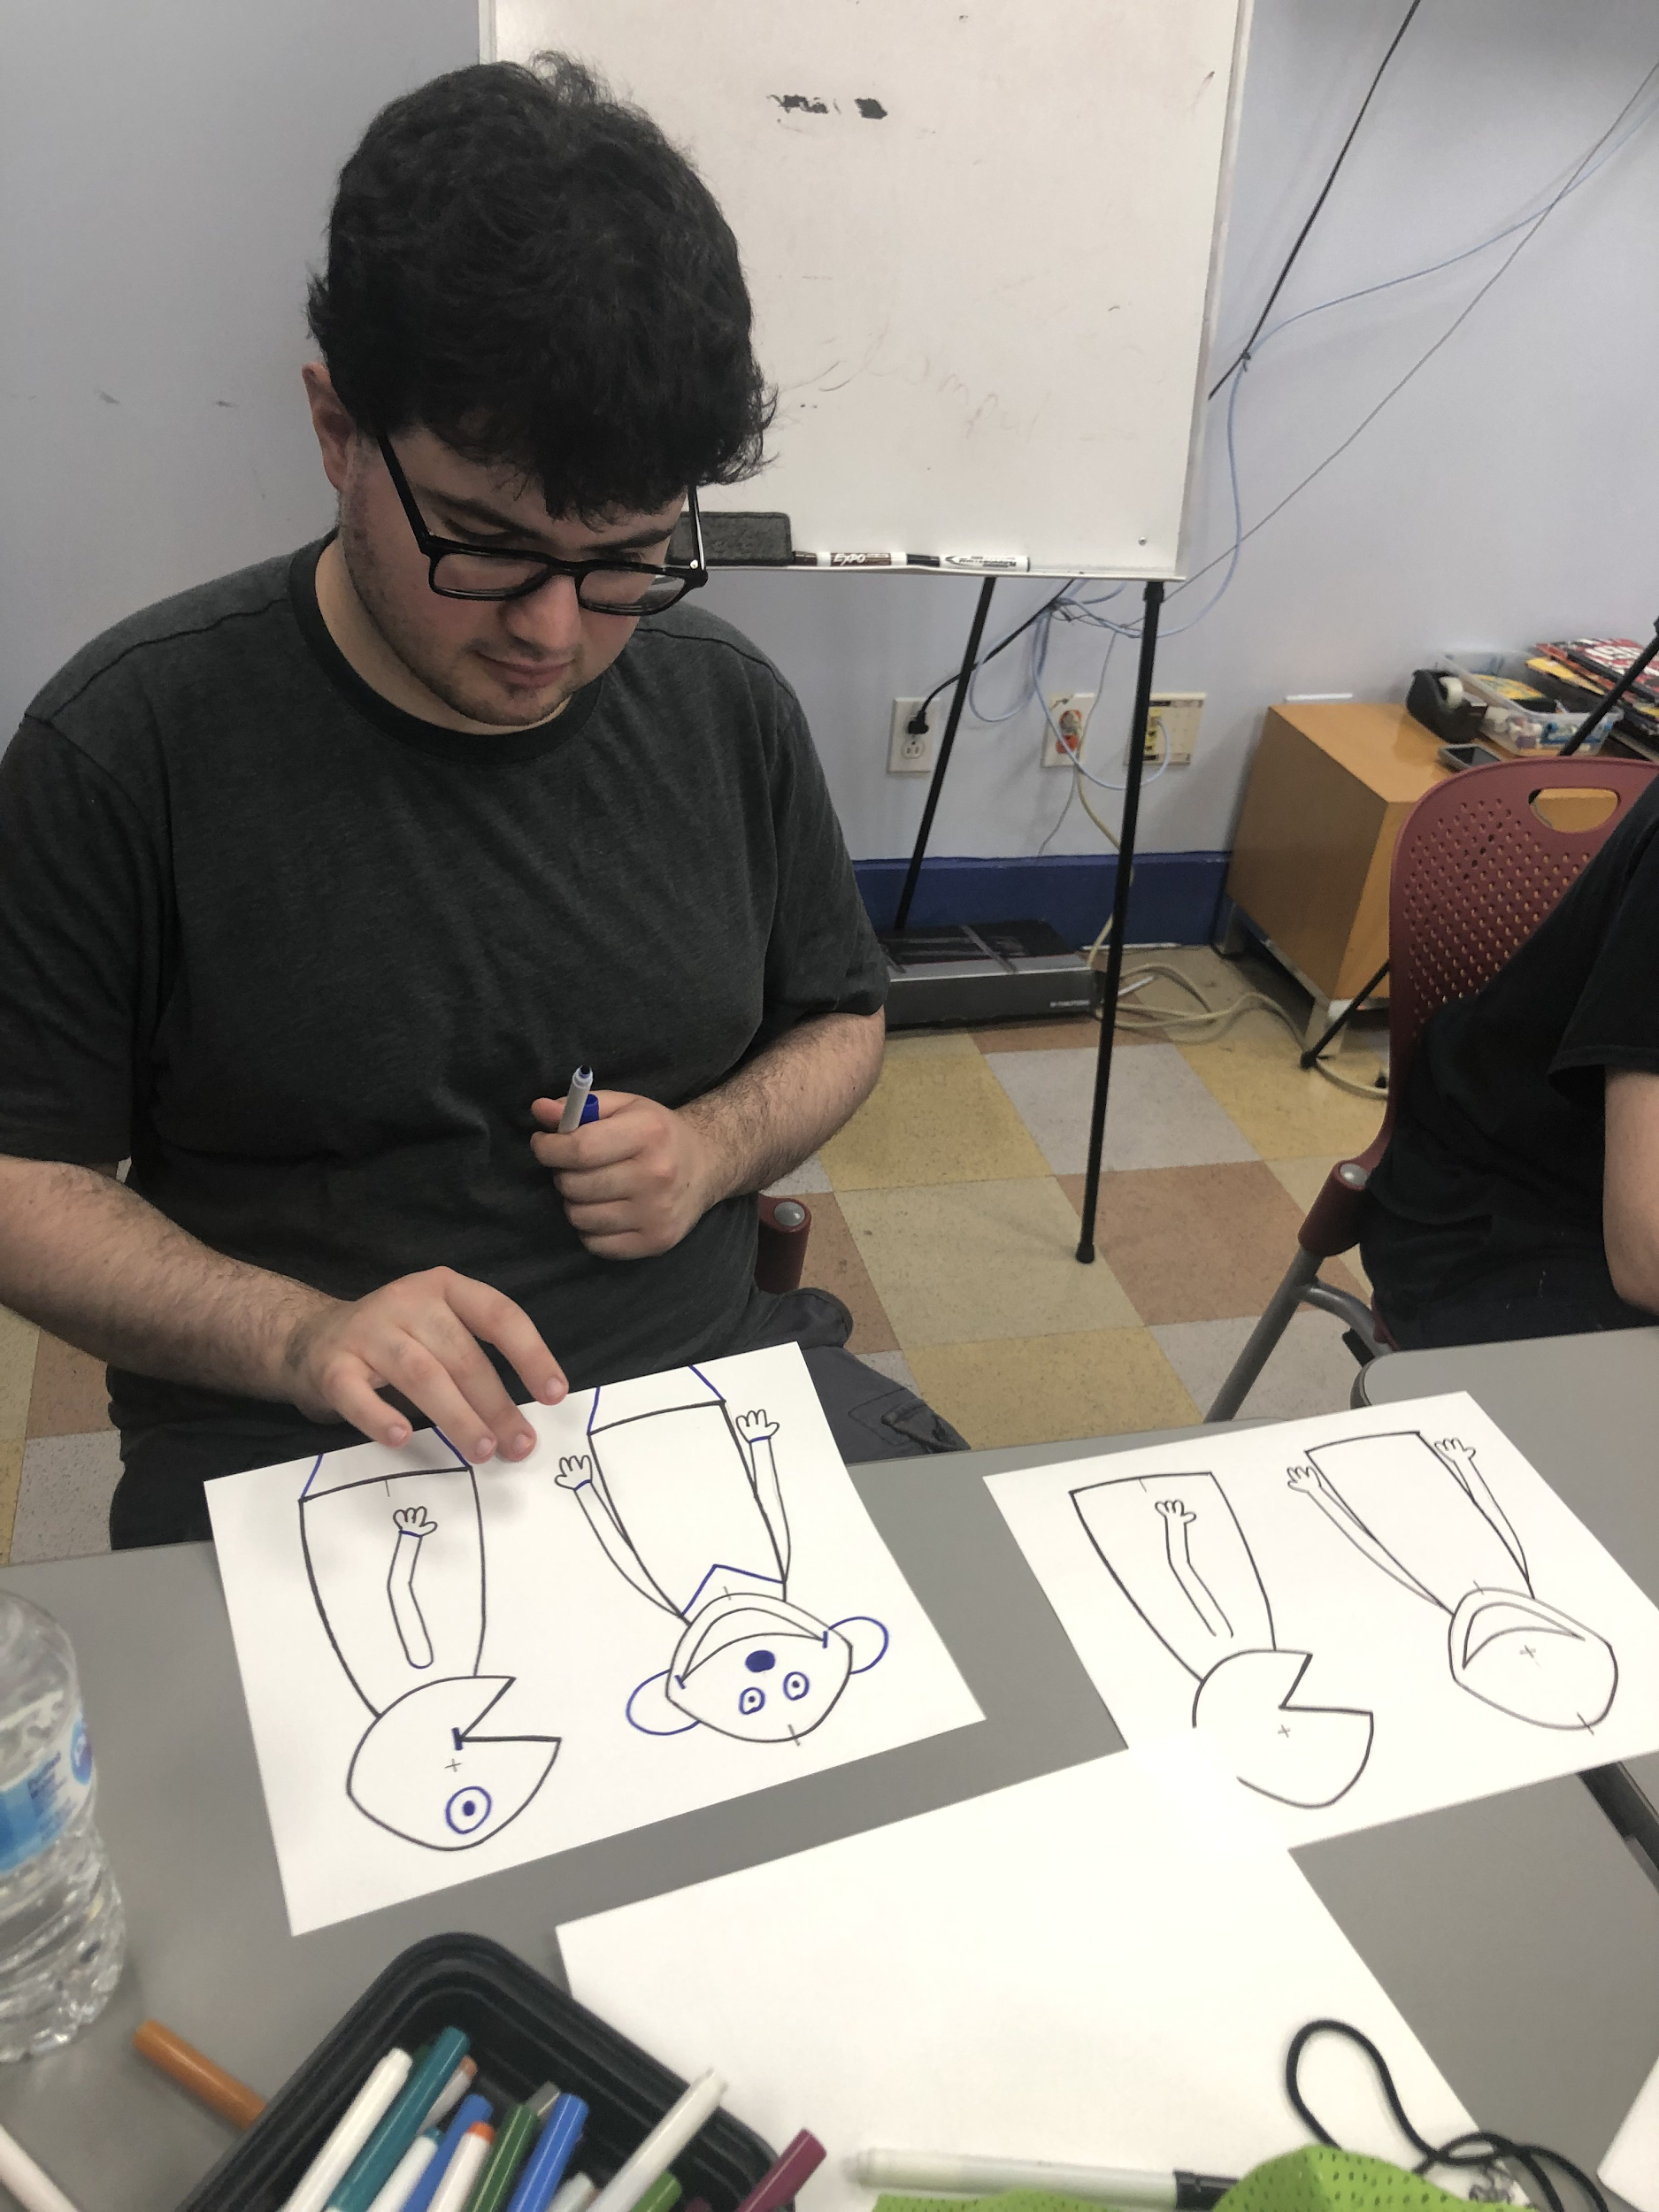
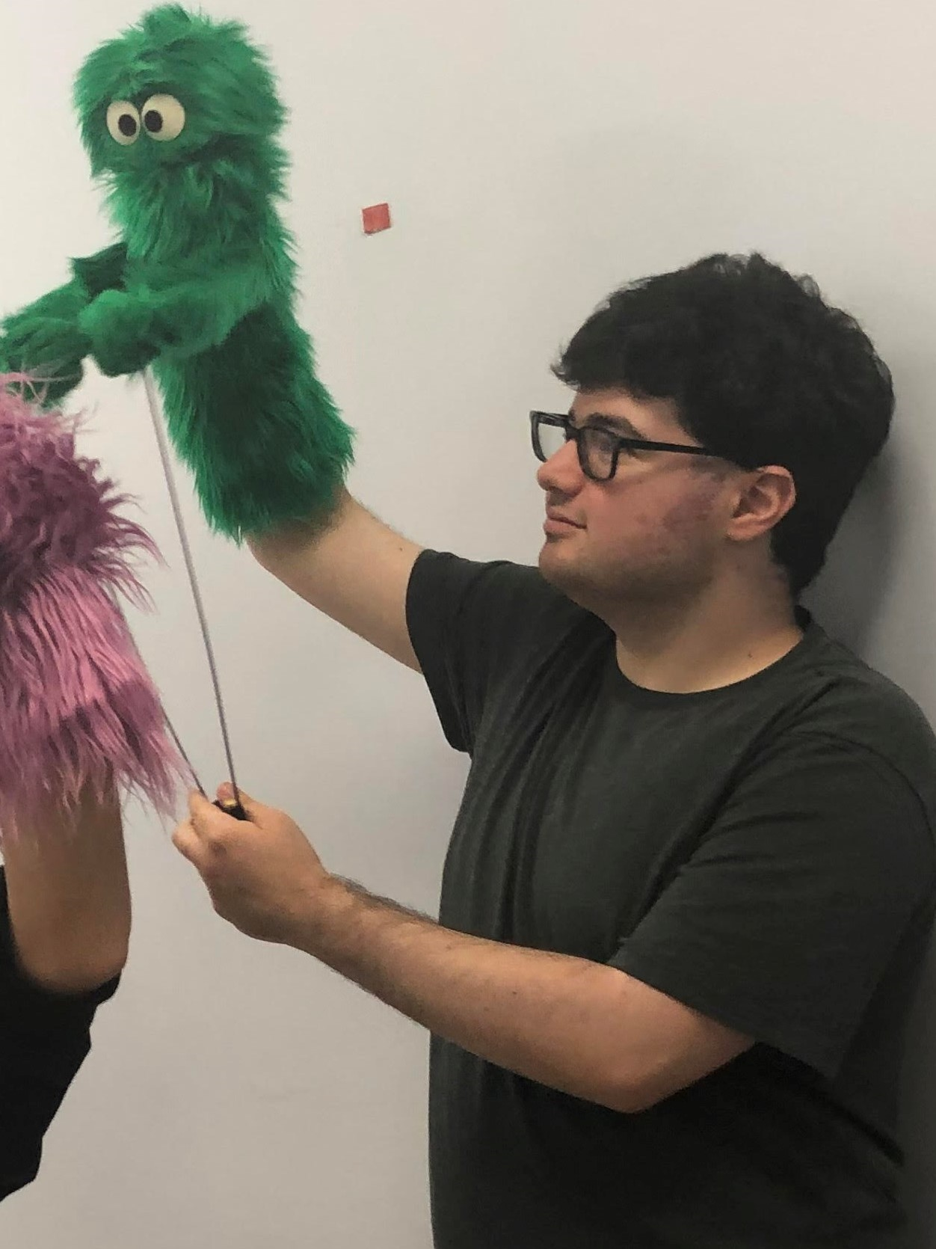
Work. Life. Community
Meet Marty...
Started through a special NYC grant
Conducted a thorough discovery for him to explore community, life and work interests
Focused on passion for puppetry through development of a six week adaptive puppetry residency. We partnered with a local Library and WonderSpark Puppets to create an artist residency titled "Puppetry in TV & Film”
Volunteers at the Central Park Swedish Cottage Marionette Theater as an usher and announcer
Currently enrolled in our Employment Program

Slide 47
Braiding Local and State Funding
City Council funding for young adults with autism for planning
Self-Direction services for at home support
Day Habilitation funding for ongoing support and resource development
VR funding for job development and intensive support

Slide 48
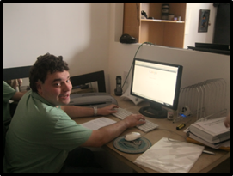
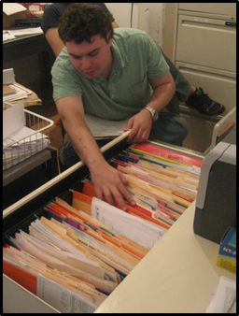
Work. Life. Community
Meet Alex…
Alex received day supports to help him complete a college education
Works at a local non-profit agency doing clerical work
Uses his creativity and advocacy skills as a member of Outside Voices and Poets, Of Course, groups supported by Job Path
Participates in Peace of Heart Choir -- mainstream choir
Works out at City Rec Center with help of support worker
Lives in his own apartment with the support of a roommate without disabilities
Attends local synagogue

Slide 49
Creative Use of Waiver and Self-directed Funding
Day Habilitation Funding
Agency Supported Self-Direction Funding
Employment
College Support
Support from live in caregiver and other direct support
ETP Funding (combined state and waiver funding) to find job
Volunteer work during summer and college years led to first job
Special self-hired staff to attend synagogue
Waiver long term supports
Poetry and theatre Groups

Slide 50
Basic Funding Building Blocks
VR
Waiver Funding
Local Funding
Foundation Funding
Ticket to Work

Slide 51
Taking a Closer Look
Waiver Funding
VR Funding
Local and Foundation Funding
Person Centered Planning and Resource Development
Discovery and Assessment
Person Centered Planning and Discovery
Discovery for Customized Employment
Paid Internships and Exploration
Resource Development
Ongoing Support for Community and Home Life
Job Development
Long Term Employment Support
Job Development
Intensive Supports
Job Development if VR Declines

Slide 52

Questions and Thoughts

Slide 53

Questions and Answers
Use Q&A button on Zoom
Slides will be archived at: https://researchondisability.org/home/ntide.
Also … take our feedback survey at …
www.researchondisability.org/ntide/ntide-survey

Slide 54


Thank You!
Thanks to our funder: Kessler Foundation (www.kesslerfoundation.org)
And thanks to our partners:
  UNH/Institute on Disability (www.ResearchOnDisability.org)
  AUCD (www.AUCD.org)
Contact us:
- Email: Disability.Statistics@unh.edu
- Call: 866-538-9521 (toll free)
Twitter at #nTIDELearn

Slide 55
Thank You!
Thanks to our funder: Kessler Foundation (www.kesslerfoundation.org)
And thanks to our partners:
  UNH/Institute on Disability (www.ResearchOnDisability.org)
  AUCD (www.AUCD.org)
Contact us:
- Email: Disability.Statistics@unh.edu
- Call: 866-538-9521 (toll free)
Twitter at #nTIDELearn

