Slide 1
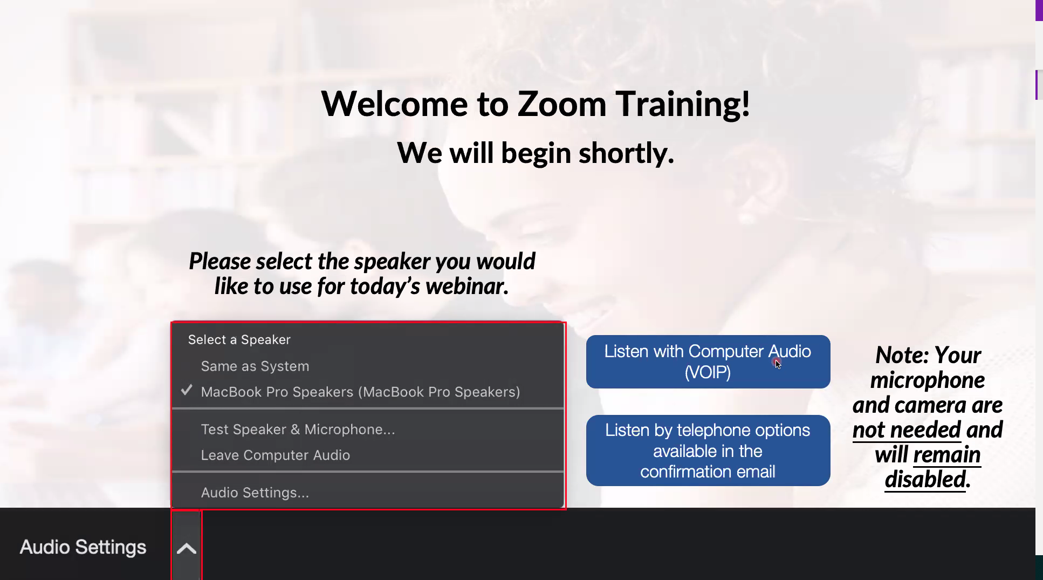
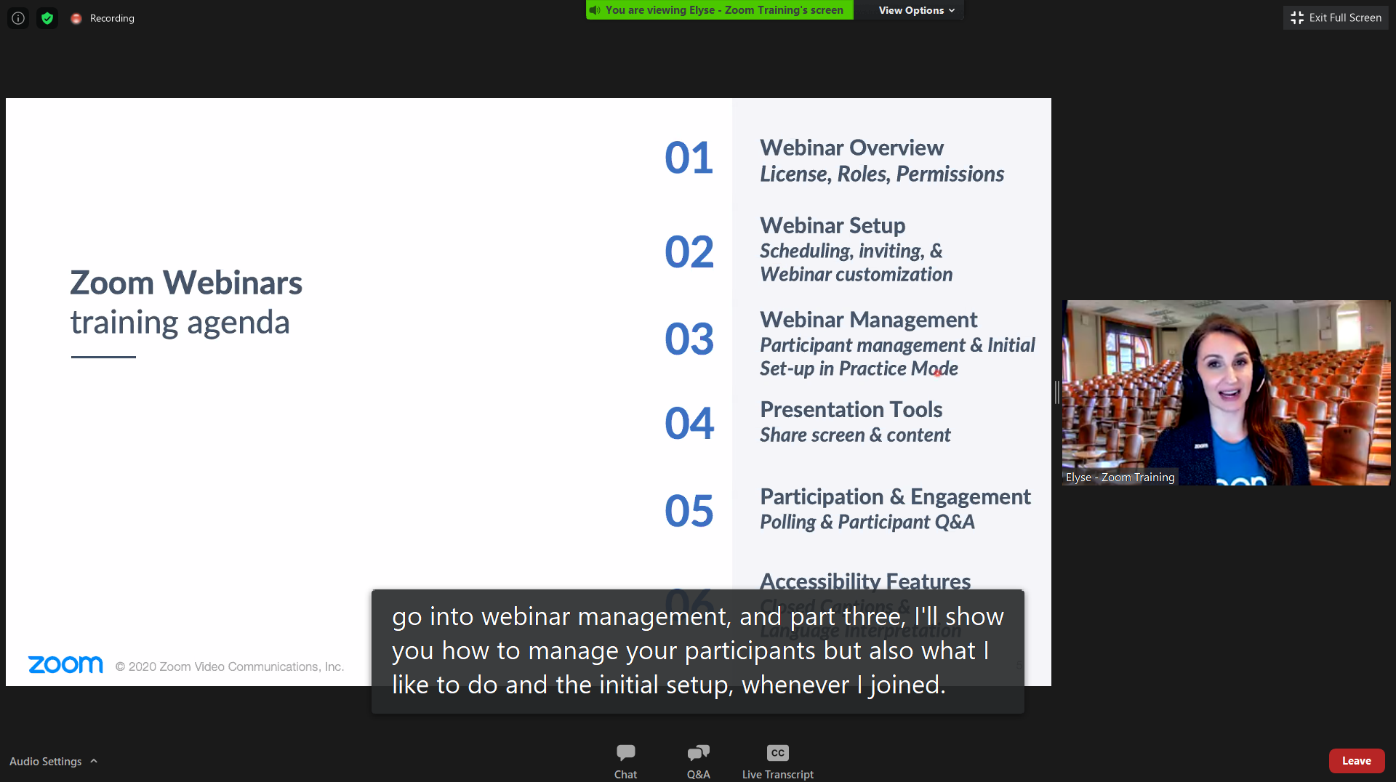
Welcome to Today’s
nTIDE Lunch & Learn
We will begin shortly.
Please select the speaker you would like to use for today’s webinar; your options may look different from those displayed here.
Note: Your microphone and camera are not needed and will remain off.

Slide 2
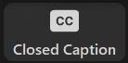
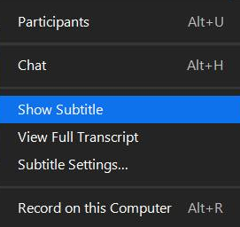
Enabling Closed Captioning
After selecting Closed Caption, pick Show Subtitle and the captions will appear on the bottom of your screen.
Note: if you pick View Full Transcript, a running transcript of the captions will appear on the side.
You can adjust the caption size by selecting Subtitle Settings.
Notes:
Art

Slide 3

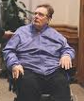

FRIDAY
August 7, 2020
Notes:
Hello, and welcome, everybody, to the new national trends in disability employment, or nTIDE lunch & learn series. On the first Friday of every month, corresponding with the Bureau of Labor Statistics jobs report, we'll be offering this live broadcast via Zoom webinar to share the results of the latest nTIDE findings. In addition, we will provide news and updates from the field on disability employment, as well as host an invited panelist who will discuss current disability related findings and events.
Just a few housekeeping items before we begin.

Slide 4

FRIDAY
August 7, 2020
Notes:
Hello, and welcome, everybody, to the new national trends in disability employment, or nTIDE lunch & learn series. On the first Friday of every month, corresponding with the Bureau of Labor Statistics jobs report, we'll be offering this live broadcast via Zoom webinar to share the results of the latest nTIDE findings. In addition, we will provide news and updates from the field on disability employment, as well as host an invited panelist who will discuss current disability related findings and events.
Just a few housekeeping items before we begin.

Slide 5

Up Front Matters
#nTIDELearn
#nTIDELearn
This webinar is being recorded. We will post an archive of each webinar, each month, on our website at www.researchondisability.org/nTIDE. This site will also provide copies of the presentations, the speakers’ bios, full transcripts, and other valuable resources.
As an attendee of this webinar, you are a viewer. To ask questions of the speakers, click on the Q & A box on your webinar screen and type your questions into the box. Speakers will review these questions and provide answers during the last section of the webinar. Some questions may be answered directly in the Q & A box.
Notes:
This webinar is being recorded. We will post an archive of each webinar, each month, on our Web site at www.researchondisability.org/nTIDE. This site will also provide copies of the presentations, the panelist bios, full transcripts and other valuable resources.
As an attendee of this webinar, you are a viewer and no sound is enabled. To ask questions of the panelists, simply click on the Q & A box on your webinar screen and type your questions into the box. Panelists will review these questions during the assigned question and answer periods.

Slide 6
Up Front Matters
#nTIDELearn
#nTIDELearn
If you have any questions following this recording, please contact us at disability.statistics@unh.edu, or toll free at 866-538-9521 for more information. Thanks for joining us. Enjoy today's webinar!
6
Notes:
This webinar is being recorded. We will post an archive of each webinar, each month, on our Web site at www.researchondisability.org/nTIDE. This site will also provide copies of the presentations, the panelist bios, full transcripts and other valuable resources.
As an attendee of this webinar, you are a viewer and no sound is enabled. To ask questions of the panelists, simply click on the Q & A box on your webinar screen and type your questions into the box. Panelists will review these questions during the assigned question and answer periods.

Slide 7
Welcome
Andrew Houtenville
University of New Hampshire
#nTIDELearn
#nTIDELearn

Slide 8
Enabling Closed Captioning
After selecting Closed Caption, pick Show Subtitle and the captions will appear on the bottom of your screen.
Note: if you pick View Full Transcript, a running transcript of the captions will appear on the side.
You can adjust the caption size by selecting Subtitle Settings.
Notes:
Art

Slide 9
Up Front Matters
#nTIDELearn
#nTIDELearn
nTIDE Lunch & Learn:
  Occurs at noon Eastern-time on the first Friday day of each month, with the release of the nTIDE Report.
  A joint effort of the University of New Hampshire, Kessler Foundation, and the Association of University Centers on Disability (AUCD).
  A part of the Rehabilitation and Research Training Center on Employment Policy and Measurement, which is funded by the National Institute on Disability, Independent Living and Rehabilitation Research (NIDILRR), grant no. 90RT0537.

Slide 10
Today’s Program
#nTIDELearn
#nTIDELearn
Part 1: nTIDE Report … “The Numbers”
  Andrew Houtenville, University of New Hampshire
  John O’Neill, Kessler Foundation
Part 2: nTIDE News
  Denise Rozell, Association of University Centers on Disabilities (AUCD)
Part 3: Guest Speakers
  Wendy Parent-Johnson, Sonoron UCEDD, University of AZ
  Julie Christensen, Association of People Supporting EmploymentFirst (APSE)
Part 4: Q&A … for Parts 1-3

Slide 11
Part 1
The nTIDE Report
John O’Neill
Kessler Foundation
#nTIDELearn
#nTIDELearn

Slide 12
The Monthly nTIDE Report
#nTIDELearn
#nTIDELearn
The monthly nTIDE Report is a press release and infographic, looking at the latest employment statistics.
Uses data from the “jobs report” released by the U.S. Bureau of Labor Statistics, on the 1st Friday of each month.

Slide 13
Source of the Data
#nTIDELearn
#nTIDELearn
U.S. BLS, Current Population Survey (CPS).
  Source of the “official” unemployment rate.
Civilians, ages 16-64, not living in institutions.
Available September 2008 onward.
Not yet seasonally adjusted.
  which is why we compare to the same month last year.

Slide 14
The Numbers
Andrew Houtenville
University of New Hampshire
#nTIDELearn
#nTIDELearn

Slide 15
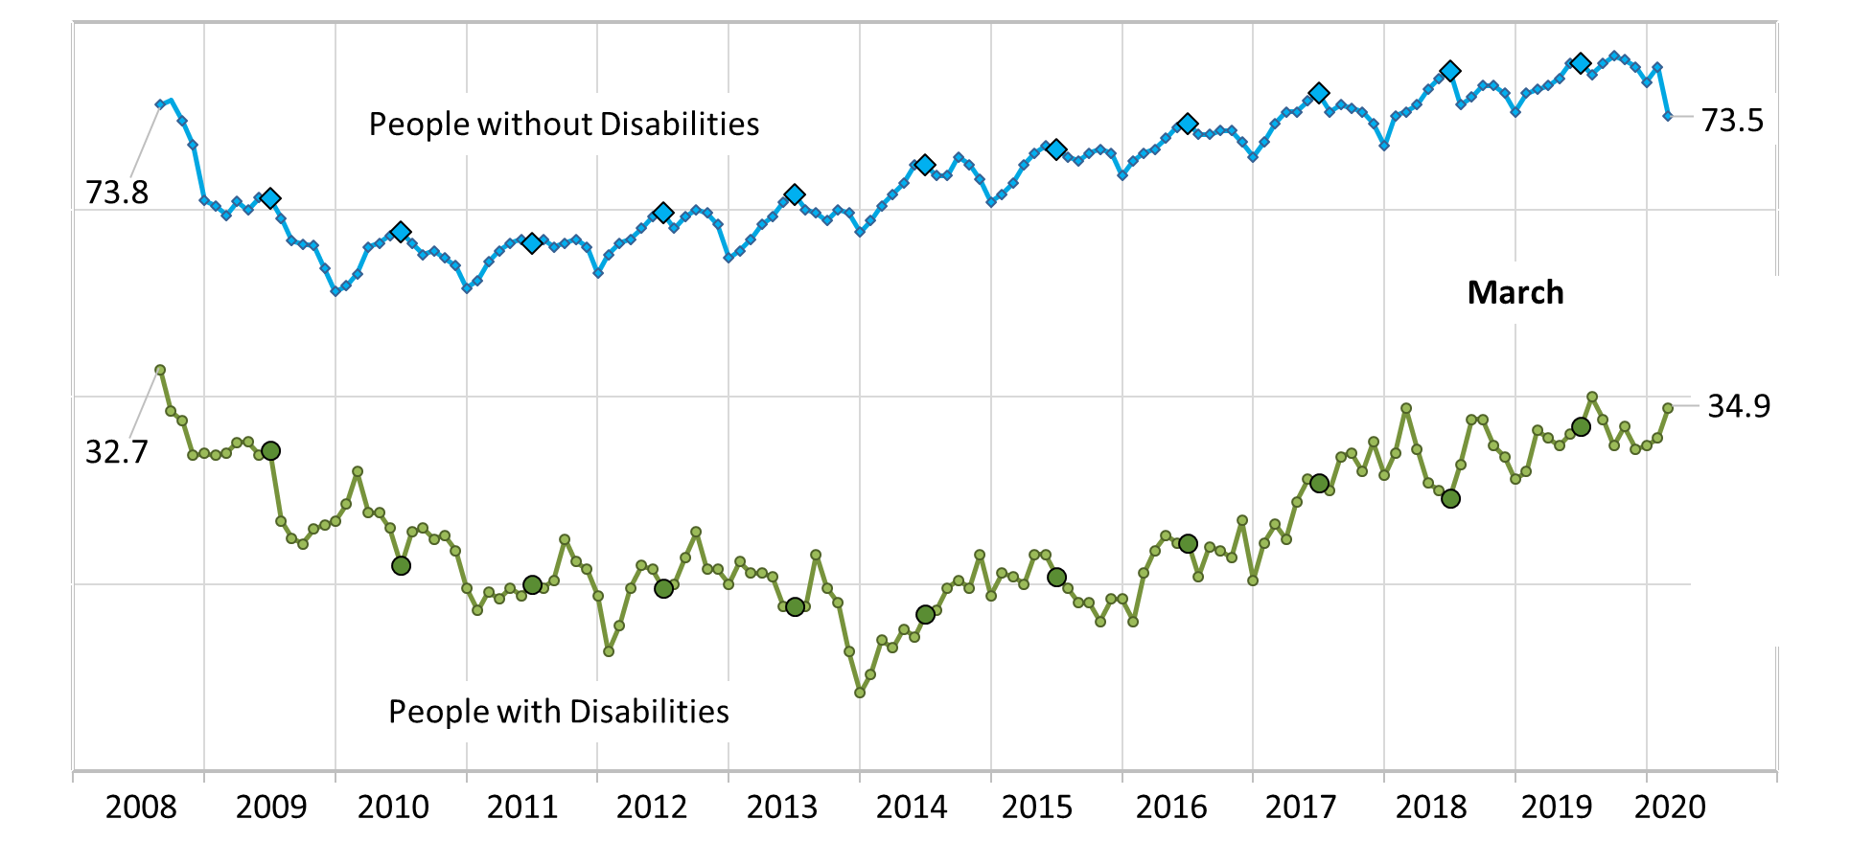
Employment-to-Population Ratio
#nTIDELearn
#nTIDELearn

Slide 16
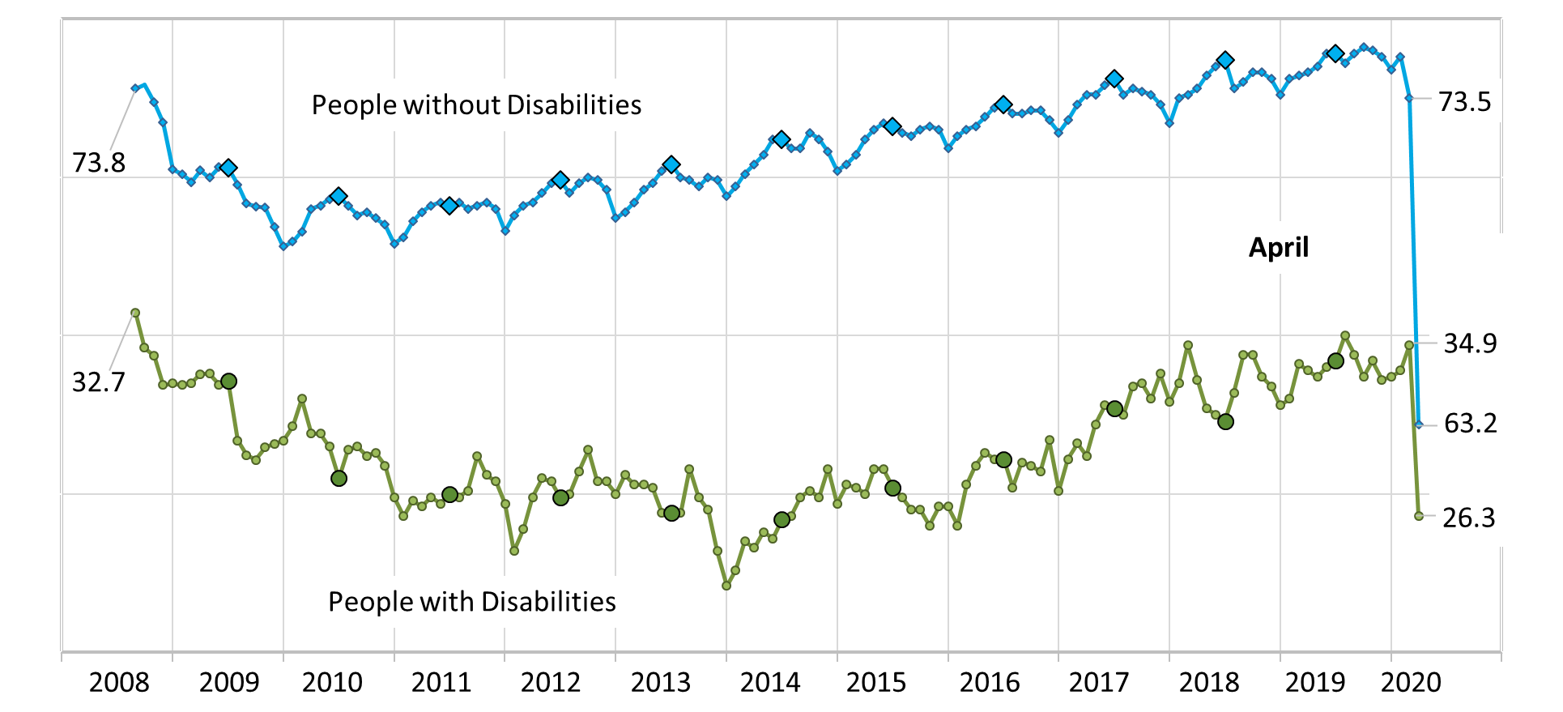
Employment-to-Population Ratio
#nTIDELearn
#nTIDELearn

Slide 17
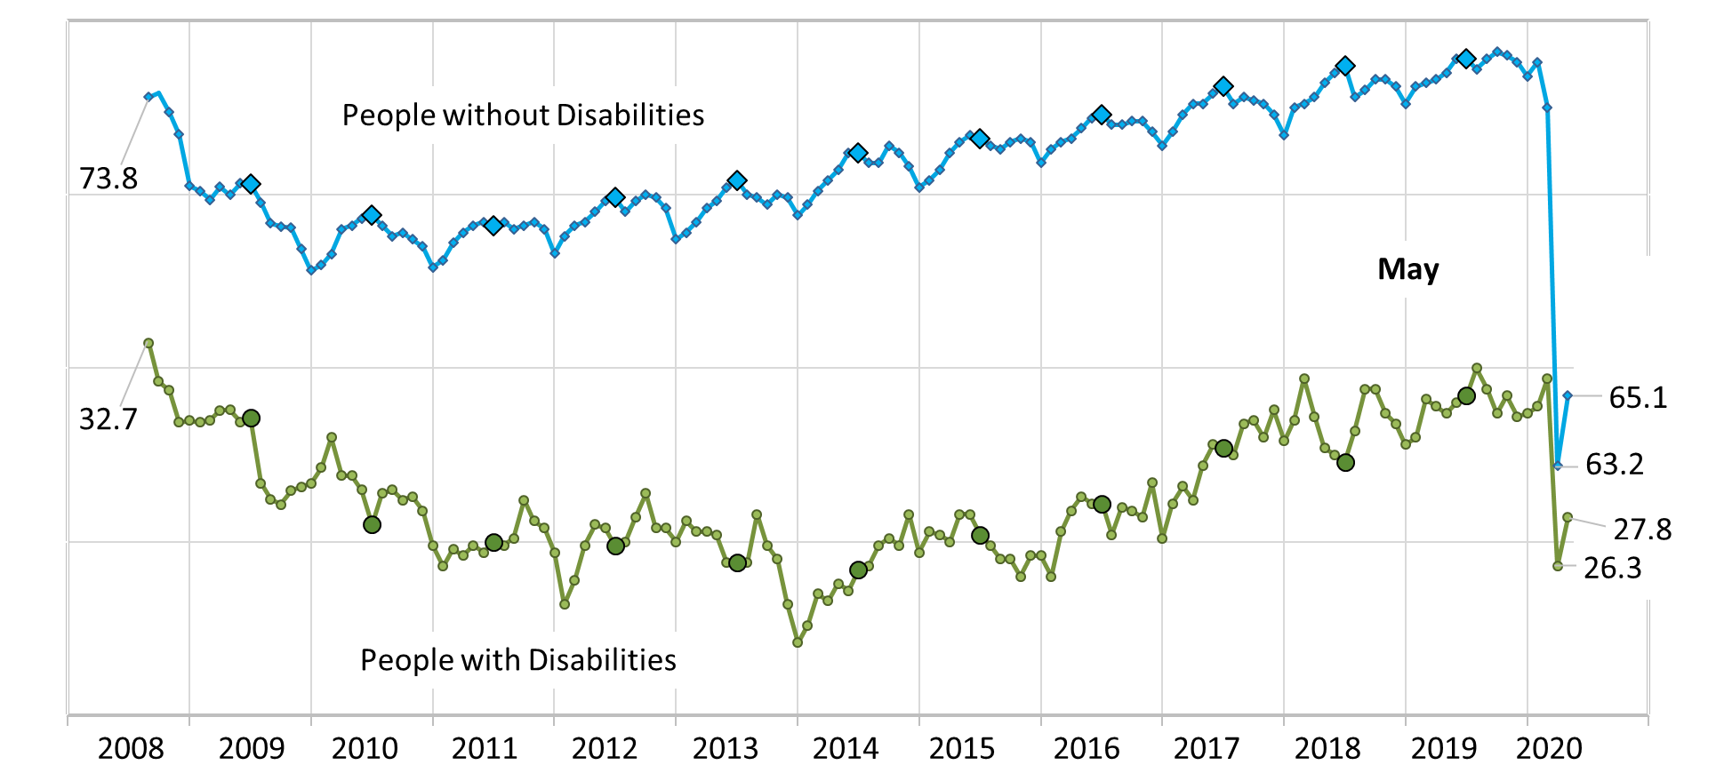
Employment-to-Population Ratio
#nTIDELearn

Slide 18
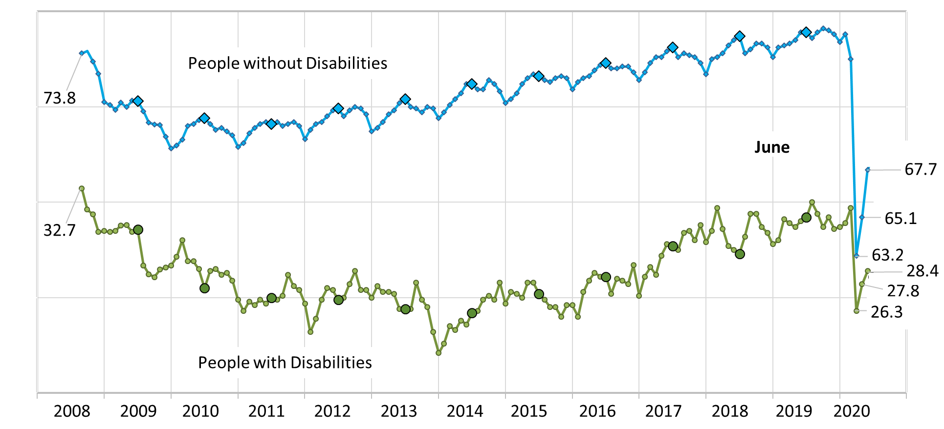
Employment-to-Population Ratio
#nTIDELearn
#nTIDELearn

Slide 19
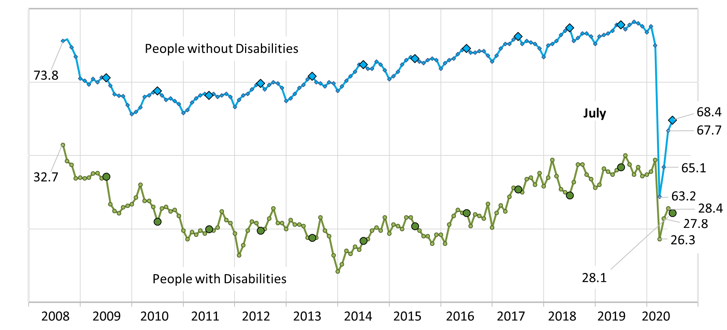
Employment-to-Population Ratio
#nTIDELearn
#nTIDELearn

Slide 20
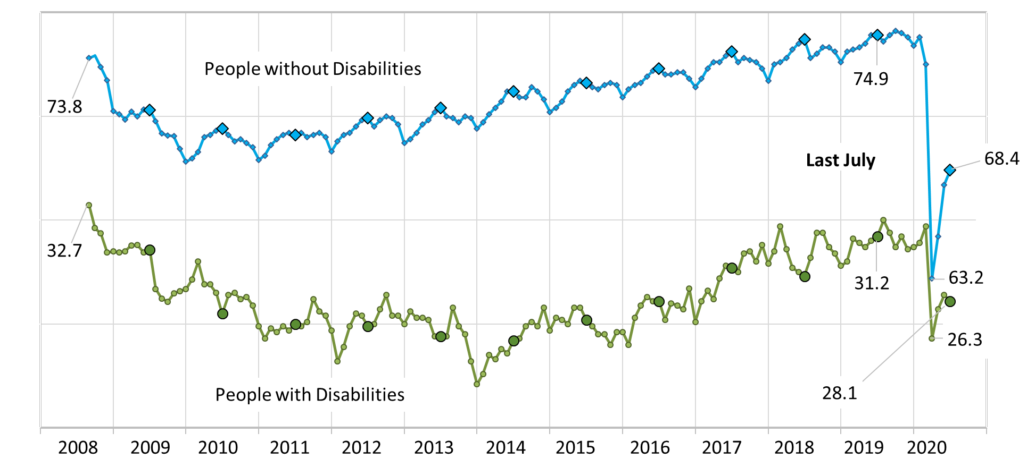
Employment-to-Population Ratio
#nTIDELearn
#nTIDELearn

Slide 21
Labor Force Participation Rate
#nTIDELearn
#nTIDELearn

Slide 22
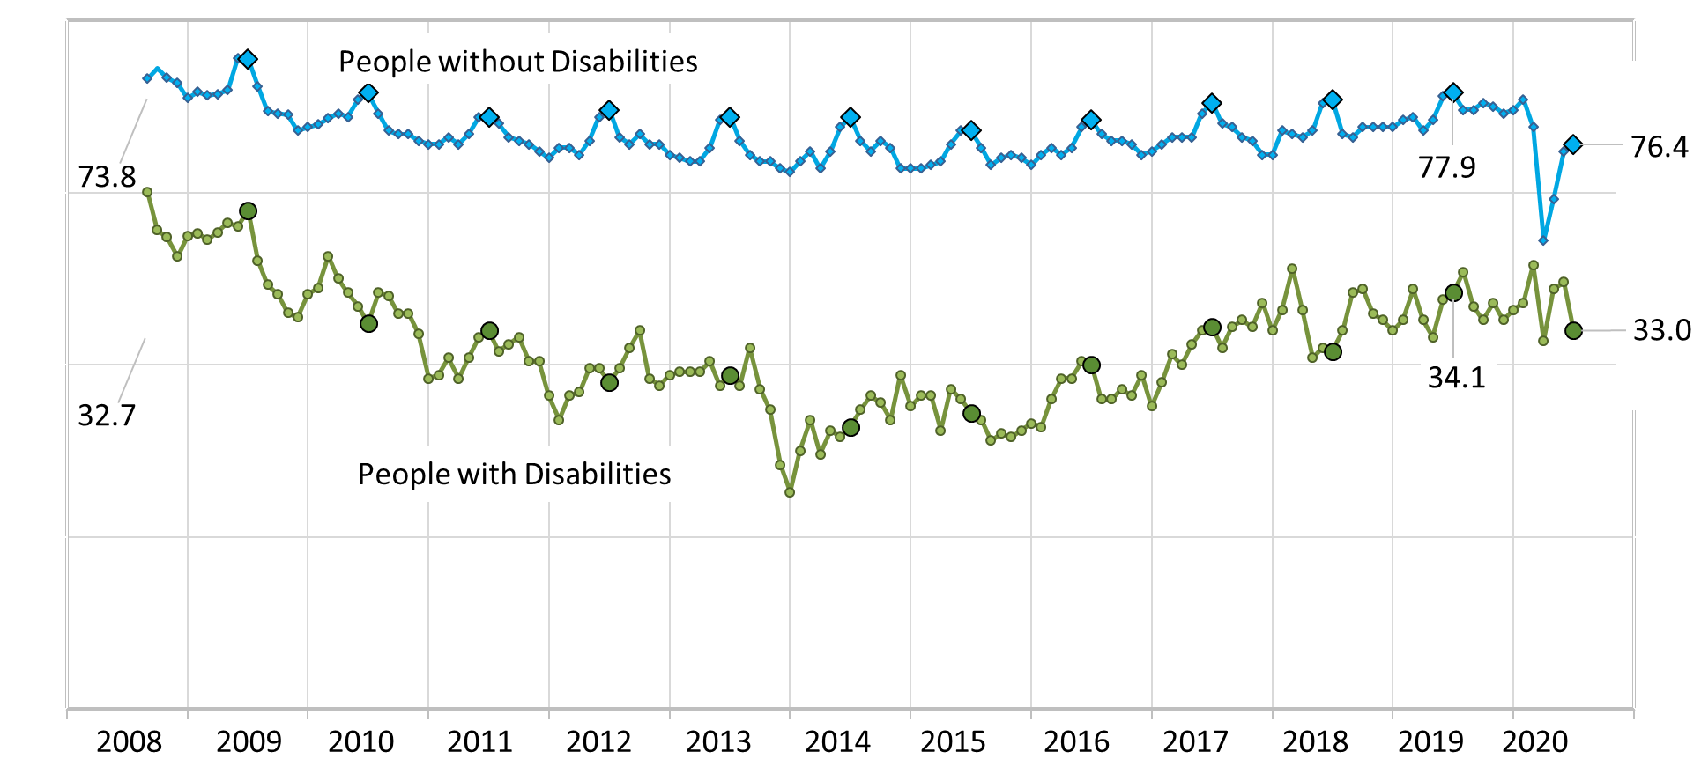
Labor Force Participation Rate
#nTIDELearn
#nTIDELearn

Slide 23

#nTIDELearn
#nTIDELearn
Part 2
nTIDE News
Denise Rozell
Association of University Centers on Disabilities (AUCD)

Slide 24
Federal Policy Update – COVID 19
Stimulus/Relief Bills
#nTIDELearn
#nTIDELearn
Final Push for COVID 4????
What we are hearing
  Negotiations are between White House and Democrats
  No top line numbers yet -- $3T vs $1T
  Limited state aid
  22 organization Call-in Day 8/4; Senate D’s Day of Action 8/5

Slide 25
COVID 19 Stimulus/Relief Bills
#nTIDELearn
#nTIDELearn
May be on the table:
  Enhanced Unemployment – extra $600 per week expired 7.31.20
  Eviction Protection
  Postal Service
  Liability Protection – ADA, civil rights, Rehab Act, GINA, ADEA,
  School Funding – specific funding for IDEA??
  Nutrition funding – SNAP; some agreement

Slide 26
Item | HEROES Act (H.R.6800) | HEALS Act | AUCD Priority
Liability Wavers | None. | Five-year shield from corona-virus related lawsuits. | No liability waivers under ADA and other civil rights legislation.
Education | $90 billion in funding for schools, none tied to IDEA. | $105 billion in funding for schools, none tied to IDEA. | $12 billion in funding specifically for IDEA.
Home- and Community-Based Services (HCBS) | Investment to support wages, services, leave, and related critical needs to support access. | None. | $20 billion in funding for HCBS.

Slide 27
JAN: Masks for COVID-19 Management and ADA Accommodations
#nTIDELearn
#nTIDELearn
Wearing a mask at work
  Do I have to?
  Can I?
  Alternative accommodations?
    Examples: flexible scheduling, telework, leave
  Quotes EEOC; based on CDC

Slide 28
Northwest ADA Center: Face Coverings and Businesses
#nTIDELearn
#nTIDELearn
FAQ format
People coming into the businesses and face covering policies
“ID cards” and Department of Justice and ADA
State specific examples
Resources and further guidance
NIDILRR funded…

Slide 29
Disability, Urban Health Equity, and the Coronavirus Pandemic: Promoting Cities for All
#nTIDELearn
#nTIDELearn
Journal of Urban Health, Pineda, Corburn, 4/23/2020
“Urban Disability Justice” strategy: how to ensure cities are more inclusive and healthier for all: intersection of disability, emergencies and urban health challenges
Inclusive cities in response to COVID 19:
  Accessible information access; inclusive decision making; access through continuity of care and social supports; economic supports; nondiscrimination and stigma.

Slide 30
Data on Racial Disparities: National Core Indicators
#nTIDELearn
#nTIDELearn
  National Core Indicators® COVID-19 Bulletin #4: Data on Racial Disparities
    Using NCI to understand racial disparities among adults with IDD during COVID-19
    2018-2019 survey
    Focuses on health, communication and location (urban/rural/suburban)

Slide 31
How to create an inclusive Workspace?
#nTIDELearn
#nTIDELearn
Recommendations from employees with disabilities for creating inclusive workplaces: Results from a grounded theory investigation ; Glade, Koch, Zaandam, Simon, Manno, Journal of Vocational Rehabilitation, volume 53, no. 1
  Based on interviews with employees with disabilities;
  Includes many strategies suggested by participants to “develop a culture that values workers with disabilities, readily provides them with needed job accommodations, and ensures they are treated with dignity and respect. “

Slide 32
CTE and Disability
#nTIDELearn
#nTIDELearn
Improving Equity and Access to Quality CTE Programs for Students with Disabilities, National Center for Learning Disabilities and Advance CTE
Includes actions CTE leaders can take:
  Leverage Perkins V funding
  Systems for high quality career guidance to students with disabilities
  Leverage data to identify and close equity gaps
  Professional development

Slide 33
Serving Justice-involved Youth With Disabilities
#nTIDELearn
#nTIDELearn
Y-TAC; VR Youth TA Center; Saleh, Cook, Cornell University
  How do you locate and reach out to youth involved in multiple systems?
  What does federal legislation say?
  Alternate educational opportunities available
  Integrating wraparound services
  Evidence-based practices
  Recommendations

Slide 34
Employment and earnings among ex-offenders with disabilities
#nTIDELearn
#nTIDELearn
Ethridge, Dowden, Brooks, Kwan, Harley, Journal of Vocational Rehabilitation, Vol. 52, no. 3
RSA-911 data 2004- 2013
Barriers to employment for ex-offenders with disabilities, and how racial/ethnically marginalized ex-offenders earn less and disproportionately unemployed
African American=employed at higher rates than both Hispanic and White ex-offenders but earn less than both of these groups

Slide 35
2020 Progress Report on National Disability Policy
#nTIDELearn
#nTIDELearn
National Council on Disability Annual Report to Congress; July 24, 2020
Focus:
  Services for Transitioning Youth:
  Public Benefits/dismantle disincentives to work present
  Federal Employment and Support of Entrepreneurship
  Employer Engagement

Slide 36
A Quick Look at the ADA: Title I -- Employment
#nTIDELearn
#nTIDELearn
NARIC – National Rehabilitation Information Center
For:
  Employees/Job Seekers
  Employers/Hiring Managers
  Learn More:
    JAN
    ODEP
  How to dig deeper in the ADA National Network Regional Centers

Slide 37

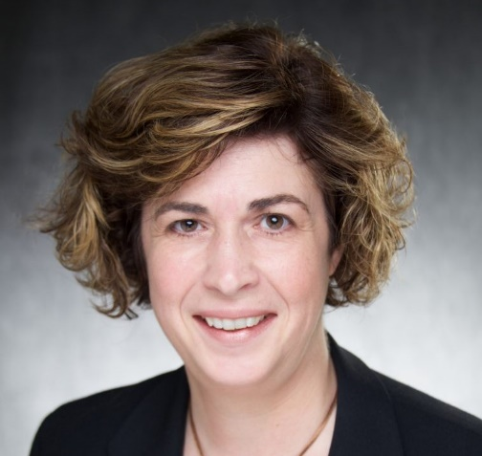
Part 3 nTIDE Guest Speakers
Wendy Parent-Johnson
Sonoran UCEDD
University of Arizona
Julie Christensen
Association of People Supporting
EmploymentFirst
#nTIDELearn
#nTIDELearn

Slide 38
COVID-19
Impact on Employment of Individuals with Disabilities

Slide 39
2020: Challenge & Opportunity
Provider operations
Individual disruptions
Paradigm shift
Policies & practice

Slide 40
Response: Virtual Webinar Series
Creative strategies
State updates
Resources & information
Discussion platform
access recordings of past webinars, please visit bit.ly/adptvirtucedd

Slide 41
Considerations: Issues & Realities
Current struggles
Funding & referrals
Shifting cultures
Training & technical assistance
Access & use
System complexities

Slide 42
APSE COVID Impact Survey
  Addressing disproportionate impact
  Data driven recovery
  600+ responses (June 15-29, 2020)
    No responses from HI, MS, NV
Download the summary of
COVID Impact Survey preliminary findings
HERE

Slide 43
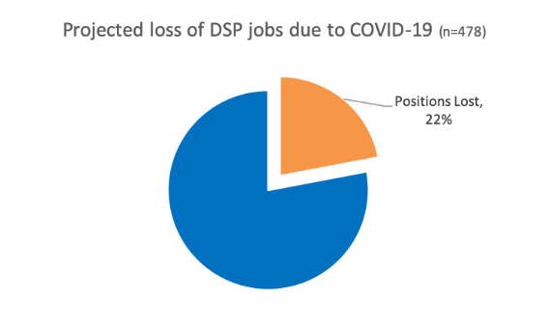
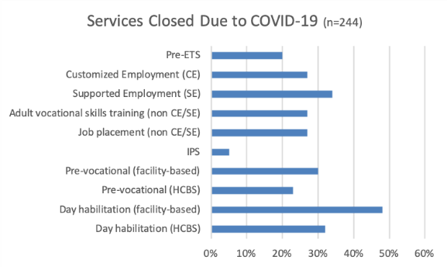
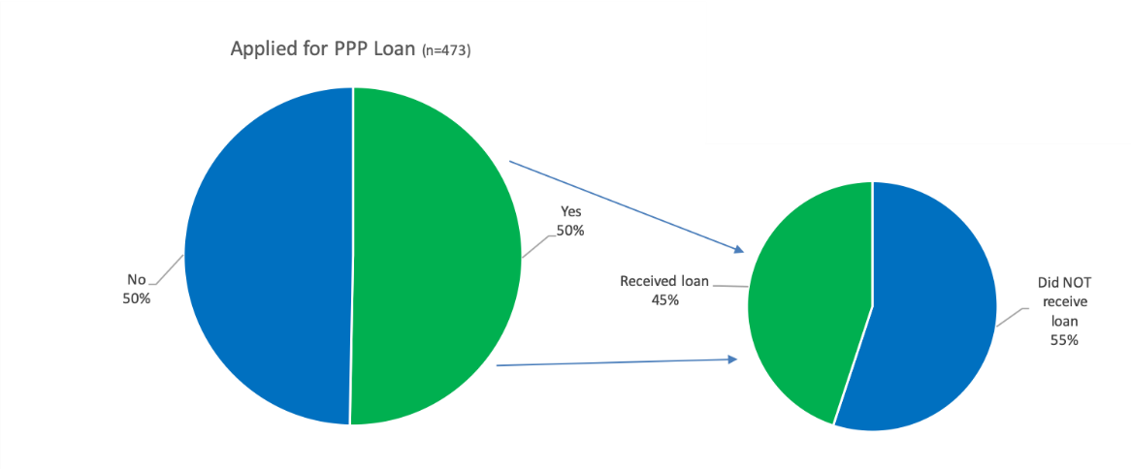
Impact on Service System
Employment services significant impacted
  67% decreased in VR referrals
  43% slowing in Medicaid reimbursements

Slide 44
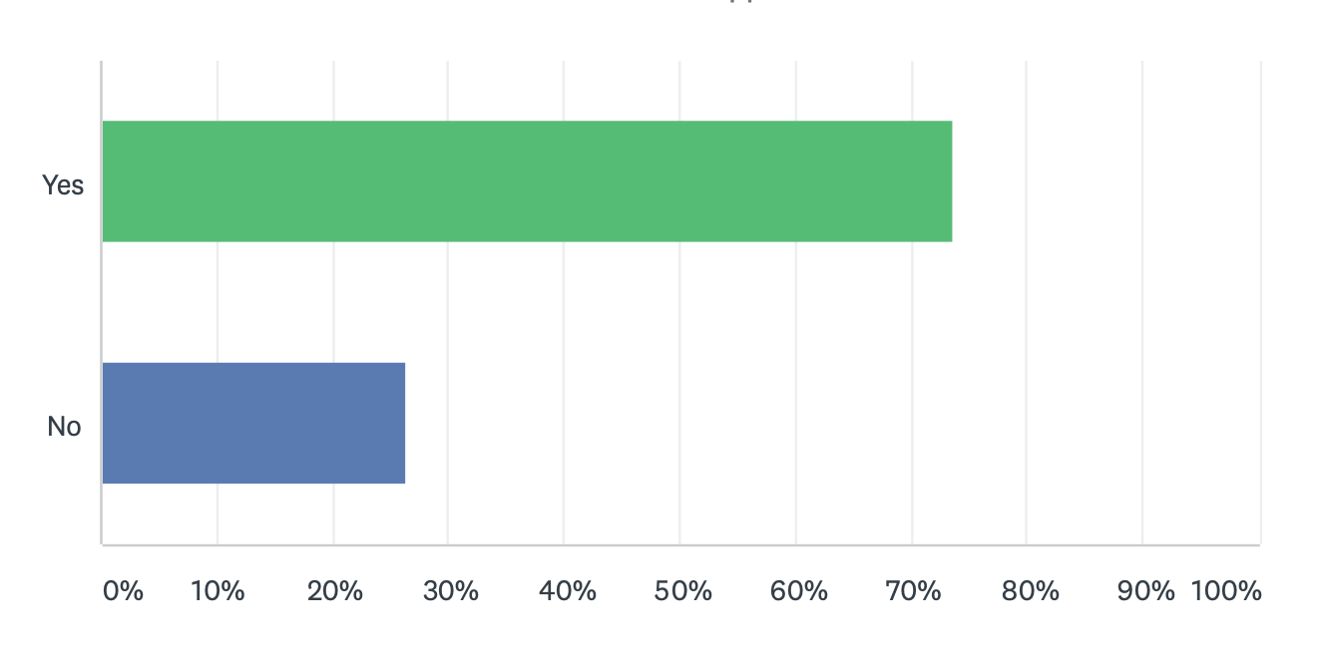

COVID Impact: Job losses for PWD

Slide 45
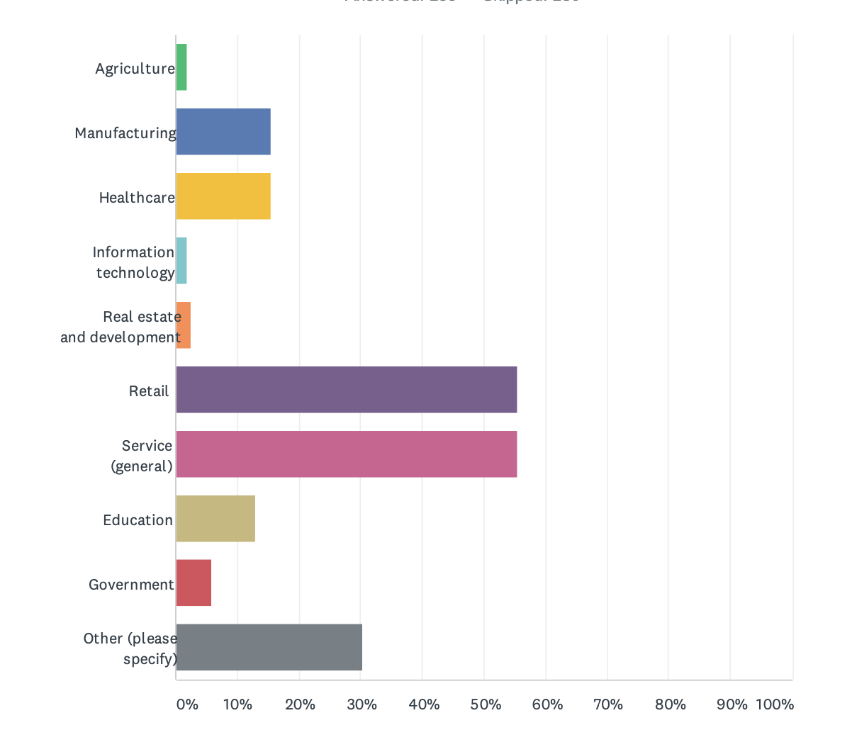
COVID Impact: Job loss by market sector

Slide 46
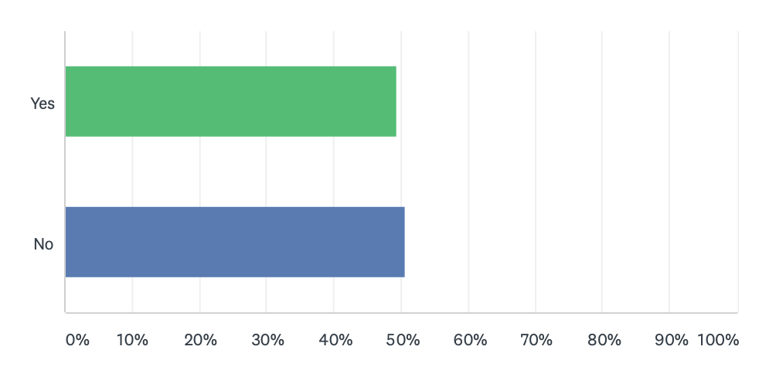
COVID Impact: Job gains for PWD

Slide 47
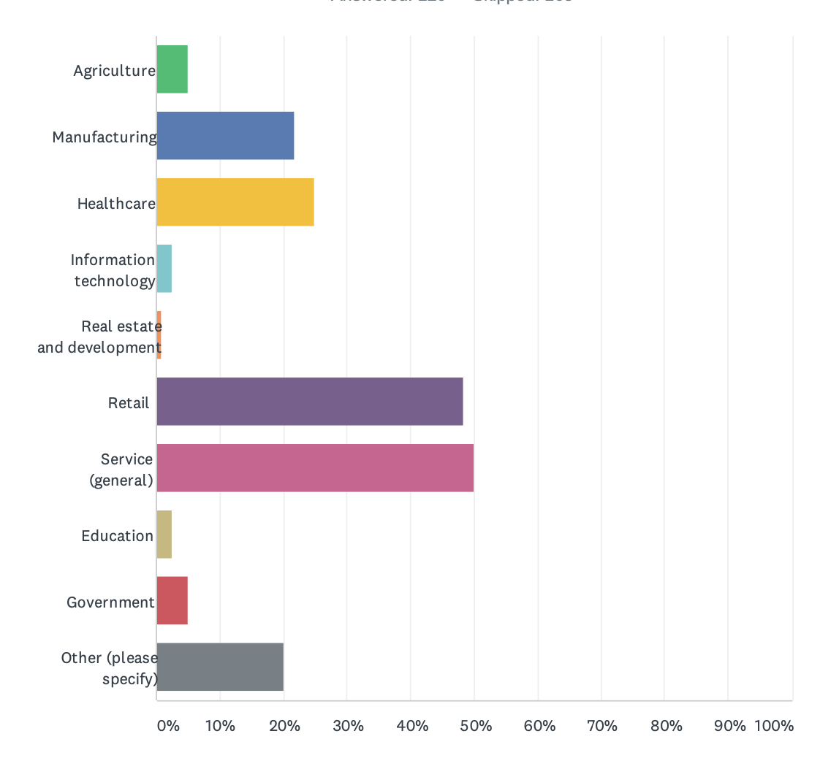
COVID Impact: Job gains by market sector

Slide 48
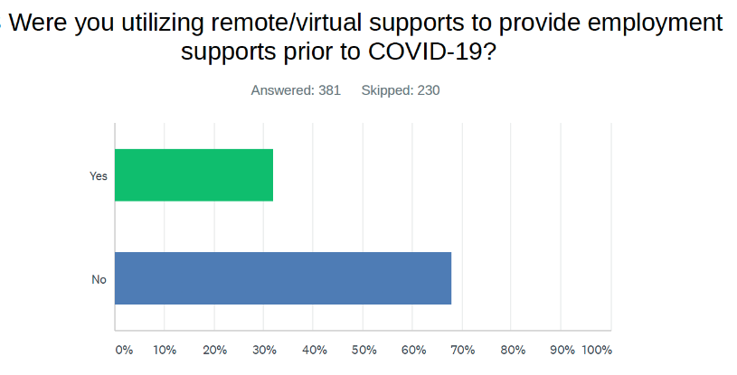
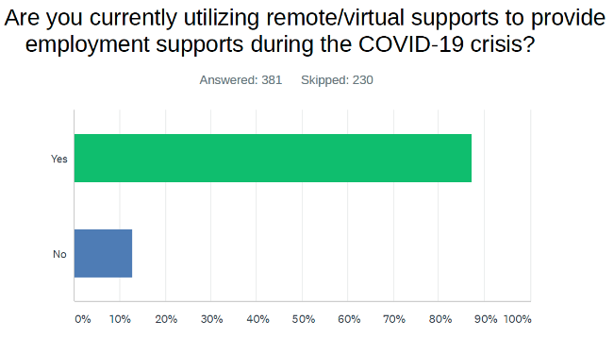
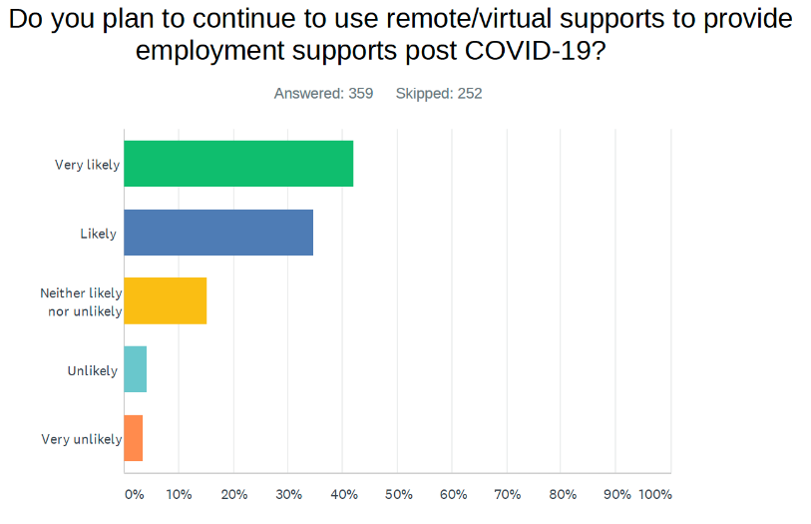
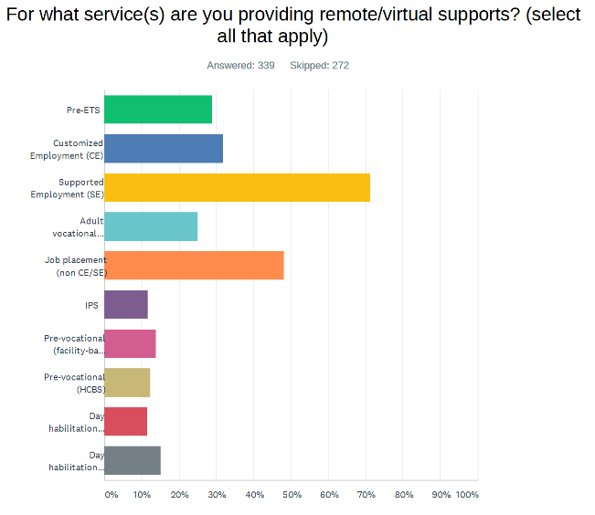
A shifting service delivery approach
A shifting service delivery approach

Slide 49
Why Virtual Supports?
Prior to COVID
COVID response & recovery
DSP workforce shortage crisis
Support for job coaches in the field
DSP workforce shortage crisis
Support for job coaches in the field
The “new normal”

Slide 50
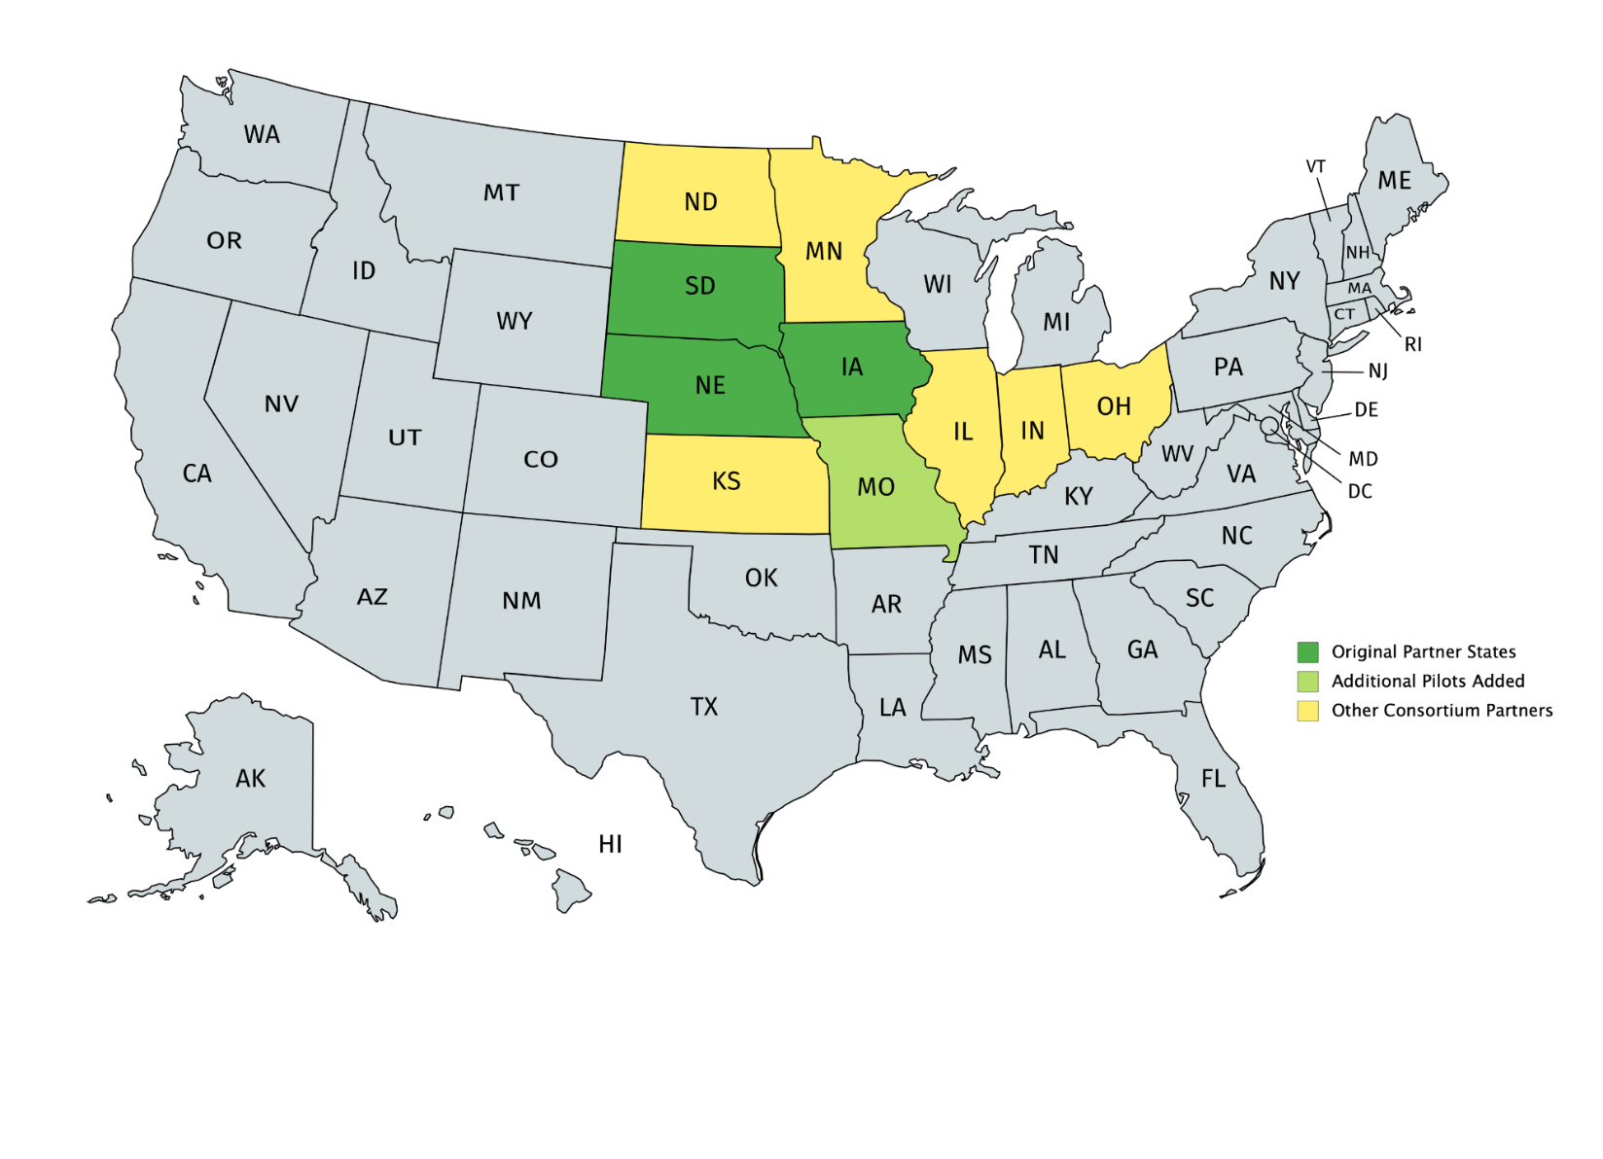

How it Began &
What We Learned

Slide 51
Challenges experienced
Technology challenges (e.g., accessing WiFi, lack of familiarity/ comfort, “forgetting”)
Addressing the culture change in the workplace to make the use of technology a standard operating procedure
Evaluating both the process and the outcome

Slide 52

Sustainability & Growth
Ongoing access to training and technical assistance (keeping up with the pace of technology)
Opportunities for sharing information is vital to problem solving
Developing and maintaining relationships with job coaches is essential

Slide 53
Funding rates and procedures
Service definitions
Access to technology & broadband
Provisions for training
Measuring outcomes
Oversight and management of remote workforce
Other
Policy Implications

Slide 54
Questions & Thank You
Wendy Parent-Johnson, wparentjohnson@arizona.edu
Director, Sonoran UCEDD
Julie Christensen, julie@apse.org
Director of Policy & Advocacy, APSE

Slide 55


Questions and Answers
#nTIDELearn
#nTIDELearn
Zoom’s Q&A button
Take our survey and tell us what you think!
www.researchondisability.org/ntide/ntide-survey
Thanks to our partners:
Institute on Disability www.ResearchOnDisability.org
Kessler Foundation www.KesslerFoundation.org
AUCD www.AUCD.org
Contact us:
Email: Disability.Statistics@unh.edu
Call: 866-538-9521 (toll free)
Twitter at #nTIDELearn

Slide 56
So Long Everyone
#nTIDELearn
#nTIDELearn
Thanks to our partners:
Institute on Disability www.ResearchOnDisability.org
Kessler Foundation www.KesslerFoundation.org
AUCD www.AUCD.org
Contact us:
Email: Disability.Statistics@unh.edu
Call: 866-538-9521 (toll free)
Twitter at #nTIDELearn
This work is funded by grant no. 90RT0537 from NIDILRR.

