Slide 1
FRIDAY
June 19, 2020
Notes:
Hello, and welcome, everybody, to the new national trends in disability employment, or nTIDE lunch & learn series. On the first Friday of every month, corresponding with the Bureau of Labor Statistics jobs report, we'll be offering this live broadcast via Zoom webinar to share the results of the latest nTIDE findings. In addition, we will provide news and updates from the field on disability employment, as well as host an invited panelist who will discuss current disability related findings and events.
Just a few housekeeping items before we begin.

Slide 2
FRIDAY
June 19, 2020
Notes:
Hello, and welcome, everybody, to the new national trends in disability employment, or nTIDE lunch & learn series. On the first Friday of every month, corresponding with the Bureau of Labor Statistics jobs report, we'll be offering this live broadcast via Zoom webinar to share the results of the latest nTIDE findings. In addition, we will provide news and updates from the field on disability employment, as well as host an invited panelist who will discuss current disability related findings and events.
Just a few housekeeping items before we begin.

Slide 3
Up Front Matters
#nTIDELearn
This webinar is being recorded. We will post an archive of along side the Monthly nTIDE broadcast on our webinar, each month, on our website at www.researchondisability.org/nTIDE. This site will also provide copies of the presentations, the speakers’ bios, full transcripts, and other valuable resources.
As an attendee of this webinar, you are a viewer. To ask questions of the speakers, click on the Q & A box on your webinar screen and type your questions into the box. Speakers will review these questions and provide answers during the last section of the webinar. Some questions may be answered directly in the Q & A box.
3
Notes:
This webinar is being recorded. We will post an archive of each webinar, each month, on our Web site at www.researchondisability.org/nTIDE. This site will also provide copies of the presentations, the panelist bios, full transcripts and other valuable resources.
As an attendee of this webinar, you are a viewer and no sound is enabled. To ask questions of the panelists, simply click on the Q & A box on your webinar screen and type your questions into the box. Panelists will review these questions during the assigned question and answer periods.

Slide 4
Up Front Matters
#nTIDELearn
If you have any questions following this recording, please contact us at disability.statistics@unh.edu, or toll free at 866-538-9521 for more information. Thanks for joining us. Enjoy today's webinar!
4
Notes:
This webinar is being recorded. We will post an archive of each webinar, each month, on our Web site at www.researchondisability.org/nTIDE. This site will also provide copies of the presentations, the panelist bios, full transcripts and other valuable resources.
As an attendee of this webinar, you are a viewer and no sound is enabled. To ask questions of the panelists, simply click on the Q & A box on your webinar screen and type your questions into the box. Panelists will review these questions during the assigned question and answer periods.

Slide 5
nTIDE COVID-19 Update - June Andrew Houtenville University of New Hampshire John O’Neill Kessler Foundation Denise Rozell Association of Centers on Disabilities (AUCD)
#nTIDELearn
5

Slide 6
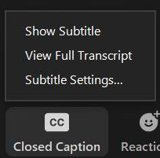
Captions are Available
#nTIDELearn
After selecting Closed Caption (CC),
pick Show Subtitle and the captions will
appear on the bottom.
If you pick View Full Transcript, a
running transcript of the captions will
appear on the side.
Select Subtitle Settings to adjust the caption size.
If you prefer to use Streamtext, here is the link: https://www.streamtext.net/player?event=UNH
6

Slide 7
Welcome
#nTIDELearn
nTIDE Lunch & Learn:
A joint effort of the University of New Hampshire, Kessler Foundation, and the Association of University Centers on Disability (AUCD).
This is a special episode of the nTIDE Lunch and Learn series based on the unique circumstances in the U.S. economy and the COVID-19 Pandemic.
A part of the Rehabilitation and Research Training Center on Employment Policy and Measurement, which is funded by the National Institute on Disability, Independent Living and Rehabilitation Research (NIDILRR), grant no. 90RT0537.
7

Slide 8
Today’s Agenda
#nTIDELearn
● 12:00 pm: Welcome and Introduction
● 12:10 pm: Updated Numbers from the Public-Use Micro Data of the Current Population Survey
● 12:20 pm: Implications for Employment Service Providers and Economic Stimulus Programs
● 12:39 pm: Open Q&A period
8

Slide 9
The Numbers Andrew Houtenville University of New Hampshire
#nTIDELearn
9

Slide 10
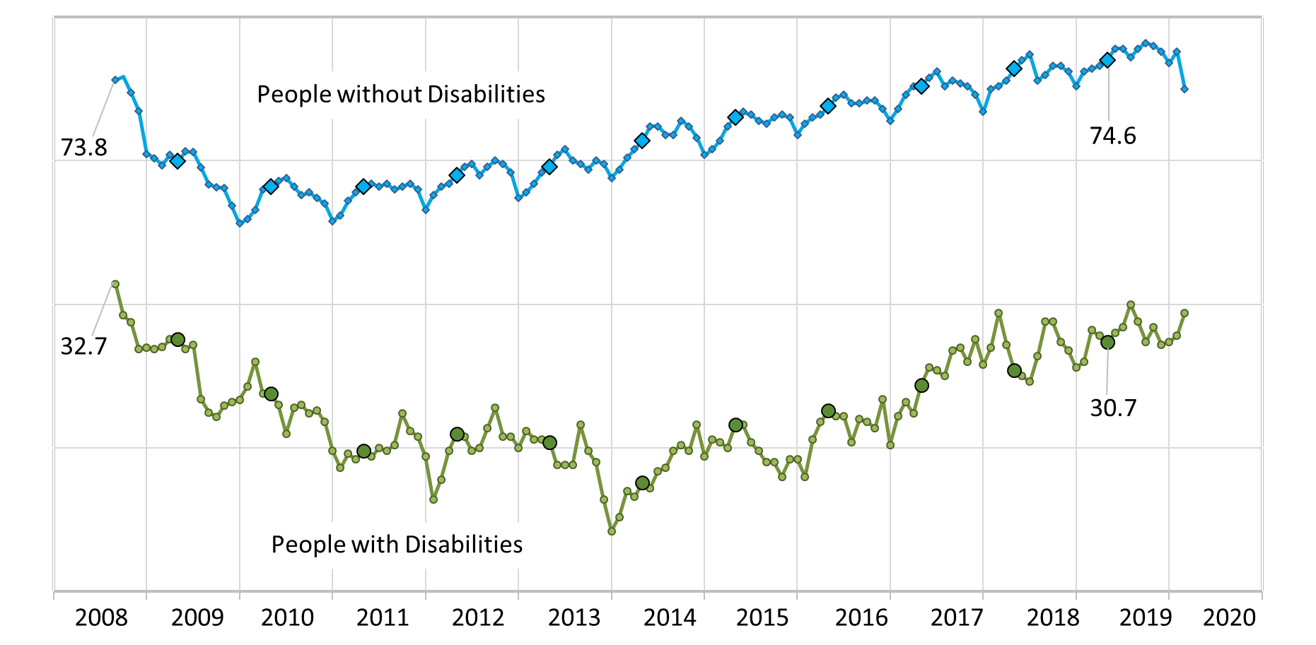
Employment-to-Population Ratio
#nTIDELearn
10

Slide 11
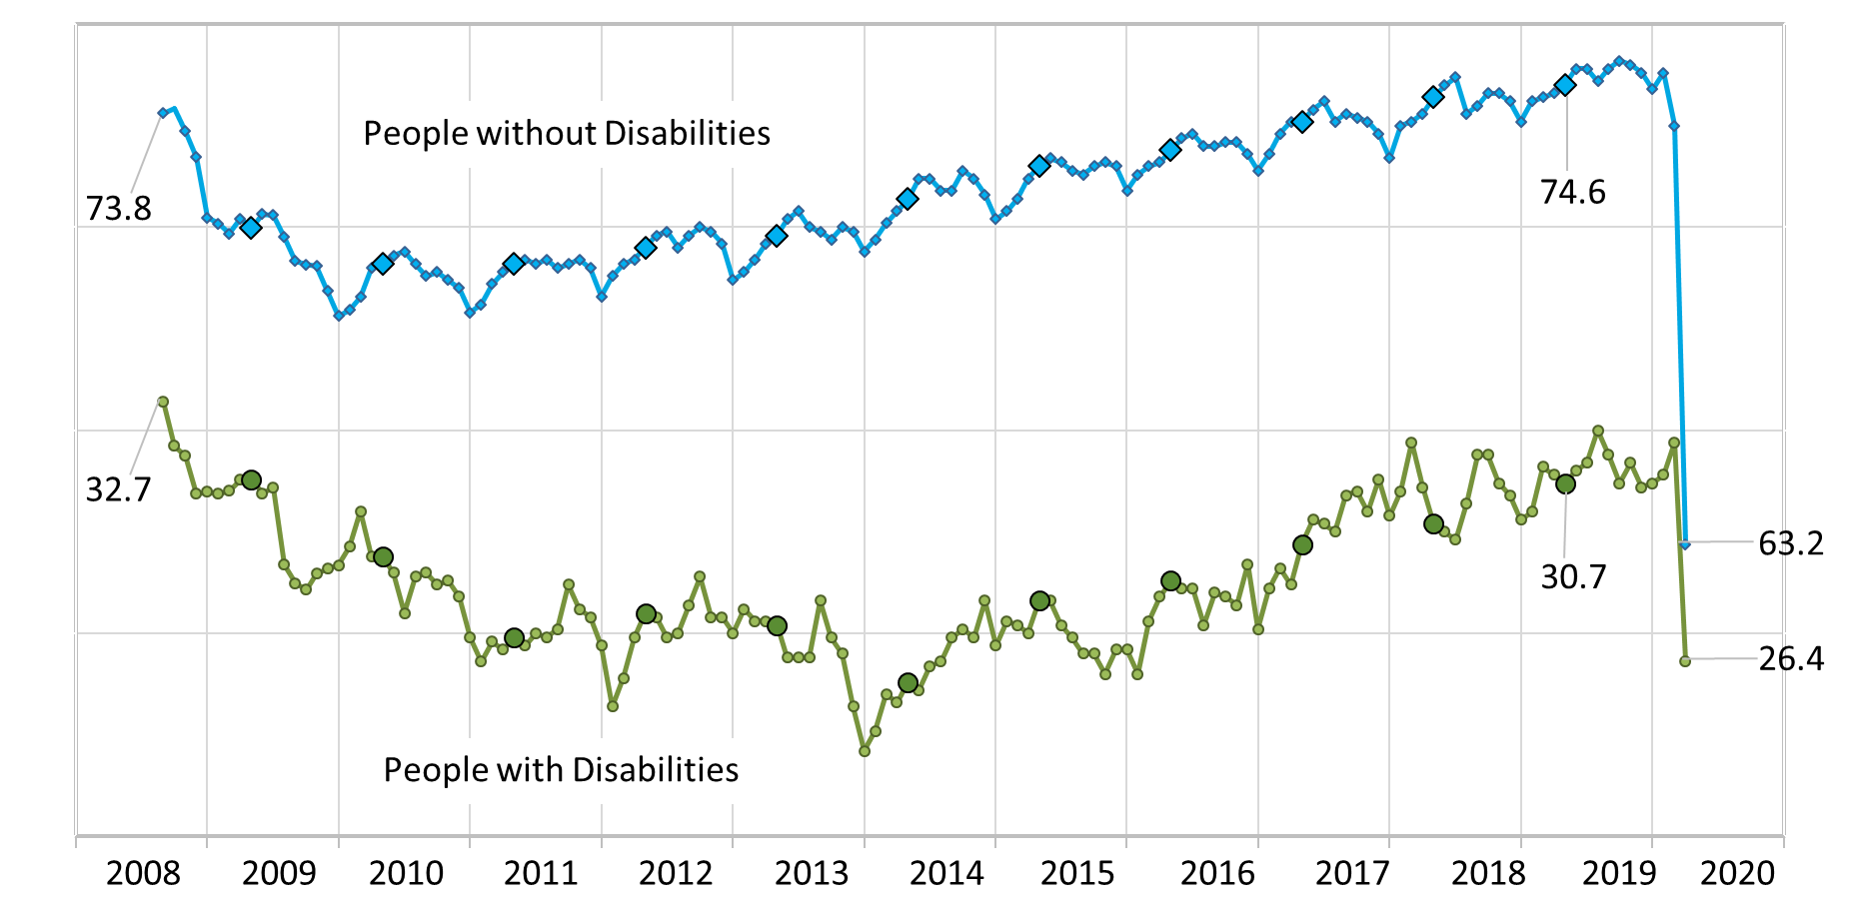
Employment-to-Population Ratio
#nTIDELearn
11

Slide 12
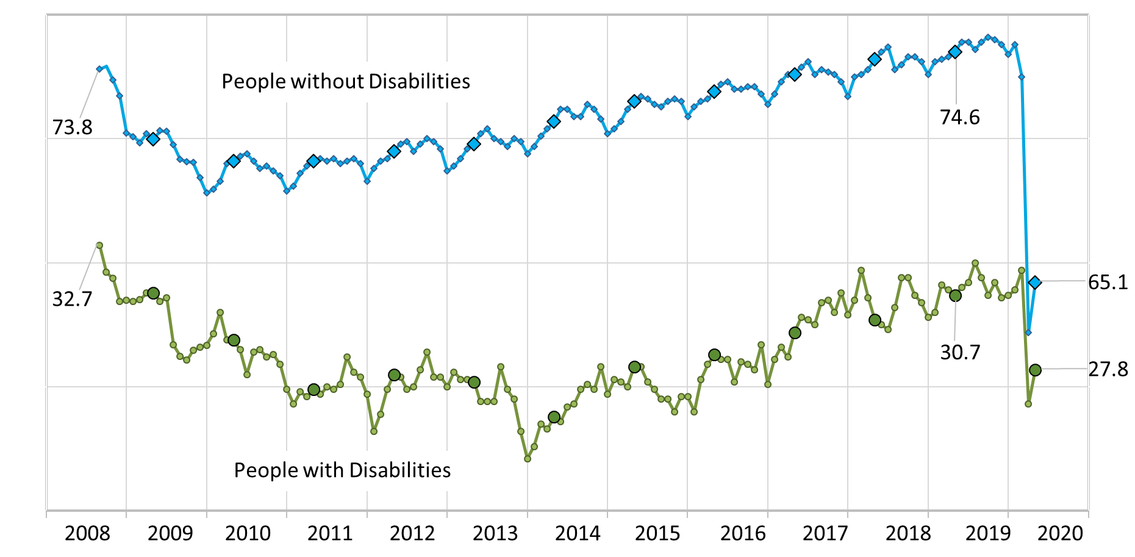
Employment-to-Population Ratio
#nTIDELearn
12

Slide 13
“Employment Status”
#nTIDELearn
People with Disabilities
People without Disabilities
Not in
Labor
Force
67.1
71.6
67.1
22.8
26.3
25.3
2.6
74.6
10.5
9.6
63.2
65.1
Unemployed
2.1
6.5
6.5
Employed
30.7
26.4
27.8
13
May 2019
April 2020
May 2020
May 2019
April 2020
May 2020

Slide 14
Unemployed
#nTIDELearn
People with Disabilities
People without Disabilities
Unemployed
945,000
27.1
945,000
31.1
20,095,000
21.0
Looking
18,355,000
27.5
79.0
72.9
68.9
72.5
On Temporary Layoff
14
April
May
April
May

Slide 15
Implications for the Field John O’Neill Kessler Foundation Denise Rozell Association of University Centers on Disabilities (AUCD)
#nTIDELearn
15

Slide 16
COVID Related Employment Challenges
#nTIDELearn
Returning to work after being furloughed
How to ensure that PwD on furlough are not the last employees to return to work
Employers and supervisors not as available saying they “just can’t think about this right now”
16

Slide 17
COVID Related Employment Opportunities
#nTIDELearn
Working from home will open up employment opportunities (e.g., contact tracing)
Employers will have a better understanding of accommodations
Organizations providing customized employment services can assist employers bring back employees into greatly changed work environments.
17

Slide 18
COVID 4 – House: Health and Economic Recovery Omnibus Emergency Solutions Act
#nTIDELearn
House Democrats $3 trillion bill legislation to provide Americans with economic relief from the coronavirus pandemic.
Passed along party lines
Some Needs Meet
HCBS
DD act dollars
Nutrition dollars
Research on disparity PWD
18

Slide 19
COVID 4 - Senate? July??
#nTIDELearn
Fund HCBS meet the emergency needs of PWD living in the community, including employment services
personal stories from each state
flag local news stories
Additional FMAP bump to assist states in meeting the needs of Medicaid eligible citizens
CDC Disability Health Program
updates on data challenges
SNAP/ Meals on Wheels remotely use their Supplemental Nutrition Assistance Program (SNAP) funds and access food delivery services during the novel coronavirus (COVID-19) pandemic.
personal stories
Hazard pay, overtime pay, shift differential pay and access to personal protective equipment for DSPs, including job coaches and job developers
State education stabilization fund that includes a requirement for no waivers to IDEA
19

Slide 20
Questions and Answers
#nTIDELearn
Use Q&A button on Zoom
Also … take our feedback survey at …
www.researchondisability.org/ntide/ntide-survey
20

Slide 21
Closing Comments
#nTIDELearn
Take our survey and tell us what you think: - www.researchondisability.org/ntide/ntide-survey
Thanks to our partners: - UNH/Institute on Disability (www.ResearchOnDisability.org) - Kessler Foundation (www.KesslerFoundation.org) - AUCD (www.AUCD.org)
Contact us: - Email: Disability.Statistics@unh.edu - Call: 866-538-9521 (toll free)
Twitter at #nTIDELearn
21

