Slide 1
FRIDAY
February 7, 2020
Notes:
Hello, and welcome, everybody, to the new national trends in disability employment, or nTIDE lunch & learn series. On the first Friday of every month, corresponding with the Bureau of Labor Statistics jobs report, we'll be offering this live broadcast via Zoom webinar to share the results of the latest nTIDE findings. In addition, we will provide news and updates from the field on disability employment, as well as host an invited panelist who will discuss current disability related findings and events.
Just a few housekeeping items before we begin.

Slide 2
FRIDAY
February 7, 2020
Notes:
Hello, and welcome, everybody, to the new national trends in disability employment, or nTIDE lunch & learn series. On the first Friday of every month, corresponding with the Bureau of Labor Statistics jobs report, we'll be offering this live broadcast via Zoom webinar to share the results of the latest nTIDE findings. In addition, we will provide news and updates from the field on disability employment, as well as host an invited panelist who will discuss current disability related findings and events.
Just a few housekeeping items before we begin.

Slide 3
Up Front Matters
#nTIDELearn
This webinar is being recorded. We will post an archive of each webinar, each month, on our website at www.researchondisability.org/nTIDE. This site will also provide copies of the presentations, the speakers’ bios, full transcripts, and other valuable resources.
As an attendee of this webinar, you are a viewer. To ask questions of the speakers, click on the Q & A box on your webinar screen and type your questions into the box. Speakers will review these questions and provide answers during the last section of the webinar. Some questions may be answered directly in the Q & A box.
3
Notes:
This webinar is being recorded. We will post an archive of each webinar, each month, on our Web site at www.researchondisability.org/nTIDE. This site will also provide copies of the presentations, the panelist bios, full transcripts and other valuable resources.
As an attendee of this webinar, you are a viewer and no sound is enabled. To ask questions of the panelists, simply click on the Q & A box on your webinar screen and type your questions into the box. Panelists will review these questions during the assigned question and answer periods.

Slide 4
Up Front Matters
#nTIDELearn
If you have any questions following this recording, please contact us at disability.statistics@unh.edu, or toll free at 866-538-9521 for more information. Thanks for joining us. Enjoy today's webinar!
4
Notes:
This webinar is being recorded. We will post an archive of each webinar, each month, on our Web site at www.researchondisability.org/nTIDE. This site will also provide copies of the presentations, the panelist bios, full transcripts and other valuable resources.
As an attendee of this webinar, you are a viewer and no sound is enabled. To ask questions of the panelists, simply click on the Q & A box on your webinar screen and type your questions into the box. Panelists will review these questions during the assigned question and answer periods.

Slide 5
Welcome John O’Neill Kessler Foundation
#nTIDELearn
5

Slide 6
Welcome
#nTIDELearn
nTIDE Lunch & Learn:
A joint effort of the University of New Hampshire, Kessler Foundation, and the Association of University Centers on Disability (AUCD).
Occurs at noon Eastern-time on the first Friday day of each month, with the release of the nTIDE Report.
A part of the Rehabilitation and Research Training Center on Employment Policy and Measurement, which is funded by the National Institute on Disability, Independent Living and Rehabilitation Research (NIDILRR), grant no. 90RT0537.
6

Slide 7
Today’s Program
#nTIDELearn
Part 1: nTIDE Report … “The Numbers”
John O’Neill, Kessler Foundation
Megan Henly, University of New Hampshire
Part 2: nTIDE News
Denise Rozell, Association of University Centers on Disabilities (AUCD)
Part 3: Guest Speakers
Richard Petty, National Center for Aging & Disability, UT McGovern Medical School
Seth Hoderewski & Joe Michener, Lehigh Valley Center for Independent Living
Part 4: Q&A … for Parts 1-3
7

Slide 8
Part 1 The nTIDE Report John O’Neill Kessler Foundation
#nTIDELearn
8

Slide 9
The Monthly nTIDE Report
#nTIDELearn
The monthly nTIDE Report is a press release and infographic, looking at the latest employment statistics.
Uses data from the “jobs report” released by the U.S. Bureau of Labor Statistics, on the 1st Friday of each month.
9

Slide 10
Source of the Data
#nTIDELearn
U.S. BLS, Current Population Survey (CPS).
Source of the “official” unemployment rate.
Civilians, ages 16-64, not living in institutions.
Available September 2008 onward.
Not yet seasonally adjusted.
which is why we compare to the same month last year.
10

Slide 11
The Numbers Megan Henly University of New Hampshire
#nTIDELearn
11

Slide 12
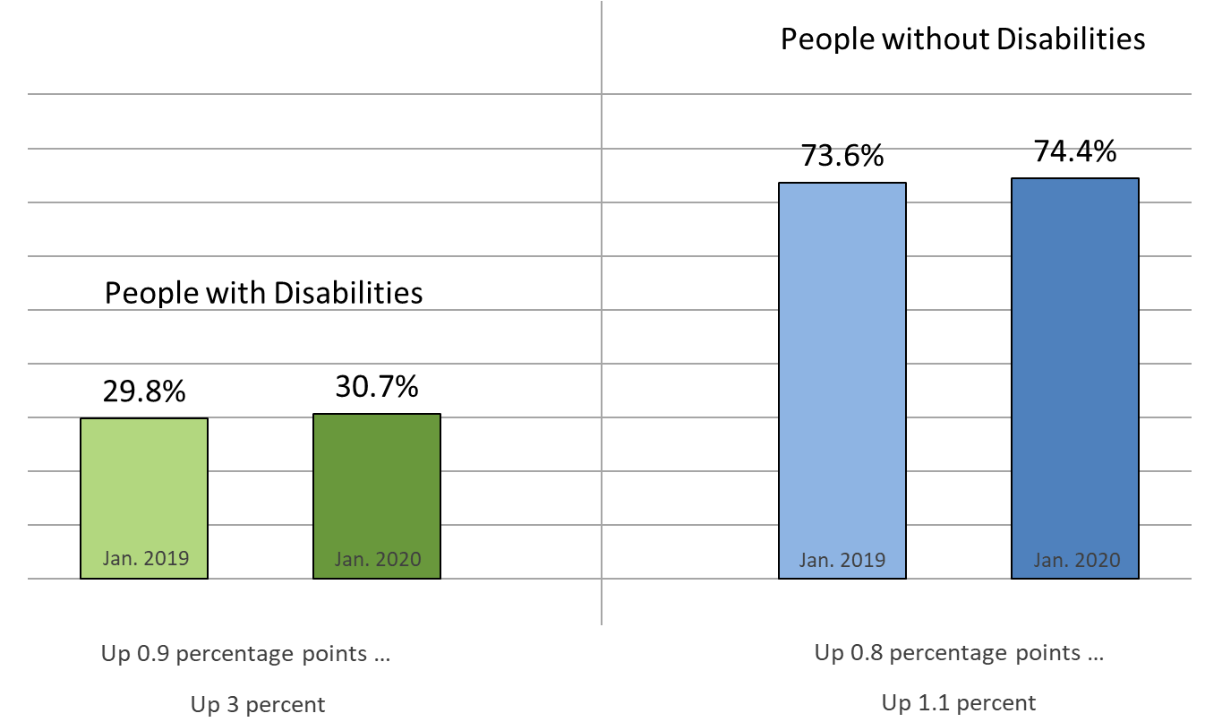
Employment-to-Population Ratio
#nTIDELearn
12

Slide 13
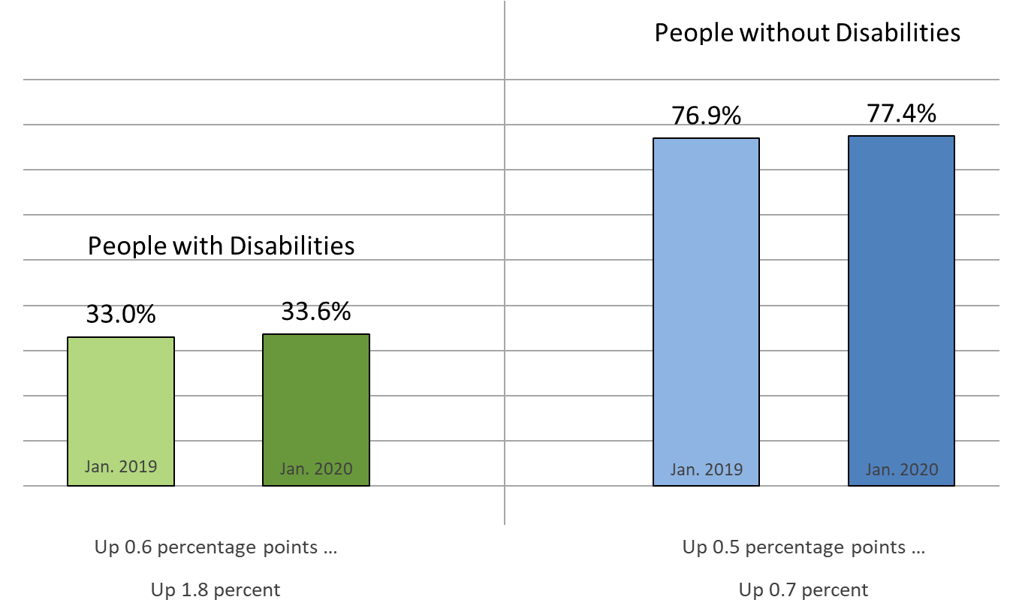
Labor Force Participation Rate
#nTIDELearn
13

Slide 14
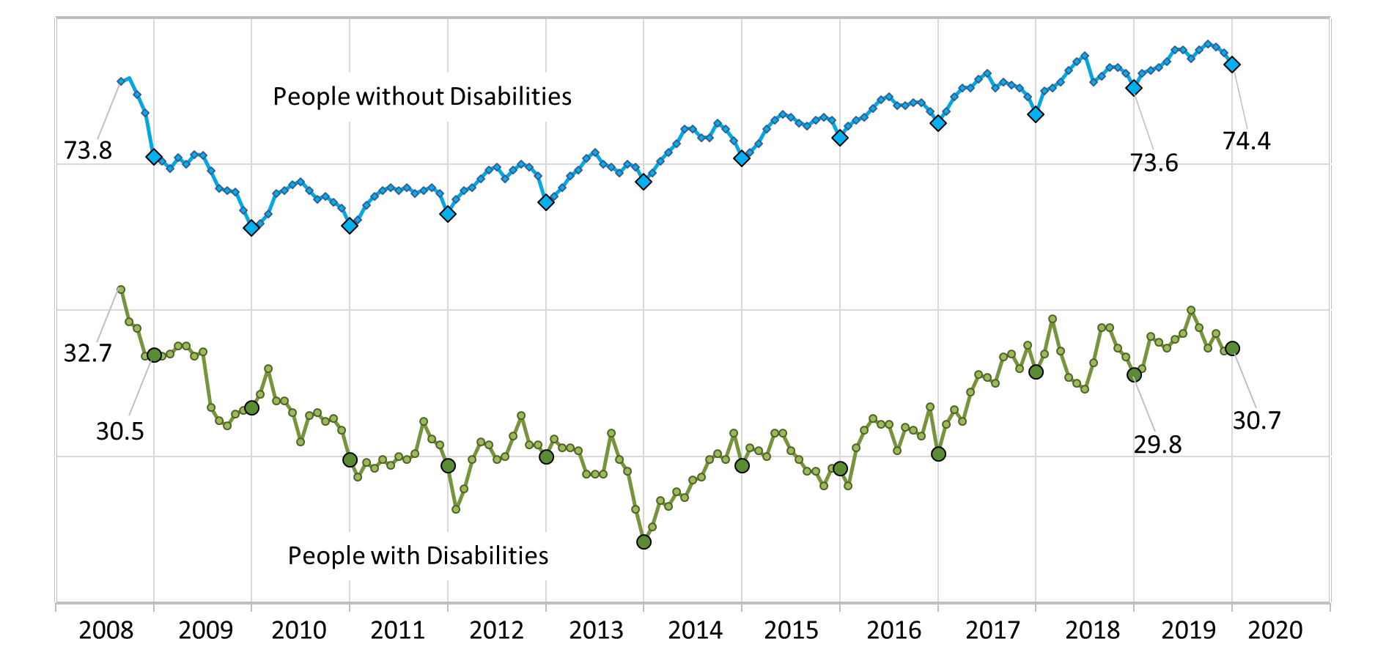
Employment-to-Population Ratio
#nTIDELearn
14

Slide 15
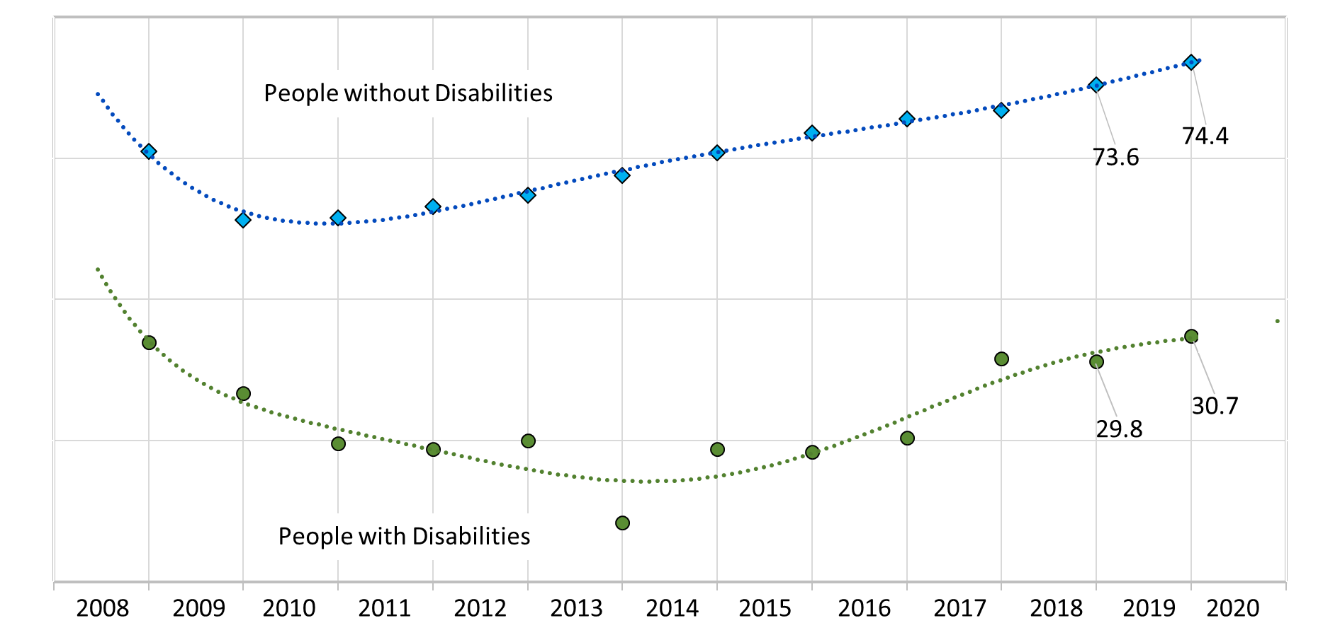
Employment-to-Population Ratio
#nTIDELearn
15

Slide 16
#nTIDELearn
Part 2 nTIDE News
Denise Rozell Association of University Centers on Disabilities (AUCD)
16

Slide 17
Federal Policy Update
#nTIDELearn
FY 2021 Budget and Appropriations
President’s Budget comes out Monday
Medicaid Block Grants
CMS’ new Healthy Adult Opportunity option
ACL/ODEP Leadership Julie Hocker

Slide 18
Informed Decision Making: Think Work
#nTIDELearn
The Employment Journey: A Focus on Informed Choice : in-depth analysis on the concept of informed choice and how making informed choices can contribute to improved employment outcomes
Informed Decision Making: It Takes More than Practice: Response of members of SABE and Green Mountain Self Advocates to a paper on NASDDDS on informed choice and decision-making

Slide 19
Pre-Employment Transition Services
#nTIDELearn
Mathematica research brief
Statistics on VR agencies’ implementation of pre-ETS in first year reporting
Baseline of nationwide delivery of pre-ETS and agency variance
Variation across states in who is served and how services are delivered
Questions remain re types of activities, how students benefit, and effect on agencies other clients

Slide 20
ODEP -- Apprenticeship
#nTIDELearn
Apprenticeship Disability-Inclusion Guide – targeted separately to youth, educators, business
Apprenticeship Toolkit
Understanding the basics
Increasing participation of youth with disabilities
Establishing new apprenticeship programs
What apprenticeship employers need to know when working with youth with disabilities
Future opportunities in apprenticeship
Apprenticeship finders

Slide 21
Addressing the Data Gap in Disability Employment
#nTIDELearn
LegisBrief, National Conference of State Legislators – Work Matters and Disability Employment
Issue: State need to collect disability-related employment data, but how to gather it?
What are states doing?
State as model employer policies
As part of Employment First
Separate data collection legislation
Federal Action -- EARN/SEED

Slide 22
Innovative Approaches to Encouraging Self-Identification of Disability
#nTIDELearn
Earn and NILG (National industries Liaison Group)
Innovative approaches to address barriers to self-identification, including specific strategies & examples
how to create a welcoming environment,
how to show commitment to diversity and disability employment,
how to help your employees build success – career development programs, professional development
supporting health and wellness,
ensuring privacy,
tracking progress/continuous improvement.

Slide 23
Disability and Employer Diversity Strategies
#nTIDELearn
Disability, diversity, and corporate social responsibility: learning from recognized leaders in inclusion; JVR, December 2019
34 corporate social responsibility reports from orgs nationally recognized for disability inclusion
Develop a descriptive and theoretical mapping of strategies used to market their disability inclusion
Four practices used to showcase disability inclusion -- diversity and inclusion statements; employee resource groups; supplier diversity initiatives, and targeted hiring and recruitment plans

Slide 24
Poor physical health: A major barrier to employment among individuals with serious mental illness
#nTIDELearn
Participants’ perceptions of physical and mental health conditions as barriers to employment
Identified physical problems more frequently than mental health problems for limiting their work or other activities
Conclusion: Integrating care of physical health conditions in mental health services for improving employment participation and outcomes.
JVR, December 2019

Slide 25
SSI Youth Solutions
#nTIDELearn
Office of Disability Employment Policy (ODEP)
Solicit ways to improve the employment and other outcomes of youth 14-24 on SSI
Some applicants selected for a $20,000 stipend to develop ideas into full papers to be published and widely shared
Propose innovative and testable policy solutions
How it could be implemented, along with technical and editorial assistance.
Deadline February 27, 2020

Slide 26
Webinar: Values of Employment First
#nTIDELearn
APSE Webinar - Wednesday, February 12; 1- 2 Eastern
What is Employment First?
What are the principles in Employment First?
Beginning of a series over next few months on APSE Universal Employment competencies – 5 more coming on core values and principles, individualized assessment and career planning, community research and job development, workplace and related supports, and long term services and supports.

Slide 27
Disability Policy Seminar
#nTIDELearn
Opportunity for 700+ passionate advocates, self-advocates, experts, and professionals to learn about key issues that affect them most.
After two days of training and learning, attendees head to Capitol Hill to meet with their Members of Congress.
March 23-25, 2020, Washington DC
Cosponsors: AUCD, the Arc, AAIDD, ASA, NACDD, NDSC, SABE, and UCP

Slide 28
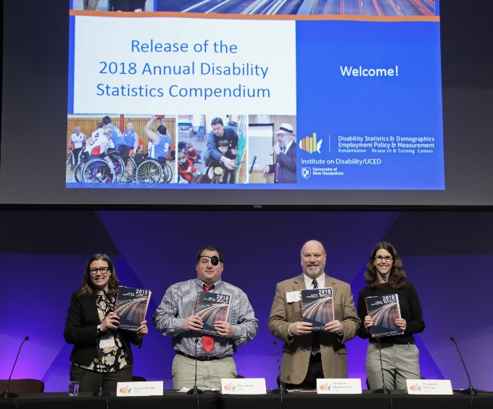
Registration is Open!
#nTIDELearn
Join us in person or online for the Release of the
Annual Disability Statistics Compendium
February 11, 2020
Holiday Inn Washington – Capitol
Washington, DC
Register here:
https://researchondisability.org/annual-compendium-registration
28

Slide 29
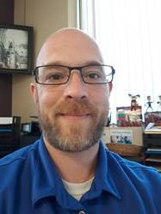
Part 3 nTIDE Guest Speaker Richard Petty Director IL-NET Training and Technical Assistance Center; Director, National Center for Aging & Disability; Co-Director, ILRU; Assistant Professor, UT McGovern Medical School Seth Hoderewski & Joe Michener Lehigh Valley Center for Independent Living
#nTIDELearn
29

Slide 30
Questions and Answers
#nTIDELearn
Zoom’s Q&A button
Take our survey and tell us what you think! www.researchondisability.org/ntide/ntide-survey
Thanks to our partners: Institute on Disability www.ResearchOnDisability.org Kessler Foundation www.KesslerFoundation.org AUCD www.AUCD.org
Contact us: Email: Disability.Statistics@unh.edu Call: 866-538-9521 (toll free)
Twitter at #nTIDELearn
30

Slide 31
So Long Everyone
#nTIDELearn
Thanks to our partners: Institute on Disability www.ResearchOnDisability.org Kessler Foundation www.KesslerFoundation.org AUCD www.AUCD.org
Contact us: Email: Disability.Statistics@unh.edu Call: 866-538-9521 (toll free)
Twitter at #nTIDELearn
This work is funded by grant no. 90RT0537 from NIDILRR.
31

