Slide 1
FRIDAY
January 10, 2020
Notes:
Hello, and welcome, everybody, to the new national trends in disability employment, or nTIDE lunch & learn series. On the first Friday of every month, corresponding with the Bureau of Labor Statistics jobs report, we'll be offering this live broadcast via Zoom webinar to share the results of the latest nTIDE findings. In addition, we will provide news and updates from the field on disability employment, as well as host an invited panelist who will discuss current disability related findings and events.
Just a few housekeeping items before we begin.

Slide 2
FRIDAY
January 10, 2020
Notes:
Hello, and welcome, everybody, to the new national trends in disability employment, or nTIDE lunch & learn series. On the first Friday of every month, corresponding with the Bureau of Labor Statistics jobs report, we'll be offering this live broadcast via Zoom webinar to share the results of the latest nTIDE findings. In addition, we will provide news and updates from the field on disability employment, as well as host an invited panelist who will discuss current disability related findings and events.
Just a few housekeeping items before we begin.

Slide 3
Up Front Matters
#nTIDELearn
This webinar is being recorded. We will post an archive of each webinar, each month, on our website at www.researchondisability.org/nTIDE. This site will also provide copies of the presentations, the speakers’ bios, full transcripts, and other valuable resources.
As an attendee of this webinar, you are a viewer. To ask questions of the speakers, click on the Q & A box on your webinar screen and type your questions into the box. Speakers will review these questions and provide answers during the last section of the webinar. Some questions may be answered directly in the Q & A box.
Notes:
This webinar is being recorded. We will post an archive of each webinar, each month, on our Web site at www.researchondisability.org/nTIDE. This site will also provide copies of the presentations, the panelist bios, full transcripts and other valuable resources.
As an attendee of this webinar, you are a viewer and no sound is enabled. To ask questions of the panelists, simply click on the Q & A box on your webinar screen and type your questions into the box. Panelists will review these questions during the assigned question and answer periods.

Slide 4
Up Front Matters
#nTIDELearn
If you have any questions following this recording, please contact us at disability.statistics@unh.edu, or toll free at 866-538-9521 for more information. Thanks for joining us. Enjoy today's webinar!
Notes:
This webinar is being recorded. We will post an archive of each webinar, each month, on our Web site at www.researchondisability.org/nTIDE. This site will also provide copies of the presentations, the panelist bios, full transcripts and other valuable resources.
As an attendee of this webinar, you are a viewer and no sound is enabled. To ask questions of the panelists, simply click on the Q & A box on your webinar screen and type your questions into the box. Panelists will review these questions during the assigned question and answer periods.

Slide 5
Welcome John O’Neill Kessler Foundation
#nTIDELearn

Slide 6
Welcome
#nTIDELearn
nTIDE Lunch & Learn:
A joint effort of the University of New Hampshire, Kessler Foundation, and the Association of University Centers on Disability (AUCD).
Occurs at noon Eastern-time on the first Friday day of each month, with the release of the nTIDE Report.
A part of the Rehabilitation and Research Training Center on Employment Policy and Measurement, which is funded by the National Institute on Disability, Independent Living and Rehabilitation Research (NIDILRR).

Slide 7
Today’s Program
#nTIDELearn
Part 1: nTIDE Report … “The Numbers”
John O’Neill, Kessler Foundation
Part 2: nTIDE News
Denise Rozell, Association of University Centers on Disabilities (AUCD)
Part 3: Guest Speaker
Kelli Crane, Center for Transition and Career Innovation, University of Maryland
Part 4: Q&A … for Parts 1-3

Slide 8
Part 1 The nTIDE Report John O’Neill Kessler Foundation
#nTIDELearn

Slide 9
The Monthly nTIDE Report
#nTIDELearn
The monthly nTIDE Report is a press release and infographic, looking at the latest employment statistics.
Uses data from the “jobs report” released by the U.S. Bureau of Labor Statistics, on the 1st Friday of each month.

Slide 10
Source of the Data
#nTIDELearn
U.S. BLS, Current Population Survey (CPS).
Source of the “official” unemployment rate.
Civilians, ages 16-64, not living in institutions.
Available September 2008 onward.
Not yet seasonally adjusted.
which is why we compare to the same month last year.

Slide 11
The Numbers John O’Neill Kessler Foundation
#nTIDELearn

Slide 12
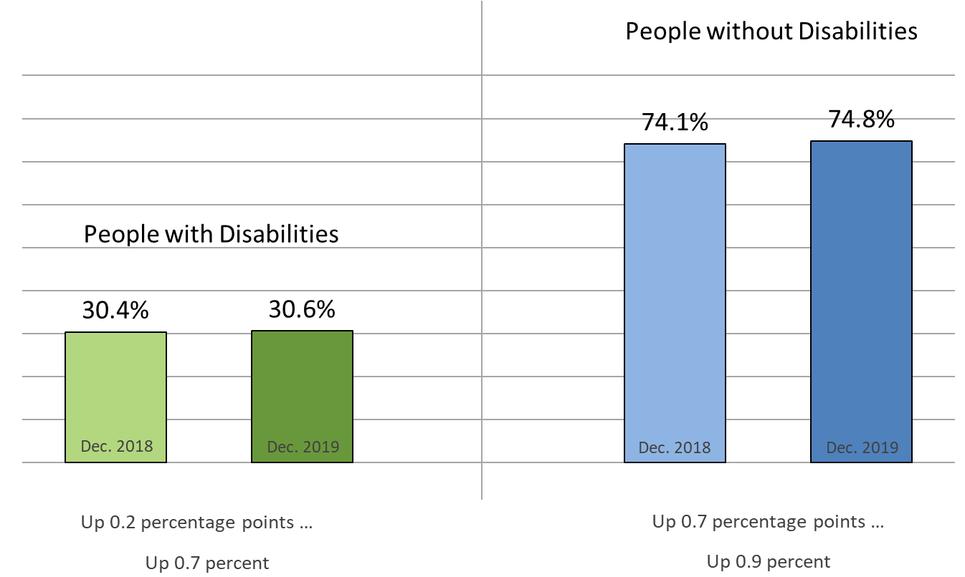
Employment-to-Population Ratio
#nTIDELearn

Slide 13
Labor Force Participation Rate
#nTIDELearn

Slide 14
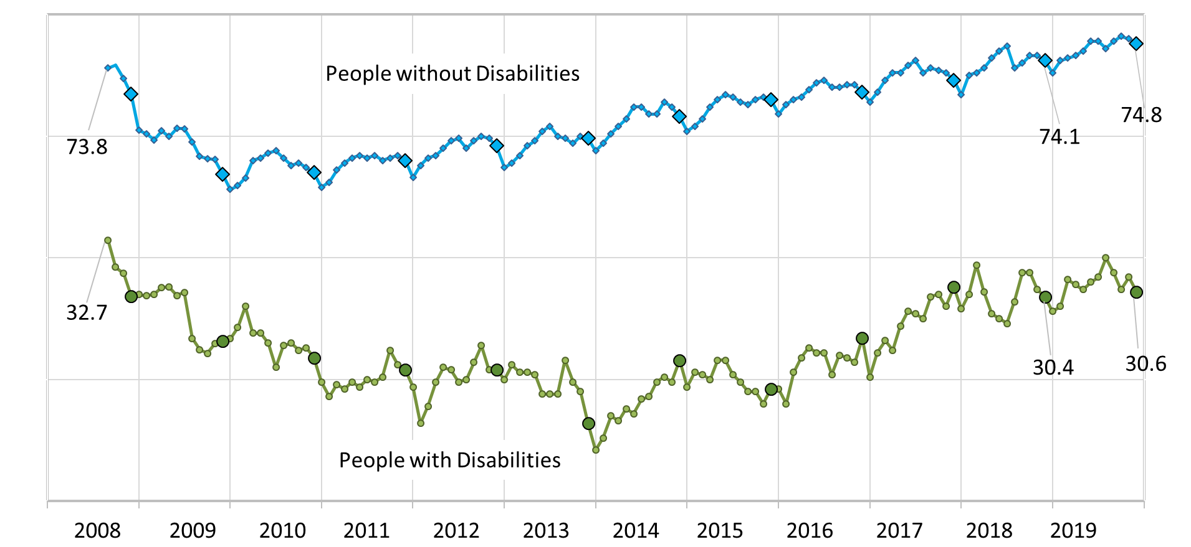
Employment-to-Population Ratio
#nTIDELearn

Slide 15
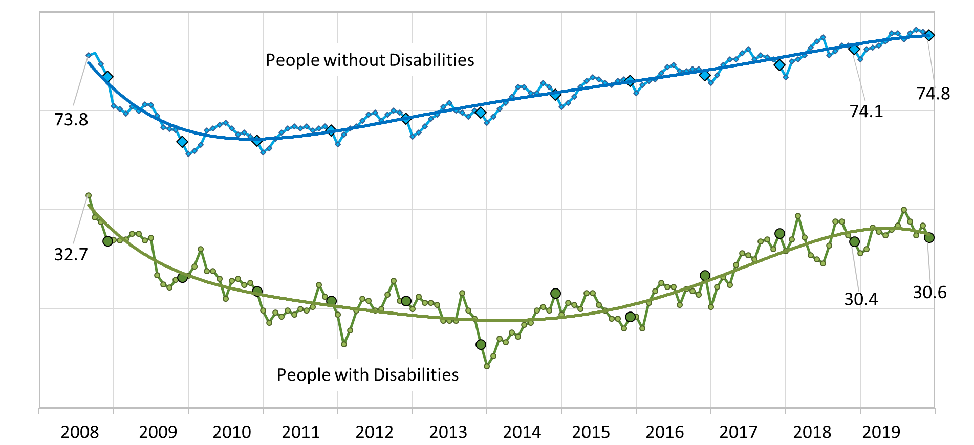
Employment-to-Population Ratio
#nTIDELearn

Slide 16
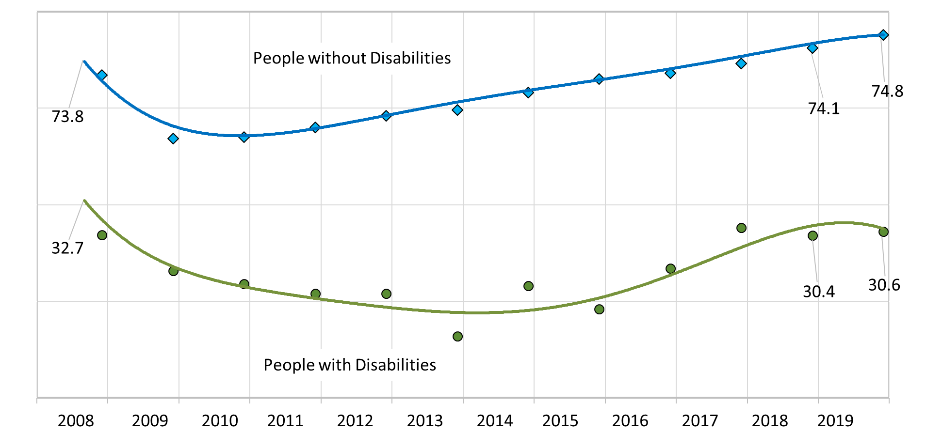
Employment-to-Population Ratio
#nTIDELearn

Slide 17
#nTIDELearn
Part 2 nTIDE News
Denise Rozell Association of University Centers on Disabilities (AUCD)

Slide 18
Federal Policy Update
#nTIDELearn
Appropriations -- FY 2020 DONE!!
MFP, Spousal Impoverishment and other extenders
Social Security Rule proposed changes: prove disability every two years under continuing disability reviews – submit comments by January 31, 2020

Slide 19
Census 2020
#nTIDELearn
People with disabilities identified as hard-to-count population = greater risk of undercount
People with disabilities overrepresented among other hard-to-count groups -- people of color people with low incomes, people experiencing homelessness.
Census important to people with disabilities because:
Allocating Congressional districts
How federal money gets distributed : IDEA, Title I, SNAP, Medicaid, Housing (Section 811), VR,
National Disability Rights Network

Slide 20
Census 2020
#nTIDELearn
The 2020 Census is accessible for everyone
An Accessible 2020 Census: Frequently Asked Questions by the Disability Community about Census Operations
States Ranked by Percent of People with Disabilities Living in Hard-to-Count Census Tracts
Why the Census Matters for People with Disabilities: A Guide to the 2020 Census Operations & Challenges
Get Out the Count Toolkit
2020 Census Group Quarters Operation

Slide 21
Call for Peer Reviewers with VR Experience
#nTIDELearn
RSA ; RFPs between April 2020 and September 2020
Fields:
Rehabilitation Long-Term Training,
Demonstration and Training Programs,
Innovative Rehabilitation Training,
Parent Training and Information,
American Indian Vocational Rehabilitation Services (AIVRS),
Vocational Rehabilitation Technical Assistance Centers,
Independent Living Services for Older Individuals Who Are Blind (OIB),
Questions: RSAPeerReview@ed.gov

Slide 22
RSA Workgroup
#nTIDELearn
Workgroup of Federal and State VR/WINTAC/DOE with data or program expertise to identify how to:
use data to best tell the story of the success of the VR program and identify areas for continued evaluation
develop tools and information that State VR agencies may use to help assess VR program performance using data that is already being collected
First project re Measurable Skill Gains data reported in Program Years 2017 and 2018.
Upcoming opportunities for stakeholder input

Slide 23
ODEP Chooses FY2020 States for TA
#nTIDELearn
Visionary Opportunities to Increase Competitive Employment (VOICE) initiative
TA to improve employment outcomes within their statewide mental health systems
Arkansas, Colorado, District of Columbia, Indiana, Iowa, Kentucky, Louisiana, Michigan, Missouri, North Carolina, Tennessee, Virginia , Wisconsin
Policy consulting, technical support & mentoring to support the efforts to increase competitive integrated employment via provider transformation, capacity building , policy development.

Slide 24
Disparities in Vocational Supports for Black Young Adults with Mental Health Conditions
#nTIDELearn
The NIDILRR-funded Learning and Working During the Transition to Adulthood Rehabilitation Research and Training Center (Transitions ACR)
significant disparities in delivery and outcomes of vocational services between white and black people with disabilities,
current research on barriers and facilitators to employment for Black young adults with disabilities,
how vocational service agencies may struggle to meet needs of young adults with disabilities from marginalized racial/ethnic backgrounds.
List of more research needed
Resources

Slide 25
Self Determination and Supported Decision-Making
#nTIDELearn
Impact: Feature Issue on Self-Determination and Supported Decision-Making for People with Intellectual, Developmental, and Other Disabilities
Institute on Community Integration, RTC on Community Living, University of Minnesota, Bol. 32, No. 1
How people with disabilities are experiencing self-determination in the U.S. and other countries, and at the emergence of Supported Decision-Making (SDM)
Self-Determination Cultural Differences in Perception and Practice
A Global Snap[shot of Self-Determination and People with Disabilities
Available in the interactive digital edition with bonus content (videos, webinars, podcasts) and also in print

Slide 26
Culturally and Linguistically Diverse (CLD) Students with Learning Disabilities (LD)
#nTIDELearn
Parental Expectations of Postsecondary Outcomes for Diverse Students with Learning Disabilities: A Funds of Knowledge and Social Capital Approach to Transition Planning
Sara Werner Juarez, Gabriel Chaparro, Cecilia Rios-Aguilar & Nancy Guarneros (2019); Journal of Latinos and Education
CLD students with LD are persistently underrepresented in higher ed; lower postsecondary outcomes than non-minority peers
examine the relationships between funds of knowledge, social capital, parental expectations, and goals via sample of individualized transition plans

Slide 27
Culturally and Linguistically Diverse Students with LD (con)
#nTIDELearn
Findings:
Parents of CLD children with LD have high educational expectations and philosophies
Goals established in students’ transition plans do not reflect these expectations
Connection between high expectations and those who build capital through support groups
Limitations and future research discussed

Slide 28
Disability Policy Seminar
#nTIDELearn
Opportunity for 700+ passionate advocates, self-advocates, experts, and professionals to learn about key issues that affect them most.
After two days of training and learning, attendees head to Capitol Hill to meet with their Members of Congress.
March 23-25, 2020, Washington DC
Cosponsors: AUCD, the Arc, AAIDD, ASA, NACDD, NDSC, SABE, and UCP

Slide 29
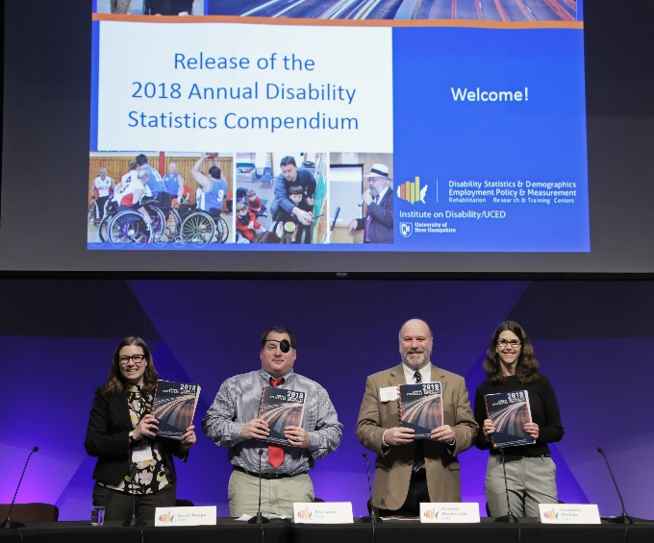
Registration is Open!
#nTIDELearn
Join us in person or online for the Release of the
Annual Disability Statistics Compendium
February 11, 2020
Holiday Inn Washington – Capitol
Washington, DC
Register here:
https://researchondisability.org/annual-compendium-registration

Slide 30
Part 3 nTIDE Guest Speaker Kelli Crane Center for Transition and Career Innovation, University of Maryland "Translating research into contemporary transition services”
#nTIDELearn

Slide 31
Translating Research into Contemporary Transition Services
Kelli Crane, Ph.D.
Center for Transition & Career Innovation
kcrane@umd.edu

Slide 32
Center for Transition and Career Innovation (CTCI)
Housed in the College of Education, University of Maryland, College Park
1 of 16 Centers or Institutes in the College
Established in 2018 in partnership with:
Maryland State Department of Education
Maryland Division of Rehabilitation Services
Maryland Department of Disabilities
Supported by Federal, State, and University funds

Slide 33
CTCI Mission
To inform policies and practices that enhance programmatic, resource, service access and opportunities for students & youth with disabilities to improve their post-school outcomes
Notes:
Primary

Slide 34
CTCI Activities
Design and conduct high-quality research and evaluation
Disseminate research findings
Build the capacity of systems by offering a range of professional development opportunities
Build collaborative interventions and partnerships to promote evidence-based practices
Notes:
that improve preparation and outcomes related to the career pursuits of youth with disabilities

Slide 35
What We Know
The Problem
The Solution
Low educational attainment and employment rates
Low postsecondary and/or vocational rehabilitation enrollment rates
Fragmented service systems
Paid work experiences while in secondary education
Work as both a critical intervention and expected outcome
Well defined & delivered intervention across service systems

Slide 36
How CTCI is translating research into effective transition services

Slide 37
One Example of CTCI Research: Way2Work Maryland
Awarded to Maryland Division of Rehabilitation Services (DORS) in partnership with University of Maryland, College Park
Funded by the U.S. Department of Education, Rehabilitation Services Administration
Purpose: To provide effective work-based learning experiences in coordination with other transition services, including pre-employment transition services
Notes:
5-year research project
Random control design

Slide 38
Way2Work Outcomes (to date)
n=94 students in Way2Work treatment group
137 total work-based learning experiences
78% secured at least 1 WBLE
52 % (49 students) with 2 or more WBLE
41% (39 students) paid directly by the employer
93 (or 99%) graduated from high school
85 with a high school diploma
8 with a certificate

Slide 39
Way2Work Paid WBLEs
N=201 students in cohorts 1 & 2
431 WBLEs and PE *
* do not have data yet on WBLEs paid by agency
129 work experience paid by employer
Avg. hourly wage $10.17
Avg. hours per week 15.7

Slide 40
CTCI Collaborative Partnerships: The Maryland Transition Tracker (The Tracker)
Partnership with and funded by the Maryland State Department of Education
User-friendly, accessible, secure software program
Direct sharing and tracking of service and outcome information
link students with IEPs with post school services
shares data among state and local partners (e.g., school, VR, DDA)

Slide 41
Professional Development: Interactive Online Training Curriculum
Partnership with and funded by the MSDE and the MDOD
Enable transition professionals to gain skills and knowledge to:
plan for and facilitate student-centered work experiences and jobs
Collaborate with families and other transition professionals
Negotiate with employers
Support students in the workplace
Self-paced curriculum
Eight sessions with skill building activities
Live coaching

Slide 42
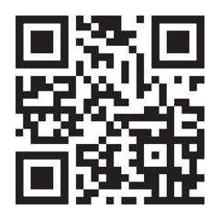
For More Information
Visit:
ctci-umd.org

Slide 44
Questions and Answers
#nTIDELearn
Zoom’s Q&A button
Take our survey and tell us what you think! www.researchondisability.org/ntide/ntide-survey
Thanks to our partners: Institute on Disability www.ResearchOnDisability.org Kessler Foundation www.KesslerFoundation.org AUCD www.AUCD.org
Contact us: Email: Disability.Statistics@unh.edu Call: 866-538-9521 (toll free)
Twitter at #nTIDELearn

Slide 45
So Long Everyone
#nTIDELearn
Thanks to our partners: Institute on Disability www.ResearchOnDisability.org Kessler Foundation www.KesslerFoundation.org AUCD www.AUCD.org
Contact us: Email: Disability.Statistics@unh.edu Call: 866-538-9521 (toll free)
Twitter at #nTIDELearn

