Slide 1

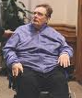

FRIDAY
October 4, 2019
Notes:
Hello, and welcome, everybody, to the new national trends in disability employment, or nTIDE lunch & learn series. On the first Friday of every month, corresponding with the Bureau of Labor Statistics jobs report, we'll be offering this live broadcast via Zoom webinar to share the results of the latest nTIDE findings. In addition, we will provide news and updates from the field on disability employment, as well as host an invited panelist who will discuss current disability related findings and events.
Just a few housekeeping items before we begin.

Slide 2

FRIDAY
October 4, 2019
Notes:
Hello, and welcome, everybody, to the new national trends in disability employment, or nTIDE lunch & learn series. On the first Friday of every month, corresponding with the Bureau of Labor Statistics jobs report, we'll be offering this live broadcast via Zoom webinar to share the results of the latest nTIDE findings. In addition, we will provide news and updates from the field on disability employment, as well as host an invited panelist who will discuss current disability related findings and events.
Just a few housekeeping items before we begin.

Slide 3

Up Front Matters
#nTIDELearn
This webinar is being recorded. We will post an archive of each webinar, each month, on our website at www.researchondisability.org/nTIDE. This site will also provide copies of the presentations, the speakers’ bios, full transcripts, and other valuable resources.
As an attendee of this webinar, you are a viewer. To ask questions of the speakers, click on the Q & A box on your webinar screen and type your questions into the box. Speakers will review these questions and provide answers during the last section of the webinar. Some questions may be answered directly in the Q & A box.
Notes:
This webinar is being recorded. We will post an archive of each webinar, each month, on our Web site at www.researchondisability.org/nTIDE. This site will also provide copies of the presentations, the panelist bios, full transcripts and other valuable resources.
As an attendee of this webinar, you are a viewer and no sound is enabled. To ask questions of the panelists, simply click on the Q & A box on your webinar screen and type your questions into the box. Panelists will review these questions during the assigned question and answer periods.

Slide 4
Up Front Matters
#nTIDELearn
If you have any questions following this recording, please contact us at disability.statistics@unh.edu, or toll free at 866-538-9521 for more information. Thanks for joining us. Enjoy today's webinar!
Notes:
This webinar is being recorded. We will post an archive of each webinar, each month, on our Web site at www.researchondisability.org/nTIDE. This site will also provide copies of the presentations, the panelist bios, full transcripts and other valuable resources.
As an attendee of this webinar, you are a viewer and no sound is enabled. To ask questions of the panelists, simply click on the Q & A box on your webinar screen and type your questions into the box. Panelists will review these questions during the assigned question and answer periods.

Slide 5
Welcome
Denise Rozell
Association of University Centers on Disability
#nTIDELearn

Slide 6
Welcome
#nTIDELearn
nTIDE Lunch & Learn:
  A joint effort of the University of New Hampshire, Kessler Foundation, and the Association of University Centers on Disability (AUCD).
  Occurs at noon Eastern-time on the first Friday day of each month, with the release of the nTIDE Report.
  A part of the Rehabilitation and Research Training Center on Employment Policy and Measurement, which is funded by the National Institute on Disability, Independent Living and Rehabilitation Research (NIDILRR).

Slide 7
Today’s Program
#nTIDELearn
Part 1: nTIDE Report … “The Numbers”
  John O’Neill, Kessler Foundation
Part 2: nTIDE News
  Denise Rozell, AUCD
Part 3: Guest Speakers
  Michael Morris, Executive Dir., National Disability Institute
Part 4: Q&A … for Parts 1-3

Slide 8
Part 1
The nTIDE Report
John O’Neill
Kessler Foundation
#nTIDELearn

Slide 9
The Monthly nTIDE Report
#nTIDELearn
The monthly nTIDE Report is a press release and infographic, looking at the latest employment statistics.
Uses data from the “jobs report” released by the U.S. Bureau of Labor Statistics, on the 1st Friday of each month.

Slide 10
Source of the Data
#nTIDELearn
U.S. BLS, Current Population Survey (CPS).
  Source of the “official” unemployment rate.
Civilians, ages 16-64, not living in institutions.
Available September 2008 onward.
Not yet seasonally adjusted.
  which is why we compare to the same month last year.

Slide 11
The
Numbers
John O’Neill
Kessler Foundation
#nTIDELearn

Slide 12
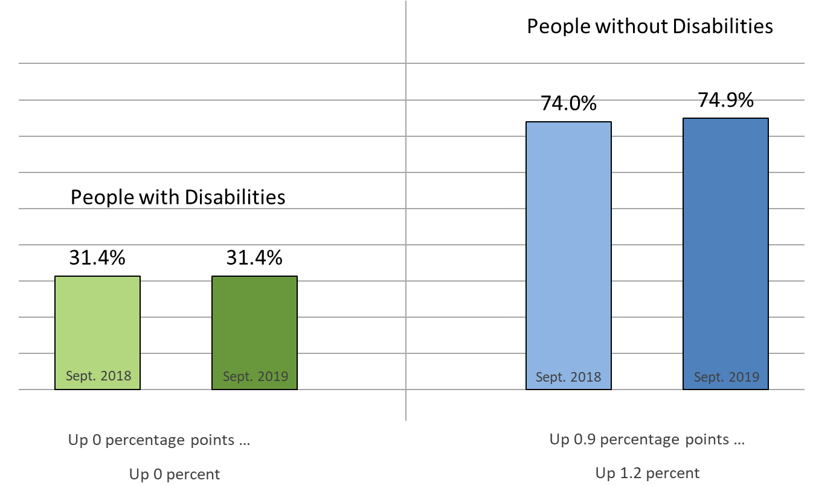
Employment-to-Population Ratio
#nTIDELearn

Slide 13

Labor Force Participation Rate
#nTIDELearn

Slide 14
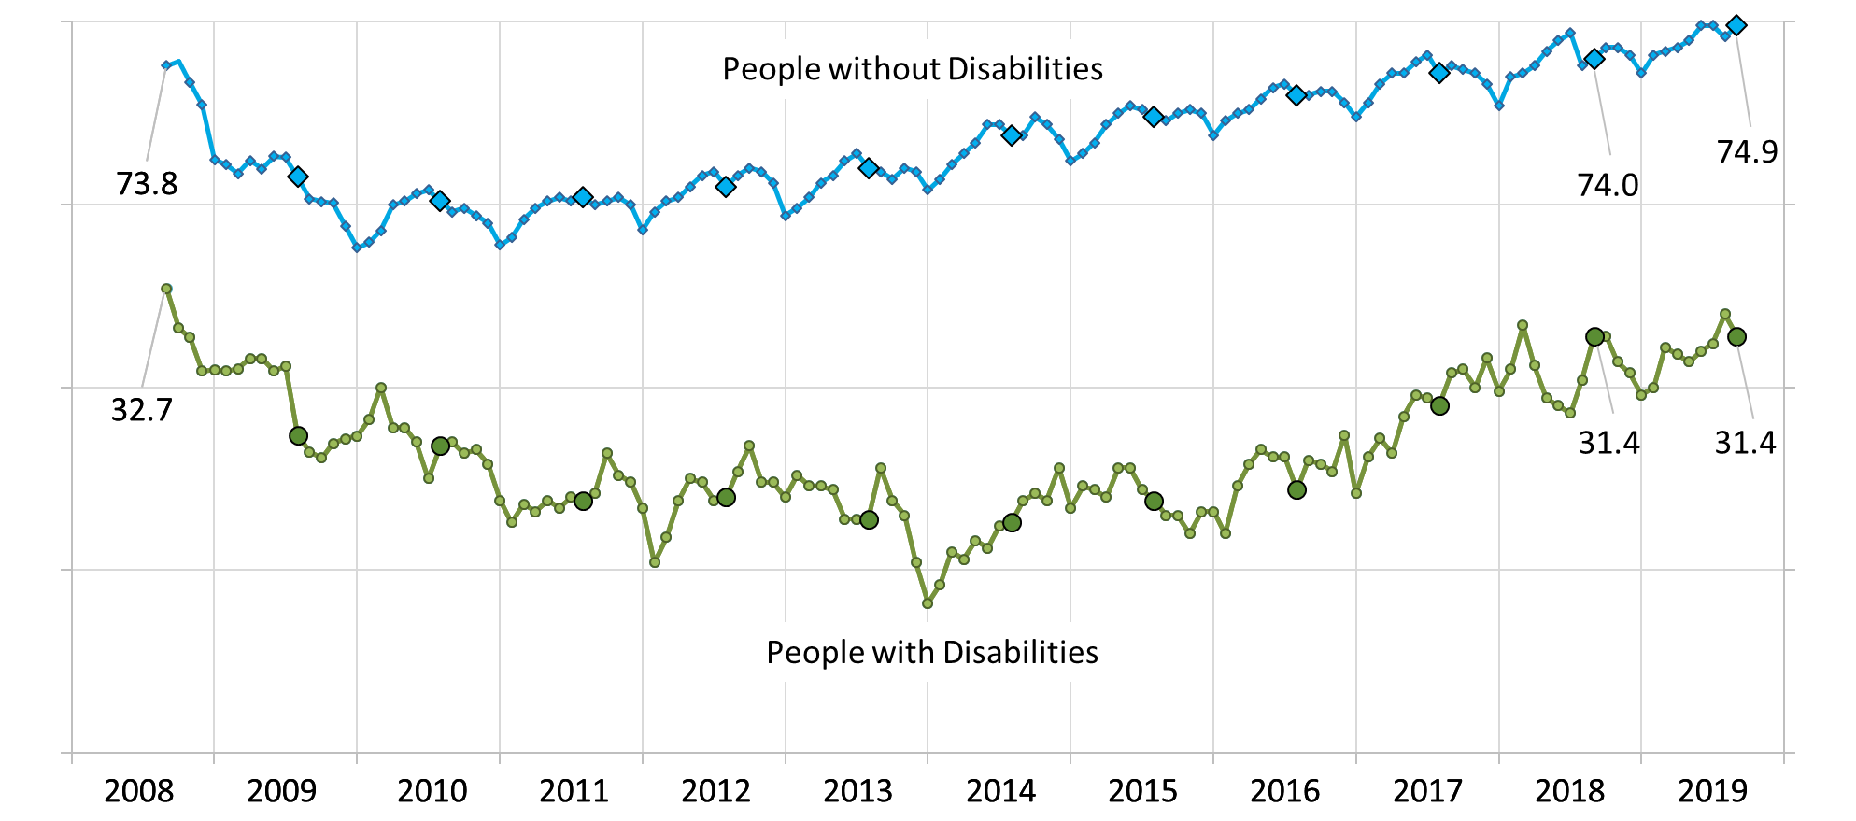
Employment-to-Population Ratio
#nTIDELearn

Slide 15
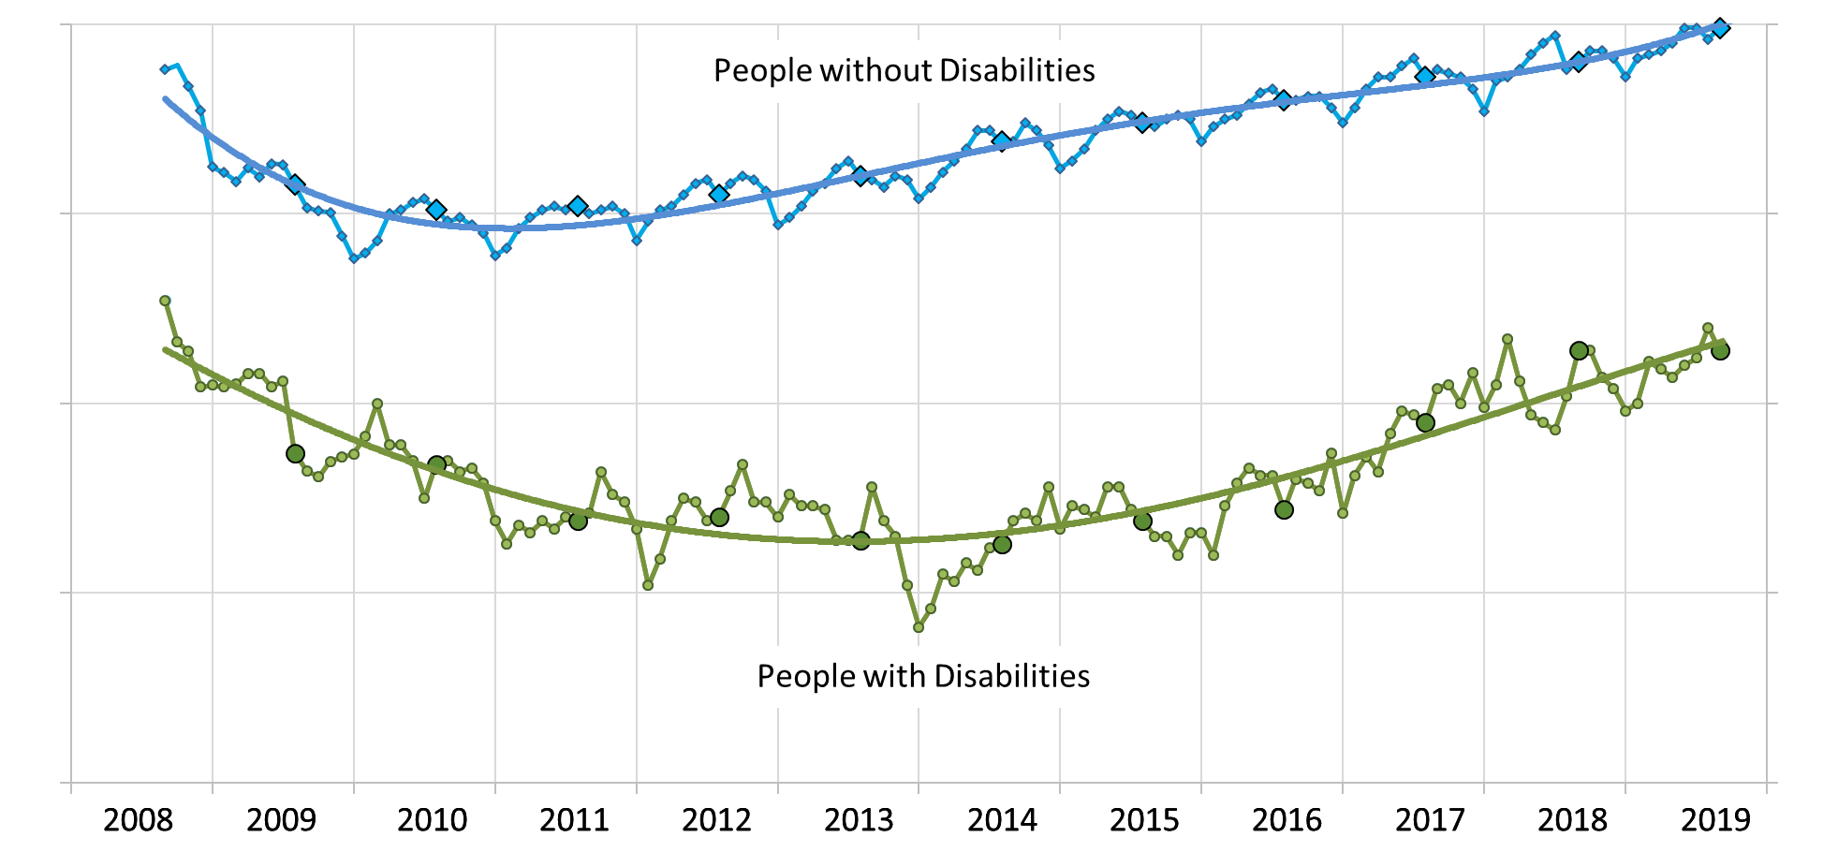
Employment-to-Population Ratio
#nTIDELearn

Slide 16

#nTIDELearn
Part 2
nTIDE News
Denise Rozell
Association of University Centers on Disabilities (AUCD)

Slide 17
Federal Policy Update
#nTIDELearn
Budget deal
  Appropriations
    House
    Senate
Department of Labor Secretary Eugene Scalia confirmed
NDEAM – National Disability Employment Awareness Month
“The Right Talent, Right Now”

Slide 18
Federal Policy Update
#nTIDELearn
Department of Education Guidance on Postsecondary Opportunities and Success for Students and Youth with Disabilities
What does it say??
IDEA Part B funds and VR funds MAY be used to support students with disabilities in:
  Dual enrollment programs
  Comprehensive Transition Programs(CTPs)
Students with disabilities who participate in CTPs can receive Federal student financial aid

Slide 19
Employment for Veterans with Disabilities
#nTIDELearn
ODEP/SEED (State Exchange on Employment & Disability) with National Conference of State Legislators (NCSL):
  Twelve policy options for states to facilitate transition into the civilian workforce.
  Highlight multiple strategies states are using to remove employment barriers, including employer incentives, apprenticeships, on-the-job training, veteran-owned business preferences, and preventing employment discrimination.

Slide 20
Yes, Youth Can Work and Still Receive SSI
#nTIDELearn
Targeted to youth who are blind or visually impaired
SSI fact sheets targeted to youth and/or parents
  Includes work incentives, calculations ad links to more information
Published by RRTC on Employment for Individuals with Blindness or Other Visual Impairments at Mississippi State

Slide 21
Neurodiversity in the Workplace
#nTIDELearn
EARN/ODEP: The Employer Assistance and Resource Network on Disability Inclusion:
  defines neurodiversity,
  explores its benefits for employers and employees,
  in-depth discussion of accommodating people with neurocognitive disabilities.
  includes evaluating job descriptions, modifying interviewing methods, and providing job accommodations in the workplace,
  Hiring initiatives and partnerships
  Autism@Work Employer Roundtable

Slide 22
PROMISE JVR Special Issue
#nTIDELearn
16 articles; Volume 51, No 2; open sourced !!
Lessons learned:
  Effect of work incentive benefits counseling on employment
  Engaging youth
  Career and work based learning interventions
  Employment supports
  Implications for policy and practice
  Interagency collaboration
  Teaching self determination
  Engaging youth and families
  Recruiting participants in randomized trials
  Cost-benefit analysis and sustainability framework…
  AND MORE!!!!

Slide 23
Post-secondary Transition Programs??
#nTIDELearn
A systematic review of post-secondary transition interventions for youth with disabilities, Lindsay, Lamptey, Cagliostro, Disability and Rehabilitation, Vol. 41, 2019,21
  6 international databases, id’ed 18 studies, 1997-2017, 2385 participants 13-28, focusing on postsecondary education program or intervention
  Improvement in at least one of the following: college enrollment, self-determination, self-confidence, social and vocational self-efficacy, autonomy, social support, career exploration, and transition skills.

Slide 24
International
#nTIDELearn
“Are They Not Nigerians? The Obligation of the State to End Discriminatory Practices Against Persons with Disabilities.” International Journal of Discrimination and the Law, Arimoro, vol. 19, no. 2, 2019, pp. 89–109.
Disability Rights in Botswana: Perspectives of Individuals With Disabilities , Journal of Disability Policy Studies, Mukhopadhyay, Moswela

Slide 25
Online Dialogue on Transportation
#nTIDELearn
Barriers and Solutions to Complete Trips for All – extended until October 7!
ODEP series of dialogues to gather input and ideas from the public and stakeholders. This project with DOT/FTA
  Trip Planning and Monitoring
  Payment
  At the Station
  Vehicle Trips
  Transferring
  Pedestrian Space

Slide 26
JAN: Job Accommodations Network
#nTIDELearn
JAN Webinar Series for 2019-2020 -- first one 10/8
Upcoming topics:
  Digital accessibility
  Disability inclusion,
  Assistive technology basics,
  Third-party vendors and accommodations, complex accommodation needs,
  ADA information requests,
  Return-to-work and stay-at-work programs,
  Workplace flexibility,

Slide 27
Save the Date!
#nTIDELearn
The Release of the Annual Disability Statistics Compendium is coming in 2020.
February 11, 2020
Holiday Inn Washington – Capitol
Washington, DC
Participate in person or online. Watch for a link to register soon!

Slide 28
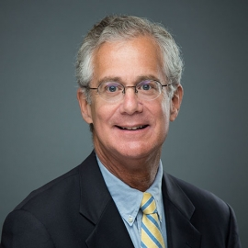
Part 3 nTIDE Guest Speaker
Michael Morris
National Disability Institute
#nTIDELearn

Slide 29
Employment as a Means:
Financial Stability as the End Goal
Michael Morris, Executive Director
National Disability Institute
Notes:
I’m Michael Morris, the executive director of National Disability Institute.
All the paintings in this presentation were done by people with disabilities…and represent a spectrum of disabilities---downs syndrome, cerebral palsy, autism, Spinal cord injuries, learning disabilities, mental health issues.

Slide 30

Building a Better Financial Future for
People with Disabilities and Their Families
Imagine • Innovate • Impact
Notes:
NDI is the organization working to change the exclusion of people with disabilities within financial inclusion…we can help you to make change within this important social issue.

Slide 31

Financial Behavior
People with disabilities are living in or near poverty
Working age adults with disabilities are twice as likely to live in poverty than those without disabilities (28 percent vs. 13 percent).
Despite significant reductions in poverty for women and people of color over the past five years, individuals with disabilities have seen no such reductions.
Notes:
To understand the importance of inclusion we need to look at the cost of exclusion.
Most working age people with disabilities are not working, half are either unbanked or underbanked, they have relatively low levels of education and one in four live in poverty.
These statistics are striking when compared to those without disabilities and puts them at the bottom of the economic ladder.

Slide 32
Financial Behavior
Poverty rates are even higher for people with disabilities of color, those with lower levels of education and women.
People with disabilities make up over 40 percent of the population of those living in long-term poverty.
Notes:
To understand the importance of inclusion we need to look at the cost of exclusion.
Most working age people with disabilities are not working, half are either unbanked or underbanked, they have relatively low levels of education and one in four live in poverty.
These statistics are striking when compared to those without disabilities and puts them at the bottom of the economic ladder.

Slide 33
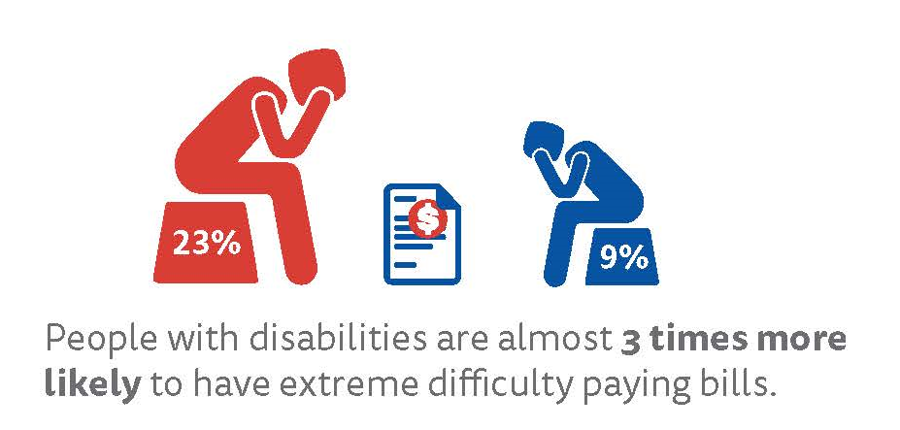
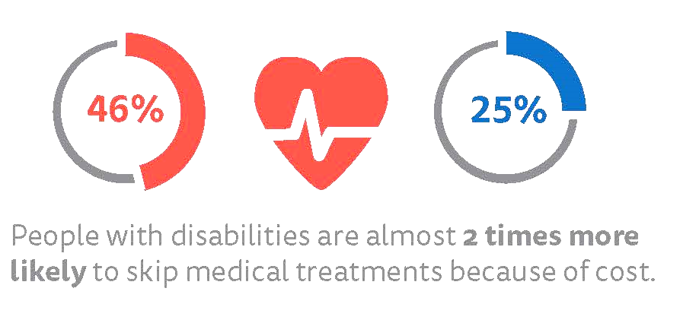
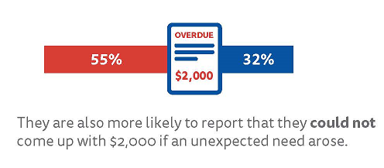
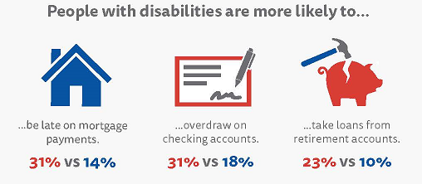
Financial Stress Among People with Disabilities
Disability
No Disability

Slide 34

New Collective Wisdom
“Employment is the means, not the end goal!”
Financial stability and security through financial empowerment is the end goal!
Artist: Liam Hassan Beserekumo, untitled

Slide 35

Financial Empowerment is …
Accessible and affordable financial services
Financial education to make informed financial decisions
Economic pathways to financial stability and security
Overcoming barriers to financial stability with reduced historical dependence on means-tested public benefits
Notes:
Financial inclusion has a two part definition
It is not only about financial services that are affordable and accessible. But it is also about the financial education and coaching that help individuals take advantage of those services and make fully informed decisions.
When we have and inclusive system, people across the economic spectrum, not just people with disabilities benefit.

Slide 36

Financial Empowerment is …
Not a fringe issue
Fundamental to the definition of community participation and inclusion
Fundamental to solving other intractable social issues
  Poverty
  Unemployment
  Hunger
  Homelessness
  Poor physical and mental health
Notes:
It is important to understand that financial inclusion
Not a fringe issue
Fundamental to the definition of community
Fundamental to solving other intractable social issues whether it relates to poverty, hunger, homelessness.

Slide 37

We as a Nation
Can Do Better
Change thinking
Change behavior
Change policy
Notes:
We as a Nation Can do Better
We need… as individuals, organizations, corporations, and as a culture,
to Change thinking
to Change behavior
to Change policy

Slide 38

Solutions
ABLE
Achieving a Better Life Experience Act
Access to Financial Education and Counseling
Inclusive Community Development (CRA)
Notes:
I’d like to share a couple of examples of us “doing better”…these are transformative policy changes.
The ABLE – Achieving a Better Life Experience Act enacted in 2014, will allow over 8 million people, families with children with disabilities, adults with disabilities, to open tax advantaged savings accounts that will not be counted against them when determining eligibility for critically needed public benefits. For many, this offers their first opportunity to save for the future.

Slide 39

Potential
For the ABLE account, there are 8 million eligible individuals with disabilities and families; but in Year Four of program implementation, there are only 50,000 accounts open.
Notes:
There’s a lot of untapped potential.
For the ABLE account, there are 8 million eligible individuals with disabilities and families but in Year Four of program implementation, there are only 35,000 accounts open.
So there is a massive outreach campaign that needs to happen.
I will share with you ways we can transform the lives of your employees with disabilities.

Slide 40
I. What is ABLE?
The Stephen Beck, Jr. Achieving a Better Life Experience (ABLE) Act (PL 113-295) amends the federal tax code to add Section 529A in order to …
create a new option for eligible people with disabilities
to save money in a tax-exempt account
that may be used for qualified disability expenses
while still keeping their eligibility for federal public benefits.

Slide 41
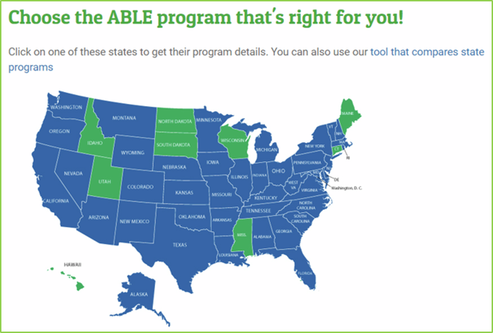
Current ABLE Picture
42 states and D.C. have ABLE programs
50,000 accounts open nationwide
$250 million invested in ABLE accounts
Average account size $5,000

Slide 42
Common Misperceptions and Fears
Fear of loss of benefits
Can’t afford to contribute funds
Lack of interpretation of ABLE account to be disregarded as an asset for means-tested benefits
“Never heard of ABLE accounts.”
“If I have a Special Needs Trust, I don’t need an ABLE account.”

Slide 43
ABLE National Resource Center
Monthly Webinars
Website: www.ablenrc.org
AchievABLE Newsletter
New Outreach Strategies
  Employers
  Credit Union Network
  Children’s Miracle Network Hospital
  Disability Organization Outreach
Roadmap to ABLE
Intensive ABLE in August Activities
Financial Literacy with CalABLE AchievABLE Corner

Slide 44
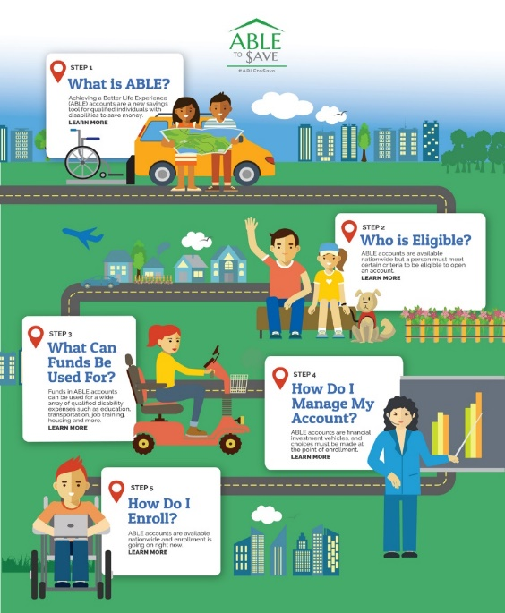
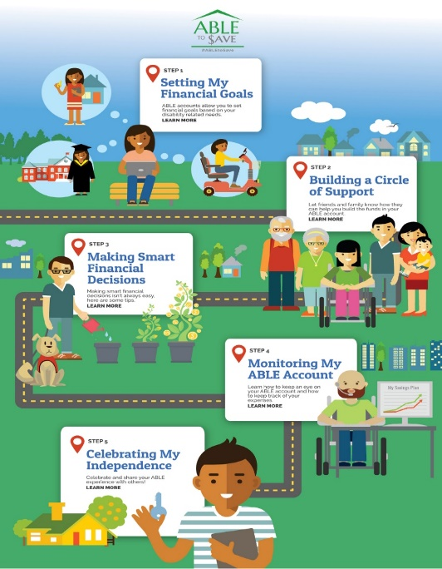
ABLE National Resource Center Tools
Road Map to Enrollment
Road Map to Independence
http://ablenrc.org/road-map-enrollment
http://ablenrc.org/road-map-independence

Slide 45

Transformational change
How do we produce transformational change within the VR and Workforce Development programs?
Notes:
So where does all of this take us? Financial inclusion offers stability and security.

Slide 46

Seize the
Higher Ground
Integrate individual employment plans with access to benefits and financial counseling
Seed and match ABLE accounts
Change expectations from employment outcomes to employment as a pathway to greater financial stability and security
Notes:
What more can we collectively do to provide that hand up…to support financial inclusion to help people with disabilities become more independent through saving and asset building?

Slide 47
A Challenge of Leadership
Disability Employment Service Providers
Jobs in diverse settings with wage growth potential
ABLE Accounts
  Seeding and matching
Financial and benefits counseling
Financial education and skills development
Community choices and inclusion
Pathways out of poverty

Slide 48
II. Access to Financial Education and Counseling
Financial capability is a combination of knowledge and skills to inform financial decisions and behaviors, identify opportunities to improve financial stability, and manage financial resources effectively.

Slide 49
II. Access to Financial Education and Counseling, cont.
For persons with disabilities, there are additional considerations to ensure individuals have the knowledge and skills they need, the opportunity to act, and the support to take action.
Financial
Education
(Knowledge & Skills)
Financial Capability
(Actions)
Financial
Well-Being
(Outcomes)

Slide 50
Menu of Employee and/or Health Benefits
Financial Counseling
Credit Improvement
Debt Reduction
The Intersection of Financial Health and Physical and Mental Health

Slide 51
III. Inclusive Community Development
CRA was enacted in 1977 to encourage regulated financial institutions to help meet the credit needs of the communities in which they operate, including low- and moderate-income neighborhoods, consistent with safe and sound banking operations.

Slide 52
Community Development
The bank’s activity must have a primary purpose of Community Development to receive CRA credit.
Primary purpose means the majority of activity dollars or beneficiaries of the activity are related to a CD purpose.
A bank activity has community development as its primary purpose when it is designed for the express purpose of:
  Affordable housing for LMI persons
  Community services targeted to LMI persons
  Economic Development | Workforce Development
  Financial Literacy and Counseling

Slide 53
Center for Disability-Inclusive Community Development
Primary Purposes
To raise broad awareness within the disability community about the opportunities for capacity building available through investment, lending and services offered by banking institutions as part of their CRA responsibilities; and
To foster greater connectivity between the financial services sector and the disability consumer and service provider communities well suited to collaborate on inclusive community development activities.

Slide 54
CDICD October Webinar
Workforce Development and Meeting Obligations Under CRA
October 16, 2019 | 3:00 - 4:30 p.m. ET
Steven Shepelwich, Senior Community Development Advisor, Federal Reserve Bank of Kansas City, Oklahoma City Branch
Virgil Miller, Group CRA Director/Group Compliance, ARVEST Bank Operations, Inc.
Sabrina Ware, Director, Goodwill TulsaWorks and Job Connection
Lisa Mifflin, District Community Affairs Officer, Office of the Comptroller of the Currency
Please keep an eye out for the registration link.
https://www.nationaldisabilityinstitute.org/events/

Slide 55
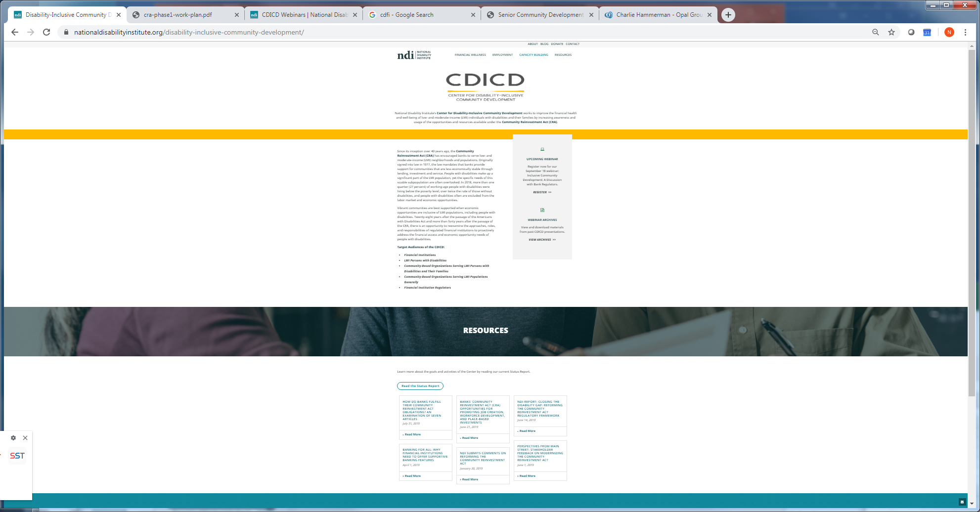
Website and Resources:
https://www.nationaldisabilityinstitute.org/disability-inclusive-community-development/
Background, Goals and Target Audiences of the Center
Webinars:
  Register for upcoming webinars
  View and download materials from past webinars
Status Report

Slide 56
Website and Resources:
https://www.nationaldisabilityinstitute.org/disability-inclusive-community-development/
Resources:
  NDI’s Law Review Article: “Closing the Disability Gap: Reforming the Community Reinvestment Act Regulatory Framework”
  NDI’s Annotated Bibliography of relevant research and publications “How Do Banks Fulfill their Community Reinvestment Act Obligations?”
  Selected External Reports from Economic Growth and Mobility Project, Federal Reserve, Yale University

Slide 57
Progress
“… progress is never permanent,
will always be threatened,
must be redoubled, restated,
and reimagined if it is to survive.”
~ Zadie Smith

Slide 58
Questions and Answers
Michael Morris
Executive Director
National Disability Institute
mmorris@ndi-inc.org

Slide 59
Artists
David A. Sampson, Plains Sky
David A. Sampson, Easter Landscape
Dadu Shin, untitled
Patrick Connally, Downtown Berkeley
Gen Gaines, A Summer Stroll on RIA
David A. Sampson, Swimmers Take Your Mark
Juan Lucero, Breaking Barriers
Chuck Close, untitled
Hank Holland, Color Me Love
Dadu Shin, Disability Series

Slide 60


Questions and Answers
#nTIDELearn
Zoom’s Q&A button
Take our survey and tell us what you think!
www.researchondisability.org/ntide/ntide-survey
Thanks to our partners:
Institute on Disability www.ResearchOnDisability.org
Kessler Foundation www.KesslerFoundation.org
AUCD www.AUCD.org
Contact us:
Email: Disability.Statistics@unh.edu
Call: 866-538-9521 (toll free)
Twitter at #nTIDELearn

Slide 61
So Long Everyone
#nTIDELearn
Thanks to our partners:
Institute on Disability www.ResearchOnDisability.org
Kessler Foundation www.KesslerFoundation.org
AUCD www.AUCD.org
Contact us:
Email: Disability.Statistics@unh.edu
Call: 866-538-9521 (toll free)
Twitter at #nTIDELearn

