Slide 1
National Center for Health Statistics
Disability Statistics at NCHS: Data and Opportunities
Julie D. Weeks, Ph.D.
Disability Statistics Compendium Annual Release
Virtual Meeting
February 10, 2021
1

Slide 2
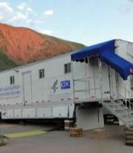
Data Systems
National Center for Health Statistics
Data Systems
National Health and Nutrition Examination Survey
National Health Interview Survey
National Vital Statistics System
National Health Care Surveys

Slide 3
The National Health and Nutrition Examination Survey
Designed to assess the health and nutritional status of the U.S. civilian noninstitutionalized population. The survey is unique in that it combines interviews and physical examinations.
Annual data collection from ≈ 5,000 adults and children
Redesigned questionnaire fielded in January 2019
Two-year release cycle (2019-2020)
Questionnaires for 2019-2020 now available online
Provides information on persons with disability:
Interview component: demographic, socioeconomic, dietary, health
Examination component: medical, dental, and physiological measurements, as well as laboratory tests
Examples: Hypertension, weight status, cholesterol, drugs/opioids

Slide 4
The National Health Interview Survey
The principal source of information on the health of the civilian noninstitutionalized population of the United States since 1957
Annual data collection from ≈ 30,000 adults and ≈ 10,000 children
Redesigned questionnaire fielded in January 2019
Data release in September 2020
Disability now part of the Early Release program
Provides information on the health status of persons with disability, as well as:
Demographics
Health care access and utilization, and insurance
Health behaviors and risk factors
Participation (social, work, civic)

Slide 5
National Health Interview Survey
Jan 2019 – Newly-redesigned NHIS content fielded
Sept 2020 – First release of public use data with full complement of redesigned disability content:
Washington Group Disability for Adults
Extended Set on Functioning, Short Set on Functioning, Short Set Enhanced
Washington Group Disability for Children
Child Functioning Module (2-4 and 5-17 years)
Activity Limitation (work, social, participation)
Mental Health (K-6, PHQ-8, GAD, for children SDQ)
Provides additional information on persons with disability:
Socio-demographic, living arrangements
Health, health behaviors and risk factors
Health care access and utilization, and insurance

Slide 6
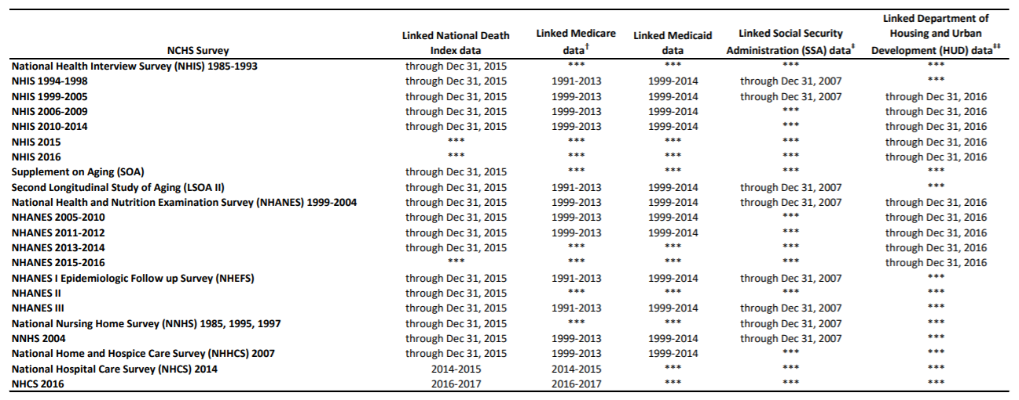
NCHS Data Linkage Program

Slide 7
NHIS Publication Releases (September-December 2020)

Slide 8
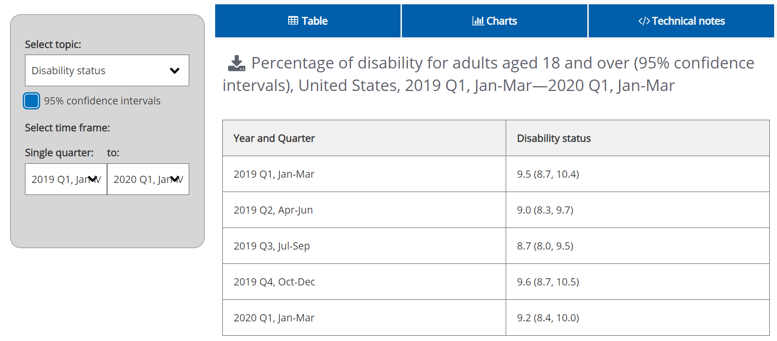
The NHIS Early Release Program
Provides estimates of key health indicators, analytic reports, and preliminary microdata files on an expedited schedule.
Interactive data query system: biannual or quarterly estimates.

Slide 9
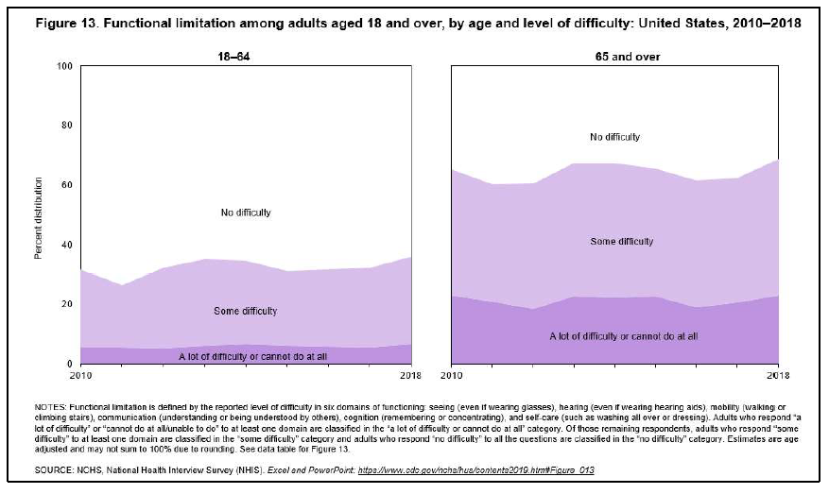
Health, U.S. Functional Limitation among adults 18+, U.S. 2010-2018
SOURCE: NCHS, National Health Interview Survey (NHIS).

Slide 10
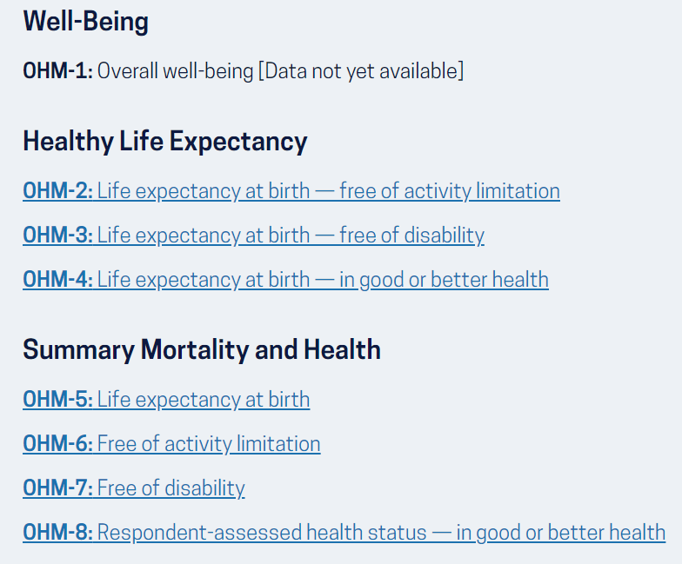
Healthy People 2030 Overall Health and Well-Being Measures
Overall Health and Well-Being Measures (OHMs) are broad, global outcome measures intended to assess the Healthy People 2030 vision.
OHMs can be used to summarize and evaluate progress toward achieving Healthy People objectives.

Slide 11
HP 2030 Data Table Template
Total
Sex
Male
Female
Race/Ethnicity
American Indian/Alaska Native only
Asian only
Native Hawaiian/Pacific Islander only
Black or African American only
White only
2 or more races
Hispanic or Latino
Not Hispanic or Latino
American Indian/Alaska Native only, not Hispanic or Latino
Asian only, not Hispanic or Latino
Native Hawaiian/Pacific Islander only, not Hispanic or Latino
Black only, not Hispanic or Latino
White only, not Hispanic or Latino
2 or more races not Hispanic or Latino
Age
[Standard groups by data system]
Educational Attainment
< High school
High school
Some college or Associates degree
4-year college degree or more
Family Income (percent poverty threshold)
<100
100-199
200-399
>=400
Health Insurance Status
Insured
Private
Public
Uninsured
Geographic Location or Region
Metropolitan
Nonmetropolitan
Marital Status
Married/Cohabiting partner
Divorced or Separated/Widowed
Never married
Country of Birth
US
Outside US
Veteran Status
Veteran
Non-Veteran
Disability Status
People with disabilities
People without disabilities
Sexual Orientation
Straight
Straight, Male
Straight, Female
Gay/Lesbian
Gay, Male
Gay/Lesbian, Female
Bisexual
Bisexual, Male
Bisexual, Female
Gender Identity
[Standard groups by data system]
Note:
If data are not collected, analyzed, or available (or need to be suppressed) for a particular demographic group by a data source, the demographic label will still be shown and a symbol or acronym will be displayed to indicate the reason data are not shown.

Slide 12
Resources
Washington Group on Disability Statistics http://www.washingtongroup-disability.com/
National Health Interview Survey https://www.cdc.gov/nchs/nhis/index.htm
National Health and Nutrition Examination Survey
https://www.cdc.gov/nchs/nhanes/index.htm
NCHS Data Linkage Program
https://www.cdc.gov/nchs/data-linkage/index.htm
Health, U.S.
https://www.cdc.gov/nchs/hus/index
Healthy People 2030
https://health.gov/healthypeople

