Slide 1
Prevalence Estimates for People with Disabilities in National Surveys: 2009-2014
Eric A. Lauer, MPH, PhD Candidate
Andrew J. Houtenville, PhD
Institute On Disability
University of New Hampshire
Durham, New Hampshire, United States

Slide 2
Financial Disclosure & Disclaimer
The following personal financial relationships with commercial interests relevant to this presentation existed during the past 12 months:
No relationships to disclose
The presentation is part of a project of the StatsRRTC, which is funded by the U.S. Department of Health and Human Services, National Institute for Disability, Independent Living, and Rehabilitation Research (NIDILRR) under cooperative agreement H133B130015. This presentation does not necessarily represent the policy of the Department of Health and Human Services, and you should not assume endorsement by the Federal Government (Edgar, 75.620 (b)).

Slide 3
Background
In 2008, a difficulty-related question set was established as part of a multi-agency effort to identify people with disabilities in national surveys.
Mandated as a data standard by the Affordable Care Act to be included in all national health surveys
Consistent with the International Classification of Functioning, Disability, and Health (ICF)
Using these questions, recent research has emphasized:
A multi-survey approach to study the health of people with disabilities (Krahn, 2015)
Studying different elements of the ICF across national surveys (Brandt, 2014)

Slide 4
Self-Report Difficulty Questions (6QS)
Intended to cover six disability types:
Hearing difficulty–Deaf or having serious difficulty hearing.
Vision difficulty–Blind or having serious difficulty seeing, even when wearing glasses.
Cognitive difficulty–Because of a physical, mental, or emotional problem, having difficulty remembering, concentrating, or making decisions.
Ambulatory difficulty–Having serious difficulty walking or climbing stairs.
Self-care difficulty–Having difficulty bathing or dressing.
Independent living difficulty–Because of a physical, mental, or emotional problem, having difficulty doing errands alone such as visiting a doctor’s office or shopping.
United States Census Bureau, American Community Survey, History of the Disability Questions: https://www.census.gov/people/disability/methodology/acs.html

Slide 5
Methods
Hypothesizing that disability estimates vary significantly between surveys, we compared estimates from the following surveys:
Current Population Survey Annual Social And Economic Supplement (CPS-ASEC, 2009-2014)
American Community Survey (ACS, 2009-2014)
National Health Interview Survey (NHIS, 2009-2014)
Survey of Income and Program Participation (SIPP, 2009-2011)
Using SAS software and taking into account complex survey design methodology we used survey data to estimate counts, percentages, and standard errors of self-reported difficulty, demographic, social, and geography questions for people with and without disabilities.

Slide 6
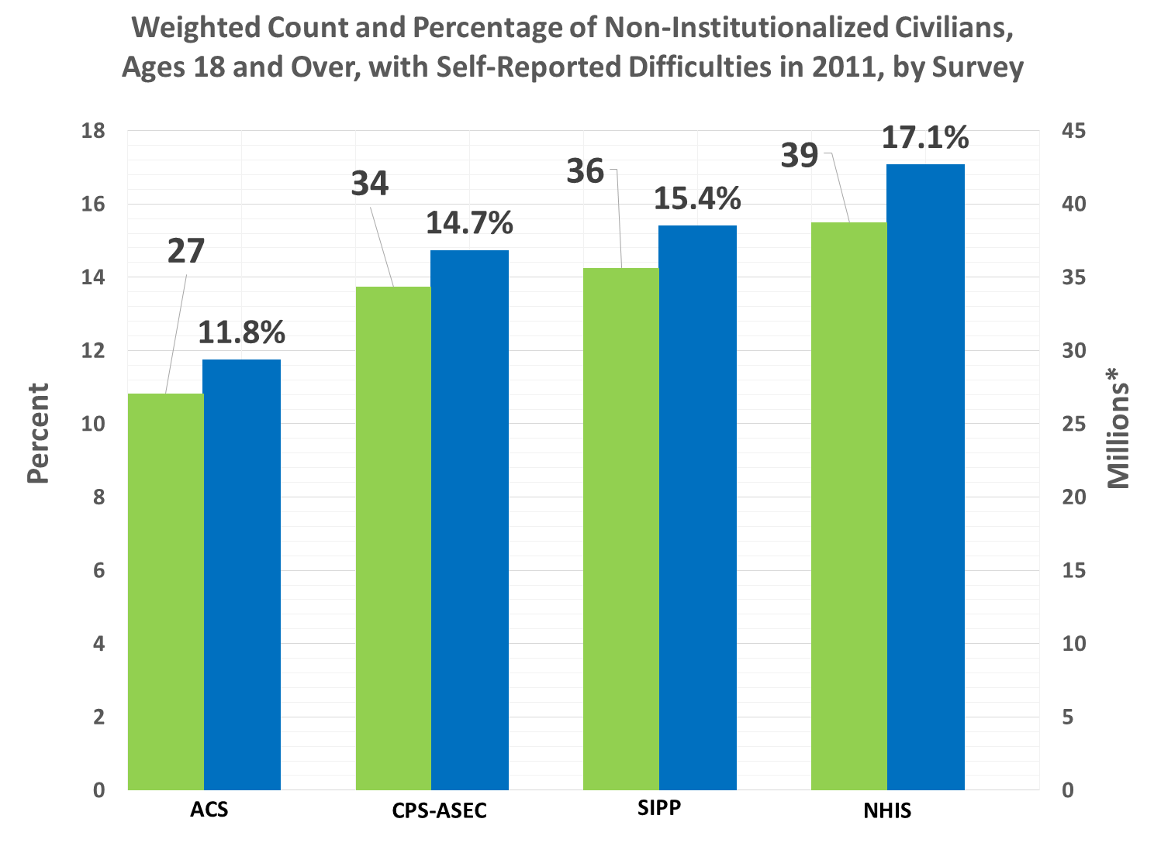
*Total non-institutional civilian population, 18 and over, across surveys was approximately 231,000,000 people

Slide 7
Weighted percentage of adult non-institutionalized civilians with self-reported difficulties by survey and year

Slide 8
Weighted percentage of non-institutionalized civilians with self-reported limitations in 2011, by survey and age group.

Slide 9
Weighted percentage of adult non-institutionalized civilians with self-reported difficulties in 2011 by gender, race, ethnicity and survey.

Slide 10
Risk Differences for Social Factors between Adult Non-Institutionalized Civilians with and without Self-Reported Difficulties in 2011 by Survey

Slide 11
Risk ratios for social factors comparing adult non-institutionalized civilians with and without self-reported difficulties in by survey
A
B

Slide 12
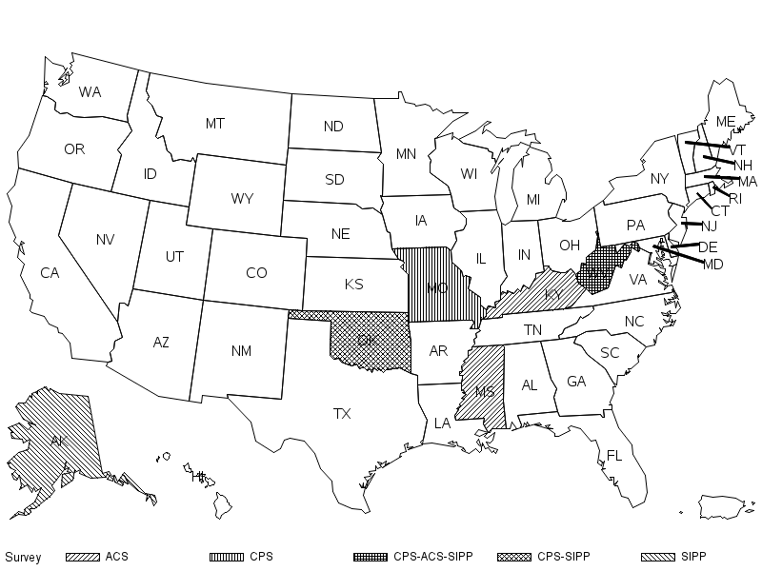
Highest Percentage of People with Self-Reported Difficulties, by Survey and State

Slide 13
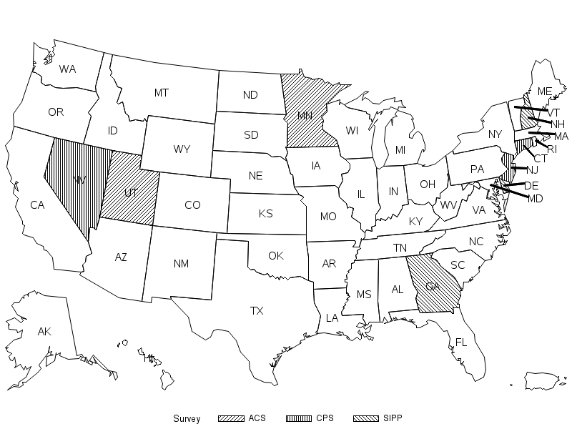
Lowest Percentages of People with Self-Reported Difficulties, by Survey and State

Slide 14
Conclusion
Substantial and significant variation of self-reported difficulties
Replicated previous findings (Picavet, 1996)
Weighting factors and unweighted sample
Similar direction and magnitude of risk differences and risk ratios across demographic and social factors
Estimation is highly dependent on age
Similar regional estimates of self-reported difficulties, with notable state variation (U.S.)

Slide 15
Study Limitations
Survey design effects
Sampling and data collection methods
Sample sizes
Reference period of the surveys and questions
Repeated interviewing (e.g. CPS and SIPP)
Sampling frame and eligibility rules
Item wording, nonresponse and allocation
Statistical approach
Unable to disentangle sampling, response and nonresponse bias and error

Slide 16
Discussion
Weighting & Standardization
Can we take conclusions and hypotheses drawn from one survey study them in another?
Statistical significance vs. policy relevance
Is variation meaningful?
Counts versus percentages
Moving away from International Classification of Functioning, Disability and Health?

