Slide 1
StatsRRTC State of the Science Conference February 13, 2017 Washington, DC
Using Local Statistics in California
Lewis E. Kraus, MPH, MCP
Center on Disability at the Public Health Institute
Oakland CA

Slide 2
Overall Project
Development and use of local disability statistics
Created website to host local disability data
Used the ACS API
Shared with interested parties locally and nationally
Discussed specific data needs

Slide 3
Project
Resulted in 4 efforts – Case Studies
Marin County, California Disability Access Program
Alameda County, California Department of Public Health
Health action partnership in Jefferson County, AL
FEMA Office of Disability Integration and Coordination

Slide 4
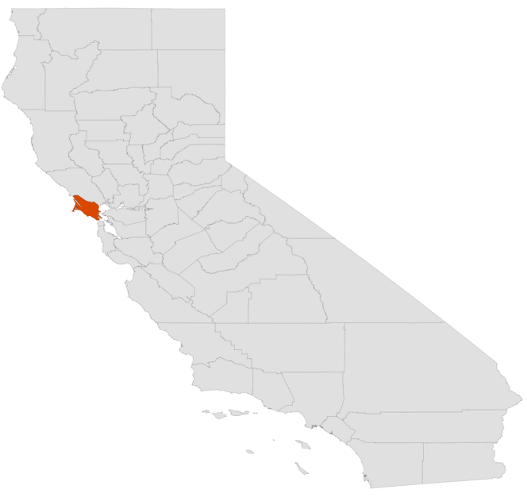
Case Study
Marin County, CA Disability Access Program
Affluent, but pockets of lower income
County disability population rate is 8.8%
Lower than US rate
Notes:
Marin County California is located north of San Francisco and while known for its relative affluence, has significant pockets of lower income areas. The disability population is 8.8% in the county, which is below the national average of 10.1%

Slide 5
Project
Marin County, CA Disability Access Program
In 2015, requested zip code level data
Purpose – set priorities in programs for people with disabilities
Capital improvements and engineering
Diversity in employment initiative
Raise disability awareness with supervisor aides
Notes:
In 2015, members of the Marin County Disability Access Program requested zip code level disability data for their county. Their purpose was to use the zip code data to help set priorities in programming for people with disabilities. The first issue was to prioritize disability within the $1 million a year budget for capital improvements and engineering by noting the existence and size of the disability population and bringing awareness to their needs. A second issue was sharing data in order to target outreach to people with disabilities for county jobs as part of a larger diversity in employment initiative. A third targeted use of the data was to raise awareness about disability rights in programs with aides to county supervisors. In general, these elected officials historically had not created public legislation in the county with an eye toward the needs of people with disabilities. The hope was that the data would trigger the officials to consider or create projects that applied to people with disabilities.

Slide 6
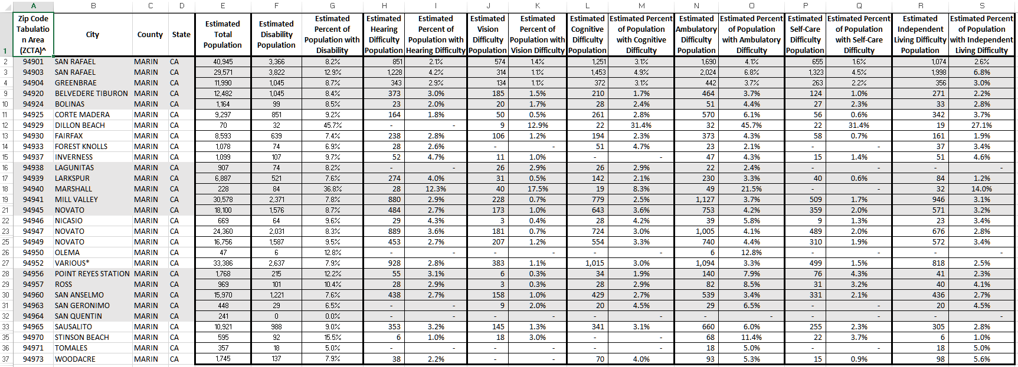
Product
Marin County, CA Disability Access Program
Zip code level disability data spreadsheet
Notes:
I know this is unreadable on this slide, but I wanted to show you what the product looked like. A little background first – You know the ZIP Code is a five-digit code assigned by the U.S. Postal Service to a section of a street, a collection of streets, an establishment, structure, or group of post office boxes, for the delivery of mail. A ZIP Code Tabulation Area (ZCTA) is a geographic area that approximates the delivery area for a five-digit ZIP Code. ZCTAs do not precisely depict the area within which mail deliveries associated with that ZIP Code occur.
Marin County received by ZCTA: the estimated total population, disability population, percent of population with a disability, and the numbers and percents for each of the 6 disability categories. They also received errors and an explanation of the meaning of error and caution they should have in using the data for a small population size.

Slide 7
Product Use Results
Marin County, CA Disability Access Program
Capital improvements and engineering
Able to prioritize facility and pedestrian right of way work
Diversity in employment initiative
Internal processes show awareness
Raise disability awareness with supervisor aides
Ongoing; hope for long-term impact
Notes:
With the data, the Disability Access Office has been able to prioritize facility and pedestrian right of way work, getting about $250,000 for fixing sidewalks and other public accessibility issues. They described this as a success, achieving a priority where they had not had one previously.
While nothing has yet occurred with the Human Resources department about use of their data, the staff thought the increased awareness affected internal processes, since now the county’s HR department has included a question about disability, thereby allowing the county to enumerate the number of employees with a disability.
The third area is ongoing and respondents had hope for a long-term impact through general education of leadership (elected and administrators), people who are often furthest from the disability and general community.

Slide 8
Product Use Results
Marin County, CA Disability Access Program
Staff feels it is a success
“I have the spreadsheet taped right above my computer. It’s the first thing I see everyday.”
Successful attributes
Needed internal advocate with plan for data, external data expert, and then let internal mechanisms work
Notes:
In this case, an internal advocate at the local agency had a plan for use of the data and knew how to proceed with the data once they had it in hand. The initial introduction to the data from the team opened their eyes to the potential impact of the data in program and policy development in their county.

Slide 9
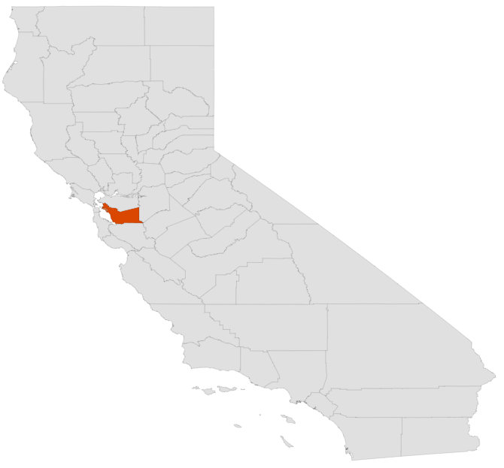
Case Study
Alameda County, CA Department of Public Health
Low income areas, racially diverse; also home to UC Berkeley; new high tech workers unable to afford housing elsewhere in Bay
County disability population rate is 9.5%
Lower than US rate
Notes:
East of San Francisco; location of Oakland, Berkeley

Slide 10
Project
Alameda County, CA Department of Public Health
2014 Accreditation
Alameda County Health Data Profile Community Health Status Assessment for Public Health Accreditation.
Would guide the Community Health Improvement Plan
About health equity, segmented population but not by disability
Notes:
In 2014, the Alameda County Public Health Department was undergoing accreditation. As part of their materials, they developed a report entitled “Alameda County Health Data Profile Community Health Status Assessment for Public Health Accreditation.” An internal staff involved in disability policy noted the report contained no disability data, but it segmented the population in many other ways (race, ethnicity, changing demographics, ethnicity, etc.). Since the report was to cover health equity, the staff approached the agency Director to point out the lack of disability data in the report. The report would guide the Community Health Improvement Plan or CHIP, meaning without action, an opportunity to focus on disability was about to be lost. The Director agreed and asked staff to address the concern.

Slide 11
Project
Alameda County, CA Department of Public Health
Report about health equity, segmented population, but not by disability
would guide the Community Health Improvement Plan or CHIP
Internal “advocate” noted no disability data in report = no awareness of disability issues
Director agreed
Notes:
An internal staff involved in disability policy noted the report contained no disability data, but it segmented the population in many other ways (race, ethnicity, changing demographics, ethnicity, etc.). Since the report was to cover health equity, the staff approached the agency Director to point out the lack of disability data in the report. The report would guide the Community Health Improvement Plan or CHIP, meaning without action, an opportunity to focus on disability was about to be lost. The Director agreed and asked staff to address the concern.

Slide 12
Product
Alameda County, CA Department of Public Health
Internal supplement to report on disability
We assisted intern
Meeting with Director about report
Consulting with Epidemiology group to clarify use of disability data (disability awareness)
Epidemiology group created report and talks
Now, trainings on inclusion of disability planned
Notes:
Brought an intern to get the disability data. The intent of the intern was to produce a report with the voice of the seniors and disability community. Discussion of what to do with the report. At first, it was not intended to be a part of the Community Health Assessment, but it started internal conversations about the need, use, and appropriateness of disability data inclusion in the report and beyond. The intern met with County Epidemiology group and received some direction. Then met with us for more direction about what data was possible and leads to where the data was at the local level. Created “Alameda County Disability and Older Adult Brief”.
After completion, we joined internal Angel in meeting with Director, where he asked for direction. We pushed the idea of inclusion of disability data to inform any health program planning. He agreed.
We consulted with Epidemiology group, and informed them of the potential use of disability data – like disability awareness. They assigned staff to look at data and developed their own report, which they presented to internal managers and directors. The interest and understanding was immediate and the county is now embarking on trainings to staff to include people with disabilities and their needs in program plans.

Slide 13
Product Use Results
Alameda County, CA Department of Public Health
Successful attributes
Too new to say (training agreements being set up now)
Internal disability awareness raised
Needed an internal advocate, external data expert, an open-minded leadership, and then let internal mechanisms work

Slide 14
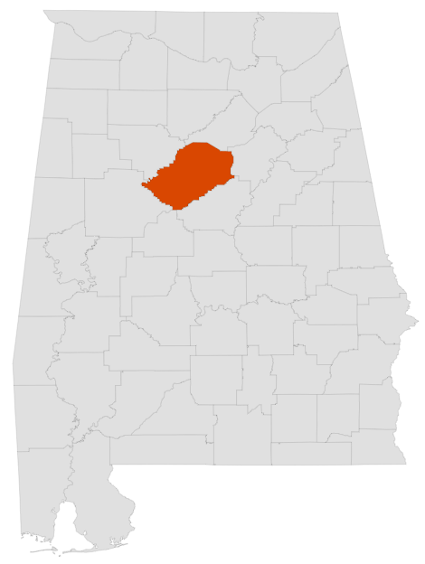
Case Study
Health action partnership in Jefferson County, AL
Community Health Improvement plan for Jefferson County
External advocates in Health Action partnership wanted disability data for grants
Also wanted surrounding counties for comparison
Notes:
Jefferson County is the most populous county in the state of Alabama. Its county seat is Birmingham, which is also the most populous city in the state.
Working off a Community Health Improvement plan for Jefferson County, external advocates from Health Action partnership (about 80-100 organizations that coordinated on grants) wanted disability data to be inclusive in their health grant writing. Also wanted surrounding county data for comparison.

Slide 15
Product
Health action partnership in Jefferson County, AL
“Disability Statistics for Alabama and the Counties of Blount, Jefferson, St. Clair, Shelby, and Walker”
A report based on Annual Report on Disability created for 5 county area
Notes:
Report based on Annual Report on Disability created for 5 county area.

Slide 16
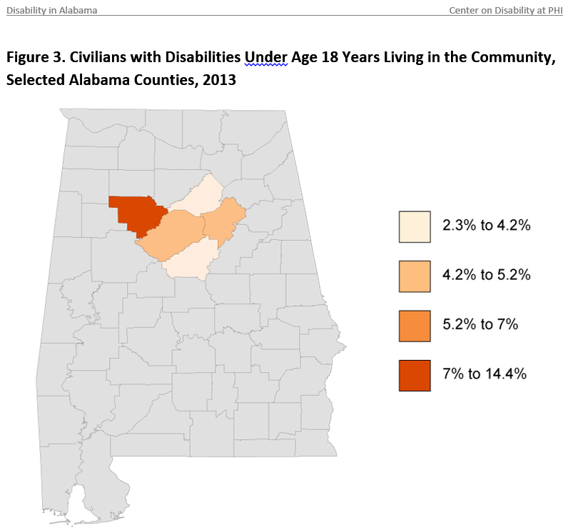
Product
Health action partnership in Jefferson County, AL
Notes:
Report covered ACS # and % of people with disabilities in the 5 Alabama counties; the prevalence of people with disabilities in the 5 counties; the prevalence of the types of disabilities in the counties; employment; earnings, poverty, and health from BRFSS (smoking, obesity, high blood pressure, and physical activity). The report provided a map with the 5 counties highlighted in their color coded to their quartile of the value within the state.

Slide 17
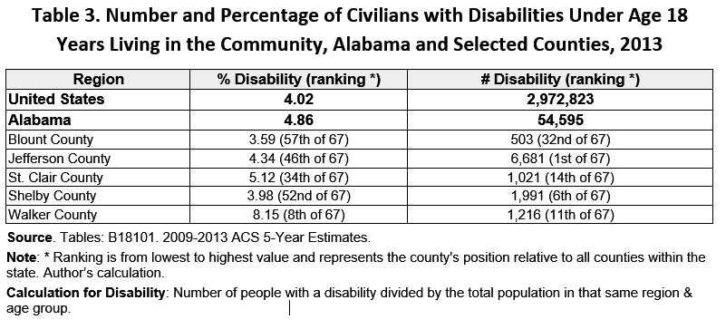
Product
Health action partnership in Jefferson County, AL
Notes:
All map data was supplemented with tables providing the US, Alabama, and county value, and the rank of each county’s value within Alabama.

Slide 18
Product Use Results
Health action partnership in Jefferson County, AL
Report used for
Disability awareness of partners
To seek further grants
Provided data to Jefferson County Health Department
Provided data to Lakeshore Foundation
Notes:
Report used to inform these partners about transportation and size of current pop. To seek further grants. Used for Rapid Health Impact Assessment grant around a couple healthcare facilities for those with mobility challenges.
Also provided disability data to Jefferson County health department as they write grants and to Lakeshore Foundation for their writing of grants for local grants.

Slide 19
Product Use Results
Health action partnership in Jefferson County, AL
Increased capacity to include disability in program grants
Raised awareness – Health People 2020 advocacy
Provided data, inclusion manual, and trainings
Outreach more inclusive
Notes:
Before, unless Lakeshore Foundation was in grant, disability was not included. Now partners have disability data, so they don’t require a connection with Lakeshore to be inclusive from the start.
Awareness has been raised. Health Action partnership was engaged in advocacy on Health People 2020 and particularly Health Equity. Provided an inclusion manual, shared data and provided trainings. Outreach has become more inclusive.

Slide 20
Product Use Results
Health action partnership in Jefferson County, AL
“Data is part of the process to moving the needle for inclusion. Takes more than just meetings. So often statistics don’t complete the narrative of the story. But data makes it more impactful.”
“Really believe they would not have been as open to receiving data without the preparation done in capacity building.”

Slide 21
Product Use Results
Health action partnership in Jefferson County, AL
Developed internal advocates through previous work, provided external data and expertise, and let organizations work within their structure to include disability.

Slide 22
Case Study
FEMA Office of Disability Integration and Coordination
Started in 2010 for whole community emergency management, inclusive of individuals with disabilities and others with access and functional needs
10 Regional Disability Integration Specialists
Guidance, training, and tools for disability-inclusive emergency preparedness, response, recovery and mitigation
Notes:
Role: “In 2010, FEMA established the Office of Disability Integration and Coordination to lead FEMA’s commitment to achieve whole community emergency management, inclusive of individuals with disabilities.
Each of the 10 FEMA regions is staffed with a Regional Disability Integration Specialist who provide guidance, training, and tools for facilitating disability-inclusive emergency preparedness, response, recovery and mitigation. Regional Disability Integration Specialists work closely with the states to ensure that their disaster planning is inclusive of people with disabilities and others with access and functional needs. Simultaneously, they work with local nonprofit disability groups to reach the disability community encouraging them to participate in federal, state, local, and community emergency planning meetings.”

Slide 23
Project
FEMA Office of Disability Integration and Coordination
Disability data “close to ground”
“Getting data at county level gives us a gauge of what is out there”
In the beginning of a disaster, everyone wants to know the number of people with disabilities mainly ages 18-65
Data for disaster exercises –give to state and local emergency management offices
Notes:
FEMA’s ODIC was interested in getting disability demographics as close to the ground as they could. Getting it at county level gives us a gauge of what is out there. Their experience is that in the beginning of a disaster, everyone wants to know the number of people with disabilities mainly ages 18-65. They also wanted data for their exercises – they could give that information to state and local emergency management offices. BY the way, this was not a funded project.

Slide 24
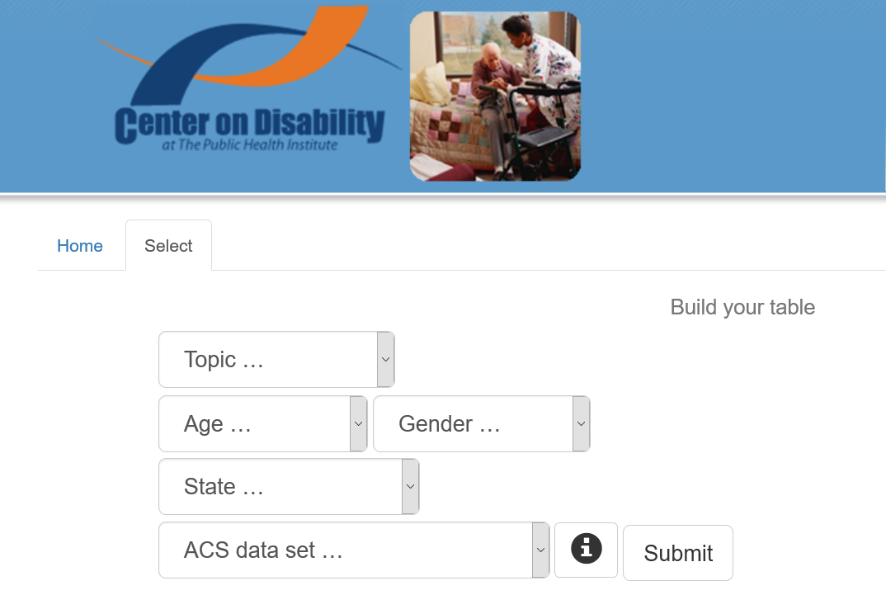
Product
FEMA Office of Disability Integration and Coordination
Notes:
Website that allowed local agencies to determine their disability population. They can customize what they want – Topics include: Type of Disability, Race/Ethnicity, Health Insurance, and Employment. Age choices include: All Ages, under 18, 18-64, and over 64; Gender: both Female and Male, Male alone, and Female alone; ACS data set choices are 1 year, 3 year, and 5 year.

Slide 25
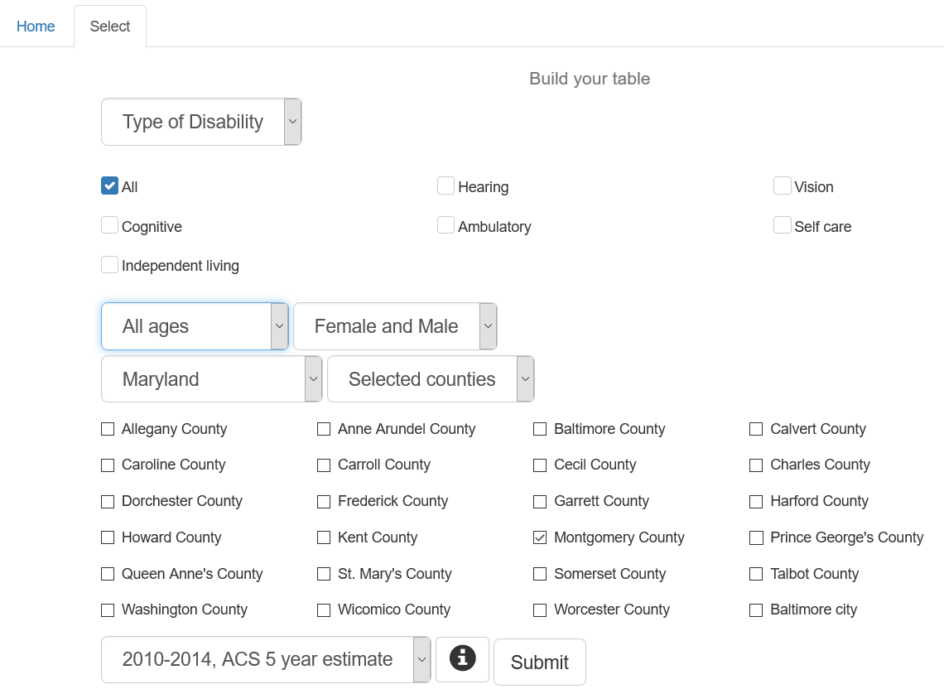
Product
FEMA Office of Disability Integration and Coordination
Notes:
Website that allowed local agencies to determine their disability population. They can customize what they want – Topics include: Type of Disability, Race/Ethnicity, Health Insurance, and Employment. Age choices include: All Ages, under 18, 18-64, and over 64; Gender: both Female and Male, Male alone, and Female alone; ACS data set choices are 1 year, 3 year, and 5 year. Also when you choose a state, you get the choices of any county or combination in the state. In this example we choose all disability types, all ages, both genders for Montgomery County Maryland.

Slide 26
Product
FEMA Office of Disability Integration and Coordination
Notes:
Results show percentages and numbers for US, for state – in this case Maryland – and the county. It also ranks the counties in the state. There is also a “combine” function that combines more than one county.

Slide 27
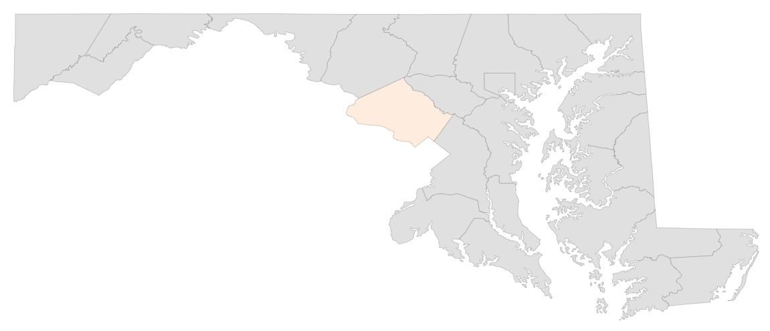
Product
FEMA Office of Disability Integration and Coordination
Notes:
And, as you have seen, it provides a map of the county (or counties) color coded for their quartile ranking in the state.

Slide 28
Product Use Results
FEMA Office of Disability Integration and Coordination
While people were interested in the exercises, the real benefit is in planning
When they provided the data to the planning section in the community, they don’t know what happens with the data.
Data specificity didn’t match their in-emergency needs.
Notes:
While people were interested in the exercises, the real benefit is in planning
When they provided the data to the planning section in the community, they don’t know what happens with the data, because they really have no mechanism to track.
In an emergency, their main interest is in finding the power dependent people with disabilities for people using oxygen for example. They needed other data from power companies, etc.

Slide 29
Product Use Results
FEMA Office of Disability Integration and Coordination
Not as successful
Possibly because:
No internal advocate for data, no plan
No real connection with outside expert
Didn’t get buy-in from agencies to use data
Again not funded – not really their project

Slide 30
Conclusions
Several important factors for success at local level:
Internal advocate for inclusion of people with disabilities
Leadership that is open to inclusion
External disability data expert
Internal advocate or group knows how to “work the system” to influence decisions

Slide 31
For More Information, Contact
Lewis Kraus
lkraus@centerondisability.org
510-285-5600

