Slide 1
A Feasibility Study of Recruiting and Maintaining a Web Panel of People with Disabilities
Presentation at StatsRRTC State of the Science Conference
Washington, DC
February 13, 2017
Jesse Chandler

Slide 2
Three Goals of This Study
Evaluate panel recruitment rates
Evaluate panel retention rates
Identify logistical challenges when fielding a web survey for people with disabilities

Slide 3
Why a Web Panel?
Web surveys are cost-effective
Easier to maintain contact
Convenient for participants
All of these benefits scale up in panel surveys

Slide 4
Concerns About the Digital Divide
13 percent of adults still do not use the Internet (Raine 2016)
People with disabilities are 40 percent less likely to use the Internet (Fox, 2011)
Older, less educated, and have lower incomes
7 percent say that their disability makes Internet use more difficult or impossible (Zickuhr and Smith 2012)
People who do not have Internet access are different

Slide 5
Overcoming the Digital Divide

Slide 6
Sample
Vocational rehabilitation applicants in Mississippi, New Jersey, and Ohio (N=2718)
Completed a previous survey on disability and employment, and agreed to be contacted again
65 percent of sample reported having Internet access at home, 28 percent had access through some other means, 7 percent reported no access
Recruited three groups of participants
90 people with Internet access at home
90 people with limited Internet access
30 people with no Internet access

Slide 7
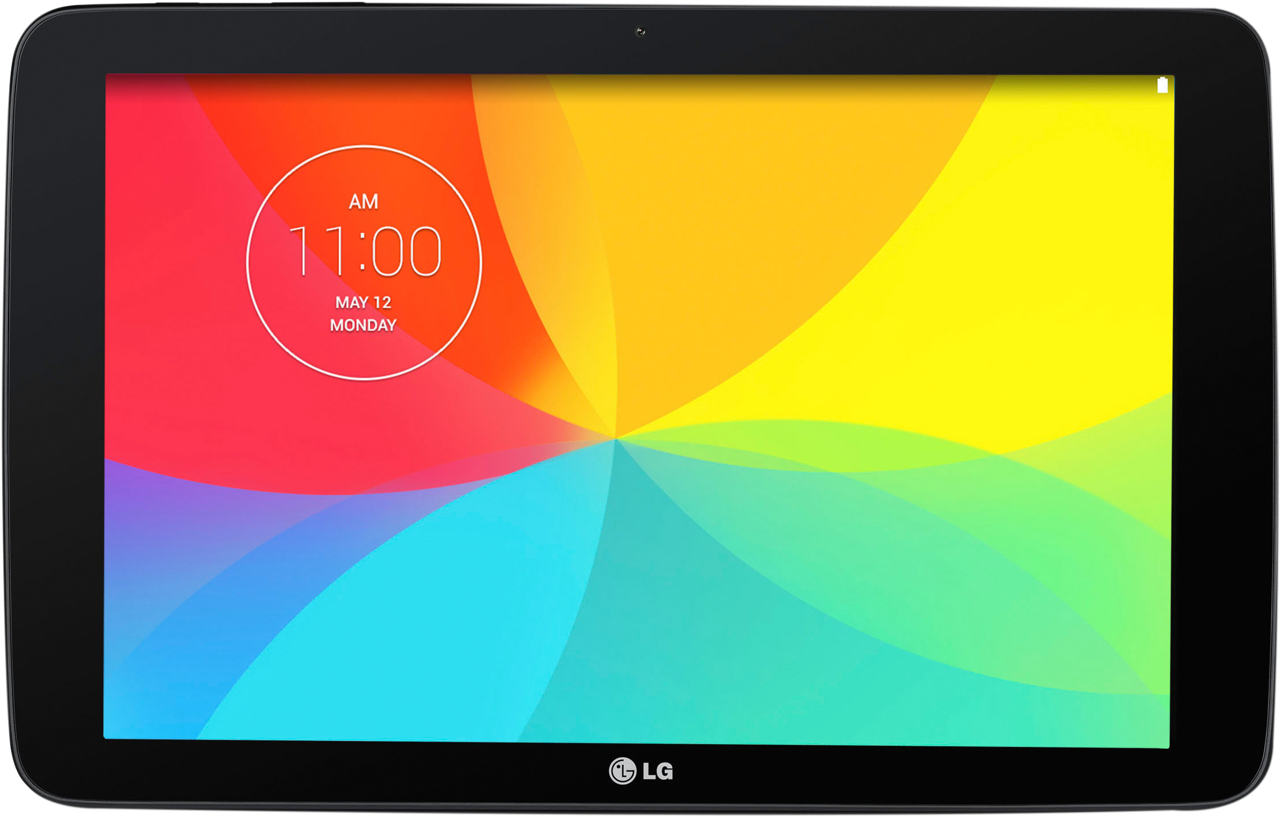
Providing Internet Access

Slide 8
Method
Original survey
Wave 1 web survey
Wave 2 web survey
Re-recruit by phone
6 months
1 month
5 months

Slide 9
Recruiting
 | Access at home | Limited access | No access
Initial survey | 1,563 | 705 | 162
Recontact Attempted | 470 | 633 | 156
Known Eligibility | N=267 | N=340 | N=118
Bad number | 22% | 32% | 27%
Eligible, Non-Interview | 30% | 27% | 9%
Refused | 15% | 19% | 19%
Agreed to Participate | 34% | 21% | 43%
267 | 340 | 118

Slide 10
Survey Fielding
Each wave was released with 2 email reminders
1-2 reminder calls per week
Moved to phone after 4 weeks (called up to 6 times)
In Wave 1, the “no access” sample required substantially more contact
Verify that tablet was received
Create an email account
Collect email account information

Slide 11
Response Rates
 |  | Wave 2
Wave 1 |  | Web | Phone | Non-Response
 | Web | 62 | 12 | 16
 | Phone | 2 | 26 | 25
 | Non-Response | 3 | 13 | 53
 |  | Wave 2
Wave 1 |  | Complete | Nonresponse
 | Complete | N=102 (48%) | N=41(19%)
 | Nonresponse | N=16 (8%) | N=53(25%)

Slide 12
Response Rates
 | Access at home | Limited access | No access | Overall
Total enrolled | N=96 | N=85 | N=31 | N=212
Wave 1
Completed web | 56% | 26% | 45% | 42%
Total Complete | 76% | 56% | 74% | 67%
Wave 2
Completed web | 43% | 18% | 35% | 32%
Total Complete | 65% | 45% | 58% | 56%

Slide 13
Sample Demographics
 | First Survey (N=2806) | Agreed to Participate (N=212) | Overall completes (N=144) | Web Completes (N=91) | Phone Completes (N=53)
Age (SD) | 43.7(10.1) | 45.4 (9.9) | 46.1 (10.1) | 45.7(10.3) | 46.8(8.8)
Income (SD) | $26k(32K) | $23k(24K) | $24K (24K) | $26K(28K) | $19K(16K)
Female | 50.2% | 52.8% | 54.2% | 57.1% | 49.1%
College | 44% | 38% | 42% | 50% | 28%
Hispanic | 6.2% | 8% | 6.1% | 12.2% | 3.8%
African American | 38.6% | 45.8% | 43.3% | 42.9% | 45.3%
Veteran | 4.5% | 5.2% | 4.9% | 3.3% | 7.5%

Slide 14
Sample Type of Disability
Impairment | SDE Sample (N = 2806) | Agreed to Participate (N = 212) | Overall completes (N =144) | Web Completes (N = 91) | Phone Completes (N = 53)
Visual | 226 (8.1%) | 24 (11.3%) | 14 (9.7%) | 7(7.7%) | 7(13.2%)
Hearing | 325 (11.6%) | 23 (10.8%) | 17 (11.8%) | 14(15.4%) | 3(5.7%)
Mobility | 828 (29.5%) | 65 (30.7%) | 42 (29.2%) | 32(35.2%) | 10(18.9%)
Psychiatric | 898 (32%) | 71 (33.5%) | 49 (34%) | 31(34.1%) | 18(34.0%)
Cognitive | 412 (14.7%) | 28 (14.8%) | 19 (13.2%) | 12(13.2%) | 7(13.2%)

Slide 15
VR Application Experience
 | Web Completes (N = 90) | Phone Completes (N = 53)
Contacted about application | 74 (82.2%) | 31 (58.5%)
Application was accepted | 64 (71.1%) | 25 (47.2%)
Has an individualized plan of employment | 44 (48.9%) | 13 (24.5%)
Is receiving services? | 29 (32.2%) | 4 (7.5%)
Satisfaction with experience (N = 104) | 3.95 (1.27) | 4.60 (0.93)

Slide 16
Lessons Learned
Shipping: 4 tablets lost in mail
Damage: 6 broken or stolen tablets
Difficulty using the Internet remained an issue for some in the No Access group
Lots of variation in data use
The hassle of getting online was a major issue in the Limited Access group

Slide 17
Using Internet or Mixed-Mode Surveys
Web becomes cost-effective when the sample is large
Respondents with Internet access at home had higher response rates than respondents with limited access
Differences in respondents using different modes suggest that a web-only survey is probably a bad idea

Slide 18
Whether to Provide Access Is More Complicated
Hardware is inexpensive even with loss and breakage
Wireless access is the major cost driver
Fiber
LinkNYC
Providing access improves response rates
Current study: 6 tablets per additional complete

Slide 19
For More Information
Contact: JChandler@Mathematica-mpr.com
Funding for this study was provided by the Research and Training Center on Disability Statistics and Demographics at the University of New Hampshire, which is funded by the National Institute for Disability, Independent Living, and Rehabilitation Research (NIDILRR) in the Administration for Community Living at the U.S. Department of Health and Human Services (DHHS Grant No: 90RT5022-02-00). The contents do not necessarily represent the policy of DHHS, and you should not assume endorsement by the federal government (Edgar, 75.620 (b)).

